Slide 1
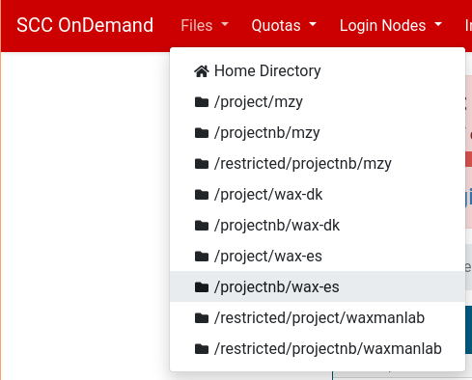
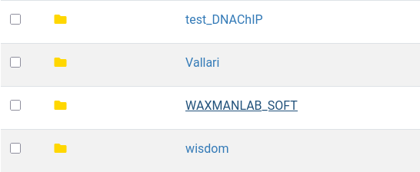
NanoporeAnalysis
login to https://scc-ondemand1.bu.edu/
1
2
and go to /projectnb/wax-es/WAXMANLAB_SOFT/NanoporeAnalysis folder

Slide 2
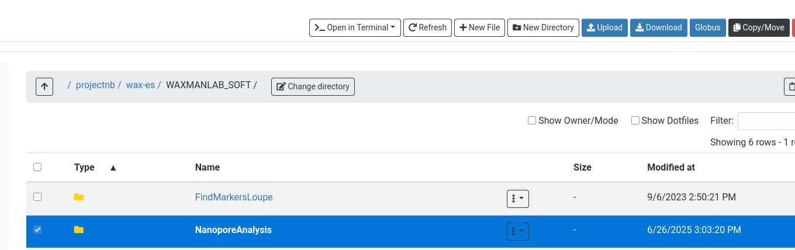
4
3
Click checkbox near the NanoporeAnalysis folder (Step 3)
Click Copy/Move button on the right top corner (Step 4)
Navigate to YOUR folder (Directory) on the SCC, and copy the folder “NanoporeAnalysis” to your directory.

Slide 3
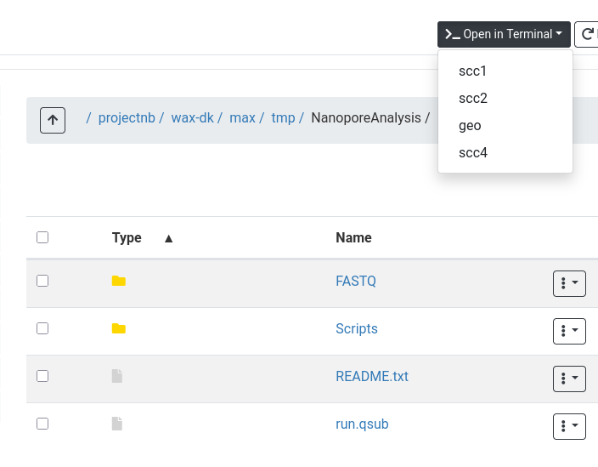
Open your “NanoporeAnalysis” directory (step 5),
Upload a copy of the FASTQ file(s) to be analyzed into the FASTQ folder (step 6)
Click “Open in Terminal” and select “scc1” (step 7)
5
7
After step 7 you can see the terminal window with prompt
6

Slide 4
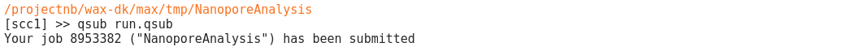
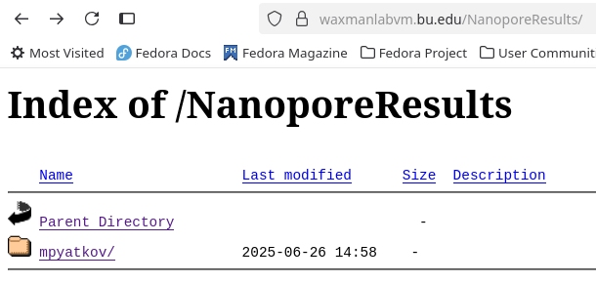
type qsub run.qsub and press Enter (Step 8)
8
There is NO indication in the Terminal, or in the program folder on the SCC whether the job has completed, or not.
To check for completion, after ~10 minutes, check this site: waxmanlabvm.bu.edu/NanoporeResults/<YourUserName>
9

Slide 5
How to upload the Nanopore sequencing tracks to the UCSC Browser:
Open UCSC browser and go to My Data → My Sessions, to access our lab’s saved UCSC Browser sessions
Inside the search input type "DEFAULT_RNASEQ"
Open this session and go to "My data" -> "Custom tracks”
Click: Add Custom Tracks
Go to http://waxmanlabvm.bu.edu/NanoporeResults/<USERNAME>/<FASTQ>/tracklines.txt in browser and copy the text, the Paste into "Custom tracks" window
Click "Submit”
Click “Return to current position” (at top right)
Navigate to the genomic region where you expect Sequence reads, e.g., lnc14873 (see Combined_Report.xlsx, tabs marked “FeatCounts” (FeatureCounts) for read numbers at each genomic regions)
For any Track with the file extension.bam, you have Right-Click on the gray edge of the Track, at the left, and change the Track setting to Squish, or to another setting to visualize (a subset) of the individual reads, including spliced reads.
To SAVE the UCSC Browser session, go to My data → My Sessions, then type a suitably descriptive name for the session, including the Nanopore sample number, anything extra to help you and others identify it, and your NAME.
Click ‘Submit’ at the Right to save.
10

