Slide 1
Cache directory structure
/projectnb/wax-es/CHIPSEQ_BAM_CACHE
.
|-- bam
| |-- G241_M01.bowtie2.log
| |-- G241_M01_sorted_filtered.bam
| `-- G241_M01_sorted_filtered.bam.bai
|-- bam_count
| |-- G241_M01_fragments.bed
| |-- G241_M01_fragments_bed6.bed
| |-- G241_M01_sorted_filtered.flagstats
| `-- G241_M01_sorted_filtered.stats
|-- epic2
| |-- G241_M01_epic2.bb
| |-- G241_M01_epic_bed3.bed
| `-- G241_M01_epic_bed6.bed
|-- fastqc
| |-- G241_M01_1_fastqc.html
| |-- G241_M01_1_fastqc.zip
| |-- G241_M01_2_fastqc.html
| |-- G241_M01_2_fastqc.zip
| `-- G241_M01_raw_reads.txt
`-- macs2
|-- G241_M01_broad_MACS2.bb
|-- G241_M01_broad_MACS2_peaks.broadPeak
|-- G241_M01_broad_MACS2_peaks.broadPeak.bed
|-- G241_M01_broad_MACS2_peaks.xls
|-- G241_M01_narrow_MACS2.bb
|-- G241_M01_narrow_MACS2_peaks.narrowPeak
|-- G241_M01_narrow_MACS2_peaks.narrowPeak.bed
`-- G241_M01_narrow_MACS2_peaks.xls

Slide 2
Summary directory
.
|-- FDR_Barcharts
| `-- STAT5_HIGH_Andy_vs_STAT5_LOW_Andy_FDR_Barcharts_MACS2.pdf
|-- Feature_Barcharts
| `-- STAT5_HIGH_Andy_vs_STAT5_LOW_Andy_Feature_Barcharts_MACS2.pdf
|-- G74A_G92_G99_STAT5_HIGH_LOW_ANDY_v1.xlsx
|-- Histograms
| |-- STAT5_HIGH_Andy_vs_STAT5_LOW_Andy_Histogram_AllChrom_MACS2.pdf
| `-- STAT5_HIGH_Andy_vs_STAT5_LOW_Andy_Histogram_noXY_MACS2.pdf
|-- Norm_Factors.tsv
|-- Summary_MACS2_PCA_correlation_plots.pdf
|-- Summary_normalization_factors.xlsx
|-- all_groups_together_overlap_manorm2_vs_diffreps.xlsx
|-- extradetailed_peaks_overlaps
| |-- EPIC2_broad_peaks_extradetailed_overlap_report.xlsx
| |-- MACS2_broad_peaks_extradetailed_overlap_report.xlsx
| `-- MACS2_narrow_peaks_extradetailed_overlap_report.xlsx
|-- manorm2_diffreps_overlap_individual_reports_for_groups
| `-- STAT5_HIGH_Andy_vs_STAT5_LOW_Andy_overlap_manorm2_vs_diffreps.xlsx
|-- manorm2_diffreps_overlap_top25
| |-- STAT5_HIGH_Andy_vs_STAT5_LOW_Andy_top25_DOWNREGULATED.xlsx
| `-- STAT5_HIGH_Andy_vs_STAT5_LOW_Andy_top25_UPREGULATED.xlsx
|-- multiqc
| `-- multiqc_report.html
`-- pileup_data_for_pca
`-- STAT5_HIGH_Andy_vs_STAT5_LOW_Andy_pileup_all_chromosomes.xlsx

Slide 3
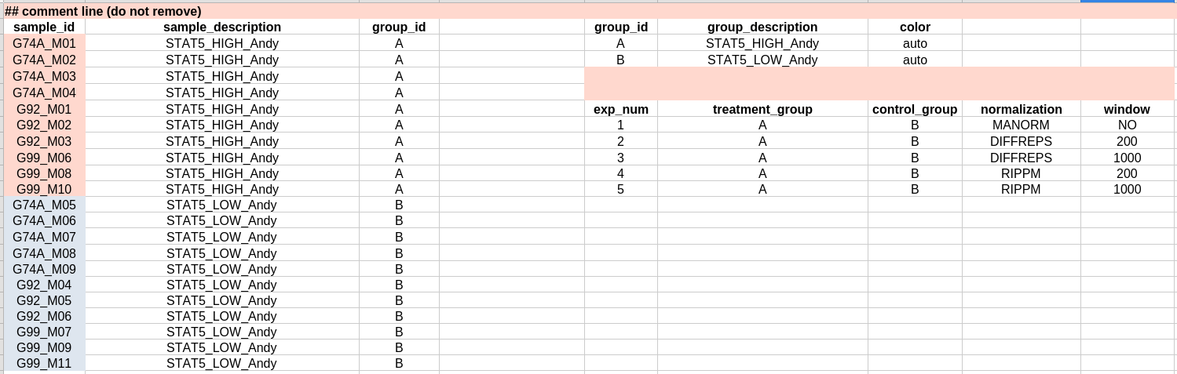
G74A_G92_G99_STAT5_HIGH_LOW_ANDY_v1.xlsx (Configuration file)
Sample labels
Group labels
Group comparisons and methods for normalization

Slide 4
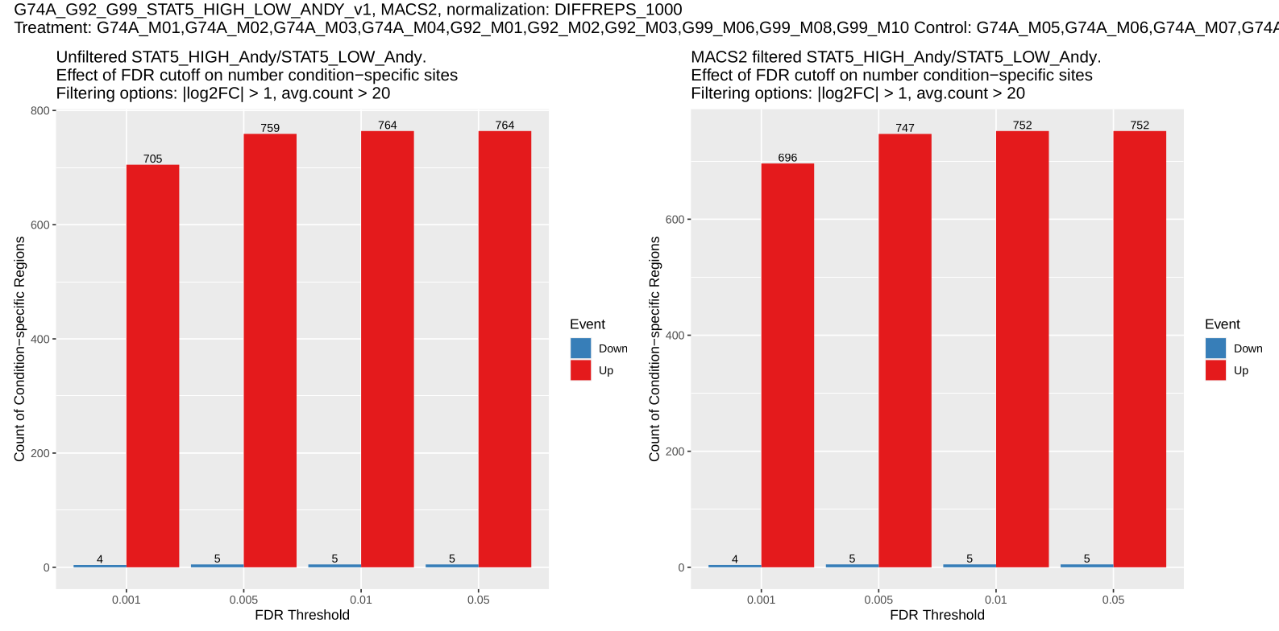
STAT5_HIGH_Andy_vs_STAT5_LOW_Andy_FDR_Barcharts_MACS2.pdf
This plot illustrates how the number of condition-specific STAT5 binding regions varies with different false discovery rate (FDR) thresholds, both before and after peak filtering with MACS2. As the FDR cutoff becomes more permissive, the number of regions identified as significantly enriched in the HIGH condition increases, then plateaus, indicating that most detectable differences are captured at moderate stringency. In contrast, the number of regions enriched in the LOW condition remains consistently low across all thresholds. This suggests that STAT5 binding is predominantly associated with the HIGH condition, and that results are stable across a range of statistical cutoffs, especially after MACS2 filtering improves signal reliability.

Slide 5
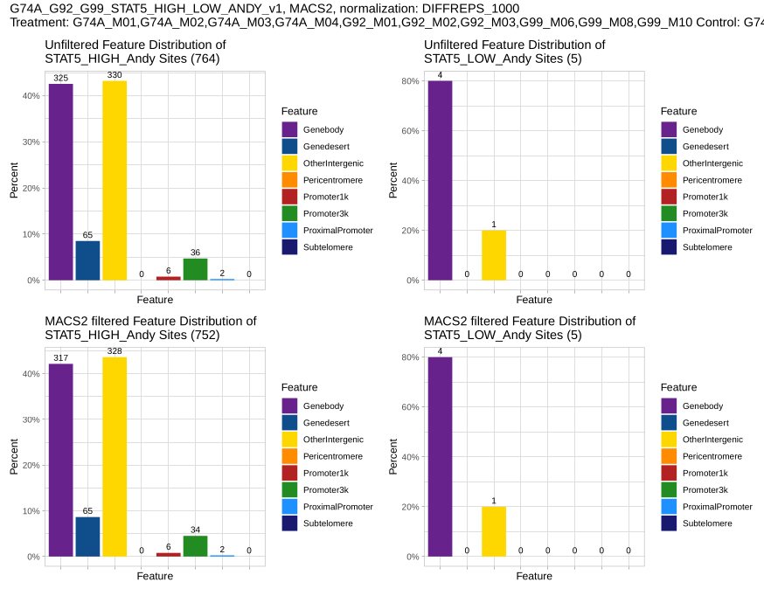
STAT5_HIGH_Andy_vs_STAT5_LOW_Andy_Feature_Barcharts_MACS2.pdf
These plots visualize the genomic feature distribution of STAT5 binding sites in two categories: HIGH and LOW, both before and after filtering with MACS2, a peak calling tool used in ChIP-seq analysis. The breakdown includes how STAT5 binding regions are distributed across various genomic features (e.g., gene body, promoter regions, etc.).

Slide 6
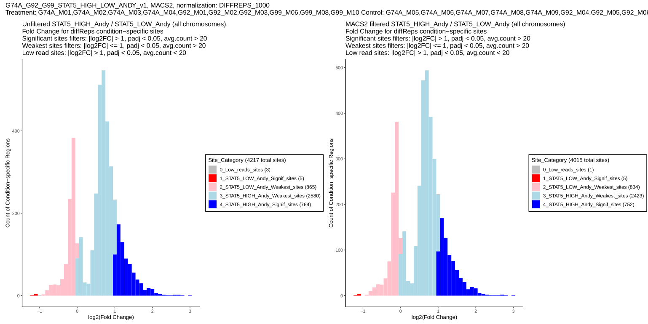
|-- STAT5_HIGH_Andy_vs_STAT5_LOW_Andy_Histogram_AllChrom_MACS2.pdf
`-- STAT5_HIGH_Andy_vs_STAT5_LOW_Andy_Histogram_noXY_MACS2.pdf
The histogram summarizes the results by showing the distribution of fold changes across all tested regions. This helps us quickly assess the overall direction and strength of STAT5 binding differences between the conditions.
To explore how STAT5 binding varies between two conditions—labeled ‘HIGH’ and ‘LOW’—we applied the DiffReps (window) tool, which systematically scans the genome for regions where the signal differs significantly between groups. By setting thresholds for fold change, adjusted p-value, and minimum read depth, we filtered out weaker signals to focus on the most reliable differences.
To further refine the results, we keep only the peaks which overlap with MACS2 peaks. This allowed us to remove background noise and retain only those genomic regions with strong evidence of STAT5 enrichment.

Slide 7
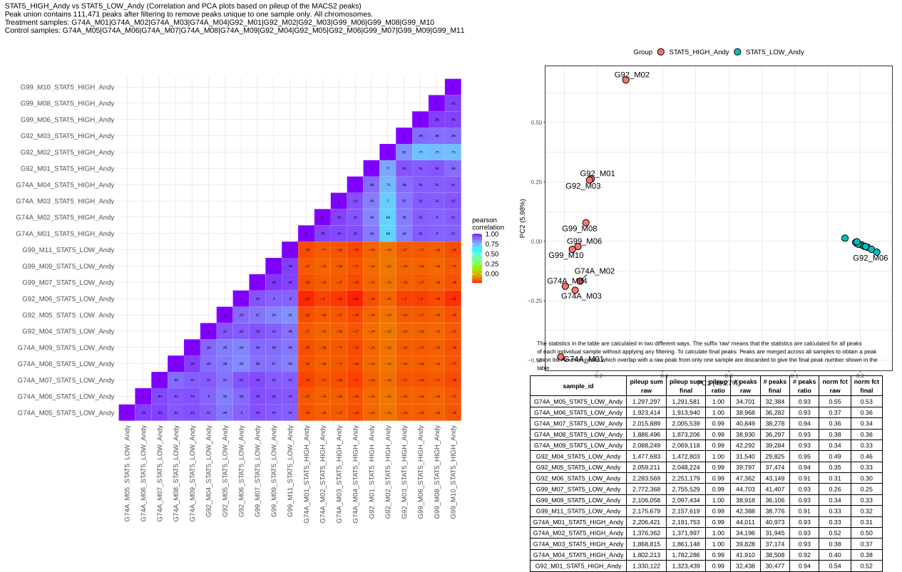
Summary_MACS2_PCA_correlation_plots.pdf
PCA plot shows the same data in 2D space. The clear separation between red and blue points demonstrates that the two conditions produce distinct genomic signatures
Shows correlation patterns between samples. The block structure indicates samples from the same condition are more similar to each other than to the other condition
Provides statistical summaries and quality metrics for each sample.

Slide 8
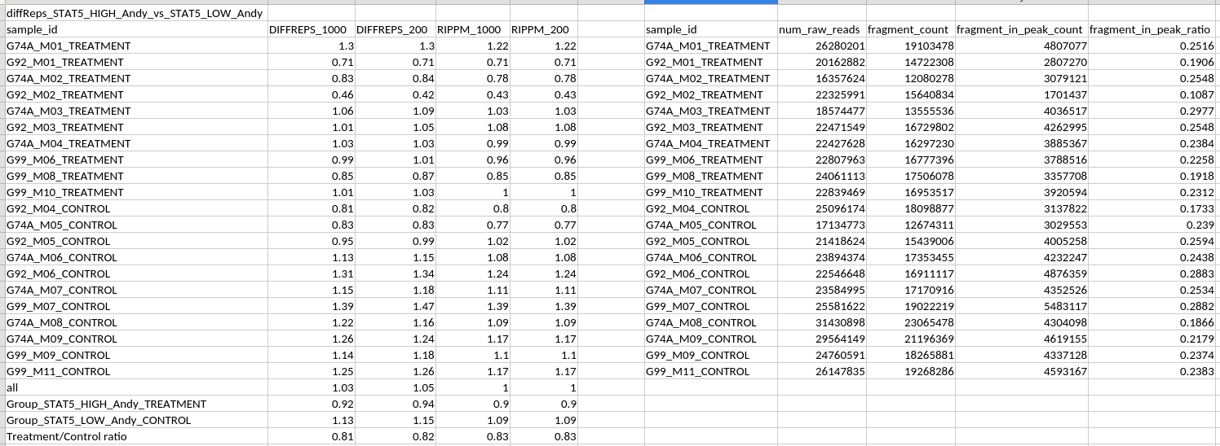
Summary_normalization_factors.xlsx
This table presents the final RiPPM normalization factors used in each differential peak analysis method (DIFFREPS with different windows and ways to normalize data). It also includes additional sample-specific metrics, such as the number of raw reads in the FASTQ files, the number of aligned fragments, and the number of fragments overlapping with MACS2 peaks.

Slide 9
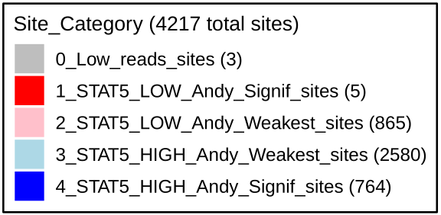
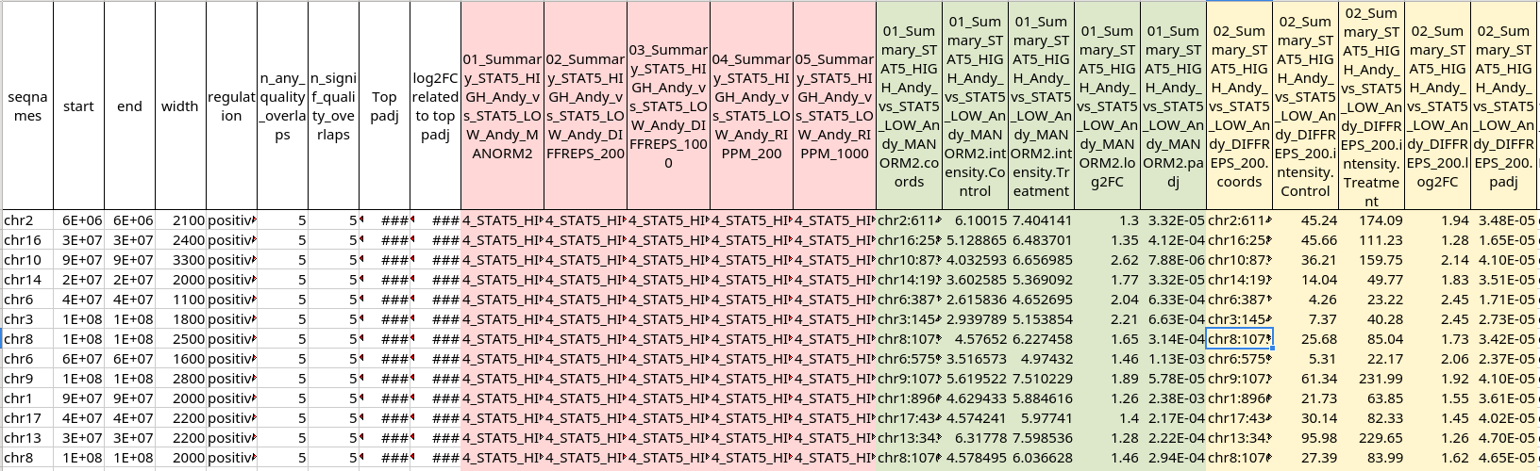
all_groups_together_overlap_manorm2_vs_diffreps.xlsx
STAT5_HIGH_Andy_vs_STAT5_LOW_Andy_overlap_manorm2_vs_diffreps.xlsx
These files have the same structure; the difference is that if there are multiple groups, the first file will include all of them, while the second will consist of multiple files, each corresponding to a specific group comparison.
The configuration file allows us to specify which methods to use for differential peak analysis. By default, five methods are included: MANORM, DIFFREPS with 200 bp and 1000 bp windows, and RIPPM with 200 bp and 1000 bp windows. The last four differ in their window sizes and normalization approaches.
n_any_quality_overlaps indicates the number of overlapping regions of any quality for a given region, while n_signif_quality_overlaps counts how many high-quality regions overlap that same region.
The quality of the regions
positive or negative regulation
coordinates and
width of region
Individual characteristics of region
Individual characteristics of region

Slide 10
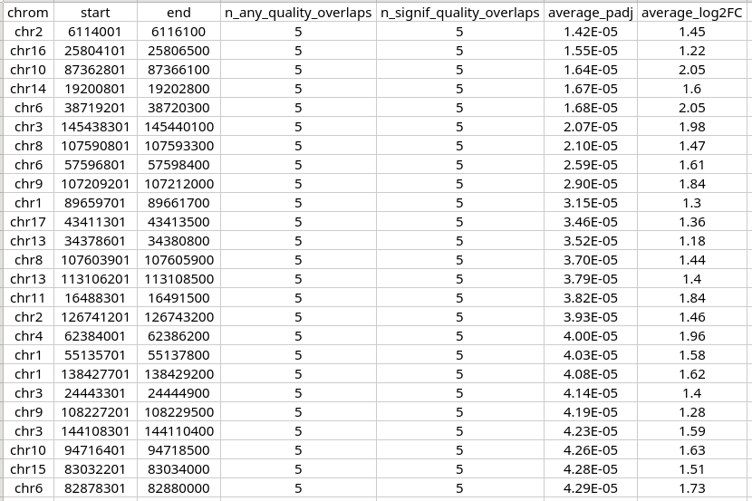
STAT5_HIGH_Andy_vs_STAT5_LOW_Andy_top25_DOWNREGULATED.xlsx
STAT5_HIGH_Andy_vs_STAT5_LOW_Andy_top25_UPREGULATED.xlsx
Uses the same notation as the file described previously,
listing the top UPREGULATED/DOWNREGULATED regions along with their coordinates and quality scores

Slide 11
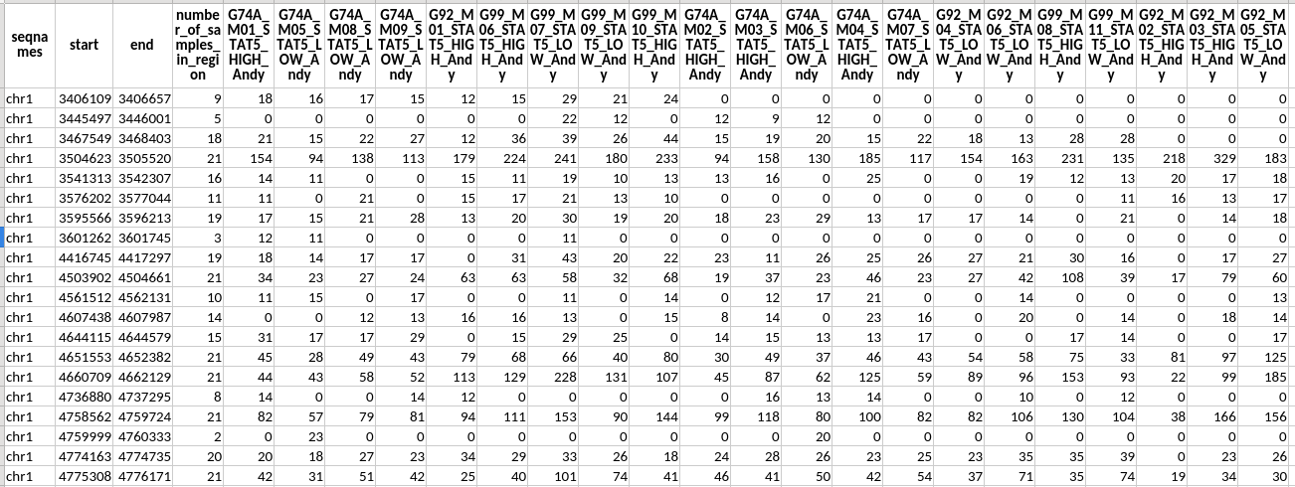
pileup_data_for_pca/STAT5_HIGH_Andy_vs_STAT5_LOW_Andy_pileup_all_chromosomes.xlsx
MACS2 merged regions from all samples
Number of sequence reads in this specific sample overlap the merged peak region
This file shows how individual MACS2 peaks from each sample overlap with the union of MACS2 peaks, which was generated by merging peaks from all samples. Filter out regions which overlapped by only 1 sample

Slide 12
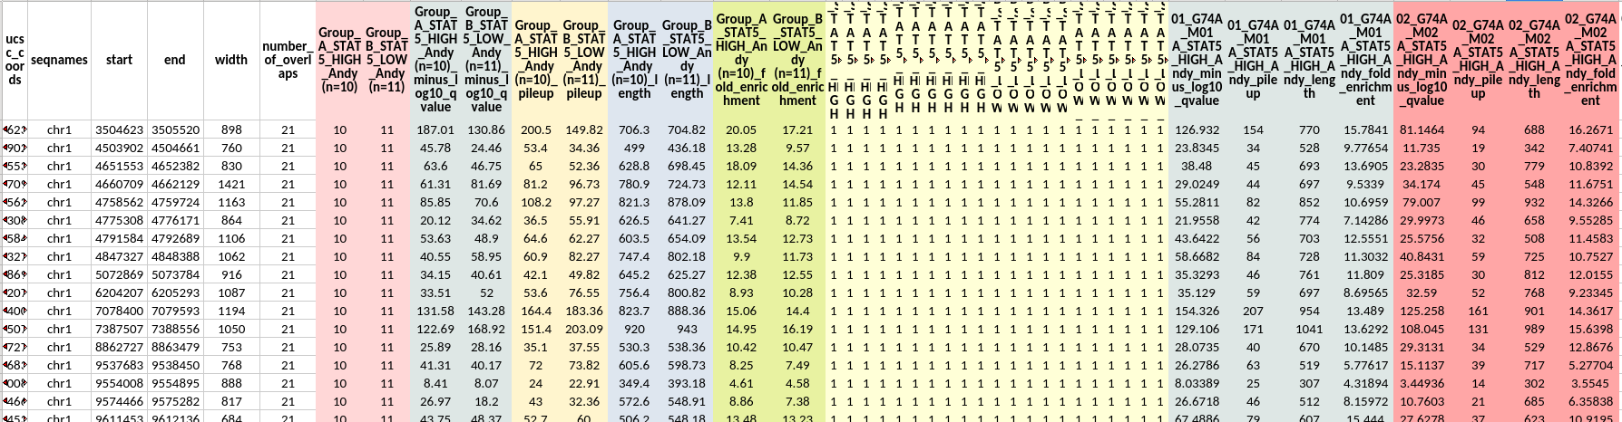
-- extradetailed_peaks_overlaps
|-- EPIC2_broad_peaks_extradetailed_overlap_report.xlsx
|-- MACS2_broad_peaks_extradetailed_overlap_report.xlsx
`-- MACS2_narrow_peaks_extradetailed_overlap_report.xlsx
The files represents highly detailed peaks overlap report (MACS2_{narrow|broad}/EPIC_peaks_extradetailed_overlap_report.xlsx) aggregating signal, annotation, and group/sample-wise statistics for each distinct genomic region identified by merging all input peak sets.
Group presence columns
(How many samples from each group have a peak in this region)
Number of samples with a peak overlapping this region
coordinates and
width of region
Group metric columns
(qvalue, pileup, length, fold_enrichment)
Sample presence columns
Sample metric columns
(qvalue, pileup, length, fold_enrichment)

