Slide 1


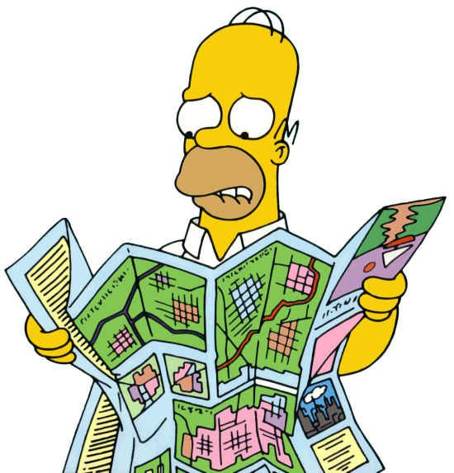
Introduction to GIS with R
Yuri Niella (PhD candidate)
yuri.niella@hdr.mq.edu.au
Department of Biological Sciences

Slide 2
Geographic Information Systems (GIS)
To represent the geographic placement of an object we need two main things:
A. The coordinates of the object
B. A system of reference for how the coordinates relate to a physical location on Earth (Coordinate Reference System = CRS)

Slide 3
Coordinate Reference System (CRS)
It includes:
A. Ellipsoid or geometric model of the shape of the Earth (projection)
B. A datum, which identifies the origin and orientation of the coordinate axes on the ellipsoid, as well as the units of measurement

Slide 4
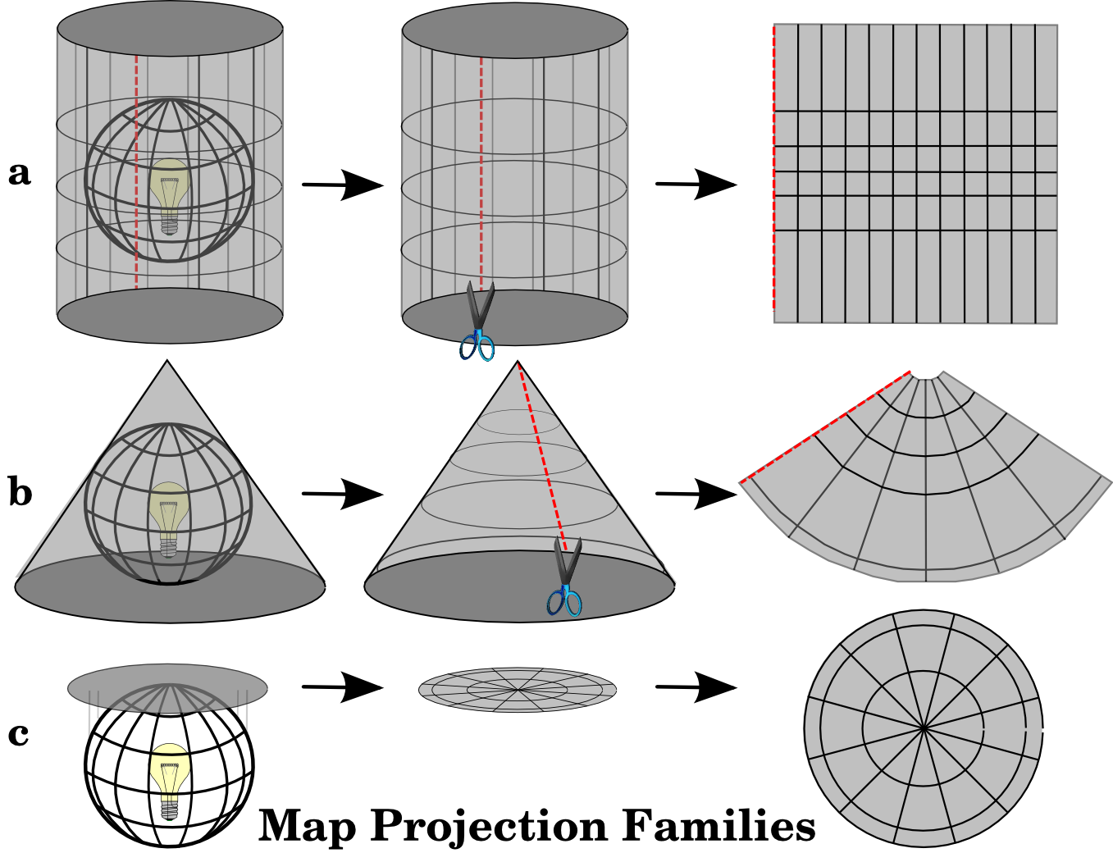
Coordinate Reference System (CRS)
Cylindrical projections
Preserves areas/distances
Conical projections:
Preserves angles
Planar projections
Preserves distances

Slide 5
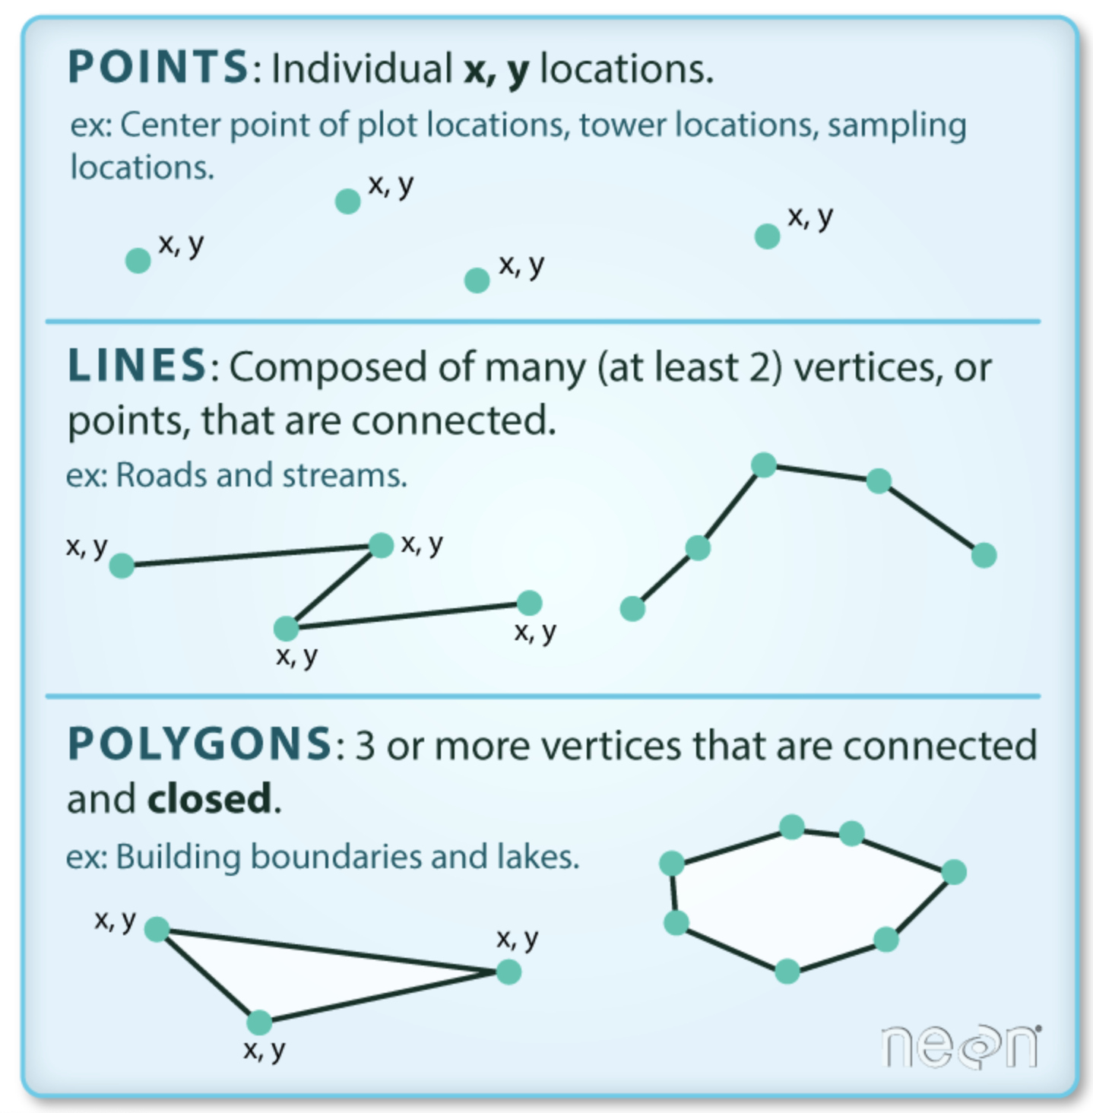
Types of GIS objects

Slide 6
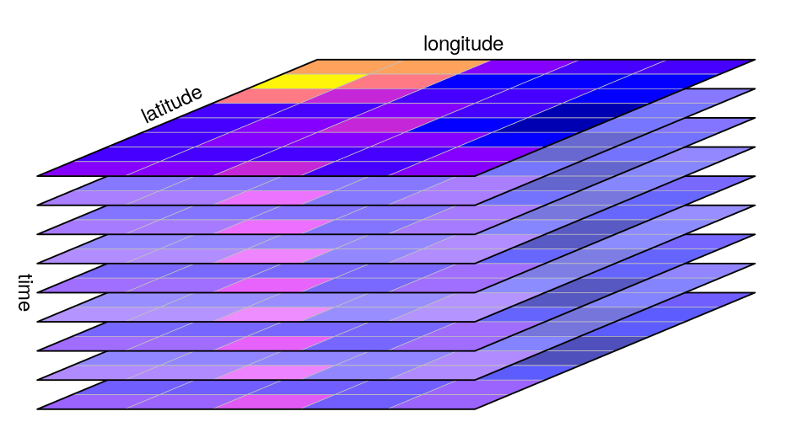
How can we store geographical information that varies temporally?
Raster
NetCDF: combination of rasters
Single band
Multi band

