Slide 1
Introduction to the “tidyverse”
Kate Dodds
Kate.dodds@mq.edu.au
@kate_c_dodds
Notes:
https://syknapptic.netlify.com/2018/03/yet-another-tidyverse-intro/
https://medium.com/@chrisvaccaro_78233/the-absolute-fastest-way-to-learn-r-for-data-science-606ab2b28b7e

Slide 2
Caveats**
It impossible to teach a whole universe in one hour
I am certainly not “All knowing”!
Aim is to showcase some great bits of functionality
Point you in the direction of finding out more

Slide 3
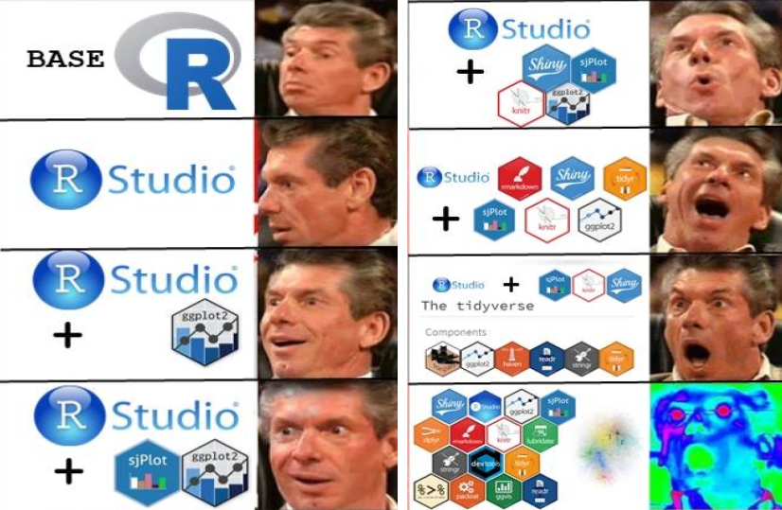
https://syknapptic.netlify.com/2018/03/yet-another-tidyverse-intro/
Notes:
A progression of emotions when learning R…

Slide 4

Where this workshop fits in…
MQ R user group git hub page: https://github.com/mqRusers
Continually building on previous and adding new lessons
MANY previous workshops dealing with specific aspects of the tidyverse
Go back to these OFTEN
DPLYR: James Lawson: https://github.com/mqRusers/2018_02_Dplyr
GGPLOT: Kyle Zawada: https://github.com/mqRusers/2018_04_ggplot
PURRR: Aniko Toth: https://github.com/mqRusers/loops-and-beyond
SHINY R: Kate Dodds: https://github.com/mqRusers/2018_07_R-Shiny_Workshop

Slide 5
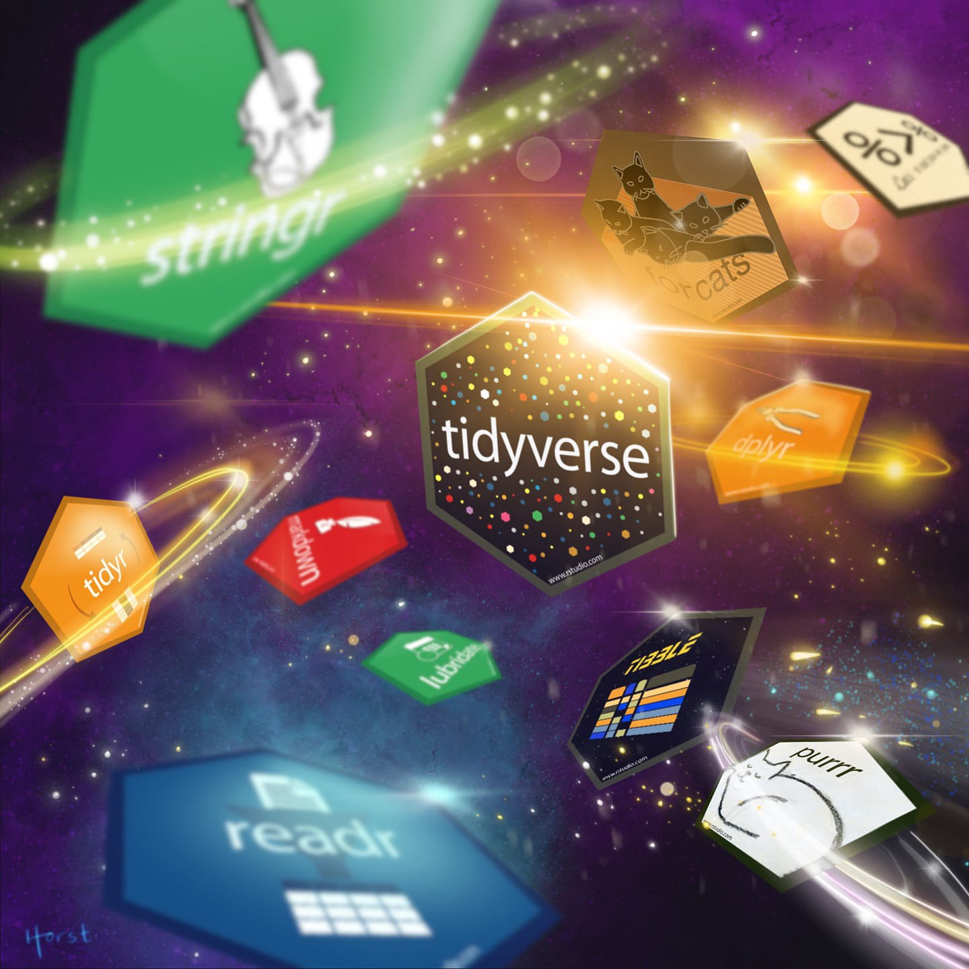
https://www.google.com/imgres?imgurl=https%3A%2F%2Fcdn-images-1.medium.com%2Fmax%2F1600%2F1*z0FQS9XOnRSs9HVwYwpzCA.jpeg&imgrefurl=https%3A%2F%2Fmedium.com%2F%40chrisvaccaro_78233%2Fthe-absolute-fastest-way-to-learn-r-for-data-science-606ab2b28b7e&docid=fwhA7XxCP4J9JM&tbnid=as2N1TdZkABBQM%3A&vet=10ahUKEwiHq-iJ2oXiAhVWcCsKHUvaATwQMwiAASg1MDU..i&w=1440&h=1440&client=firefox-b-e&bih=943&biw=1920&q=Tidyverse%20meme&ved=0ahUKEwiHq-iJ2oXiAhVWcCsKHUvaATwQMwiAASg1MDU&iact=mrc&uact=8

Slide 6
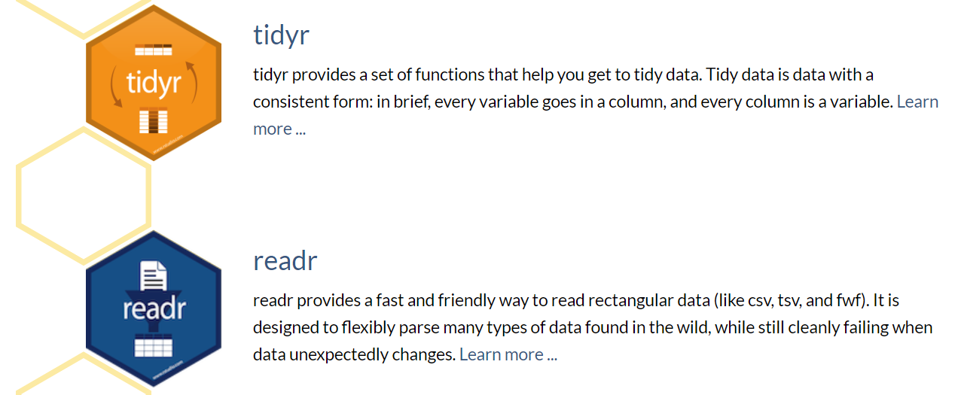
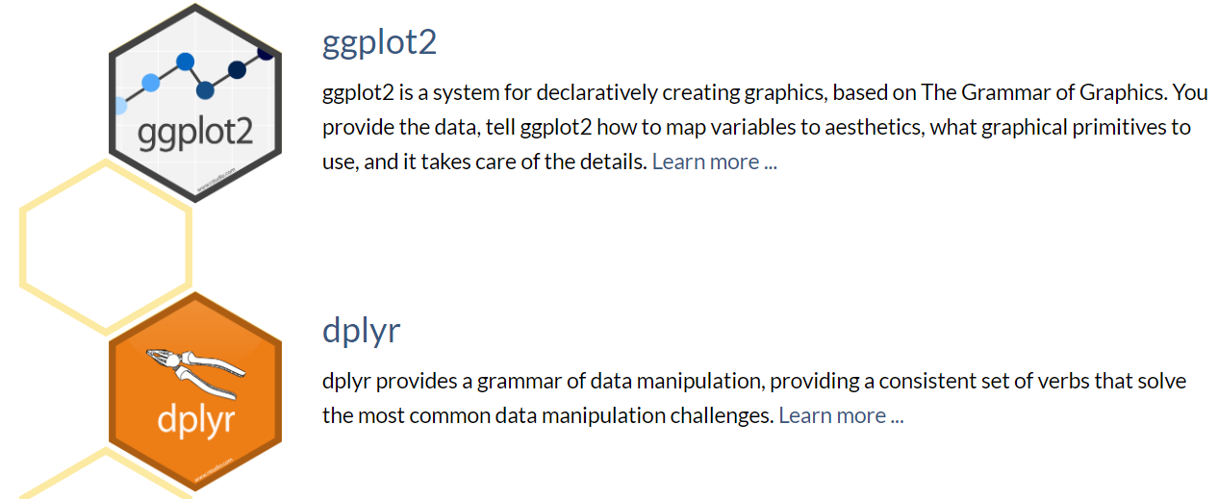
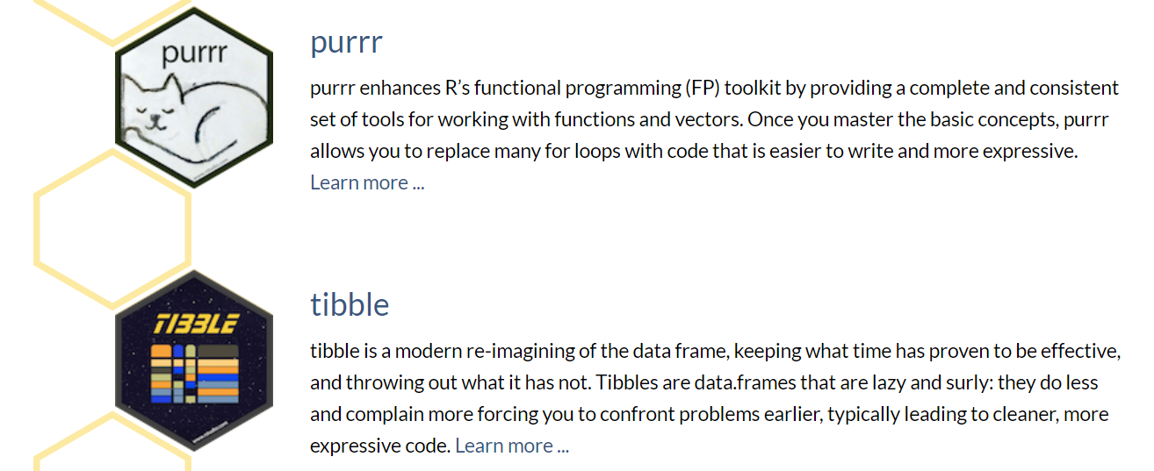
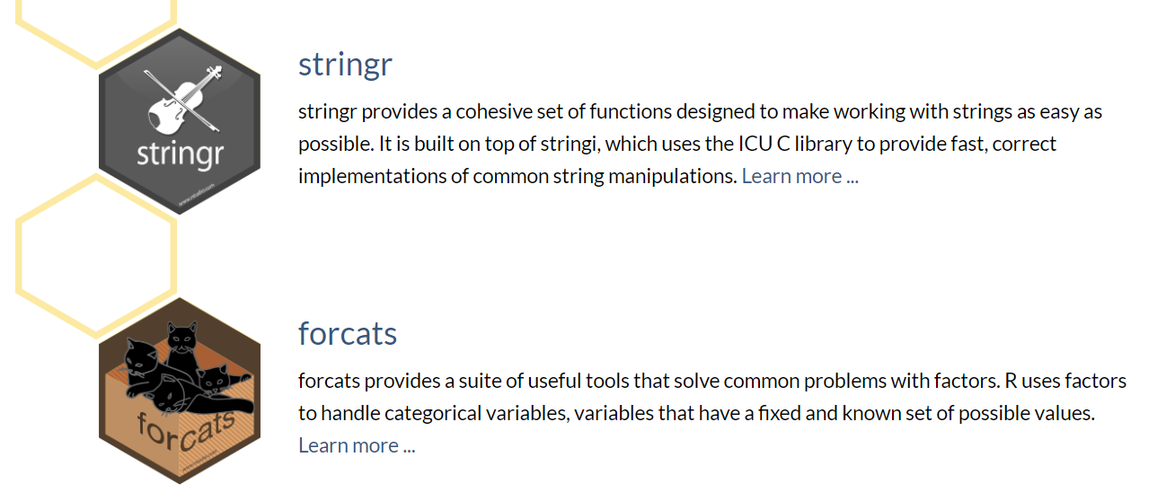
CORE TIDYVERSE
https://tidyverse.tidyverse.org.
Notes:
Information from developer – there are more examples in most recent vingettes..

Slide 7
What is a package??
TOOL
Example of a Vignette. A vignette should be descriptive, whether it is about a setting, a character, or another aspect of a story. ... The vignette above uses descriptive words to paint a literary picture of a single room. On its own and out of context, this passage does not serve much of a purpose
In this case: a mini toolbox that you can use with other toolboxes.

Slide 8
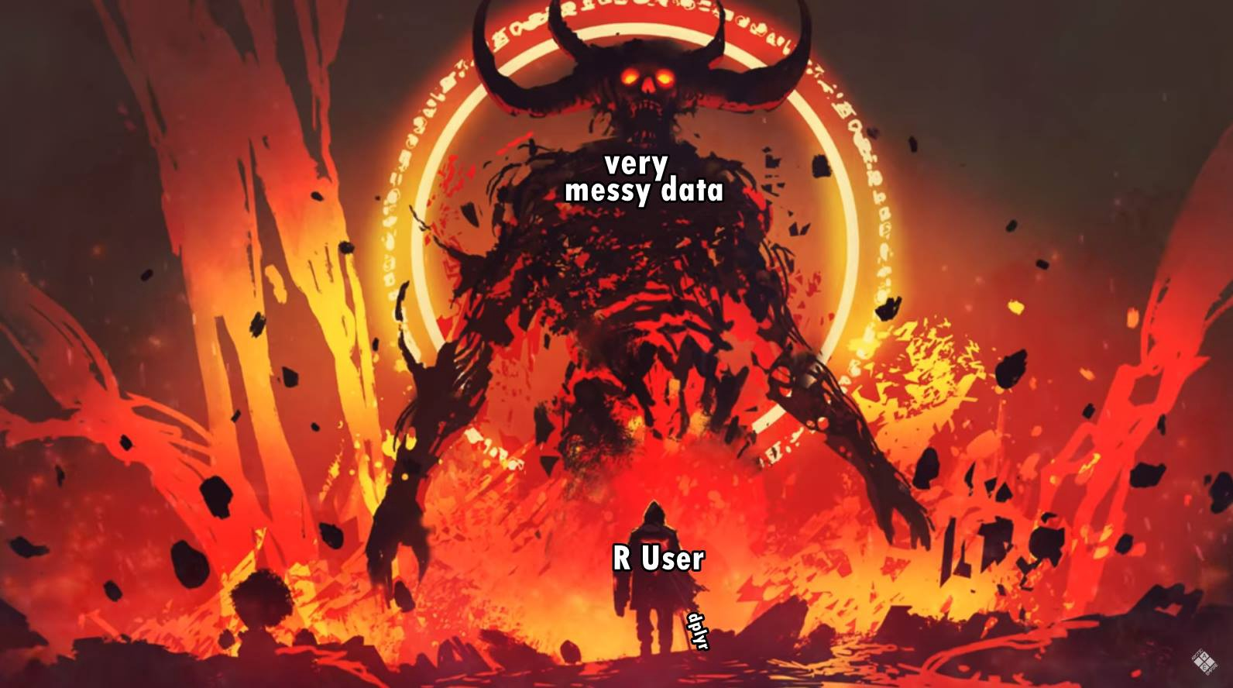
https://medium.com/@chrisvaccaro_78233/the-absolute-fastest-way-to-learn-r-for-data-science-606ab2b28b7e
Notes:
Why the tidyverse was created.. So all post processing and stats could be done using data in the same format

Slide 9
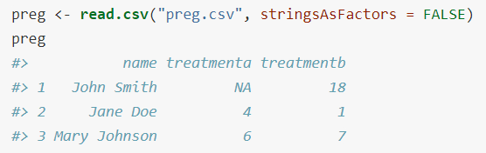
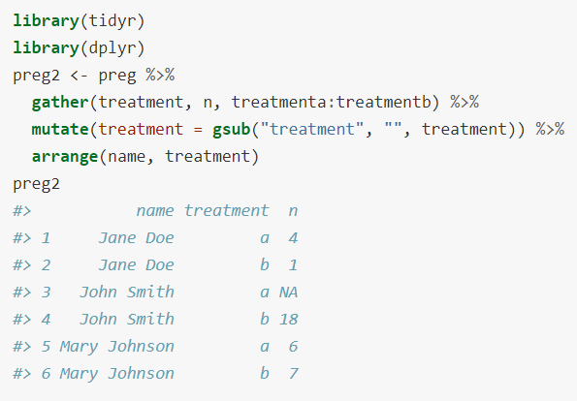
What is tidy data..
Each variable forms a column.
Each observation forms a row.
Each type of observational unit forms a table.

Slide 10
Messy Data
Column headers are values, not variable names.
Multiple variables are stored in one column.
Variables are stored in both rows and columns.
Multiple types of observational units are stored in the same table.
A single observational unit is stored in multiple tables.

Slide 11
Ways to Tidy it
tidying: structuring datasets to facilitate analysis.
Tidy datasets and tidy tools work hand in hand to make data analysis easier, allowing you to focus on the interesting domain problem, not on the uninteresting logistics of data.
gathering, separating and spreading.
OR nowadays: pivot_wider and pivot_longer
Mostly using DPLYR

Slide 12
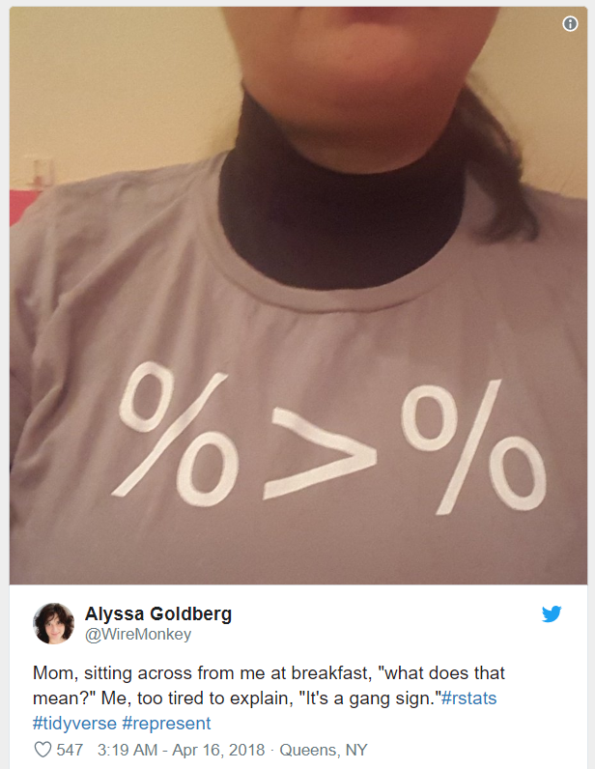
THE PIPE
%>%
a 'pipe' - means 'and then do this next thing with the output‘
“Pipe” instructions down a workflow
pipes allow us to build chains of operations without making intermediate objects
when using 'pipes' they need to go at the end of a line, not the beginning of a new line
or you can put everything on one line if there isn't too much code
Notes:
Thanks to James Lawsons DPLYR workshop.
How the packages fit together.. And how to write easy to follow and reproducible code

Slide 13
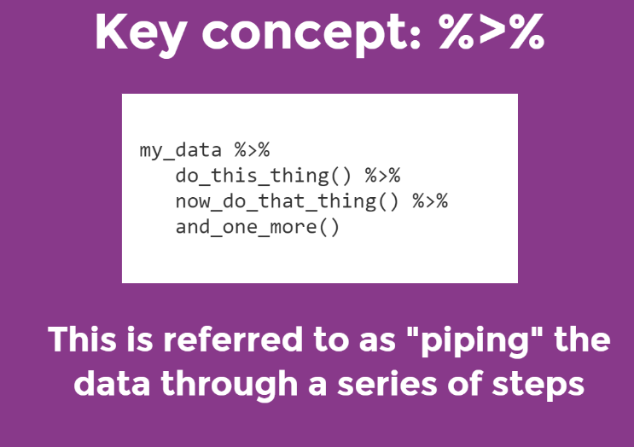

Slide 14
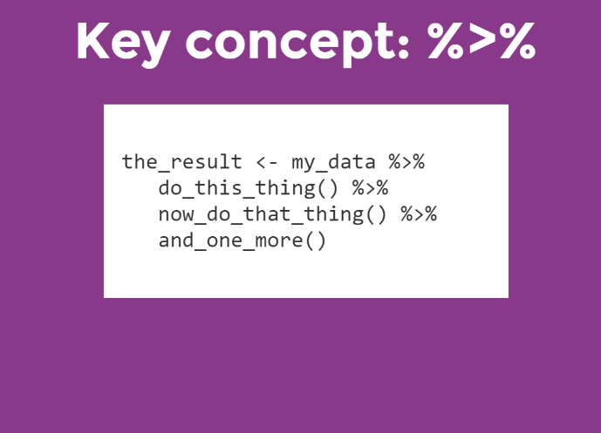

Slide 15
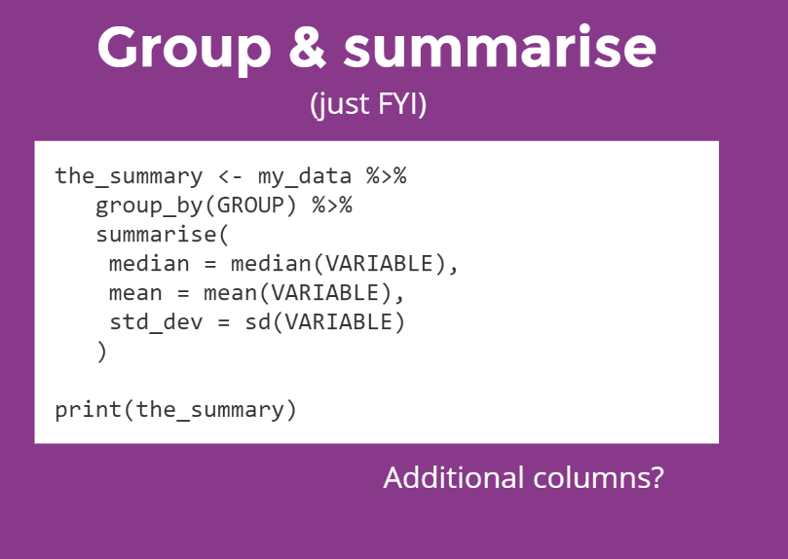

Slide 16
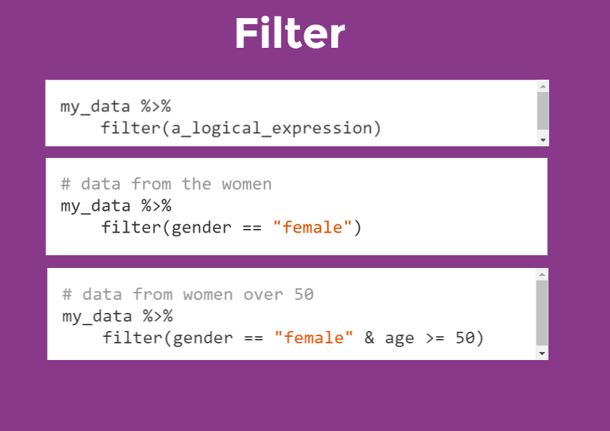

Slide 17
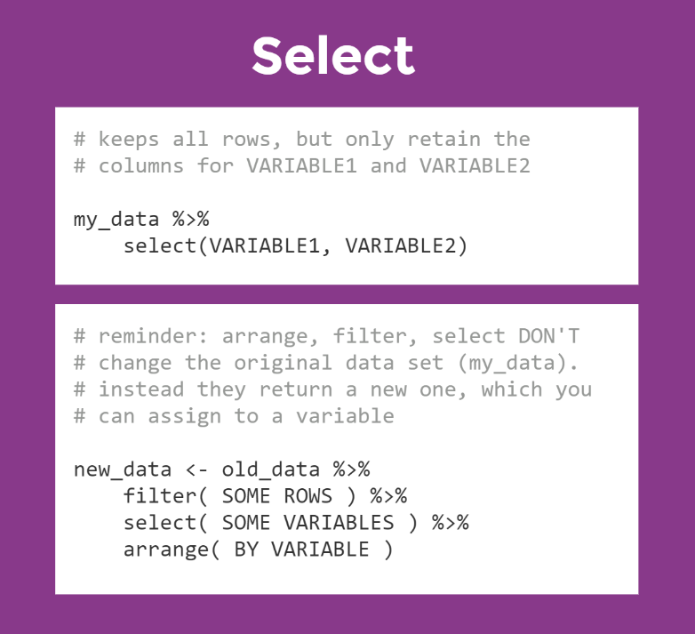

Slide 18
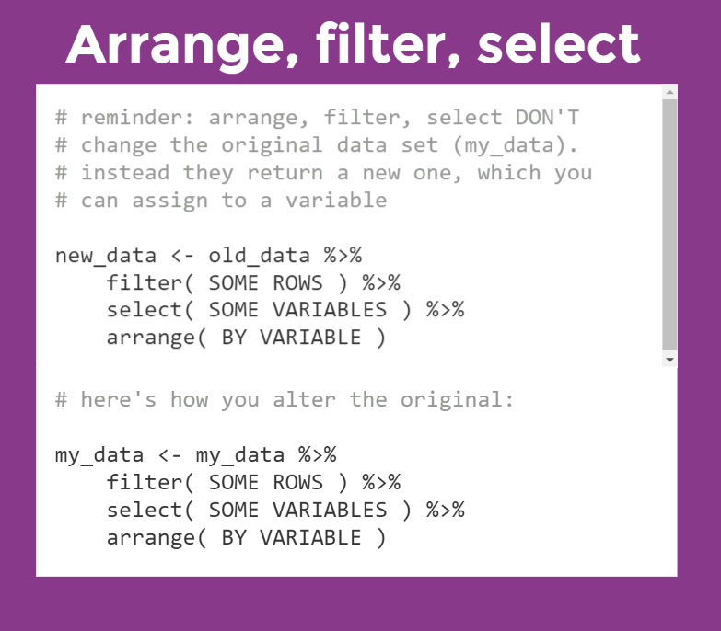

Slide 20
Little miss tidy verse
R Ladies Sydney
Great source of learning material
Before we start….

Slide 21
BUT…
Create muscle memory for the commands you use.
Never ever ever copy and paste commands you’re trying to learn.
Notes:
This seems to work

Slide 22
What's next..
Use bits of the tidyverse in your own data
The beginning is frustrating.. But you WILL get faster
Most of your problems have already been solved by someone on stackoverflow or somewhere on google.
Always think of ways to make your code sleeker and simpler
Once your data is tidy – you can do anything with it
Stats, models etc
If you’re doing something multiple times
Write it as a function
Or better still create your own package… you could expand the tidyverse

Slide 23
Useful resources:
You can always learn more and its sometimes helpful to know where to look for help:
https://adv-r.hadley.nz/ - Advanced R
https://r4ds.had.co.nz/ - Using the Tidy verse for Data science
http://r-pkgs.had.co.nz/ - instructions for using packages correctly and also writing your own packages (ENCOURAGED!).
Rstudio cheatsheets – not a “one stop shop” but very helpful once you’ve tried a few things and done some reading:
https://www.rstudio.com/resources/cheatsheets/

Slide 24
Next Workshops…
INTRO R (30th May)
Invite people that you think should learn basics in R
R Spatial (27th June)
Matt Kerr
Linear and non-linear Modelling (25th July)
Yuri Niella

