Slide 1
PM 2.5 Exposure by Race
Qasim Mehdi
Advanced Policy Analysis

Slide 2






Fine Particulate Matter
Any particle that is larger than 2.5 microns
Sources
Health Risks
Population distribution is not uniform
Map of PM 2.5 exposure by race
Notes:
Any matter that is larder that 2.5 microns in width

Slide 3
Data
Census: Race demographics by county (2020)
Georgia Tech: PM 2.5 deposition by county (µg/m3)
BAU 2030
Census: County and state shape files
Notes:
Any matter that is larder that 2.5 microns in width

Slide 4
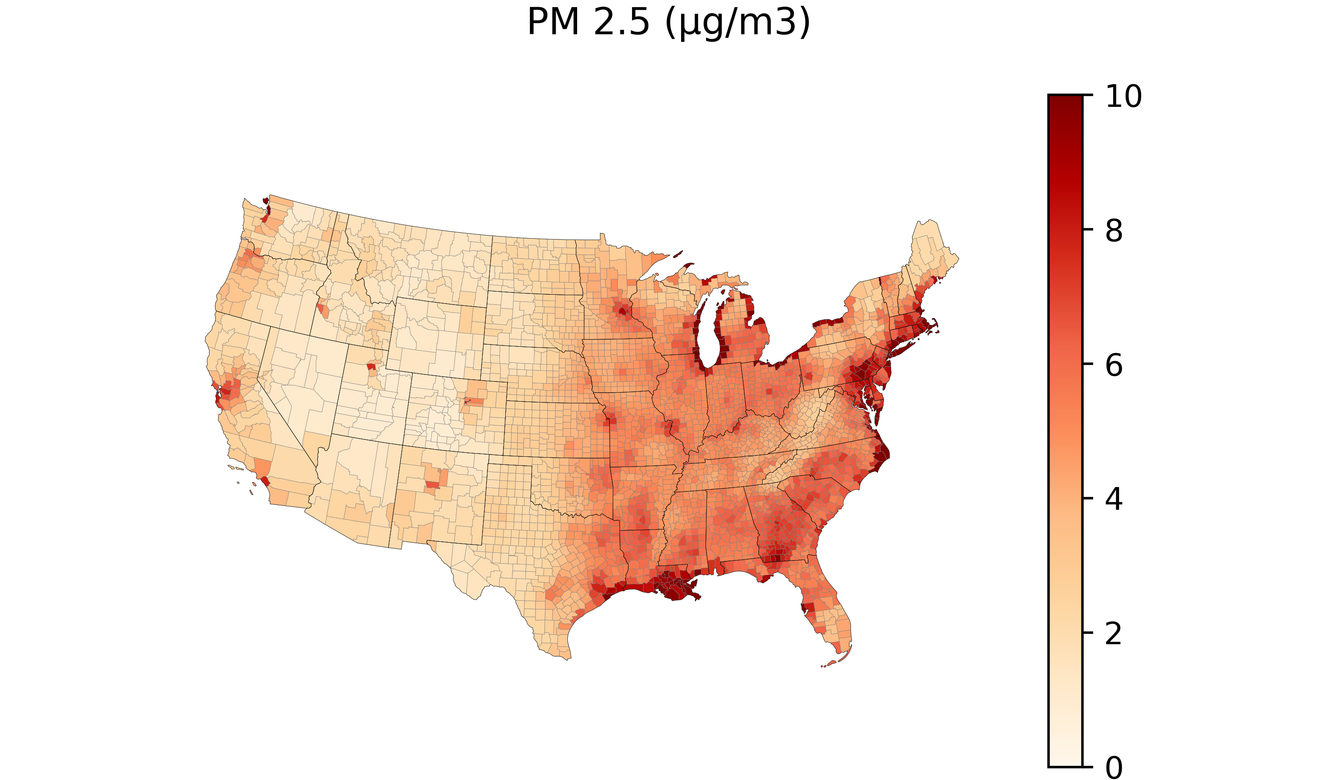

Slide 5
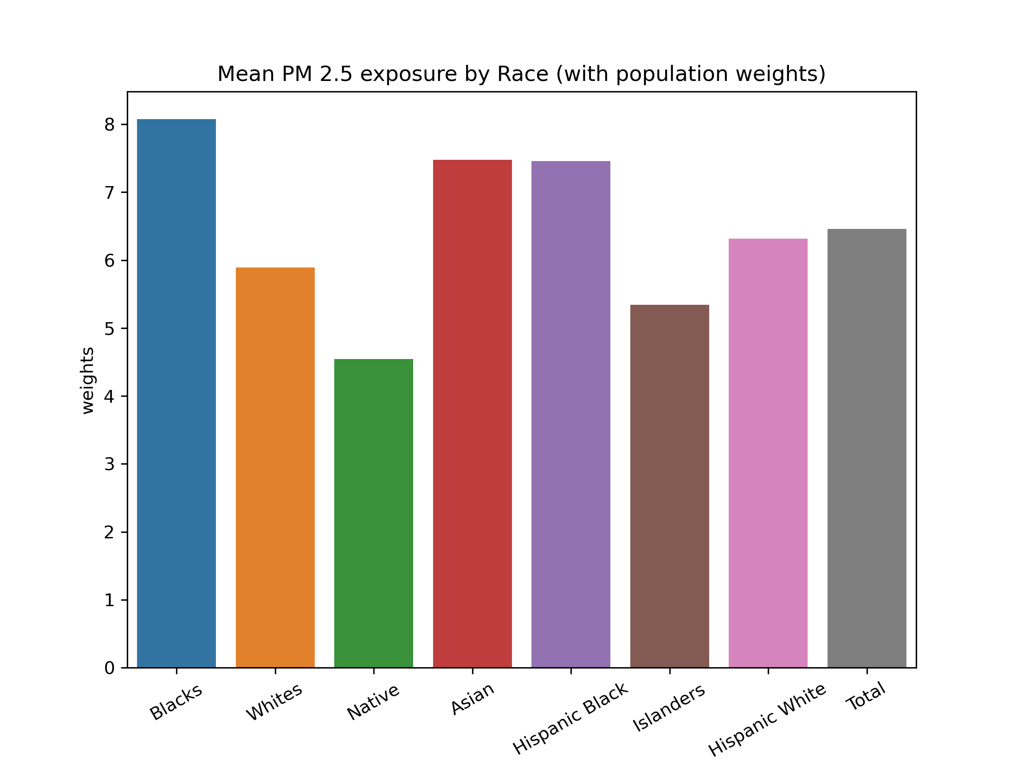

Slide 6
Blacks have 38% higher mean exposure compared to Whites
Asians have 29% higher mean exposure compared to Whites

Slide 7
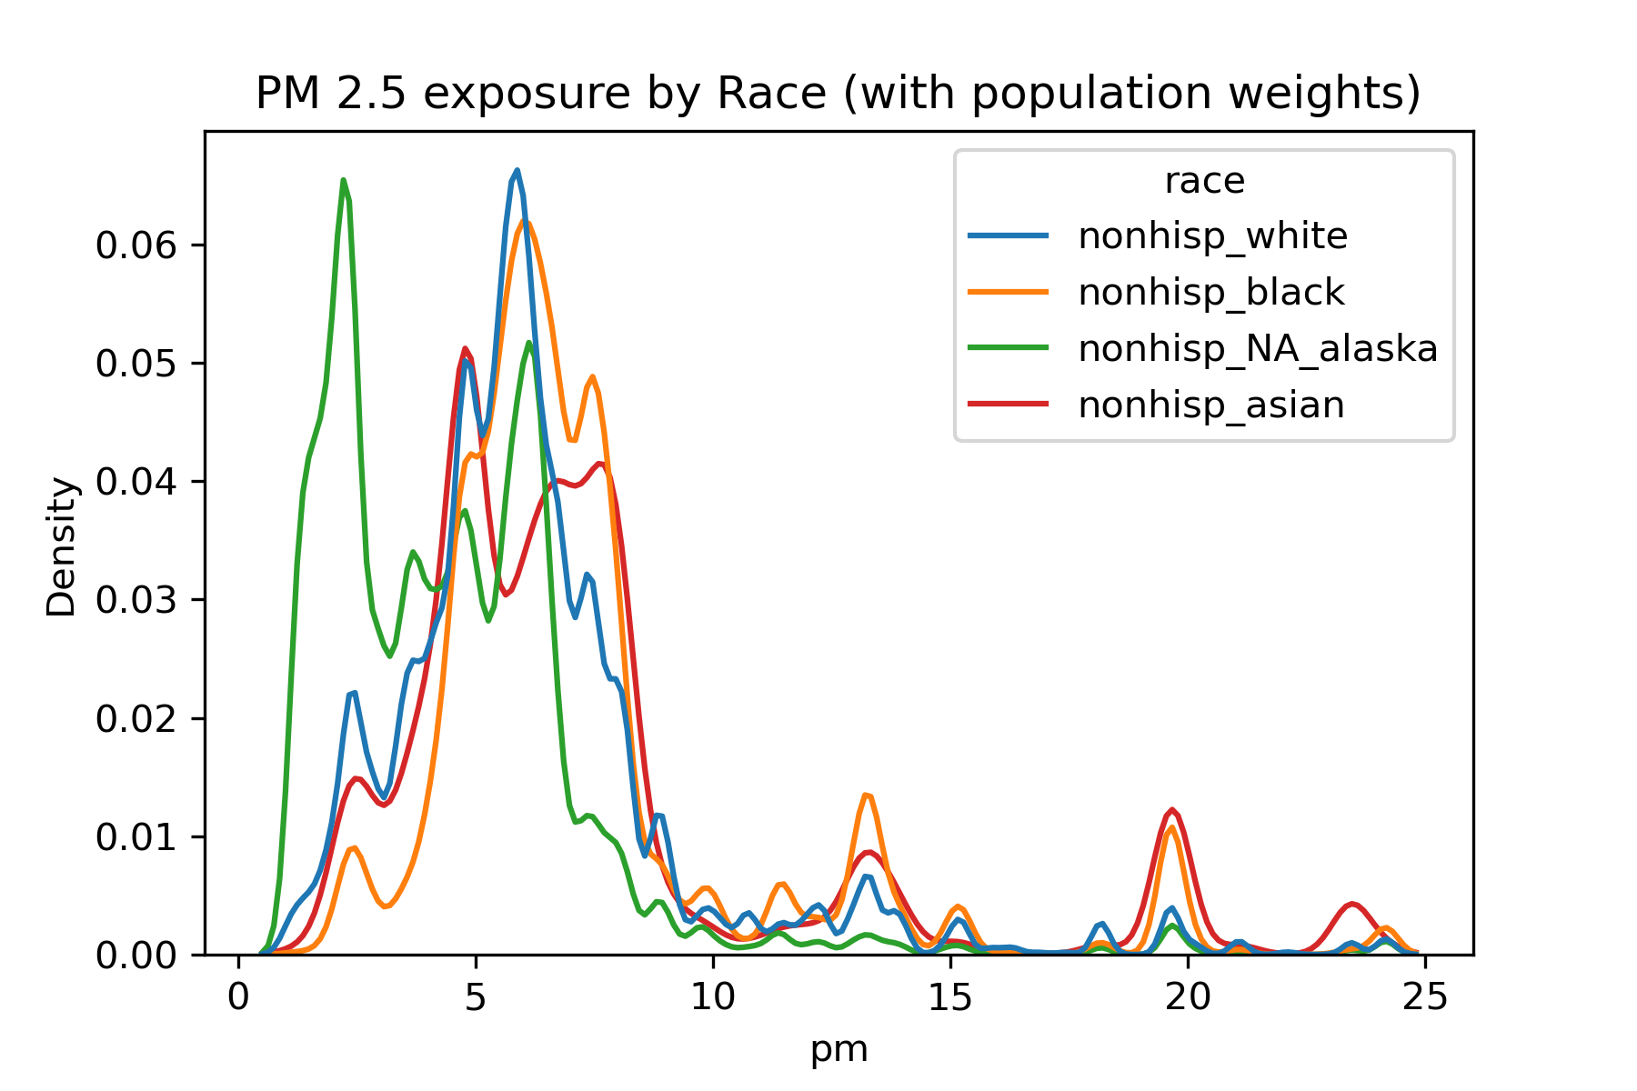

Slide 8
Chicago and New York

Slide 9
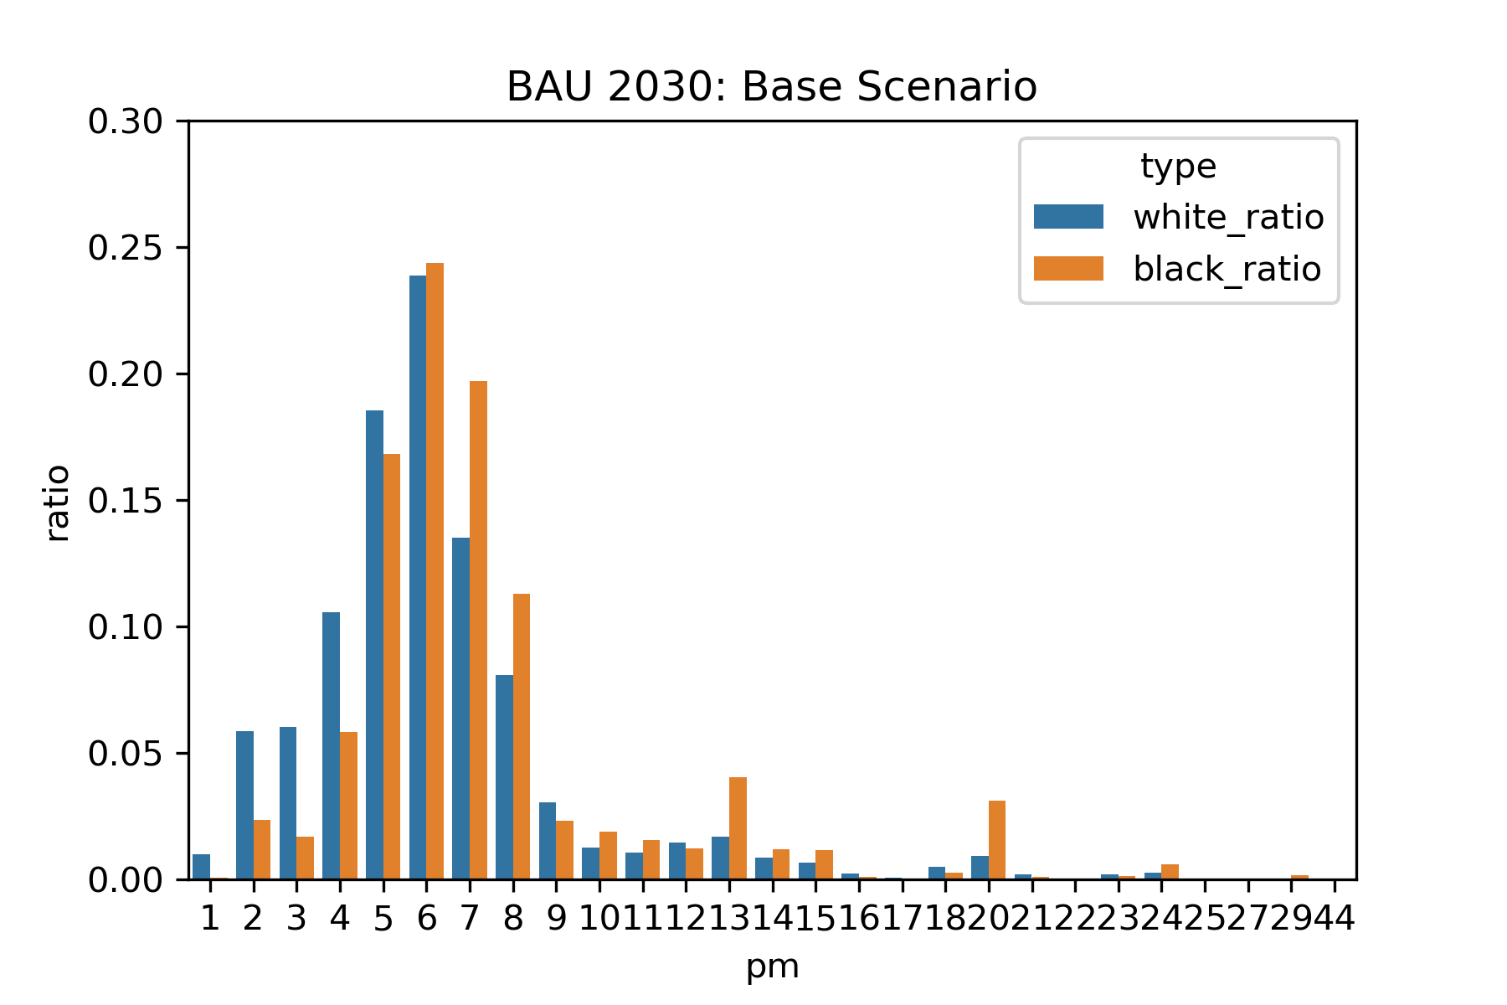

Slide 10
Chicago and New York

Slide 11
Findings
Blacks and Asians have higher PM 2.5 exposure as they are more concentrated in big cities
Native Americans have the lowest exposure as their reservations are not close to large cities
Notes:
Any matter that is larder that 2.5 microns in width

