Slide 1

Stars Performance Analysis Health Case Study
Michelle Qian

Slide 2

Executive Summary
Key Insights
• BCS performs strongly across both payers, achieving the highest star ratings.
• CBP represents the largest improvement opportunity, with the lowest compliance rates.
• COA-PNS demonstrates similar performance across both payers.
Operational Opportunity
• Gap analysis highlights targeted opportunities, where relatively small increases in compliant patients could improve star ratings.

Slide 3
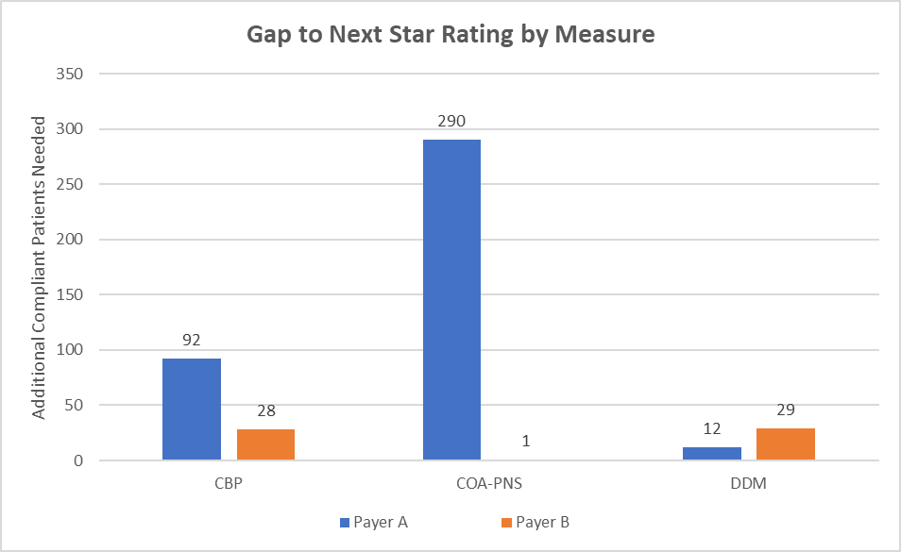
Performance Analysis: Gap to Next Star Rating
• COA-PNS for Payer A requires the largest improvement to reach the next star rating.
• Payer B generally requires fewer additional compliant patients, indicating stronger performance.
• Several measures require relatively small improvements to increase star ratings, suggesting near-term opportunities.

Slide 4

Strategic Recommendations
Focus on Measures with the Largest Gaps
• Prioritize improvement efforts for COA-PNS for Payer A, which requires the largest number of additional compliant patients to reach the next star rating.
Leverage Quick Wins
• Target measures with small gaps to the next star rating, such as COA-PNS for Payer B and DDM for Payer A, where modest improvements could quickly increase star ratings.
Strengthen Patient Engagement and Care Coordination
• Implement patient outreach initiatives such as reminders, care coordination, and provider follow-ups to improve compliance across key measures.
Additional Data to Inform Strategy
• Patient-level adherence trends • Outreach completion and provider engagement by site • Historical performance trends across Star measures

Slide 5

MEASURING SUCCESS AND MONITORING PROGRESS
Key Performance Indicators
• Track compliance rates across Star measures to evaluate improvements over time.
• Monitor the number of additional compliant patients required to reach the next star rating.
Operational Metrics
• Track patient outreach completion rates, including reminders, screenings, and follow-ups.
• Monitor provider engagement and care coordination activities related to Stars measures.
Reporting and Continuous Improvement
• Develop monthly performance dashboards to track progress across measures.
• Share results with leadership and care teams to identify gaps and adjust strategies as needed.

Slide 6

Thank you

