Slide 1



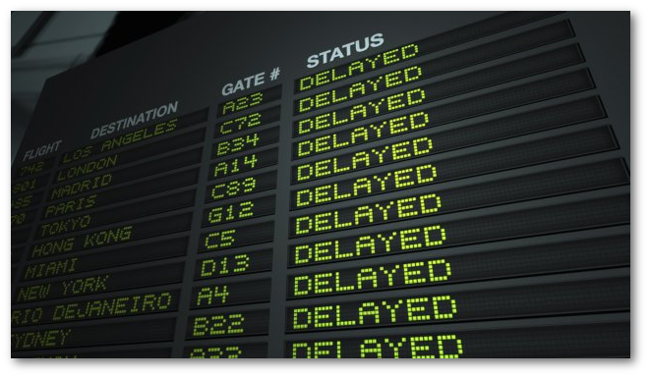


Mike Kuhlen, Insight 2013C
A flight delay estimator providing ticket purchasing advice
Notes:
Hi everyone!
My name is Mike Kuhlen. Today I want to pitch (present?) to you my data project “Delay Me Not!”
Delay Me Not makes flight delay predictions at ticket purchase time.
Using Delay Me Not, you're going to be able to make informed decisions on what ticket to purchase to minimize your risk of a flight delay and possibly missing your connection.
Let me show you!

Slide 2
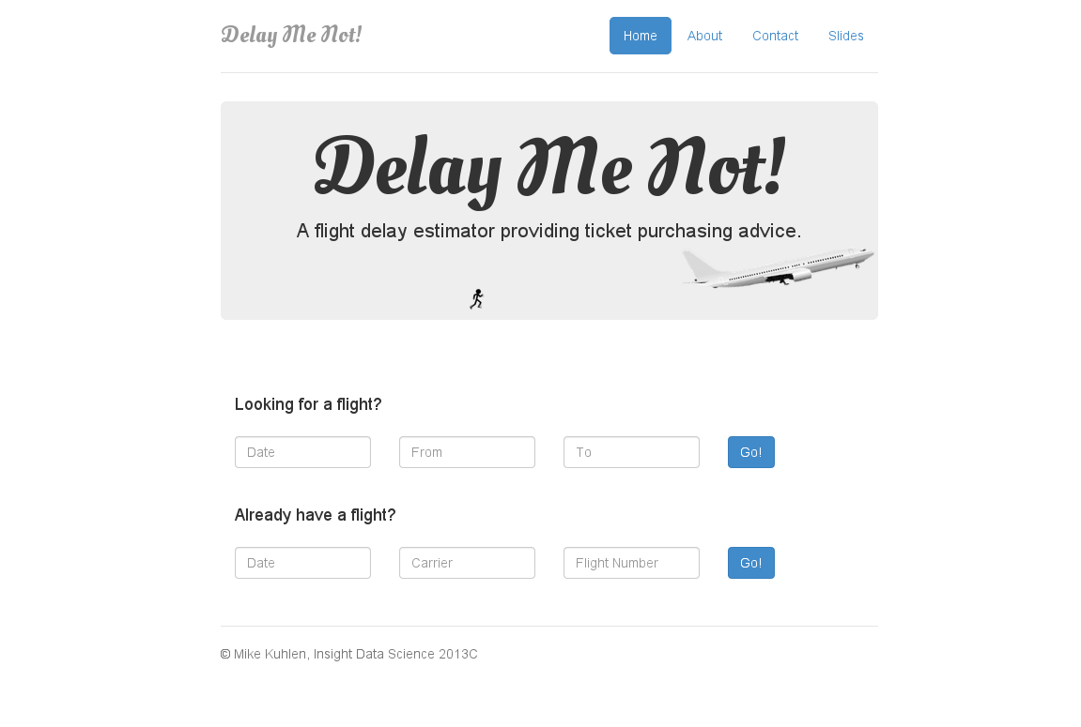
Notes:
Here it is, delaymenot.com
It has two usage cases. One is if you already have a flight, and want to know how likely it is to be delayed.
But the feature i want to focus on today is if you're trying to decide on a flight.
So let's say you're trying to book a flight for Christmas, to visit your familiy in New York.
Christmas is on a Wednesday this year, so let's pick the previous Saturday, Dec. 21. And we're going to be flying from SFO to JFK.
Click Go, and you get back a list of flights. Some non-stop, some with connections. In the very right column it lists the delay probability, where delay here is defined as more than 30 minutes delayed.
The flight you've been considering is this United flight leaving at around 11am with a stopover at LAX. Now delaymenot tells you that this is probably not a good flight to buy, since it has an almost 40% chance of being delayed by more than 30 min., and that means you're going to miss your connection, which would be a horrible start to your x-mas vacation.
Instead you could pick the flight just below it, with the same stopover, but leaving earlier in the morning. It has a much lower chance of being delayed.
Or maybe you're now more interested in non-stop flights? Well, sorting here by departure time, you can see that there's a monotonic relationship between flight delays and departure time.
The earlier you leave, the less likely you're going to be delayed.
Great, right? Delaymenot helps you make informed decision about which flight to buy in order to minimize your risk of annoying delays.

Slide 3



FLIGHT DELAY MODEL
150 million US domestic flights from 1987 – 2013
(for computational ease, restricted analysis to 2008-2013)
sklearn.ensemble.RandomForestClassifier
11 continuous features (DayOfYear, ScheduledDepartureTime, DaysFromNearestHoliday, ...)
100+ “dummified” categorical features (Carrier, Origin/Destination)
171 Origin models, 101 Destination models (67 GB)
Notes:
So, how did I do this?
I started with this publicly available dataset from Research and Innovative Technology Association (RITA) from the Federal Bureau of Transportation, containing information about all US domestic flights flown from 1987 – 2013.
It contains scheduled and actual departure and arrival information for 150 million flights in total, although for computational feasibility I restricted myself to the past 5 years.
I tried a bunch of different classification methods, but Random Forests seemed to give the best results.
In total I have 11 continuous features, such as “day of year”, “departure time”, and “days from nearest holiday”, and then a bunch of “dummified” categorical variables.
I created separate Origin and Destination models for all routes with more than 50,000 flights in my dataset.

Slide 4
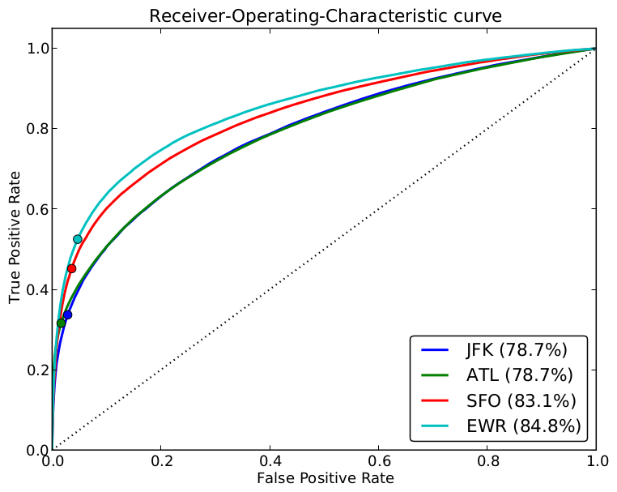
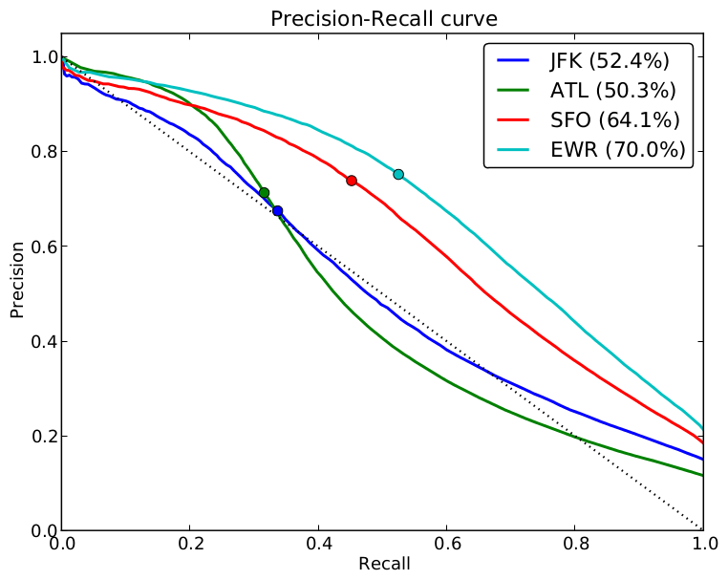
VALIDATION
Accuracy: around 90% F₁ score: up to 0.64
Comparable to industry standards! (and I got to this in two weeks... ☺)

Slide 5
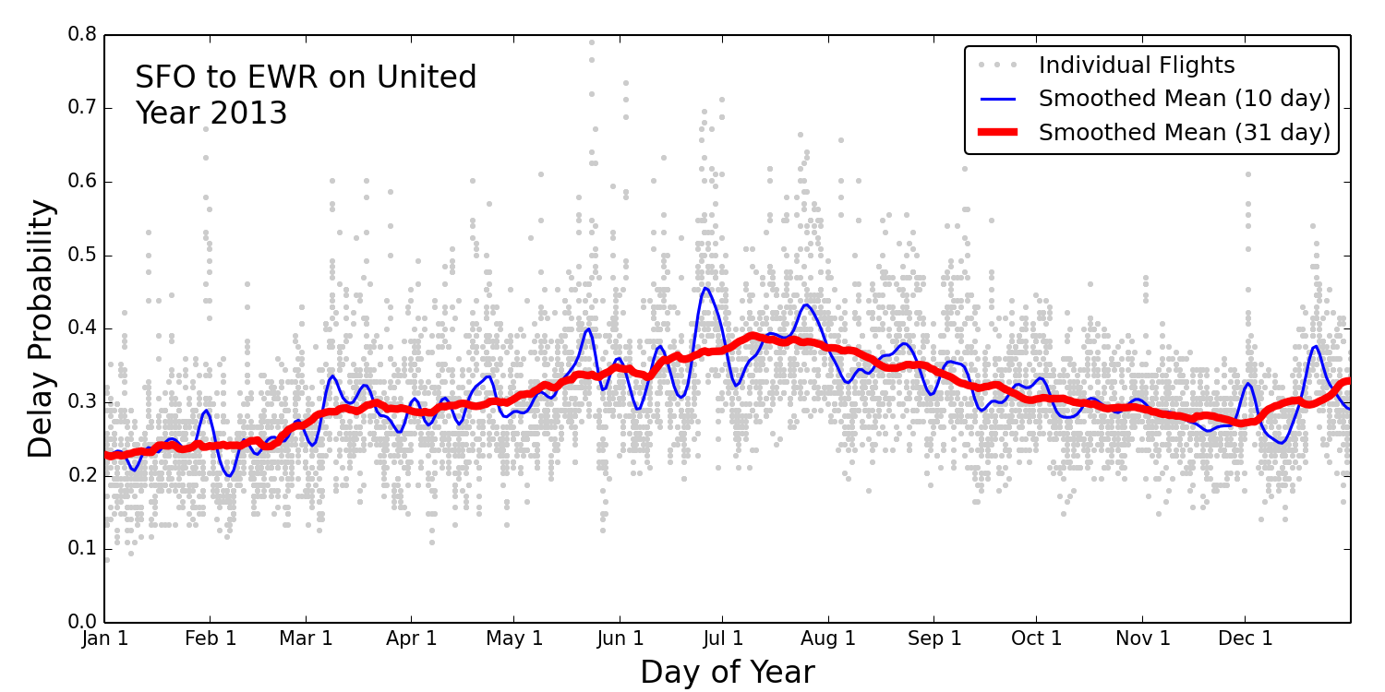
Delays vs. Day of Year
Notes:
Here are some interesting trends I found in my modeling. As an example I'm looking at flights from SFO to EWR on United over an entire year, departing in hourly intervals from 6am to midnight..
The blue and red curves show the mean delay probability, smoothed over 10 and 31 days.
As you can see, delays are more likely in the summer months, presumably because traffic volumes are up and perhaps because fog is more likely in SFO and thunderstorms more likely in NY.

Slide 6
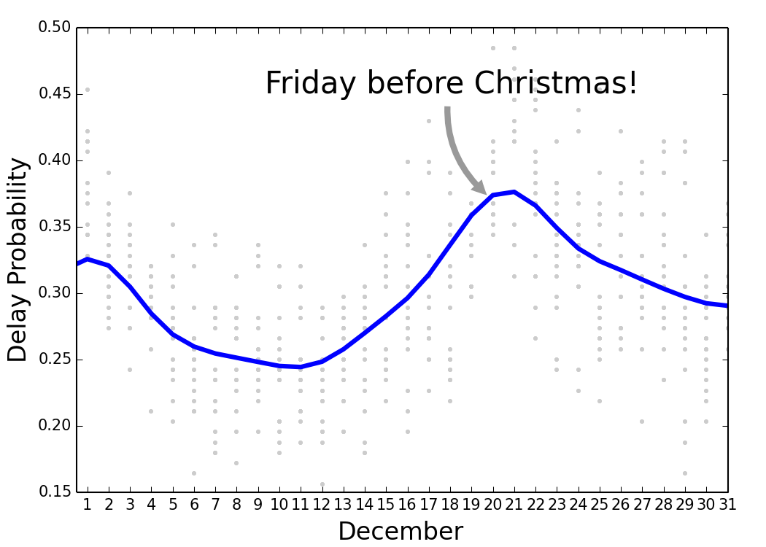
Delays vs. Day of Year
Notes:
Now let's zoom in on Christmas.
This is great! The model very clearly predicts a spike in delay probability as we get closer to X-mas.
The probability peaks on the Saturday before X-mas, so in our earlier example, we'd be better off flying a bit earlier in the month.

Slide 7







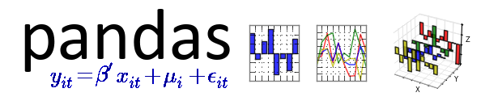
The Data
The Front End
The Modeling & Analysis
Notes:
Here's a summary of the data and tools I used to do the modeling:
As mentioned, I used the RITA dataset as input, and for the webapp I used the FlightStats API to get a list of scheduled flights on a given date and route.
The modeling and analysis was done in python, using numpy, scipy, pandas, and scikit-learn.
The webapp was built with Twitter bootstrap and Flask and is hosted on my own webserver running nginx.

Slide 8
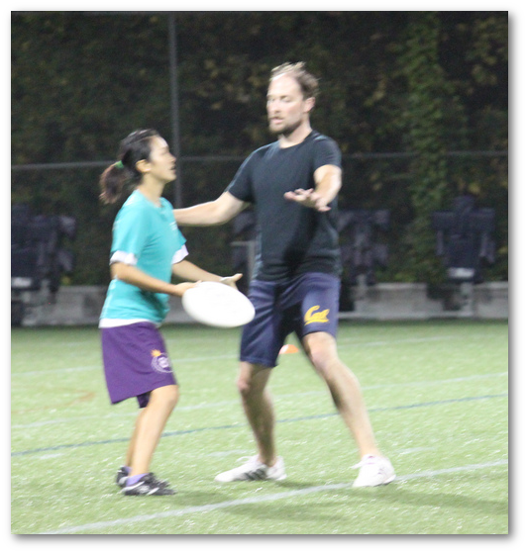

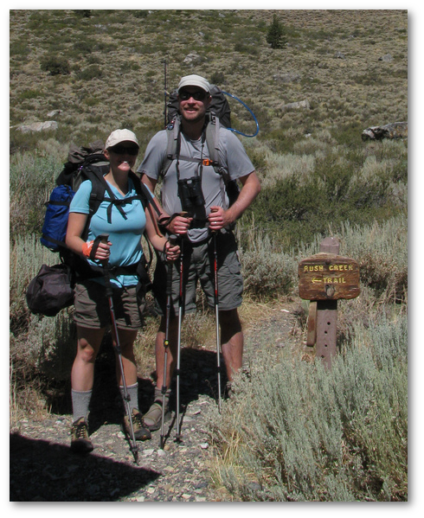
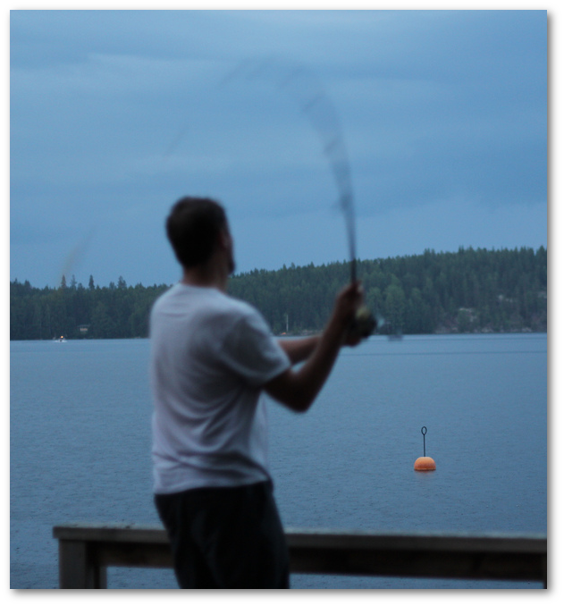

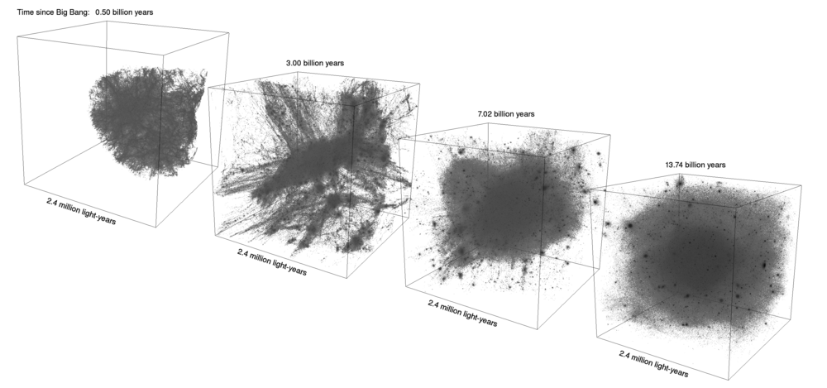


About me: Mike Kuhlen
Numerical Simulations of
Dark Matter Structure Formation
Notes:
A little bit about me:
I got my bachelors in physics from Caltech, then my Ph.D. in astrophysics from UC Santa Cruz, and since then I've done two postdocs, one at the Institute for Advanced Study in Princeton, and most recently at UC Berkeley.
The research I pursued was mostly large-scale numerical simulations of dark matter structure formation.
I've recently picked up fishing, I'm an avid backcountry hiker, and I play Ultimate.

