Slide 1


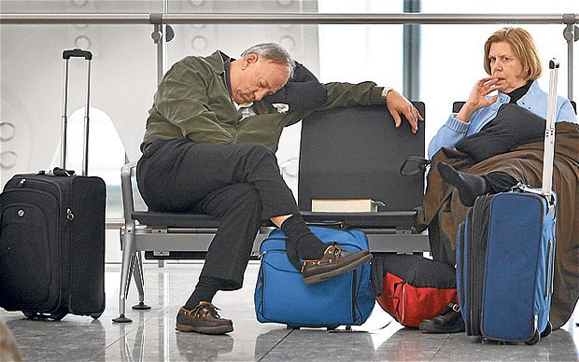
Mike Kuhlen, Insight 2013C
Delay Me Not!
A flight delay estimator providing ticket purchasing advice

Slide 2
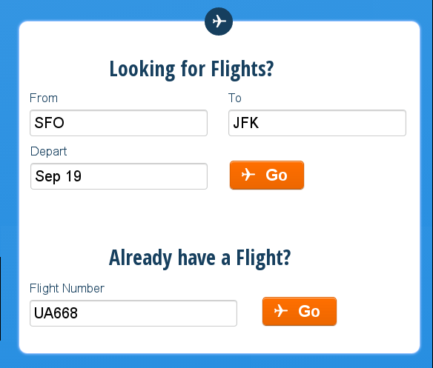
Mike Kuhlen, Insight 2013C
Delay Me Not!
A flight delay estimator providing ticket purchasing advice

Slide 3
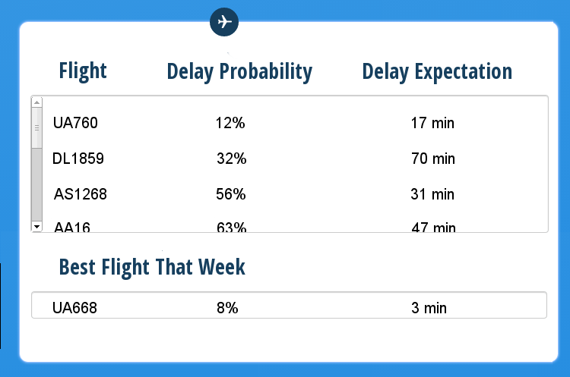
Mike Kuhlen, Insight 2013C
Delay Me Not!
A flight delay estimator providing ticket purchasing advice

Slide 4
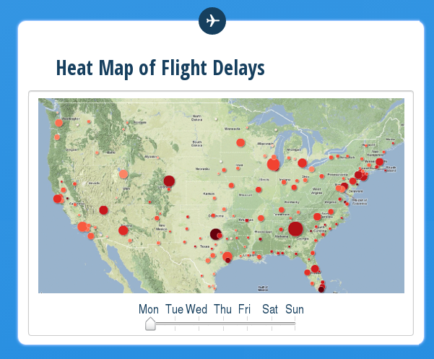
Mike Kuhlen, Insight 2013C
Delay Me Not!
A flight delay estimator providing ticket purchasing advice

