Slide 1
Introduction to Machine Learning and Artificial Intelligence

Slide 2
What is Machine Learning
From a limited set of examples, generalize regularities through algorithms and apply them to unknown data.
In most cases, machine learning learns p(y|X = x) for discriminative model / p(x|Y = y) and p(y) for generative model.
Notes:
NLP、CV、Autonomous Driving等等

Slide 3
v.s. Artificial Intelligence
Intelligence is general topic.
Machine learning for artificial intelligence means make machine as smart as human.
Notes:
智能，智能手机？通用智能？

Slide 4
v.s. Statistics
Statistics emphasizes on means; machine learning emphasizes on ends.
Probably-approximately-correct Theory; coding practice.
Notes:
课本中小而美

Slide 5
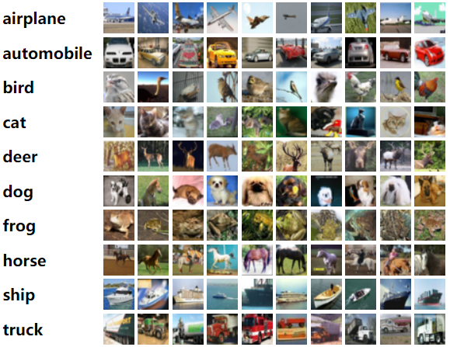
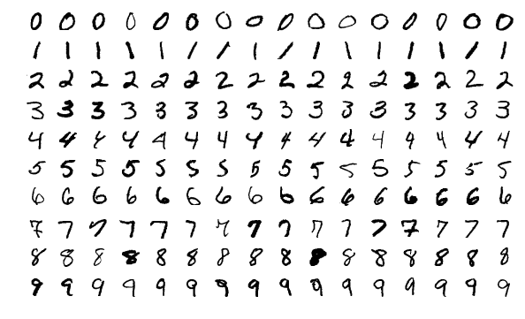
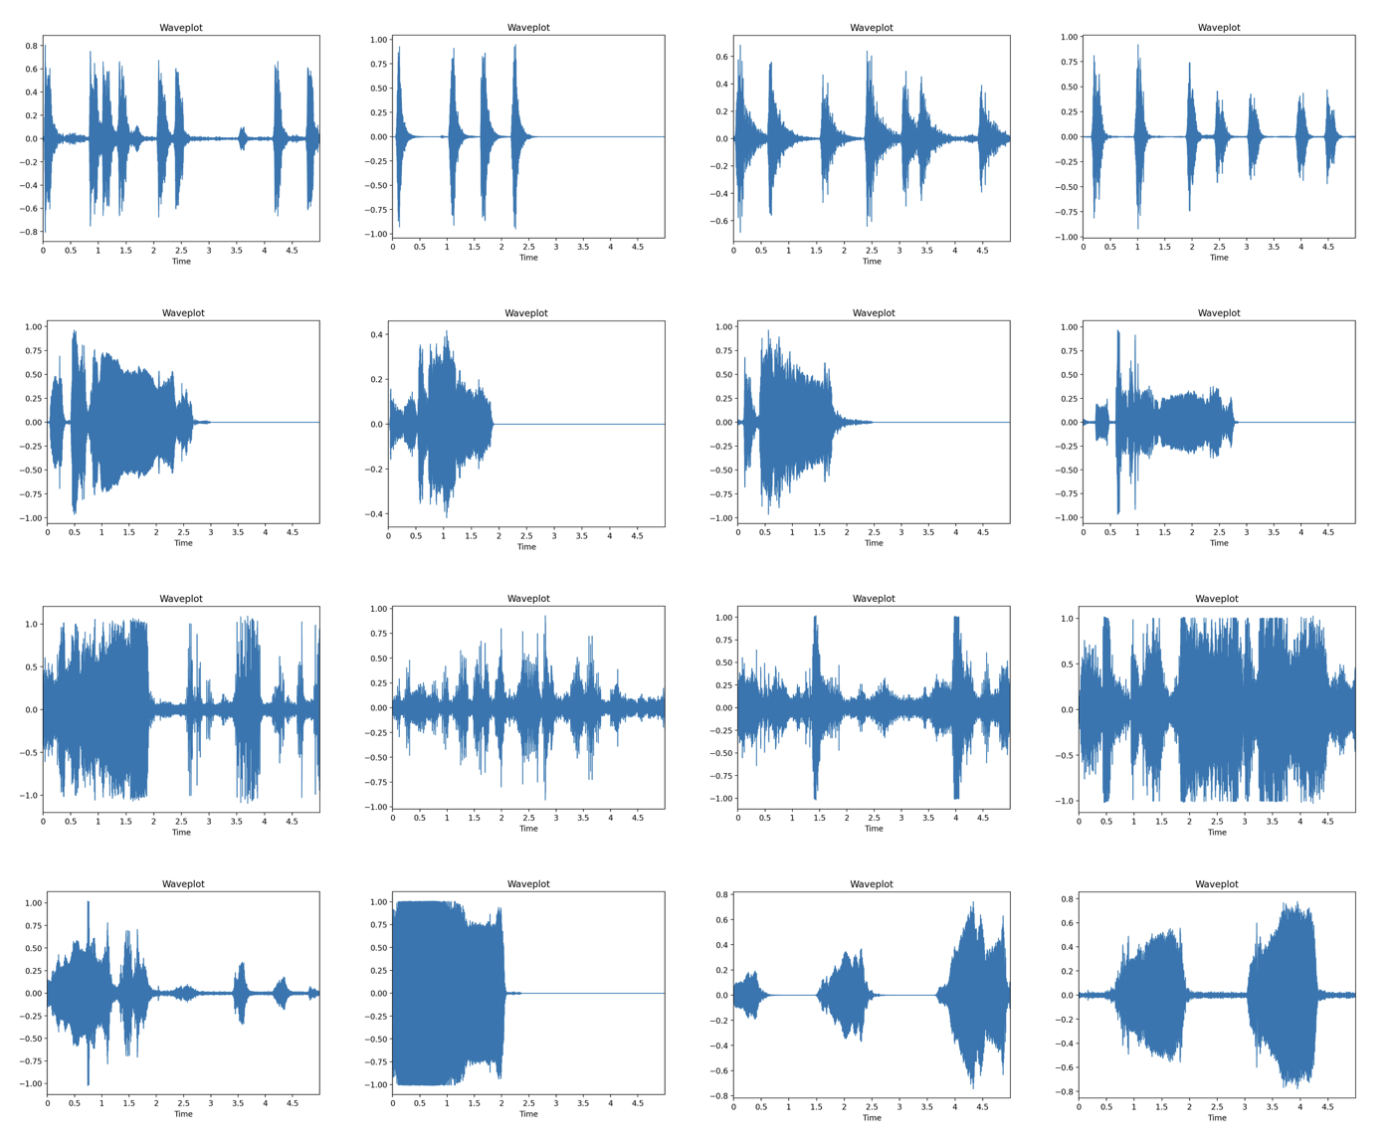
v.s. Data Science
Data are of complex forms in machine learning

Slide 6
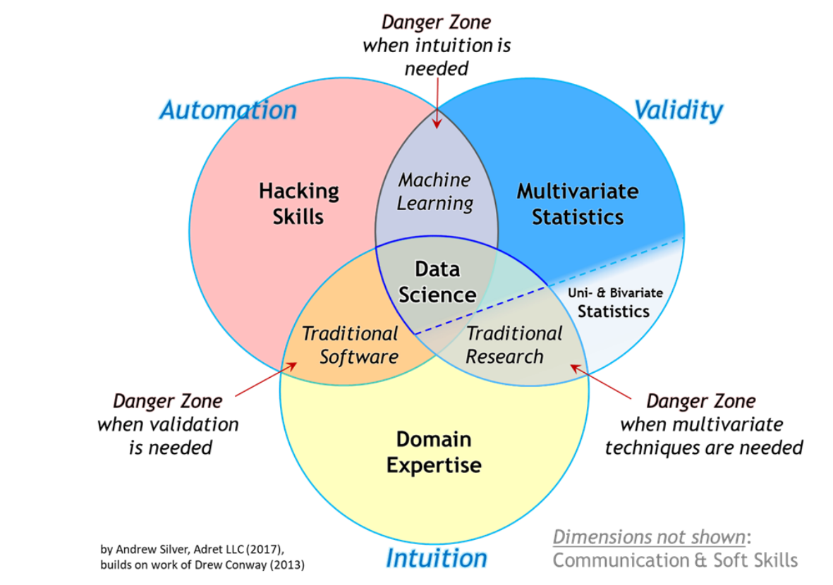
What is Machine Learning

Slide 7
What is Machine Learning
Calculus
Probability and Statistics
Linear Algebra
Optimization

Slide 8
What is Machine Learning
From a limited set of examples, generalize regularities through algorithms and apply them to unknown data.
Theoretically, it is data + algorithm + knowledge.
Practically, it is data + algorithm + evaluation.
Notes:
计算机中没有草稿纸

