Slide 1
Frequentist Data Analysis
Prof. Pradeep Ravikumar
pradeepr@cs.cmu.edu

Slide 2
Recall: Model-based ML
MODEL LEARNING
MODEL INFERENCE
DATA
MODEL
KNOWLEDGE
Learning: From data to model
A model explains how the data was “generated”
E.g. given (symptoms, diseases) data, a model explains which symptoms arise from which diseases
Inference: From model to knowledge
Given the model, we can then answer questions relevant to us
E.g. given (symptom, disease) model, given some symptoms, what is the disease?

Slide 3
Model Learning: Data to Model
What are some general principles in going from data to model?
What are the guarantees of these methods?

Slide 4
Let us consider the example of a simple model

Slide 5
Your first consulting job
A billionaire from the suburbs of Seattle asks you a question:
He says: I have a coin, if I flip it, what’s the probability it will fall with the head up?
You say: Please flip it a few times:

Slide 6
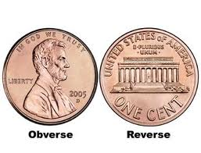
Your first consulting job
A billionaire from the suburbs of Seattle asks you a question:
He says: I have a coin, if I flip it, what’s the probability it will fall with the head up?
You say: Please flip it a few times:
You say: The probability is 3/5
He says: Why???
You say: Because… frequency of heads in all flips

Slide 7
Questions
Why frequency of heads?
How good is this estimation?
Would you be willing to bet money on your guess of the probability?
Why not?

Slide 8
Model-based Approach
First we need a model that would explain the experimental data
What is the experimental data?
Coin Flips

Slide 9
Model
First we need a model that would capture the experimental data
What is the experimental data?
Coin Flips

Slide 10
Model
A model for coin flips
Bernoulli Distribution
X is a random variable with Bernoulli distribution when:
X takes values in {0,1}
P(X = 1) = p
P(X = 0) = 1 - p
Where p in [0,1]

Slide 11
Model
X is a random variable with Bernoulli distribution when:
X takes values in {0,1}
P(X = 1) = p, P(X = 0) = 1 – p, where p in [0,1]
X = 1 i.e. heads with probability p, and X = 0 i.e. tails with probability 1 – p
And we draw independent samples that are identically distributed from same distribution
flip the same coin multiple times

Slide 12
Bernoulli distribution
Data, D =
P(Heads) = θ, P(Tails) = 1-θ
Flips are i.i.d.:
Independent events
Identically distributed according to Bernoulli distribution
Choose θ that maximizes the probability of observed data

Slide 13
Probability of one coin flip

Slide 14
Probability of Multiple Coin Flips

Slide 15
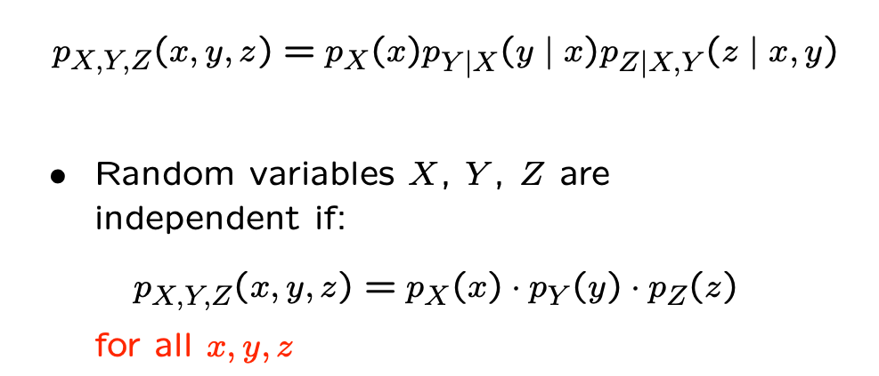
Recall: Independent Random Variables

Slide 16
Probability of Multiple Coin Flips
…Independence of samples

Slide 17
Probability of Multiple Coin Flips

Slide 18
Probability of Multiple Coin Flips
…probability of a Bernoulli sample

Slide 19
Probability of Multiple Coin Flips

Slide 20
Probability of Multiple Coin Flips

Slide 21
Maximum Likelihood Estimator (MLE)

Slide 22
Maximum Likelihood Estimator (MLE)
…argmax_x f(x) = argmax_x log f(x)

Slide 23
MLE for coin flips

Slide 24
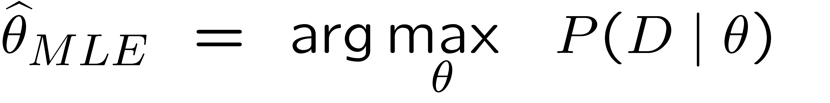
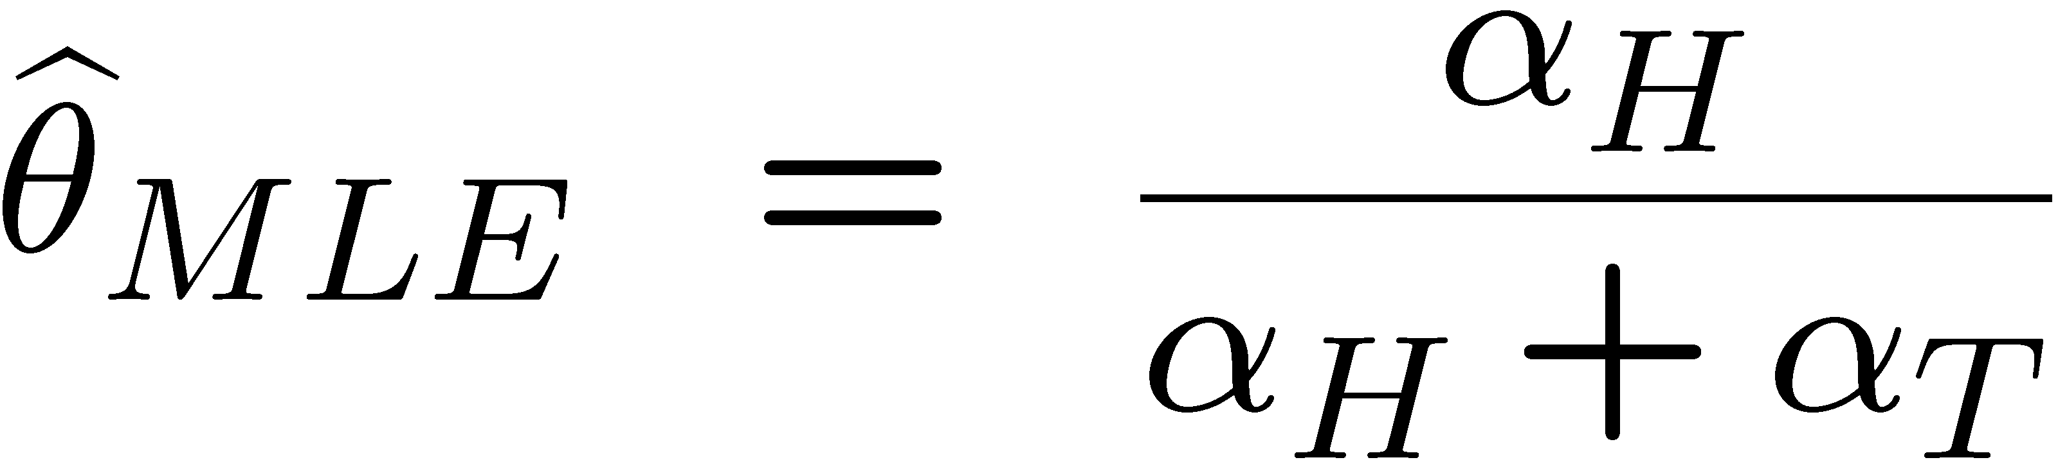
Maximum Likelihood Estimation
Choose θ that maximizes the probability of observed data
MLE of probability of head:
= 3/5
“Frequency of heads”

Slide 25
How many flips do I need?
Billionaire says: I flipped 3 heads and 2 tails.
You say: θ = 3/5, it is the MLE!
He says: What if I flipped 30 heads and 20 tails?
You say: Same answer, it is the MLE!
He says: If you get the same answer, would you prefer to flip 5 times or 50 times?
You say: Hmm… The more the merrier???
He says: Is this why I am paying you the big bucks???

Slide 26
SO FAR: THE MLE is a class of estimators that Estimate model from data
KEY Question: How good is THE MLE (OR ANY OTHER ESTIMATOR)?

Slide 27
How good is this MLE: Infinite Sample Limit

Slide 28
How good is this MLE: Infinite Sample Limit

Slide 29
How good is this MLE: Infinite Sample Limit

Slide 30
How good is this MLE: Infinite Sample Limit

Slide 31
How good is this MLE: Infinite Sample Limit

Slide 32
How good is this MLE: Infinite Sample Limit

Slide 33
How good is this MLE: Infinite Sample Limit

Slide 34
How good is this MLE: Infinite Trial Average

Slide 35
How good is this MLE: Infinite Trial Average

Slide 36
How good is this MLE: Infinite Trial Average

Slide 37
How good is this MLE: Infinite Trial Average

Slide 38
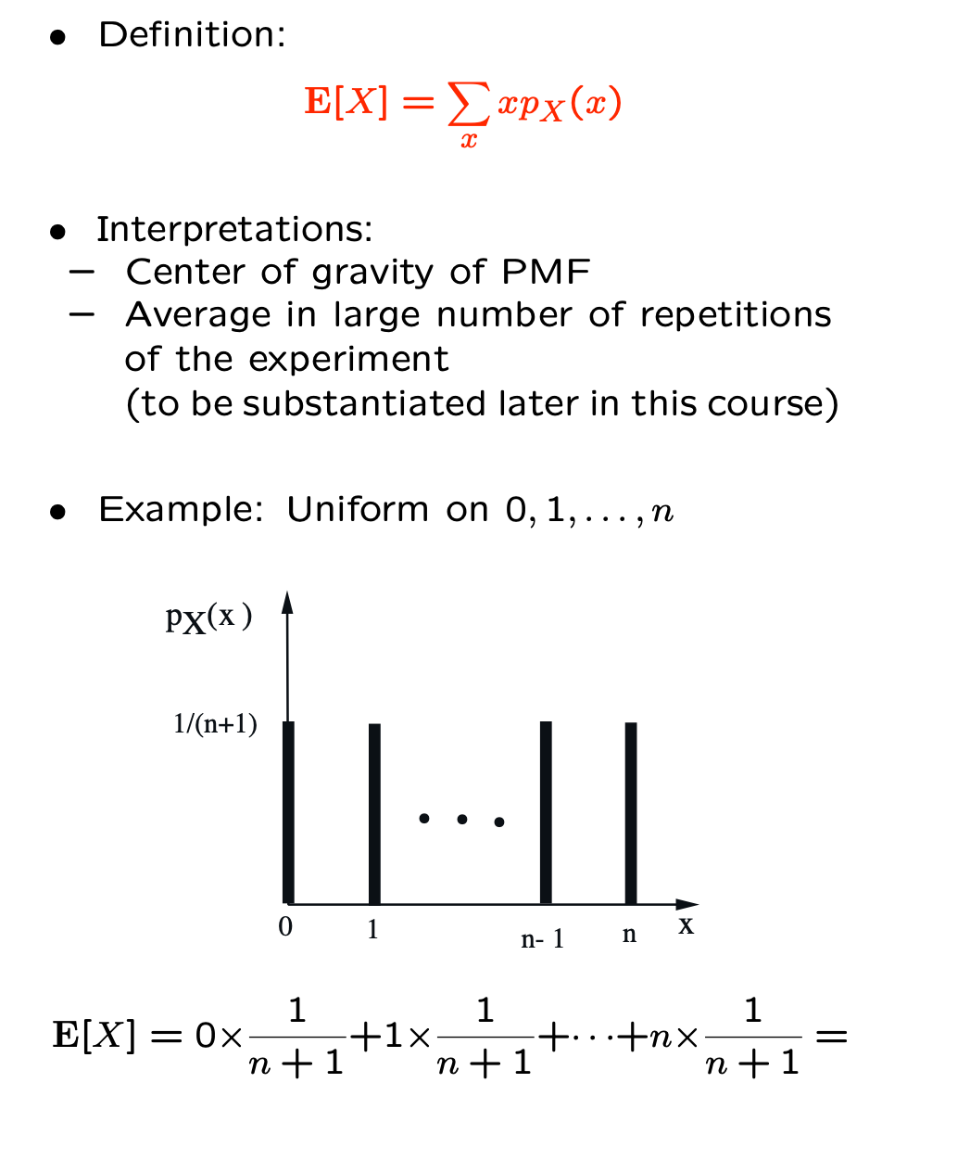
Expectation

Slide 39
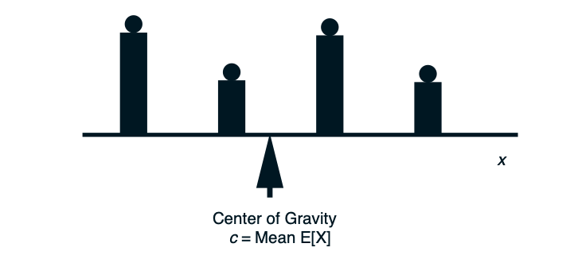
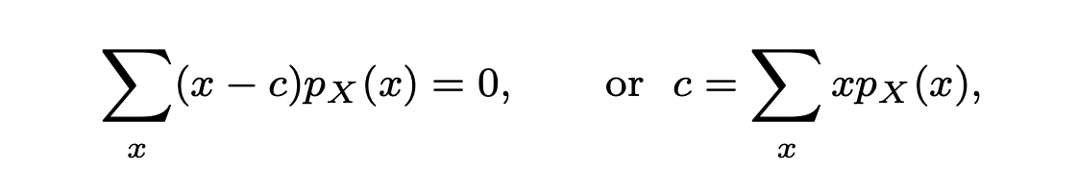
Expectation
Given a bar with a weight pX(x) placed at each point x
with pX(x) > 0, the center of gravity c is the point at which
the sum of the torques from the weights to its left are equal
to the sum of the torques from the weights to its right.
Text

Slide 40
How good is this MLE?

Slide 41
How good is this MLE?
…linearity of expectation:
E(a X + b Y) = a E(X) + b E(Y)

Slide 42
How good is this MLE?

Slide 43
How good is this MLE?

Slide 44
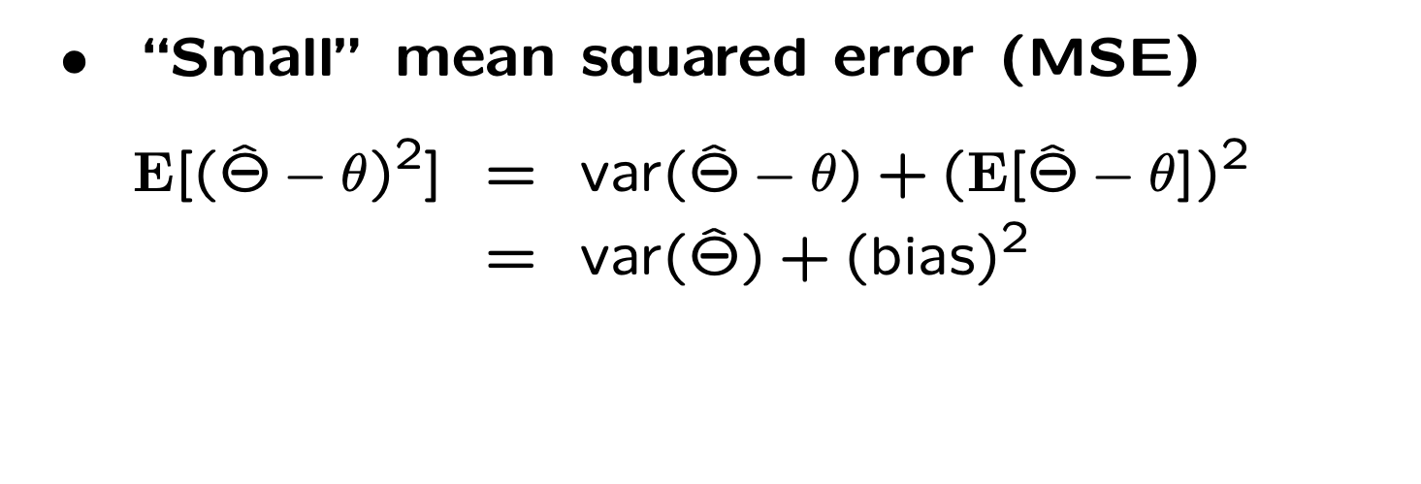
How good is this MLE?
In general, there is a tradeoff between the two terms: bias and variance.
A reduction in one increases the other.
A good estimator manages to keep both small.

Slide 45
How good is this MLE?

Slide 46

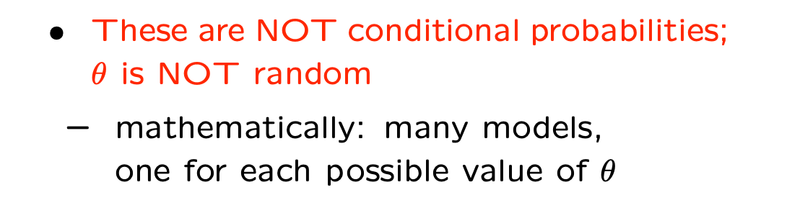
Summary: Classical/Frequentist Data Analysis
Parameter
Observation
is a deterministic (i.e. not random) but unknown quantity
is random, with distribution

Slide 47
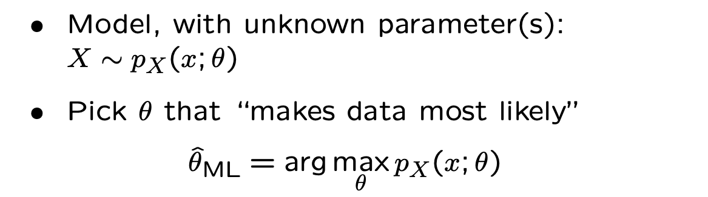
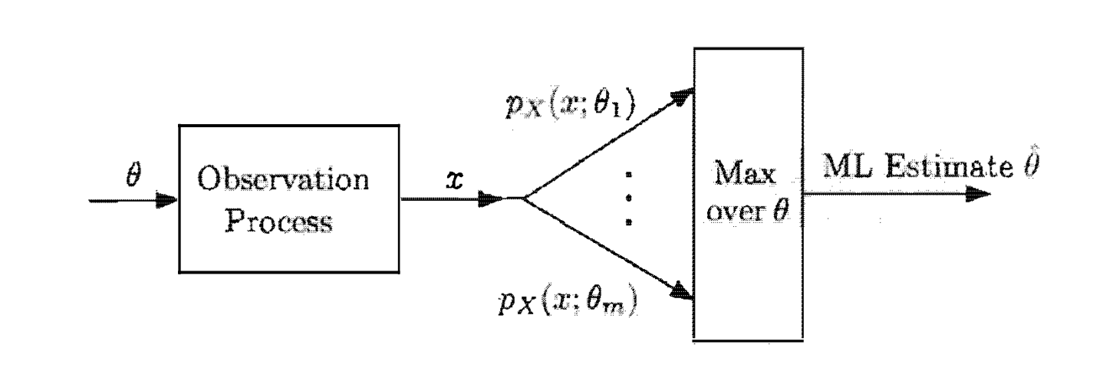
Summary: Maximum Likelihood Estimation

Slide 48
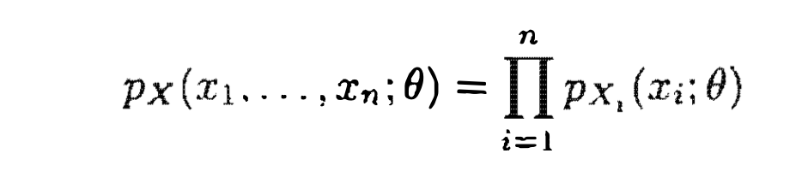
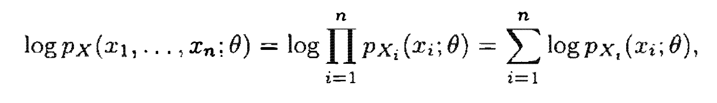
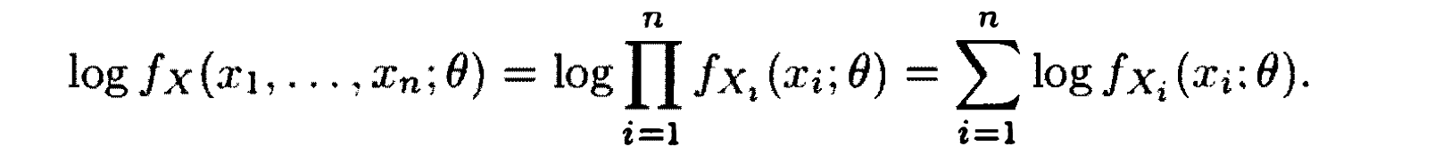
Likelihood Function
We refer to
Note that this is a function of
If the observations X_i are independent, the likelihood function takes the form
Log-likelihood function:

Slide 49
Log-Likelihood
Log-likelihood function
It might be analytically more convenient to maximize log-likelihood rather than likelihood --- though either would yield the same answer

Slide 50
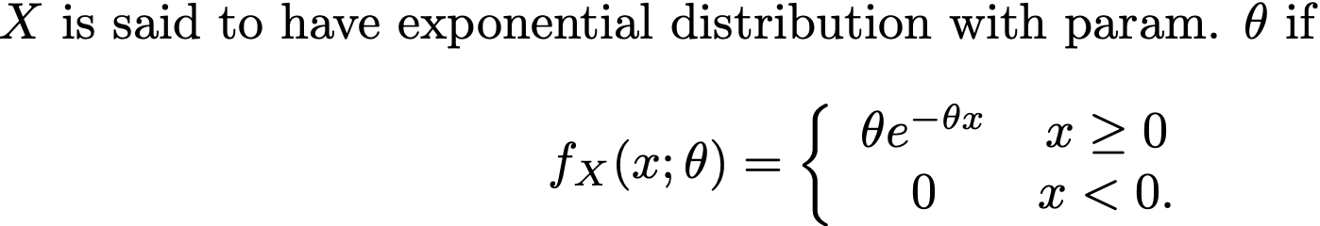

Example

Slide 51
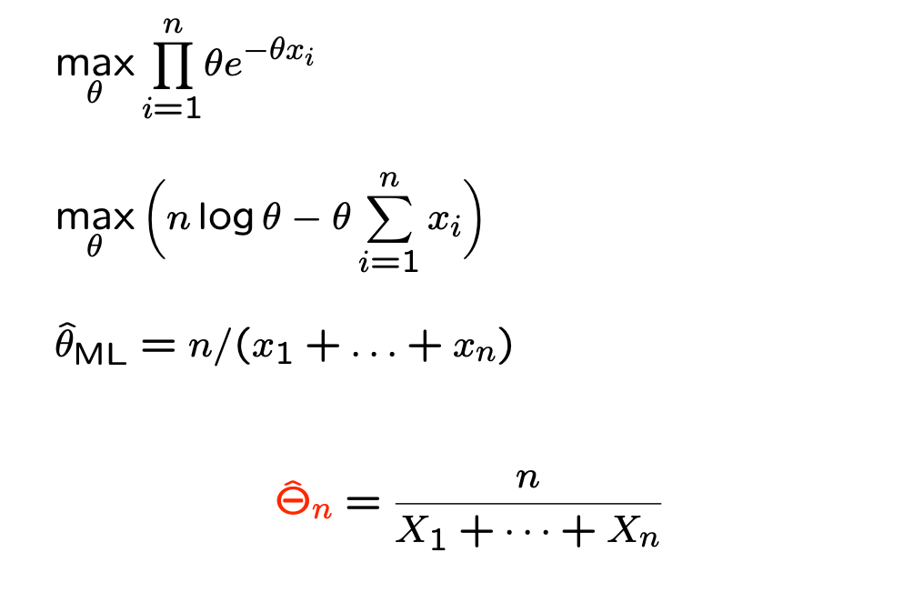
Example

Slide 52
Example

Slide 53
Example I

Slide 54
Example I

Slide 55
Example
Romeo and Juliet are dating, but Juliet is late on any date by a random amount X, uniformly distributed over the interval [0,θ] where θ is unknown. Let us assume here that θ is deterministic (i.e. not random). What is the ML estimate of θ, if Juliet is late by an amount x on their first date?

Slide 56
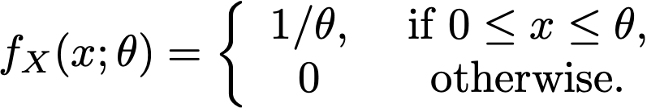
Example
Romeo and Juliet are dating, but Juliet is late on any date by a random amount X, uniformly distributed over the interval [0,θ] where θ is unknown. Let us assume here that θ is deterministic (i.e. not random). What is the ML estimate of θ, if Juliet is late by an amount x on their first date?
Data PDF

Slide 57
Example
Romeo and Juliet are dating, but Juliet is late on any date by a random amount X, uniformly distributed over the interval [0,θ] where θ is unknown. Let us assume here that θ is deterministic (i.e. not random). What is the ML estimate of θ, if Juliet is late by an amount x on their first date?
Data PDF
ML estimate of θ is x

Slide 58
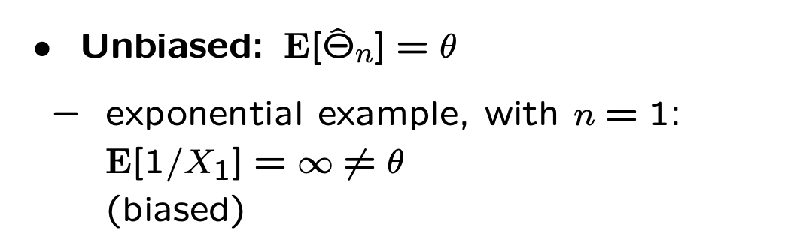

Desirable Properties of Estimators I
Bias:
Unbiased: bias equals zero

Slide 59
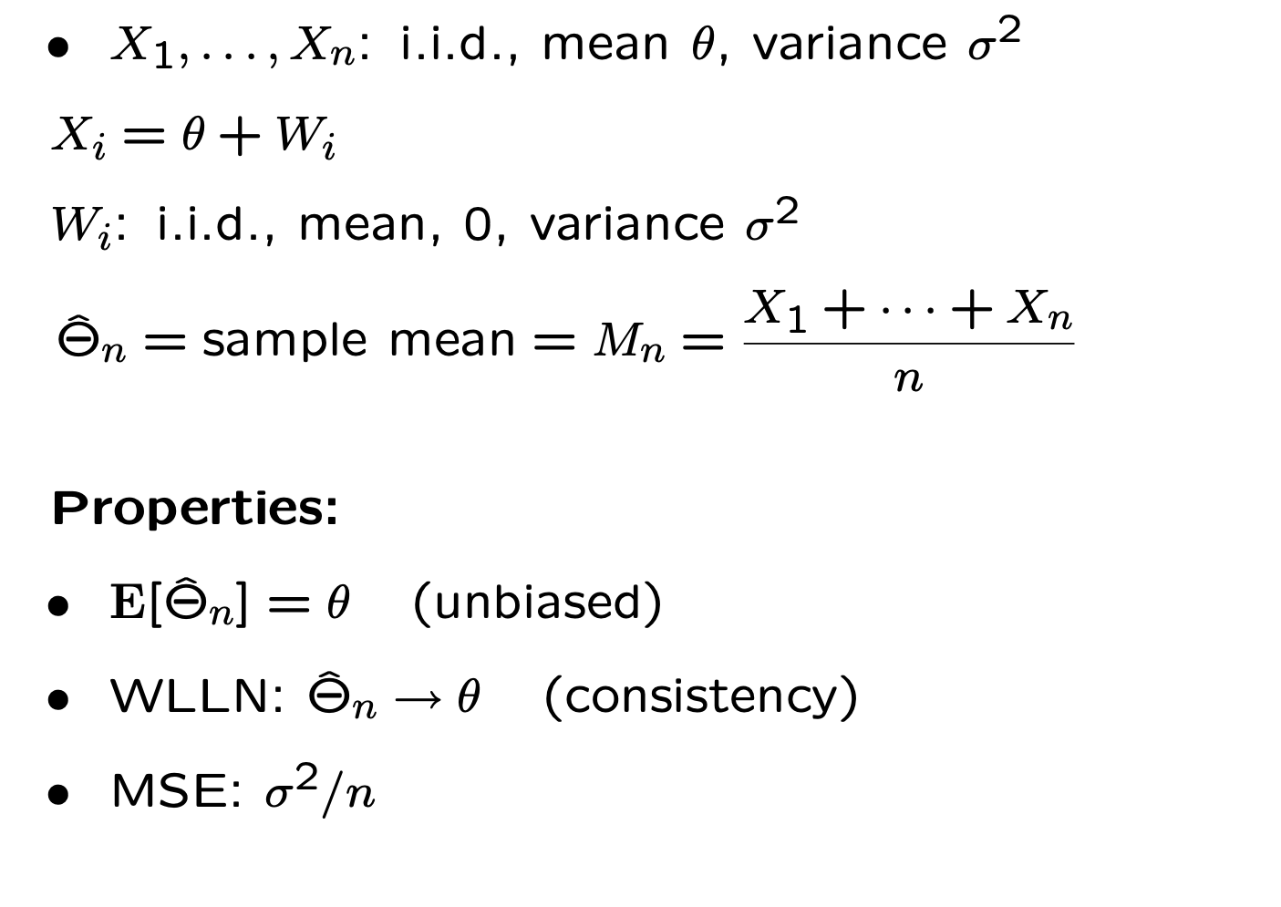
There are frequentist estimators beyond MLE!

Slide 60
Example: Sample Mean

Slide 61
Example: Sample Mean

Slide 62
Example: Sample Mean

Slide 63
Example: Sample Mean

