Slide 1

Scaling with NodeJS
Tran Diep Bang
Notes:
1. NodeJS
a. What
b. Why NodeJS
i. Simplicity
c. Concurrency vs Parallel
d. Cluster
i. PM2
e. Child Process
2. Type of Scalability
3. Others (TBC)
a. Tweaking OS
b. Cache
c. Compression
d. Co-hosted nginx
e. CPU
f. Disk
g. Memory
h. Logging
i. Docker
4. Final Thoughts

Slide 2
About me
Software Engineer at Trusting Social
Fan of NodeJS, React
Golang newbie
Notes:
REDUNDANT

Slide 3
What is NodeJS?

Slide 4
Open source
Server side runtime environment built on Chrome’s V8 Javascript Engine
It provides an event driven
Non-blocking (asynchronous)
I/O and cross-platform runtime environment for building highly scalable server-side application using Javascript.

Slide 5






Who is using NodeJS?

Slide 6
WHY NODEJS?

Slide 7
SIMPLICITY

Slide 8
Single thread Non-blocking I/O
Good support with REST, GraphQL and WebSocket
Over 15k npm modules
Really active community
Built-in support for promises and generator-based coroutines
HTTP/2
blah… blah blah….blah
Notes:
1. NodeJS
a. What
b. Why NodeJS
i. Simplicity
c. Concurrency vs Parallel
d. Cluster
i. PM2
e. Child Process
2. Type of Scalability
3. Others (TBC)
a. Tweaking OS
b. Cache
c. Compression
d. Co-hosted nginx
e. CPU
f. Disk
g. Memory
h. Logging
i. Docker
4. Final Thoughts

Slide 9
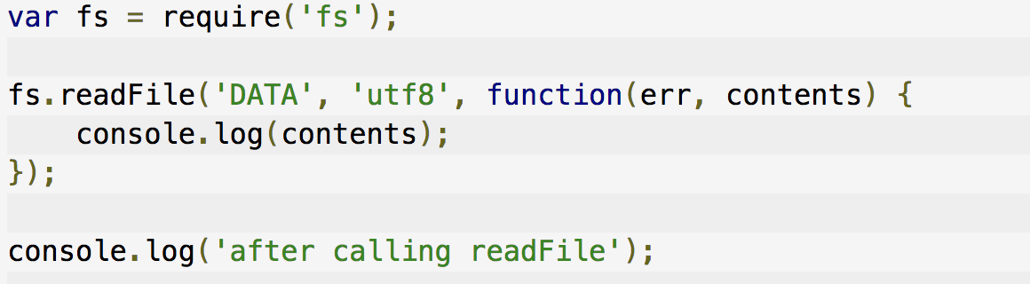
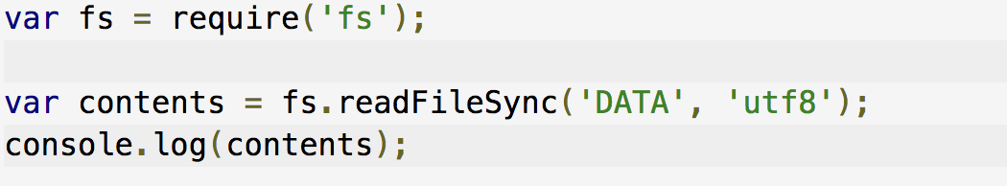
Non-blocking
Blocking

Slide 10
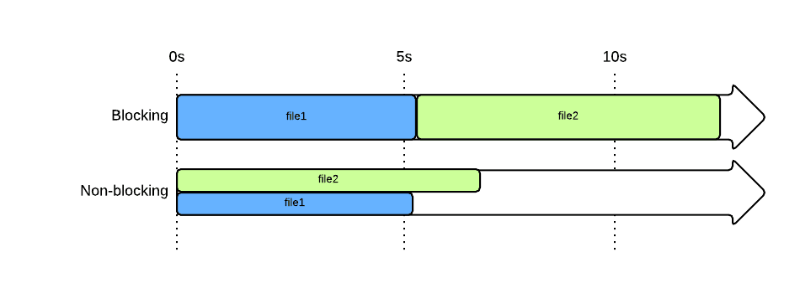
Benchmark

Slide 11
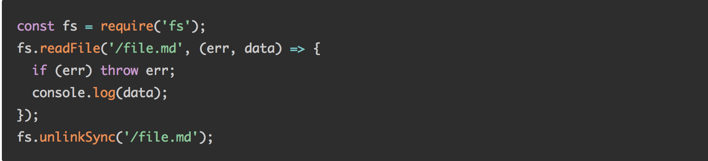
Don’t do this !!

Slide 12
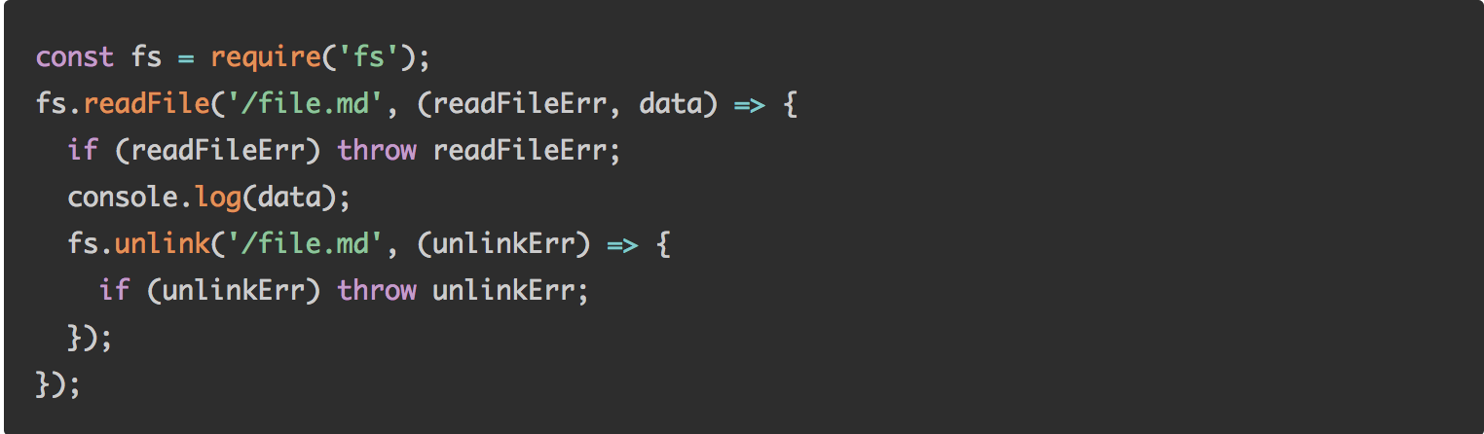
Do this !!

Slide 13
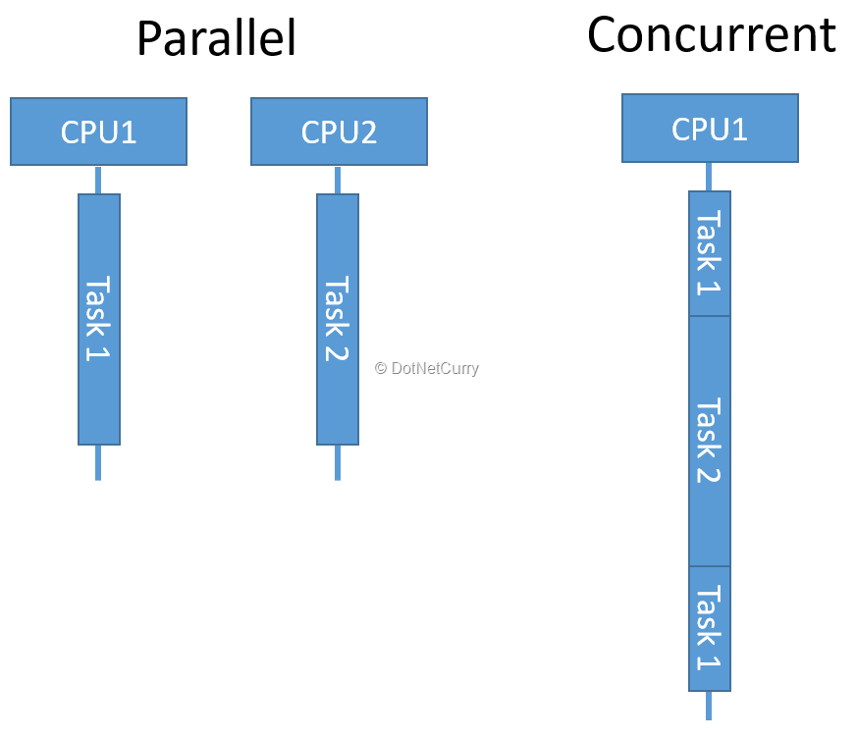
Concurrency vs Parallel

Slide 14
Type of scalability

Slide 15
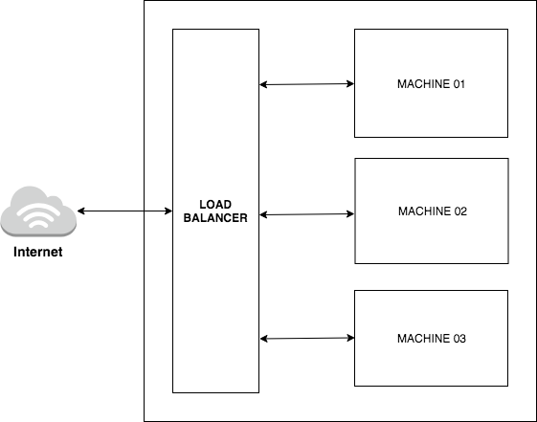
Horizontal scaling

Slide 16
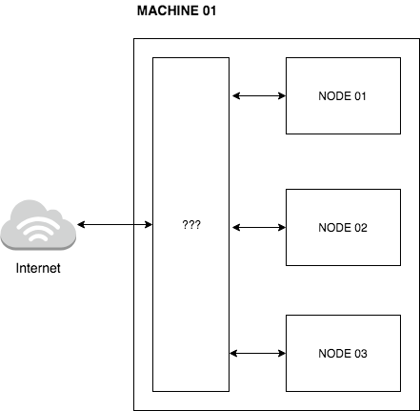
Vertical scaling

Slide 17
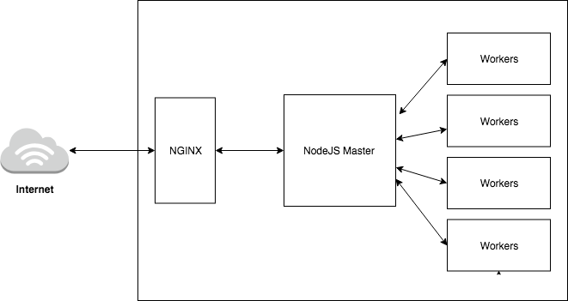
Cluster
We want to take advantage multi-core of CPU
Better performance
Zero downtime
Load balancing

Slide 18
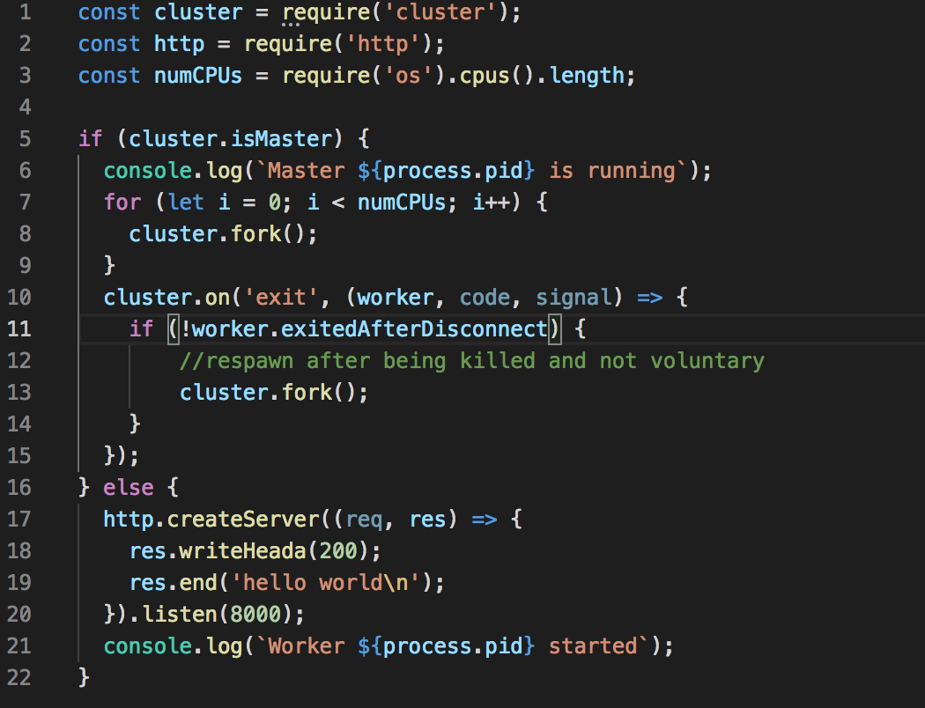

Slide 19
PM2

Slide 20
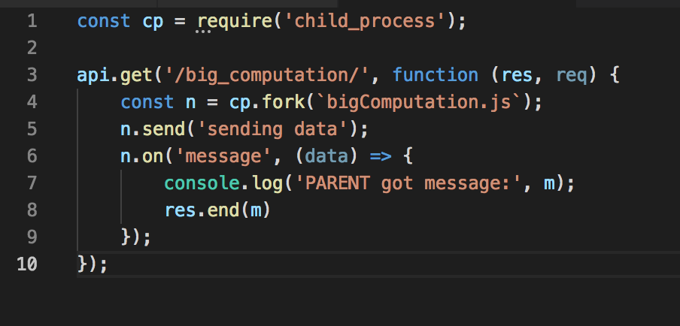
Child process
CPU Intensive task
Big computation

Slide 21
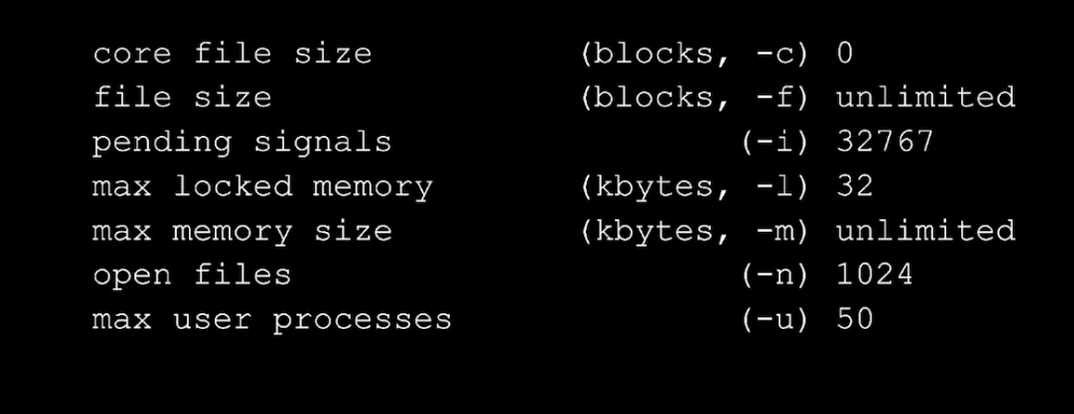
Tweaking OS

Slide 22
Compression
const compression = require(“compression”)
app.use(compression)

Slide 23
Nginx

Slide 24
Docker
Faster deployment
Consistent environment
Layer and image version control
Work well in DevOps and CI/CD
Fast boot
Easy to scale

Slide 25
Machine 01
Nginx
Docker API Service
Internet
Docker MySQL

Slide 26
Machine 01
NGINX
Docker API Service
Internet
Docker Database Service
Machine 02

Slide 27
Other
CPU
Disk
Memory
Logging
Cache

Slide 28
Final thoughts
Don’t block the event loop
Big computation use child process
Use clusters, take advantage of multiple core cpu
Don’t write blocking code or mix blocking and non-blocking code
Always logging
Use nginx for compression, load balancing
Caching
Beware of memory, disk, cpu, network ...v.v
Use Docker

Slide 29
Reach me at :
darklegend2009@gmail.com

Slide 30
trustingsocial.com/jobs

Slide 31
Thank you

