Slide 1
Hancock: A Language for Extracting Signatures from Data Streams
Kathleen Fisher
Karin Högstedt
Anne Rogers
Fred Smith

Slide 2
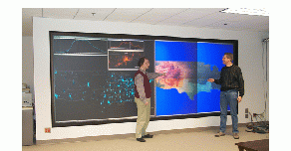
AT&T Infolab
Networks:
Applications:
Long distance
Frame Relay
ATM
IP
Manage Network
Prevent/Detect Fraud
Understand Customers
Challenge:
To convert this data into useful information.
Notes:
The idea behind the issues part of that slide is that there are
many issues to deal with to accomplish the goal of putting
data into an easy to understand format. Scale is an issue.
Processing the data in a timely fashion is also an issue.
Some applications (such as International Toll Fraud) require
real time processing. Other applications can wait as much
as a month. The issue is how to understand what can be done
in a given time frame. Good abstractions and metaphors
for data presentation are also not well understood.
The picture shows part of AT&Ts frame relay network.
In particular, it high traffic links in a particular
window of time.

Slide 3
Whole data analysis
Individualized analysis: Signatures
  Anomaly detection: fraud, access arbitrage, etc.
  Classification problems: target marketing, biz/res, etc.
Technical challenge:
  Massive data sets and real-time queries ⇒
  Hard I/O and storage requirements ⇒
  Complex programs (hard to read, write, and maintain).
Solution:
  A system that reduces the complexity of signature programs.

Slide 4

Processing transactions
Data
Warehouse
Transaction Data
Hancock
Signature
Database

Slide 5
Evolution of fraud detection
Country-based thresholds:
  Aggregate calls in 1/4/24 hour windows.
  Compare aggregates to fixed thresholds.
  Exclude common false positives.
International signatures:
  Signature is an evolving profile.
  Match calls against the customer’s and known fraud signatures.
Domestic signatures?
  Much larger scale…

Slide 6
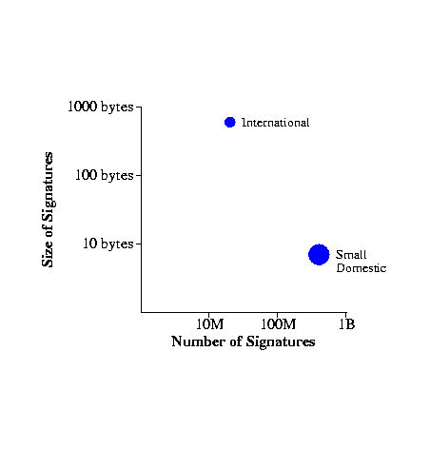
Problem scale

Slide 7
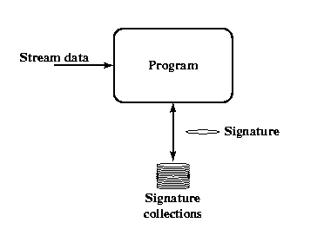
Computational issues
Efficiently managing communications-scale data requires substantial programming expertise.
Locality, locality, locality!

Slide 8
Hancock
Identified abstractions for computing with large data streams.
Embedded these abstractions in Hancock, a C-based domain-specific programming language.
Built experimental and production signatures using a number of different data streams.
Intended as an experiment in practical language design.

Slide 9
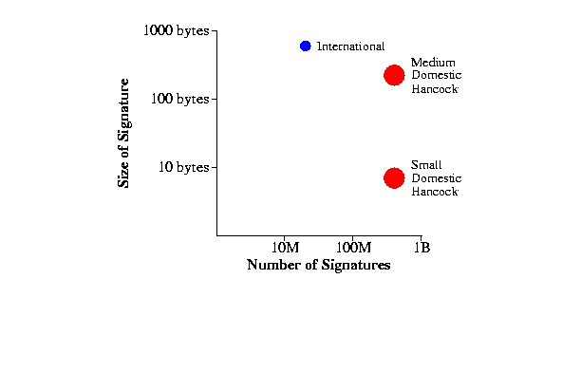
Concrete results

Slide 10
Outline
Introduction
Language overview
Implementation overview
Conclusions

Slide 11
Abstraction overview
Streams. The transactional data to be consumed “daily.”
Views. The information to store for each “customer.”
Iterate statement. How to combine today’s data with historic signatures and other data.
Maps. The collection of customer signatures.

Slide 12
Hancock maps
Persistently associate data with keys.
Support direct addressing, programmable defaults, and a customized, compressed format.
map sig_m {
key 1999999999LL .. 9999999999LL;
split (10000, 100);
value sig_t;
default SIG_DEFAULT;
compress sig_compress;
uncompress sig_uncompress;
};

Slide 13
Map operations
Supported: read, write, test, remove, iteration, and copy.
Unsupported: atomic transactions, locking, secondary indices, declarative queries.
sig_m myMap = “data/myMap”;
long long id1, id2;
sig_t oldS, newS;
oldS = myMap<:id1:>; /* read id1’s old data */

myMap<:id1:> = newS; /* write id1’s new data */
if (myMap@<:id2:>) /* test if id2 is in myMap */
myMap\<:id2:>; /* remove id2’s data */

Slide 14
Computation model
Detect “events of interest” in transactional stream; respond to those events.
Hancock’s iterate statement
  prepares stream for computation,
  separates event detection from event response, and
  generates scaffolding code.
A
A
A
B
C1
C2
C3
C4
begin_line(A)
call(C1)
call(C2)
call(C3)
end_line(A)
begin_line(B)
call(C4)
end_line(B)

Slide 15
Iterate statement
intl
3608675
intl
3608077
intl
3608675
dom
9833545
C1
C2
C3
C4
Iterate
over calls
filteredby onlyInternational
sortedby origin
withevents detectCalls
{
event line_begin (pn_t pn) { … }
event call (callRec_t c) { … }
event line_end (pn_t pn) { … }
}

Slide 16
Iterate statement
intl
3608675
intl
3608077
intl
3608675
dom
9833545
C1
C2
C3
C4
Iterate
over calls
filteredby onlyInternational
sortedby origin
withevents detectCalls
{
event line_begin (pn_t pn) { … }
event call (callRec_t c) { … }
event line_end (pn_t pn) { … }
}

Slide 17
Iterate statement
intl
3608675
intl
3608077
intl
3608675
C1
C2
C3
Iterate
over calls
filteredby onlyInternational
sortedby origin
withevents detectCalls
{
event line_begin (pn_t pn) { … }
event call (callRec_t c) { … }
event line_end (pn_t pn) { … }
}

Slide 18
Iterate statement
intl
3608675
intl
3608077
intl
3608675
C1
C2
C3
Iterate
over calls
filteredby onlyInternational
sortedby origin
withevents detectCalls
{
event line_begin (pn_t pn) { … }
event call (callRec_t c) { … }
event line_end (pn_t pn) { … }
}

Slide 19
Iterate statement
intl
3608077
intl
3608675
intl
3608675
C2
C1
C3
Iterate
over calls
filteredby onlyInternational
sortedby origin
withevents detectCalls
{
event line_begin (pn_t pn) { … }
event call (callRec_t c) { … }
event line_end (pn_t pn) { … }
}

Slide 20
Iterate statement
intl
3608077
intl
3608675
intl
3608675
C2
C1
C3
Iterate
over calls
filteredby onlyInternational
sortedby origin
withevents detectCalls
{
event line_begin (pn_t pn) { … }
event call (callRec_t c) { … }
event line_end (pn_t pn) { … }
}

Slide 21
intl
3608077
intl
3608675
intl
3608675
C2
C1
C3
line_begin(...)
call(C2)
line_end(...)
line_begin(…)
call(C1)
call(C3)
line_end(...)
Iterate
over calls
filteredby onlyInternational
sortedby origin
withevents detectCalls
{
event line_begin (pn_t pn) { … }
event call (callRec_t c) { … }
event line_end (pn_t pn) { … }
}

Slide 22
intl
3608077
intl
3608675
intl
3608675
C2
C1
C3
line_begin(...)
call(C2)
line_end(...)
line_begin(…)
call(C1)
call(C3)
line_end(...)
Iterate
over calls
filteredby onlyInternational
sortedby origin
withevents detectCalls
{
event line_begin (pn_t pn) { … }
event call (callRec_t c) { … }
event line_end (pn_t pn) { … }
}

Slide 23
Iterate statement
intl
3608077
intl
3608675
intl
3608675
C2
C1
C3
line_begin(...)
call(C2)
line_end(...)
line_begin(…)
call(C1)
call(C3)
line_end(...)
Iterate …
{
event line_begin(pn_t pn) { numToday = 0; }
event call(callRec_t c) { numToday++; }
event line_end(pn_t pn) { numCalls<:pn:> =
0.8 * numCalls<:pn:> + 0.2 * numToday; }
}

Slide 24
Result: Cleaner code
Hand-coding results in complex event detection code that obscures simple event response code:
A
A
A
B
C1
C2
C3
C4
end_line(?)
begin_line(A)
call(C1)
call(C2)
call(C3)
end_line(A)
begin_line(B)
call(C4)

Slide 25
Representing events
Hancock’s multi-union (munion): A set of labels and associated values.
Supported operations: value construction, right-dominant union, test for label, access value, difference, and remove.
munion line_e {:
pn_t begin_line,
callRec_t call,
pn_t end_line,
:};

Slide 26
Detecting events
An event detection function:
  takes a window onto a stream
  returns a munion that describes the detected events.
current
A
A
A
B
C1
C2
C3
C4
call(C3)
end_line(A)

Slide 27
Event detection example
line_e originDetect(callRec_t *w[3:1]){
line_e b, e;
callRec_t *prev, *current, *next;
prev = w[0];
current = w[1];
next = w[2];
b = beginLineDetect(prev, current);
e = endLineDetect(current, next);
return b :+: {: call = *current :} :+: e;
:};

Slide 28
Code sizes
Streams: 110 to 250 lines.
Views: 5 to 30 lines.
Iterate statement: 70 to 330 lines.
Maps: 5 to 200 lines.

Slide 29
Implementation
Compiler:
  Based on CKIT C-to-C translator (SML/NJ).
Runtime system:
  Written in C.
  Map representation is essentially a stripped-down database.
  Goal: balance space limits against access-time requirements.
Available for non-commercial use.

Slide 30
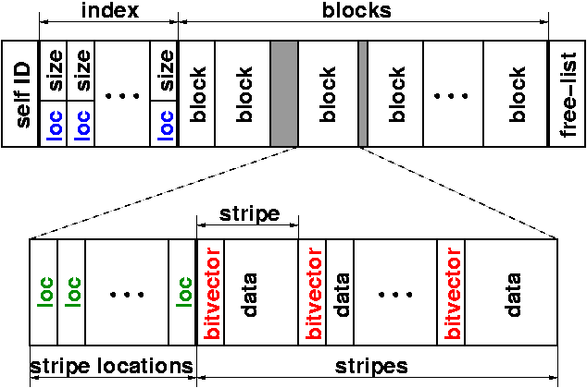
Maps: On-disk representation
Multi-level table. Key split into three pieces: block, stripe, entry.
(973360 86 75)

Slide 31
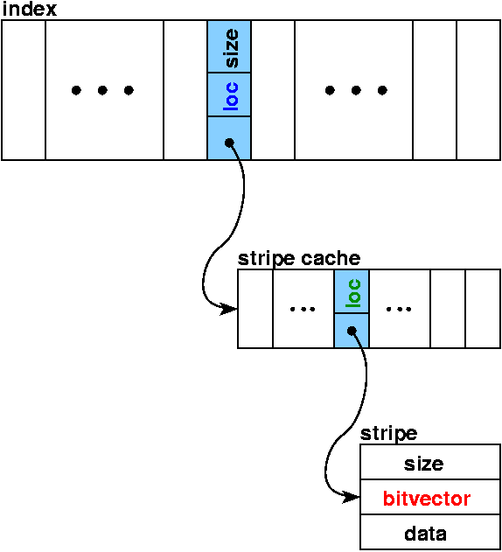
Maps: In-memory representation
Map index and compressed
stripe cache kept in memory
(973360 86 75).

Slide 32
Performance requirements
Process transactions: | < ½ batch window
Select single key: | web time | (1 second)
Select worklist: | coffee break time | (5 minutes)
Touch all values: | lunch time | (1 hour)

Slide 33
Experimental setup
Platform:
Activity: 1.27GB on disk
  maps phone numbers (464M) to 3-byte signatures
Features: 1.10 GB on disk
  maps phone numbers (163M) to 124-byte signatures
R12000 processor (SGI Origin 2000).
32-KB primary cache/8-MB secondary cache
6GB main memory

Slide 34
Experimental results
Action |  | Requirements | Activity | Features
Process calls (275M calls) |  | ½ batch time | 19m | 30m
Select single value |  | web time | 1.1s | 1.1s
Select worklist (160,000 keys) |  | coffee time | 3m30s | 4m3s
Touch all values |  | lunch time | 17m3s | 12m18s

Slide 35
Concrete results

Slide 36
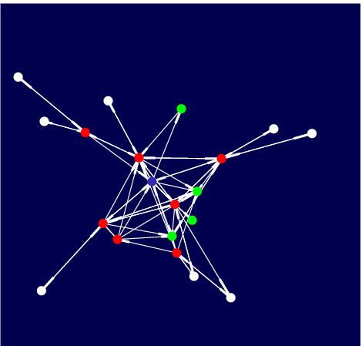
Communities of Interest
Used to detect 800 subscription fraud.
Known fraudster
Inbound calls
Outbound calls

Slide 37
Performance: Outgoing COI
Signature size: 120 bytes
Active keys: 228M
Signature collection size: 7GB
Daily update time: 2 hours
Neighborhood computation: 1 second to compute a neighborhood of size 2 from a seed phone number.

Slide 38
Why a language?
Disadvantages:
  Limited scope
  New language (albeit one based on C).
  Lack of tools, e.g.source-level debuggers, profilers, etc.
Advantages:
  Static type-checking
    protects data integrity and promotes clarity of use
  High-level and tailored abstractions
    reduce code size, hide issues of scale, and provide a framework for structuring applications.

Slide 39
Further work
Compare with database implementations (DBPL 2001)
Allow users to specify streams declaratively (see PADS).
Add support for variable-width data (urls).
Improve compression mechanisms.

Slide 40
Try it!
Hancock is available for non-commercial use:
http://www.research.att.com/projects/hancock
Inquiries to hancock@research.att.com.
References:
Domain Specific Languages Conference, 1999
Knowledge Discovery and Data Mining Conference, 2000
Databases and Programming Languages workshop, 2001
Transactions on Programming Languages and Systems, 2004

