Slide 1

TOPIC DETECTION & TRACKING
Omid Dadgar

Slide 2
Background
Topic Detection and tracking is a fairly new area of
research in IR: Developed over the past 7 years
Began during 1996 and 1997 with a Pilot Study
conducted to explore various approaches and
establish performance baseline.
Followed by TDT2 which this presentation is
primarily based on.

Slide 3
Background
Since TDT2 in 1998 there have been several open evaluations of TDT and progress has been made.
TDT2 however is important as it was the first major step in TDT after the pilot study and established the foundation for further work.

Slide 4
Background
– To solve the TDT challenges, researchers are looking for robust, accurate, fully automatic algorithms that are source, medium, domain, and language independent.

Slide 5
Goals
– To develop automatic techniques for finding topically related material in streams of data. This could be valuable in a wide variety of applications where efficient and timely information access is important. Eg. (CNN or Yahoo News)
– It would be very helpful if computers were able to map out data automatically finding story boundaries, determining what stories go with one another, and discovering when something new (unforeseen) has happened.

Slide 6
Introduction
• Purpose: To develop technologies for retrieval and automatic organization of Broadcast news and Newswire stories and to evaluate the performance.
• Corpus: TDT2 processing addresses multiple sources of information, including newswire (text) and broadcast news (speech).
• The information is modeled as a sequence of stories. These stories provide information on many topics

Slide 7
Introduction
"Topic" is defined in a special way specifically for TDT research. For the purposes of this project, topics refer to specific events or activities, such as the crash of a China Airlines airplane in Taipei, Taiwan on February 16, 1998, and encompass all facts, events and activities that are directly related to them. Here is the definition of topic and a few other essential terms, as used in TDT research:

Slide 8
Terms
TOPIC- A topic is an event or activity, along with all directly related events and activities.
EVENT- An event is something that happens at some specific time and place, and the unavoidable consequences. Specific elections, accidents, crimes and natural disasters are examples of events.

Slide 9
ACTIVITY- An activity is a connected set of actions that have a common focus or purpose. Specific campaigns, investigations, and disaster relief efforts are examples of activities.
STORY- A story is a newswire article or a segment of a news broadcast with a coherent news focus. They must contain at least two independent, declarative clauses.

Slide 10
• Definition of topic: A seminal event or activity, along with all directly related events and activities.
• Stories “on topic” is story directly connected to the associated event.
• TDT technique explore for detecting the appearance of new topics and for tracking the reappearance and evolution of them.

Slide 11
TDT2 vs. Pilot Study
In 1998, TDT2 address the same three core
tasks(segmentation, detection, and tracking).
Evaluation procedures were modified.
Volume and variety of data and the number of target topics were expanded.
TDT2 attacked the problems introduced by imperfect,
machine-generated transcripts of audio data

Slide 12
Corpus
• Linguistic Data Consortium (LDC) undertook the corpus creation efforts for TDT2
• TDT2 Corpus contains data from
– Newswire: Associated Press WorldStream, New
York Times News Services
– Radio: Voice of America World News, Public
Radio International The World

Slide 13
Corpus cont.
– Television: CNN Headline News, ABC
World News Tonight
• There are 300 stories/day, 5 hrs digital recordings/day, 54,000 stories, 630 hours of audio
• For newswire source each story is clearly delimited by the newswire format

Slide 14
Corpus cont.
For audio source segmentation of the broadcast news consists two pass procedures
First pass: LDC staff inserted story boundaries
and identified no-story segments
Second pass: annotators confirmed or adjusted
existing story boundaries

Slide 15
Corpus cont.
• The audio source were provided in three forms
– The sampled date audio signal
– A manual transcription of the speech
– An automatic transcription of the speech (ASR) by
an automatic speech recognizer.

Slide 16
The TDT2 Corpus Cont.
• Audio source transcription include non-news and news stories. Each story was labeled as “News”, “Miscellaneous”, “Untranscribed”.
– Stories marked as NEWS were used
• LDC defined 100 topics based upon random sample of the six sources from 01-06,98
– Each topic was defined in terms of a three-part identification (what/where/when)

Slide 17
Example Topic
Title: Mountain Hikers Lost
  WHAT: 35 or 40 young Mountain Hikers were lost in an avalanche in France around the 20th of January.
  WHERE: Orres, France
  WHEN: January 4, 1998

Slide 18
Corpus cont.
– Annotation staff worked with daily news files, each story was labeled “yes”, “brief” or”no”
• TDT2 topics are based on an assumption that news stories are about events
– TDT2 Event is an activity that happens at a
specific place and time and all of its necessary
causes and unavoidable consequences
– Rules of interpretation specify the scope of related events also to be considered part of the same topic

Slide 19
Corpus cont.
TDT2 topic definition was a collaborative process with annotators negotiating the scope
– The randomly selected story was often neither the best not even a good representative of the seminal events. Annotators researched each
event elsewhere in the news
– Response to changes in the real world, new stories were reevaluated and the topics modified.

Slide 20

Organization of the TDT2 Corpus
TDT2 Corpus was divided into three parts for research management purpose
– Training set: the data may be used without limit for research purposes
– Development test set: the data will be available for testing TDT algorithm
– Evaluation test set: the data will be reserved for final formal evaluation of performance
Organization of the TDT2 Corpus

Slide 21
The Three Tasks
• The input to TDT2 project is a stream of stories. This stream may not be pre-segmented
into stories, and the topics may not be known to
the system.
• Three technical tasks are segmentation of a news source into stories, the tracking of known topics, and the detection of unknown topics.

Slide 22
Segmentation
– Segmenting the stream of data into constituent stories,
applies to audio (radio and TV) source.
– Segmentation output must be performed as the data is
being processed. The deferral period is a primary task
parameter.
– Story segmentation performance depends on the forms of
the source and on the deferral period.

Slide 23
Segmentation cont.
Three source condition:
♦ Manual transcription
♦ Automatic transcription
♦ Sample data signal
Decision deferral period:
♦ Transcription in text form(words)
100 1000 10,000
♦ Sample data in audio form(seconds)
30 300 3,000

Slide 24
Tracking
Associating incoming stories with topics that are known to
the system. A topic is “known” by its association with the
stories that discuss it.
A set of training stories is identified for each topic. The system may train on the target topic by using all of the stories in the corpus
A goal of Topic tracking is to keep track of the topics
users are interested in . The user therefore spends less time
searching large amounts of data, in newswire, WWW-
based news and broadcast news(BN).

Slide 25
Tracking cont
Performance depends on the form of the source and on the number of training stories for the topic, also on whether story boundaries are provided to the system
◊ Three source condition:
♦ newswire text and a manual transcription of the audio
sources
♦ Newswire text and the automatic transcription of
the audio sources
♦ Newswire text and the sampled data signal
representing the audio sources
◊ Five different training conditions (# of training stories)
1 2 4 8 16
◊ Two story boundary conditions:
Given Not Given

Slide 26
Detection
– Detecting and tracking topics not previously known to the system.
– Identifying topics as defined by their association with the stories that discuss them
– Detection Using a whole (2 month) sub-corpus as input
– Performance depends on the form of the source and on the form of the source and the maximum delay allowed before topic detection decisions must be output, and depends on whether story boundaries are provided.

Slide 27
Detection cont.
◊ Three source condition:
♦ newswire text and a manual transcription of the audio
sources
♦ Newswire text and the automatic transcription of
the audio sources
♦ Newswire text and the sampled data signal
representing the audio sources
◊ Three different decision deferral periods (in terms of #
source file)
1 10 100
◊ Two story boundary conditions:
Given Not Given

Slide 28
Evaluation
• The general TDT evaluation will be in terms of classical detection theory
– Type I error “misses”: the target is not detected
when it is present
– Type II error “false alarms”: the target is
falsely detected when it is not present
• These error probabilities are combined into a
single detection cost C_{det}

Slide 29
C_{Det} = C_{miss} . P_{miss} . P_{target} + C_{FA} . P_{FA} . P_{NOT.Target}
C_{miss and} CFA are are the costs of Miss and a False Alarm Respectively
P_{miss and} PNOT.Target are the conditional probabilities of a Miss and false Alarm respectively.
P_{target and} P_{NOT.Target}
are the a priori target probabilities
(The a prior probability of a story being on some given topic or not.)
₍P_{target = 1 -} P_{NOT.Target)}

Slide 30
Participants
Sponsor: DARPA
Researches: BBN, CMU, Dragon, GE, IBM, SRI, Umass, Upenn, Uiowa, Umd
Corpus: Collection, Annotation, Transcription, Dissemination: LDC
Automatic Transcription: Dragon
Evaluation: NIST

Slide 31

PARTICIPANTS
Eleven research sites participated in NIST’s 1998 TDT2 evaluation
1998 TDT Evaluation Task Site Participation
* Submitted after the December 21, 1998 deadline

Slide 32
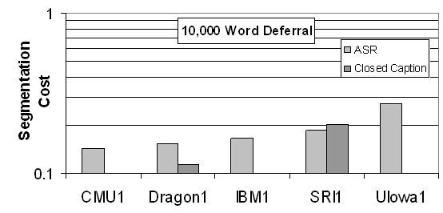
Story Segmentation Results
• Five research sites participated in the story segmentation
• Segmentation costs achieved by the participants for ASR-transcription and
manual transcriptions
1998 TDT2 Primary Tracking Systems
Observation: the lowest cost on ASR text was 0.14, achieved by CMU
Dragon’s performance improved in manual transcription (0.11)

Slide 33
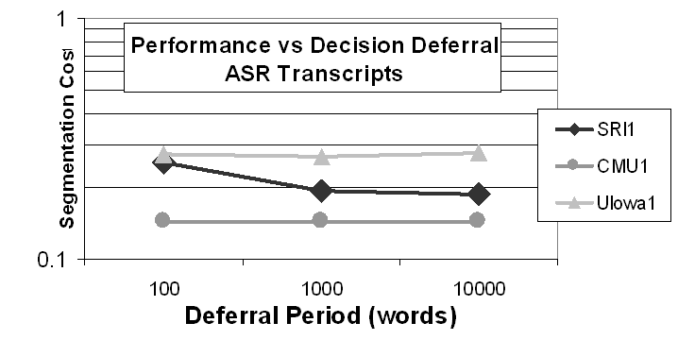
Decision Deferral Periods
The period defines the amount of future material a segmentation system can use before making a decision
Observation: Extended decision deferral periods were helpful for SRI, not for others
CMU used 100 words to make decision which had the lowest cost

Slide 34
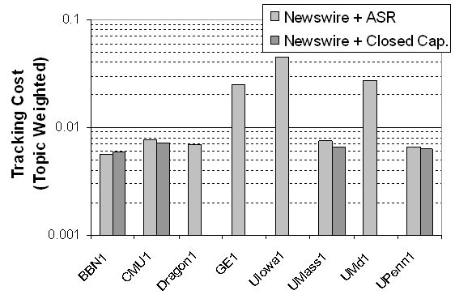
Topic Tracking Results
Eight research sites ran a primary system on the required evaluation, which was to track topics from both Newswire and ASR sources, using 4 training stories per topic
1998 TDT2 Primary Tracking Systems
BBN achieved the lowest cost 0.0056 corresponds to missing 14% of on-topic stories and falsely detecting 0.2% of the off-topic

Slide 35
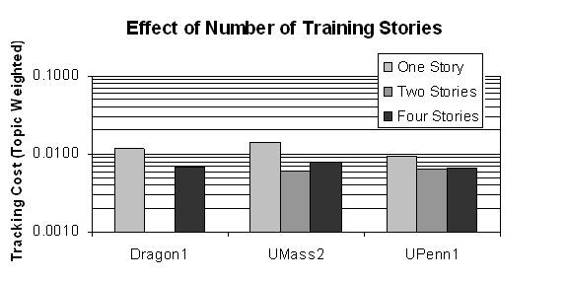
Effect of Number of Training Stories
Varied number of training stories supported tracking performance
Effect of topic training performance on tracking
Performance was better when systems were presented with four training stories rather than one, with an average of 38% relative improvement

Slide 36
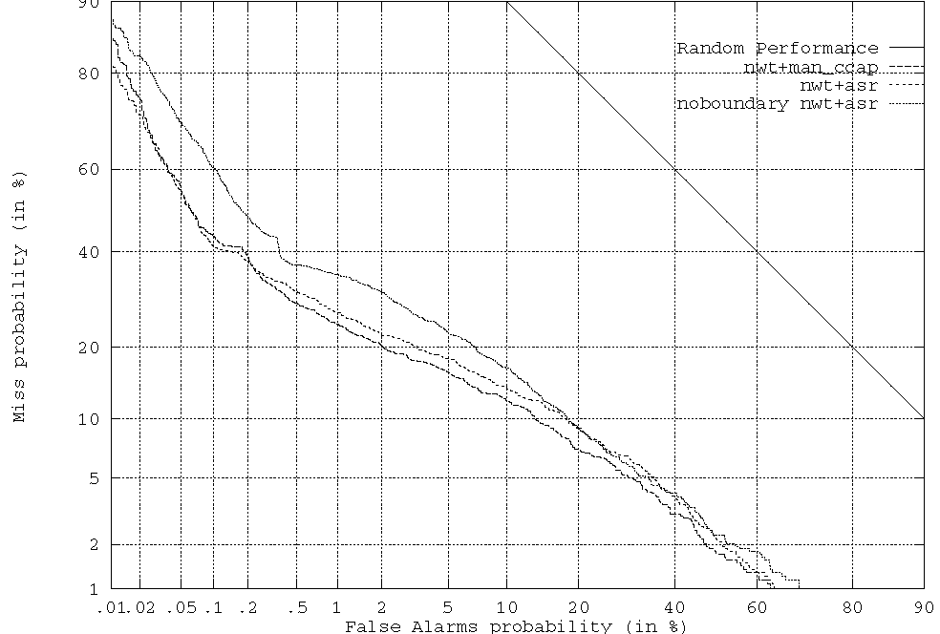
Effect of Automatic Segmentation on Tracking
Replaces the given story boundaries in the ASR texts with the output of an automatic story segmentation algorithm.
Presents a fully automated topic tracking system from newswire and broadcast news audio source

Slide 37
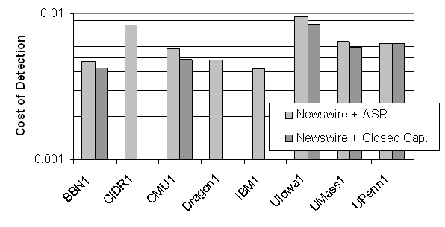
Topic Detection Results
The required evaluation was to detect topics in the newswire+ASR source transcripts, deferral decisions for up to 10 source file, and using given reference story boundaries
1998 TDT2 Primary Detection System
IBM’s detection cost of 0.0042 corresponds to missing 20% of the documents and falsely including 0.07% of the documents
Detection performance improved slightly for the manual transcriptions

Slide 38
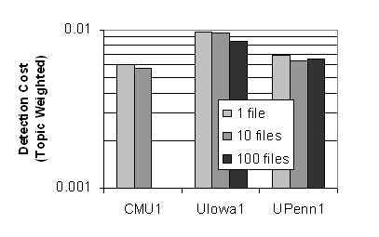
Effect of Decision Deferral on Detection
Detection evaluation supported decision deferral period
Effect of Decision Deferral Detection
Small improvement with extended decision deferral periods(an average of
7% relative improvement)

Slide 39
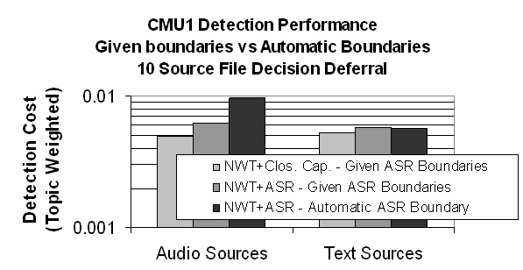
Effect of Automatic Segmentation Detection
The detection cost have been computed by dividing the corpus into tow sets
– Broadcast news “audio source” transcripts
– Newswire “text source” after mapping the reference topic to the system-defined topics
Effect of Automatic Segmentation on Detection

Slide 40
Conclusion and Further Work
• The first TDT2 Benchmark test was
successfully completed and involved eleven
research sites.
• The errors introduced by ASR errors appear to affect tracking and detection.
• Automatic segmentation of ASR text degrades tracking and detection more than ASR errors alone

Slide 41
Conclusion and Further Work cont.
• Decision deferral periods appear to be useful for detection, more so than for segmentation
• Since TDT2 in 1998 there have been 4 open
evaluations

Slide 42
Further Work
• Other tasks have been added to the core three tasks of segmentation, tracking and detection.
• Further work has looked at monitoring streams of news in multiple languages (eg. Mandarin) and media –newswire, radio, television, web sites or some future combination.

Slide 43
Questions

Slide 44
Thank you

