Slide 1
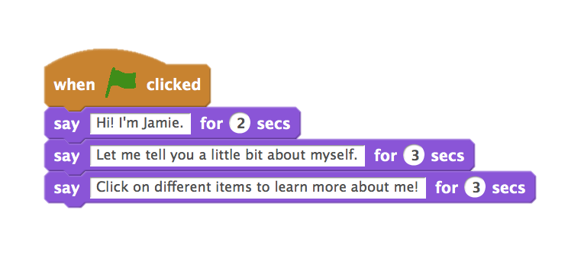
UNIT 1
EXPLORING
WHAT’S INCLUDED
YOU ARE HERE
PROGRAMMED TO DANCE 26
STEP-BY-STEP 28
10 BLOCKS 30
MY STUDIO 32
DEBUG IT! 34
ABOUT ME 36
0
1
2
3
4
5
6
23
Notes:
<numéro>

Slide 2
UNIT 1
OVERVIEW
THE “BIG IDEA”
Many of the educators that we have worked with over the years wrestle with two questions when getting started with creative computing: “What’s the best way of helping learners get started?” and “What do I, as teacher, need to know?” The writings of Seymour Papert (a renowned mathematician, educator, and major influence on the development of Scratch through the Logo programming language) serve as inspiration for thinking about these questions.
With respect to the first question, two extreme positions tend to be taken up. Either learners need to be told what to do and should have highly structured experiences – or learners need to be left totally alone to explore under their own direction. Papert, a proponent of the notion that young learners should act as advocates for and explorers of their own thinking and learning, encouraged teachers to seek a balance between teaching and learning. Throughout the guide, we vary the amount of structure in the activities in an effort to provide balance.
With respect to the second question, educators sometimes worry that they don’t “know” enough about Scratch to be able to help others. We encourage you to take a broad view of what it means to “know” Scratch. You don’t need to know everything about the Scratch interface or how to solve every problem that a learner encounters. But, as Papert noted, educators can serve as cognitive guides, asking questions and helping break down problems into manageable pieces.
As they puzzled together the child had a revelation: “Do you mean,” he said, “that you really don’t know how to fix it?” The child did not yet know how to say it, but what had been revealed to him was that he and the teacher had been engaged together in a research project. The incident is poignant. It speaks of all the times this child entered into teachers’ games of “let’s do that together” all the while knowing that the collaboration was a fiction. Discovery cannot be a setup; invention cannot be scheduled.
(Papert, 1980, p. 115)
KEY WORDS, CONCEPTS, & PRACTICES
experimenting and iterating
testing and debugging
sequence
sprite
motion
looks
sound
costume
backdrop
tips window
remix
interactive collage
pair-share
Students will:
build on initial explorations of the Scratch environment by creating an interactive Scratch project
be introduced to a wider range of Scratch blocks
become familiar with the concept of sequence
practice experimenting and iterating while creating projects
LEARNING OBJECTIVES
NOTES
Make sure students already have a Scratch account for saving and sharing their projects online.
Think about how you plan to access your students’ work. For example, you can create class studios to collect projects, have students email you project links, or start a class blog.
24
Notes:
<numéro>

Slide 3
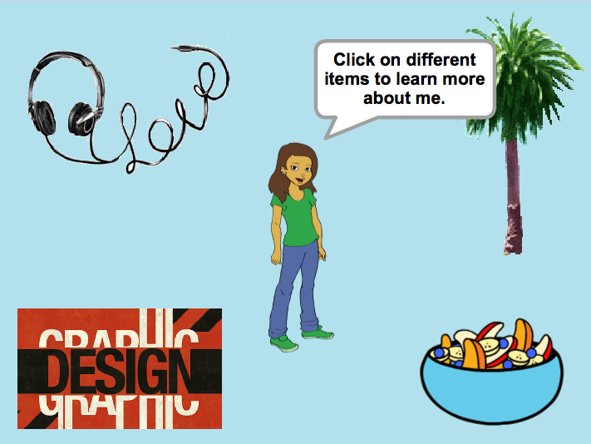
CHOOSE YOUR OWN ADVENTURE
This unit includes a mix of structured and open-ended activities that engage students in exploration of the key concept of sequence – identifying and specifying an ordered series of instructions. This is often a powerful moment for students: they’re telling the computer what to do, by translating their ideas into blocks of computer code.
From a step-by-step tutorial, to playing with a constrained number of blocks, to a debugging challenge, each activity helps learners build the skills needed to create an About Me project. In the culminating project, learners will explore and experiment with sprites, costumes, looks, backdrops, and sounds to create a personalized, interactive collage in Scratch.
Take advantage of all the activities or pick a few that cater to your students’ specific needs and interests; the choice is up to you. If you’re not sure where to start, a possible order for the activities is suggested below.
POSSIBLE PATH
SESSION 1
SESSION 2
SESSION 3
SESSION 4 & SESSION 5
PROGRAMMED TO DANCE
STEP-BY-STEP
10 BLOCKS
MY STUDIO
DEBUG IT!
ABOUT ME
How can you express a sequence of dance moves using simple verbal instructions?
New to Scratch? Create your first Scratch project!
What can you create with only 10 Scratch blocks?
What can be created with Scratch?
Help!
Can you debug these five Scratch programs?
How can you combine images and sounds to make an interactive collage about yourself?
25

Slide 4


PROGRAMMED TO DANCE
OBJECTIVES
By completing this activity, students will:
learn to express a complex activity using a sequence of simple instructions
UNIT 1 ACTIVITY
_{SUGGESTED TIME}
45–60 MINUTES
ACTIVITY DESCRIPTION
RESOURCES
Ask for 8 volunteers – four people who don’t mind being bossy and four people who don’t mind being bossed. Create four bossy/bossed pairs. Optionally, have a projector ready to present the Programmed to Dance videos.
For each bossy/bossed pair: 1. Have the bossed partner facing away from the display and the bossy partner (and the rest of the group) facing the display. 2. Show the video to the bossy partner and the group, but NOT to the bossed partner. 3. Ask the bossy partner to describe to their partner (using only words!) how to perform the sequence of dance moves shown in the video.
Use this activity to start a discussion about the importance of sequence in specifying a set of instructions. You can let students reflect individually in their design journals or facilitate a group discussion by inviting different bossy/bossed pairs and observers to share their thoughts.
projector (optional)
Programmed to Dance videos http://vimeo.com/28612347 http://vimeo.com/28612585 http://vimeo.com/28612800 http://vimeo.com/28612970
REFLECTION PROMPTS
What was easy/difficult about being the bossy partner?
What was easy/difficult about being the bossed partner?
What was easy/difficult about watching?
How does this activity relate to what we’re doing with Scratch?
REVIEWING STUDENT WORK
Can students explain what is important about sequence when specifying instructions?
NOTES
NOTES TO SELF
This is one of several activities in this guide that are computer-free. Stepping back from the computer can support fresh perspectives on and new understandings of computational concepts, practices, and perspectives.
Have students write down step-by-step instructions for one of the dances. In programming, this is called “pseudocode”.
26
Notes:
<numéro>

Slide 5
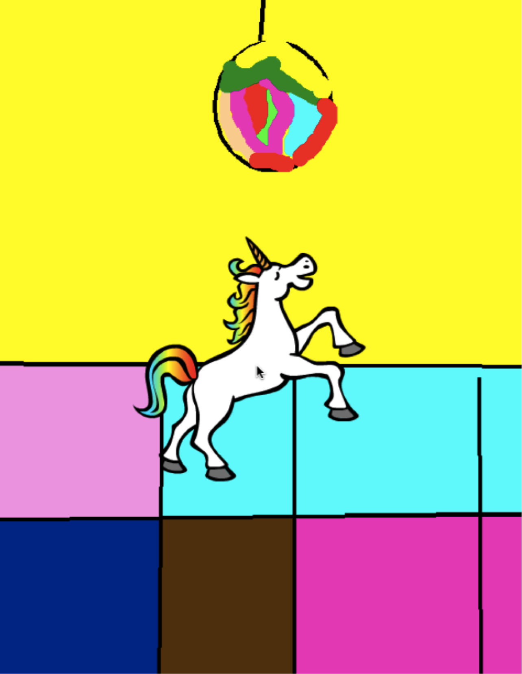
Notes:
<numéro>

Slide 6

STEP-BY-STEP
OBJECTIVES
By completing this activity, students will:
create a dancing cat in Scratch by following a step-by-step tutorial
experience building up a program by experimenting and iterating
UNIT 1 ACTIVITY
_{SUGGESTED TIME}
15–30 MINUTES
ACTIVITY DESCRIPTION
RESOURCES
Help students sign in to their Scratch accounts and click on the Create button at the top of the Scratch website to open the project editor. Optionally, have the Step-by-Step handout and Scratch Cards available to guide students during the activity.
Have students open the Tips window and follow the Getting Started with Scratch step-by-step tutorial to create a dancing cat program. Encourage students to add other blocks and experiment with motion, sprites, looks, costumes, sound, or backdrops to make the project their own.
Let students share their first Scratch creations with one another! Optionally, help students share and add their projects to the Step-by-Step studio or a class studio.
Ask students to think back on the design process by responding to the reflection prompts in their design journals or as a group discussion.
Step-by-Step handout
Step-by-Step studio http://scratch.mit.edu/studios/475476
Scratch Cards http://scratch.mit.edu/help/cards
REFLECTION PROMPTS
What was surprising about the activity?
How did it feel to be led step-by-step through the activity?
When do you feel most creative?
REVIEWING STUDENT WORK
Were students able to open Scratch and find the Tips Window?
Were students able to create a dancing cat?
Were students able to save and share projects?
NOTES
NOTES TO SELF
If they don’t have one already, help learners create a Scratch account using the Unit 0 Scratch Account activity, so that students can save and share their first Scratch project with friends and family.
Remind students how to add a project to a studio with the Unit 0 Scratch Studio activity or handout.
28
Notes:
<numéro>

Slide 7
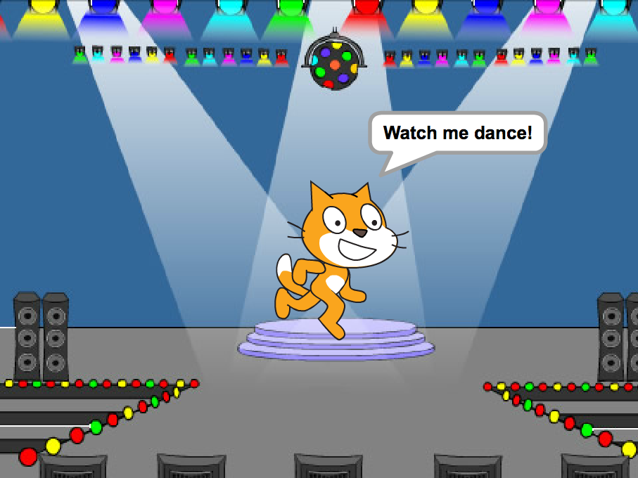
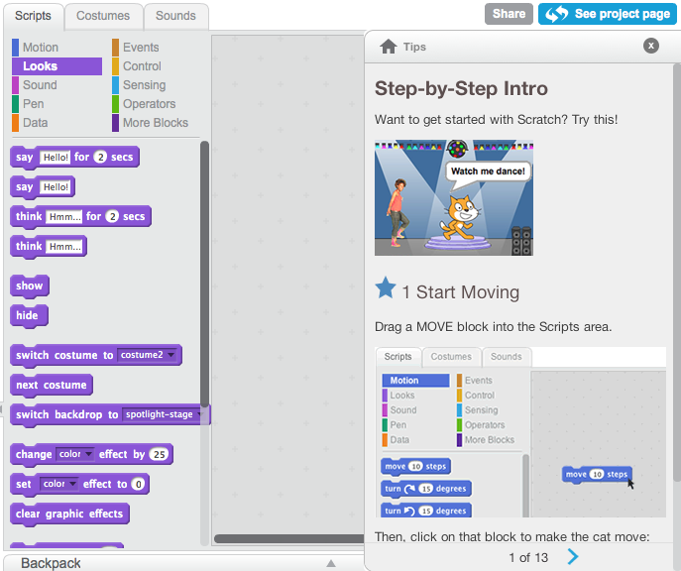
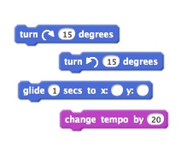
STEP-BY-STEP
NEW TO SCRATCH? CREATE YOUR FIRST SCRATCH PROJECT!
In this activity, you will follow the Step-by-Step Intro in the Tips Window to create a dancing cat in Scratch. Once you have completed the steps, experiment by adding other Scratch blocks to make the project your own.
START HERE
Follow the Step-by-Step Intro in the Tips Window.
Add more blocks.
Experiment to make it your own!
What blocks do you want to experiment with?
THINGS TO TRY
FINISHED?
Try recording your own sounds.
Create different backdrops.
Turn your project into a dance party by adding more dancing sprites!
Try designing a new costume for your sprite.
Add your project to the Step-by-Step Studio: http://scratch.mit.edu/studios/475476
Challenge yourself to do more! Play with adding new blocks, sound, or motion.
Help a neighbor!
Choose a few new blocks to experiment with. Try them out!
Notes:
<numéro>

Slide 8
10 BLOCKS
UNIT 1 ACTIVITY
OBJECTIVES
By completing this activity, students will:
create a project with the constraint of only being able to use 10 blocks
_{SUGGESTED TIME}
15–30 MINUTES
ACTIVITY DESCRIPTION
ACTIVITY DESCRIPTION
RESOURCES
Help students sign in to their Scratch accounts and click on the Create button at the top of the Scratch website to start a new project. Optionally, have the 10 Blocks handout available to guide students during the activity.
Give students time to create a project with only these 10 Scratch blocks: go to, glide, say, show, hide, set size to, play sound until done, when this sprite clicked, wait, and repeat. Remind students to use each block at least once in their project and encourage them to experiment with different sprites, costumes, or backdrops.
Invite students to share their projects in their critique groups (see the Unit 0 Critique Group activity). Optionally, have students add their projects to the 10 Blocks studio or a class studio.
Ask students to think back on the design process by responding to the reflection prompts in their design journals or in a group discussion.
10 Blocks handout
10 Blocks studio
http://scratch.mit.edu/studios/475480
REFLECTION PROMPTS
What was difficult about being able to use only 10 blocks?
What was easy about being able to use only 10 blocks?
How did it make you think of things differently?
REVIEWING STUDENT WORK
Do projects include all 10 blocks?
How do different students react to the idea of creating with constraints? What might this tell you about how this student learns?
NOTES
NOTES TO SELF
It’s surprising how much one can do with just 10 blocks! Take this opportunity to encourage different ideas and celebrate creativity by inviting a few students to present their projects in front of the class or by exploring other projects online in the 10 Blocks studio.
30
Notes:
<numéro>

Slide 9
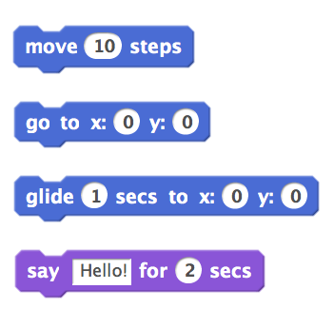
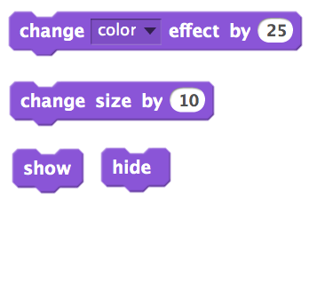

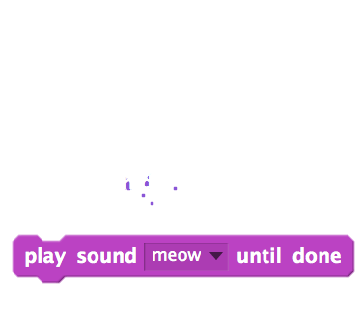
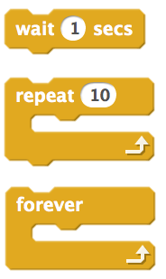
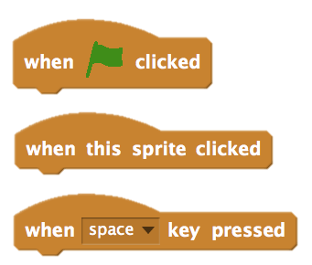
10 BLOCKS
WHAT CAN YOU CREATE WITH ONLY 10 SCRATCH BLOCKS?
Create a project using only these 10 blocks. Use them once, twice, or multiple times, but use each block at least once.
START HERE
Test ideas by experimenting with each block.
Mix and match blocks in various ways.
Repeat!
FEELING STUCK?
_{THAT’S OKAY! TRY THESE THINGS…}
FINISHED?
Test ideas by trying out different block combinations. Mix and match blocks until you find something that interests you!
Try brainstorming ideas with a neighbor!
Explore other projects to see what others are doing in Scratch. This can be a great way to find inspiration!
Add your project to the 10 Blocks Studio:
http://scratch.mit.edu/studios/475480
Play with different sprites, costumes, or backdrops.
Challenge yourself to do more! See how many different projects you can create with these 10 blocks.
Swap projects with a partner and remix each others’ creations.
Notes:
<numéro>

Slide 10
MY STUDIO
OBJECTIVES
By completing this activity, students will:
investigate the range of creative possibilities with Scratch by exploring some of the millions of projects on the Scratch website
curate a collection of 3 or more Scratch projects in a Scratch studio
UNIT 1 ACTIVITY
_{SUGGESTED TIME}
15–30 MINUTES
ACTIVITY DESCRIPTION
RESOURCES
Optionally, demonstrate how to create a new studio or have the My Studio handout available to guide students.
Optionally, show example inspiration studios using the links provided. Give students 10 minutes to browse existing Scratch projects on the Scratch homepage and search for interesting programs using the Explore page.
Ask students to identify three or more Scratch projects that can be used to inform and inspire a project of their own. Help students create a new studio from their My Stuff page and add the inspirational projects to the studio.
Invite students to share their approaches for finding inspirational programs. We suggest pair-share: have students share studios and discuss search strategies in pairs.
Ask students to think back on the process of discovery by responding to the reflection prompts in their design journals or in a group discussion.
My Studio handout
example studios http://scratch.mit.edu/studios/211580 http://scratch.mit.edu/studios/138296 http://scratch.mit.edu/studios/138297 http://scratch.mit.edu/studios/138298
REFLECTION PROMPTS
What search strategies did you use to find interesting projects?
How might each example project help with future work?
It’s important to give credit to sources of inspiration. How can you give credit for inspiration from these projects?
REVIEWING STUDENT WORK
Are there three or more projects in the studio?
What do these projects tell you about your students’ design interests?
NOTES
NOTES TO SELF
If students don’t have individual Scratch accounts, create a class studio that students can curate.
A variety of studios can be created - students could collect Scratch projects that are similar in theme or topic to what they want to create or gather programs that include techniques or assets to incorporate in a future creation.
32
Notes:
<numéro>

Slide 11
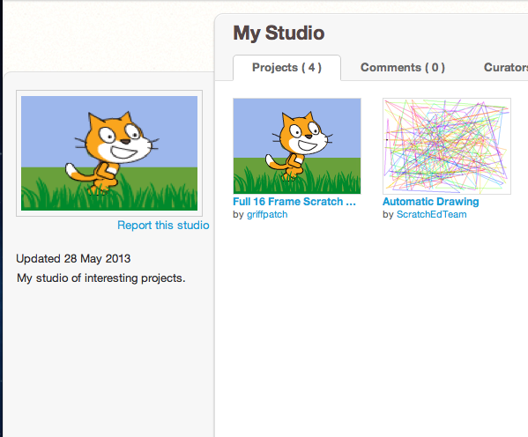
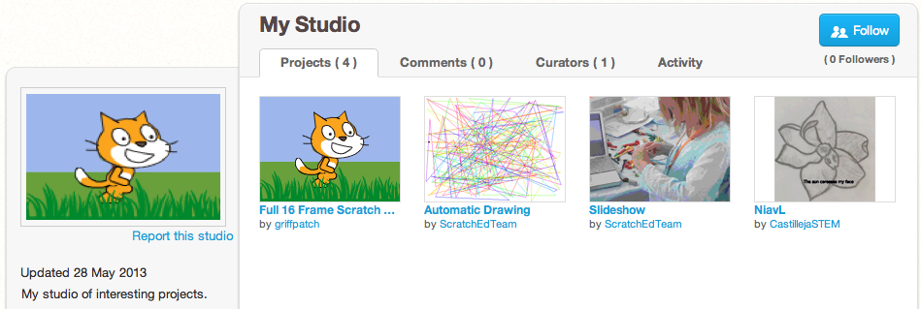
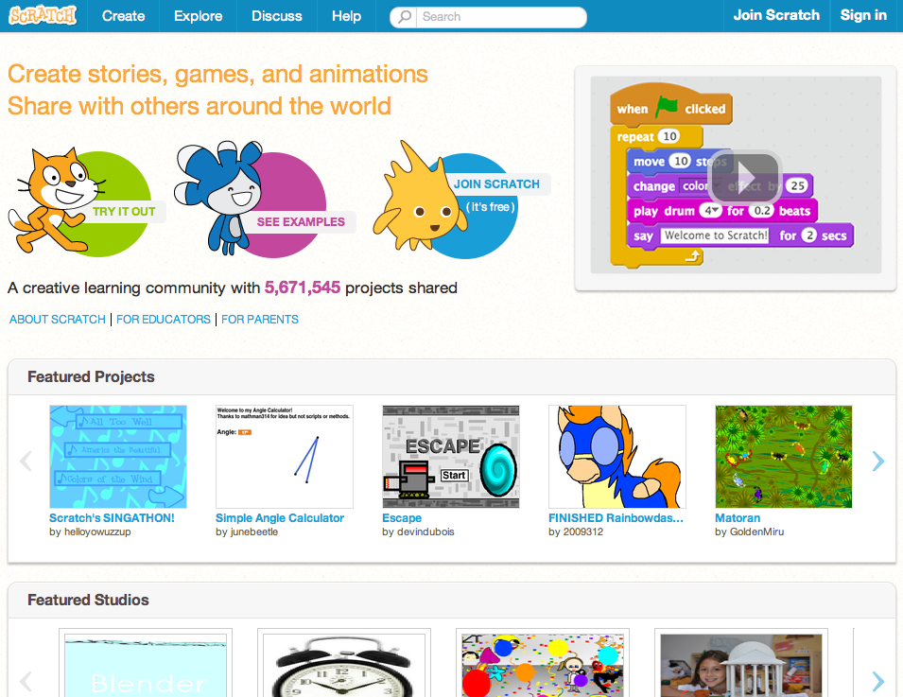
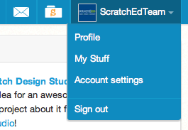
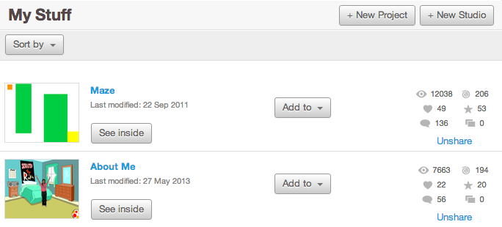
MY STUDIO
WHAT CAN BE CREATED WITH SCRATCH?
In this activity, you will investigate the range of creative possibility with Scratch by exploring some of the millions of projects on the Scratch website -- and start a collection of favorites in a Scratch studio!
START HERE
Browse projects on the Scratch homepage OR click on “Explore” to search for specific types of projects.
Create a new studio from your My Stuff page.
Add three (or more!) inspiring projects to your studio.
THINGS TO TRY
FINISHED?
Use the search bar to find projects that relate to your interests.
Explore each of the Animations, Art, Games, Music, & Stories categories on the Explore page.
Look through the Featured Studios on the homepage for ideas.
Challenge yourself to do more! The more Scratch projects you explore, the more you learn about what can be accomplished in Scratch!
Find studios created by other Scratchers that you find interesting!
Ask a neighbor what strategies they used to find interesting projects.
Share your newly created studio with a neighbor!
Notes:
<numéro>

Slide 12
DEBUG IT!
OBJECTIVES
By completing this activity, students will:
investigate the problem and find a solution to five debugging challenges
explore a range of concepts (including sequence) through the practices of testing and debugging
develop a list of strategies for debugging projects
UNIT 1 ACTIVITY
_{SUGGESTED TIME}
15–30 MINUTES
ACTIVITY DESCRIPTION
ACTIVITY DESCRIPTION
RESOURCES
Optionally, have the Unit 1 Debug It! handout available to guide students during the activity.
Help students open the Debug It! programs from the Unit 1 Debug It! studio or by following the project links listed on the Unit 1 Debug It! handout. Encourage students to click on the “Look Inside” button to investigate the buggy program, tinker with problematic code, and test possible solutions.
Give students time to test and debug each Debug It! challenge. Optionally, have students use the remix function in Scratch to fix the bugs and save corrected programs.
Ask students to reflect back on their testing and debugging experiences by responding to the reflection prompts in their design journals or in a group discussion.
Create a class list of debugging strategies by collecting students’ problem finding and problem solving approaches.
Unit 1 Debug It! handout
Unit 1 Debug It! studio http://scratch.mit.edu/studios/475483
REFLECTION PROMPTS
What was the problem?
How did you identify the problem?
How did you fix the problem?
Did others have alternative approaches to fixing the problem?
REVIEWING STUDENT WORK
Were students able to solve all five bugs? If not, how might you clarify the concepts expressed in the unsolved programs?
What different testing and debugging strategies did students employ?
NOTES
NOTES TO SELF
This activity works well in groups! Get students working in teams of 2-4 people to collectively problem solve and share debugging strategies.
Testing and debugging is probably the most common activity of programmers. Things rarely work as planned, so developing a set of testing and debugging strategies will be beneficial to any computational creator.
34
Notes:
<numéro>

Slide 13
DEBUG IT!
DEBUG IT! 1.1 http://scratch.mit.edu/projects/10437040
When the green flag is clicked, both Gobo and Scratch Cat should
start dancing. But only Scratch Cat starts Dancing! How do we fix the
program?
HELP! CAN YOU DEBUG THESE FIVE SCRATCH PROGRAMS?
In this activity, you will investigate what is going awry and find a solution for each of the five Debug It! challenges.
DEBUG IT! 1.2 http://scratch.mit.edu/projects/10437249
In this project, when the green flag is clicked, the Scratch Cat should
start on the left side of the stage, say something about being on the
left side, glide to the right side of the stage, and say something
about being on the right side. It works the first time the green flag is
clicked, but not again. How do we fix the program?
START HERE
DEBUG IT! 1.3 http://scratch.mit.edu/projects/10437366
The Scratch Cat should do a flip when the space key is pressed. But
when the space key is pressed, nothing happens! How do we fix the
program?
Go to the Unit 1 Debug It! studio: http://scratch.mit.edu/studios/475483
Test and debug each of the five debugging challenges in the studio.
Write down your solution or remix the buggy program with your solution.
DEBUG IT! 1.4 http://scratch.mit.edu/projects/10437439
In this project, the Scratch Cat should pace back and forth across the
stage, when it is clicked. But the Scratch Cat is flipping out – and is
walking upside down! How do we fix the program?
FEELING STUCK?
_{THAT’S OKAY! TRY THESE THINGS…}
DEBUG IT! 1.5 http://scratch.mit.edu/projects/10437476
In this project, when the green flag is clicked, the Scratch Cat should
saw ‘Meow, meow, meow!’ in a speech bubble and as a sound. But
the speech bubble happens before the sound – and the Scratch Cat
only makes one ‘Meow’ sound! How do we fix the program?
FINISHED?
Make a list of possible bugs in the program.
Keep track of your work! This can be a useful reminder of what you have already tried and point you toward what to try next.
Share and compare your problem finding and problem solving approaches with a neighbor until you find something that works for you!
Discuss your testing and debugging practices with a partner. Make note of the similarities and differences in your strategies.
Add code commentary by right clicking on blocks in your scripts. This can help others understand different parts of your program!
Help a neighbor!
Notes:
<numéro>

Slide 14
ABOUT ME
OBJECTIVES
By completing this activity, students will:
become familiar with a wider range of Scratch blocks
be able to create an open-ended Scratch project that is an interactive digital representation of their personal interests
UNIT 1 ACTIVITY
_{SUGGESTED TIME}
45–60 MINUTES
ACTIVITY DESCRIPTION
RESOURCES
Introduce students to the concept of the interactive collage, a Scratch project that represents aspects of themselves through clickable sprites. Optionally, show interactive project examples from the About Me studio.
Have students sign in to their Scratch accounts and open a new project. Optionally, have the About Me handout and Scratch Cards available to provide guidance. Give students time to create an About Me interactive collage Scratch project, encouraging them to build up their programs by experimenting and iterating.
Allow students to share their works-in-progress with others. We suggest pair-share: have students share and discuss their projects in pairs. Optionally, invite students to add their projects to the About Me studio or a class studio.
Ask students to think back on the design process by responding to the reflection prompts in their design journals or in a group discussion.
About Me handout
About Me studio http://scratch.mit.edu/studios/475470
Scratch Cards http://scratch.mit.edu/help/cards
REFLECTION PROMPTS
What are you most proud of? Why?
What did you get stuck on? How did you get unstuck?
What might you want to do next?
What did you discover from looking at others’ About Me projects?
REVIEWING STUDENT WORK
Do projects make creative use of sprites, costumes, looks, backdrops, or sound?
Are projects interactive? Can users interact with various elements within the project?
NOTES
NOTES TO SELF
Example projects can simultaneously inspire and intimidate, open the creative space and constrain it. Encourage a wide range of creations; diversity is great!
Students can further personalize projects by using a camera or webcam to bring images into the project.
36
Notes:
<numéro>

Slide 15
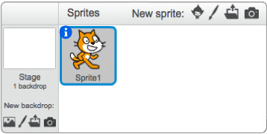
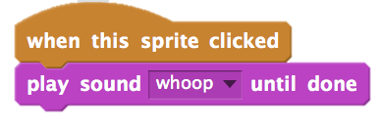
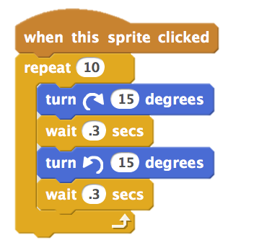
ABOUT ME
HOW CAN YOU COMBINE INTERESTING IMAGES AND SOUNDS TO MAKE AN INTERACTIVE COLLAGE ABOUT YOURSELF?
Experiment with sprites, costumes, backdrops, looks, and sounds to create an interactive Scratch project -- a project that helps other people learn more about YOU and the ideas, activities, and people that you care about.
START HERE
Create a sprite.
Make it interactive.
Repeat!
THINGS TO TRY
Use costumes to change how your sprite looks.
Create different backdrops.
Try adding sound to your project.
Try adding movement into your collage.
Make your sprite interactive by adding scripts that have
the sprite respond to clicks, key presses, and more!
TIPS & TRICKS
BLOCKS TO PLAY WITH
FINISHED?
Add your project to the About Me Studio: http://scratch.mit.edu/studios/475470
Challenge yourself to do more! Play with adding new blocks, sound, or motion!
Help a neighbor!
Notes:
<numéro>

Slide 16
38

