Slide 1
Project 3
Alex, Yiyang, Junshuo

Slide 2
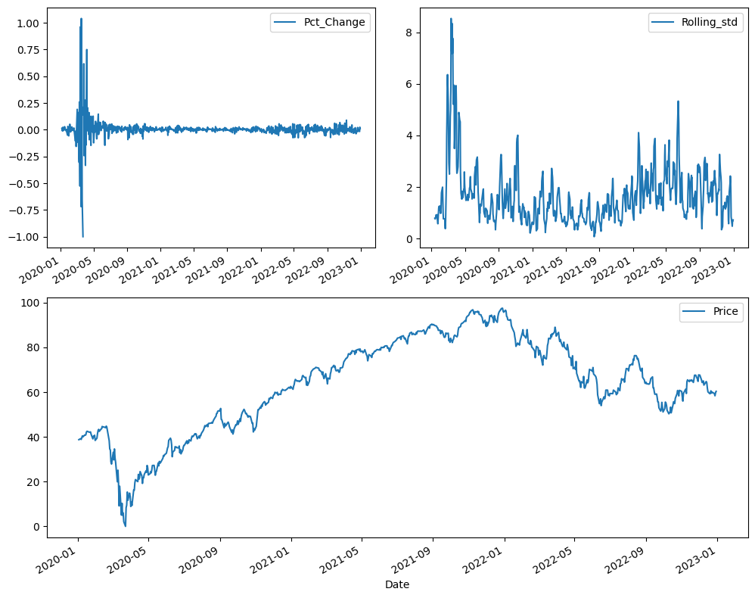
Overview

Slide 3
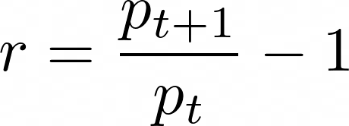
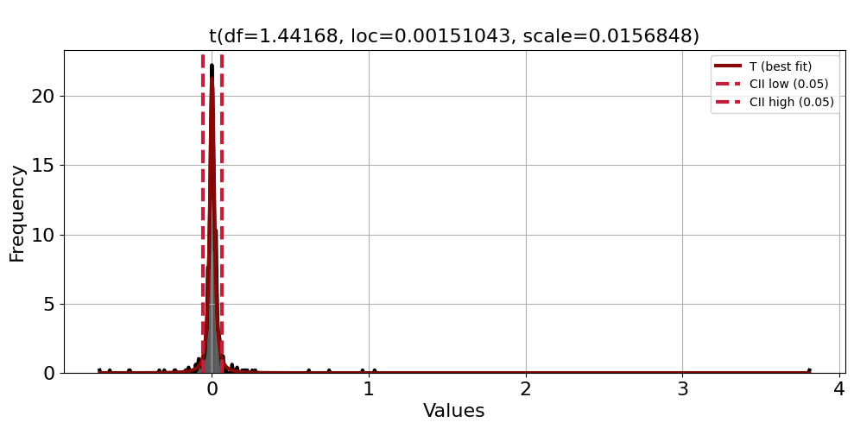
Transforming Returns
Distribution of raw returns
Best fitting dist is T
Fat tails
Not symmetric

Slide 4
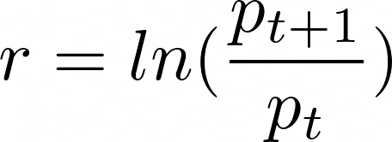
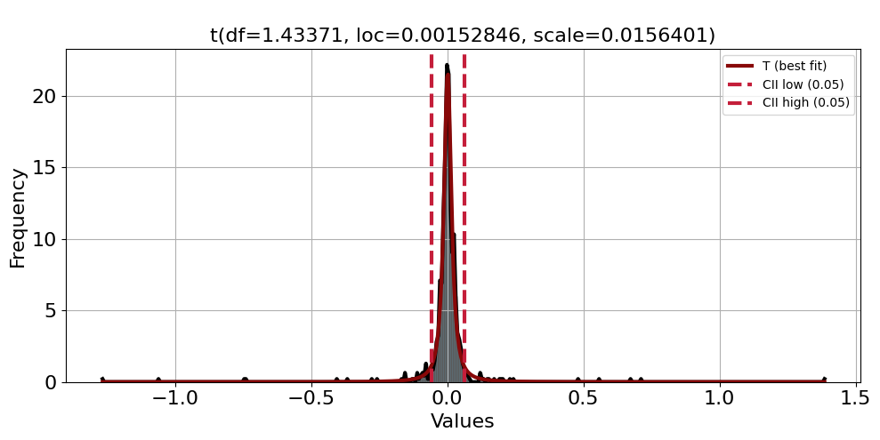
Transforming Returns
Distribution of log returns
Best fitting dist is T
Fat tails still
Now symmetric

Slide 5
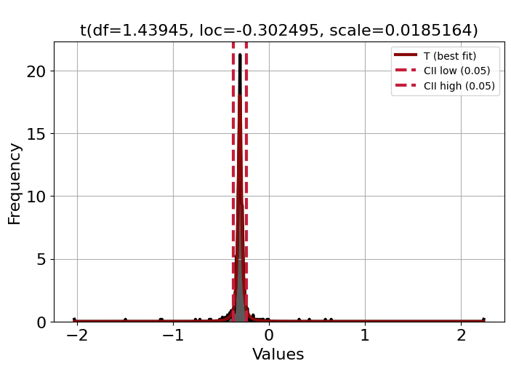
Transforming returns
We perform boxcox to try and get more normal returns
Log returns seem most normal
We can try other methods….

Slide 6
Models:
_{Bayesian_Ridge}
_{Random_Forest_Regressor}
Ensemble(Bayesian_Ridge, Random_Forest_Regressor, Gradient_Boost_Regressor)
_{Multi-layer Neural Network}

Slide 7
Used Hyperparameters For ML:
_{Bayesian_Ridge}
Alpha_1, Alpha_2 = 1e-6: parameters to control the prior distribution of Gamma.
Lambda_1, Lambda_2 = 1e-6: parameters of prior Gamma distribution of noise accuracy.
Tolerant = 1e-3: convergence threshold of the model.

Slide 8
Used Hyperparameters:
_{2. Random_Forest_Regressor:}
_{N_estimators = 200}
_{Max_depth = 10}
_{Min_sample_split = 10}
_{Min_sample_leaf = 4}
_{N_jobs = -1}
_{3. Gradient_Boost_Regressor:}
_{N_estimator = 200}
_{Learning_rate = 0.1}
_{Max_depth = 5}
_{Min_sample_split = 5}
_{Min_sample_leaf = 5}

Slide 9
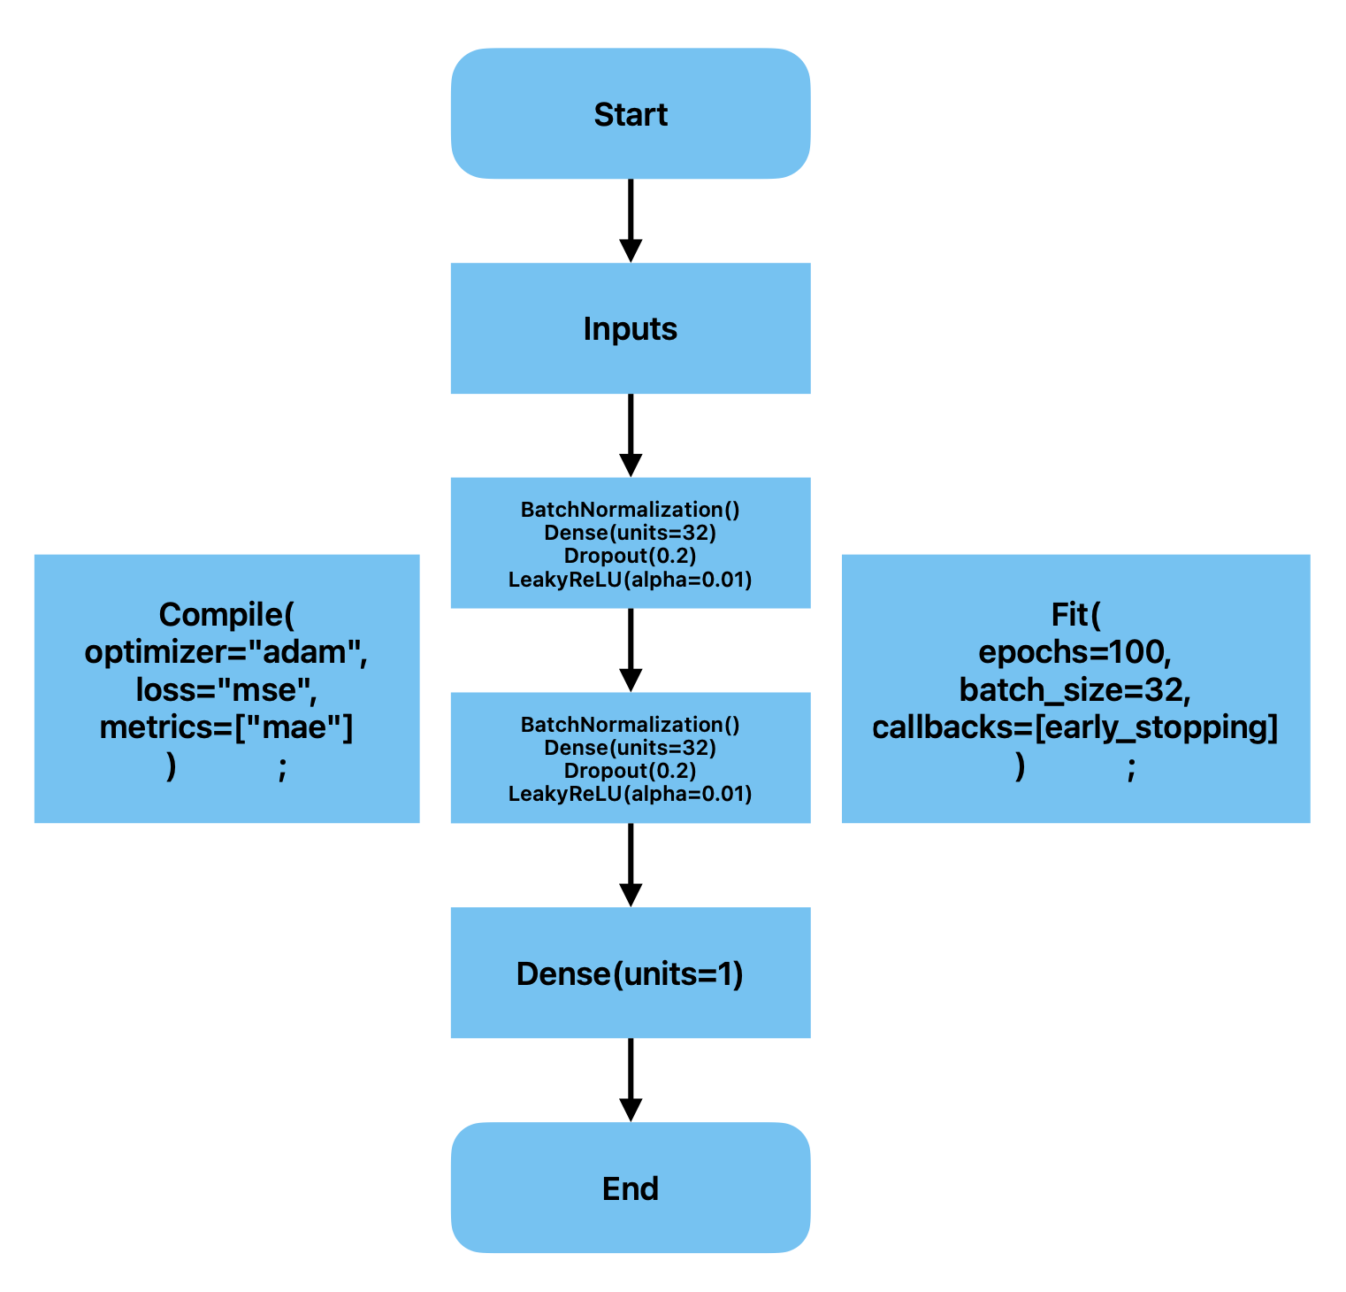
Used Hyperparameters:
4. MNN:
Epochs = 100
Batch_size = 32
Optimizer = adam
Loss = MSE
Metrics = MAE
Activation = LeakyReLU
Units = 32
Dropout = 0.2

Slide 10
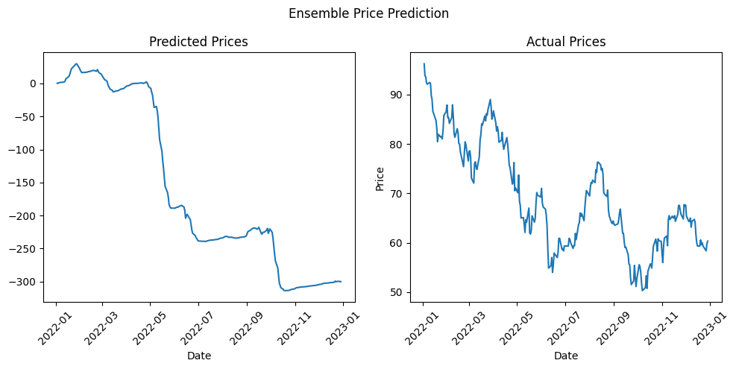
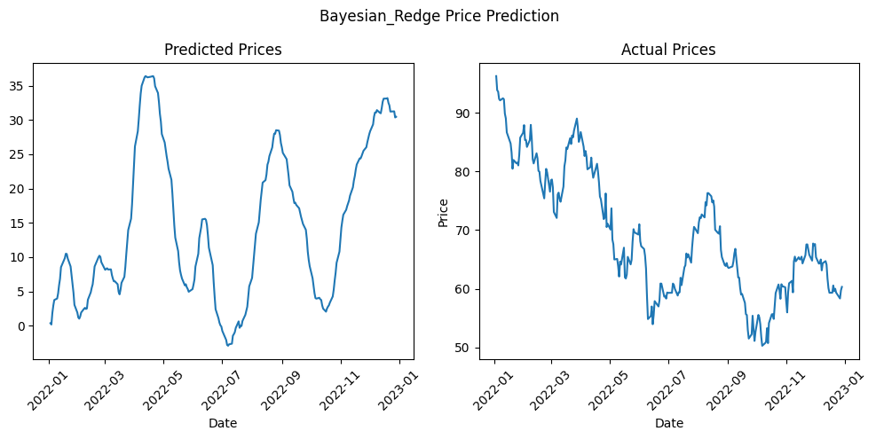
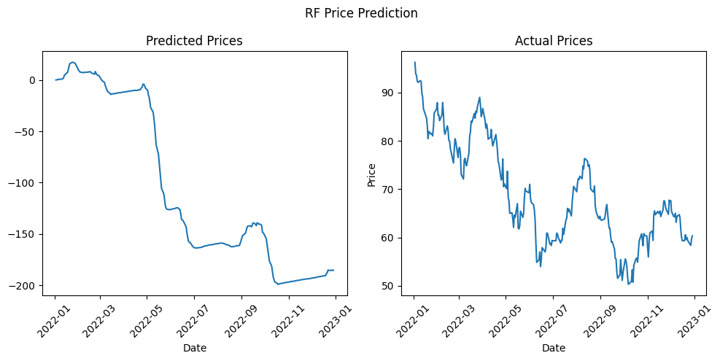
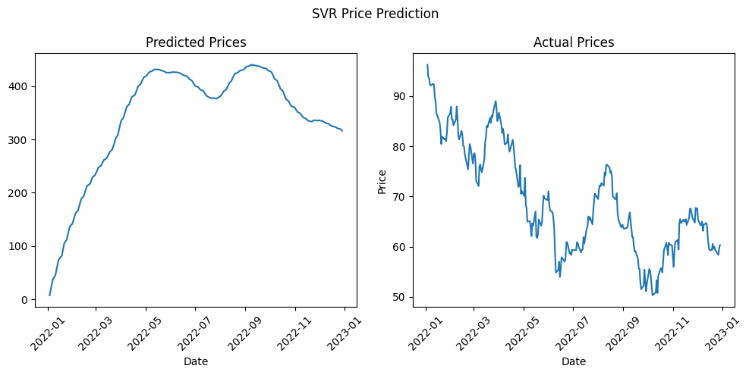
Predictions (Stage 1)

Slide 11
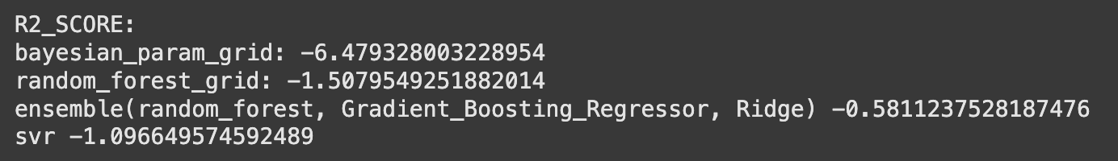
Metrics (Stage 1)

Slide 12
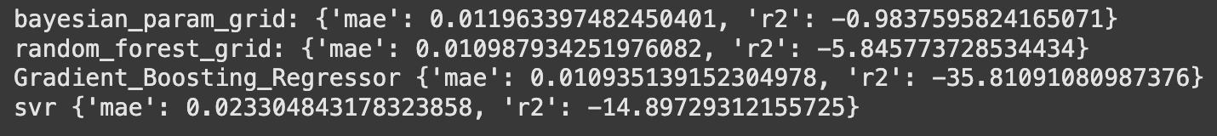
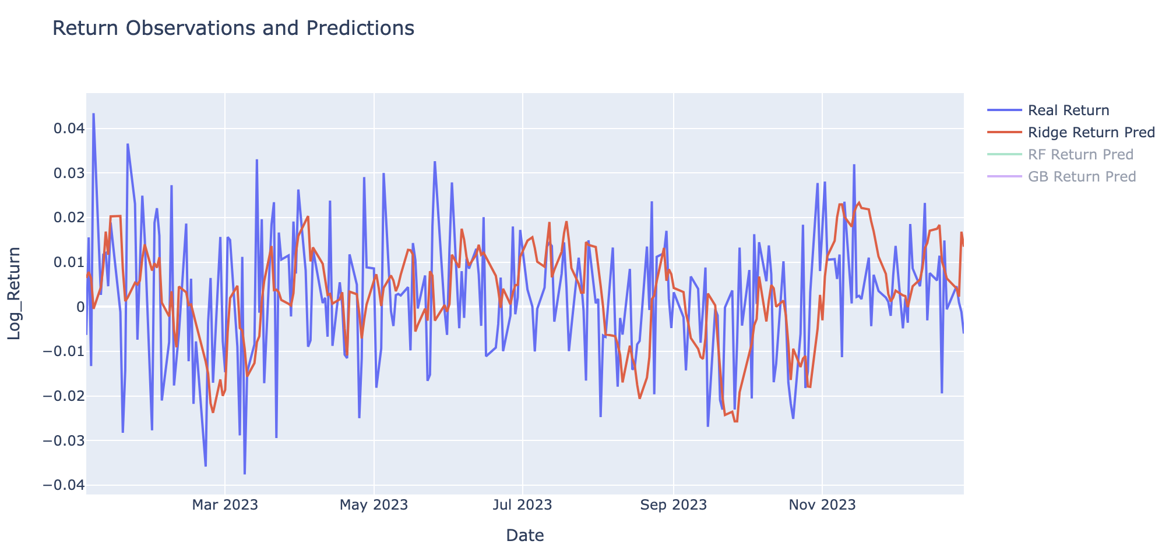
Metrics (Stage 2), with retrain after 10 periods

Slide 13
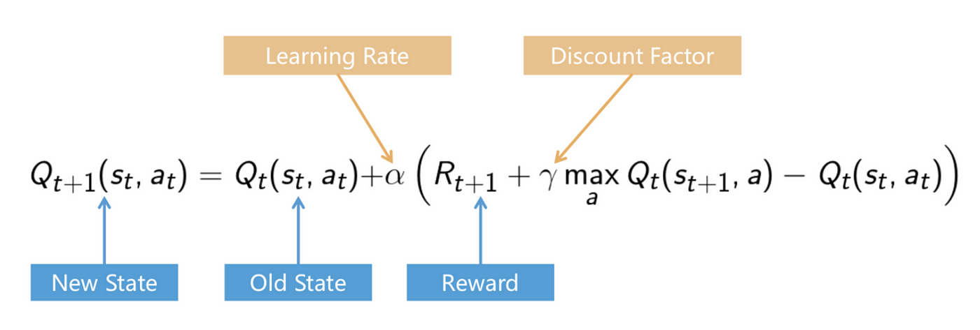
Q-learning Transition Function

Slide 14
Reward System
Preferring Buy and Sell over Hold
Penalizes when portfolio value drops below threshold 10000
Delayed Rewards: rewarding buy low, sell high

Slide 15
Parameter Overview
State (bins): current_price, inventory, cash
'price': np.linspace(min(prices_values), max(prices_values), 60)
'inventory': range(50)
'cash': np.linspace(7000, 13000, 100)
State Space = (300000,3)
Action: Buy, Sell, Hold

Slide 16
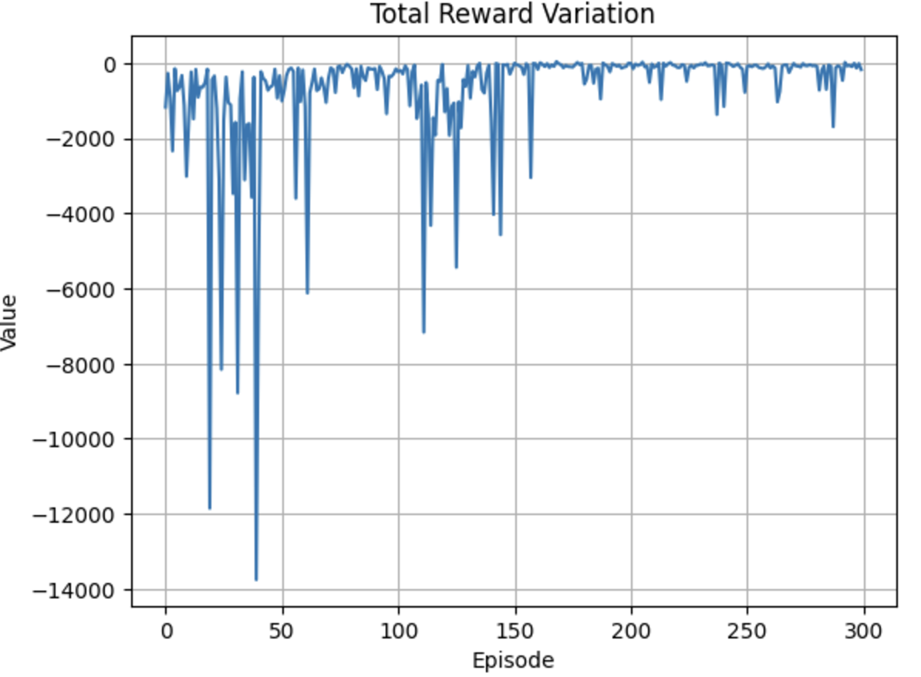
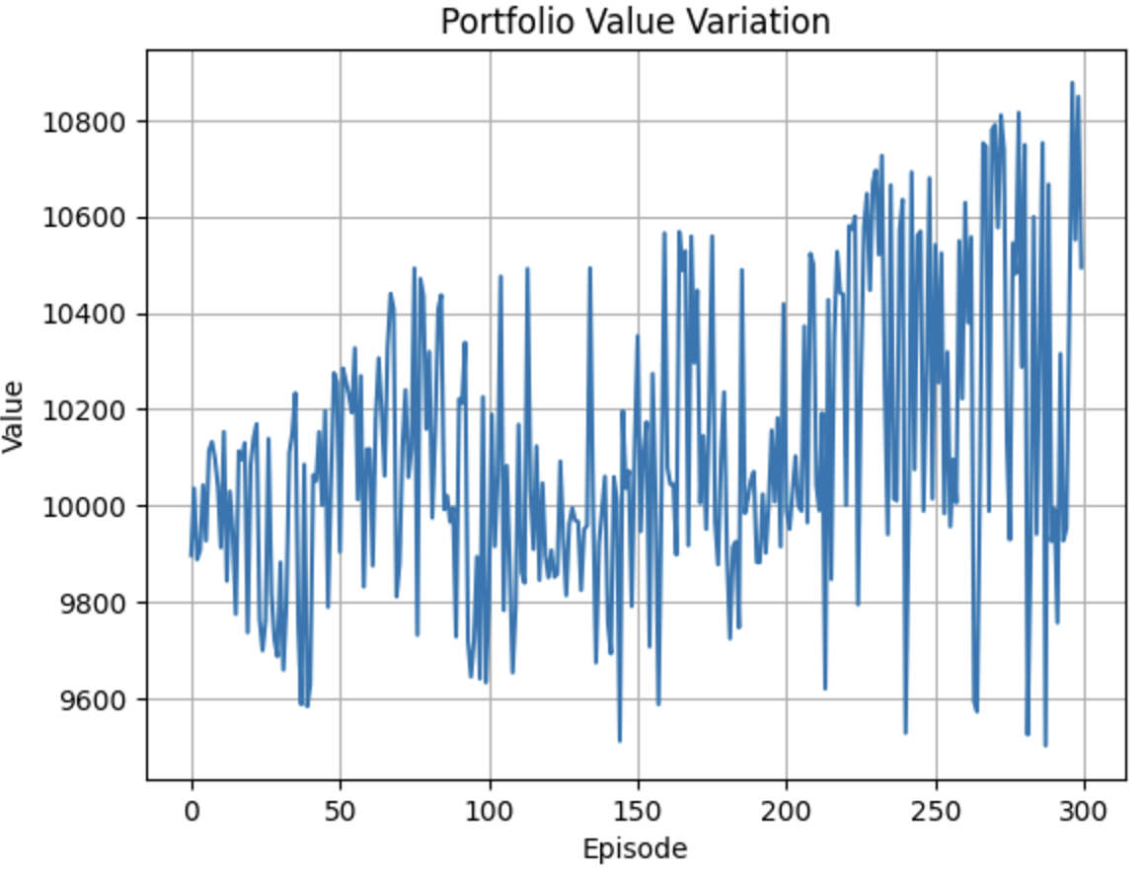
Training Results

Slide 17
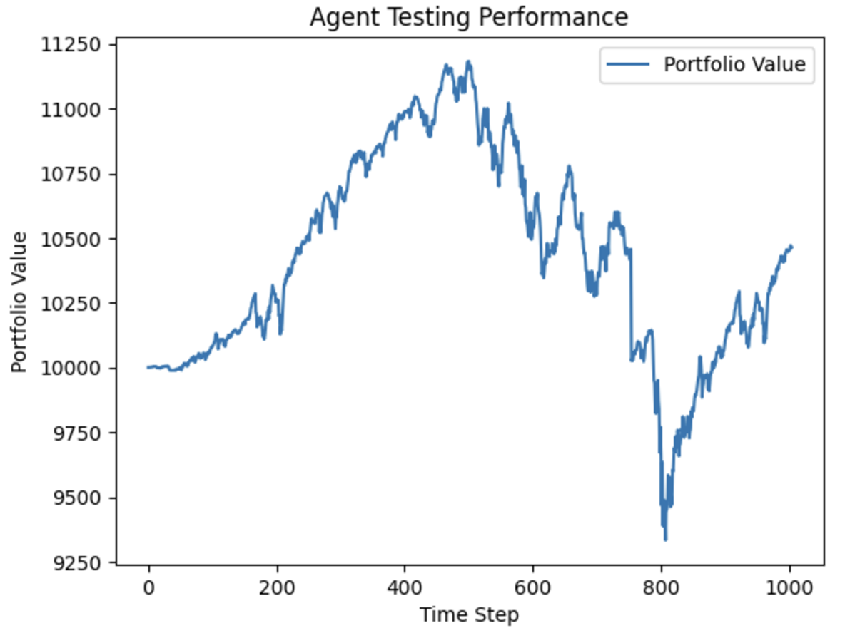
Testing Results
Final Portfolio Value: 10463.65

Slide 18
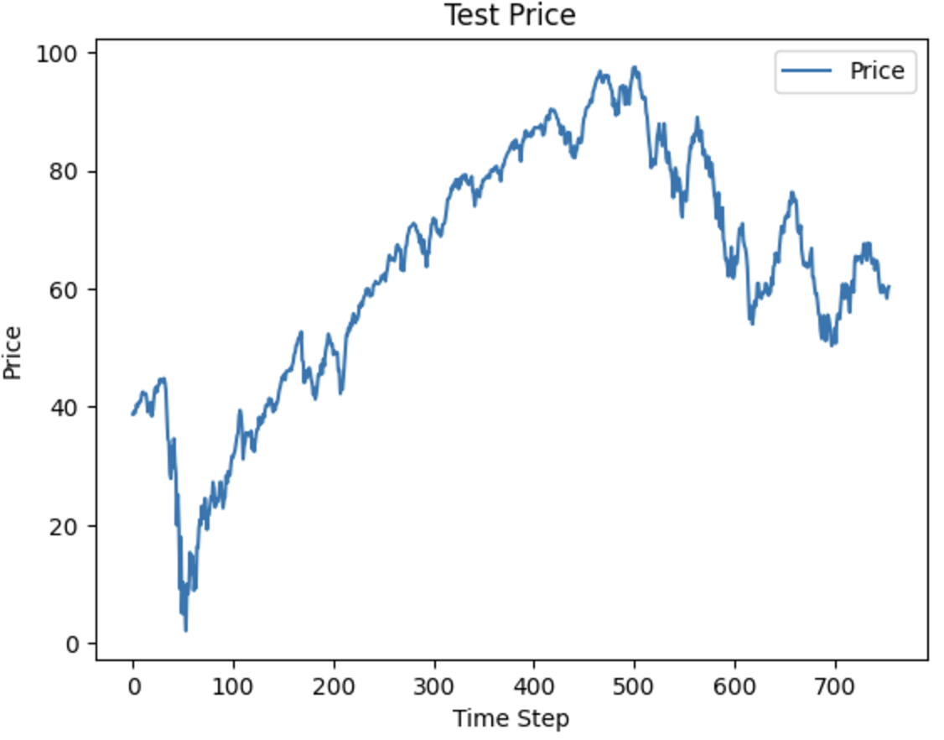

Slide 19
Potential Improvements
Reward and Portfolio Value alignment
Balancing Policies for Bullish and Bearish Market Conditions
Sign prediction rather than point prediction

