Slide 1
Methods for Estimating Parasite Induced Mortality
Will any of these work for the Raccoon Roundworm?

Slide 2
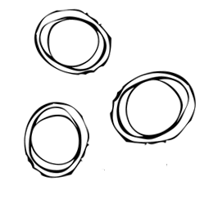


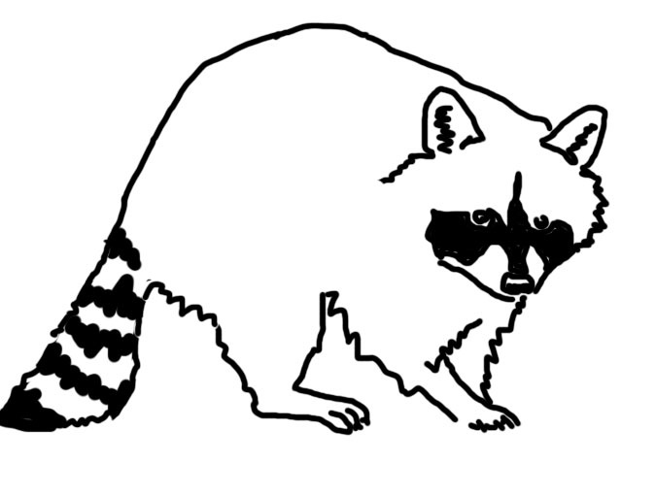
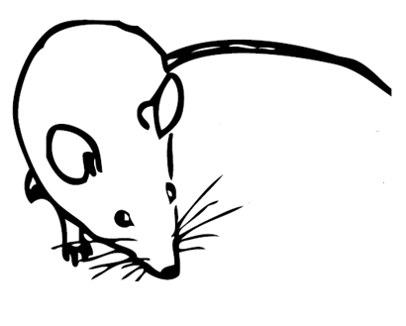
Raccoon Roundworm

Slide 3
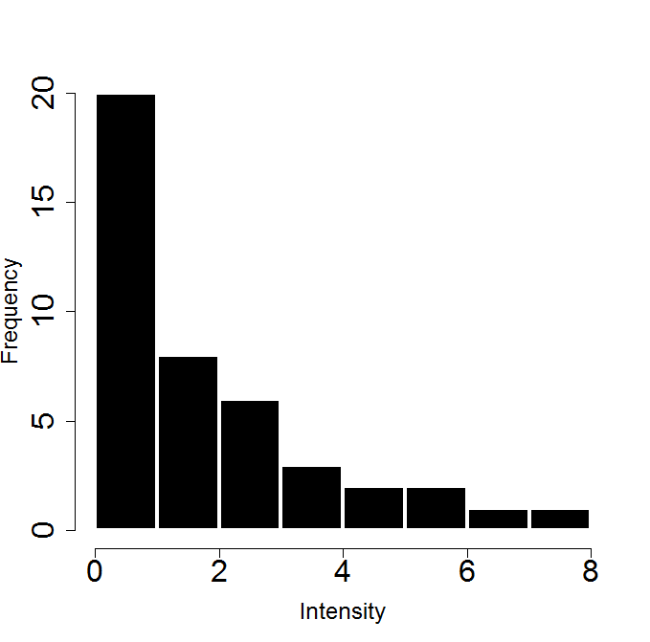



Modeling Parasite Transmission
Parasite population regulation
Parasite induced host mortality?

Slide 4
Methods for estimating Parasite Induce Host mortality
Ideal experiment
capture animals from an uninfected population, infect some and then release them back into the wild
Second best
treat some of the infected hosts in a wild population and then monitor survival
Third (?) best
monitor survival of wild animals with a range of known infection intensities

Slide 5
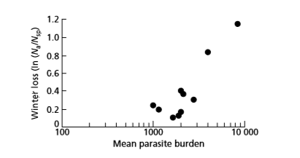
When experiments aren’t an option
Long term data that correlates mortality with worm loads
Hudson et al 1992
Notes:
Note that mortality can also be estimated from a full parasite population model, but that is probably not a great idea because you can only estimate so many parameters from the model before it becomes useless for looking at what you really are interested in.

Slide 6
When experiments aren’t an option
Autopsy data

Slide 7
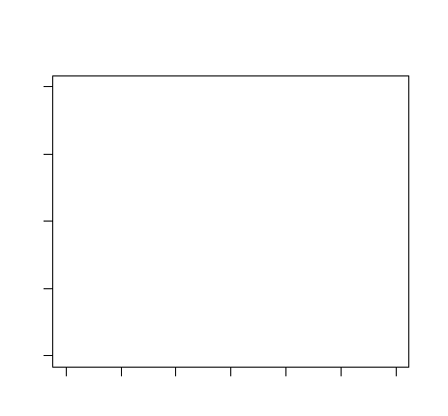
Age intensity data
decrease in infection intensity in older hosts
Infection Intensity
Host Age

Slide 8
Age intensity data
decrease in infection intensity in older hosts
The variance/mean ratio
Infection Intensity
Host Age

Slide 9
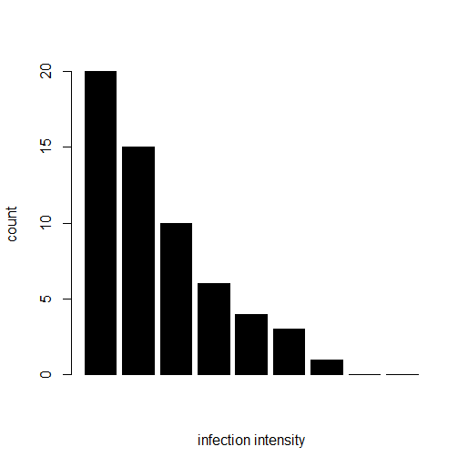
Parasite distribution
Deviations from negative binomial distribution (NBD)

Slide 10
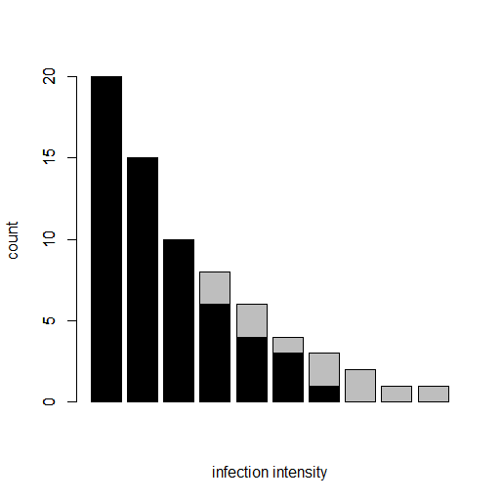
Parasite distribution
Deviations from negative binomial distribution (NBD)
Adjei et al 1986

Slide 11
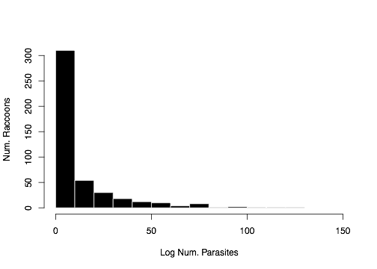
Does this work for the raccoon data?
N=457 raccoons (69 raccoons from Oregon, 226 from Ohio, 162 from California)

Slide 12

The basic methods
Fit the NBD to truncated parasite distribution
Compare observed and predicted distributions
Estimate survival function
Calculate parasite-induced mortality

Slide 13
The assumptions
Infection
occurs
Death due
to infection
Hosts
sampled
Host age

Slide 14
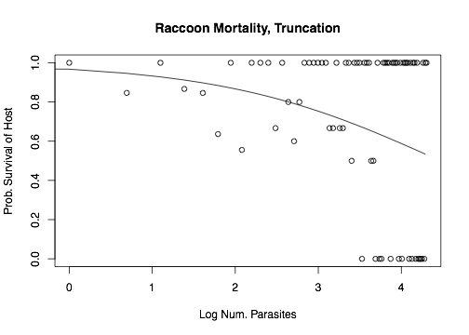
Does this work for the raccoon data?
Parasite-induced Mortality = 11%
Truncation at 40 worms

Slide 15
Does this work for the raccoon data?
These numbers seem high
Literature suggests that worm induced mortality is rare in raccoons
If parasite induced host mortality is low, Raccoon Roundworm may not be a good system to test this method

Slide 16
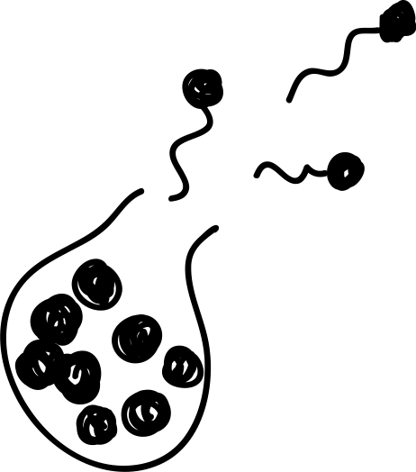



Let’s test something deadly…chytrid!
Batrachochytrium dendrobatidis (Bd)
Devastating fungal disease of amphibians
Load-dependent morality

Slide 17
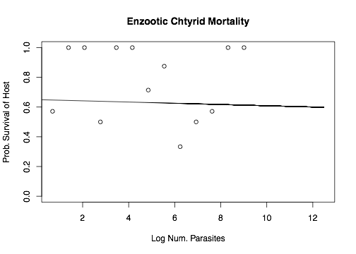


Does this work for the Bd data? *3
10,000 Zoospores
Parasite-induced Mortality = 32%
Truncated at 5,000 ZEs

Slide 18
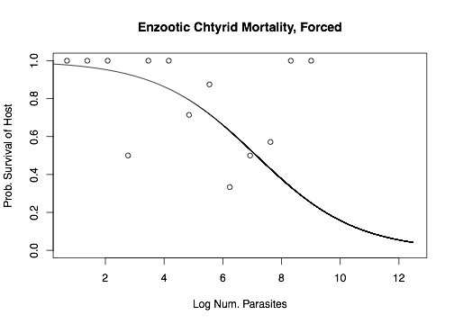
Does this work for the Bd data?
10,000 Zoospores
Parasite-induced Mortality = 22%
Truncated at 5,000 ZEs

Slide 19
What are some problems?
Forcing observed prediction!
Other mortality
Truncation
Where do you truncate?
Truncation changes aggregation
Changes our mean
Fix original mean and get MLE for k
How accurate are outputs?

Slide 20
Testing the perfect data set
Can we recover known survival probability function and parasite-induced mortality?
Specify true survival function, h(x)
Draw hosts from NBD
Kill hosts based on h(x)
Apply previous technique to estimate

Slide 21
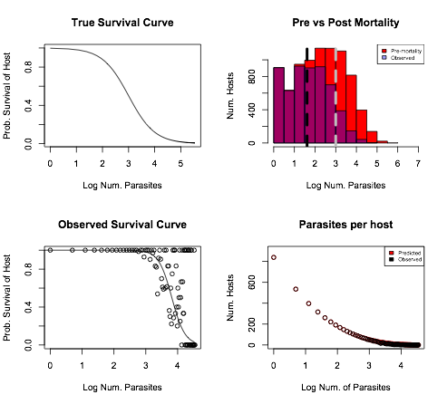

Testing the perfect data set

Slide 22
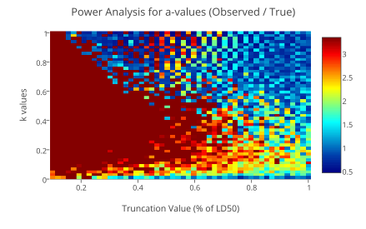
Testing the perfect data set

Slide 23
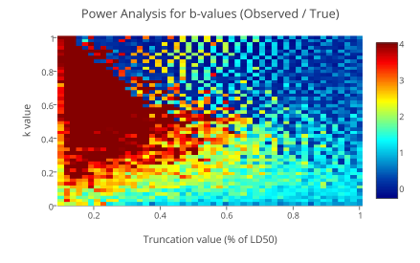
Testing the perfect data set

Slide 24
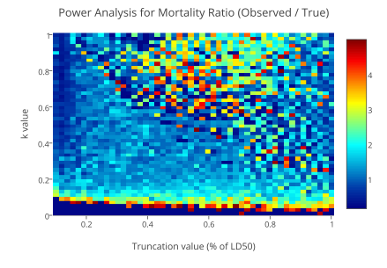
Testing the perfect data set

Slide 25
Does this method ever work?
Unlikely to ever work with a realistic dataset
Ambitious parasite dataset: 200 hosts

Slide 26
Future work
Host Age- move to age intensity comparisons

