Slide 1
Methods for Estimating Parasite Induced Mortality
Will any of these work for the Raccoon Roundworm?

Slide 2
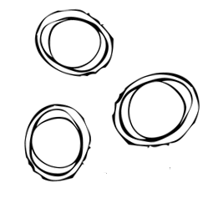


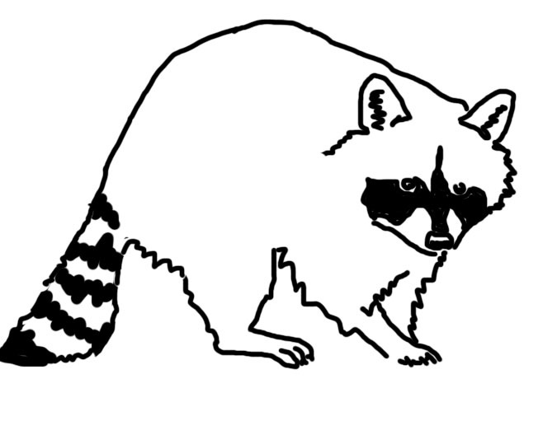
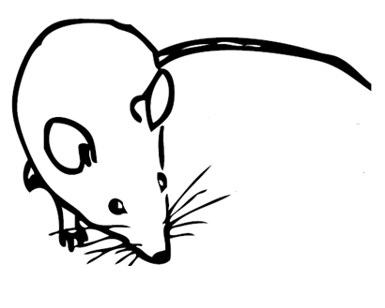
Raccoon Roundworm

Slide 3
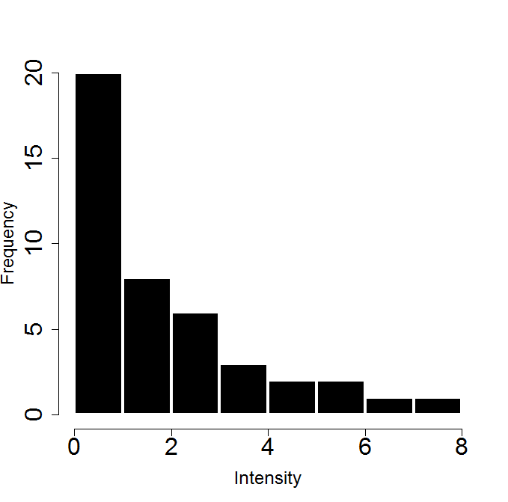



Modeling Parasite Transmission
Parasite population regulation
Parasite induced host mortality?

Slide 4
Methods for estimating Parasite Induce Host mortality
Ideal experiment
capture animals from an uninfected population, infect some and then release them back into the wild
Second best
treat some of the infected hosts in a wild population and then monitor survival
Third (?) best
monitor survival of wild animals with a range of known infection intensities

Slide 5
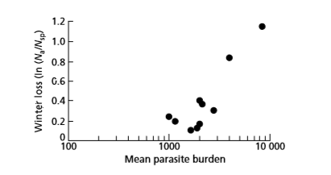
When experiments aren’t an option
Long term data that correlates mortality with worm loads
Hudson et al 1992
Notes:
Note that mortality can also be estimated from a full parasite population model, but that is probably not a great idea because you can only estimate so many parameters from the model before it becomes useless for looking at what you really are interested in.

Slide 6
When experiments aren’t an option
Autopsy data

Slide 7
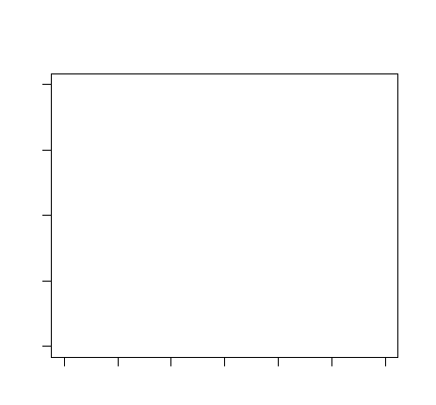
Age intensity data
decrease in infection intensity in older hosts
Infection Intensity
Host Age

Slide 8
Age intensity data
decrease in infection intensity in older hosts
The variance/mean ratio
Infection Intensity
Host Age

Slide 9
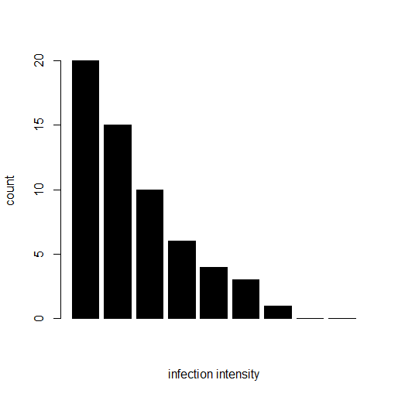
Parasite distribution
Deviations from negative binomial distribution (NBD)

Slide 10
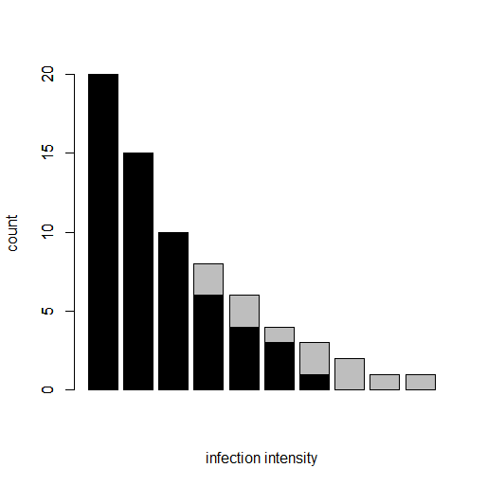
Parasite distribution
Deviations from negative binomial distribution (NBD)
Adjei et al 1986

Slide 11
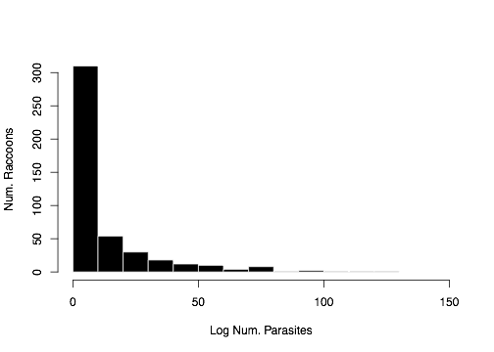
Does this work for the raccoon data?
N=457 raccoons, *1

Slide 12
The basic methods
Fit the NBD to your parasite data (truncated?)
Calc. observed number of hosts with 0, 1, 2, 3… parasites
Calc. predicted number with 0, 1, 2, 3 … parasites
Does observed match predicted?
Calculate parasite-induced mortality
Weighted Logistic Regression
Binning?

Slide 13
The Assumptions
*2 (Drawing of paper assumptions)

Slide 14
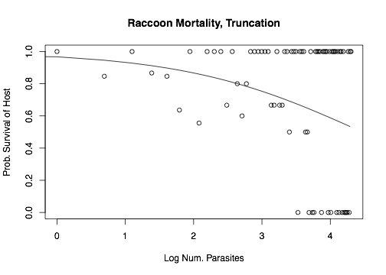
Does this work for the raccoon data?
Parasite-induced Mortality = 11%
Truncation at 40 worms

Slide 15
Does this work for the raccoon data?
Something seems fishy…

Slide 16
Let’s test something deadly…chytrid!
Batrachochytrium dendrobatidis (Bd)
Devastating fungal disease of amphibians
Load-dependent morality *4

Slide 17
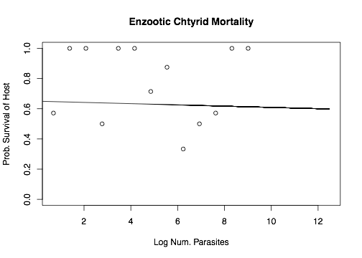
Does this work for the Bd data? *3
10,000 Zoospores
Parasite-induced Mortality = 32%
Truncated at 5,000 ZEs

Slide 18
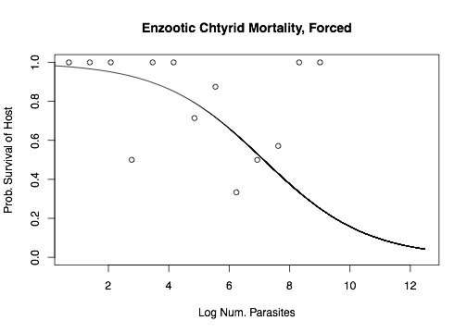
Does this work for the Bd data?
10,000 Zoospores
Parasite-induced Mortality = 22%
Truncated at 5,000 ZEs

Slide 19
What are some problems?
Forcing observed <= prediction!
Other mortality inevitably occurs
Truncation
Where do you truncate?
Truncation decreases aggregation
Changes our mean. We dealt with this by using our original mean
How accurate are outputs?

Slide 20
Testing the perfect data set

Slide 21
Does this method ever work?
Maybe under really limited circumstances

Slide 22
Future work
Host Age- move to age intensity comparisons

