Slide 1
Fitcar
Mingqi Wu and Paul Spurgeon

Slide 2
Data
Data Base
Vehicles
Drivers
Users
Geofences
Trips

Slide 3
Analytic progress
Data Base downloaded
Data exploratory analysis
Descriptive statistics on Vehicles and Maintenance

Slide 4
Vehicles
# of Vehicles: 957
# of Make: 53
# of Make-Model: 251
# of Make-Model-Year: 706
Make | Count | %
HONDA | 98 | 10.2
TOYOTA | 97 | 10.1
NISSAN/DATSUN | 81 | 8.5
FORD TRUCKS | 76 | 7.9
CHEVROLET | 68 | 7.1
Make | Model | Count | %
CHEVROLET | IMPALA | 35 | 3.7
HONDA | ACCORD | 33 | 3.4
FORD TRUCKS | F150 PICKUP | 32 | 3.3
HONDA | CIVIC | 23 | 2.4
TOYOTA | CAMRY | 22 | 2.3
Make | Model | Year | Count | %
FORD TRUCKS | F150 PICKUP | 2009 | 6 | 0.6
CHEVROLET | IMPALA | 2008 | 5 | 0.5
HONDA | ACCORD | 2005 | 5 | 0.5
HONDA | CIVIC | 2009 | 5 | 0.5
TOYOTA | CAMRY | 2007 | 5 | 0.5

Slide 5
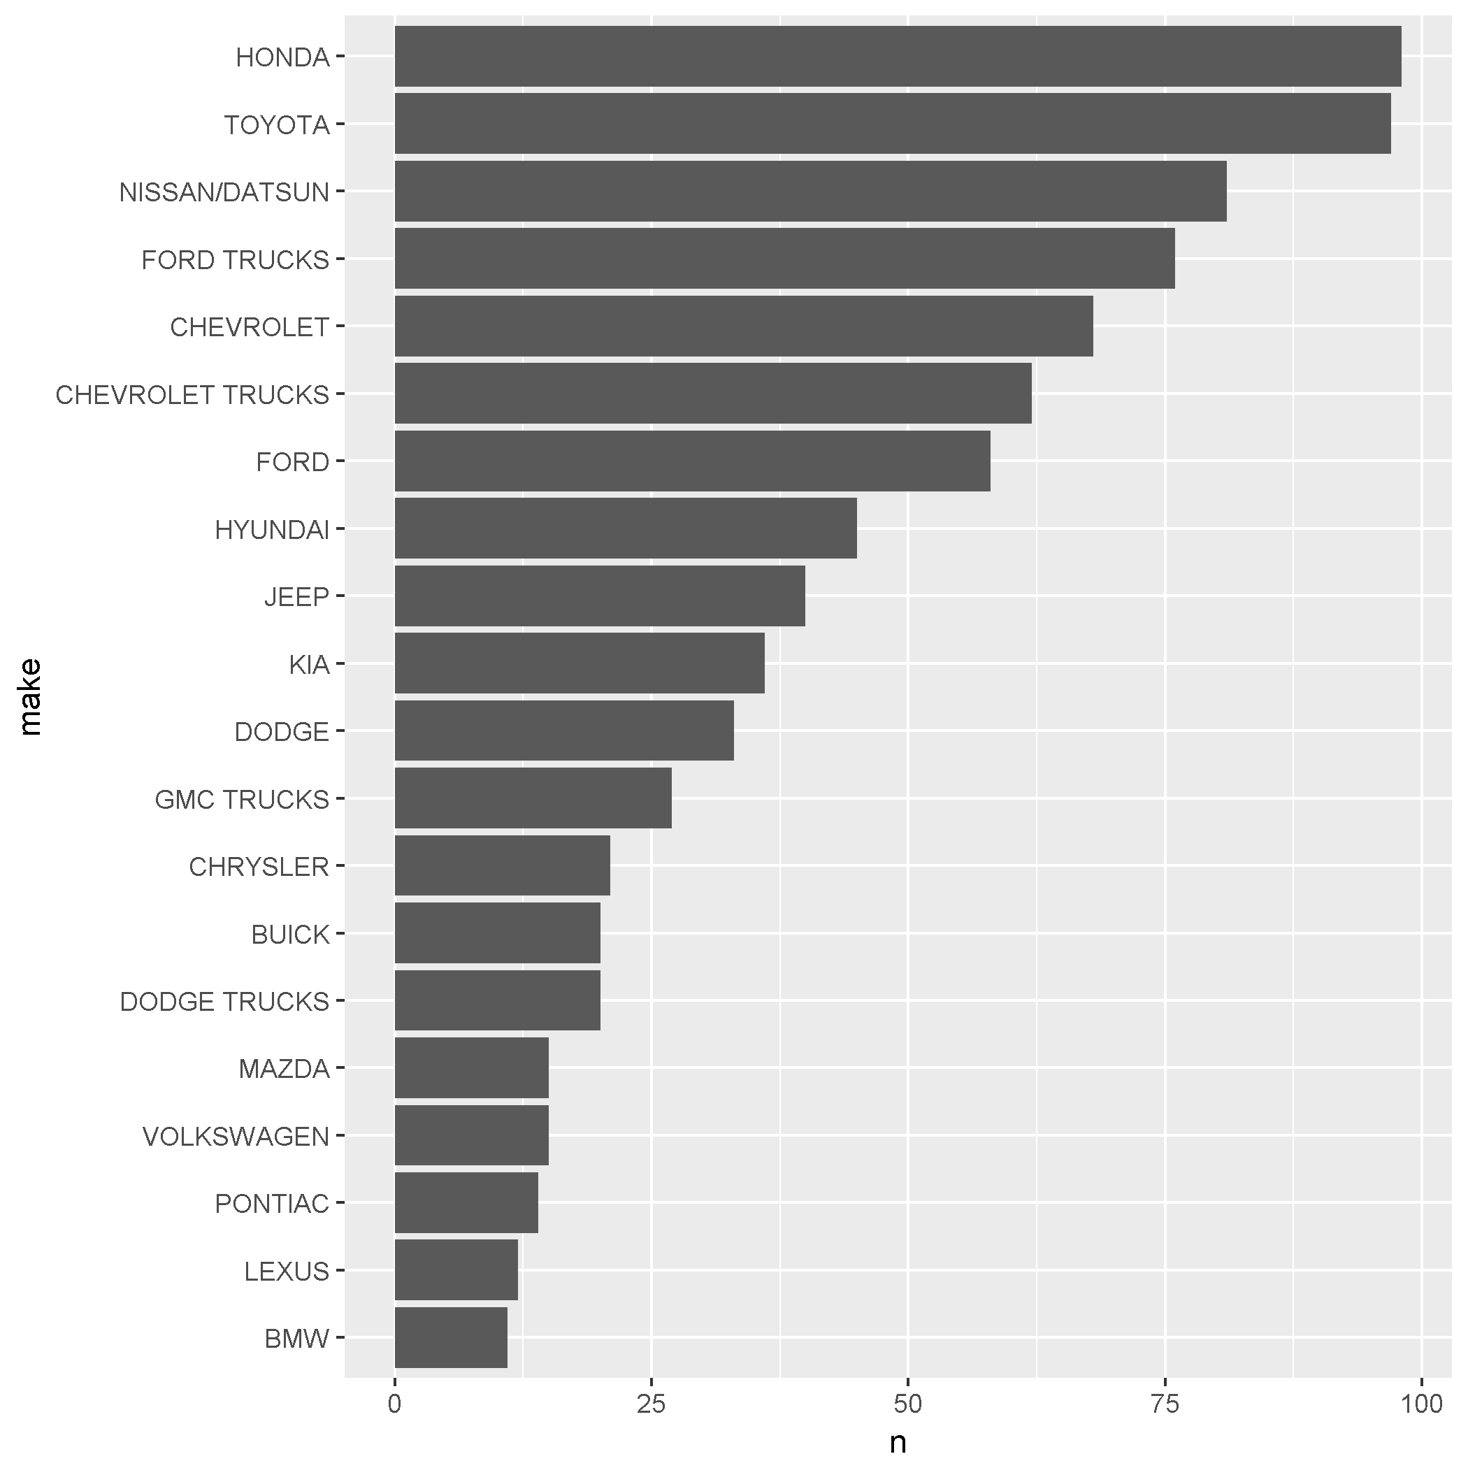

Vehicle by Make (53)

Slide 6
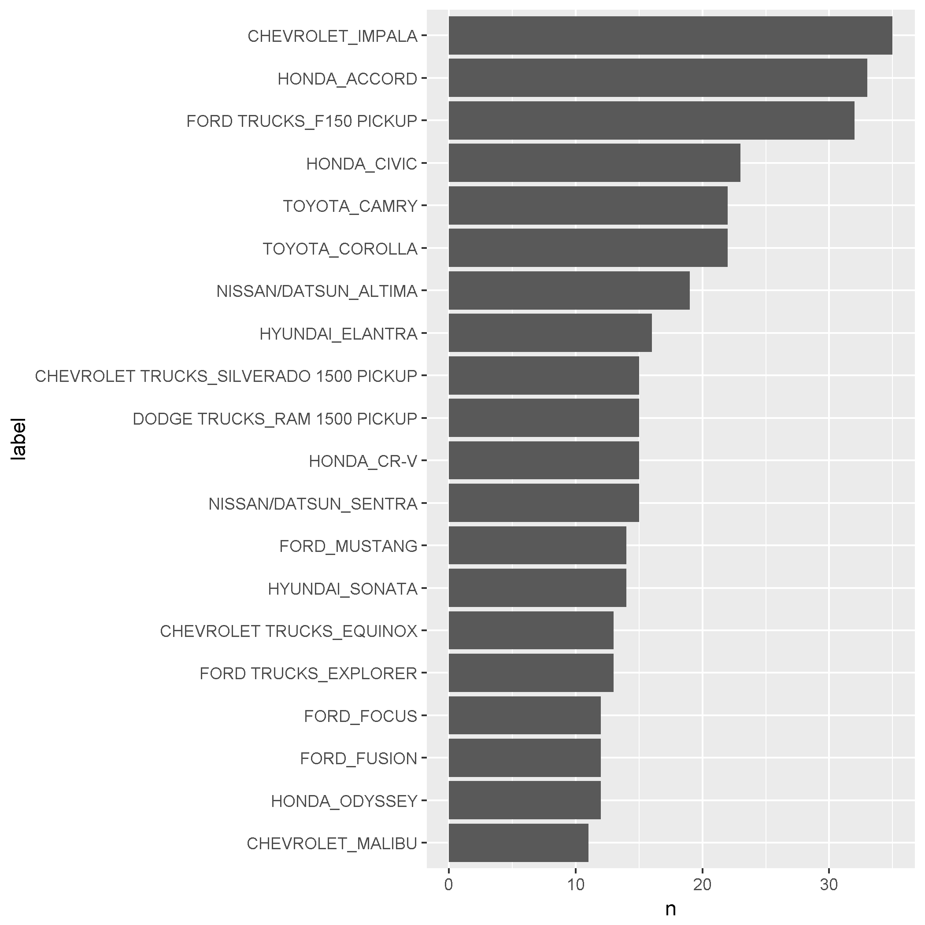

Vehicle by Make-Model (251)

Slide 7
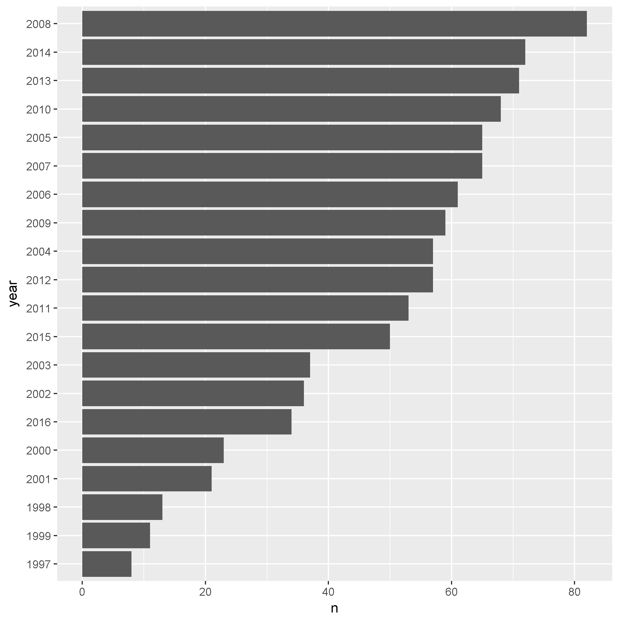
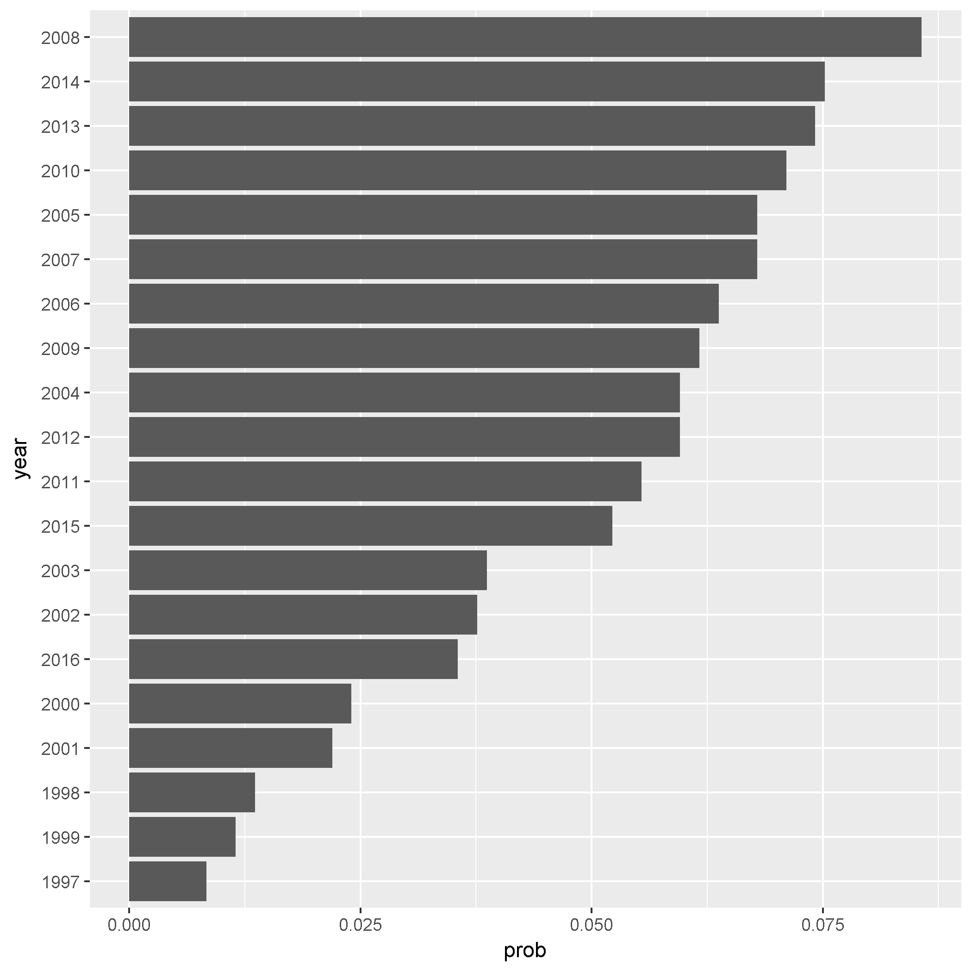
Vehicle by Year (25)

Slide 8
Maintenance
Maintenance
Service Update
Diagnostics
Service Id | Service Name
1 | Jiffy Lube Signature ServiceÂ® Oil Change
2 | Air Filter
3 | Automatic Transmission Fluid Service
4 | Cabin Air Filter
5 | Wiper Blades
6 | Tire Rotation
7 | Front Differential Service
11 | Belts
12 | Fuel Filter
15 | Brake Fluid Exchange
16 | Power Steering Fluid Exchange
17 | Spark Plugs
18 | Radiator Fluid Exchange
20 | Rear Differential Service
Service Id | Count
1 | 946
2 | 944
3 | 944
4 | 944
5 | 944
6 | 944
7 | 945
11 | 944
12 | 944
15 | 944
16 | 945
17 | 944
18 | 944
20 | 945
Service Id | Count
1 | 2453
2 | 1125
3 | 980
4 | 1057
5 | 1096
6 | 1169
7 | 946
11 | 954
12 | 954
15 | 1009
16 | 971
17 | 990
18 | 959
20 | 969
Detc Code | Count
NULL | 3120
P0420 | 1865
P0171 | 895
P0300 | 747
P0442 | 597
P0128 | 582
P0430 | 561
P0011 | 517
P0303 | 449
P0141 | 397
P0326 | 397
P0133 | 392
P0455 | 392
P0036 | 377

Slide 9
Use Case I
For each car:
… ON B C D H K B K A C A C D A H K ON H C B C A A H K A D ON …
Time
<1 week
> 1 hour
ID: 1 2 3 4 5 6 7 8 9 10 11 12 13 14 15 16
End Code ID | Proceeding Code ID | Code
8 | 7 | K
8 | 8 | A
9 | 8 | A
9 | 9 | C
10 | 9 | C
10 | 10 | A
11 | 10 | A
11 | 11 | C

