Slide 1
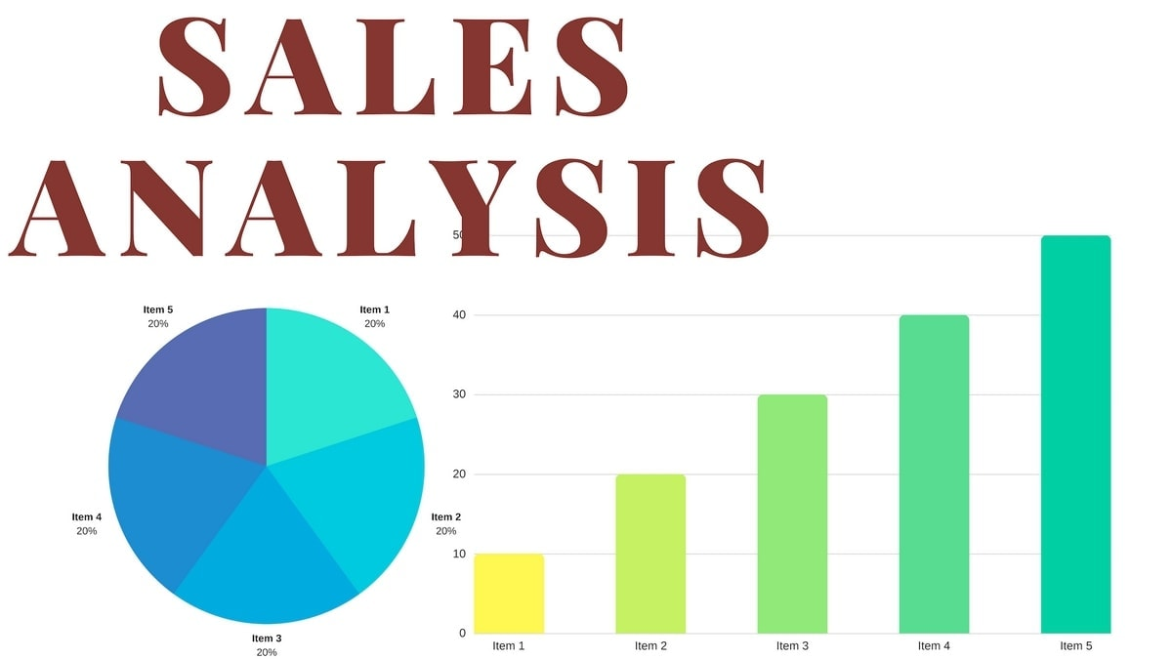

Title: “Regional Sales Analysis IN USA

Slide 2
🎯 Objective of the Project
The goal of this sales analysis is to:
Track overall sales performance (revenue, profit, margin).
Identify best-performing products, channels, and regions.
Spot risks such as overdependence on certain products/customers.
Provide data-driven recommendations for future growth and efficiency.

Slide 3
📊 Data Overview
🔹 Key Columns / Dimensions
Date – The time period of each sale (helps see seasonality & trends).
Region / State – Geographic sales data (e.g., West, South, California, New York).
Customer Name – Individual customers/companies making purchases.
Product ID / Name – Products sold, used to compare bestsellers vs. weak performers.
Sales Channel – How the sale happened (Wholesale, Distributor, Export, etc.).
Revenue (Sales Amount) – Total sales value for each transaction.
Profit / Margin – Profit generated from the sale (Revenue – Costs).
Order Quantity – Units sold per transaction.
Time Period: Multiple years (with monthly granularity).
Regions: Covers all U.S. regions (West, South, Midwest, Northeast).
Products: 25+ unique products.
Customers: 100+ customers, with a mix of small buyers & a few large accounts.
Channels: Wholesale, Distributor, Export.

Slide 4
Current State (Performance Snapshot)
🔑 Key Highlights
Revenue & Profit Trend: Overall growth 📈, but uneven across products & regions.
Top 5 Products: These drive the majority of sales (80/20 effect).
Regional Performance:
West & South = best-performing regions.
Northeast = weakest region.
Sales Channels:
Wholesale is the largest contributor.
Distributor steady.
Export = small but potential for expansion.

Slide 5
📊 Summary of the Dashboard
Revenue: $1.2B total revenue, $461.8M profit with ~37% margin.
Seasonality: Sales show peaks in March, June, and August → seasonal spikes.
Top Products: A few products (like Product 26, 25, 13) drive the majority of revenue.
Sales Channels: Wholesale is the main source (54%+ revenue), followed by distributors & export.
Regions: California (19.5% of revenue) & the West region deliver the highest revenue & margins.
Customers: A small group of customers (like Aibox & Neutrogena) are driving most revenue → dependency risk.

Slide 6
💡 Key Insights
Revenue Concentration
Few products & few customers are responsible for the bulk of revenue.
Strong dependence on wholesale channel.
Profitability
Some products generate high sales but low profit margin.
Other smaller products are very efficient (high-margin heroes).
Regional Story
California & West region are the biggest growth drivers.
Northeast lags behind in both revenue and margins → opportunity for expansion.
Customer Spending
Most customers place small-to-medium orders, only a few place high-value orders.
Risk: If top 5 customers reduce orders, overall sales could dip.

Slide 7
Customer & Product Insights
🔑 Customer Insights
Few key customers account for the majority of revenue (dependency risk).
Many smaller buyers contribute little individually but collectively form a growth opportunity.
Need to diversify customer base → reduces risk & expands stability.
📦 Product Insights
Top products dominate sales but show different profit margins → high revenue ≠ always high profit.
Some products consistently underperform against budget → they drain resources (marketing, inventory, logistics).
Opportunity to focus on profitable products & decide whether to improve or phase out weak ones.
“Our business currently depends on a handful of big customers and a few top products. While these bring in most of our sales, it also creates risk if we lose even one. At the same time, our smaller customers, though less significant individually, could become a new growth driver if nurtured. On the product side, not all top sellers are profitable—some drain resources. To maximize profitability, we should focus on strengthening high-margin products and reevaluate underperforming ones.”

Slide 8
🌍 – Regional Insights
🔑 Key Points
West & South = strongest contributors
Driving the majority of revenue.
Well-established customer base.
Northeast = weakest region
Consistently underperforming.
Market penetration challenges.
Opportunities
Expand distributor/wholesale network in weaker regions.
Tailor regional marketing campaigns.
Explore local product preferences.
👉 Storytelling for stakeholders: “Our regional sales picture shows that the West and South are leading revenue growth, but the Northeast is consistently lagging behind. This imbalance means we are missing opportunities in weaker regions. By expanding our distributor network, strengthening marketing efforts, and tailoring products to local needs, we can capture untapped revenue and reduce overreliance on a few regions.”

Slide 9
🛒 – Channel Performance
🔑 Key Points
Wholesale = strongest channel
Main driver of revenue.
Strengthen partnerships & contracts to secure stability.
Distributor = stable but smaller
Consistent, but contributes less than wholesale.
Opportunity to expand in underperforming regions.
Export = small but growing
Currently limited contribution.
Potential future growth through new markets.
👉 Storytelling for stakeholders: “Our sales channels show a clear leader—wholesale, which contributes the majority of revenue. Distributors are stable, but smaller in scale. The export channel, though small, holds real potential for future growth if we explore new markets or partnerships. Strengthening wholesale partnerships while strategically expanding distributors and exports can help us balance our channel performance.”

Slide 10
⚠️ – Risks & Challenges
🔑 Key Risks from Data
Overdependence on a few products & key customers → concentration risk.
Underperforming products → drain resources & reduce profitability.
Seasonal peaks → create inventory & forecasting challenges.
Regional imbalance → weak Northeast performance limits overall growth.
👉 Storytelling for stakeholders: “While our business is growing, there are clear risks. Too much of our revenue comes from just a handful of products and customers—if one declines, it could hurt us significantly. Some products aren’t meeting expectations, pulling down overall profit. Seasonal peaks also strain our inventory and forecasting, while the Northeast region continues to lag behind. These challenges highlight why we need a balanced strategy to reduce risks and unlock growth.”

Slide 11
🚀 Future Focus & Recommendations
Product Strategy:
Continue to push top sellers (Product 26, 25, 13).
Evaluate underperformers → discontinue or reposition.
Expand profitable niche product
Channel Growth:
Wholesale is strong but risky to over-rely on.
Strengthen distributor & export partnerships for diversification.
Regional Play:
Double down in West & California (already strong).
Launch growth campaigns in Northeast & Midwest where margins are good but sales are weaker.
Customer Strategy:
Build loyalty programs for top customers (retention).
Acquire new mid-tier customers to reduce dependency.
Forecasting & Inventory:
Prepare for seasonal peaks (March, June, Aug) to avoid stockouts.
Improve demand forecasting with historical trends.

Slide 12
📖 Simple Storytelling
👉 *“Our sales story shows big wins but also hidden risks. Right now, most of our revenue comes from a few products, a few regions, and mainly wholesale customers. That’s good for growth, but risky if any one of them slows down. For example, California alone gives us almost 20% of revenue, and 2-3 products dominate sales. If demand shifts, we could feel the hit quickly.
The opportunity? We already know what works — strong products, wholesale channel, and the West region. If we double down there, while also growing in weaker regions and diversifying customers, we can secure sustainable growth.
So, the path forward is clear: push best-sellers, strengthen partnerships, expand in underperforming regions, and prepare inventory for seasonal peaks. This way, we don’t just grow revenue, we reduce risk and make the business more resilient.”*

Slide 13
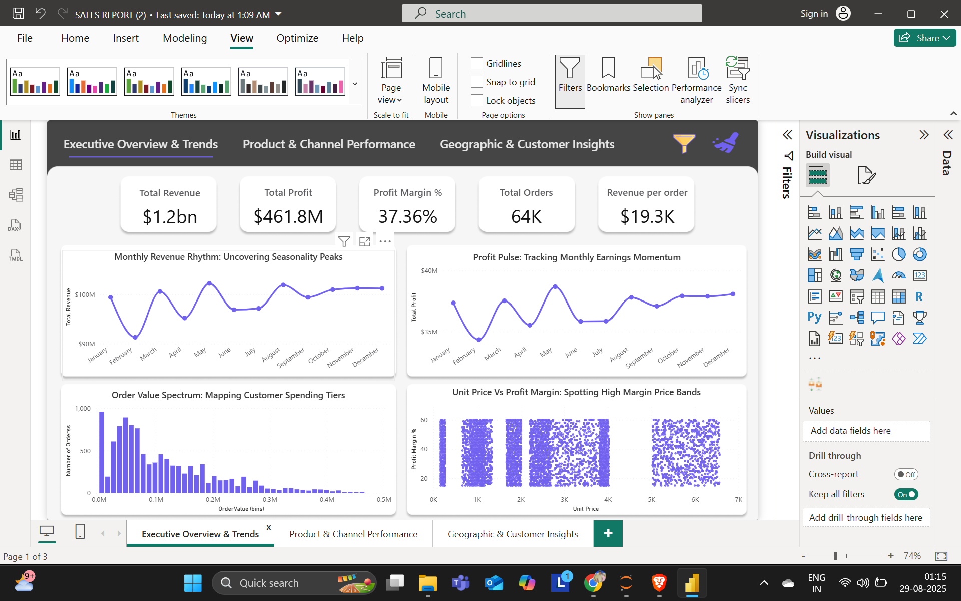
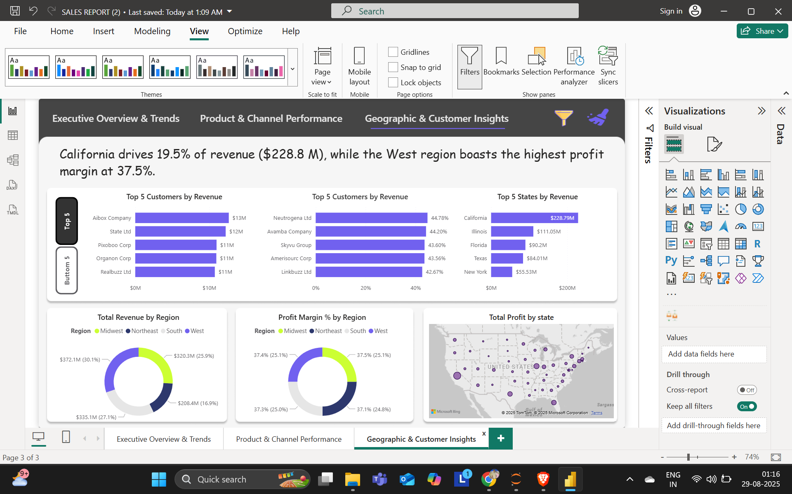
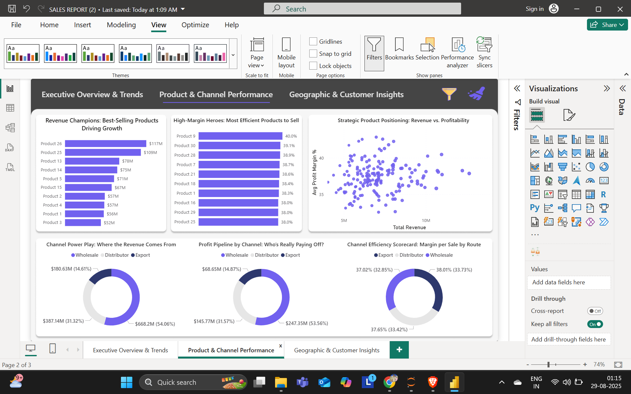
🎯 Sales Performance Dashboard

