Slide 1


Real-Time Skin Cancer Detection: MobileNet-Based Analysis for Accurate Classification
Dyavanapally Sri Anjaneyam
Institute of Aeronautical Engineering
RTET - 2024

Slide 2

Introduction
Skin cancer is widespread, with millions of cases annually, mainly due to UV exposure..
Diagnosing skin cancer is difficult due to similarities between benign and malignant lesions.
Automated tools are crucial for early detection and accurate diagnosis.
Deep learning, especially CNNs, offers potential for improving diagnostic accuracy.
The paper develops a MobileNet-based model for efficient skin cancer classification.
RTET - 2024

Slide 3
Background of the Paper
The paper uses CNNs for classifying skin cancer.
It focuses on classifying seven types of skin lesions.
  Melanoma
  Melanocytic Nevi
  Basal Cell Carcinoma
  Benign Keratosis
Previous models like ResNet and VGGNet face challenges such as overfitting, heavy, needs high computational power.
MobileNet is chosen for its efficiency in real-time applications without compromising performance.
The HAM10000 dataset, containing 10,015 images, is used for training and evaluation.
  Actinic Keratosis
  Vascular Lesions
  Dermatofibroma.
RTET - 2024

Slide 4
Related works
Previous studies on skin cancer detection highlight the effectiveness of deep learning models like ResNet and Inception-V3, though they struggle with overfitting and poor real-world validation. GAN-based methods addressed data limitations but failed to replicate real-world lesion diversity. Ensemble models like DenseNet improved accuracy but lacked generalizability. Lightweight models such as Inception-V2 achieved real-time performance but faced robustness issues. Challenges like noise interference, dataset imbalance, and overfitting remain areas for future improvement.
RTET - 2024

Slide 5
Problem Formulation
Skin cancer diagnosis will be visually challenging due to fine-grained variability, necessitating the need for accurate multiclass classification.
Dermatologists face challenges in accurately diagnosing skin lesions due to their visual similarities.
Existing diagnostic methods lack efficiency, often requiring high computational power and resources.
This paper aims to develop an efficient and accurate skin cancer detection system using MobileNet.
RTET - 2024

Slide 6
Proposed System
Overview:
The system uses a MobileNet-based CNN model for multi-class skin lesion classification
The HAM10000 dataset with 10,015 images is used for training and evaluation.
Employs transfer learning by fine-tuning a pre-trained MobileNet model on skin lesion data.
Designed for lightweight deployment, ensuring compatibility with real-time applications.
RTET - 2024

Slide 7
Proposed System
Methodology:
Preprocessing: Images resized to 224x224 pixels, augmented using rotations, flips, and brightness adjustments.
Model Training: Transfer learning applied on MobileNet with dropout layers to reduce overfitting.
Optimization: Adam optimizer with a learning rate of 0.01 used to enhance performance.
Evaluation Metrics: Precision, recall, F1-score, and accuracy measured for each lesion type.
RTET - 2024

Slide 8
Proposed System
Key Features:
High Classification Accuracy: 89.21% categorical, with top-2 and top-3 accuracies of 96.55% and 98.45%.
Efficient Architecture: MobileNet offers faster inference with reduced computational load.
User-friendly deployment: Real-time web-based interface for uploading images and viewing predictions.
Scalable for clinical use: The model is robust and can handle multiple inputs efficiently.
RTET - 2024

Slide 9
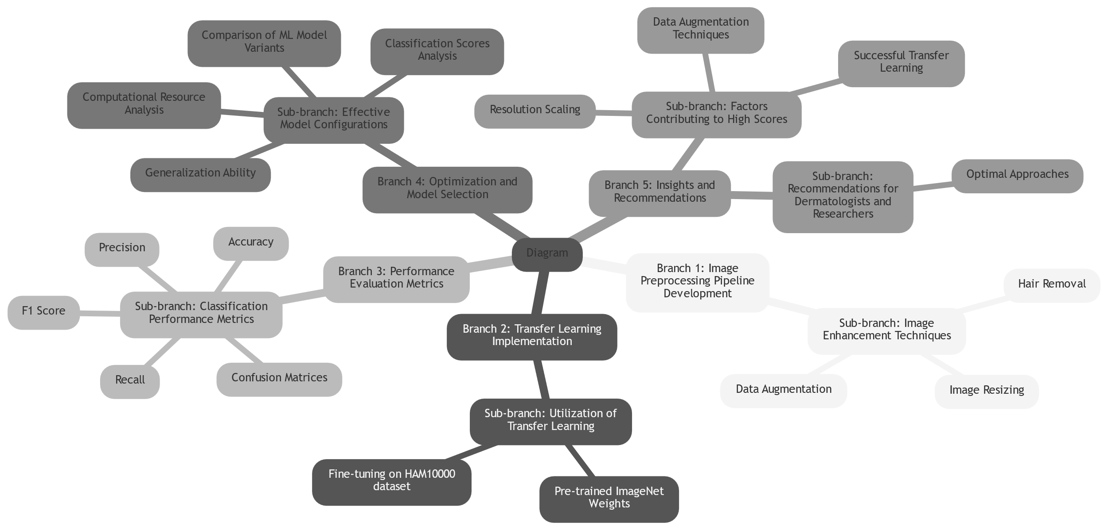
Block Diagram
RTET - 2024

Slide 10
Results
Evaluation Metrics:
Categorical Accuracy: Achieved 89.21% across 7 lesion types.
Top2 and Top3 Accuracies: 96.55% and 98.45%, respectively.
Precision, Recall, F1-Score: Weighted averages of 89% for all three metrics.
Best-Performing Class: Melanocytic Nevi with an F1-score of 96%.
Challenging Classes: Lower performance observed for Melanoma and Benign Keratosis.
RTET - 2024

Slide 11
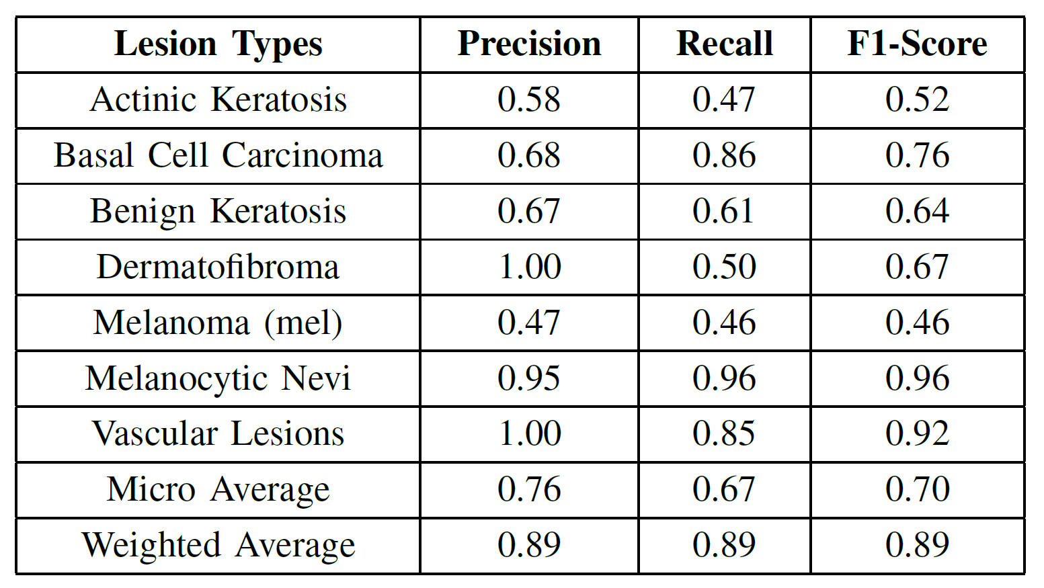
Results
Classification results (Evaluation Process)
RTET - 2024

Slide 12
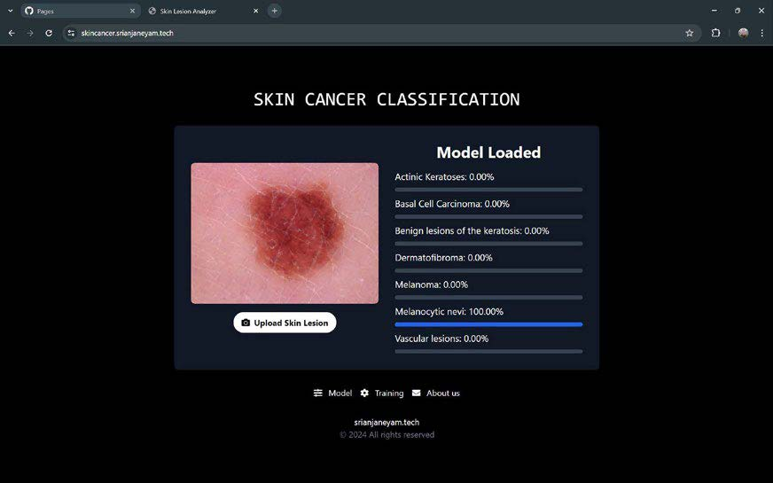
Results
Classification results (Frontend)
RTET - 2024

Slide 13
Results
Deployment:
Real-Time Testing: Successfully handled unseen images with accurate predictions.
User Interface: Displays probabilities for each class with interactive visualizations.
Clinical Applicability: Robust performance in a scalable and resource-efficient setup.
Future Scope: Potential for integrating patient-specific data to improve predictions.
RTET - 2024

Slide 14
Comparison
Confusion Matrix: Demonstrates class-wise prediction accuracy, highlighting areas for improvement in certain lesion types.
Comparison with Previous Studies:
  ResNet-50: 83.6% Accuracy
  Inception-V3: 85.6% Accuracy
  MobileNet (This study): 89.21% Accuracy
Outperforms prior models in efficiency and accuracy for multi-class classification.
RTET - 2024

Slide 15
Conclusions
This paper successfully addresses the challenge of accurate skin cancer diagnosis by leveraging the lightweight and efficient MobileNet architecture. With a categorical accuracy of 89.21% and top-2 and top-3 accuracies of 96.55% and 98.45%, the proposed system outperforms previous models while maintaining computational efficiency. The study demonstrates the potential of CNN-based approaches to support dermatologists in early and accurate detection, paving the way for scalable and real-time clinical applications. Future work could focus on integrating patient-specific data and explainable AI to enhance diagnostic precision and personalized care.
RTET - 2024

Slide 16
Future work
Class Imbalance: Improve accuracy for under-represented and challenging classes like Melanoma and Benign Keratosis.
Real-World Validation: Conduct extensive testing on diverse, real-world clinical datasets to enhance robustness and reliability.
Patient-Specific Data: Incorporate additional features like patient history, genetic predisposition, and risk factors to enhance diagnostic precision.
RTET - 2024

Slide 17
References
Dheiver Francisco Santos, “Advancing Skin Cancer Detection: Harnessing the Power of CNNs”, Research Square, Brazil, 21 March 2024. https://doi.org/10.21203/rs.3.rs-4137983/v1
Manoj Ganthya, “Convolutional Neural Networks in Dermatology: Skin Cancer Detection and Analysis”, Research Square, India, 27 August 2024. https://doi.org/10.21203/rs.3.rs-4833522/v1
Devaraj Verma C, Prajwala R, “Skin Cancer Cell Detection Using Machine Learning and Image Processing”, International Journal of Advanced Medical Sciences and Technology (IJAMST), ISSN: 2582-7596, Pp. 5-9, Volume 5, Issue 1, December 2024.
Hritwik Ghosh, Irfan Sadiq Rahat, “A Study on the Application of Machine Learning and Deep Learning Techniques for Skin Cancer Detection”, World Academy of Science, Engineering and Technology International Journal of Computer and Systems Engineering Vol:18, No:1, 2024
C. Kavitha, S. Priyanka, “Skin Cancer Detection and Classification using Deep Learning Techniques”, International Conference on Machine Learning and Data Engineering (ICMLDE 2023), Pages 2793-2802, Volume 235, 2024
RTET - 2024

