Slide 1

INSTITUTE OF AERONAUTICAL ENGINEERING
Advancing Dermatological Diagnosis with Multiclass Lesion Analysis
Mentor: Dr. M Pala Prasad Reddy, Department of Information Technology
Presented by
D. Sri Anjaneyam - 21951A1291
T. Yashaswini - 21951A12C6
D. Saiteja - 22955A1210

Slide 2
Contents
Abstract
Introduction
Problem Statement
Objectives
Literature Survey
Methodology
Diagrams (Mind Map, Class Diagram, Usecase Diagram, Flow Diagram)
Conclusion

Slide 3
Abstract
Skin cancer is the most common form of cancer globally, ranking as the 17th most prevalent cancer with 2-3 million non-melanoma and 132,000 melanoma cases worldwide. It arises due to the abnormal growth of skin cells, primarily caused by excessive exposure to ultraviolet rays. Early detection and accurate classification of skin lesions are crucial for effective treatment and improved patient outcomes. Given the challenges dermatologists face in accurately diagnosing skin cancer, there is an urgent need for an automated and efficient diagnostic system. This study presents an automated system for classifying skin lesions into seven different types of skin cancer using a Convolutional Neural Network (CNN) model, trained on the HAM10000 dataset, which includes 10,015 dermatoscopic images of various skin lesions. Our approach leverages the MobileNet architecture, renowned for its efficiency and effectiveness in image classification tasks. The MobileNet model, pre-trained on the extensive ImageNet dataset, is fine-tuned on the HAM10000 dataset to specialize in skin lesion classification by employing transfer learning. The model achieved an overall accuracy of 89.21% across the seven skin cancer classes, with top-2 and top-3 accuracies of 96.55% and 98.45%, respectively. The trained model demonstrated promising results, underscoring its potential as a reliable tool for assisting dermatologists in the early detection of skin cancer.
Keywords: Skin Cancer, CNN, MobileNet, HAM10000, Lesion Classification, ImageNet.

Slide 4
Introduction
Skin cancer is one of the most common cancers worldwide, with millions of new cases each year.
Ultraviolet (UV) radiation from the sun is a major risk factor, causing DNA damage in skin cells and leading to cancerous mutations.
Early detection and treatment of skin cancer, especially melanoma, are crucial for better prognosis.
The visual similarity between benign and malignant skin lesions makes accurate diagnosis challenging, even for experienced dermatologists.
Advances in artificial intelligence (AI) and deep learning offer new ways to improve skin cancer diagnosis.

Slide 5
Introduction
Convolutional Neural Networks (CNNs) are effective in image recognition tasks, making them suitable for medical image analysis.
MobileNet, a lightweight CNN architecture, is efficient and performs well on mobile and embedded devices, optimizing for both speed and accuracy.
MobileNet is pretrained on the ImageNet dataset and fine-tuned on the HAM10000 dataset, leveraging transfer learning to differentiate skin lesions accurately.
Early and accurate detection with MobileNet improves patient outcomes by reducing misdiagnosis and enabling timely treatment, lowering melanoma mortality rates.
Integrating MobileNet into clinical practice supports dermatologists in making better-informed decisions and enhances the accessibility and practicality of advanced diagnostic tools, improving overall skin cancer treatment effectiveness.

Slide 6
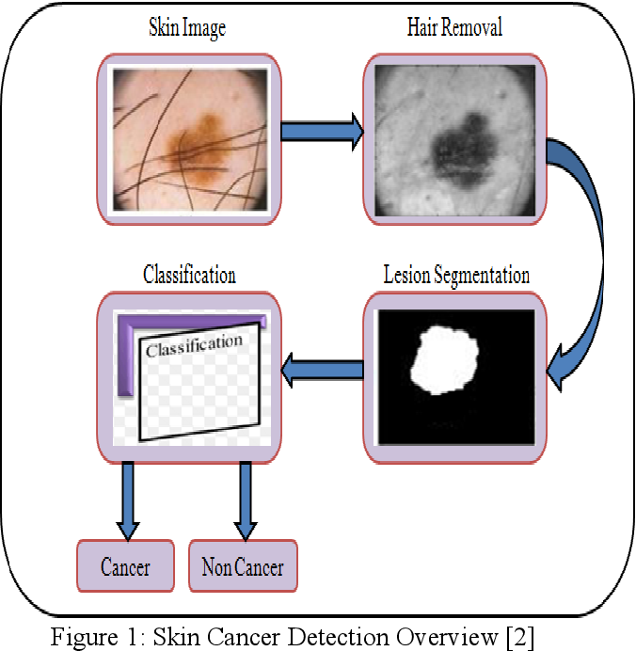
Problem Statement
Skin cancer diagnosis will be visually challenging due to fine-grained variability, necessitating the need for accurate multiclass classification.
An image preprocessing pipeline will be developed, and MobileNet model will be fine-tuned using transfer learning on the HAM10000 dataset.
The goal will be to improve classification accuracy using metrics like Precision, Recall, Accuracy, and F1 Score, with a focus on evaluating the impact of transfer learning and model complexity.

Slide 7
Objectives:
Objectives
Image Preprocessing Pipeline Development:
Develop a comprehensive preprocessing pipeline to enhance the quality of skin lesion images.
Include techniques such as hair removal, data augmentation, and resizing to ensure standardized input for the models.
Transfer Learning Implementation:
Utilize transfer learning by initializing MobileNet model with pre-trained weights from the ImageNet dataset.
Fine-tune the models on the HAM10000 dataset to adapt to the specific characteristics of seven classes of skin lesion classification.
Performance Evaluation Metrics:
Evaluate the classification performance using a range of metrics, including Precision, Recall, Accuracy, F1 Score, and Confusion Matrices.
Analyze the impact of MobileNet trained model on these metrics to understand trade-offs between accuracy and computational efficiency.

Slide 8
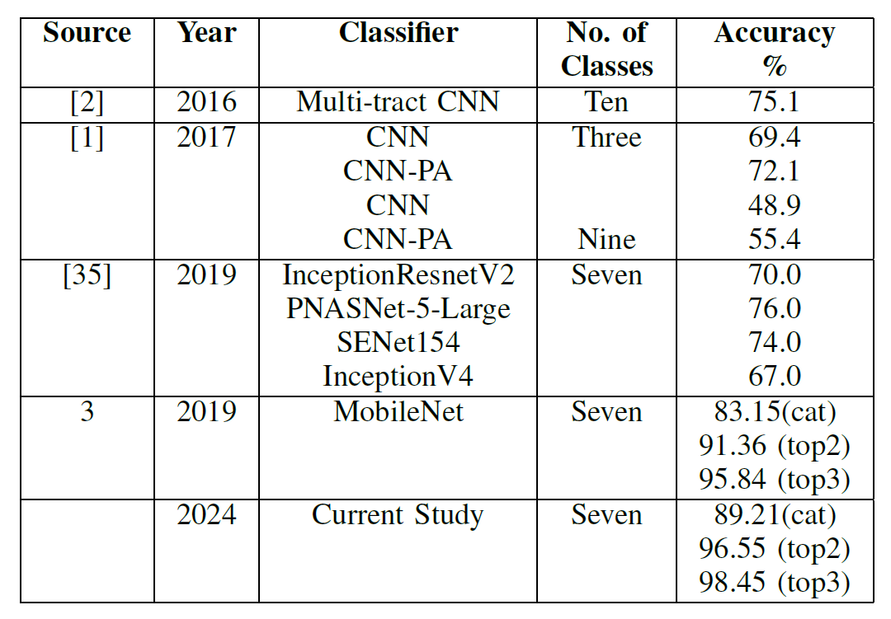
Objectives
Comparison with Previous works:
Identify the works done by various researchers on the topic and compare the performance of model and metrics such as accuracy, precision, recall with our trained model.
Some of the previous works with their model, classes, accuracy are listed in the table below.
Insights and Recommendations:
Provide insights into the factors contributing to high classification scores, such as resolution scaling, data augmentation techniques, and successful transfer learning.
Make recommendations for dermatologists and researchers based on the findings, highlighting optimal approaches for accurate and efficient skin cancer diagnosis.

Slide 9
Literature Survey:
Literature Survey
S.NO | Title of the paper | Authors & Published Year | Remarks
1. | Radiation: ultraviolet (UV) radiation and skin cancer – how common is skin cancer | World Health Organization, 2021 | This paper proposes different types of skin cancer, classification of skin cancer, consequences and risk factors of skin cancer.
2. | Digitization of handwritten Devanagari text using CNN transfer learning – A better customer service support | S.D. Pande, P.P. Jadhav, R. Joshi, A.D. Sawant, V. Muddebihalkar, S. Rathod, S. Das 2021 | In this paper, Automating the digitization of Devanagari script using Convolutional Neural Networks (CNN) for effective recognition and conflict resolution, enhancing access and manipulation of ancient Vedic literature.
3. | Malignant Melanoma Metastatic to the Central Nervous System | M.R. Lekkala and S. Mullangi, 2021 | This paper tells about a serious form of skin cancer called Malignant melanoma.

Slide 10
Literature Survey:
Literature Survey
S.NO | Title of the paper | Authors & Published Year | Remarks
4. | Melanoma brain metastases presenting as delirium: a case report | J.C. Benson, V.T. Lehman, C.M. Carr, J.T. Wald, H.J. Cloft, G. Lanzino, W. Brin-jikji, 2021 | A pictorial review aids in distinguishing non-atherosclerotic pathologies of the common carotid artery (CCA) and extracranial internal carotid artery (ICA) to prevent misdiagnosis and confusion..
5. | Classification of optimal brain tissue using dynamic region growing and fuzzy min-max neural network in brain magnetic resonance images | Sunil L. Bangare, 2021 | Automating brain MRI segmentation with fuzzy min-max neural networks and dynamic region growing for accurate tissue classification and tumor detection.
6. | Brain volumes quantification from MRI in healthy controls. | H. Chaves, F. Dorr, M.E. Costa, M.M. Serra, D.E Slezak, M.F. Farez, C. cejas, 2021 | A convolutional neural network (CNN)-based software, Entelai Pic, demonstrated robust brain volume estimation comparable to traditional softwares.

Slide 11
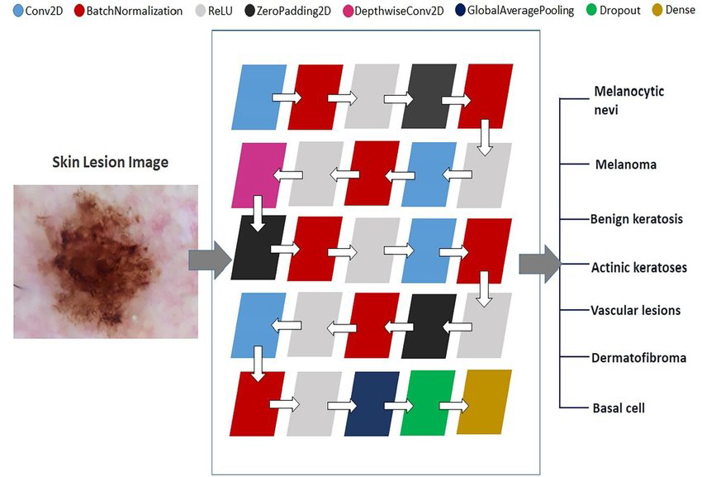
Methodology
The dataset comprising 10,015 dermoscopic images was pre-processed using Keras ImageDataGenerator. Images were downscaled from 600x450 pixels to 224x224 pixels for compatibility with the MobileNet model. The dataset was split into a training set (8,912 images) and a validation set (1,103 images), ensuring no duplication in the validation set to maintain authenticity.
MobileNet Layers

Slide 12
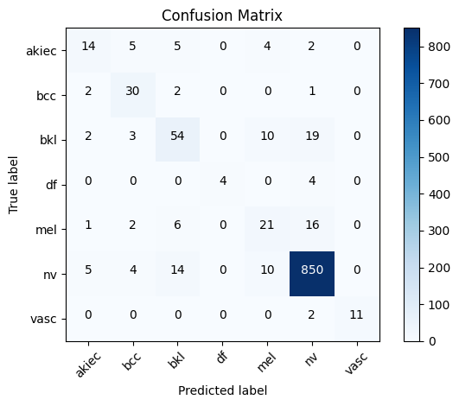
Methodology
Data augmentation techniques, including random rotations, flips, zoom transformations, and brightness/contrast adjustments, were applied to the training data to increase diversity and prevent overfitting. The MobileNet model, pre-trained on the ImageNet dataset, was fine-tuned for classifying skin lesions. The top layers of MobileNet were replaced with a Global Average Pooling layer, a Dropout layer (rate of 0.25), and a Dense layer with 7 units for the seven skin cancer classes, using a softmax activation function.
The model was compiled with the Adam optimizer (learning rate of 0.01) and the categorical cross-entropy loss function. Metrics such as categorical accuracy, top-2 accuracy, and top-3 accuracy were monitored. Training was conducted over 100 epochs with early stopping and model checkpointing based on validation accuracy to save the best model weights.

Slide 13
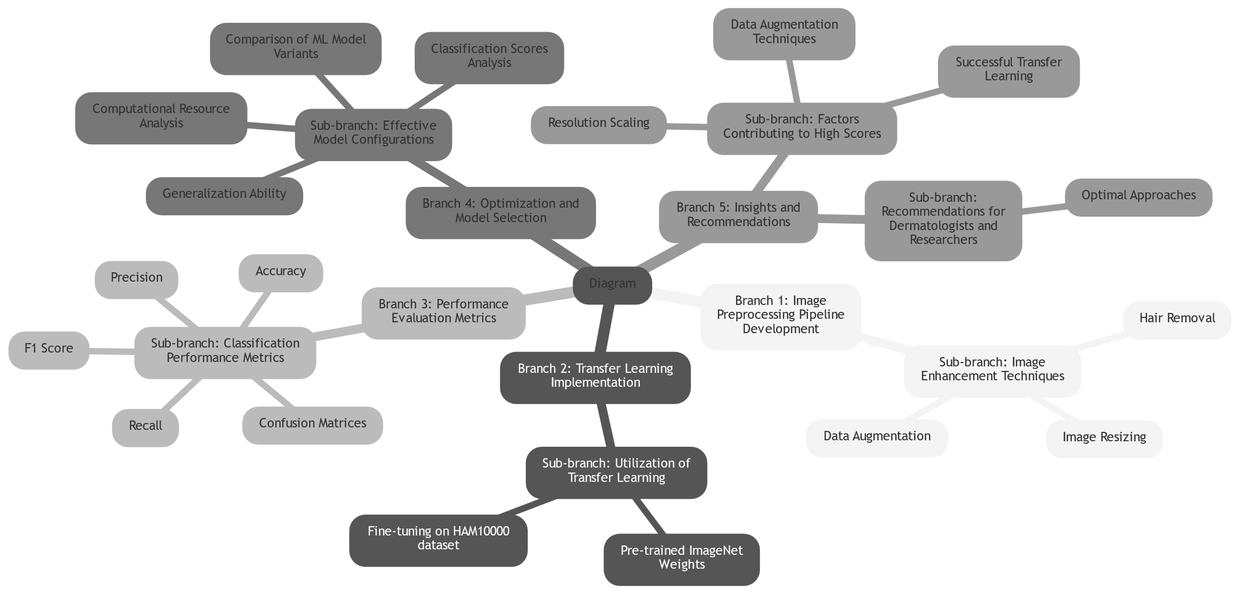
Mind Map

Slide 14
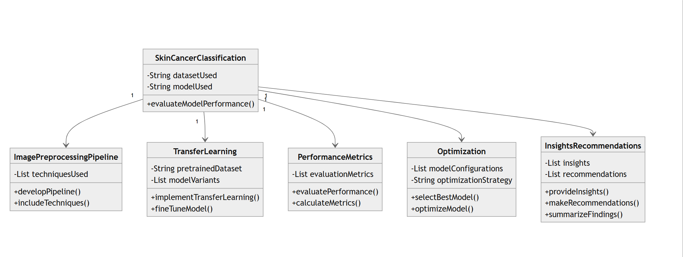
Class Diagram

Slide 15
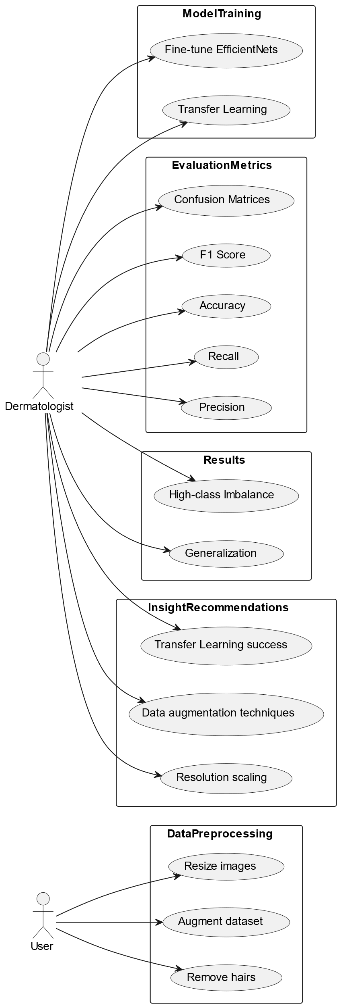
Use Case Diagram

Slide 16
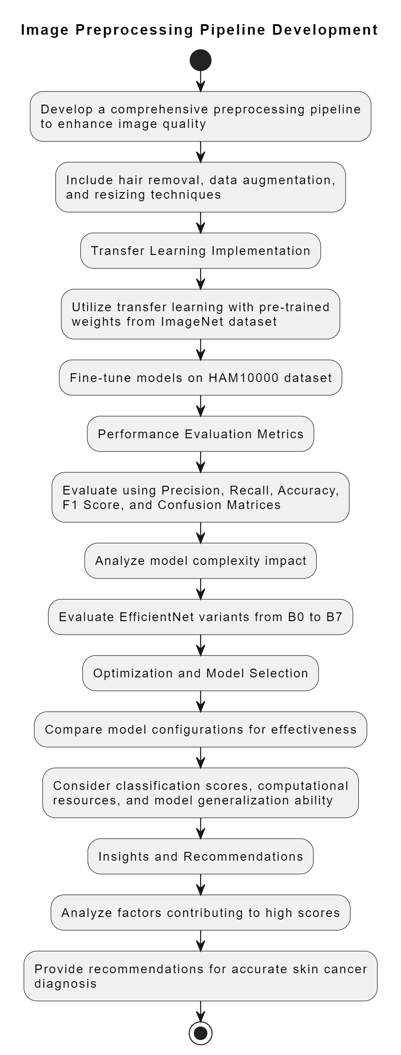
Flow Diagram

Slide 17
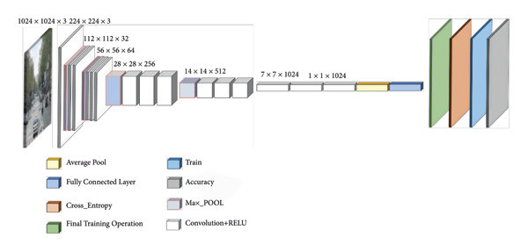
MobileNet Architecture

Slide 18
Conclusion
In this project, we developed an automated system for skin lesion classification using a Convolutional Neural Net work (CNN) model based on the MobileNet architecture. By leveraging the HAM10000 dataset, which comprises 10,015 dermoscopic images, our model demonstrated high accuracy in differentiating between seven types of skin cancer. The MobileNet model, pre-trained on the ImageNet dataset and fine-tuned on our specific task, achieved a categorical accuracy of 89.21%, top-2 accuracy of 96.55%, and top-3 accuracy of 98.45%. These results outperform previous studies, highlighting the effectiveness of our approach in early and accurate skin cancer detection. The confusion matrix analysis showed that Melanocytic Nevi were most accurately identified, while there were challenges in distinguishing Benign Keratosis. Overall, this study underscores the potential of using lightweight CNN architectures like MobileNet for real-time and efficient skin cancer diagnosis, providing significant support to dermatologists in clinical settings.

Slide 19
THANK YOU!

