Slide 1

Chapter 5
Analog Transmission
5.<number>
Copyright © The McGraw-Hill Companies, Inc. Permission required for reproduction or display.

Slide 2
5-1 DIGITAL-TO-ANALOG CONVERSION
Digital-to-analog conversion is the process of changing one of the characteristics of an analog signal based on the information in digital data.
Topics discussed in this section:
Aspects of Digital-to-Analog Conversion
Amplitude Shift Keying
Frequency Shift Keying
Phase Shift Keying
Quadrature Amplitude Modulation
5.<number>

Slide 3

Figure 5.1 Digital-to-analog conversion
5.<number>

Slide 4

Note
Bit rate is the number of bits per second. Baud rate is the number of signal
elements per second.
In the analog transmission of digital data, the baud rate is less than
or equal to the bit rate.
5.<number>

Slide 5
Example 5.1
An analog signal carries 4 bits per signal element. If 1000 signal elements are sent per second, find the bit rate.
Solution
In this case, r = 4, S = 1000, and N is unknown. We can find the value of N from
5.<number>

Slide 6

Figure 5.3 Binary amplitude shift keying
5.<number>

Slide 7

Figure 5.6 Binary frequency shift keying
5.<number>

Slide 8
Example 5.5
We have an available bandwidth of 100 kHz which spans from 200 to 300 kHz. What should be the carrier frequency and the bit rate if we modulated our data by using FSK with d = 1?
Solution
This problem is similar to Example 5.3, but we are modulating by using FSK. The midpoint of the band is at 250 kHz. We choose 2Δf to be 50 kHz; this means
5.<number>

Slide 9

Figure 5.9 Binary phase shift keying
5.<number>

Slide 10
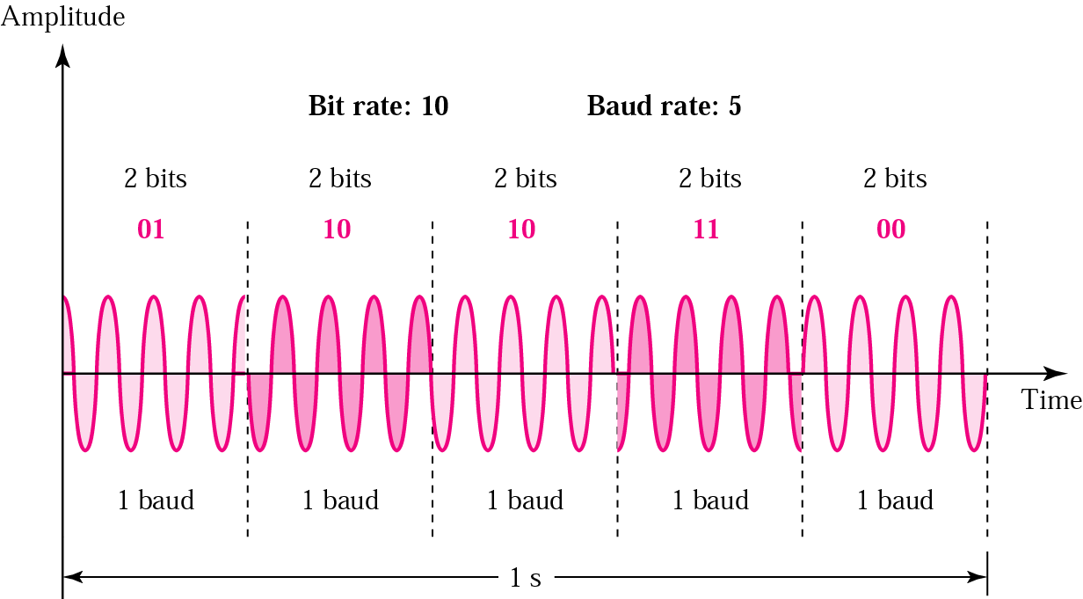
The 4-PSK method

Slide 11
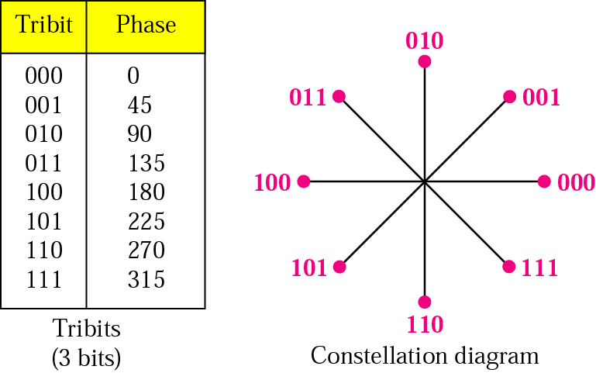
The 8-PSK characteristics

Slide 12

Figure 5.12 Concept of a constellation diagram
5.<number>

Slide 13
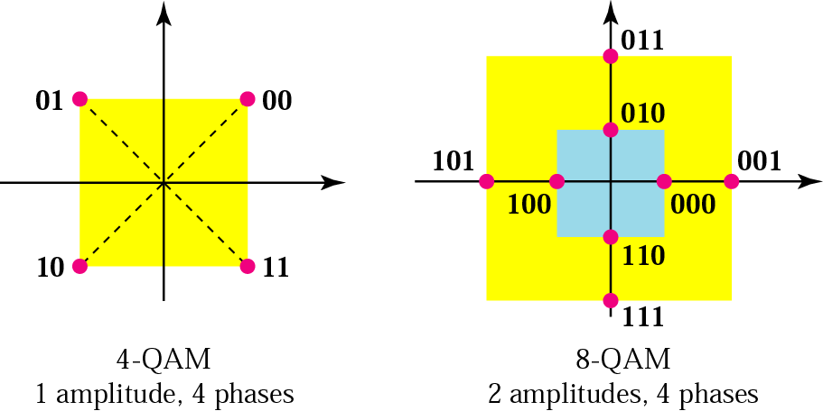
The 4-QAM and 8-QAM constellations

Slide 14
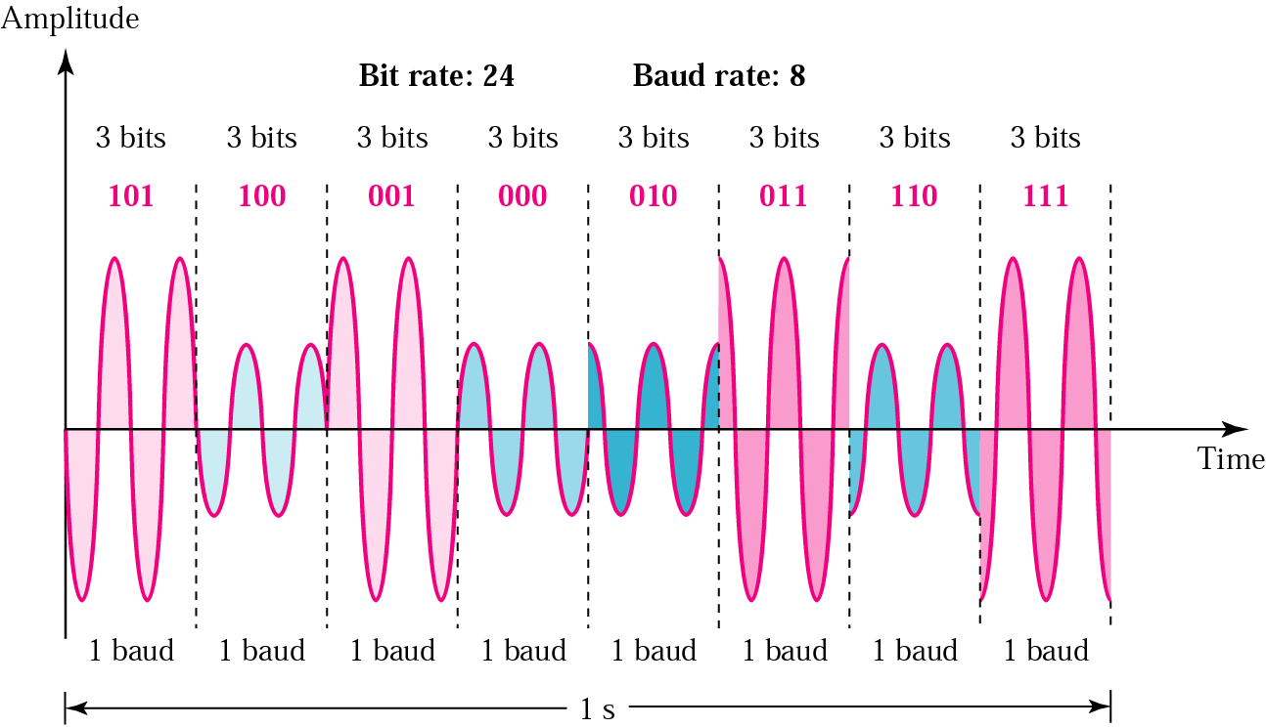
Time domain for an 8-QAM signal

Slide 15
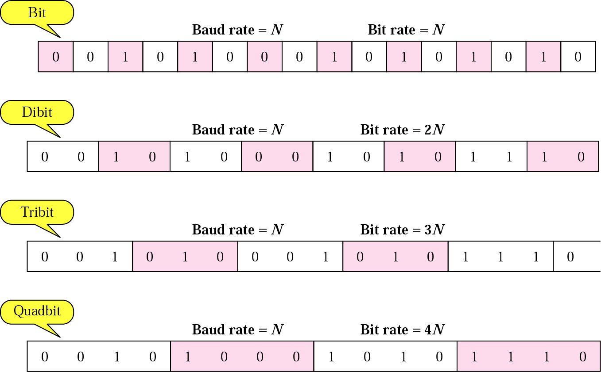
Bit and baud

Slide 16
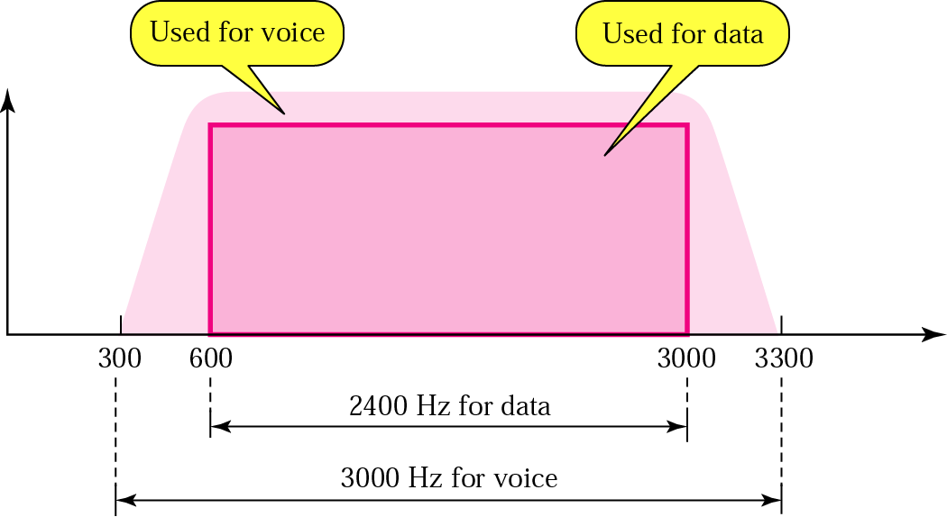
Telephone line bandwidth

Slide 17
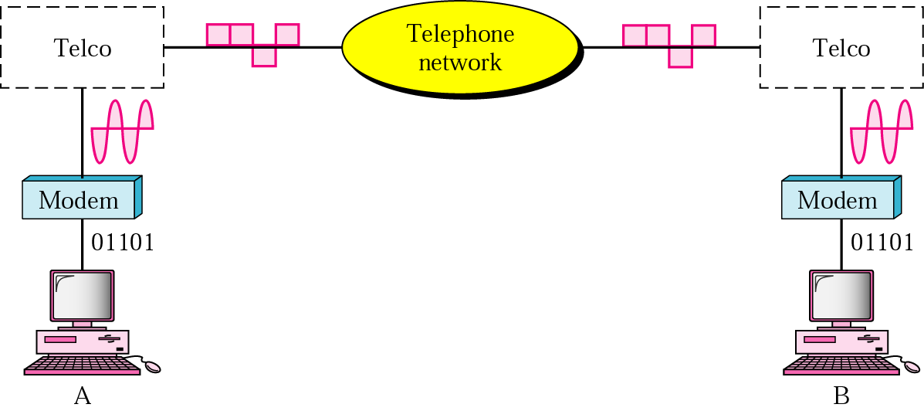
Modulation/demodulation

Slide 18
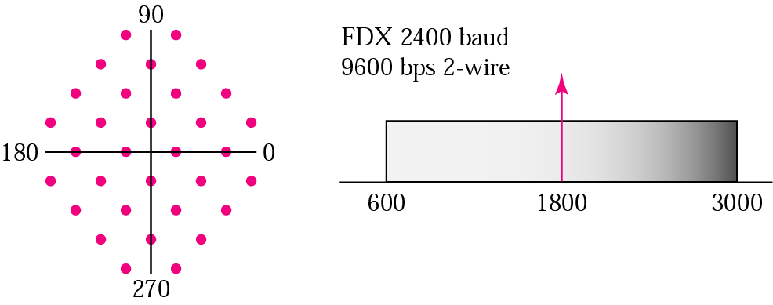
Modem Standards
V.32
  Trellis-coded modulation
  Calls for 32-QAM with a baud rate of 2400
  4-bits (data) per baud resulting in 4*2400=9600bps

Slide 19
V.32 bis
  Support 14,400 bps (2400*6)
  Uses 128-QAM transmission: 7 bits/baud with 1 bit for error control
V.34bis
  Provides a bit rate of 28,800 with 960 point constellation
  33,600 with 1664 point constellation
V.90
  Traditional modem have limitation on data rate (maximum 33.6 Kbps)
  V.90 with a data rate of 56,000bps called 56k modems
  Telephone companies sample 8000 times per second with 8 bits per sample.
V.92

Slide 20
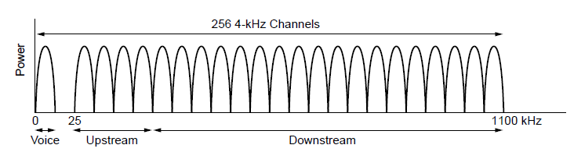
Digital Subscriber Lines (2)
Operation of ADSL using discrete
multitone modulation.
224 downstream channels
Within each channel, a modulation scheme similar to V.34 is used.

Slide 21
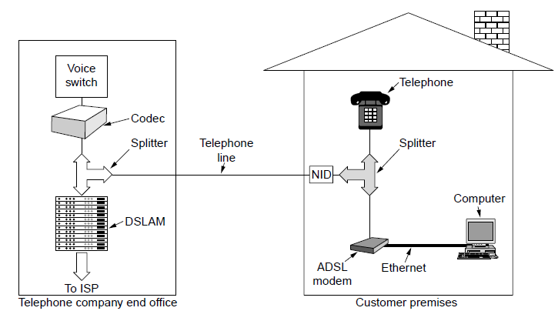
Digital Subscriber Lines (3)
A typical ADSL modem is actually up to act as 250 QAM modems operating in parallel at different frequencies.

Slide 22
5-2 ANALOG AND DIGITAL
Analog-to-analog conversion is the representation of analog information by an analog signal. One may ask why we need to modulate an analog signal; it is already analog. Modulation is needed if the medium is bandpass in nature or if only a bandpass channel is available to us.
Topics discussed in this section:
Amplitude Modulation
Frequency Modulation
Phase Modulation
5.<number>

Slide 23


Figure 5.17 AM band allocation
5.<number>

Slide 24


Figure 5.19 FM band allocation
5.<number>

Slide 25
Figure 5.20 Phase modulation
5.<number>

