Slide 1


Introduction and Networking Fundamental
Lecture No. 1

Slide 2
Data networks
Businesses needed a solution that would successfully address the following three problems:
  How to avoid duplication of equipment and resources
  How to communicate efficiently
  How to set up and manage a network

Slide 3
Network history
In the 1980s users with stand-alone computers started to share files using modems to connect to other computers. This was referred to as point-to-point, or dial-up communication
Bulletin boards became the central point of communication in a dial-up connection. Drawbacks to this type of system were:
  That there was very little direct communication
  Availability was limited to only with those who knew about the location of the bulletin board
  Required one modem per connection. If five people connected simultaneously it would require five modems connected to five separate phone lines
From the 1960s-1990s, the DoD developed large, reliable, WANs for military and scientific reasons.
In 1990, the DoDs WAN eventually became the Internet

Slide 4
In Our Highway Analogy...
What is flowing?
  Traffic
What different forms flow?
  Cars, Trucks, Buses, etc.
What rules govern flow?
  Traffic Laws & Rules of Courtesy
Where does the flow occur?
  Streets

Slide 5
In Computer Networks...
What is flowing?
  Data
What different forms flow?
  Text, Video, Audio
What rules govern flow?
  Standards & Protocols
Where does the flow occur?
  Wires, Fiber, Atmosphere

Slide 6
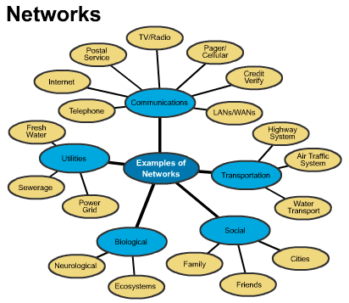

Slide 7
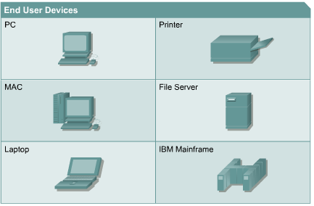
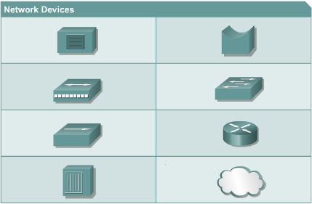
Networking Terminology
End-user devices provide users with a connection to the network.
Also referred to as hosts.
Allow users to share, create, and obtain information.
Network devices provide transport for data between end-user devices.
Provide cable connections, extensions, concentration. Conversion of data formats, and management of data transfers

Slide 8
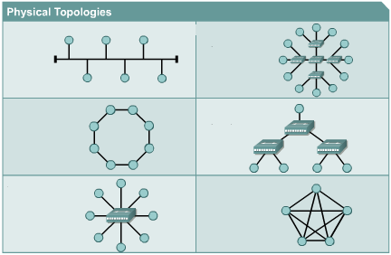
Physical Topologies
Physical topology is the actual layout of the wire or media

Slide 9
Logical Topology
Logical topology defines how media is accessed by hosts
Broadcast means that each host sends its data to all other hosts on the network medium.
Non-deterministic - there is no order that the stations must follow to use the network. First come, first served.
Example:
Ethernet
Token Passing controls network access by passing an electronic token sequentially to each host.
When a host receives the token, that host can send data on the network.
If the host has no data to send, it passes the token to the next host and the process repeats itself.
Examples:
Token Ring, FDDI

Slide 10
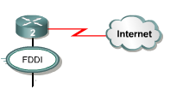
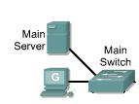

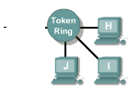
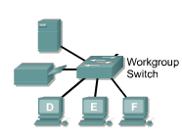
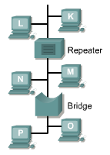


Slide 11
Network protocols
Protocol suites are collections of protocols that enable network communication from one host through the network to another host.
Protocols control all aspects of data communication such as:
  How the physical network is built
  How computers connect to the network
  How the data is formatted for transmission
  How that data is sent
  How to deal with errors

Slide 12
LAN
MAN
WAN
SAN
VPN
Operate within limited geographical area
Allow multi-access to high bandwidth media
Control network privately under local administration
Provide full-time connectivity to local services
Connect physically adjacent devices
Spans a metropolitan area such as a city or suburban area
Usually consists of LANs in a common geographic area
Example: a bank with multiple branches may utilize a MAN
Operate over a large geographical area
Allow access over serial interfaces operating at lower speeds
Provide full-time and part-time connectivity
Connect devices separated over wide areas
High-performance network to move data to/from storage areas
Separate, dedicated network avoids traffic conflict
Private network constructed within public network such as Internet
Access VPNs, Intranet VPNs, Extranet VPNs

Slide 13
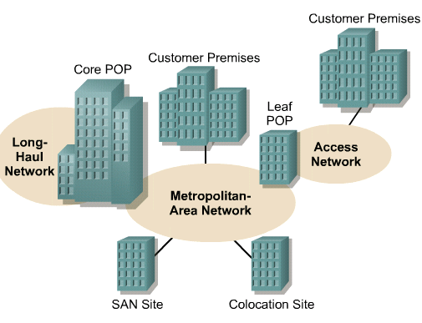
Metropolitan-area networks (MANs)
A MAN is a network that spans a metropolitan area such as a city or suburban area.
Usually consists of 2 or more LANs in a common geographic area.
Ex: a bank with multiple branches may utilize a MAN.
Typically, a service provider is used to connect two or more LAN sites using private communication lines or optical services.

Slide 14
Storage-area networks (SANs)
A SAN is a dedicated, high-performance network used to move data between servers and storage resources.
Separate, dedicated network, that avoids any traffic conflict between clients and servers
SANs offer the following features:
  Performance – allows concurrent access of disk or tape arrays by two or more servers at high speeds
  Availability – have disaster tolerance built in, because data can be mirrored using a SAN up to 10km or 6.2 miles away.
  Scalability – Like a LAN/WAN, it can use a variety of technologies. This allows easy relocation of backup data, operations, file migration, and data replication between systems.

Slide 15
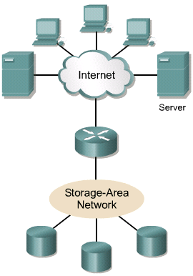
SAN

Slide 16
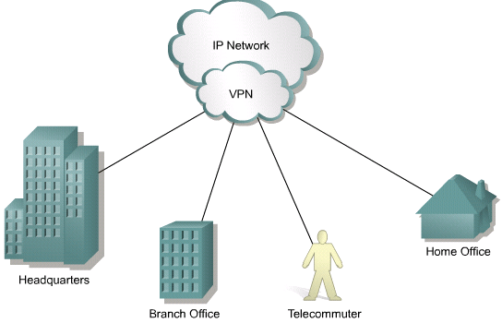
Virtual private network (VPN)
A VPN is a private network that is constructed within a public network such as the Internet.
It offers secure, reliable connectivity over a shared public network infrastructure such as the Internet.

Slide 17
Benefits of VPNs
Three main types of VPNs:
  Access VPNs – provide remote access to a mobile worker and a SOHO to the hq of the Intranet or Extranet over a shared infrastructure. Access VPNs use analog, dialup, ISDN, DSL, cable technologies
  Intranet VPNs – link regional and remote offices to the hq of the internal network over a shared infrastructure using dedicated connections. They allow access only to the employees of the enterprise.
  Extranet VPNs – link business partners to the hq of the network over a shared infrastructure using dedicated connections. They allow access to users outside the enterprise

Slide 18
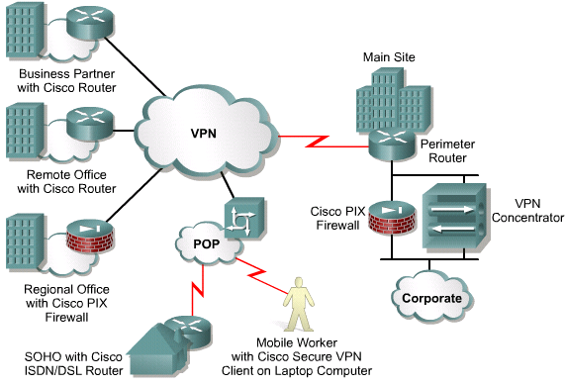
VPNs

Slide 19


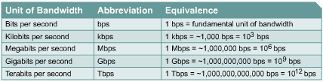
Bandwidth
Bandwidth is limited by physics and technology
Bandwidth is not free
Bandwidth requirements are growing at a rapid rate
Bandwidth is critical to network performance

Slide 20


Throughput
Throughput refers to actual measured bandwidth, at a specific time of day, using specific Internet routes, and while a specific set of data is transmitted on the network.
Often far less than the maximum possible digital bandwidth.
Factors that determine throughput:
      Internetworking devices
      Type of data being transferred
      Network topology
      Number of users on the network
      User computer
      Server computer
      Power conditions
T = Time S = Size
BW = Bandwidth
P = Throughput

Slide 21
Using layers to analyze problems in a flow of materials
The concept of layers is used to describe communication from one computer to another
The information that travels on a network is generally referred to as data or a packet
A packet is a logically grouped unit of information that moves between computer systems.
As the data passes between layers, each layer adds additional information that enables effective communication with the corresponding layer on the other computer.

Slide 22
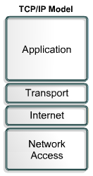
Networking Models
The historical and technical standard of the Internet is the TCP/IP model
The U.S. Department of Defence created the TCP/IP reference model, to design a network that could survive any conditions, including a nuclear war
Application layer handles issues of representation, encoding, and dialog control.
Transport layer deals with the quality of service issues of reliability, flow control, and error correction
Internet layer is to divide TCP segments into packets and send them from any network. Best path determination and packet switching occur at this layer
Network Access layer (aka host-to-network layer) concerned with all components, both physical and logical, that are required to make a physical link

Slide 23
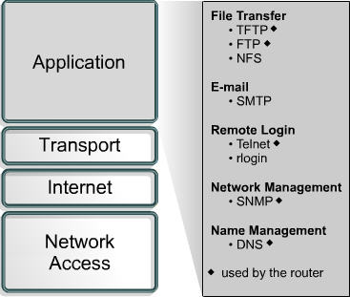
Application layer

Slide 24
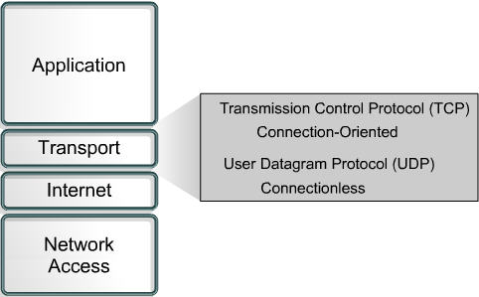
Transport layer
TCP and UDP
Segmenting upper-layer application data
Sending segments from one end device to another end device
TCP only
Establishing end-to-end operations
Flow control provided by sliding windows
Reliability provided by sequence numbers and acknowledgme

Slide 25
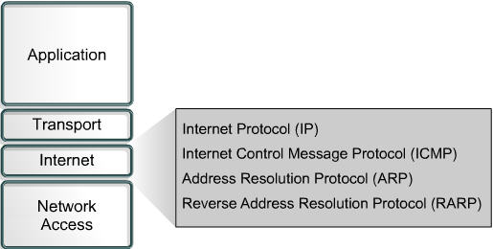
Internet layer
The purpose of the Internet layer is to select the best path through the network for packets to travel
IP provides connectionless, best-effort delivery routing of packets.
Internet Control Message Protocol (ICMP) provides control and messaging capabilities.
ARP resolves MAC address, for known IP addresses.
Reverse Address Resolution Protocol (RARP) determines IP addresses when the MAC address is known

Slide 26
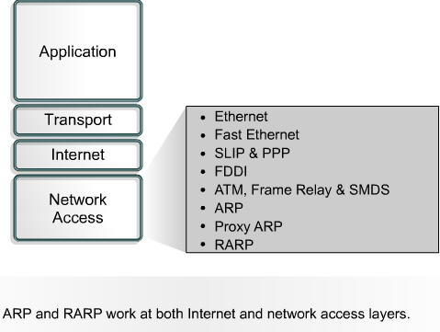
Network access layer
The network access layer defines the procedures for interfacing with the network hardware and accessing the transmission medium.
Drivers for software applications, modem cards and other devices operate at the network access layer

Slide 27
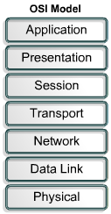
OSI Model
Reduces complexity
Standardizes interfaces
Facilitates modular engineering
Ensures interoperable technology
Accelerates evolution
Simplifies teaching and learning
The OSI reference model was released in 1984 to help network builders implement networks that could communicate (interoperability)
The OSI reference model is the primary model for network communications
The process of moving information between computers is divided into seven smaller and more manageable steps

Slide 28

Source
Destination
DATA
Application
Application
Presentation
Presentation
DECAPSULATION
Session
ENCAPSULATION
Session
SEGMENT
Transport
Transport
PACKET
Network
Network
FRAME
Data-Link
Data-Link
BITS
Physical
0101010101010101010
Physical

Slide 29
OSI Top 3 Layers – Application issues
Application
  provides network services to the user's applications
  file, print, message, database and application services
  HTTP, SMTP, FTP
Presentation
  responsible for manipulating data’s appearance as needed by the Application layer
  Data encryption, compression and translation services
  JPEG, MIDI, QuickTime, EBCDIC to ASCII
Session
  establish and maintain communication between two hosts
  Dialogue control
  NFS, SQL, RPC
NESCOT CATC

Slide 30
OSI Lower 4 Layers – Data Transport issues
Transport
  PDU – Segment
  the transport layer establishes, maintains, and tears down virtual circuits
  Windowing
  TCP and UDP
Network
  PDU - Packet
  Routing
  Data packets and route update packets
  connectivity and path selection between two hosts
Data-Link
  PDU - Frame
  physical addressing, network topology, network access, error notification, ordered delivery of frames, and flow control
  Ethernet LCC and MAC layers
Physical
  PDU – bits
  Cabling, standards

Slide 31
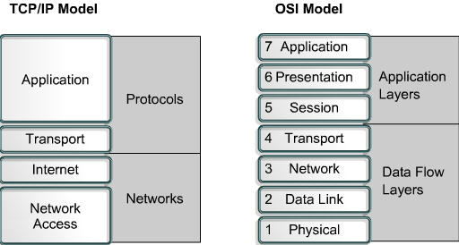
TCP/IP Vs OSI
Similarities of the OSI and TCP/IP models:
Both have layers
Both have application layers, though they include very different services
Both have comparable transport and network layers
Packet-switched, not circuit-switched, technology is assumed
Networking professionals need to know both models

Slide 32
Differences of the OSI and TCP/IP models:
TCP/IP combines the presentation and session layer into its application layer
TCP/IP combines the OSI data link and physical layers into one layer
TCP/IP appears simpler because it has fewer layers
TCP/IP transport layer using UDP does not always guarantee reliable delivery of packets as the transport layer in the OSI model does

Slide 33
Connecting Devices
Networking Devices
Internetworking
Devices
Repeaters
Bridges
Routers
Gateways

Slide 34
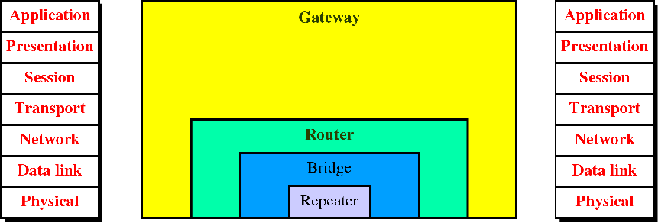
Connecting Devices
Hub

Slide 35
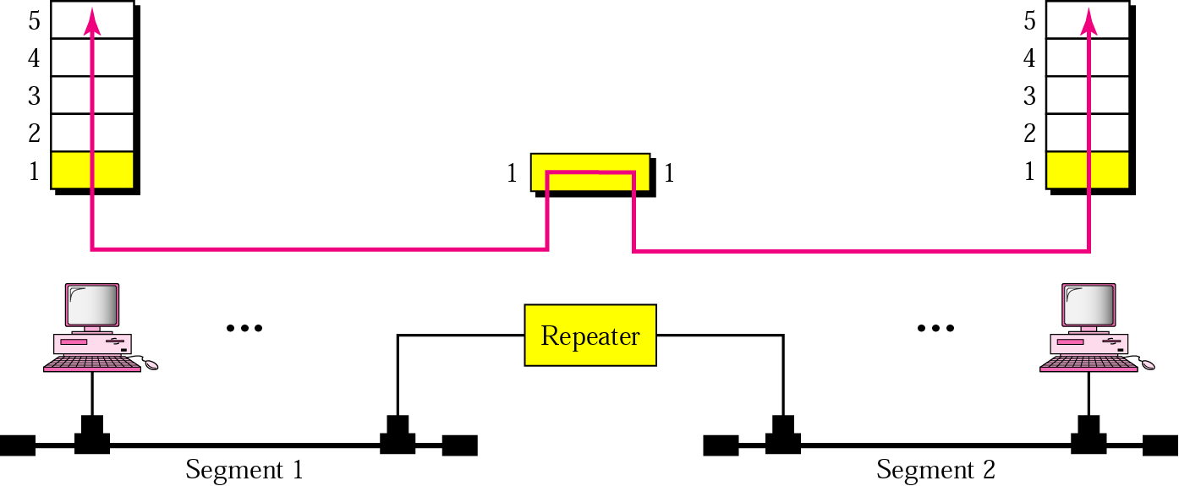
Repeater
Extend the physical length
No network function has been changed
Location is matter

Slide 36
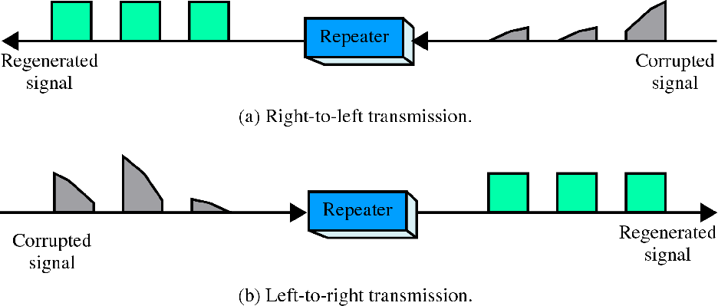
Function of repeater
Repeater is not exactly as same as Amplifier

Slide 37
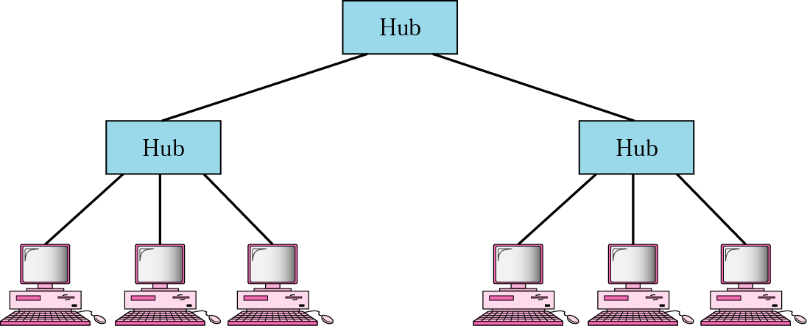
Hub
Actually is a multiport repeater
Star / Tree Topology

Slide 38
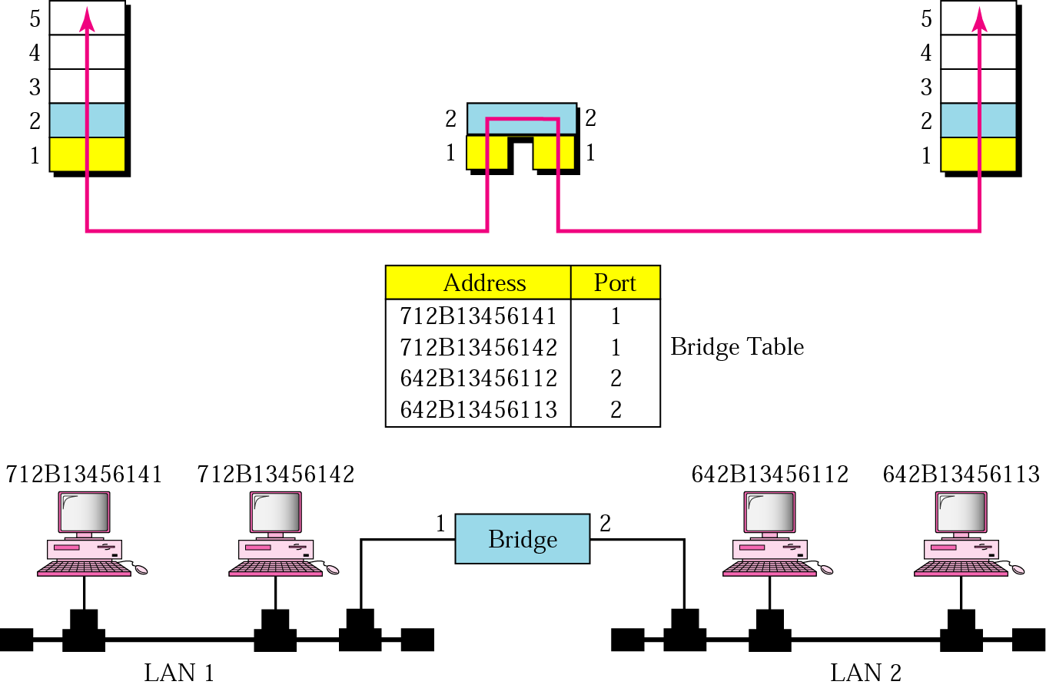
Bridge

Slide 39
Bridge
Divide a large network into smaller segment
Isolating and controlling the link problems (e.g. congestion)
Regenerate signal + Checking Physical Address and forward only to the specified segment

Slide 40
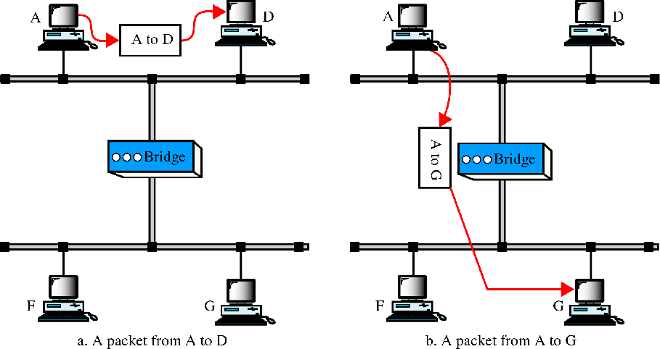
Function of a bridge

Slide 41
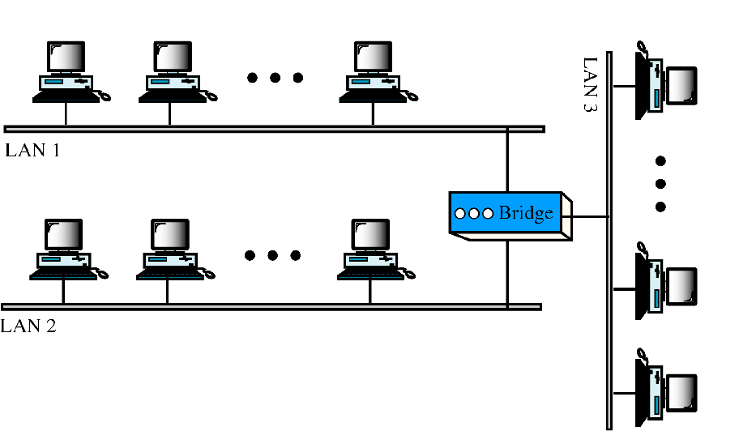
Multiport bridge

Slide 42
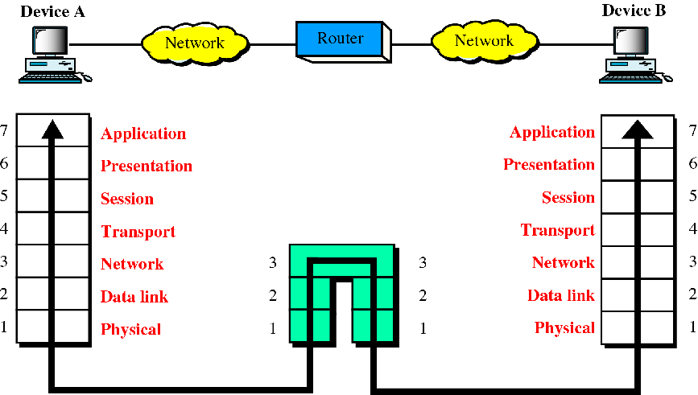
Routers

Slide 43
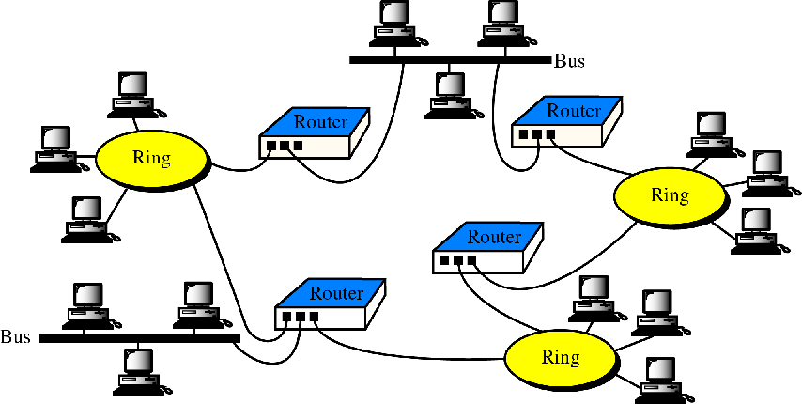
Routers in an internet

Slide 44
Routers
Act like stations on a network
Multi-home
Definition (Goal)
  “Learning how to get from here to there."
  “Process of discovering, selecting, and employing paths from one place to another (or to many others) in a network” [from David M. Piscitello, Bellcore and A. Lyman Chapin, BBN]

Slide 45
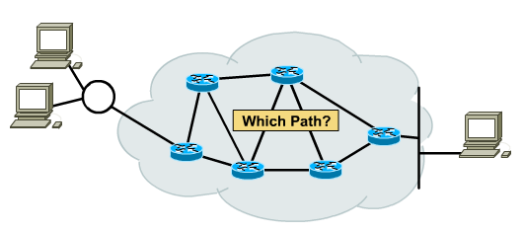
Routing Principle
Goal: Arriving at the destination
Considerations:
  Direct route (shortest)
  Reliable route
  Cheap route
  Safe route
  Scenic route ☺

Slide 46
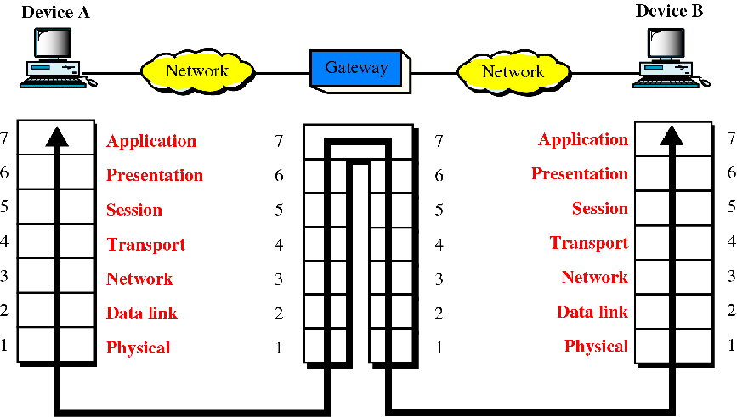
Gateways (protocol converter)

Slide 47
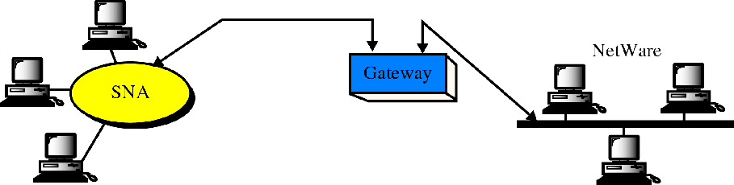
A gateway
SNA network (IBM)
Netware network (Novell)

Slide 48
Connecting Devices
Networking Devices
Internetworking
Devices
Repeaters
Bridges
Routers
Gateways

Slide 49
Other devices
Multiprotocol routers
Brouters
Switches

Slide 50
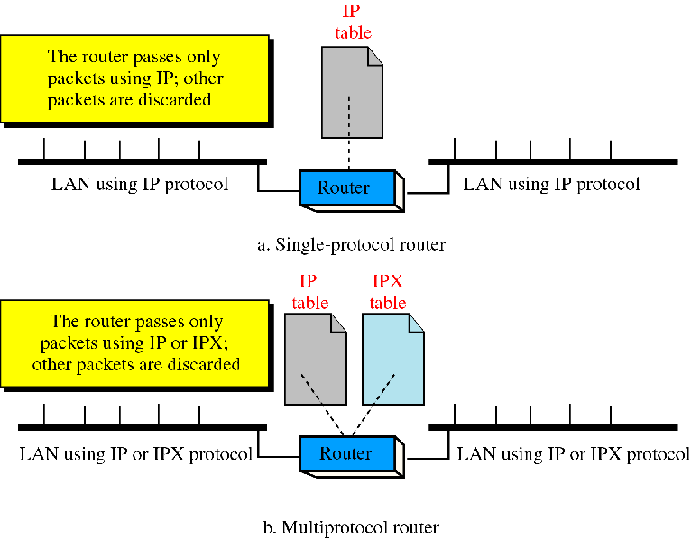
Single VS. Multiprotocol router

Slide 51
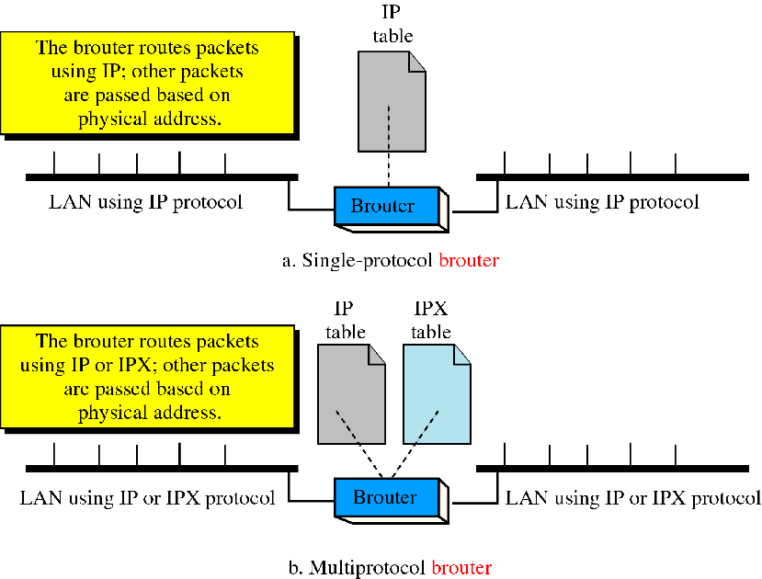
Brouter

Slide 52
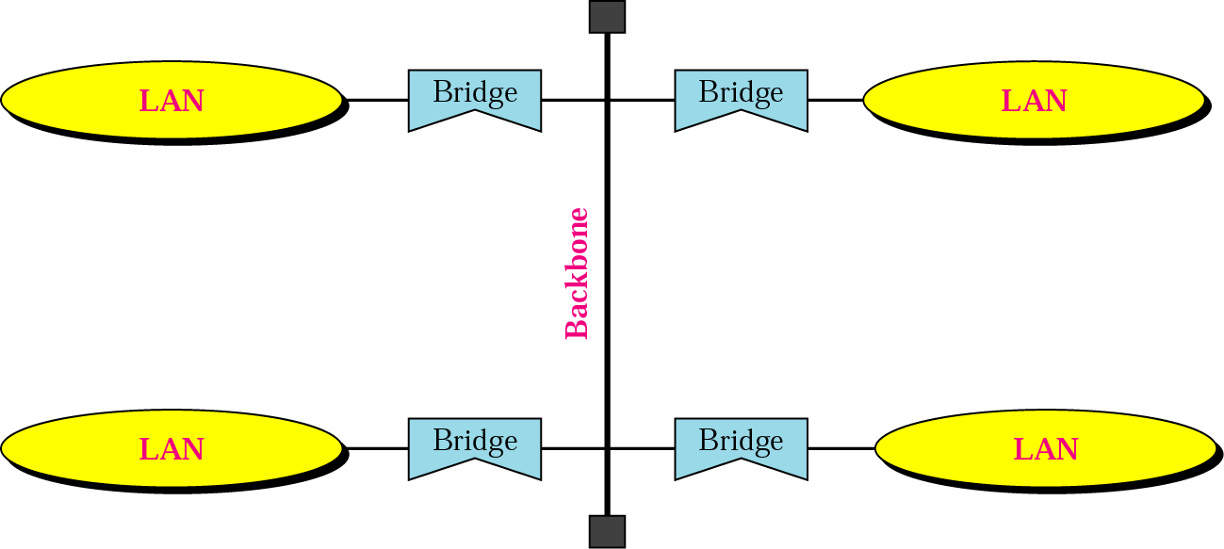
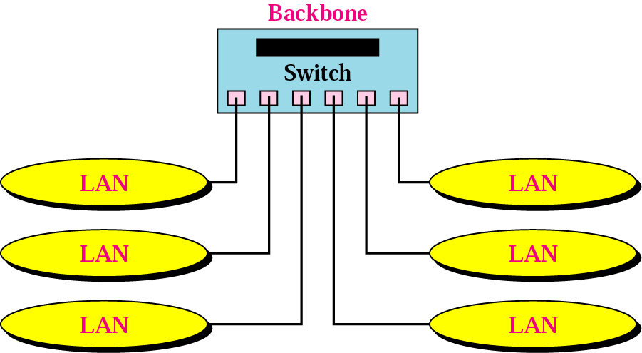
Backbone Network
Bus Backbone
Star Backbone

Slide 53
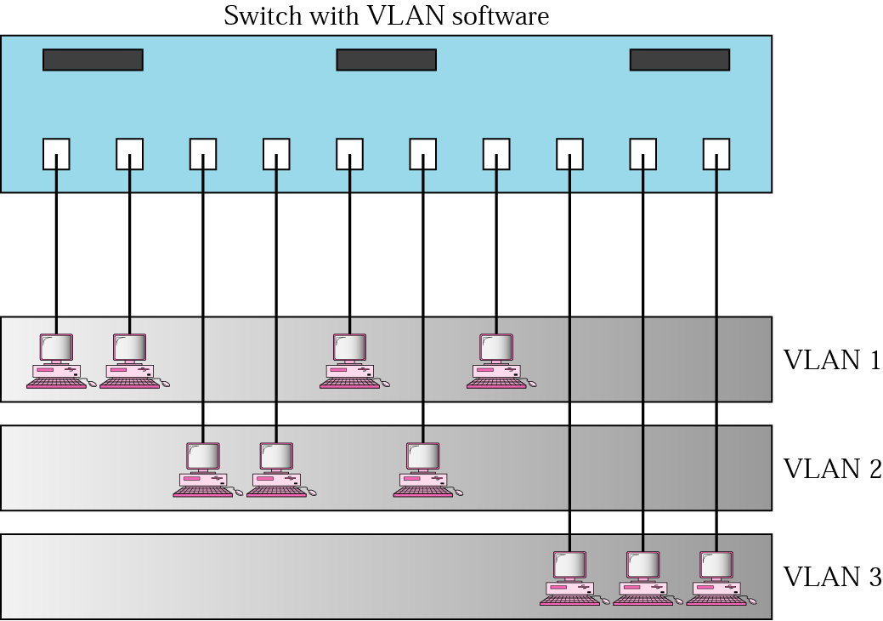
Virtual LAN (VLAN)
VLANs create broadcast domains

Slide 54
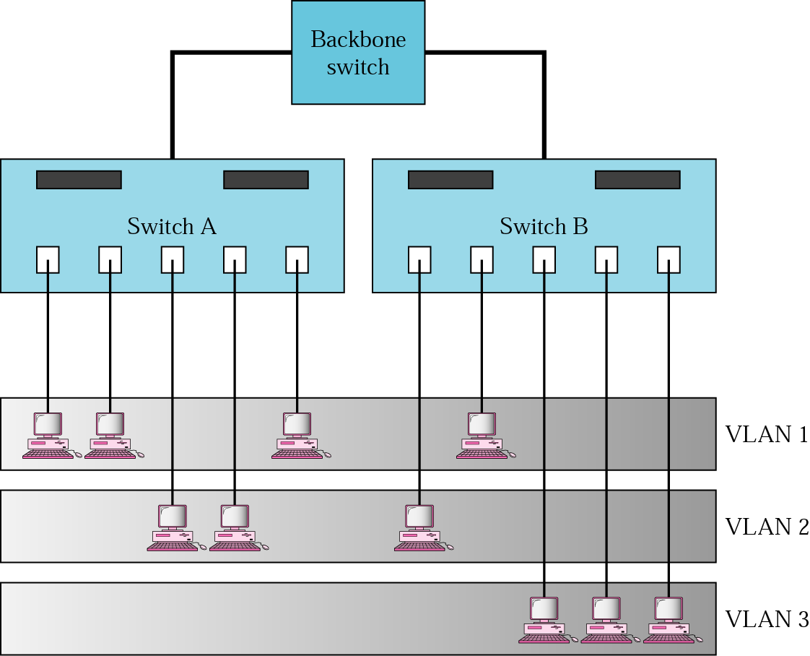
VLAN with backbone switch

Slide 55




Copper Media
Cable specifications
Coaxial cable

Slide 56
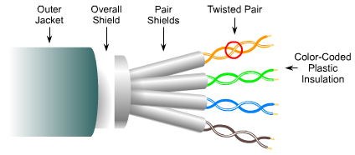
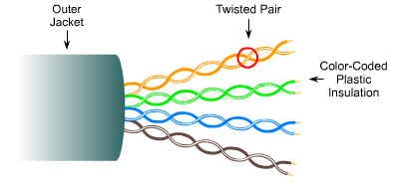
STP
Costs more and harder to install than UTP
Must be grounded at both ends
Reduces both internal and external sources of interference
UTP
Relies on cancellation effect produced by the twisting to limit signal degradation caused by EMI and RFI
Easier to install, thinner and less expensive

Slide 57
Straight-Through, Rollover and Crossover Cables
Straight-Through
  Used for up-links
Crossover
  Used for linking devices at the same level
Rollover
  Used for connecting a terminal to the console port
Cross 1 with 3 and 2 with 6

Slide 58

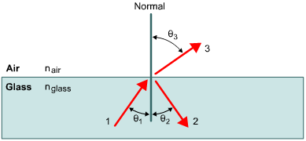

Optical Media
Radio, microwaves, radar, visible light, x-rays, and gamma rays are all types of electromagnetic waves
The wavelength of the light in optical fiber is either 850 nm, 1310 nm, or 1550 nm
In a vacuum light travels at 300,000 kps - light travels at slower speeds through air, water, and glass

Slide 59
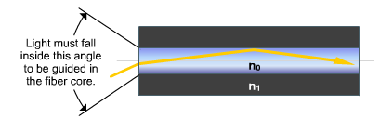
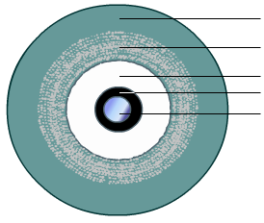
Two conditions must be met to prevent loss due to refraction and achieve Total Internal Reflection:
The core of the optical fiber has to have a larger index of refraction than the cladding.
The angle of incidence must be greater than the critical angle for the core and its cladding.
The numerical aperture of a core is the range of angles of incident light rays entering the fiber that will be completely reflected
Orange jacket
Kevlar
Plastic buffer
Cladding
Core

Slide 60
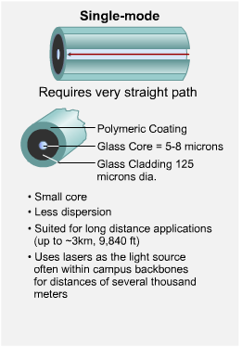
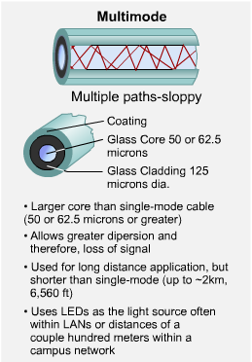

Slide 61
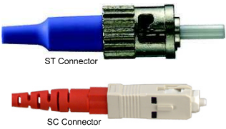
Other Optical Components
There are two types of light sources:
Light Emitting Diode (LED) producing infrared light with wavelengths of either 850nm or 1310 nm
Used with multimode fiber in LANs.
LASER producing a thin beam of intense infrared light with wavelengths of 1310nm or 1550 nm
Used with single-mode fiber over longer distance
Extra care should be exercised to prevent eye injury
Fibre-optic receivers are called PIN photodiodes (p-intrinsic-n diodes)
On single-mode fiber, the ST (Straight Tip) connector is frequently used.
With multimode fiber the SC connector (Subscriber Connector ) is used

Slide 62
Wireless Media
IEEE Standards for Wireless
802.11 | Includes Direct Sequence Spread Spectrum. DSSS applies to wireless devices operating within a 1 to 2 Mbps range
802.11b | Wi-Fi™ - Increased transmission capabilities to 11 Mbps Typically speeds 2 to 4 Mbps All 802.11b systems are backward compliant Operate within 2.4 GHZ transmission band
802.11a | Operate within 5 GHZ transmission band No interoperability with 802.11b Capable of throughput of 54 Mbps (typically 20-26 Mbps)
802.11g | Same throughout as 802.11a Backwards compatibility for 802.11b Uses Othogonal Frequency Division Multiplexing (OFDM)

Slide 63
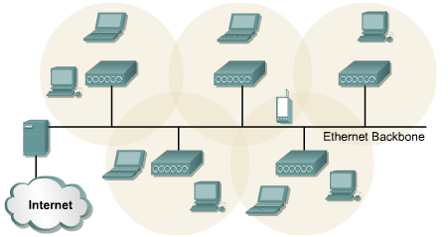
Wireless Devices and Topologies
Wireless network may consist of as few as two devices equipped with wireless NICs
Access Point (AP) are installed to act as central hubs for the WLAN and to solve NIC compatibility issues
APs are equipped with antennae and provide wireless connectivity over a specified area referred to as a cell

Slide 64
Three types of frames are used in wireless communication:
control, management, and data
WLANs use CSMA/CA
(Carrier Sense Multiple Access/Collision Avoidance)
WLAN authentication authenticates the device, not the user
Authentication and Association types
Unauthenticated and unassociated
Authenticated and unassociated - The node has been authenticated on the network but has not yet associated with the access point
Authenticated and associated
Wireless security can be difficult to achieve. Tools include:
EAP-MD5 Challenge,LEAP (Cisco), User authentication, Encryption, Data authentication
VPN technology effectively closes the wireless network

