Slide 1
Object Oriented Programming & Concepts
UML – Class Diagrams

Slide 2
Object-Oriented Programming
Understanding OOP is fundamental to writing good Java applications
  Improves design of your code
  Improves understanding of the Java APIs
There are several concepts underlying OOP:
  Abstract Types (Classes)
  Encapsulation (or Information Hiding)
  Aggregation
  Inheritance
  Polymorphism
Notes:
There are two ways to approach Java. Either as just another language, I.e. begin with the basic syntax and show how procedural programs can be created, and then teach OO concepts later on. Or you begin with the OO concepts and introduce the syntax along the way.
I prefer the latter approach, which this course will take, because understanding OOP is critical to working well with Java. You can only get the most from the language by understanding these features.
OOP has several key concepts which we’ll review now, but will investigate in more detail as we learn more about the Java language. At this point we’re just introducing some of the basic terminology.

Slide 3
Aggregation
Aggregation is the ability to create new classes out of existing classes
  Treating them as building blocks or components
Aggregation allows reuse of existing code
  “Holy Grail” of software engineering
Two forms of aggregation
Whole-Part relationships
  Car is made of Engine, Chassis, Wheels
Containment relationships
  A Shopping Cart contains several Products
  A List contains several Items
Notes:
Aggregation should be familiar to anyone who has used Visual Basic: forms are made up from other components (controls).
In engineering terms its like taking pre-fabricated components (e.g. resistors, transistors, etc) and building
something out of those parts (e.g. a radio). Should be obvious why this is the “holy grail” – could significantly
Reduce costs of developing software. While OO doesn’t get us there, its currently the best way we know of building maintainable applications.

Slide 4
Inheritance
Inheritance is the ability to define a new class in terms of an existing class
  The existing class is the parent, base or superclass
  The new class is the child, derived or subclass
The child class inherits all of the attributes and behaviour of its parent class
  It can then add new attributes or behaviour
  Or even alter the implementation of existing behaviour
Inheritance is therefore another form of code reuse
Notes:
Define one type in terms of another type.
Both motorbikes and cars are types of vehicles.

Slide 5
Polymorphism
Means ‘many forms’
Difficult to describe, easier to show, so we’ll look at this one in a later lesson
In brief though, polymorphism allows two different classes to respond to the same message in different ways
E.g. both a Plane and a Car could respond to a ‘turnLeft’ message,
  however the means of responding to that message (turning wheels, or banking wings) is very different for each.
Allows objects to be treated as if they’re identical

Slide 6
Unified Modeling Language
Unified Modeling Language (UML) is a standardized general-purpose modeling language in the field of software engineering. The standard is managed, and was created by, the Object Management Group.
UML includes a set of graphic notation techniques to create visual models of software-intensive systems.

Slide 7
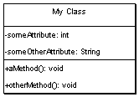
UML -- Classes
Box with 3 sections
The top contains the class name
The middle lists the classes attributes
The bottom lists the classes methods
Can indicate parameters and return types to methods, as well as their visibility

Slide 8
Class Diagrams
In the system design of a system, a number of classes are identified and grouped together in a class diagram which helps to determine the static relations between those objects
With detailed modeling, the classes of the conceptual design are often split in a number of subclasses
In order to further describe the behavior of systems, these diagrams can be complemented by state diagram or UML state machine
Also instead of class diagrams, Object role modeling can be used if you just want to model the classes and their relationships

Slide 9
Steps followed
Draw class symbol in the editor and name it
List the class attributes
List the class operations/methods
Make the links and associations
Give notations

Slide 10
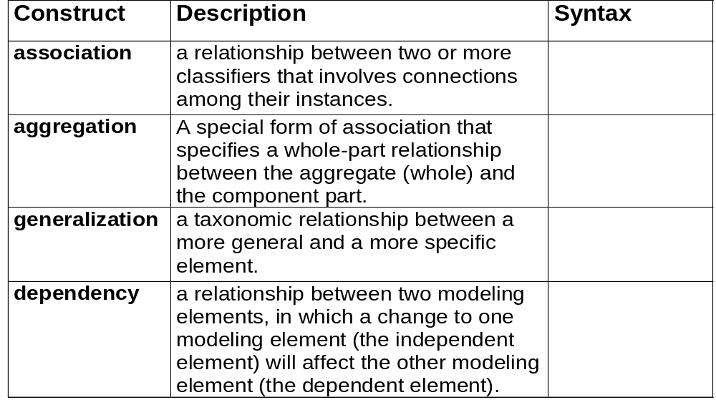
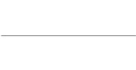




Structural Modeling:
Core Relationships
Reference: OMG tutorial on UML by Cris Kobryn

Slide 11
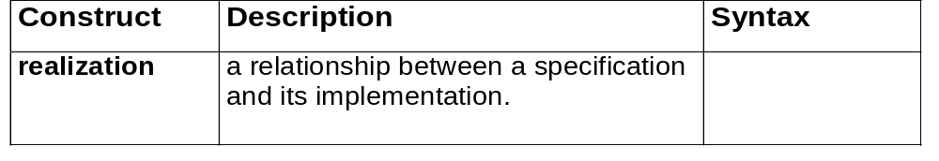

Structural Modeling:
Core Relationships (cont’d)
Reference: OMG tutorial on UML by Cris Kobryn

Slide 12
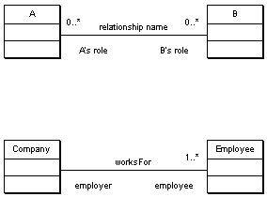
UML -- Association
A line between two classes indicates a relationship
Extra information can be added to describe the relationship
Including
  Its name
  The roles that the classes play
  The cardinality of the relationship (how many objects are involved)
E.g. a Person worksFor a Company, which has many employees

Slide 13
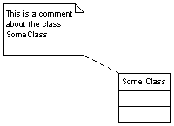
UML -- Comments
Useful for adding text for the readers of your diagram
The symbol looks like a little post-it note, with a dotted line joining it to the class or relationship that its describing

Slide 14

UML -- Aggregation
Aggregation (a whole-part relationship) is shown by a line with clear diamond.
As aggregation is a form of relationship you can also add the usual extra information
I.e.
  Name
  Roles
  Cardinality

Slide 15
Aggregation
Creating an instance of one class as a reference in another class is called object aggregation.
Aggregation creates a “has a” relationship between objects.
9-<number>

Slide 16
Aggregation in UML Diagrams
Course
- courseName : String
- Instructor : Instructor
- textBook : TextBook
+ Course(name : String, instr : Instructor, text : TextBook)
+ getName() : String
+ getInstructor() : Instructor
+ getTextBook() : TextBook
+ toString() : String
Instructor
TextBook
lastName : String
firstName : String
officeNumber : String
title : String
author : String
publisher : String
+ Instructor(lname : String, fname : String,
office : String)
+Instructor(object2 : Instructor)
+set(lname : String, fname : String,
office : String): void
+ toString() : String
+ TextBook(title : String, author : String, publisher :
String)
+ TextBook(object2 : TextBook)
+ set(title : String, author : String, publisher : String)
: void
+ toString() : String
9-<number>

Slide 17

Aggregations
Aggregation is a variant of the "has a" or association relationship; aggregation is more specific than association
It is an association that represents a part-whole or part-of relationship. As a type of association, an aggregation can be named and have the same adornments that an association can
However, an aggregation may not involve more than two classes

Slide 18
Aggregations
Aggregation can occur when a class is a collection or container of other classes, but where the contained classes do not have a strong life cycle dependency on the container—essentially, if the container is destroyed, its contents are not
In UML, it is graphically represented as a hollow diamond shape on the containing class end of the tree of lines that connect contained class(es) to the containing class

Slide 19
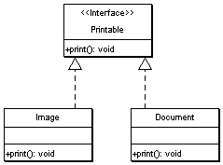
UML -- Interfaces
Interfaces are a way to specify behaviour (a public contract) without data or implementation.
Interfaces are classed with an extra label next to their name: <<Interface>>
A dotted arrow from a class to an interface explains that the class fulfills the contract specified by that interface

Slide 20
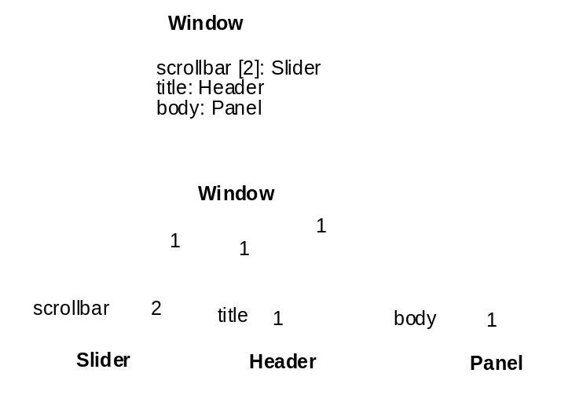
Composition
Composition is a stronger variant of the "owns a" or association relationship; composition is more specific than aggregation
It is represented with a solid diamond shape
Has a strong life cycle dependency between instances of the container class and instances of the contained class(es): If the container is destroyed, normally every instance that it contains is destroyed as well
Note that a part can (where allowed) be removed from a composite before the composite is deleted, and thus not be deleted as part of the composite
The UML graphical representation of a composition relationship is a filled diamond shape on the containing class end of the tree of lines that connect contained class(es) to the containing class
Fig. 3-45, UML Notation Guide
Reference: OMG tutorial on UML by Cris Kobryn

Slide 21
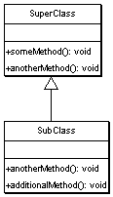
UML – Inheritance\Generalization
Inheritance is shown by a solid arrow from the sub-class to the super-class
The sub-class doesn’t list its super-class attributes or methods,
unless its providing its own alternate version (I.e. is extending the behaviour of the base class)

Slide 22
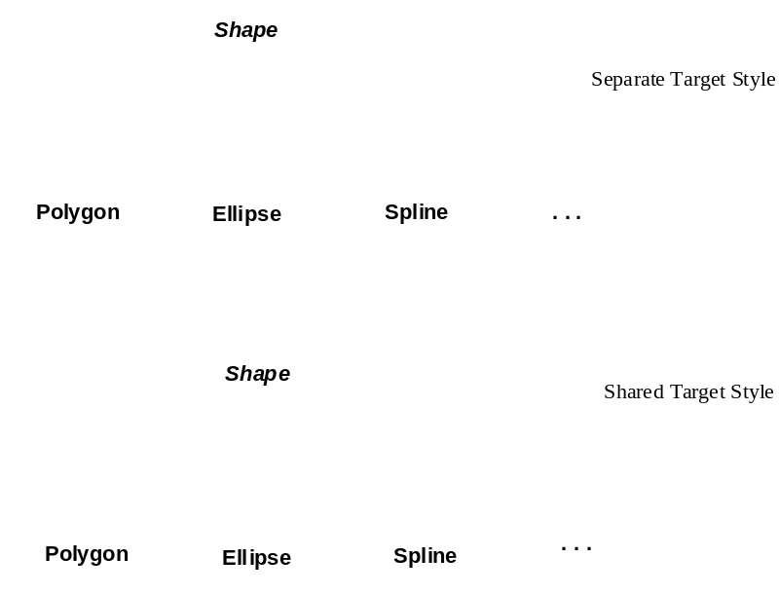
Generalization
Indicates that one of the two related classes (the subtype) is considered to be a specialized form of the other (the super type) and supertype is considered as 'Generalization' of subtype
In practice, this means that any instance of the subtype is also an instance of the supertype
An exemplary tree of generalizations of this form is found in binomial nomenclature: human beings are a subtype of simian, which are a subtype of mammal, and so on. The relationship is most easily understood by the phrase 'A is a B' (a human is a mammal, a mammal is an animal).
Fig. 3-47, UML Notation Guide
Reference: OMG tutorial on UML by Cris Kobryn

Slide 23
Generalization
The UML graphical representation of a Generalization is a hollow triangle shape on the supertype end of the line (or tree of lines) that connects it to one or more subtypes.
The generalization relationship is also known as the inheritance or "is a" relationship.
  The supertype in the generalization relationship is also known as the "parent", superclass, base class, or base type.
  The subtype in the specialization relationship is also known as the "child", subclass, derived class, derived type, inheriting class, or inheriting type.
Fig. 3-47, UML Notation Guide
Reference: OMG tutorial on UML by Cris Kobryn

Slide 24
Generalization
Note that this relationship bears no resemblance to the biological parent/child relationship: the use of these terms is extremely common, but can be misleading
Generalization-Specialization relationship
  A is a type of B
  E. g. "an oak is a type of tree", "an automobile is a type of vehicle"
Generalization can only be shown on class diagrams and on Use case diagrams.
Fig. 3-47, UML Notation Guide
Reference: OMG tutorial on UML by Cris Kobryn

Slide 25
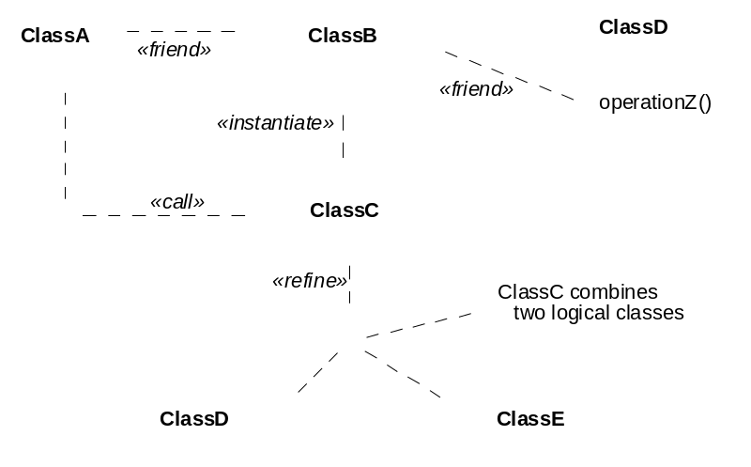
Dependencies
Dependency is a weaker form of relationship which indicates that one class depends on another because it uses it at some point of time
It exists if a class is a parameter variable or local variable of a method of another class
Fig. 3-50, UML Notation Guide
Reference: OMG tutorial on UML by Cris Kobryn

Slide 26
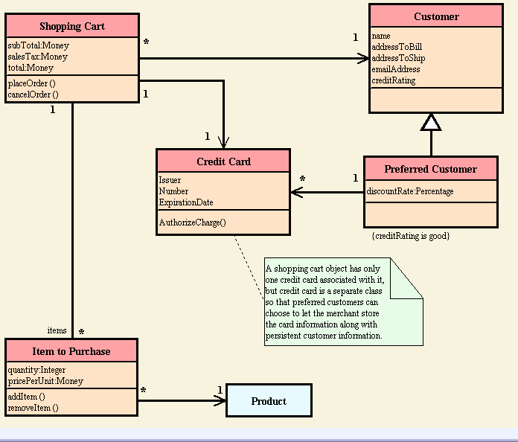
UML Class Diagram Examples
Reference: www.smartdraw.com

Slide 27
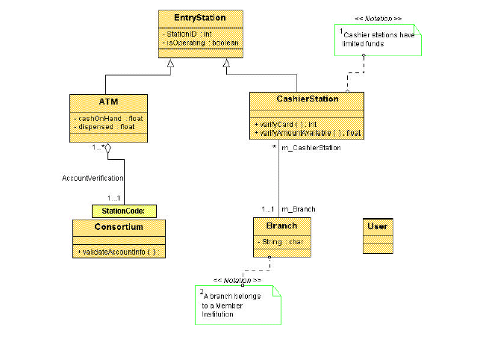

Slide 28
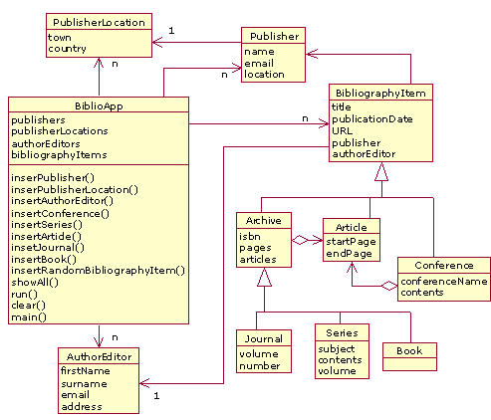

Slide 29
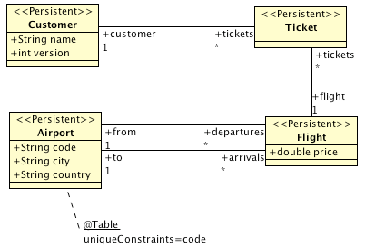

Slide 30
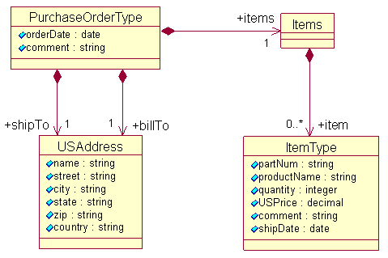

Slide 31
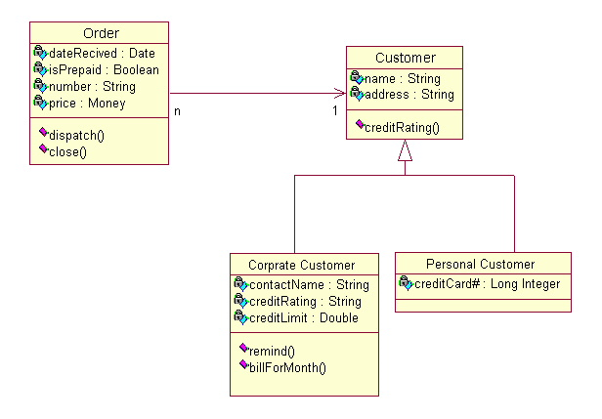

Slide 32
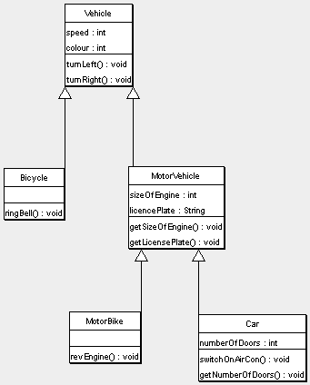
Example #1

Slide 33
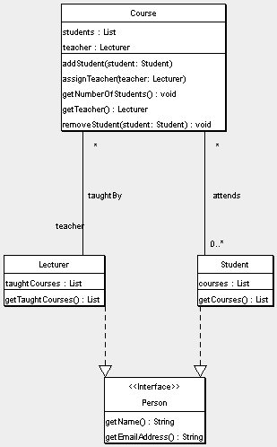
Example #2

Slide 34
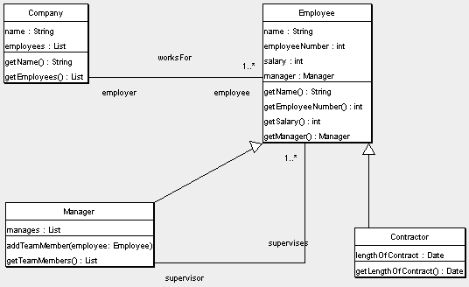
Example #3

