Slide 1
Abstract Classes and Interfaces

Slide 2
Abstract class in Java
A class that is declared with abstract keyword, is known as abstract class in java. It can have abstract and non-abstract methods (method with body).

Slide 3
Abstraction in Java
Abstraction is a process of hiding the implementation details and showing only functionality to the user.
Another way, it shows only important things to the user and hides the internal details for example sending sms, you just type the text and send the message. You don't know the internal processing about the message delivery.
Abstraction lets you focus on what the object does instead of how it does it.

Slide 4
Ways to achieve Abstraction
There are two ways to achieve abstraction in java
Abstract class (0 to 100%)
Interface (100%)

Slide 5
Abstract class in Java
A class that is declared as abstract is known as abstract class. It needs to be extended and its method implemented. It cannot be instantiated.
Example abstract class
abstract class A{}

Slide 6
abstract method
A method that is declared as abstract and does not have implementation is known as abstract method.
abstract void printStatus();//no body and abstract

Slide 7
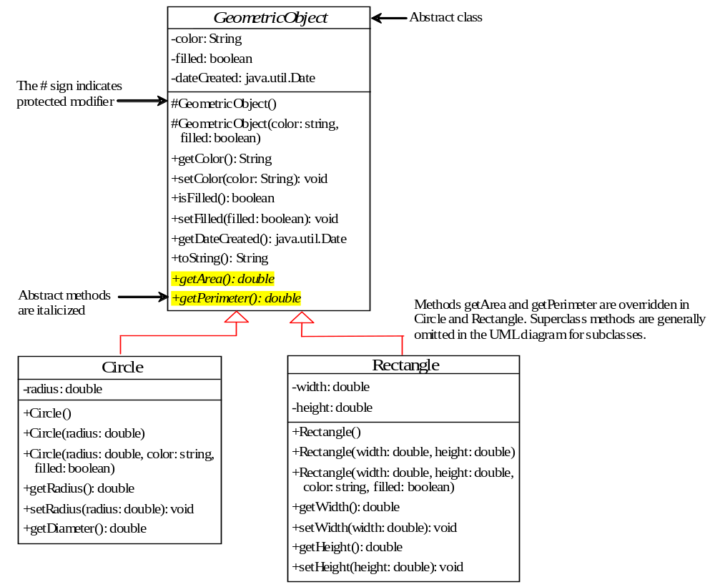
Abstract Classes and Abstract Methods
GeometricObject
Circle
Rectangle
TestGometricObject
Run

Slide 8
abstract method in abstract class
An abstract method cannot be contained in a nonabstract class. If a subclass of an abstract superclass does not implement all the abstract methods, the subclass must be defined abstract. In other words, in a nonabstract subclass extended from an abstract class, all the abstract methods must be implemented, even if they are not used in the subclass.

Slide 9
object cannot be created from abstract class
An abstract class cannot be instantiated using the new operator, but you can still define its constructors, which are invoked in the constructors of its subclasses. For instance, the constructors of GeometricObject are invoked in the Circle class and the Rectangle class.

Slide 10
abstract class without abstract method
A class that contains abstract methods must be abstract. However, it is possible to define an abstract class that contains no abstract methods. In this case, you cannot create instances of the class using the new operator. This class is used as a base class for defining a new subclass.

Slide 11
superclass of abstract class may be concrete
A subclass can be abstract even if its superclass is concrete. For example, the Object class is concrete, but its subclasses, such as GeometricObject, may be abstract.

Slide 12
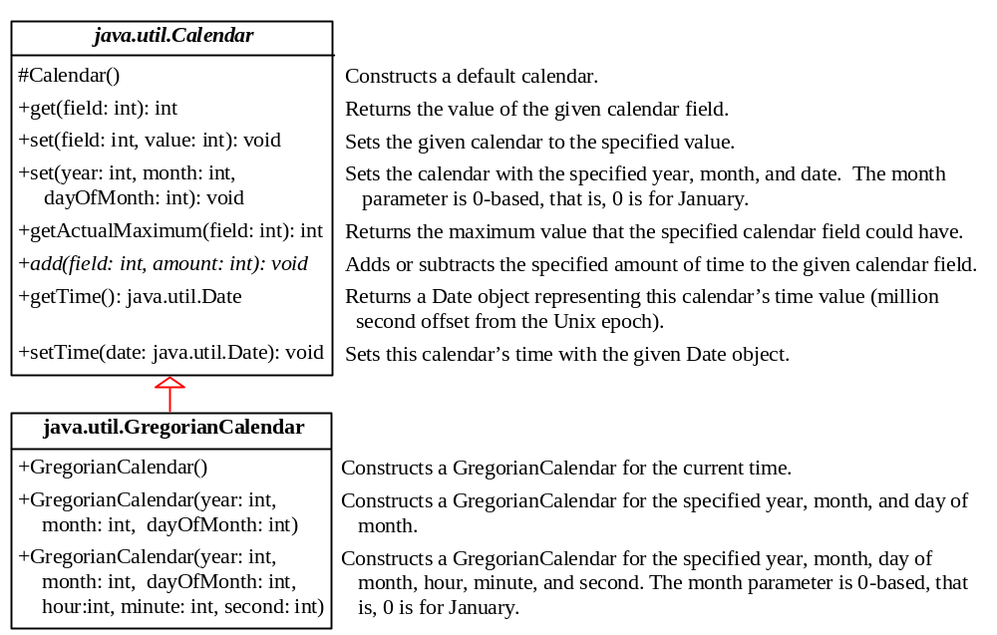
The Abstract Calendar Class and Its GregorianCalendar subclass

Slide 13
Abstract classes are classes that contain one or more abstract methods. An abstract method is a method that is declared, but contains no implementation. Abstract classes may not be instantiated, and require subclasses to provide implementations for the abstract methods. Let's look at an example of an abstract class, and an abstract method.

Slide 14
abstract class Bike{
abstract void run();
}
class Honda4 extends Bike{
void run(){System.out.println("running safely..");}
public static void main(String args[]){
Bike obj = new Honda4();
obj.run();
}
}
Output: running safely..

Slide 15
Interfaces
What is an interface?
Why is an interface useful?
How do you define an interface?
How do you use an interface?

Slide 16
What is an interface?
Why is an interface useful?
An interface is a classlike construct that contains only constants and abstract methods. In many ways, an interface is similar to an abstract class, but the intent of an interface is to specify behavior for objects. For example, you can specify that the objects are comparable, edible, cloneable using appropriate interfaces.

Slide 17
What Is an Interface?
• As you've already learned, objects define their interaction with the outside world through the methods that they expose.
• Methods form the object's interfacewith the outside world;
• The buttons on the front of your television set, for example, are the interface between you and the electrical wiring on the other side of its plastic casing. You press the "power" button to turn the television on and off.
• In its most common form, an interface is a group of related methods with empty bodies.

Slide 18
Define an Interface
To distinguish an interface from a class, Java uses the following syntax to define an interface:
public interface InterfaceName {
constant declarations;
method signatures;
}
Example:
public interface Edible {
/** Describe how to eat */
public abstract String howToEat();
}

