Slide 1

CSCE 330
Programming Language Structures
Chapter 2: Syntax
Fall 2009
Marco Valtorta
mgv@cse.sc.edu
A language that is simple to parse for the compiler is also simple to parse for the human programmer.
N. Wirth

Slide 2
Syntax and Semantics
Syntax is the set of rules that specify the composition of programs from letters, digits and other characters.
Semantics is the set of rules that specify what the result/outcome of a program is.
Problems with English language description of Syntax and Semantics:
  verbosity
  ambiguity

Slide 3
Contents
2.1 Grammars
2.1.1 Backus-Naur Form
2.1.2 Derivations
2.1.3 Parse Trees
2.1.4 Associativity and Precedence
2.1.5 Ambiguous Grammars
2.2 Extended BNF
2.3 Syntax of a Small Language: Clite
2.3.1 Lexical Syntax
2.3.2 Concrete Syntax
2.4 Compilers and Interpreters
2.5 Linking Syntax and Semantics
2.5.1 Abstract Syntax
2.5.2 Abstract Syntax Trees
2.5.3 Abstract Syntax of Clite

Slide 4
Thinking about Syntax
The syntax of a programming language is a precise description of all its grammatically correct programs.
Precise syntax was first used with Algol 60, and has been used ever since.
Three levels:
  Lexical syntax
  Concrete syntax
  Abstract syntax

Slide 5
Levels of Syntax
Lexical syntax = all the basic symbols of the language (names, values, operators, etc.)
Concrete syntax = rules for writing expressions, statements and programs.
Abstract syntax = internal representation of the program, favoring content over form. E.g.,
  C: if ( expr ) ... discard ( )
  Ada: if ( expr ) then discard then

Slide 6
2.1 Grammars
A metalanguage is a language used to define other languages.
A grammar is a metalanguage used to define the syntax of a language.
Our interest: using grammars to define the syntax of a programming language.

Slide 7
2.1.1 Backus-Naur Form (BNF)
Stylized version of a context-free grammar (cf. Chomsky hierarchy)
Sometimes called Backus Normal Form
First used to define syntax of Algol 60
Now used to define syntax of most major languages

Slide 8
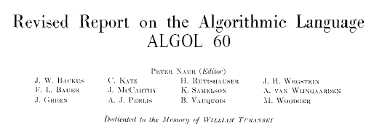


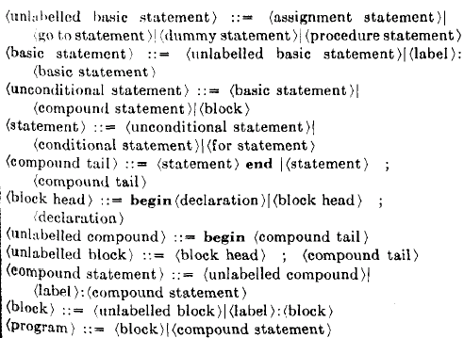
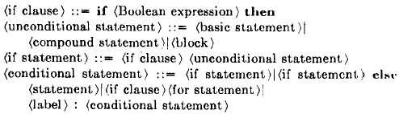
BNF History
In Java:
<IfThenStat> ::= if (<Expr>) <Stat>
<IfThenElseStat> ::= if (<Expr>)
<StatNoShortIf> else <Stat>

Slide 9




BNF Grammar
Set of productions: P
terminal symbols: T
nonterminal symbols: N
start symbol:
A production has the form
where and

Slide 10
Example: Binary Digits
Consider the grammar:
binaryDigit → 0
binaryDigit → 1
or equivalently:
binaryDigit → 0 | 1
Here, | is a metacharacter that separates alternatives.

Slide 11
2.1.2 Derivations
Consider the grammar:
  Integer → Digit | Integer Digit
  Digit → 0 | 1 | 2 | 3 | 4 | 5 | 6 | 7 | 8 | 9
We can derive any unsigned integer, like 352, from this grammar.

Slide 12
Derivation of 352 as an Integer
A 6-step process, starting with:
Integer

Slide 13
Derivation of 352 (step 1)
Use a grammar rule to enable each step:
  Integer ⇒ Integer Digit

Slide 14
Derivation of 352 (steps 1-2)
Replace a nonterminal by a right-hand side of one of its rules:
  Integer ⇒ Integer Digit
  ⇒ Integer 2

Slide 15
Derivation of 352 (steps 1-3)
Each step follows from the one before it.
  Integer ⇒ Integer Digit
  ⇒ Integer 2
  ⇒ Integer Digit 2

Slide 16
Derivation of 352 (steps 1-4)
  Integer ⇒ Integer Digit
  ⇒ Integer 2
  ⇒ Integer Digit 2
  ⇒ Integer 5 2

Slide 17
Derivation of 352 (steps 1-5)
  Integer ⇒ Integer Digit
  ⇒ Integer 2
  ⇒ Integer Digit 2
  ⇒ Integer 5 2
  ⇒ Digit 5 2

Slide 18
Derivation of 352 (steps 1-6)
You know you’re finished when there are only terminal symbols remaining.
  Integer ⇒ Integer Digit
  ⇒ Integer 2
  ⇒ Integer Digit 2
  ⇒ Integer 5 2
  ⇒ Digit 5 2
  ⇒ 3 5 2

Slide 19
A Different Derivation of 352
  Integer ⇒ Integer Digit
  ⇒ Integer Digit Digit
  ⇒ Digit Digit Digit
  ⇒ 3 Digit Digit
  ⇒ 3 5 Digit
  ⇒ 3 5 2
This is called a leftmost derivation, since at each step the leftmost nonterminal is replaced.
(The first one was a rightmost derivation.)

Slide 20
Notation for Derivations
Integer ⇒* 352
  Means that 352 can be derived in a finite number of steps using the grammar for Integer.
352 ∈ L(G)
  Means that 352 is a member of the language defined by grammar G.
L(G) = { ω ∈ T* | Integer ⇒* ω }
  Means that the language defined by grammar G is the set of all symbol strings ω that can be derived as an Integer.

Slide 21
2.1.3 Parse Trees
A parse tree is a graphical representation of a derivation.
The root of the tree is the start symbol.
  Each internal node of the tree corresponds to a step in the derivation.
  The children of a node represent a right-hand side of a production.
  Each leaf node represents a symbol of the derived string, reading from left to right.

Slide 22
E.g., The step Integer ⇒ Integer Digit appears in the parse tree as:
Integer
Integer
Digit

Slide 23
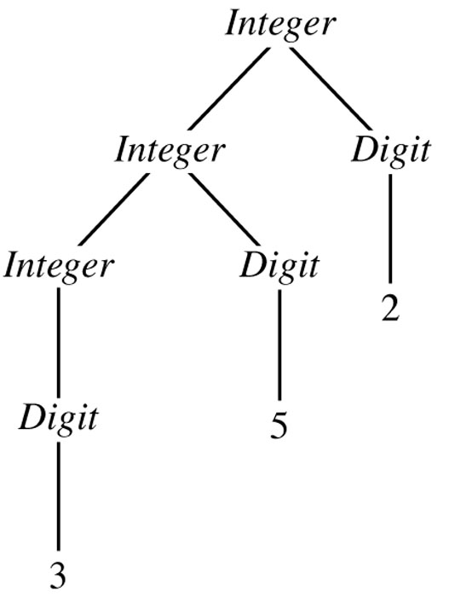
Parse Tree for 352
as an Integer
Figure 2.1

Slide 24
Arithmetic Expression Grammar
The following grammar defines the language of arithmetic expressions with 1-digit integers, addition, and subtraction.
Expr → Expr + Term | Expr – Term | Term
Term → 0 | ... | 9 | ( Expr )

Slide 25
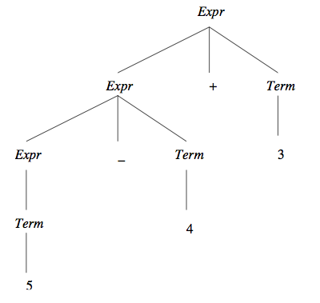
Parse of the
String 5-4+3
Figure 2.2

Slide 26
Contents
2.1 Grammars
2.1.1 Backus-Naur Form
2.1.2 Derivations
2.1.3 Parse Trees
2.1.4 Associativity and Precedence
2.1.5 Ambiguous Grammars
2.2 Extended BNF
2.3 Syntax of a Small Language: Clite
2.3.1 Lexical Syntax
2.3.2 Concrete Syntax
2.4 Compilers and Interpreters
2.5 Linking Syntax and Semantics
2.5.1 Abstract Syntax
2.5.2 Abstract Syntax Trees
2.5.3 Abstract Syntax of Clite

Slide 27
2.1.4 Associativity and Precedence
A grammar can be used to define associativity and precedence among the operators in an expression.
  E.g., + and - are left-associative operators in mathematics;
  * and / have higher precedence than + and - .
Consider the more interesting grammar G₁:
  Expr -> Expr + Term | Expr – Term | Term
  Term -> Term * Factor | Term / Factor |
  Term % Factor | Factor
  Factor -> Primary ** Factor | Primary
  Primary -> 0 | ... | 9 | ( Expr )

Slide 28
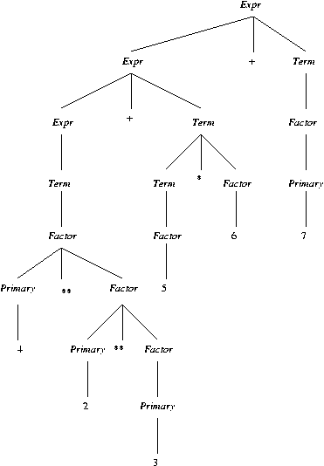
Parse of 4**2**3+5*6+7
for Grammar G₁
Figure 2.3

Slide 29
Associativity and Precedence
for Grammar G₁
Table 2.1
Precedence Associativity Operators
3 right **
2 left * / % \
1 left + -
Note: These relationships are shown by the structure of the parse tree: highest precedence at the bottom, and left-associativity on the left at each level.

Slide 30
2.1.5 Ambiguous Grammars
A grammar is ambiguous if one of its strings has two or more different parse trees.
  E.g., Grammar G₁ above is unambiguous.
C, C++, and Java have a large number of
  operators and
  precedence levels
Instead of using a large grammar, we can:
  Write a smaller ambiguous grammar, and
  Give separate precedence and associativity (e.g., Table 2.1)

Slide 31
An Ambiguous Expression Grammar G₂
Expr -> Expr Op Expr | ( Expr ) | Integer
Op -> + | - | * | / | % | **
Notes:
  G₂ is equivalent to G₁. i.e., its language is the same.
  G₂ has fewer productions and nonterminals than G₁.
  However, G₂ is ambiguous.

Slide 32
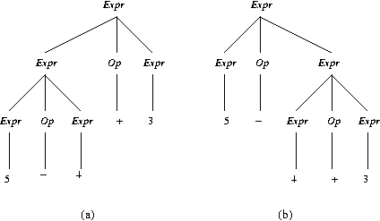
Ambiguous Parse of 5-4+3
Using Grammar G₂
Figure 2.4

Slide 33
The Dangling Else
IfStatement -> if ( Expression ) Statement |
if ( Expression ) Statement else Statement
Statement -> Assignment | IfStatement | Block
Block -> { Statements }
Statements -> Statements Statement | Statement

Slide 34
Example of Dangling Else
With which ‘if’ does the following ‘else’ associate?
if (x < 0)
if (y < 0) y = y - 1;
else y = 0;
Answer: either one!

Slide 35
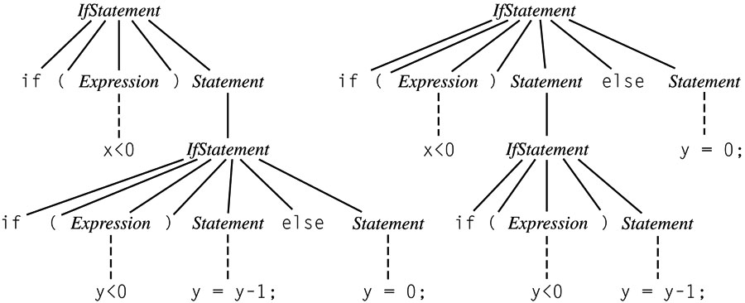
The Dangling Else Ambiguity
Figure 2.5

Slide 36
Solving the dangling else ambiguity
Algol 60, C, C++: associate each else with closest if; use {} or begin…end to override.
Algol 68, Modula, Ada: use explicit delimiter to end every conditional (e.g., if…fi)
Java: rewrite the grammar to limit what can appear in a conditional:
  IfThenStatement -> if ( Expression ) Statement
  IfThenElseStatement -> if ( Expression ) StatementNoShortIf
  else Statement
The category StatementNoShortIf includes all except IfThenStatement.

Slide 37
2.2 Extended BNF (EBNF)
BNF:
  recursion for iteration
  nonterminals (abstractions) for grouping
EBNF: additional metacharacters
  { } for a series of zero or more
  ( ) for a list, must pick one
  [ ] for an optional list; pick none or one

Slide 38
EBNF Examples
Expression is a list of one or more Terms separated by operators + and -
  Expression -> Term { ( + | - ) Term }
  IfStatement -> if ( Expression ) Statement [ else Statement ]
C-style EBNF lists alternatives vertically and uses _{opt} to signify optional parts. E.g.,
IfStatement:
if ( Expression ) Statement ElsePart_{opt}
ElsePart:
else Statement

Slide 39
EBNF to BNF
We can always rewrite an EBNF grammar as a BNF grammar. E.g.,
A -> x { y } z
can be rewritten:
A -> x A' z
A' -> | y A'
(Rewriting EBNF rules with ( ), [ ] is left as an exercise.)
While EBNF is no more powerful than BNF, its rules are often simpler and clearer.

Slide 40
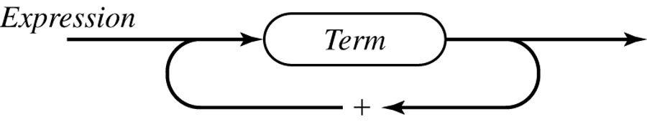
Syntax Diagram for
Expressions with Addition
Figure 2.6 includes subtraction

Slide 41
Contents
2.1 Grammars
2.1.1 Backus-Naur Form
2.1.2 Derivations
2.1.3 Parse Trees
  2.1.4 Associativity and Precedence
2.1.5 Ambiguous Grammars
2.2 Extended BNF
2.3 Syntax of a Small Language: Clite
2.3.1 Lexical Syntax
2.3.2 Concrete Syntax
2.4 Compilers and Interpreters
2.5 Linking Syntax and Semantics
2.5.1 Abstract Syntax
2.5.2 Abstract Syntax Trees
2.5.3 Abstract Syntax of Clite

Slide 42
2.3 Syntax of a Small Language: Clite
Motivation for using a subset of C:
  Grammar
  Language (pages) Reference
  Pascal 5 Jensen & Wirth
  C 6 Kernighan & Richie
  C++ 22 Stroustrup
  Java 14 Gosling, et. al.
The Clite grammar fits on one page (Figure 2.7 on p.38 [T]; next 3 slides), so it’s a far better tool for studying language design.

Slide 43
Fig. 2.7 Clite Grammar: Statements
Program → int main ( ) { Declarations Statements }
Declarations → { Declaration }
Declaration → Type Identifier [ [ Integer ] ] { , Identifier [ [ Integer ] ] } ;
Type → int | bool | float | char
Statements → { Statement }
Statement → ; | Block | Assignment | IfStatement | WhileStatement
Block → { Statements }
Assignment → Identifier [ [ Expression ] ] = Expression ;
IfStatement → if ( Expression ) Statement [ else Statement ]
WhileStatement → while ( Expression ) Statement

Slide 44
Fig. 2.7 Clite Grammar: Expressions
Expression → Conjunction { || Conjunction }
Conjunction → Equality { && Equality }
Equality → Relation [ EquOp Relation ]
EquOp → == | !=
Relation → Addition [ RelOp Addition ]
RelOp → < | <= | > | >=
Addition → Term { AddOp Term }
AddOp → + | -
Term → Factor { MulOp Factor }
MulOp → * | / | %
Factor → [ UnaryOp ] Primary
UnaryOp → - | !
Primary → Identifier [ [ Expression ] ] | Literal | ( Expression ) |
Type ( Expression )

Slide 45
Fig. 2.7 Clite grammar: lexical level
Identifier → Letter { Letter | Digit }
Letter → a | b | ... | z | A | B | ... | Z
Digit → 0 | 1 | ... | 9
Literal → Integer | Boolean | Float | Char
Integer → Digit { Digit }
Boolean → true | False
Float → Integer . Integer
Char → ‘ ASCII Char ‘

Slide 46
Issues Not Addressed by this Grammar
Comments
Whitespace
Distinguishing one token <= from two tokens < =
Distinguishing identifiers from keywords like if
These issues are addressed by identifying two levels:
  lexical level
  syntactic level
All issues above are lexical ones

Slide 47
2.3.1 Lexical Syntax
Input: a stream of characters from the ASCII set, keyed by a programmer.
Output: a stream of tokens or basic symbols, classified as follows:
  Identifiers e.g., Stack, x, i, push
  Literals e.g., 123, 'x', 3.25, true
  Keywords bool char else false float if int
  main true while
  Operators e.g., = || && == != < <= > >= + - * / !
  Punctuation ; , { } ( )
“A token is a logically cohesive sequence of characters representing a single symbol” [T, p.60]

Slide 48
Scan: Divide Input into Tokens
An example mini Triangle source program:
let var y: Integer
in !new year
y := y+1
Scan is a synonim of lexically analyze
Tokens are “words” in the input, for example keywords, operators, identifiers, literals, etc.
scanner
let
var
ident.
colon
ident.
in
...
let
var
y
:
Integer
in
ident.
becomes
ident.
op.
intlit
eot
...
y
:=
y
+
1

Slide 49
Developing a Scanner
The scanner will return an array of Tokens:
public class Token {
byte kind; String spelling;
final static byte
IDENTIFIER = 0; INTLITERAL = 1; OPERATOR = 2;
BEGIN = 3; CONST = 4; ...
...
public Token(byte kind, String spelling) {
this.kind = kind; this.spelling = spelling;
if spelling matches a keyword change my kind
automatically
}
...
}

Slide 50
Whitespace
Whitespace is any space, tab, end-of-line character (or characters), or character sequence inside a comment
No token may contain embedded whitespace
(unless it is a character or string literal)
Example:
  >= one token
  > = two tokens

Slide 51
Whitespace Examples in Pascal
while a < b do legal - spacing between tokens
while a<b do spacing not needed for <
whilea<bdo illegal - can’t tell boundaries
whilea < bdo between tokens

Slide 52
Comments
Not defined in grammar
Clite uses // comment style of C++

Slide 53
Identifier
Sequence of letters and digits, starting with a letter
if is both an identifier and a keyword
Most languages require identifiers to be distinct from keywords
In some languages, identifiers are merely predefined (and thus can be redefined by the programmer)

Slide 54
Redefining Identifiers can be dangerous
program confusing;
const true = false;
begin
if (a<b) = true then
f(a)
else …

Slide 55
Should Identifiers be case-sensitive?
Older languages: no. Why?
  Pascal: no.
  Modula: yes
  C, C++: yes
  Java: yes
  PHP: partly yes, partly no. What about orthogonality?

Slide 56
2.3.2 Concrete Syntax
Based on a parse of its Tokens
; is a statement terminator
(Algol-60, Pascal use ; as a separator)
Rule for IfStatement is ambiguous:
  “The else ambiguity is resolved by connecting an else with the last encountered else-less if.”
  [Stroustrup, 1991]

Slide 57
Expressions in Clite
13 grammar rules
Use of meta braces – operators are left associative
C++ expressions require 4 pages of grammar rules [Stroustrup]
C uses an ambiguous expression grammar [Kernighan and Ritchie]

Slide 58
Associativity and Precedence
Clite Operator Associativity
Unary - ! none
* / left
+ - left
< <= > >= none
== != none
&& left
|| left

Slide 59
Clite Equality, Relational Operators
… are non-associative
(an idea borrowed from Ada)
Why is this important?
  In C++, the expression:
  if (a < x < b)
  is not equivalent to
  if (a < x && x < b)
  But it is error-free!
  So, what does it mean?
Notes:
(a<x) is either true (1) or false (0) in C++. < is less associative, so: (a<x) < b.

Slide 60
Contents
2.1 Grammars
2.1.1 Backus-Naur Form
2.1.2 Derivations
2.1.3 Parse Trees
2.1.4 Associativity and Precedence
2.1.5 Ambiguous Grammars
2.2 Extended BNF
2.3 Syntax of a Small Language: Clite
2.3.1 Lexical Syntax
2.3.2 Concrete Syntax
2.4 Compilers and Interpreters
2.5 Linking Syntax and Semantics
2.5.1 Abstract Syntax
2.5.2 Abstract Syntax Trees
2.5.3 Abstract Syntax of Clite

Slide 61
2.4 Compilers and Interpreters
Intermediate Code (IC)
Intermediate Code (IC)
Abstract Syntax
Tokens
Source
Program
Machine
Code
Lexical
Analyzer
Syntactic
Analyzer
Semantic
Analyzer
Code
Optimizer
Code
Generator

Slide 62
Lexer
Based on a regular grammar, simpler than the context-free grammars described in EBNF
Input: characters
Output: tokens
Separate:
  Speed: 75% of time for non-optimizing
  Simpler design
  Character sets
  End of line conventions

Slide 63
Parser
Based on BNF/EBNF grammar
Input: tokens
Output: abstract syntax tree (parse tree)
Abstract syntax: parse tree with punctuation, many nonterminals discarded

Slide 64
Semantic Analysis
Check that all identifiers are declared
Perform type checking
Insert implied conversion operators
(i.e., make them explicit)
Sometimes called contextual analysis, and including the determination of scope

Slide 65
Code Optimization
Evaluate constant expressions at compile-time
Reorder code to improve cache performance
Eliminate common subexpressions
Eliminate unnecessary code

Slide 66
Code Generation
Output: machine code
Instruction selection
Register management
Peephole optimization

Slide 67
Interpreter
Replaces last 2 phases of a compiler
Input:
  Mixed: intermediate code
  Pure: stream of ASCII characters
Mixed interpreters
  Java, Perl, Python, Haskell, Scheme
Pure interpreters:
  most Basics, shell commands

Slide 68
2.5 Linking Syntax and Semantics
Output: parse tree is inefficient
Example: Fig. 2.9

Slide 69
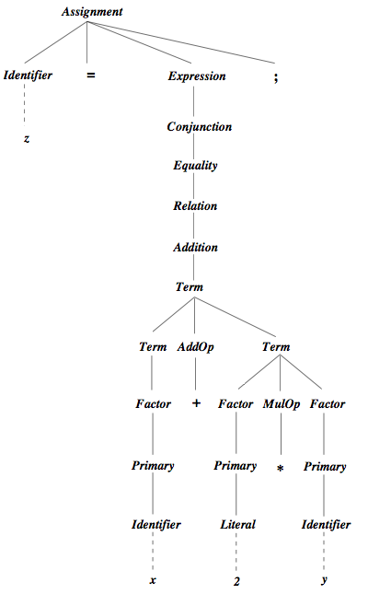
Parse Tree for z = x + 2*y;
Fig. 2.9

Slide 70
Finding a More Efficient Tree
The shape of the parse tree reveals the meaning of the program.
So we want a tree that removes its inefficiency and keeps its shape.
  Remove separator/punctuation terminal symbols
  Remove all trivial root nonterminals
  Replace remaining nonterminals with leaf terminals
Example: Fig. 2.10

Slide 71
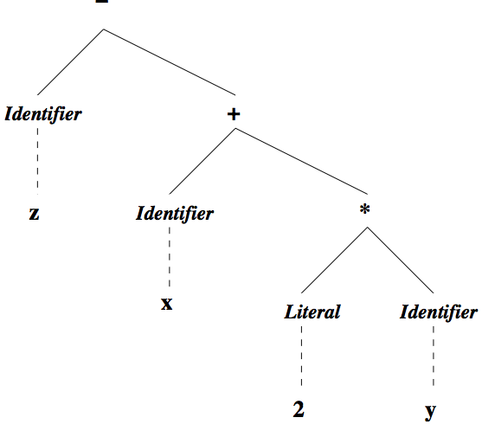
Abstract Syntax Tree for z = x + 2*y;
Fig. 2.10

Slide 72
Abstract Syntax
Removes “syntactic sugar” and keeps essential elements of a language. E.g., consider the following two equivalent loops:
Pascal
while i < n do begin
  i := i + 1;
end;
C/C++
while (i < n) {
  i = i + 1;
}
The only essential information in each of these is 1) that it is
a loop, 2) that its terminating condition is i < n, and 3) that
its body increments the current value of i.

Slide 73
Abstract Syntax of Clite Assignments
Assignment = Variable target; Expression source
[[The RHS of the rule above is a list of named essential elements that compose the LHS]]
Expression = VariableRef | Value | Binary | Unary
[[The RHS of the rule of above has a list of alternatives for the LHS---This type of rule translates into an abstract class in a Java lexer]]
VariableRef = Variable | ArrayRef
Variable = String id
ArrayRef = String id; Expression index
Value = IntValue | BoolValue | FloatValue | CharValue
Binary = Operator op; Expression term1, term2
Unary = UnaryOp op; Expression term
Operator = ArithmeticOp | RelationalOp | BooleanOp
IntValue = Integer intValue
…

Slide 74
Abstract Syntax as Java Classes
abstract class Expression { }
abstract class VariableRef extends Expression { }
class Variable extends VariableRef { String id; }
class Value extends Expression { … }
class Binary extends Expression {
Operator op;
Expression term1, term2;
}
class Unary extends Expression {
UnaryOp op;
Expression term;
}

Slide 75
Example Abstract Syntax Tree
op term1 term2
Binary node
Abstract Syntax Tree
for x+2*y (Fig 2.13)
Binary
Operator
Variable
Binary
+
x
Operator
Value
Variable
*
2
y

Slide 76
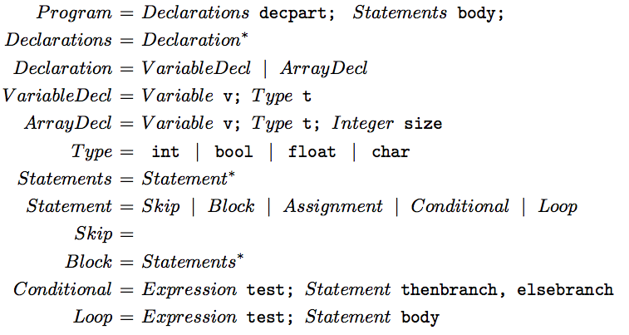
Remaining Abstract Syntax of Clite
(Declarations and Statements)
Fig 2.14

