Slide 1

CSCE 330
Programming Language Structures
Chapter 5: Types
Fall 2009
Marco Valtorta
mgv@cse.sc.edu
Types are the leaven of computer programming; they make is digestible
Robin Milner
Notes:
[T]

Slide 2
5.1 Type Errors
5.2 Static and Dynamic Typing
5.3 Basic Types
5.4 NonBasic Types
5.5 Recursive Data Types
5.6 Functions as Types
5.7 Type Equivalence
5.8 Subtypes
5.9 Polymorphism and Generics
5.10 Programmer-Defined Types

Slide 3
A type is a collection of values and operations on those values.
Example: Integer type has values ..., -2, -1, 0, 1, 2, ... and operations +, -, *, /, <, ...
The Boolean type has values true and false and operations ∧, ∨, ¬.

Slide 4
Computer types have a finite number of values due to fixed size allocation; problematic for numeric types
Exceptions:
  Smalltalk uses unbounded fractions
  Haskell type Integer represents unbounded integers.
Floating point problems? Even more problematic is fixed sized floating point numbers:
  0.2 is not exact in binary---Why?
    There is no way of summing a finite series of powers of 2 and obtain exactly 0.2
So 0.2 * 5 is not exactly 1.0
Floating point is inconsistent with real numbers in mathematics

Slide 5
In the early languages, Fortran, Algol, Cobol, all of the types were built in
If needed a type color, could use integers; but what does it mean to multiply two colors?
Purpose of types in programming languages is to provide ways of effectively modeling a problem solution

Slide 6
5.1 Type Errors
Machine data carries no type information.
Basically, just a sequence of bits.
Example: 0100 0000 0101 1000 0000 0000 0000 0000
  The floating point number 3.375
  The 32-bit integer 1,079,508,992
  Two 16-bit integers 16472 and 0
  Four ASCII characters: @ X NUL NUL

Slide 7
A type error is any error that arises because an operation is attempted on a data type for which it is undefined.
Type errors are common in assembly language programming.
High level languages reduce the number of type errors.
A type system provides a basis for detecting type errors.

Slide 8
5.2 Static and Dynamic Typing
A type system imposes constraints such as the values used in an addition must be numeric
  Cannot be expressed syntactically in EBNF
  Can often be expressed using contextual languages, using attribute grammars
Some languages perform type checking at compile time (e.g., C)
Other languages (e.g., Perl) perform type checking at run time
Still others (e.g., Java) do both

Slide 9
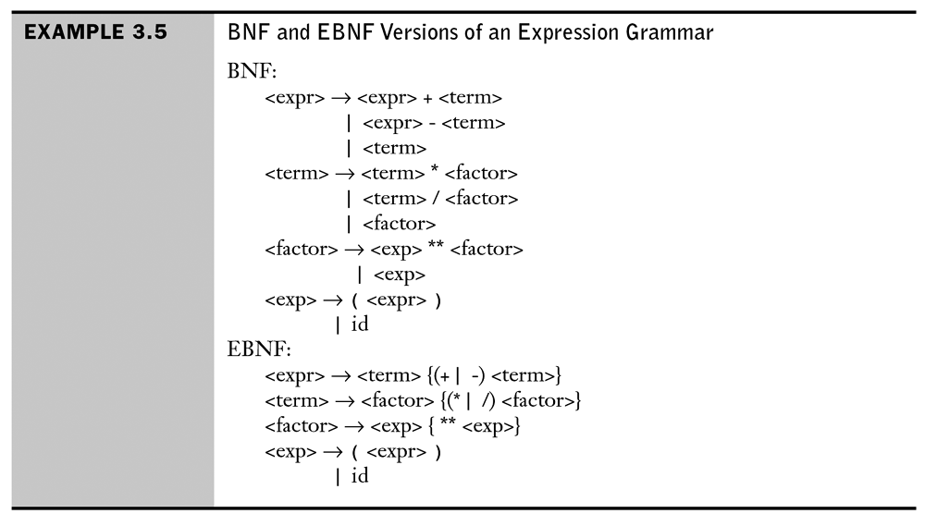
Attribute Grammars: An Example
Notes:
[Sebesta]

Slide 10
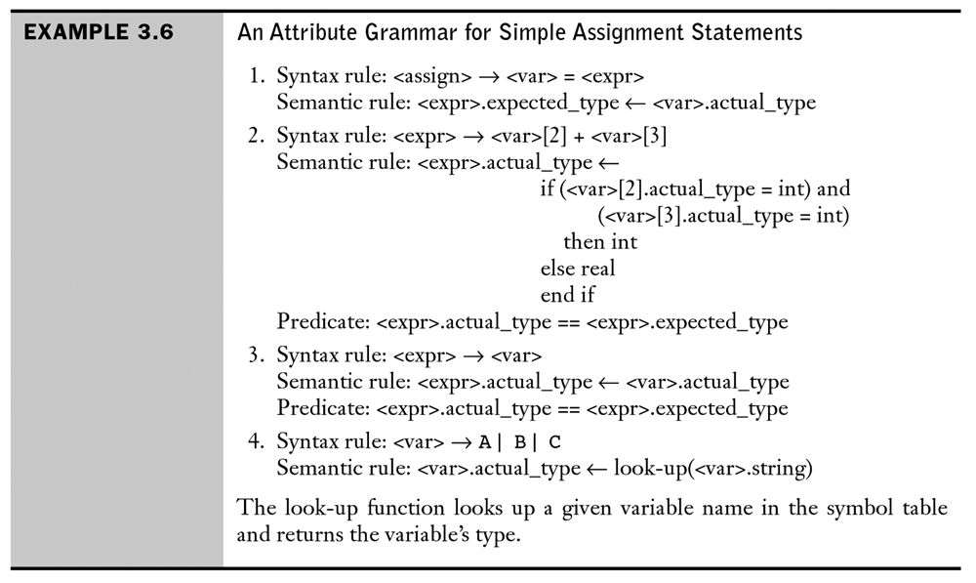
Attribute Grammars: An Example
Notes:
[Sebesta]

Slide 11
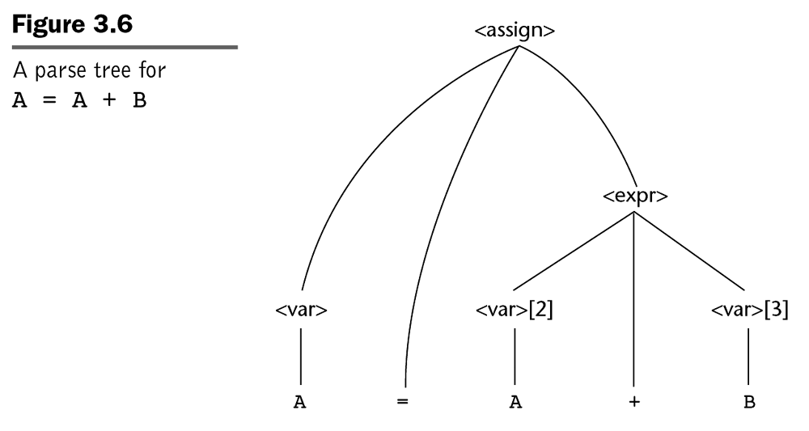
Attribute Grammars: An Example
Notes:
[Sebesta]

Slide 12
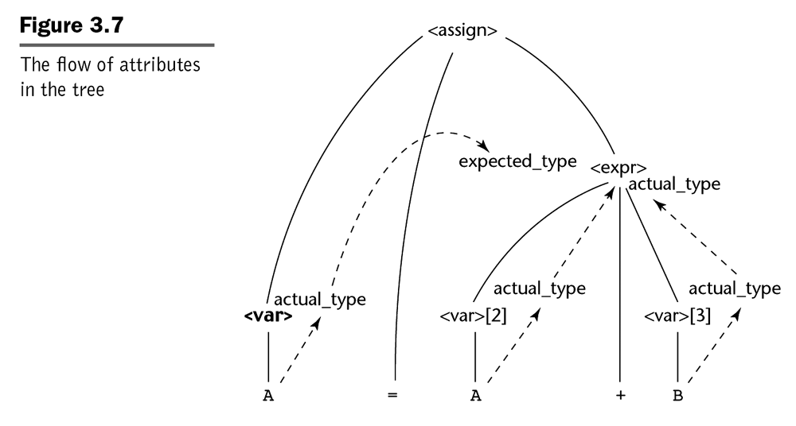
Attribute Grammars: An Example
Notes:
[Sebesta]

Slide 13
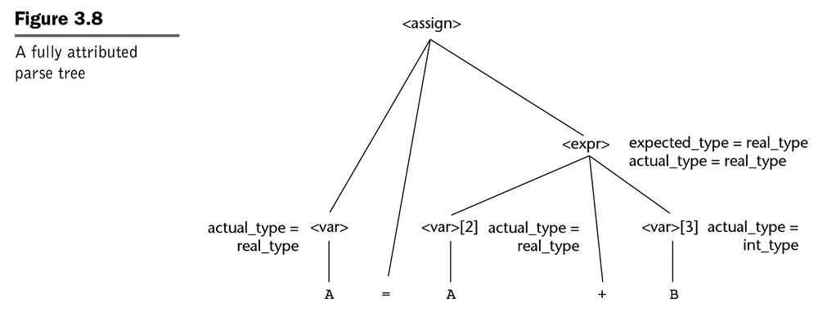
Attribute Grammars: An Example (End)
Notes:
[Sebesta]

Slide 14
A language is statically typed if the types of all variables are fixed when they are declared at compile time
A language is dynamically typed if the type of a variable can vary at run time depending on the value assigned
A language is strongly typed if its type system allows all type errors in a program to be detected either at compile time or at run time
A strongly typed language can be either statically or dynamically typed
Union types are a hole in the type system of many languages
  See p.104[T] for an example in C
Most dynamically typed languages associate a type with each value

Slide 15
5.3 Basic Types
Terminology in use with current 32-bit computers:
  Nibble: 4 bits
  Byte: 8 bits
  Half-word: 16 bits
  Word: 32 bits
  Double word: 64 bits
  Quad word: 128 bits

Slide 16
In most languages, the numeric types are finite in size.
So a + b may overflow the finite range.
Unlike mathematics:
  a + (b + c) ≠ (a + b) + c
Also in C-like languages, the equality and relational operators produce an int, not a Boolean

Slide 17
An operator or function is overloaded when its meaning varies depending on the types of its operands or arguments or result.
Java: a + b (ignoring size)
  integer add
  floating point add
  string concatenation
  Mixed mode: one operand an int, the other floating point

Slide 18
A type conversion is a narrowing conversion if the result type permits fewer bits, thus potentially losing information
Otherwise it is termed a widening conversion
Should languages ban implicit narrowing conversions?
Why?
See Figure 5.2 [T] for the ANSI C implicit type conversion rules

Slide 19
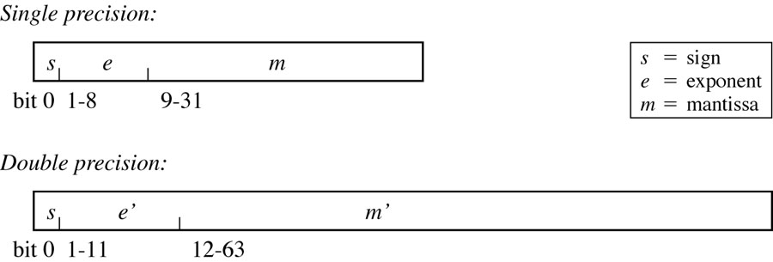
IEEE 754 Floating Point Number Representation
Figure 5.1 [T]
(-1)^{s} x 1.m x 2^{(e-127)} for single precision

Slide 20
5.4 Nonbasic Types
Enumeration:
  enum day {Monday, Tuesday, Wednesday, Thursday, Friday, Saturday, Sunday};
  enum day myDay = Wednesday;
In C/C++ the above values of this type are 0, ..., 6
More powerful in Java:
  for (day d : day.values())
Sytem.out.println(d);

Slide 21
Pointers
C, C++, Ada, Pascal
Value is a memory address
Indirect referencing
Java???
  has references
    like pointers, but always implicitly dereferenced, so that the address value cannot be accessed
Operator in C: *
C# allows both references and (unsafe) pointers

Slide 22

Example
struct Node {
int key;
struct Node* next;
};
struct Node* head;
--read: next is a pointer to Node, head is a pointer to Node
--or: Node *next, i.e., the object at address next is a Node
Node *head, i.e., the object at address head is a Node
Fig 5.4: A Simple Linked List in C

Slide 23
Problems with Pointers
Bane of reliable software development
Error-prone
Buffer overflow, memory leaks
Particularly troublesome in C
float sum(float a[ ], int n) {
int i;
float s = 0.0;
for (i = 0; i<n; i++)
s += a[i];
return s;
float sum(float *a, int n) {
int i;
float s = 0.0;
for (i = 0; i<n; i++)
s += *a++;
return s;

Slide 24
strcpy
void strcpy(char *p, char *q) {
while (*p++ = *q++) ;
}

Slide 25
Pointer Operations
If T is a type and ref T is a pointer:
  & : T → ref T
  read: “address of” (maps an element of type T to
  a reference to an element of type T)
  * : ref T → T read: (maps a reference to an element of type T to an element of type T)
For an arbitrary variable x:
  *(&x) = x (the value contained in the address of x is x)

Slide 26
Symbols
The symbol data type appears in some new programming languages: Ruby, Python, Scala, Clojure (a LISP-like language for the JVM), Erlang.
“Symbols are identifiers that are normally used to refer to something else. They can be used in program forms to refer to function parameters, let bindings, class names and global vars” [http://clojure.org/data_structures]
“A symbol is something that you use to represent names and strings. What this boils down to is a way to efficiently have descriptive names while saving the space one would use to generate a string for each naming instance” [http://glu.ttono.us/articles/2005/08/19/understanding-ruby-symbols]
Symbols seem to have features of enums and references
Credit Gary Fredericks for this information---more in the notes for this slide
Notes:
I'm sending some links re: the symbol type. Symbols, like enums, are objects that carry no information other than their own identity (it is often said that they "evaluate to themselves"), and are only used for comparison of equality with other symbols. They are much more convenient than enums in heavily object-oriented languages because they don't require any declaration (I once saw a GenderEnum declaration in java that took up over 100 lines of code - it's this kind of OOP bloat that symbols are avoiding). They're not as safe, like named integer constants, because there's no way to restrict their possible values. Like enums and named integer constants, they make code a lot more readable. They're often used as the keys of dictionary-data-structures. They're generally implemented as pointers to strings, so having many identical symbols doesn't take up unnecessary space in memory, and comparisons can be done in one constant-time operation.
The literal syntax is usually something like
my_symbol = :something
In erlang symbols are even more fundamental, and their syntax looks like most language's identifiers: erlang uses capitalized words for variable identifiers, and lowercase words for symbols.
Of the languages I know (the same 8 I listed on the board today), all but Java/Javascript/C++ have symbols:
Ruby: http://glu.ttono.us/articles/2005/08/19/understanding-ruby-symbols
Python: http://dirtsimple.org/2006/07/symbols-in-python.html
Scala: http://www.artima.com/forums/flat.jsp?forum=282&thread=238176
Clojure (lisp for JVM): http://clojure.org/data_structures#toc8
Erlang: http://www.erlang.org/doc/getting_started/part_frame.html
--
Gary Fredericks
(660)-623-1095
fredericksgary@gmail.com
www.gfredericks.com

Slide 27
Arrays and Lists
int a[10];
float x[3][5]; /* odd syntax vs. math */
char s[40];
/* indices: 0 ... n-1 */

Slide 28
Indexing
Only operation for many languages
Type signature
  [ ] : T[ ] x int → T
Examples
  float x[3] [5];
  type of x: float[ ][ ]
  type of x[1]: float[ ]
  type of x[1][2]: float
Equivalence between arrays and pointers
  a = &a[0]
If either e1 or e2 is type: ref T
  e1[e2] = *((e1) + (e2))
Example: a is float[ ] and i int
  a[i] = *(a + i) address of a + offset i * size_of_float

Slide 29
Contents
5.1 Type Errors
5.2 Static and Dynamic Typing
5.3 Basic Types
5.4 NonBasic Types
5.5 Recursive Data Types
5.6 Functions as Types
5.7 Type Equivalence
5.8 Subtypes
5.9 Polymorphism and Generics
5.10 Programmer-Defined Types

Slide 30
Strings
Now so fundamental, directly supported.
In C, a string is a one-dimensional array with the string value terminated by a NUL character (value = 0).
In Java, Perl, Python, a string variable can hold an unbounded number of characters.
Libraries of string operations and functions.

Slide 31
Structures or Records
Analogous to a tuple in mathematics
Collection of elements of different types
Used first in Cobol, PL/I
Absent from Fortran, Algol 60
Common to Pascal-like, C-like languages
Omitted from Java as redundant
  classes without methods are structures
struct employeeType {
int id;
char name[25];
int age;
float salary;
char dept;
};
struct employeeType employee;
...
employee.age = 45;

Slide 32
Unions
C: union
Pascal: case-variant record, with tagged discriminant
Logically: multiple views of same storage
Unsafe in Pascal and C
Useful in some systems applications
The example is in Ada, where tag and data must be assigned at the same time, thus ensuring type safety
type union =
record
case b : boolean of
true : (i : integer);
false : (r : real);
end;
var tagged : union;
begin tagged := (b => false, r => 3.375);
put(tagged.i); -- error

Slide 33
// simulated union type
class Value extends Expression {
// Value = int intValue | boolean boolValue
Type type; int intValue; boolean boolValue;
Value(int i) { intValue = i;
type = new Type(Type.INTEGER);
}
Value(boolean b) { boolValue = b;
type = new Type(Type.BOOLEAN);
}

Slide 34
5.5 Recursive Data Types
Haskell example
Definition of Clite values
Recursive definitions of Clite expressions
Equality, Ordering, and Display characteristics are inherited from the component types
State is a list of pairs
Variable and Op are strings
data Value = IntValue Integer | FloatValue Float | BoolValue Bool | CharValue Char
deriving (Eq, Ord, Show)
data Expression = Var Variable | Lit Value |
Binary Op Expression Expression |
Unary Op Expression
deriving (Eq, Ord, Show)
type Variable = String
type Op = String
type State = [(Variable, Value)]

Slide 35
5.6 Functions as Types
Java example:
public interface RootSolvable {
double valueAt(double x);
}
public double Newton(double a, double b, RootSolvable f);
Any function that implements the RootsSolvable interface can be passed as a parameter to Newton. Any such function has one double argument
Pascal example:
function newton(a, b: real; function f: real): real;
Know that f returns a real value, but the arguments to f are unspecified

Slide 36
5.7 Type Equivalence
Pascal Report: “The assignment statement serves to replace the current value of a variable with a new value specified as an expression. ... The variable (or the function) and the expression must be of identical type.”
Nowhere does it define identical type.
Two options:
name equivalence
structural equivalence
struct complex {
float re, im;
};
struct polar {
float x, y;
};
struct {
float re, im;
} a, b;
struct complex c, d;
struct polar e;
int f[5], g[10];
// which are equivalent types?

Slide 37
5.8 Subtypes
subtype one_to_ten is Integer range 1 .. 10;
type Day is (Monday, Tuesday, Wednesday, Thursday, Friday, Saturday, Sunday);
subtype Weekend is Day range Saturday .. Sunday;
type Salary is delta 0.01 digits 9
range 0.00 .. 9_999_999.99;
subtype Author_Salary is Salary digits 5
range 0.0 .. 999.99;
A subtype is a type that has certain constraints placed on its values or operations
In Ada subtypes can be directly specified

Slide 38
Java Subtypes via Class Hierarchy
Integer is a subclass of Number in java.lang
Integer i = new Integer(3);
...
Number v = i;
...
Integer x = (Integer) v;
//Integer is a subclass of Number,
// and therefore a subtype

Slide 39
Polymorphism and Generics
A function or operation is polymorphic if it can be applied to any one of several related types and achieve the same result.
An advantage of polymorphism is that it enables code reuse.
Comes from Greek, meaning: having many forms
Example: overloaded built-in operators and functions
  + - * / == != ...
Java: + also used for string concatenation
Ada, C++: define + - ... for new types
Java overloaded methods: number or type of parameters
Example: class PrintStream
  print, println defined for:
  boolean, char, int, long, float, double, char[ ]
  String, Object

Slide 40
Generics in Ada
Ada generics: generic sort
  parametric polymorphism
  type binding delayed from code implementation to compile time, thus adding the ability to (re)use code for different types
  Code for sort on the next slide
  Additional example (stack package) in [T]
generic
type element is private;
type list is array(natural range <>) of element;
with function ">"(a, b : element) return boolean;
package sort_pck is
procedure sort (in out a : list);
end sort_pck;

Slide 41
package sort_pck is
procedure sort (in out a : list) is
begin
for i in a'first .. a'last - 1 loop
for j in i+1 .. a'last loop
if a(i) > a(j) then
declare t : element;
begin
t := a(i);
a(i) := a(j);
a(j) := t;
end;
end if;
Notes:
Figure 5.10 [T]

Slide 42
Instantiation
package integer_sort is
new generic_sort( Integer, ">" );

Slide 43
Programmer-defined Types
Recall the definition of a type:
  A set of values and a set of operations on those values.
Structures allow a definition of a representation
Problems:
  Representation is not hidden
  Type operations cannot be defined
Defer further until Chapter 12

