Slide 1

CSCE 330
Programming Language Structures
Chapter 6: Type Systems
Fall 2009
Marco Valtorta
mgv@cse.sc.edu
I was eventually persuaded of the need to design programming
notations so as to maximize the number of errors that cannot be
made, or if made, can be reliably detected at compile time.
C.A.R Hoare
Notes:
[T]

Slide 2
Contents
6.1 Type System for Clite
6.2 Implicit Type Conversion
6.3 Formalizing the Clite Type System

Slide 3
Motivation: Detecting Type Errors
The detection of type errors, either at compile time or at run time, is called type checking.
  Type errors occur frequently in programs.
  Type errors can’t be prevented/detected by EBNF
  If undetected, type errors can cause severe run-time errors.
  A type system can identify type errors before they occur.

Slide 4
6.1 Type System for Clite
Static binding
Single function: main
Single scope: no nesting, no globals
Name resolution errors detected at compile time
  Each declared variable must have a unique identifier
  Identifier must not be a keyword (syntactically enforced)
  Each variable referenced must be declared.

Slide 5
Example Clite Program (Fig 6.1)
// compute the factorial of integer n
void main ( ) {
int n, i, result;
n = 8;
i = 1;
result = 1;
while (i < n) {
i = i + 1;
result = result * i;
}
}

Slide 6
Designing a Type System
A set of rules V in highly-stylized English
  return true or false
  based on abstract syntax
    Note: standards use concrete syntax
  Mathematically a function:
  V: AbstractSyntaxClass → Boolean
Facilitates static type checking
Implementation throws an exception if invalid

Slide 7
Type Rule 6.1
All referenced variables must be declared.
  Type map is a set of ordered pairs
  E.g., {<n, int>, <i, int>, <result, int>}
  Can implement as a hash table
  Function typing creates a type map
  Function typeOf retrieves the type of a variable:
  typeOf(id) = type

Slide 8
The typing Function Creates a Type Map
public static TypeMap typing (Declarations d) {
TypeMap map = new TypeMap( );
for (Declaration di : d) {
map.put (di.v, di.t);
}
return map;
}

Slide 9
Type Rule 6.2
All declared variables must have unique names.
public static void V (Declarations d) {
for (int i=0; i<d.size() - 1; i++)
for (int j=i+1; j<d.size(); j++) {
Declaration di = d.get(i);
Declaration dj = d.get(j);
check( ! (di.v.equals(dj.v)),
"duplicate declaration: " + dj.v);
}
}

Slide 10
Rule 6.2 example
// compute the factorial of integer n
void main ( ) {
int n, i, result;
n = 8;
i = 1;
result = 1;
while (i < n) {
i = i + 1;
result = result * i;
}
}
These must all be unique

Slide 11
Type Rule 6.3
A program is valid if
its Declarations are valid and
its Block body is valid with respect to the type map for those Declarations
public static void V (Program p) {
V (p.decpart);
V (p.body, typing (p.decpart));
}

Slide 12
Rule 6.3 Example
// compute the factorial of integer n
void main ( ) {
int n, i, result;
n = 8;
i = 1;
result = 1;
while (i < n) {
i = i + 1;
result = result * i;
}
}
These must be valid.

Slide 13
Type Rule 6.4
Validity of a Statement:
A Skip is always valid
An Assignment is valid if:
  Its target Variable is declared
  Its source Expression is valid
  If the target Variable is float, then the type of the source Expression must be either float or int
  Otherwise if the target Variable is int, then the type of the source Expression must be either int or char
  Otherwise the target Variable must have the same type as the source Expression.

Slide 14
Type Rule 6.4 (continued)
  A Conditional is valid if:
    Its test Expression is valid and has type bool
    Its thenbranch and elsebranch Statements are valid
  A Loop is valid if:
    Its test Expression is valid and has type bool
    Its Statement body is valid
  A Block is valid if all its Statements are valid.

Slide 15
Rule 6.4 Example
// compute the factorial of integer n
void main ( ) {
int n, i, result;
n = 8;
i = 1;
result = 1;
while (i < n) {
i = i + 1;
result = result * i;
}
}
This assignment is valid if:
n is declared,
8 is valid, and
the type of 8 is int or char
(since n is int).

Slide 16
Rule 6.4 Example
// compute the factorial of integer n
void main ( ) {
int n, i, result;
n = 8;
i = 1;
result = 1;
while (i < n) {
i = i + 1;
result = result * i;
}
}
This loop is valid if
i < n is valid,
i < n has type bool, and
the loop body is valid

Slide 17
Type Rule 6.5
Validity of an Expression:
A Value is always valid.
A Variable is valid if it appears in the type map.
A Binary is valid if:
  Its Expressions term1 and term2 are valid
  If its Operator op is arithmetic, then both Expressions must be either int or float
  If op is relational, then both Expressions must have the same type
  If op is && or ||, then both Expressions must be bool
A Unary is valid if:
  Its Expression term is valid,
  …

Slide 18
Type Rule 6.6
The type of an Expression e is:
  If e is a Value, then the type of that Value.
  If e is a Variable, then the type of that Variable.
  If e is a Binary op term1 term2, then:
    If op is arithmetic, then the (common) type of term1 or term2
    If op is relational, && or ||, then bool
  If e is a Unary op term, then:
    If op is ! then bool
    …

Slide 19
Rule 6.5 and 6.6 Example
// compute the factorial of integer n
void main ( ) {
int n, i, result;
n = 8;
i = 1;
result = 1;
while (i < n) {
i = i + 1;
result = result * i;
}
}
This Expression is valid since:
op is arithmetic (*) and
the types of i and result are int.
Its result type is int since:
the type of i is int.

Slide 20
6.2 Implicit Type Conversion
Clite Assignment supports implicit widening conversions
We can transform the abstract syntax tree to insert explicit conversions as needed.
The types of the target variable and source expression govern what to insert.

Slide 21
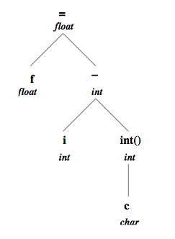
Example: Assignment of int to float
Suppose we have an assignment
f = i - int(c);
(f, i, and c are float, int, and char variables).
The abstract syntax tree is:

Slide 22
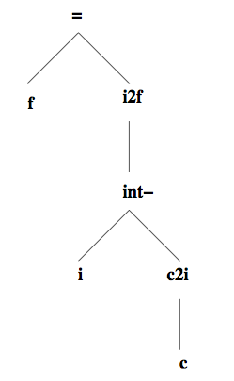
Example (cont’d)
So an implicit widening is inserted to transform the tree to:
Here, c2i denotes conversion from char to int, and itof denotes conversion from int to float
Note: c2i is an explicit conversion given by the operator int() in the program

Slide 23
Contents
6.1 Type System for Clite
6.2 Implicit Type Conversion
6.3 Formalizing the Clite Type System

Slide 24
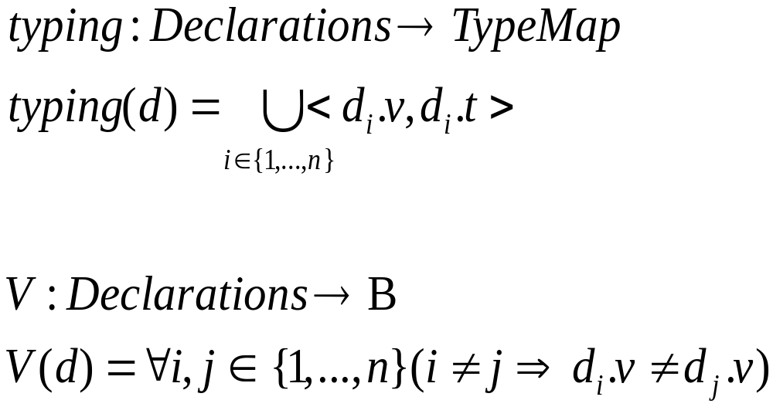
6.3 Formalizing the Clite Type System
Type map:
Created by:
(Type Rule 6.1)
Validity of
Declarations:
(Type Rule 6.2)

Slide 25
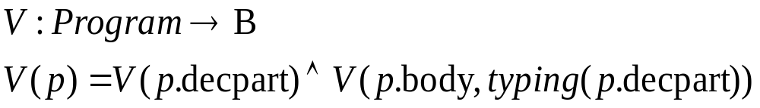
Validity of a Clite Program
(Type Rule 6.3)

Slide 26
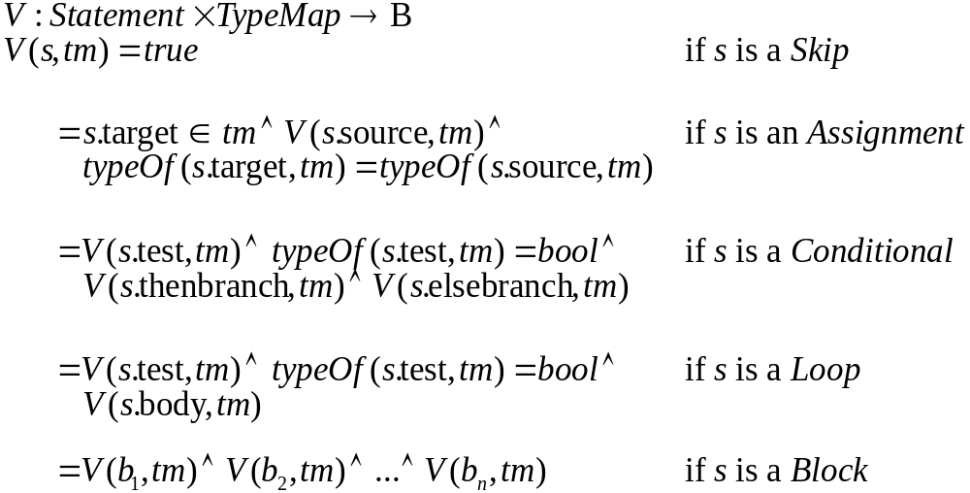
Validity of a Clite Statement
(Type Rule 6.4)

Slide 27
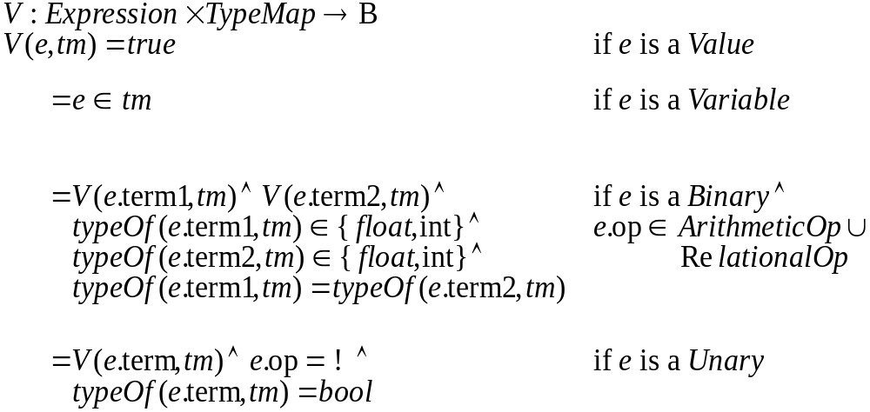
Validity of a Clite Expression
(Type Rule 6.5, abbreviated versions for Binary and Unary)

Slide 28
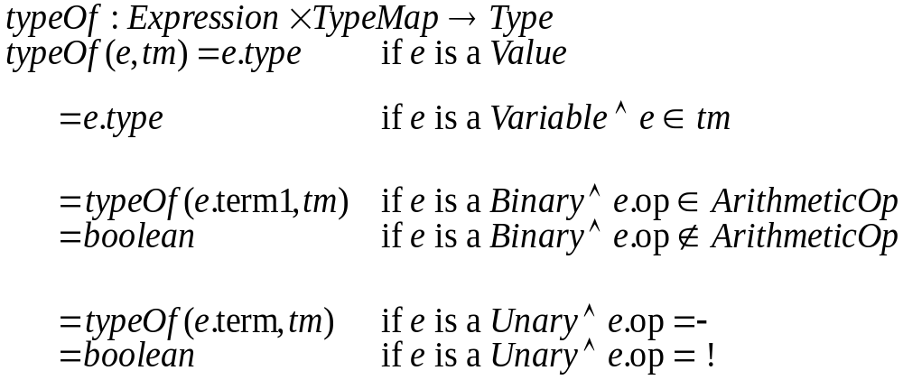
Type of a Clite Expression
(Type Rule 6.6, abbreviated version)

