Slide 1

CSCE 330
Programming Language Structures
Chapter 7: Semantics
Fall 2009
Marco Valtorta
mgv@cse.sc.edu
Surely all this is not without meaning.
Ishmael in Moby Dick by Herman Melville
Notes:
[T]

Slide 2
Contents
7.1 Motivation
7.2 Expression Semantics
7.3 Program State
7.4 Assignment Semantics
7.5 Control Flow Semantics
7.6 Input/Output Semantics
7.7 Exception Handling Semantics

Slide 3
7.1 Motivation
To provide an authoritative definition of the meaning of all language constructs for:
Programmers
Compiler writers
Standards developers
A programming language is complete only when its syntax, type system, and semantics are well-defined.

Slide 4
Semantics is a precise definition of the meaning of a syntactically and type-wise correct program
Ideas of meaning:
  Operational Semantics: The meaning attached by compiling using compiler C and executing using machine M. Ex: Fortran on IBM 709; C using SimpleSem
  Axiomatic Semantics: Chapter 18
  Denotational Semantics: Statements as state transforming functions
This chapter uses an informal, operational model.

Slide 5

7.2 Expression Semantics
Infix notation: (a + b) - (c * d)
Polish prefix notation: - + a b * c d
  generated by preorder traversal of the expression tree
Polish postfix notation: a b + c d * -
  generated by postorder traversal of the expression tree
  good for stacks
Cambridge prefix notation: (- (+ a b) (* c d))
  LISP-like
  allows use of the same operator with different arity
Infix uses associativity and precedence to disambiguate: a + b – c * d

Slide 6
Associativity of Operators
Language + - * / Unary- ** == != < ...
C-like L R not appl L
Ada L non non non
Fortran L R R L
Meaning of: a < b < c in C:
  if (a < x) 1 < b else 0 < b

Slide 7
Precedence of Operators
Operators C-like Ada Fortran
Unary - 7 3 3
** not applicable 5 5
* / 6 4 4
+ - 5 3 3
== != 4 2 2
< <= ... 3 2 2
Not 7 2 2
Logical and 2 1 1
Logical or 1 1 1

Slide 8
Short Circuit Evaluation
a and b evaluated as:
if a then b else false
a or b evaluated as:
if a then true else b
while (p != null) {
if (p.info == key)
break;
p = p.next;
}
Node p = head;
while (p != null && p.info != key)
p = p.next;
if (p == null) // not in list
...
else // found it
...
boolean found = false;
while (p != null && ! found) {
if (p.info == key)
found = true;
else
p = p.next;
}

Slide 9
Addition of Integers Is Not Associative
Recall that addition of floats is not associative
If a is the largest possible positive integer, b is 3, and c is -5, then
(a + b) + c is undefined (or leads to an error)
a + (b + c) evaluates to the largest integer minus 2
So, (a + b) + c != a + (b + c)

Slide 10
Side Effect
A change to any variable or I/O.
C expressions may have side effects: they are not referentially transparent.
What is the value of:
i = 2; b = 2; c = 5;
a = b * i++ + c * i;
14 if i is incremented after its second reference
19 if i is incremented before its second reference
In C, the above expression is undefined

Slide 11
7.3 Program State
The state of a program is the collection of all active objects and their current values. It maps:
the pairing of active objects with specific memory locations (the environment function)
the pairing of active memory locations with their current values (the memory function)
So: state = memory x environment
The current statement (portion of an abstract syntax tree) to be executed in a program is interpreted relative to the current state.
The individual steps that occur during a program run can be viewed as a series of state transformations.
For the purposes of this chapter, use only a map from a variable to its value; like a debugger watch window, tied to a particular statement.

Slide 12
// compute the factorial of n
1 void main ( ) {
2 int n, i, f;
3 n = 3;
4 i = 1;
5 f = 1;
6 while (i < n) {
7 i = i + 1;
8 f = f * i;
9 }
10 }

Slide 13
// compute the factorial of n
1 void main ( ) {
2 int n, i, f;
3 n = 3;
4 i = 1;
5 f = 1;
6 while (i < n) {
7 i = i + 1;
8 f = f * i;
9 }
10 }
n i f
undef undef undef
3 undef undef

Slide 14
// compute the factorial of n
1 void main ( ) {
2 int n, i, f;
3 n = 3;
4 i = 1;
5 f = 1;
6 while (i < n) {
7 i = i + 1;
8 f = f * i;
9 }
10 }
n i f
3 undef undef
3 1 undef

Slide 15
// compute the factorial of n
1 void main ( ) {
2 int n, i, f;
3 n = 3;
4 i = 1;
5 f = 1;
6 while (i < n) {
7 i = i + 1;
8 f = f * i;
9 }
10 }
n i f
3 1 undef
3 1 1

Slide 16
// compute the factorial of n
1 void main ( ) {
2 int n, i, f;
3 n = 3;
4 i = 1;
5 f = 1;
6 while (i < n) {
7 i = i + 1;
8 f = f * i;
9 }
10 }
n i f
3 1 1
3 1 1

Slide 17
// compute the factorial of n
1 void main ( ) {
2 int n, i, f;
3 n = 3;
4 i = 1;
5 f = 1;
6 while (i < n) {
7 i = i + 1;
8 f = f * i;
9 }
10 }
n i f
3 1 1
3 2 1

Slide 18
// compute the factorial of n
1 void main ( ) {
2 int n, i, f;
3 n = 3;
4 i = 1;
5 f = 1;
6 while (i < n) {
7 i = i + 1;
8 f = f * i;
9 }
10 }
n i f
3 2 2
3 2 1

Slide 19
// compute the factorial of n
1 void main ( ) {
2 int n, i, f;
3 n = 3;
4 i = 1;
5 f = 1;
6 while (i < n) {
7 i = i + 1;
8 f = f * i;
9 }
10 }
n i f
3 2 2
3 2 2
3 3 2
3 3 6

Slide 20
// compute the factorial of n
1 void main ( ) {
2 int n, i, f;
3 n = 3;
4 i = 1;
5 f = 1;
6 while (i < n) {
7 i = i + 1;
8 f = f * i;
9 }
10 }
n i f
3 3 6
3 3 6

Slide 21
7.4 Assignment Semantics
Issues
Multiple assignment
Assignment statement vs. expression
Copy vs. reference semantics

Slide 22
Multiple Assignment
Example:
a = b = c = 0;
Sets all 3 variables to zero
Commonly used for initializations

Slide 23
Assignment Command vs. Expression
In most languages, assignment is a command; cannot appear in an expression.
In C-like languages, assignment is an expression.
  Example: if (a = 0) ... // most likely an error
  while (*p++ = *q++) ; // strcpy
  while (ch = getc(fp)) ... // ???
  while (p = p->next) ... // ???

Slide 24
Copy vs. Reference Semantics
Copy: a = b;
  a, b have same value.
  Changes to either have no effect on other.
  Used in imperative languages.
Reference
  a, b point to the same object.
  A change in object state affects both
  Used by many object-oriented languages.

Slide 25
public void add (Object word, Object number) {
Vector set = (Vector) dict.get(word);
if (set == null) { // not in Concordance
set = new Vector( );
dict.put(word, set);
}
if (allowDupl || !set.contains(number))
set.addElement(number);
}
Under copy semantics, the last statement would not update the concordance properly
Notes:
Tucker and Noonan, 1sr ed., p. 191.

Slide 26
7.5 Control Flow Semantics
To be complete, an imperative language needs:
Statement sequencing
Conditional statement
Looping statement
This is the Bohm-Jacopini theorem (1966): C. Bohm and G. Jacopini. “Flow Diagrams, Turing Machines, and Languages with Only Two Formation Rules.” Communications of the ACM, 9, 5 (May 1966), 213-217.

Slide 27
Sequence
s1 s2
Semantics: in the absence of a branch:
First execute s1
Then execute s2
Output state of s1 is the input state of s2

Slide 28
Conditional
IfStatement → if ( Expression ) Statement
[ else Statement ]
Example:
if (a > b)
z = a;
else
z = b;

Slide 29
If the test expression is true,
then the output state of the conditional is the output state of the then branch,
else the output state of the conditional is the output state of the else branch.

Slide 30
Loops
WhileStatement → while ( Expression ) Statement
The expression is evaluated.
If it is true, first the statement is executed,
and then the loop is executed again.
Otherwise the loop terminates.

Slide 31
7.6 Input/Output Semantics
Binding: open, close
Access: sequential vs. random
Stream vs. fixed length records
Character vs. binary
Format

Slide 32
Standard Files
Unix: stdin, stdout, stderr
C: stdin, stdout, stderr
C++: cin, cout, cerr
Java: System.in, System.out, System.err

Slide 33
Input/Output Streams
Fortran
  integer :: i, a(8)
  write(8,*) “Enter 8 integers: “
  read(*,*) a
  write(*,*) a
Java
  file, pipe, memory, url
  filter
  reader, writer

Slide 34
Formats
C
  Codes: d, e, f, c, s (decimal. float, float, char, string)
  Specifier: % opt-width code
  Ex: %s %5d %20s %8.2f
Fortran
  Codes: i, f, a (integer, float, string)
  Specifier: op-repeat code width
  Ex: 8i4, f8.2, a20

Slide 35
Contents
7.1 Motivation
7.2 Expression Semantics
7.3 Program State
7.4 Assignment Semantics
7.5 Control Flow Semantics
7.6 Input/Output Semantics
7.7 Exception Handling Semantics

Slide 36
Purpose
Simplify programming
Make applications more robust.
What does robust mean?

Slide 37
(* Pascal - what can go wrong *)
reset(file, name);
sum := 0.0;
count := 0;
while (not eof(file)) do begin
end;
ave := sum / count;
count := count + 1;
sum := sum + number;
read(file, number);
(* open *)

Slide 38
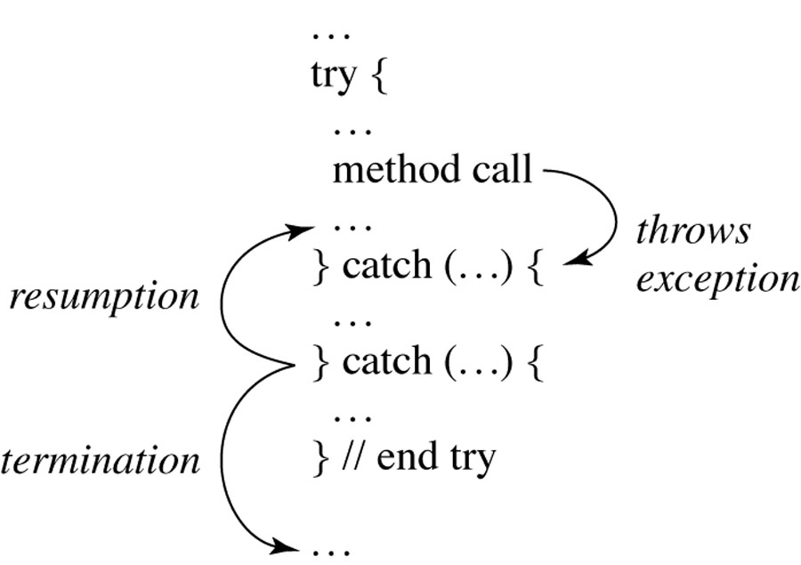
Exception Handling
Figure 7.9

Slide 39
#include <iostream.h>
int main () {
char A[10];
cin >> n;
try {
for (int i=0; i<n; i++){
if (i>9) throw "array index error";
A[i]=getchar();
}
}
catch (char* s)
{ cout << "Exception: " << s << endl; }
return 0;
}

Slide 40
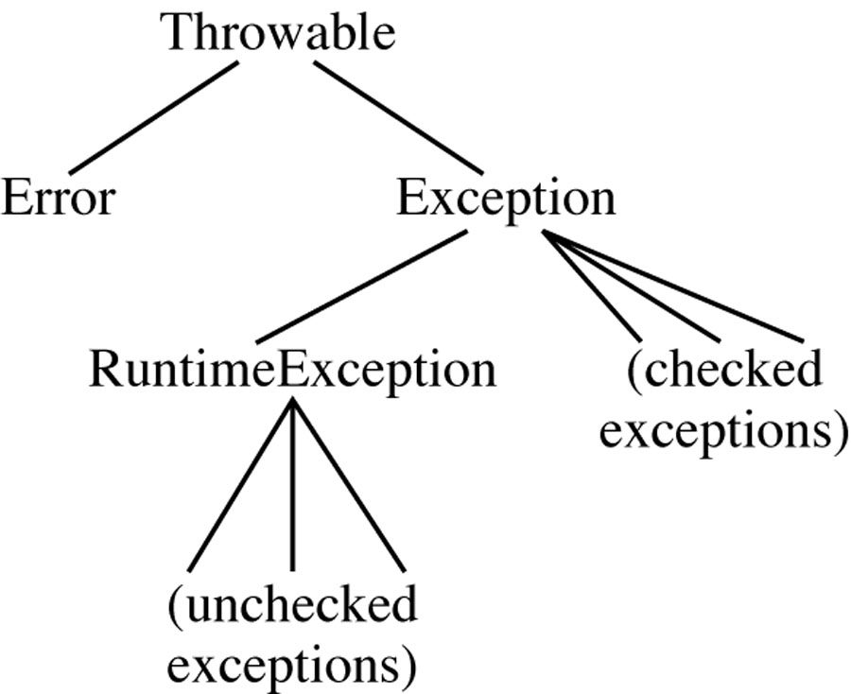
Java Exception Type Hierarchy
Figure 7.10

Slide 41
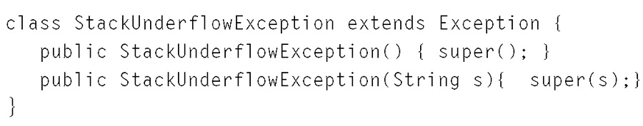
Creating a New Exception Class

Slide 42
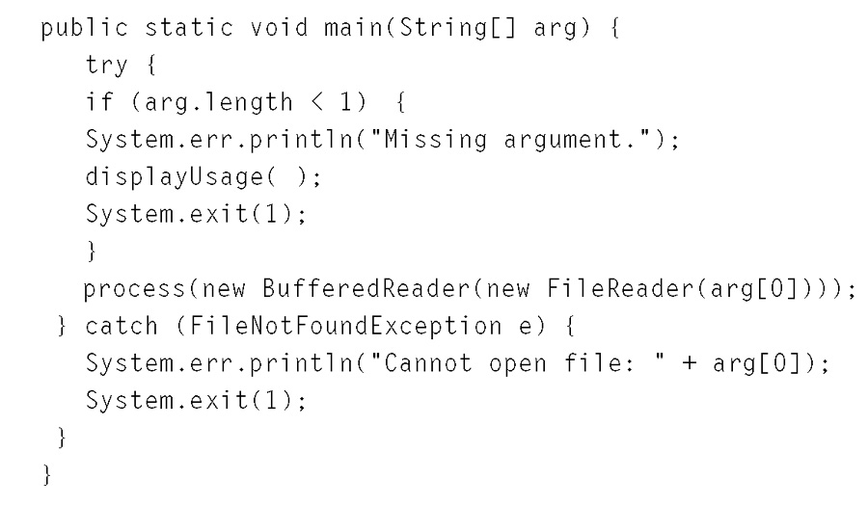
Missing Argument Exception

Slide 43
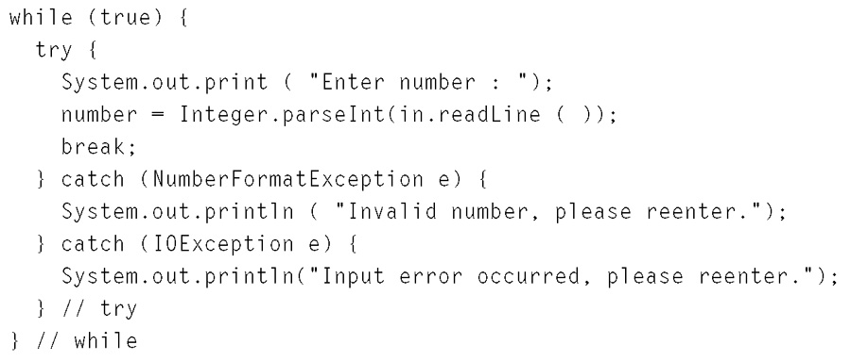
Invalid Input Exception
Figure 7.12

Slide 44
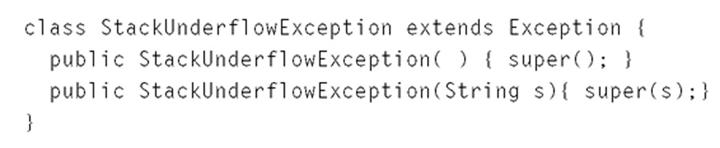
StackUnderflowException Class
Figure 7.13

Slide 45
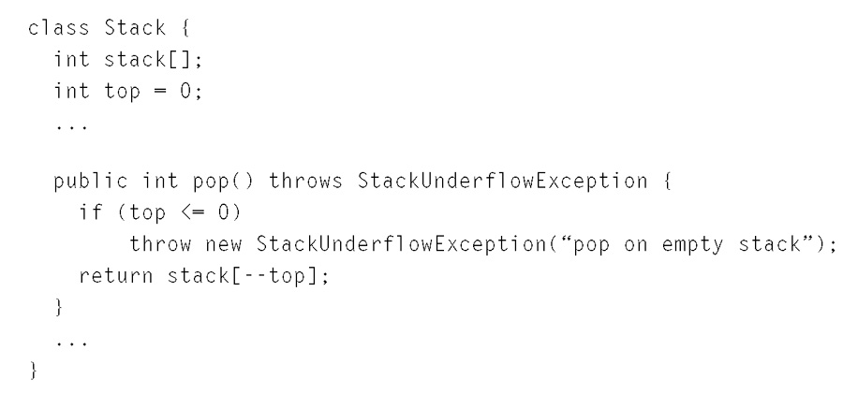
Throwing an Exception
Figure 7.13

Slide 46
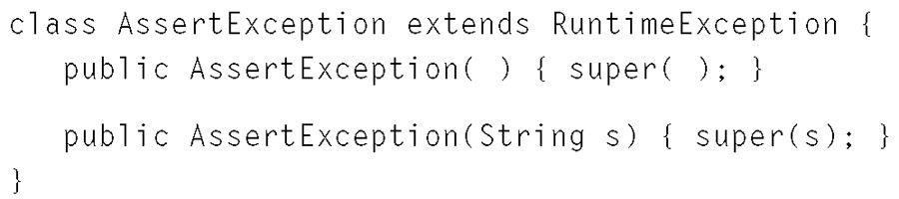
AssertException Class

Slide 47
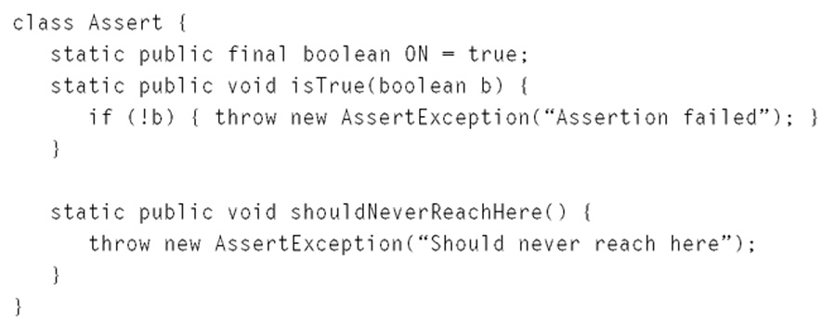
Assert Class
Figure 7.15

Slide 48
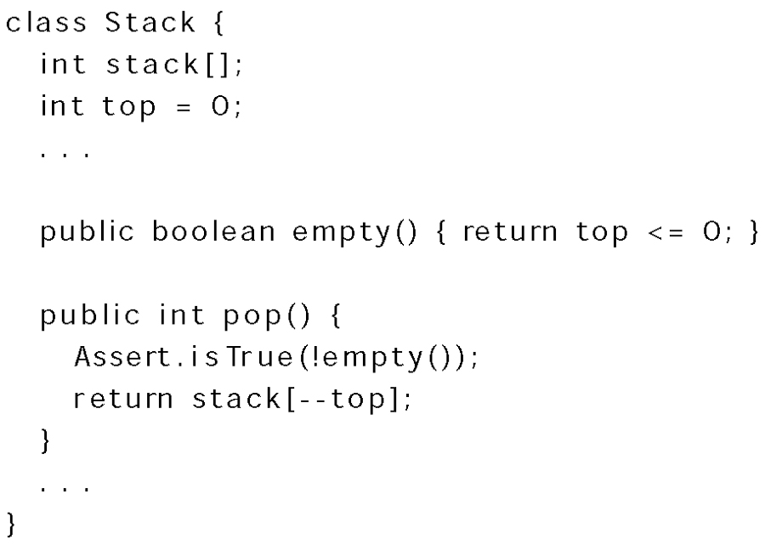
Using Asserts

