Slide 1
Data Governance

Slide 2

Data As An Enterprise - Corporate - Asset
Data Should be accepted as an enterprise asset
  Data Quality should be part of everyone’s job description
  Data Quality should be a parameter of performance evaluations and incentive packages
Employees should be assigned responsibility of data
  Stewardship responsibility including
    Establishing and forcing the policies
    Defining data quality parameters and standards
    Data classifications and processing
  Address the major reasons for the failure to fill this role
    Data is not recognized as an asset
    Political or cultural consideration (e.g. who should be responsible for customer data)
    The difficulty involved and other priorities
Data should be modeled like other assets
Data should be modeled via business or enterprise data model
Compromise between accuracy and availability of data

Slide 3

Data Governance
People
The formal orchestration of people, process, and technology to enable an organization to leverage data as an enterprise asset.
Data
Governance
Processes
Technology
CH Data governance Model is a set of processes, policies, standards and technologies required to manage and ensure the availability, accessibility, quality, consistency, auditability, and security of data within the organization

Slide 4

Why Data Governance
Do you have in mind any of the following questions
  What policies are in place, who writes them, and how they get approved and changed
  Which data should be prioritized, the location and value of the data
  What vulnerabilities exist, how risks are classified and which risks to accept, mitigate or transfer
  What controls are in place, who pays for the controls and their location
  How progress is measured, audit results and who receives this information
  What the governance process looks like and who is responsible for governing
Having one or more of these questions means
you need Data Governance

Slide 5

Data Governance Challenges
Cultural barriers
Lack of senior-level sponsorship
Underestimating the amount of work involved
Long on structure and policies, short on action
Lack of business commitment
Lack of understanding that business definitions vary
Trying to move very fast from no-data-governance to enterprise-wide- data governance
A lack of cross-organizational data governance structures, policy-making, risk calculation or data asset appreciation, causing a disconnect between business goals and IT programs.
Governance policies are not linked to structured requirements gathering, forecasting and reporting.
Risks are not addressed from a lifecycle perspective with common data repositories, policies, standards and calculation processes.
Metadata and business glossaries are not used as to track data quality, bridge semantic differences and demonstrate the business value of data.
Few technologies exist today to assess data values, calculate risk and support the human process of governing data usage in an enterprise.
Controls, compliance and architecture are deployed before long-term consequences are modeled.

Slide 6
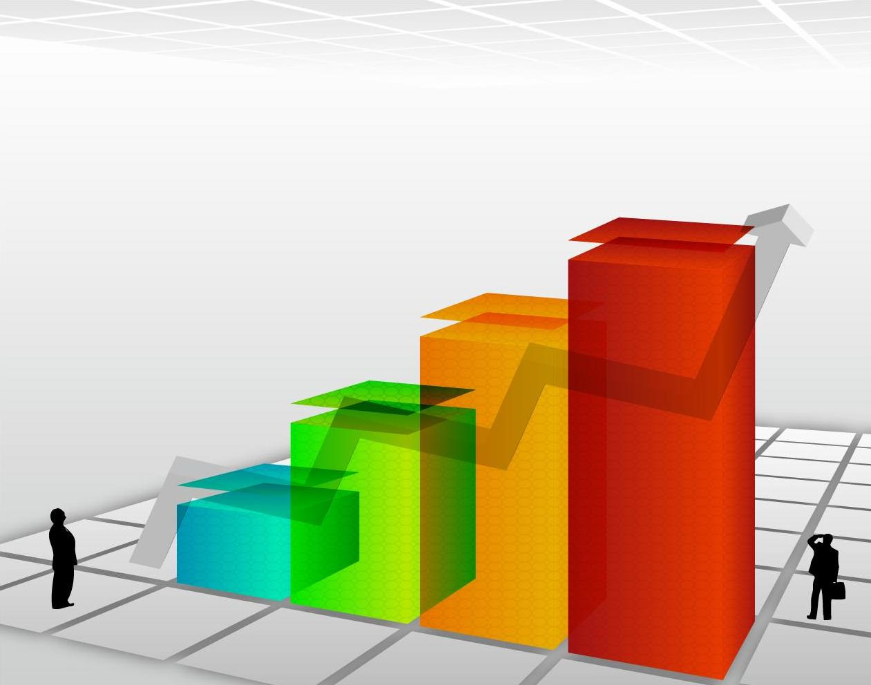
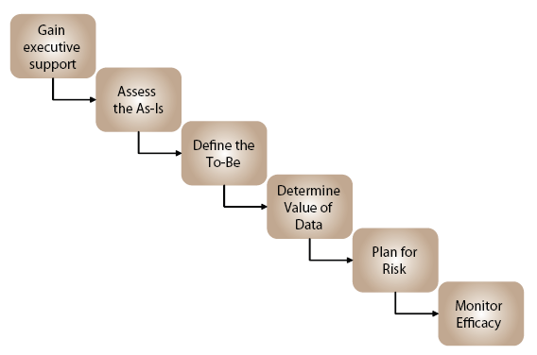
Data Governance Process
Identify Target Source Systems
Identify Current Registration Processes
Document the current Data Lifecycle
Perform proper Data Profiling
Identify Data cleansing Rules
Identify Rules of duplications
Identify Critical data changes
Governance Mission
Strategy, metrics and success measurements
Compliance
Compliance to internal standards, polices and guidelines based on contracts, SLAs and Data definitions
Governance Office
Data Stewards, stakeholders
Monitor and Measure
Sponsorship
Strategic Direction
Funding
Advocacy
Oversight

Slide 7
Data Governance Maturity Model
Category |  | Description
1 | Organizational Structures & Awareness | Describes the level of mutual responsibility between business and IT, and recognition of the fiduciary responsibility to govern data at different levels of management.
2 | Stewardship | Stewardship is a quality control discipline designed to ensure custodial care of data for asset enhancement, risk mitigation, and organizational control.
3 | Policy | Policy is the written articulation of desired organizational behavior.
4 | Value Creation | The process by which data assets are qualified and quantified to enable the business to maximize the value created by data assets.
5 | Data Risk Management & Compliance | The methodology by which risks are identified, qualified, quantified, avoided, accepted, mitigated, or transferred out.
6 | Information Security & Privacy | Describes the policies, practices and controls used by an organization to mitigate risk and protect data assets.

Slide 8
Data Governance Maturity Model Cont.
Category |  | Description
7 | Data Architecture | The architectural design of structured and unstructured data systems and applications that enable data availability and distribution to appropriate users.
8 | Data Quality Management | Methods to measure, improve, and certify the quality and integrity of production, test, and archival data.
9 | Classification & Metadata | The methods and tools used to create common semantic definitions for business and IT terms, data models, types, and repositories. Metadata that bridge human and computer understanding.
10 | Information Lifecycle Management | Management A systemic policy-based approach to information collection, use, retention, and deletion.
11 | Audit Information, Logging & Reporting | The organizational processes for monitoring and measuring the data value, risks, and efficacy of governance.

Slide 9






Short Term Plan – Collaborative Pattern
Create Data Governance project
Analyst leads from BUs to be the main members
Modify the JDs and KPIs to reflect the data governance responsibilities
Discuss and realize the Data governance mission statements, for example
  Data quality has to be within 90-to-95%
  Duplicates to be eliminated completely
  License Numbers to be validated and corrected
  … etc
Identify the changes required at the source systems level
BUs to modify their source systems to conform the data governance rules
Get the right permissions to access PRD data
Identify the key parameters for data profiling
Dedicated resources for data profiling and data cleansing
Plan for multiple iterations each of 2 weeks duration time
Rebuild the data hub every 2 iterations
Get the feed back from the consolidated view
Repeat the same for maximum 6 months and close the project after documenting the as-is situation
Gain
Executive
support
Assess
The
As-Is
Monitor
Efficiency
Data
Governance
Process
Plan
For
Risk
Define
The
To-Be
Determine
Value of Data

Slide 10
Long Term Plan – Operational Pattern
Establish the data governance committee
Create workgroup of techno-function members
Modify the JDs and KPIs to reflect the data governance responsibilities
Identify the master data domains (Customer, Product, ….etc)
Identify the CLDM
Standardize the reference data and lookup entities
Streamline the maintenance and registration process (UMRP)
Initiate an implementation project
Go for Agile methodology having multiple iterations, assuring the backward compatibly
Deploy components separately and monitor the situation
Rebuild the data hub every 2 iterations
Revise the mission statement, scope and technology
Stabilize and finalize the process
Identify the main integration points and realize them in a loosely coupled fashion as a separate integration layer

Slide 11
Roles To be involved
Domain Expert – Function consultant
Information architect
Data steward
Data Analyst
Business Analyst

