Slide 1
8
C Characters and Strings

Slide 2
The chief defect of Henry King
Was chewing little bits of string.
  Hilaire Belloc
Vigorous writing is concise.
A sentence should contain no unnecessary words, a paragraph no unnecessary sentences.
  William Strunk, Jr.
I have made this letter longer than usual, because I lack the time to make it short.
  Blaise Pascal

Slide 3
The difference between the almost-right word & the right word is really a large matter—it’s the difference between the lightning bug and the lightning.
  Mark Twain
Mum’s the word.
  Miguel de Cervantes,
  Don Quixote de la Mancha

Slide 4
OBJECTIVES
In this chapter you will learn:
To use the functions of the character-handling library (ctype).
To use the string-conversion functions of the general utilities library (stdlib).
To use the string and character input/output functions of the standard input/output library (stdio).
To use the string-processing functions of the string handling library (string).
The power of function libraries as a means of achieving software reusability.

Slide 5
8.1 Introduction
8.2 Fundamentals of Strings and Characters
8.3 Character-Handling Library
8.4 String-Conversion Functions
8.5 Standard Input/Output Library Functions
8.6 String-Manipulation Functions of the
String-Handling Library
8.7 Comparison Functions of the String-Handling Library
8.8 Search Functions of the String-Handling Library
8.9 Memory Functions of the String-Handling Library
8.10 Other Functions of the String-Handling Library

Slide 6
8.1 Introduction
Introduce some standard library functions
  Easy string and character processing
  Programs can process characters, strings, lines of text, and blocks of memory
These techniques used to make
  Word processors
  Page layout software
  Typesetting programs

Slide 7
8.2 Fundamentals of Strings and Characters
Characters
  Building blocks of programs
    Every program is a sequence of meaningfully grouped characters
  Character constant
    An int value represented as a character in single quotes
    'z' represents the integer value of z
Strings
  Series of characters treated as a single unit
    Can include letters, digits and special characters (*, /, $)
  String literal (string constant) - written in double quotes
    "Hello"
  Strings are arrays of characters
    String a pointer to first character
    Value of string is the address of first character

Slide 8
Portability Tip 8.1
When a variable of type char * is initialized with a string literal, some compilers may place the string in a location in memory where the string cannot be modified. If you might need to modify a string literal, it should be stored in a character array to ensure modifiability on all systems.

Slide 9
Common Programming Error 8.1
Not allocating sufficient space in a character array to store the null character that terminates a string is an error.

Slide 10
Common Programming Error 8.2
Printing a “string” that does not contain
a terminating null character is an error.

Slide 11
Error-Prevention Tip 8.1
When storing a string of characters in a character array, be sure that the array is large enough to hold the largest string that will be stored. C allows strings of any length to be stored. If a string is longer than the character array in which it is to be stored, characters beyond the end of the array will overwrite data in memory following the array.

Slide 12
8.2 Fundamentals of Strings and Characters
String definitions
  Define as a character array or a variable of type char *
      char color[] = "blue";
      char *colorPtr = "blue";
  Remember that strings represented as character arrays end with '\0'
    color has 5 elements
Inputting strings
  Use scanf
      scanf("%s", word);
    Copies input into word[]
    Do not need & (because a string is a pointer)
  Remember to leave room in the array for '\0'

Slide 13
Common Programming Error 8.3
Processing a single character as a string. A string is a pointer—probably a respectably large integer. However, a character is a small integer (ASCII values range 0–255). On many systems this causes an error, because low memory addresses are reserved for special purposes such as operating-system interrupt handlers—so “access violations” occur.

Slide 14
Common Programming Error 8.4
Passing a character as an argument to a function when a string is expected is a syntax error.

Slide 15
Common Programming Error 8.5
Passing a string as an argument to a function when a character is expected is a syntax error.

Slide 16
8.3 Character Handling Library
Character handling library
  Includes functions to perform useful tests and manipulations of character data
  Each function receives a character (an int) or EOF as an argument
The following slides contain a table of all the functions in <ctype.h>

Slide 17
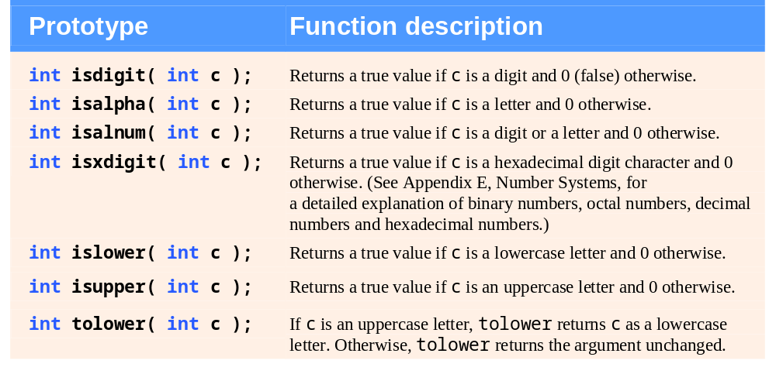
Fig. 8.1 | Character-handling library functions. (Part 1 of 2.)

Slide 18
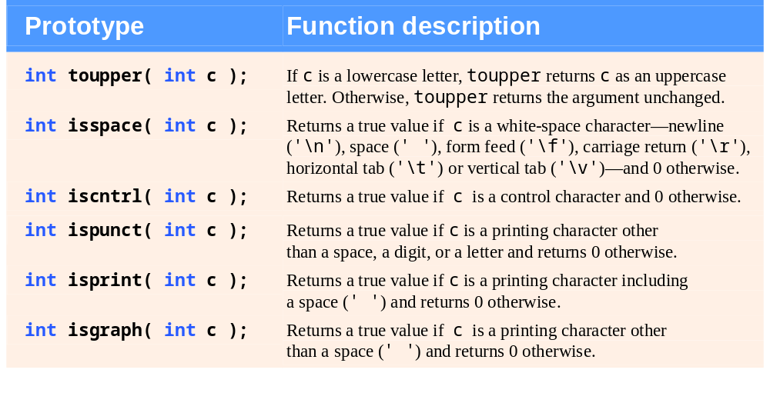
Fig. 8.1 | Character-handling library functions. (Part 2 of 2.)

Slide 19
Error-Prevention Tip 8.2
When using functions from the character-handling library, include the <ctype.h> header.

Slide 20
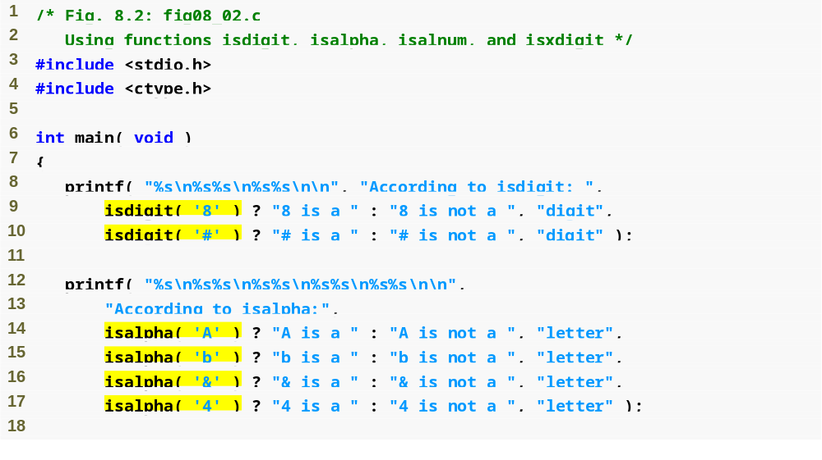
Outline
fig08_02.c
(1 of 3 )
isdigit tests if a character is a decimal digit
isalpha tests if a character is a letter

Slide 21
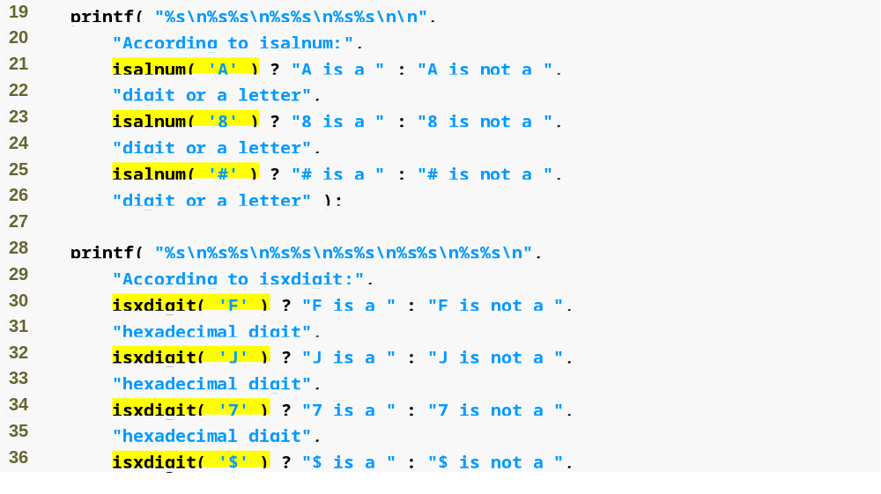
Outline
fig08_02.c
(2 of 3 )
isdigit tests if a character is a decimal digit or a letter
isxdigit tests if a character is a hexadecimal digit

Slide 22
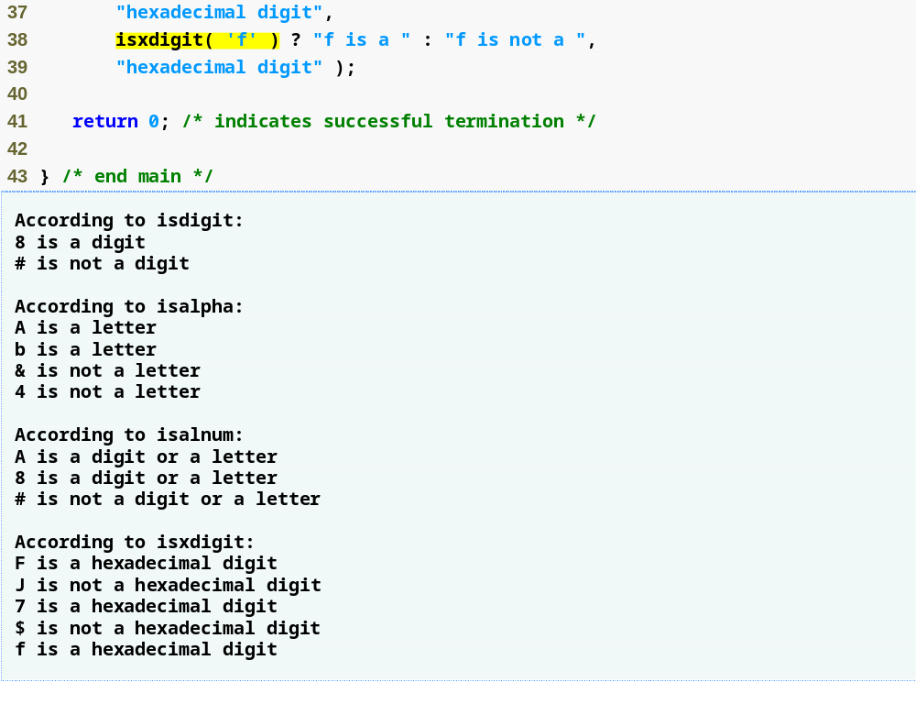
Outline
fig08_02.c
(3 of 3 )

Slide 23
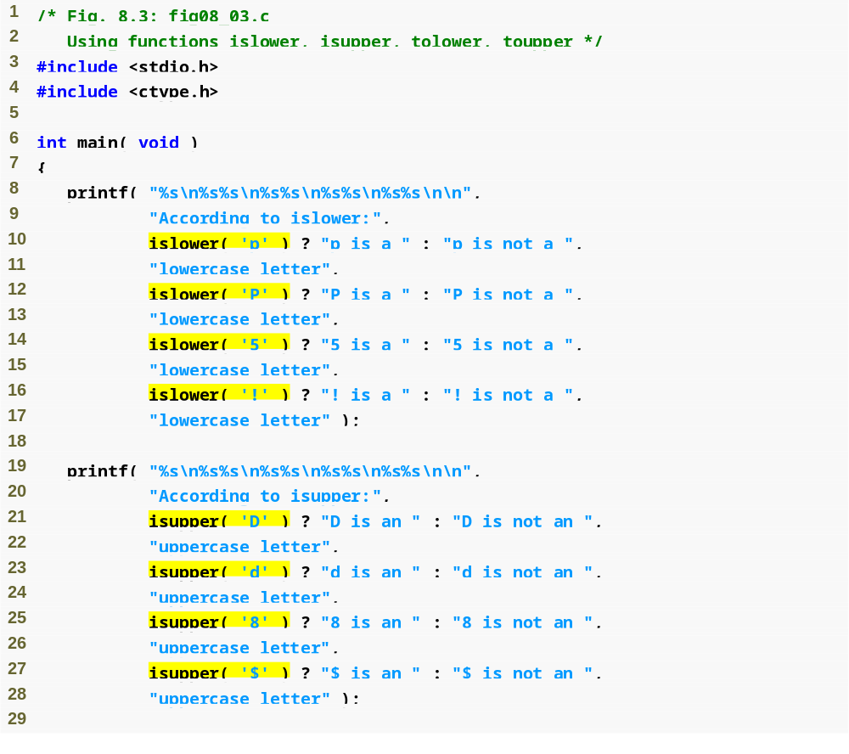
Outline
fig08_03.c
(1 of 2 )
islower tests if a character is a lowercase letter
isupper tests if a character is an uppercase letter

Slide 24
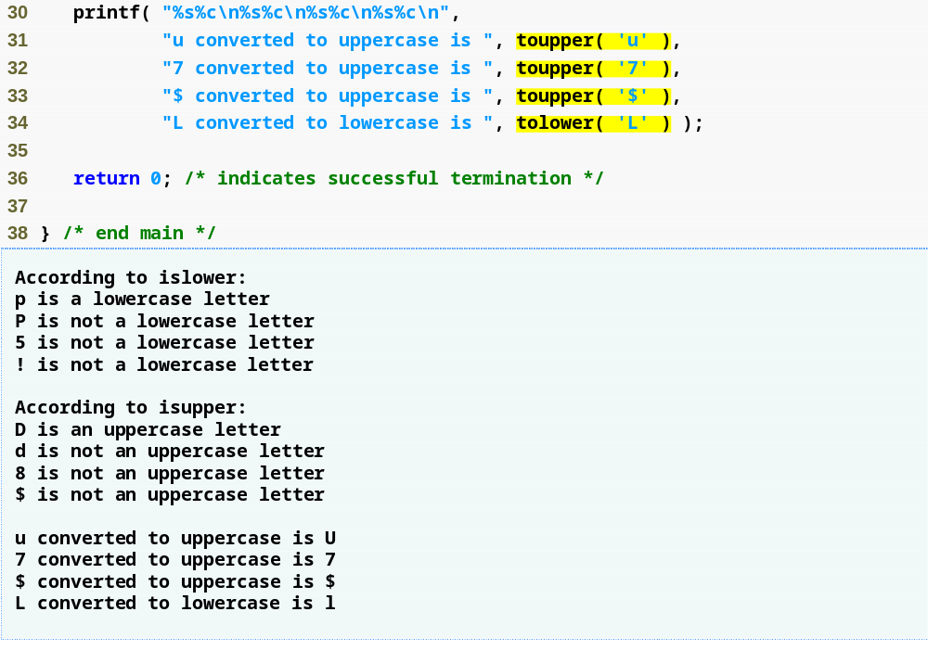
Outline
toupper and tolower convert letters to upper or lower case
fig08_03.c
(2 of 2 )

Slide 25
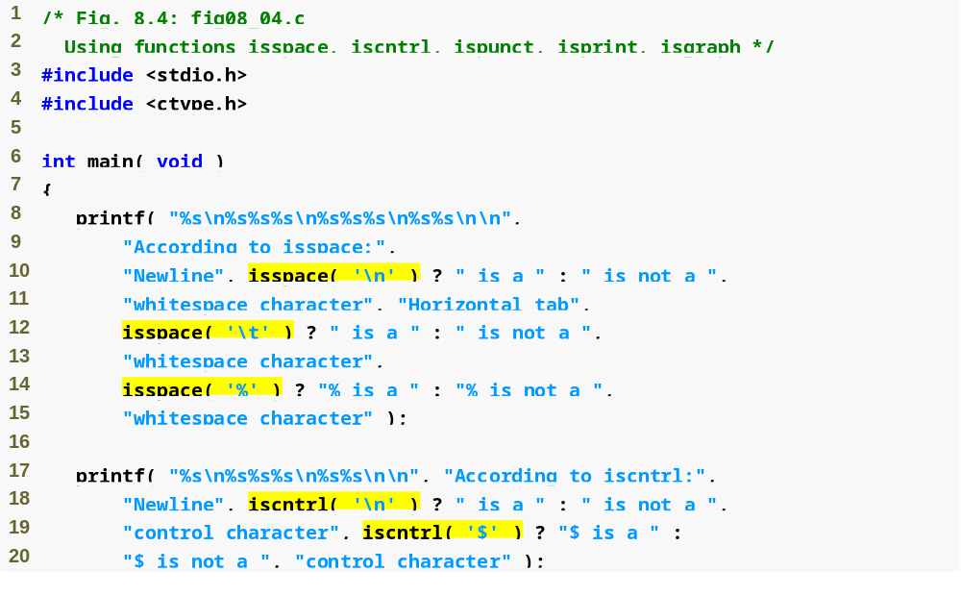
Outline
fig08_04.c
(1 of 3 )
isspace tests if a character is a whitespace character
iscntrl tests if a character is a control character

Slide 26
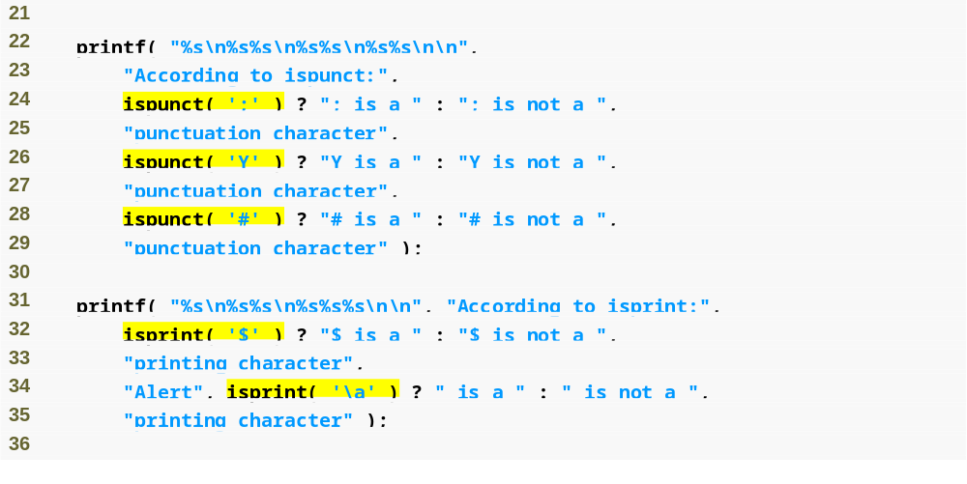
Outline
fig08_04.c
(2 of 3 )
ispunct tests if a character is a punctuation character
isprint tests if a character is a printing character

Slide 27
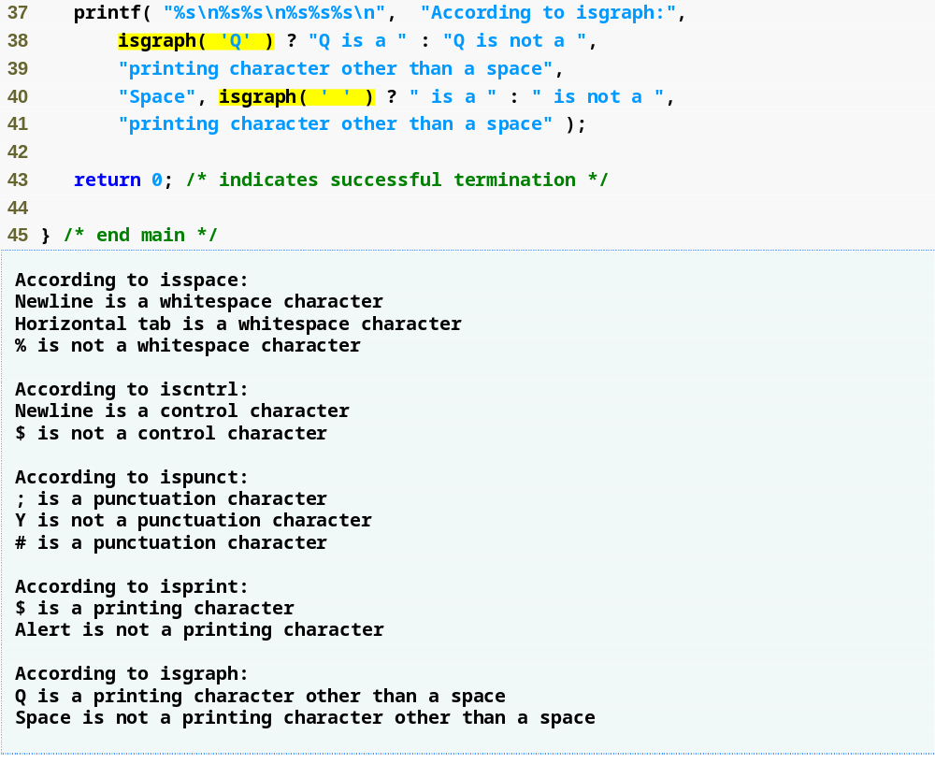
Outline
isgraph tests if a character is a printing character that is not a space
fig08_04.c
(3 of 3 )

Slide 28
8.4 String-Conversion Functions
Conversion functions
  In <stdlib.h> (general utilities library)
Convert strings of digits to integer and floating-point values

Slide 29
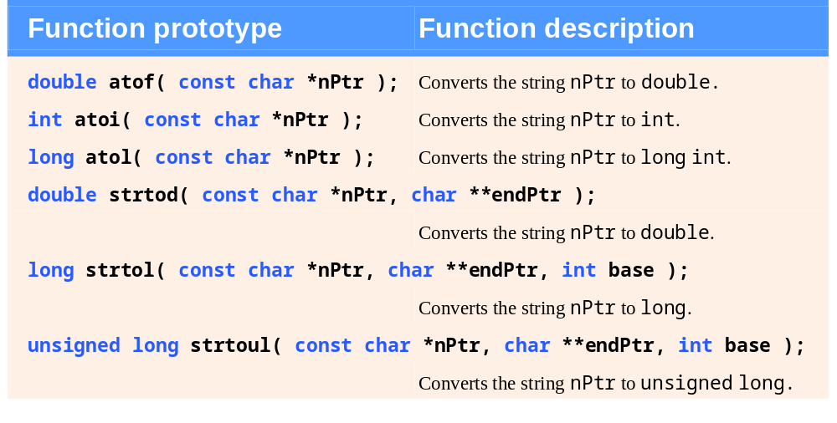
Fig. 8.5 | String-conversion functions of the general utilities library.

Slide 30
Error-Prevention Tip 8.3
When using functions from the general utilities library, include the <stdlib.h> header.

Slide 31
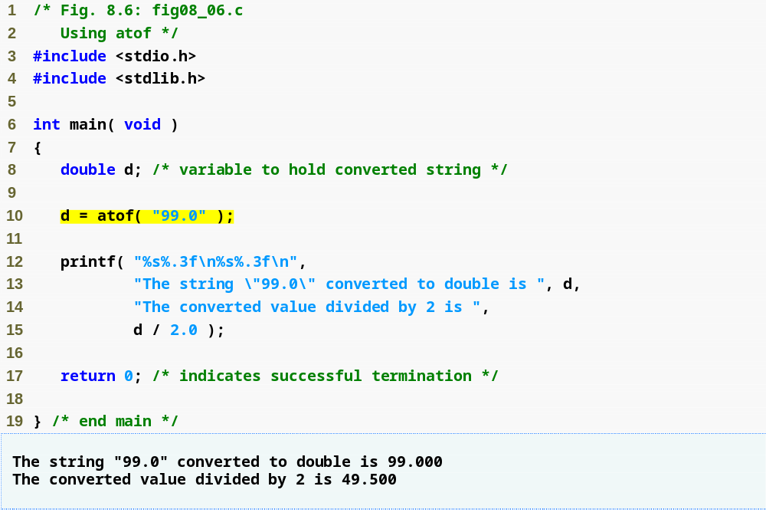
Outline
fig08_06.c
atof converts a string to a double

Slide 32
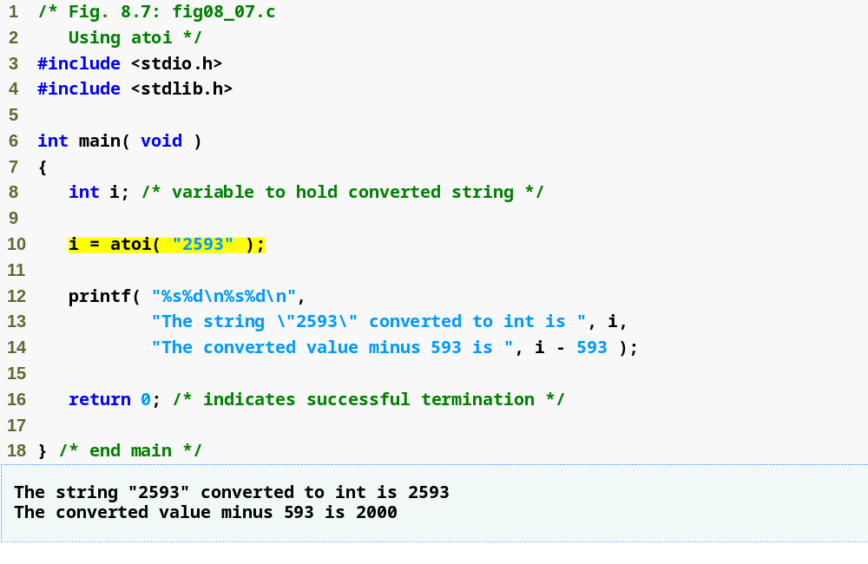
Outline
fig08_07.c
atoi converts a string to an int

Slide 33
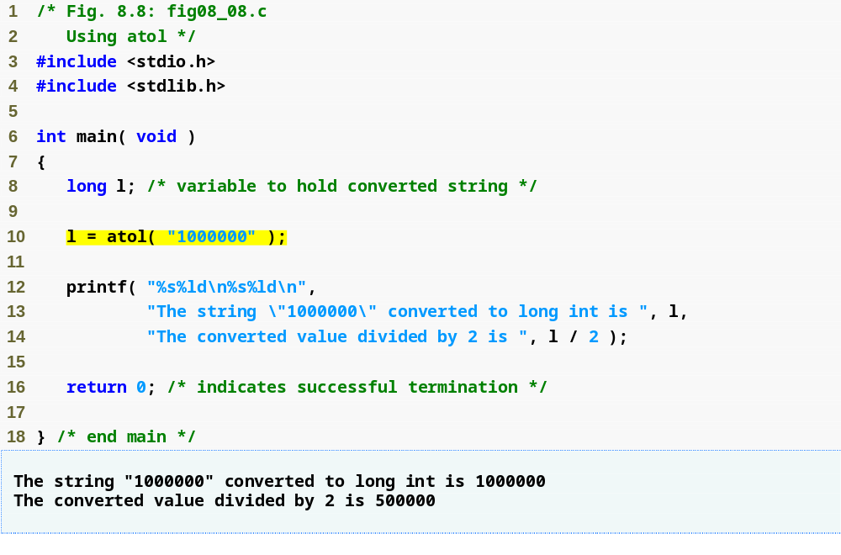
Outline
fig08_08.c
atol converts a string to a long

Slide 34
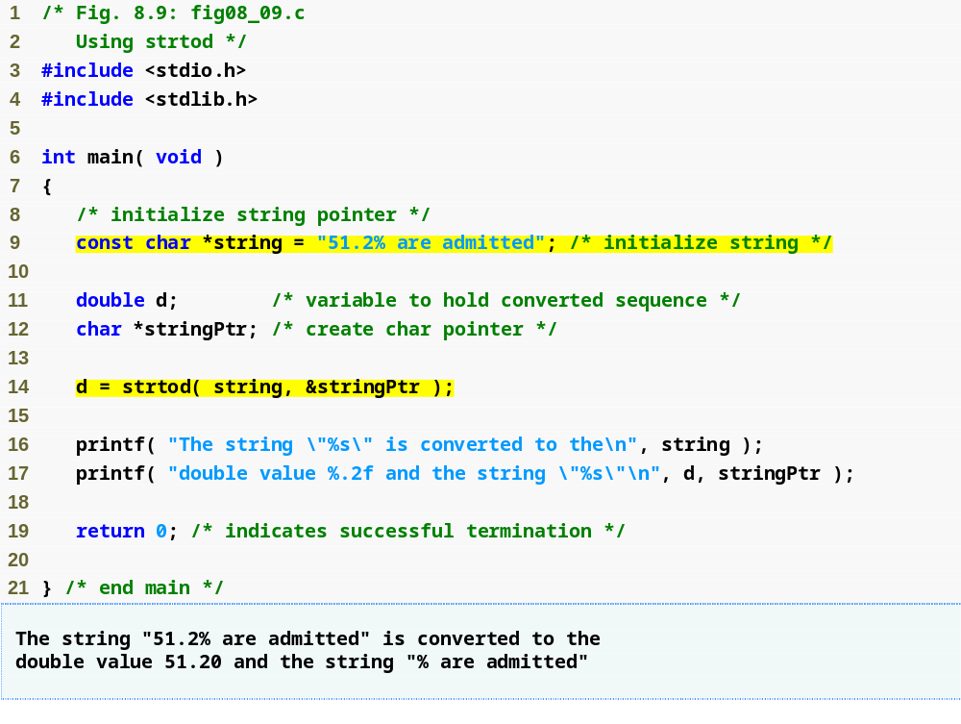
Outline
fig08_09.c
strtod converts a piece of a string to a double

Slide 35
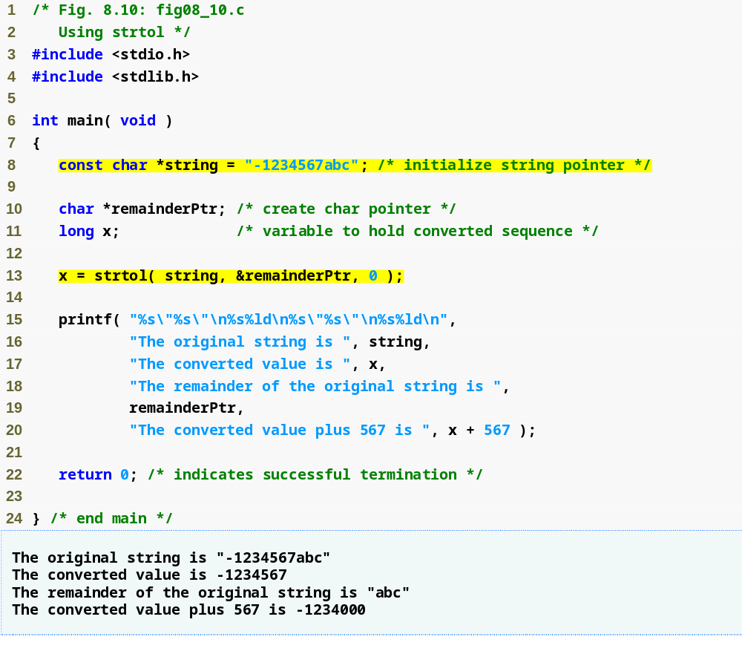
Outline
fig08_10.c
strtol converts a piece of a string to a long

Slide 36
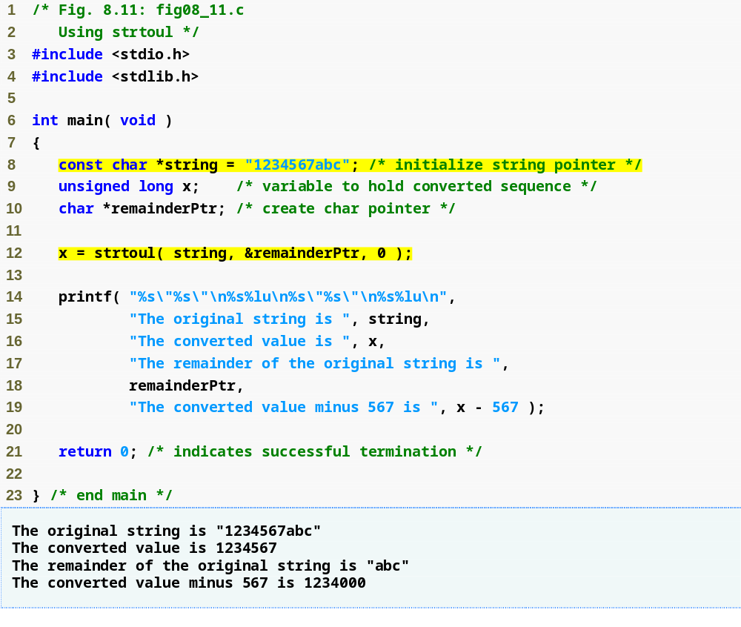
Outline
fig08_11.c
strtoul converts a piece of a string to an unsigned long

Slide 37
8.5 Standard Input/Output Library Functions
Functions in <stdio.h>
Used to manipulate character and string data

Slide 38
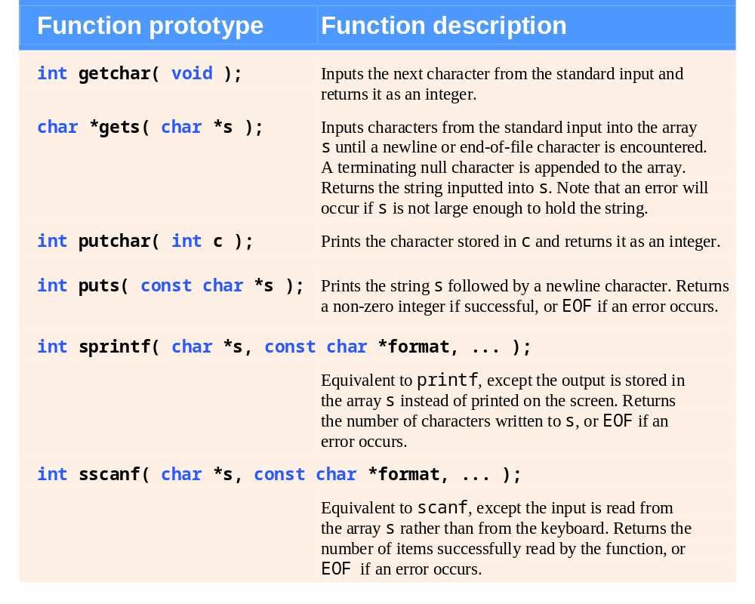
Fig. 8.12 | Standard input/output library character and string functions.

Slide 39
Error-Prevention Tip 8.4
When using functions from the standard input/output library, include the <stdio.h> header.

Slide 40
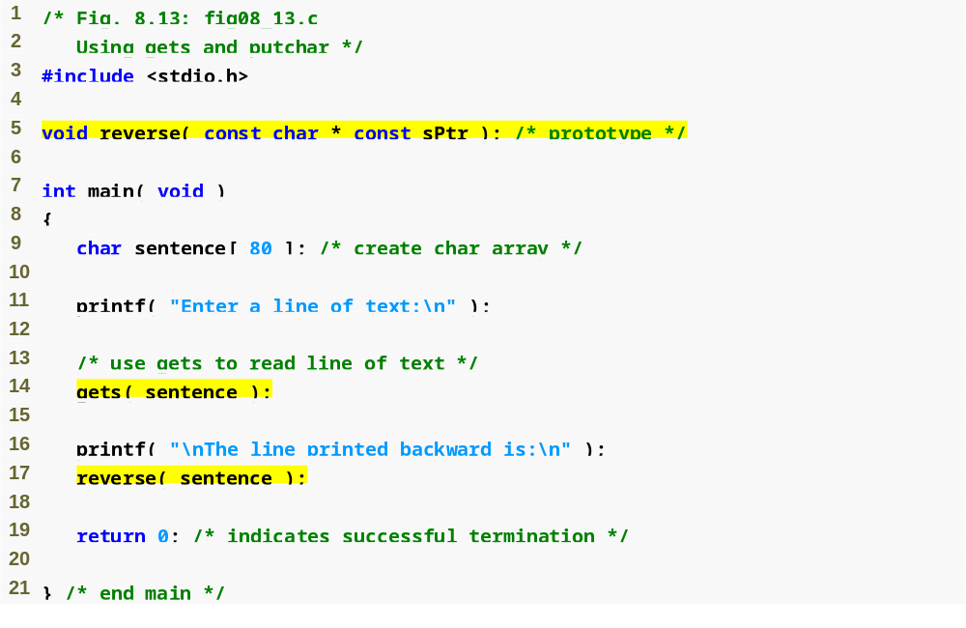
Outline
fig08_13.c
(1 of 2 )
gets reads a line of text from the user

Slide 41
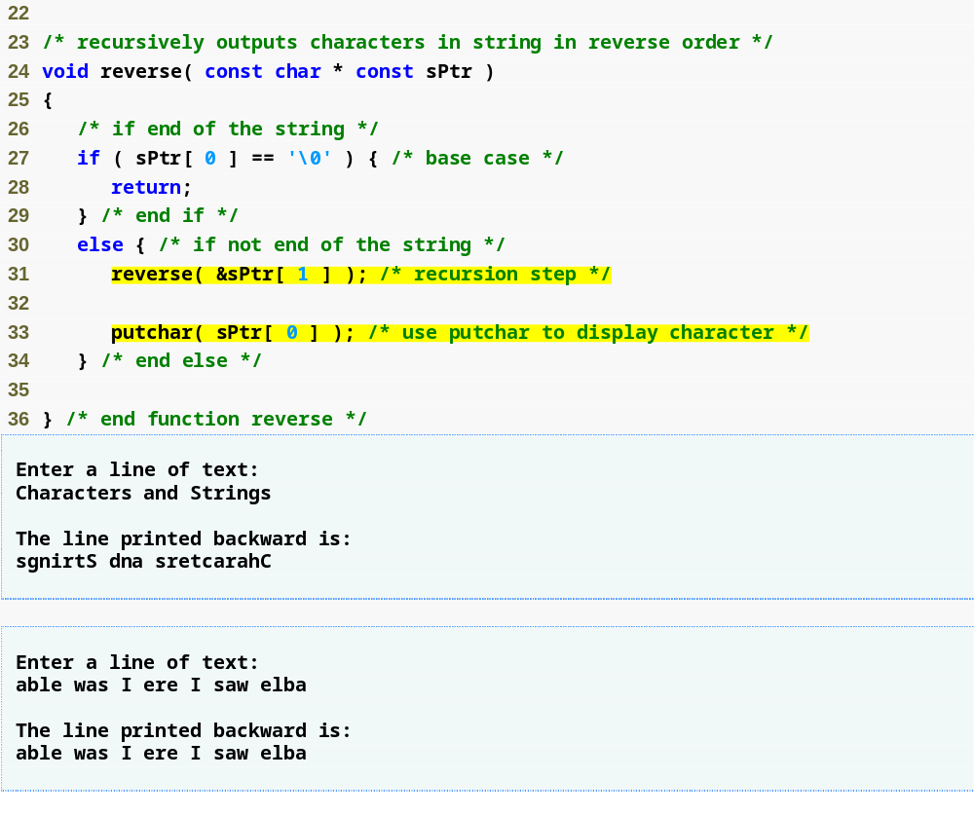
Outline
fig08_13.c
(2 of 2 )
putchar prints a single character on the screen

Slide 42
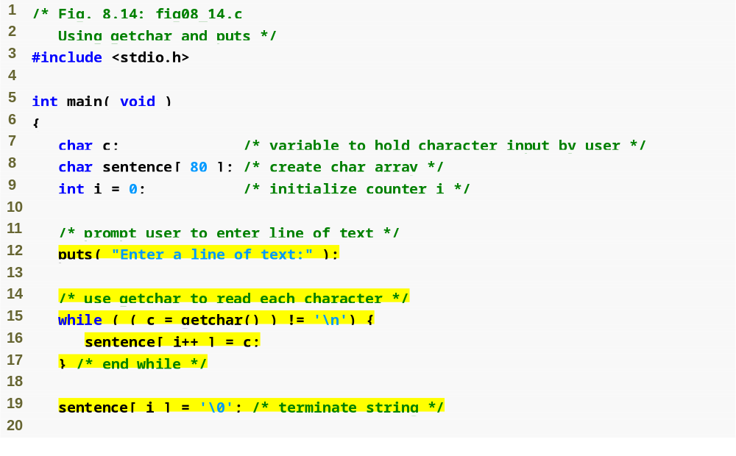
Outline
fig08_14.c
(1 of 2 )
puts prints a line of text on the screen
getchar reads a single character from the user

Slide 43
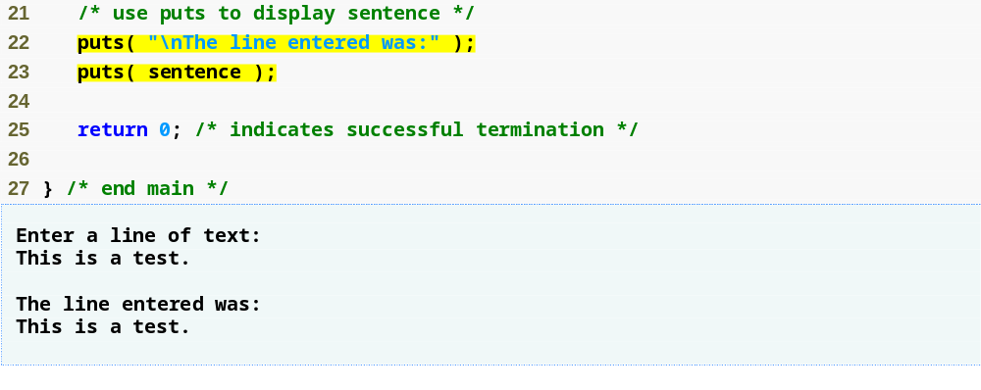
Outline
fig08_14.c
(2 of 2 )

Slide 44
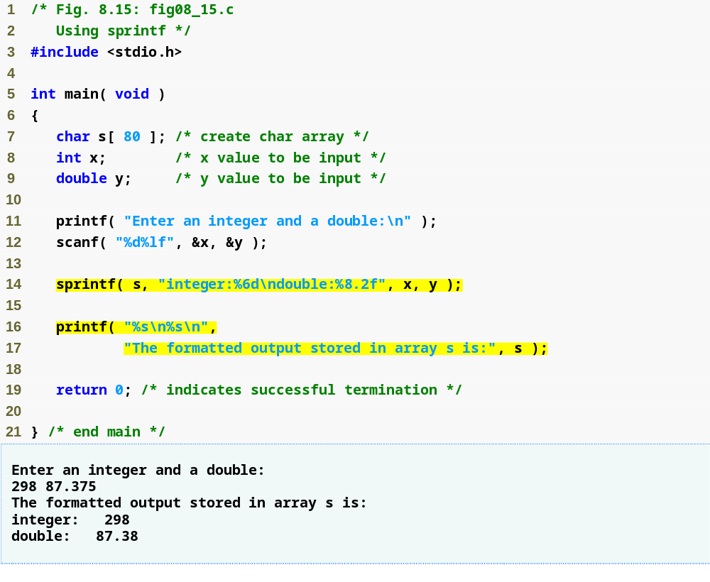
Outline
fig08_15.c
sprintf prints a line of text into an array like printf prints text on the screen

Slide 45
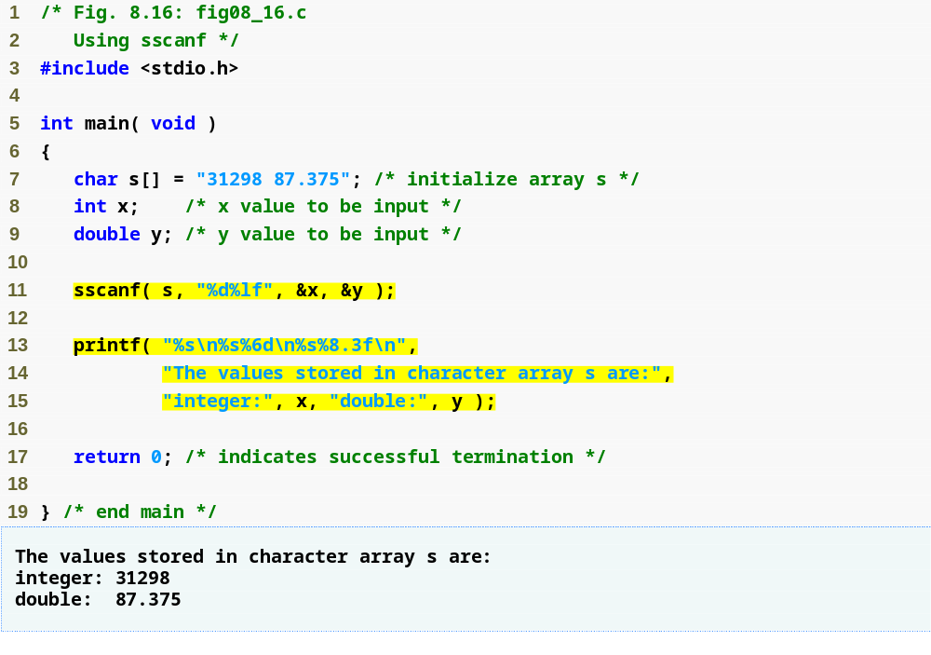
Outline
fig08_16.c
sscanf reads a line of text from an array like scanf reads text from the user

Slide 46
8.6 String Manipulation Functions of the String Handling Library
String handling library has functions to
  Manipulate string data
  Search strings
  Tokenize strings
  Determine string length

Slide 47
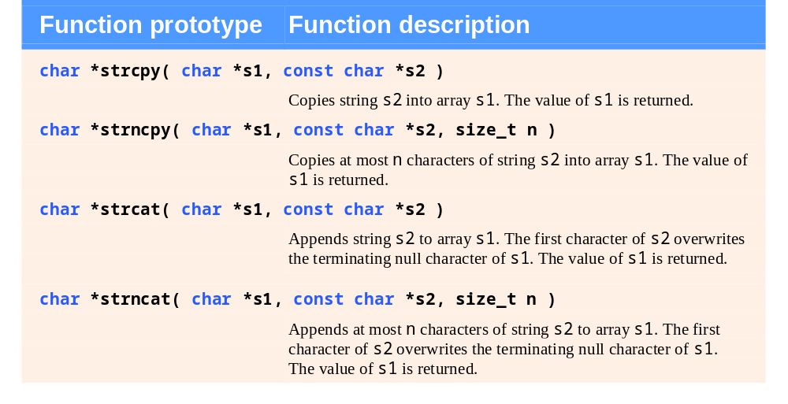
Fig. 8.17 | String-manipulation functions of the string-handling library.

Slide 48
Portability Tip 8.2
Type size_t is a system-dependent
synonym for either type unsigned
long or type unsigned int.

Slide 49
Error-Prevention Tip 8.5
When using functions from the string-handling library, include the <string.h> header.

Slide 50
Common Programming Error 8.6
Not appending a terminating null character to the first argument of a strncpy when the third argument is less than or equal to the length of the string in the second argument.

Slide 51
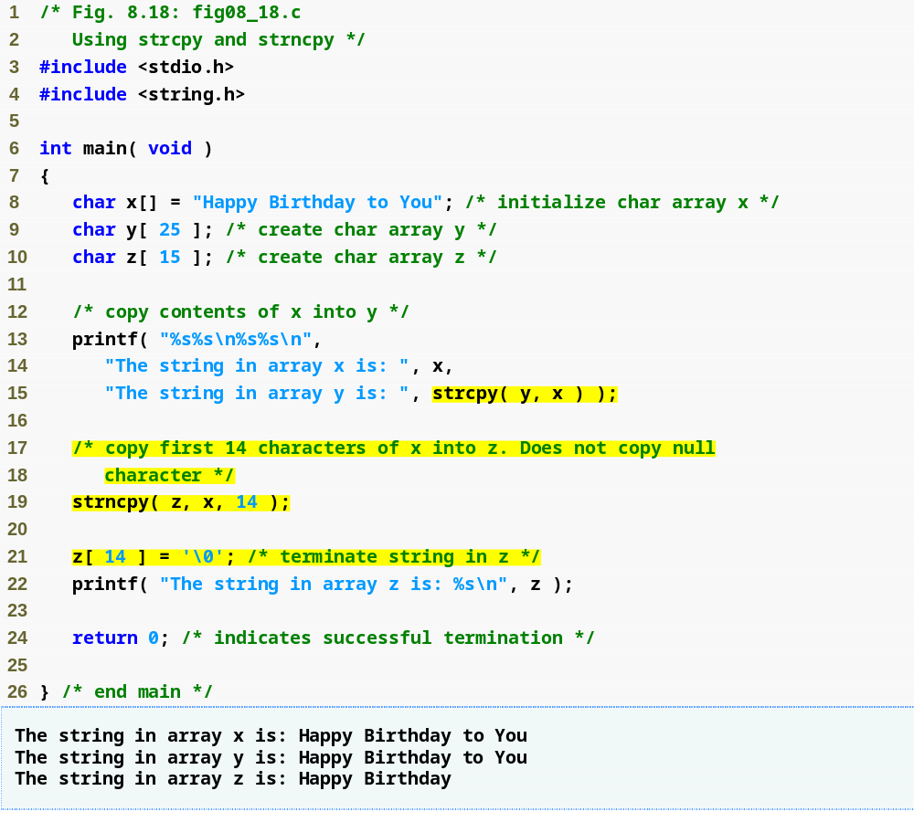
Outline
fig08_18.c
strcpy copies string x into character array y
strncpy copies 14 characters of string x into character array z
Note that strncpy does not automatically append a null character

Slide 52
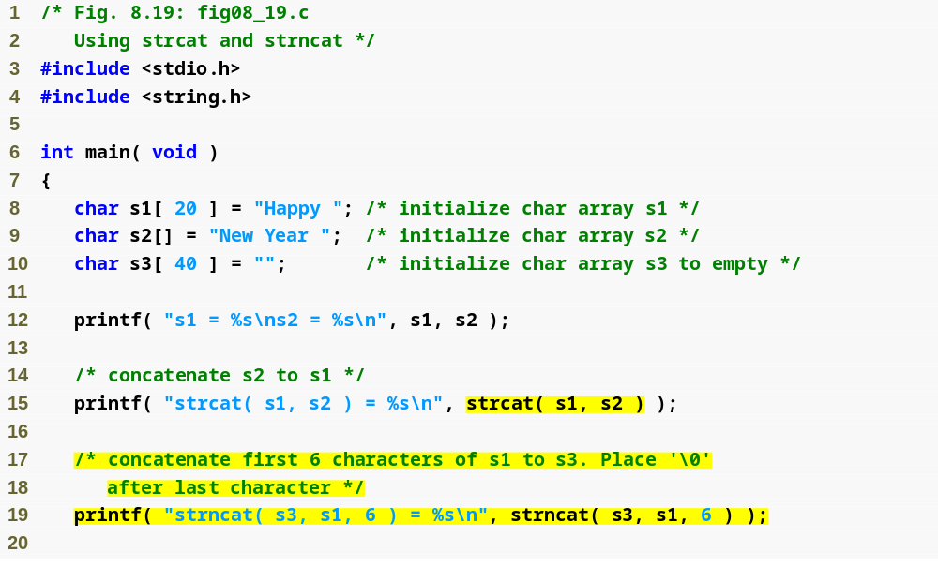
Outline
fig08_19.c
(1 of 2 )
strcat adds the characters of string s2 to the end of string s1
strncat adds the first 6 characters of string s1 to the end of string s3

Slide 53
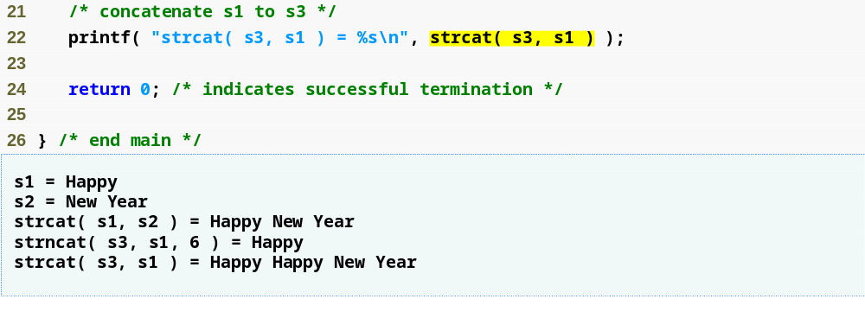
Outline
fig08_19.c
(2 of 2 )

Slide 54
8.7 Comparison Functions of the String-Handling Library
Comparing strings
  Computer compares numeric ASCII codes of characters in string
  Appendix D has a list of character codes

Slide 55
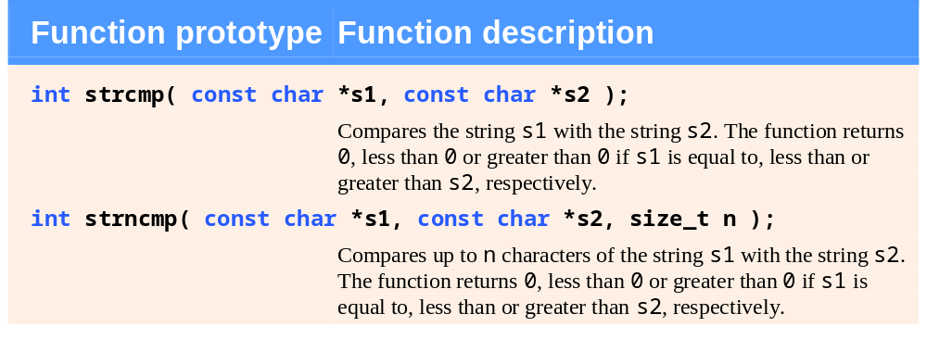
Fig. 8.20 | String-comparison functions of the string-handling library.

Slide 56
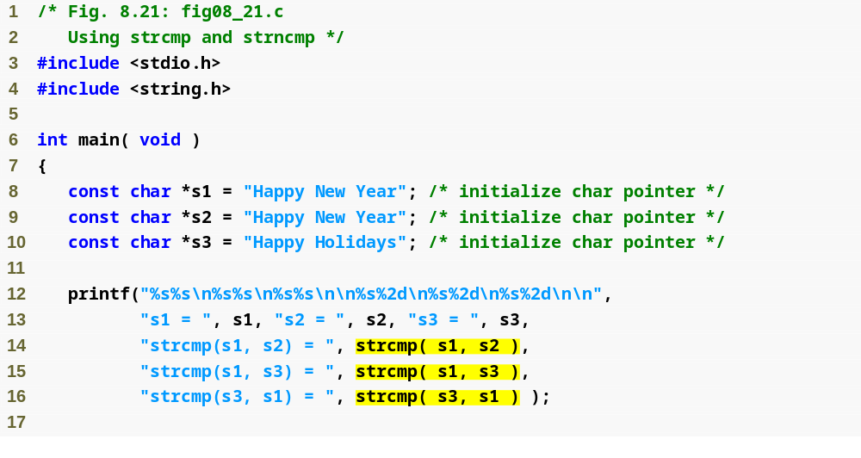
Outline
fig08_21.c
(1 of 2 )
strcmp compares string s1 to string s2

Slide 57
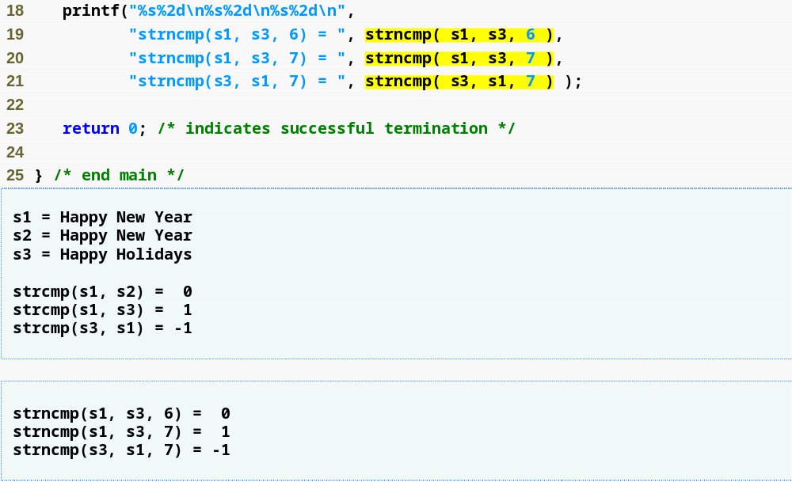
Outline
fig08_21.c
(2 of 2 )
strncmp compares the first 6 characters of string s1 to the first 6 characters of string s3

Slide 58
Common Programming Error 8.7
Assuming that strcmp and strncmp return 1 when their arguments are equal is a logic error. Both functions return 0 (strangely, the equivalent of C's false value) for equality. Therefore, when testing two strings for equality, the result of function strcmp or strncmp should be compared with 0 to determine if the strings are equal.

Slide 59
Portability Tip 8.3
The internal numeric codes used to represent characters may be different on different computers.

Slide 60
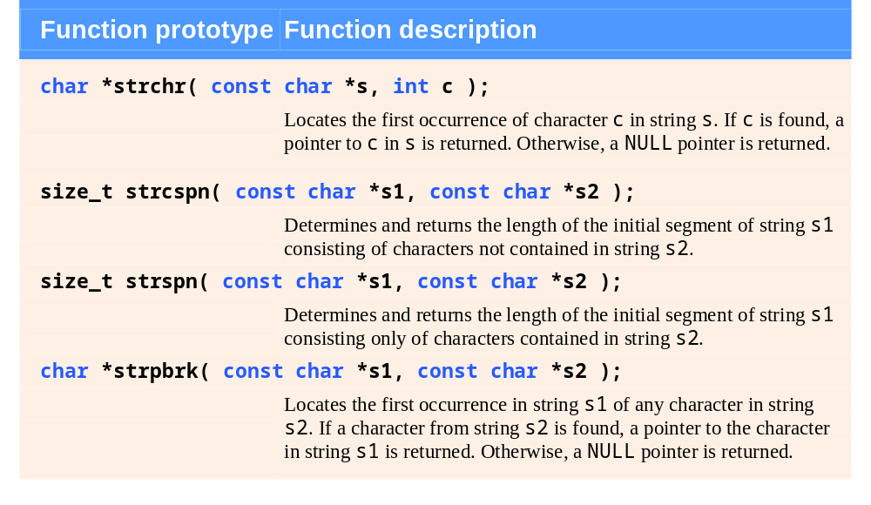
Fig. 8.22 | String-manipulation functions of the string-handling library. (Part 1 of 2.)

Slide 61
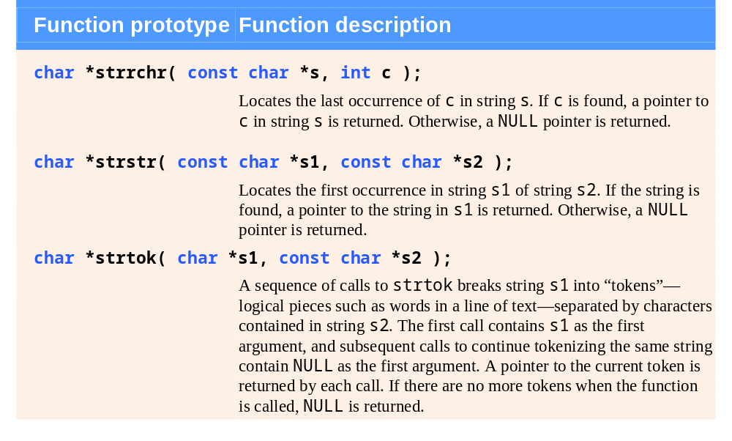
Fig. 8.22 | String-manipulation functions of the string-handling library. (Part 2 of 2.)

Slide 62
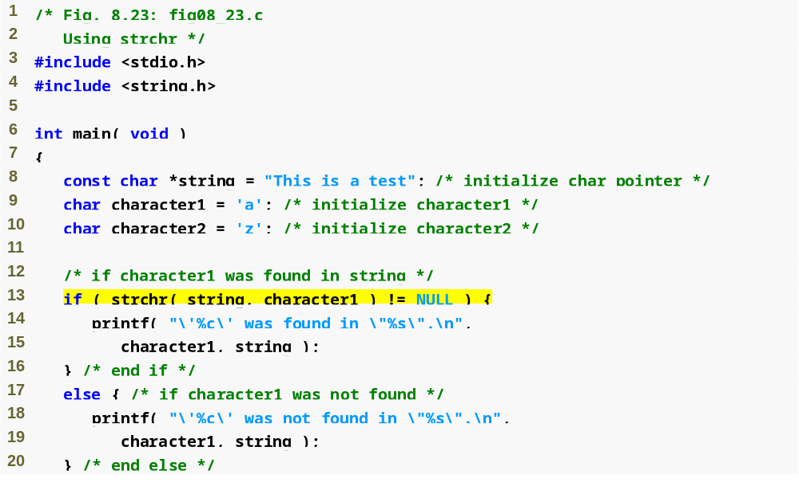
Outline
fig08_23.c
(1 of 2 )
strchr searches for the first instance of character1 in string

Slide 63
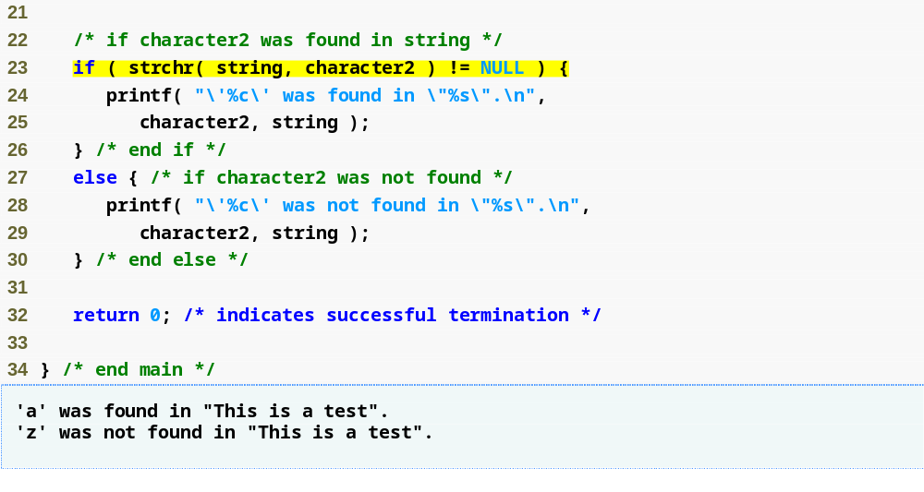
Outline
fig08_23.c
(2 of 2 )

Slide 64
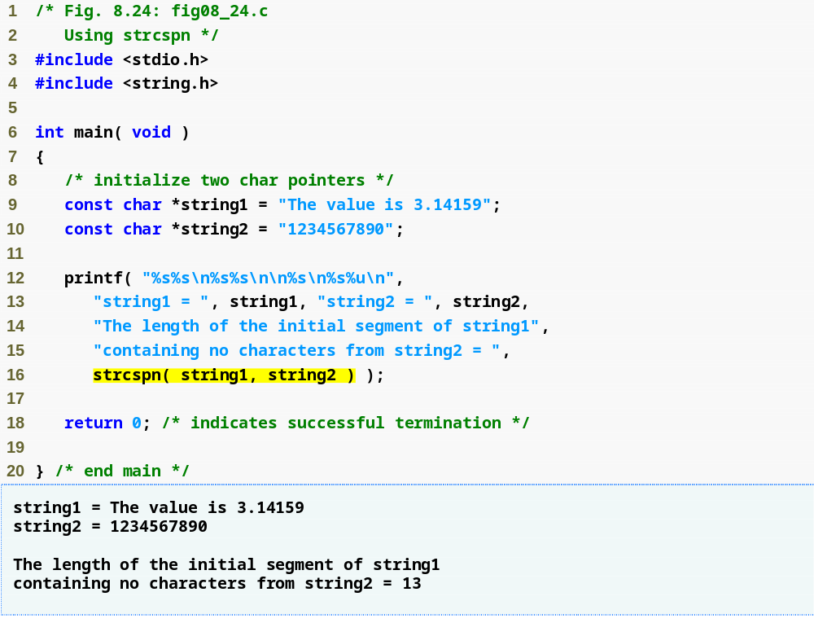
Outline
fig08_24.c
strcspn returns the length of the initial segment of string1 that does not contain any characters in string2

Slide 65
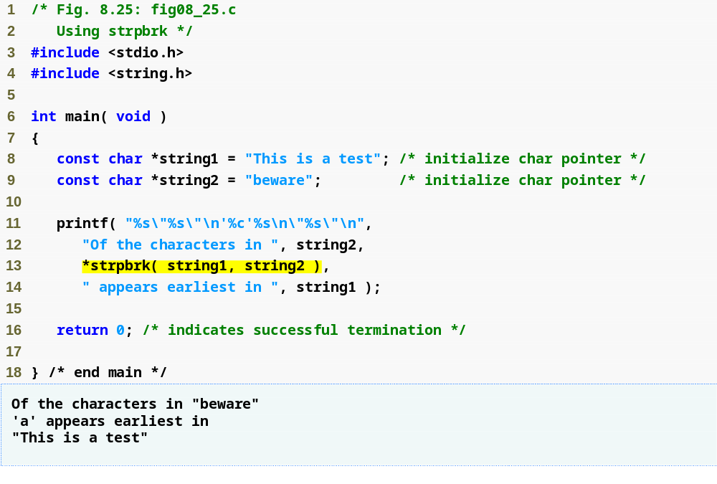
Outline
fig08_25.c
strpbrk returns a pointer to the first appearance in string1 of any character from string2

Slide 66
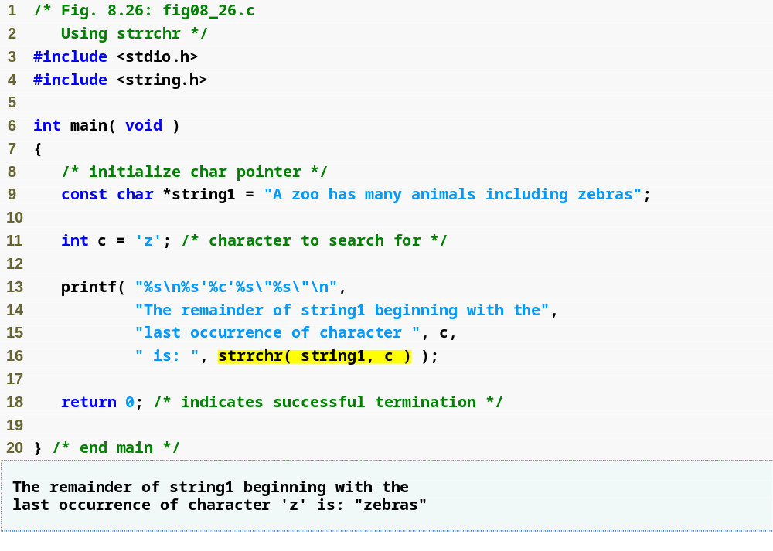
Outline
fig08_26.c
strrchr returns the remainder of string1 following the last occurrence of the character c

Slide 67
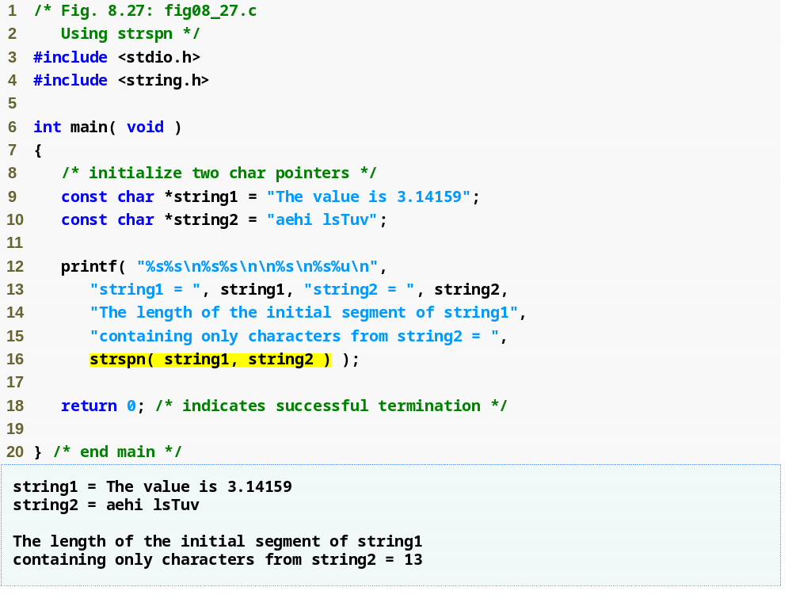
Outline
fig08_27.c
strspn returns the length of the initial segment of string1 that contains only characters from string2

Slide 68
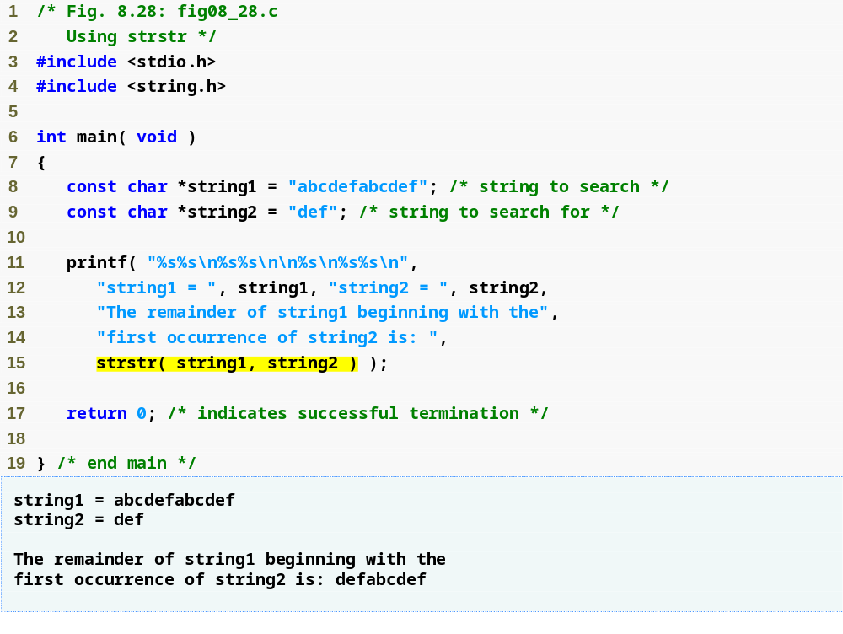
Outline
fig08_28.c
strstr returns the remainder of string1 following the last occurrence of string2

Slide 69
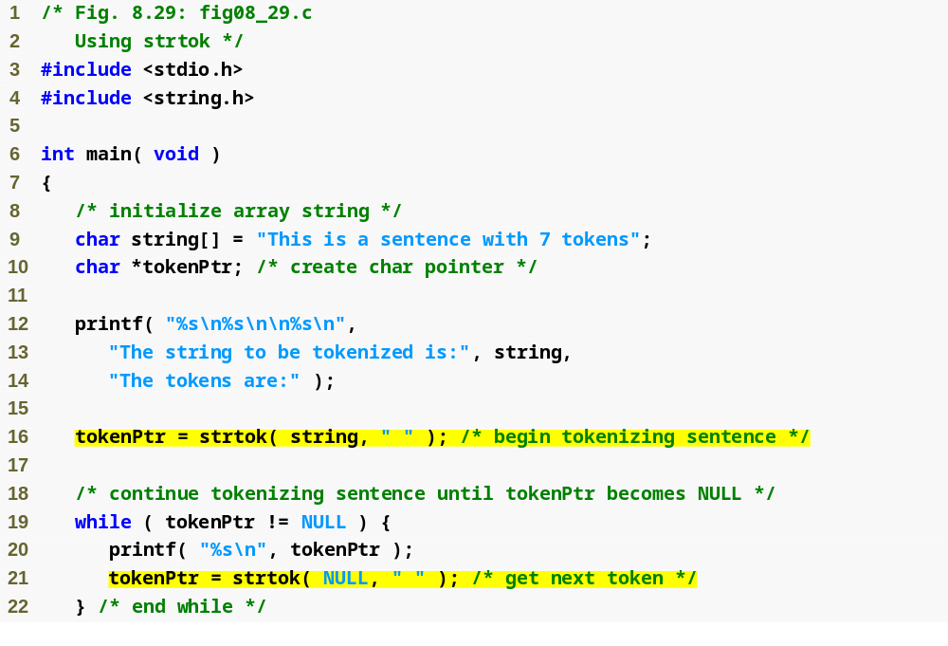
Outline
fig08_29.c
(1 of 2 )
strtok “tokenizes” string by breaking it into tokens at each space
Calling strtok again and passing it NULL continues the tokenizing of the previous string

Slide 70
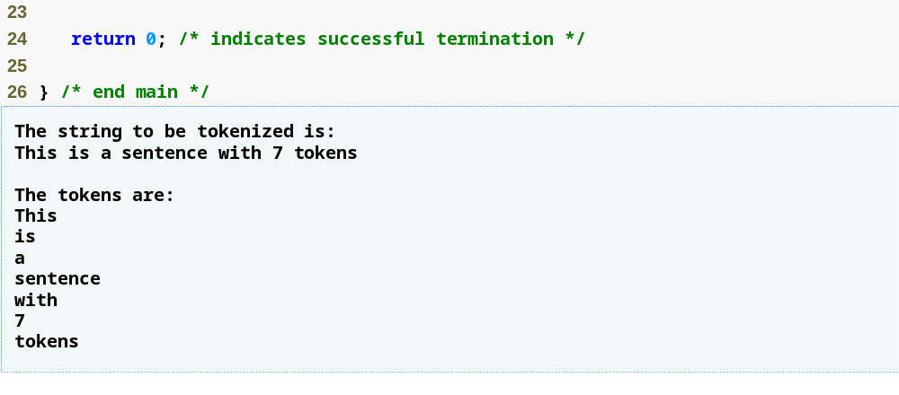
Outline
fig08_29.c
(2 of 2 )

Slide 71
8.9 Memory Functions of the String-Handling Library
Memory Functions
  In <stdlib.h>
  Manipulate, compare, and search blocks of memory
  Can manipulate any block of data
Pointer parameters are void *
  Any pointer can be assigned to void *, and vice versa
  void * cannot be dereferenced
    Each function receives a size argument specifying the number of bytes (characters) to process

Slide 72
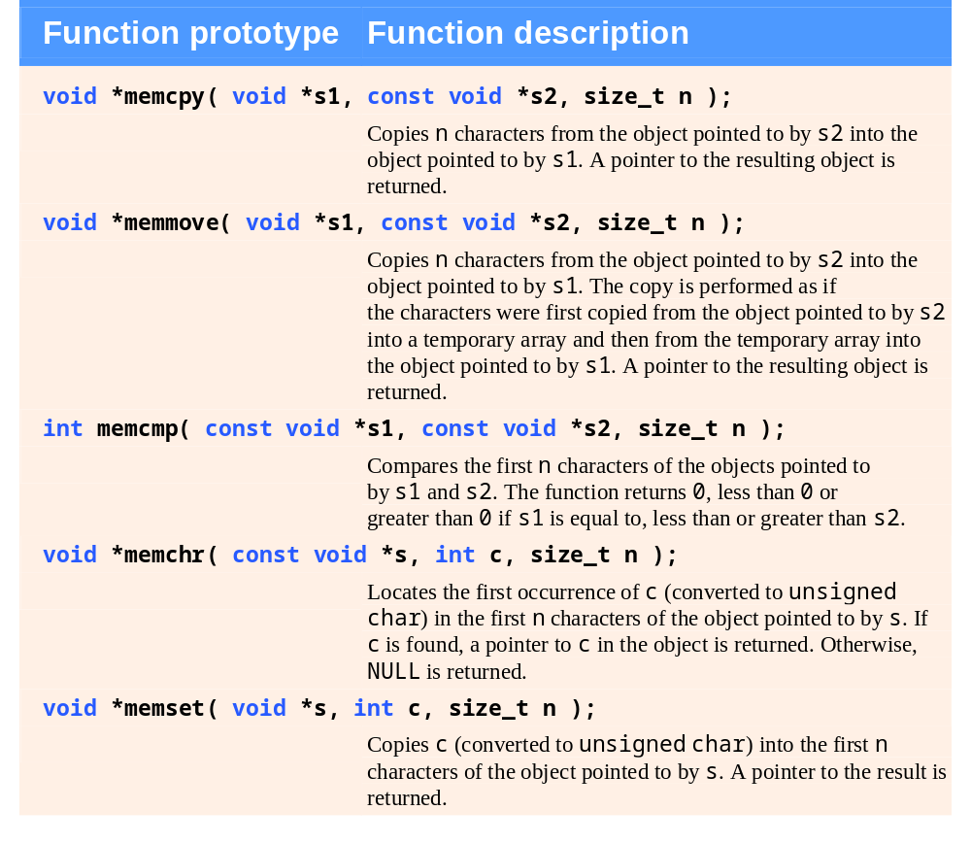
Fig. 8.30 | Memory functions of the string-handling library.

Slide 73
Common Programming Error 8.8
String-manipulation functions other than memmove that copy characters have undefined results when copying takes place between parts of the same string.

Slide 74
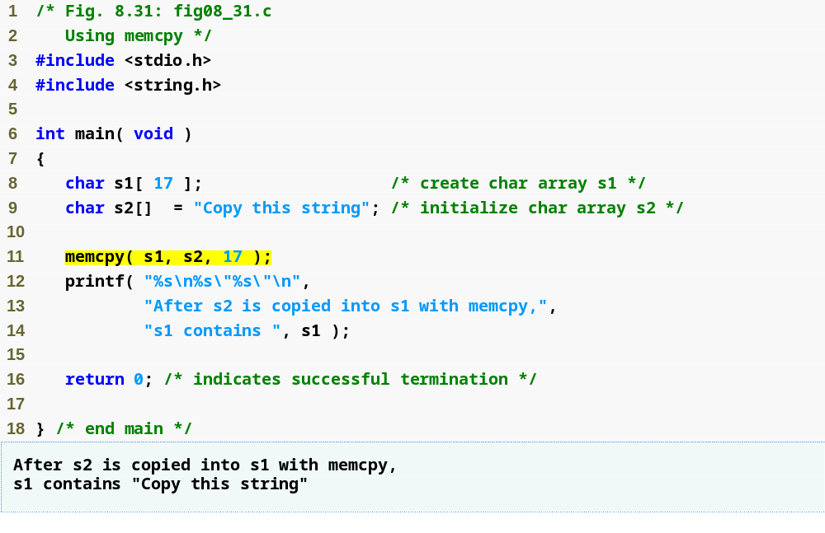
Outline
fig08_31.c
memcpy copies the first 17 characters from object s2 into object s1

Slide 75
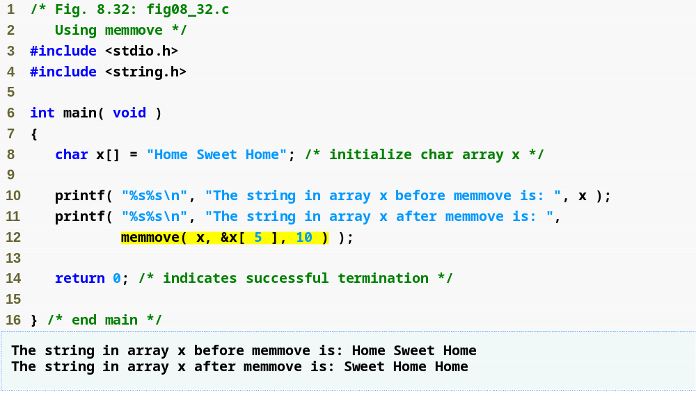
Outline
fig08_32.c
memmove copies the first 10 characters from x[5] into object x by means of a temporary array

Slide 76
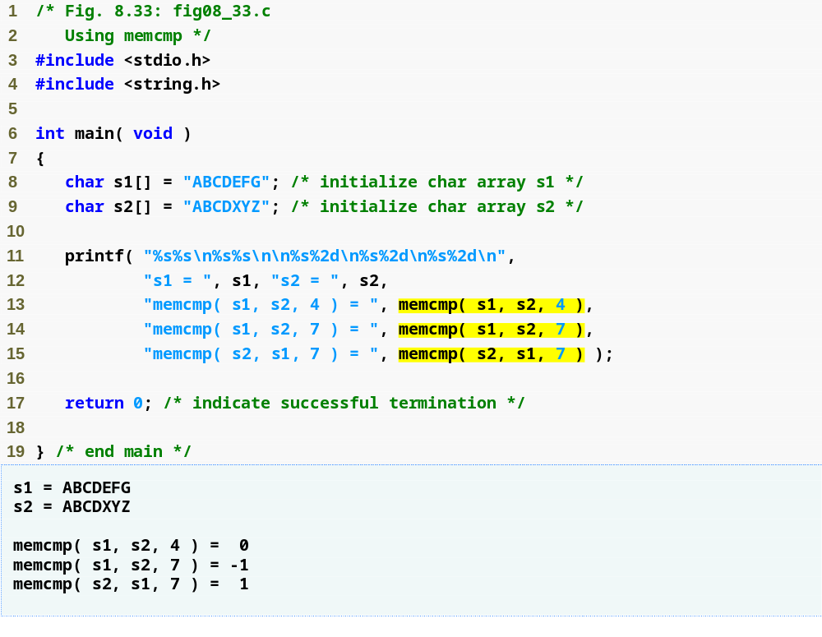
Outline
fig08_33.c
memcmp compares the first 4 characters of objects s1 and s2

Slide 77
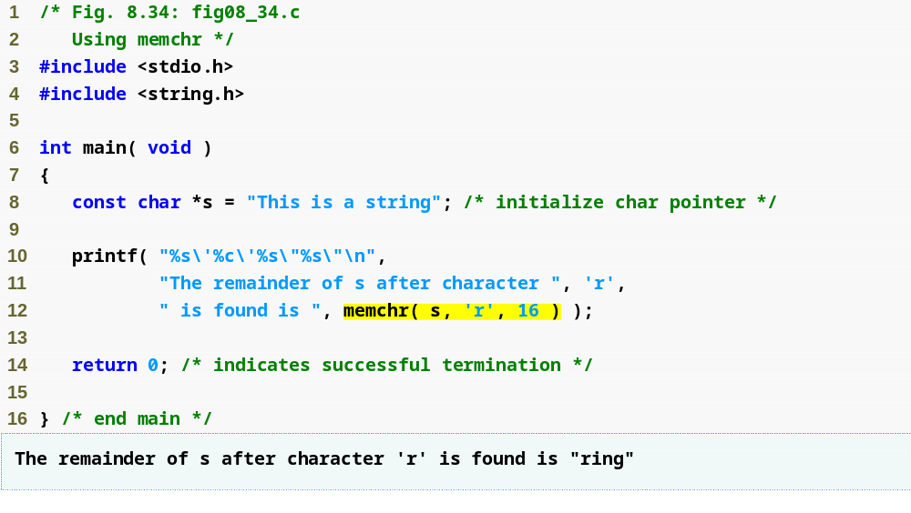
Outline
fig08_34.c
memchr locates the first occurrence of the character r inside the first 16 characters of object s

Slide 78
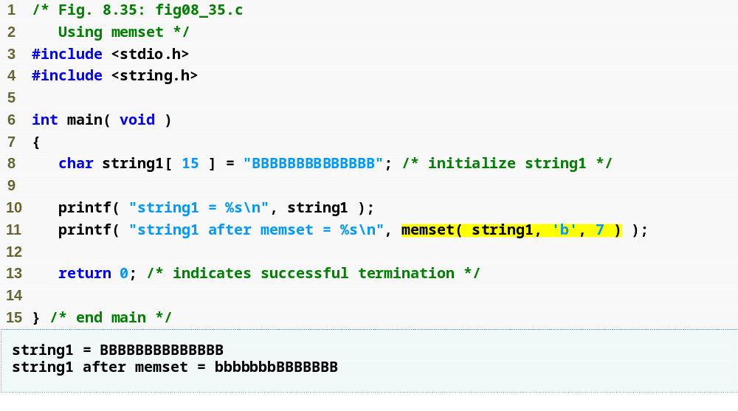
Outline
fig08_35.c
memset copies the character b into the first 7 characters of object string1

Slide 79
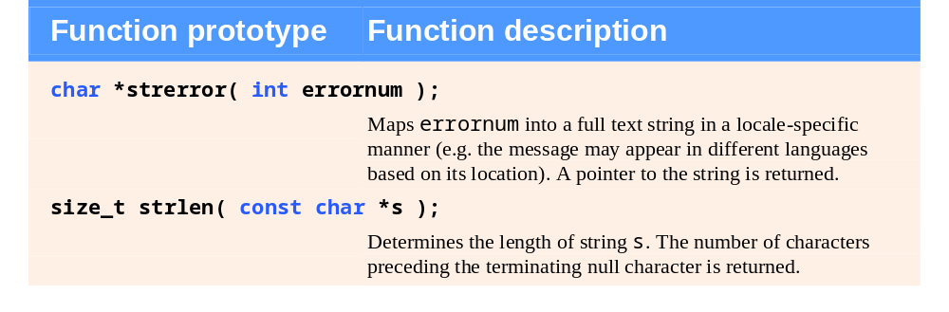
Fig. 8.36 | Other functions of the string-handling library.

Slide 80
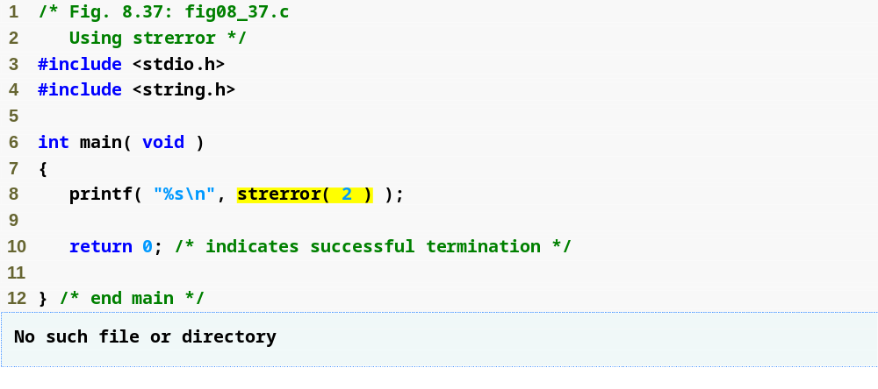
Outline
strerror returns an error message based on the number passed to it
fig08_37.c

Slide 81
Portability Tip 8.4
The message generated by strerror is system dependent.

Slide 82

Outline
fig08_38.c
strlen returns the length of string1

