Slide 1
9
C Formatted Input/Output

Slide 2
All the news that’s fit to print.
  Adolph S. Ochs
What mad pursuit? What struggle to escape?
  John Keats
Remove not the landmark on the boundary
of the fields.
  Amenemope

Slide 3
OBJECTIVES
In this chapter you will learn:
To use input and output streams.
To use all print formatting capabilities.
To use all input formatting capabilities.
To print with field widths and precisions.
To use formatting flags in the printf format control string.
To output literals and escape sequences.
To format input using scanf.

Slide 4
9.1 Introduction
9.2 Streams
9.3 Formatting Output with printf
9.4 Printing Integers
9.5 Printing Floating-Point Numbers
9.6 Printing Strings and Characters
9.7 Other Conversion Specifiers
9.8 Printing with Field Widths and Precision
9.9 Using Flags in the printf Format Control String
9.10 Printing Literals and Escape Sequences
9.11 Reading Formatted Input with scanf

Slide 5
9.1 Introduction
In this chapter
  Presentation of results
  scanf and printf
  Streams (input and output)
    gets, puts, getchar, putchar (in <stdio.h>)

Slide 6
9.2 Streams
Streams
  Sequences of characters organized into lines
    Each line consists of zero or more characters and ends with newline character
    ANSI C must support lines of at least 254 characters
  Performs all input and output
  Can often be redirected
    Standard input – keyboard
    Standard output – screen
    Standard error – screen
    More in Chapter 11

Slide 7
9.3 Formatting Output with printf
printf
  Precise output formatting
    Conversion specifications: flags, field widths, precisions, etc.
  Can perform rounding, aligning columns, right/left justification, inserting literal characters, exponential format, hexadecimal format, and fixed width and precision
Format
  printf( format-control-string, other-arguments );
  Format control string: describes output format
  Other-arguments: correspond to each conversion specification in format-control-string
    Each specification begins with a percent sign(%), ends with conversion specifier

Slide 8
Common Programming Error 9.1
Forgetting to enclose a format-control-string in quotation marks is a syntax error.

Slide 9
Good Programming Practice 9.1
Format outputs neatly for presentation to make program outputs more readable and reduce user errors.

Slide 10
9.4 Printing Integers
Integer
  Whole number (no decimal point): 25, 0, -9
  Positive, negative, or zero
  Only minus sign prints by default (later we will change this)

Slide 11
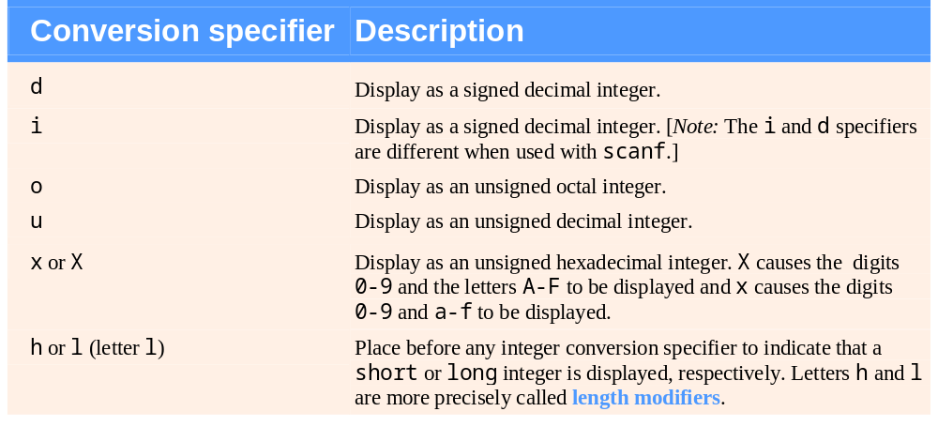
Fig. 9.1 | Integer conversion specifiers.

Slide 12
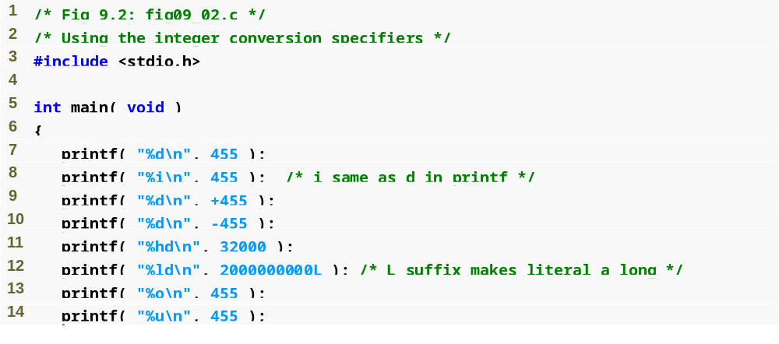
Outline
d and i specify signed integers
fig09_02.c
(1 of 2 )
h specifies a short number
l specifies a long number
o specifies an octal integer
u specifies an unsigned integer

Slide 13
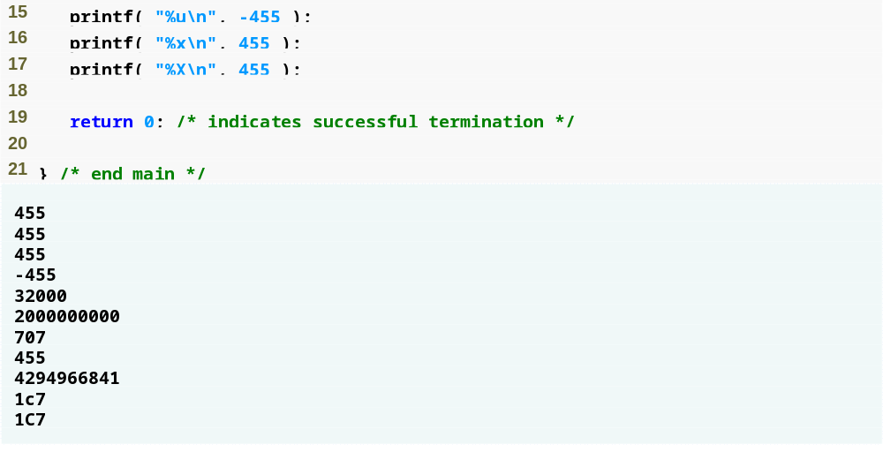
Outline
x and X specify hexadecimal integers
fig09_02.c
(2 of 2 )

Slide 14
Common Programming Error 9.2
Printing a negative value with a conversion specifier that expects an unsigned value.

Slide 15
9.5 Printing Floating-Point Numbers
Floating Point Numbers
  Have a decimal point (33.5)
  Exponential notation (computer's version of scientific notation)
    150.3 is 1.503 x 10² in scientific
    150.3 is 1.503E+02 in exponential

Slide 16
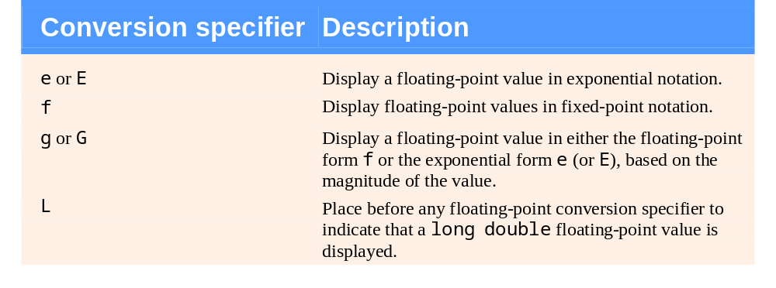
Fig. 9.3 | Floating-point conversion specifiers.

Slide 17
Error-Prevention Tip 9.1
When outputting data, be sure that the user is aware of situations in which data may be imprecise due to formatting (e.g., rounding errors from specifying precisions).

Slide 18
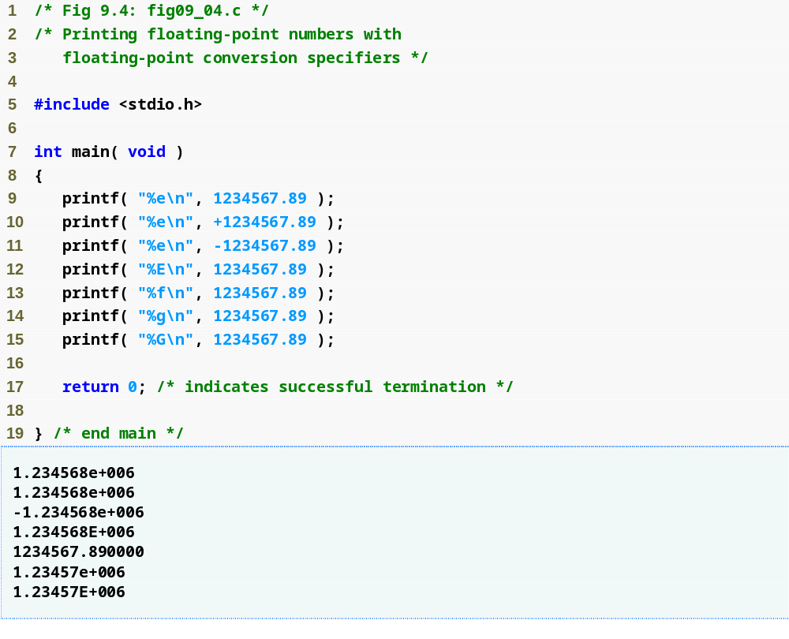
Outline
fig09_04.c
e and E specify exponential notation
f specifies fixed-point notation
g and G specify either exponential or fixed-point notation depending on the number’s size

Slide 19
9.6 Printing Strings and Characters
c
  Prints char argument
  Cannot be used to print the first character of a string
s
  Requires a pointer to char as an argument
  Prints characters until NULL ('\0') encountered
  Cannot print a char argument
Remember
  Single quotes for character constants ('z')
  Double quotes for strings "z" (which actually contains two characters, 'z' and '\0')

Slide 20
Common Programming Error 9.3
Using %c to print a string is an error. The conversion specifier %c expects a char argument. A string is a pointer to char (i.e., a char *).

Slide 21
Common Programming Error 9.4
Using %s to print a char argument, on
some systems, causes a fatal execution-time error called an access violation. The conversion specifier %s expects an argument of type pointer to char.

Slide 22
Common Programming Error 9.5
Using single quotes around character strings is a syntax error. Character strings must be enclosed in double quotes.

Slide 23
Common Programming Error 9.6
Using double quotes around a character constant creates a pointer to a string consisting of two characters, the second of which is the terminating null. A character constant is a single character enclosed in single quotes.

Slide 24
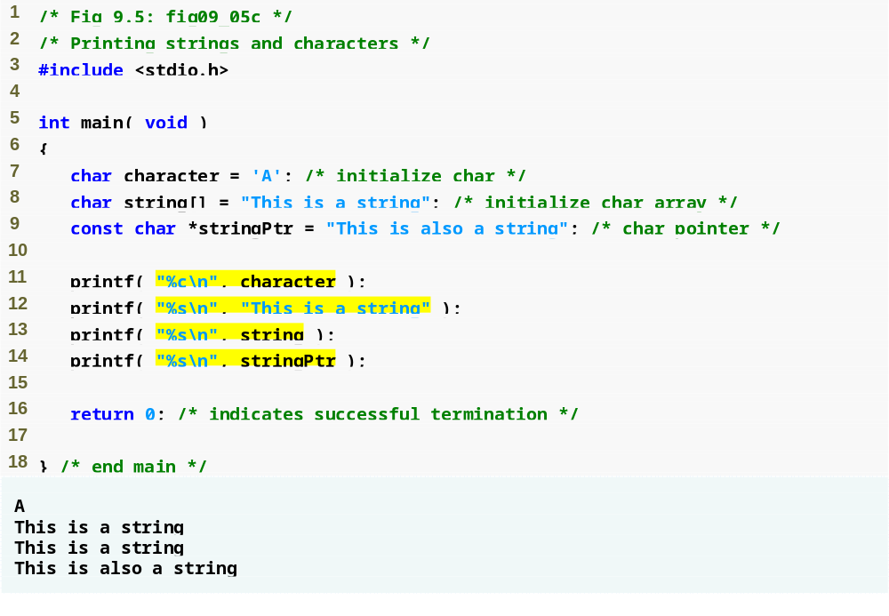
Outline
fig09_05.c
c specifies a character will be printed
s specifies a string will be printed

Slide 25
9.7 Other Conversion Specifiers
p
  Displays pointer value (address)
n
  Stores number of characters already output by current printf statement
  Takes a pointer to an integer as an argument
  Nothing printed by a %n specification
  Every printf call returns a value
    Number of characters output
    Negative number if error occurs
%
  Prints a percent sign
  %%

Slide 26
Portability Tip 9.1
The conversion specifier p displays an address in an implementation-defined manner (on many systems, hexadecimal notation is used rather than decimal notation).

Slide 27
Common Programming Error 9.7
Trying to print a literal percent character using % rather than %% in the format control string. When % appears in a format control string, it must be followed by a conversion specifier.

Slide 28
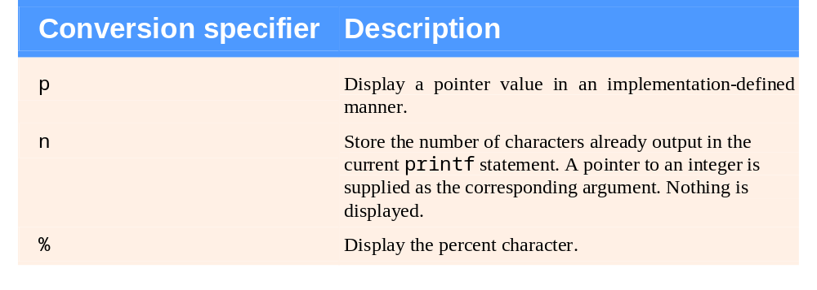
Fig. 9.6 | Other conversion specifiers.

Slide 29
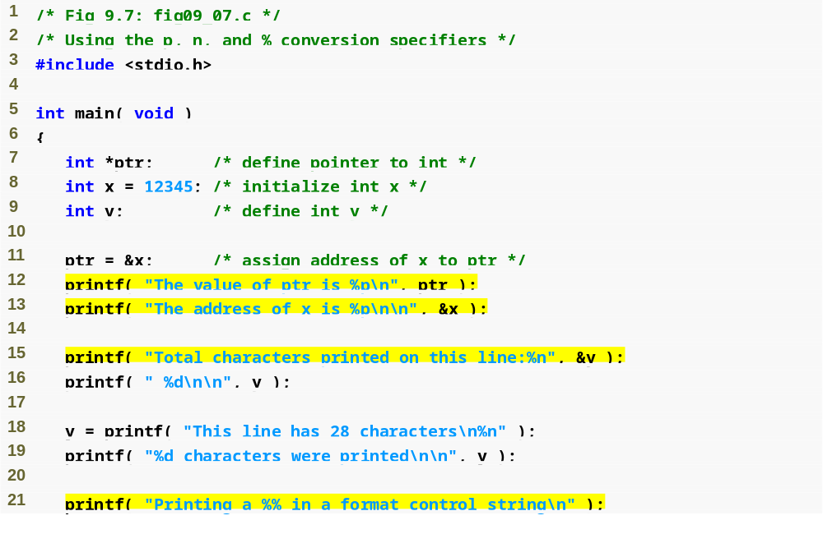
Outline
fig09_07.c
(1 of 2 )
p specifies a memory address will be printed
n stores the number of characters printed on a line
% prints a percent sign

Slide 30
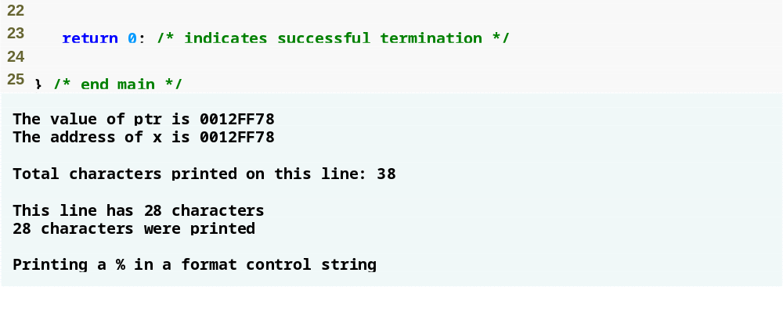
Outline
fig09_07.c
(2 of 2 )

Slide 31
9.8 Printing with Field Widths and Precision
Field width
  Size of field in which data is printed
  If width larger than data, default right justified
    If field width too small, increases to fit data
    Minus sign uses one character position in field
  Integer width inserted between % and conversion specifier
  %4d – field width of 4

Slide 32
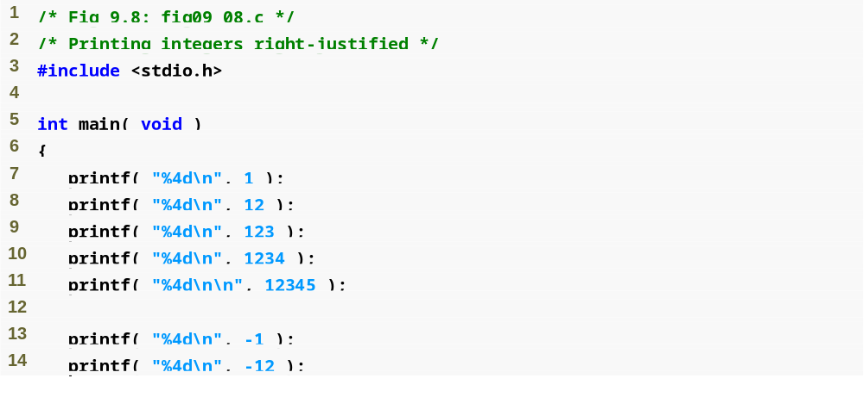
Outline
fig09_08.c
(1 of 2 )
A field width of 4 will make C attempt to print the number in a 4-character space
Note that C considers the minus sign a character

Slide 33
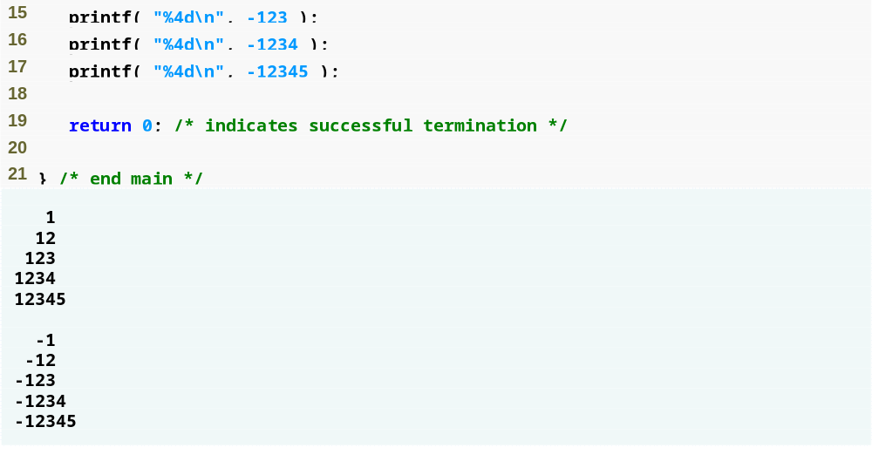
Outline
fig09_08.c
(2 of 2 )

Slide 34
Common Programming Error 9.8
Not providing a sufficiently large field
width to handle a value to be printed can offset other data being printed and can produce confusing outputs. Know your data!

Slide 35
9.8 Printing with Field Widths and Precision
Precision
  Meaning varies depending on data type
  Integers (default 1)
    Minimum number of digits to print
      If data too small, prefixed with zeros
  Floating point
    Number of digits to appear after decimal (e and f)
      For g – maximum number of significant digits
  Strings
    Maximum number of characters to be written from string
  Format
    Use a dot (.) then precision number after %
      %.3f

Slide 36
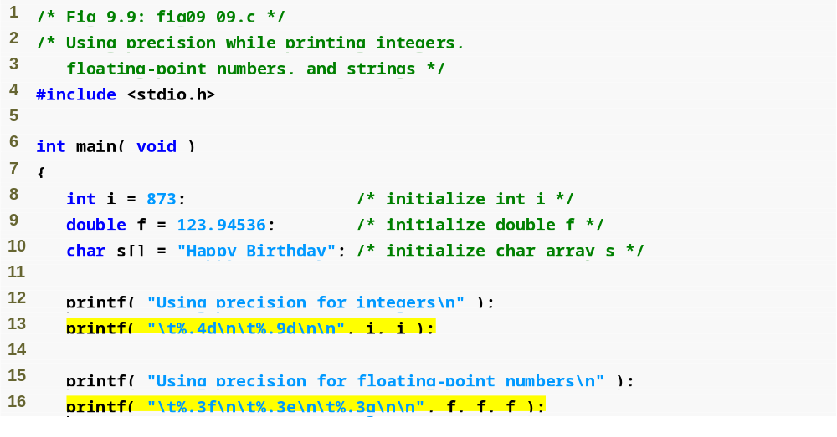
Outline
fig09_09.c
(1 of 2 )
Precision for integers specifies the minimum number of characters to be printed
Precision for the g specifier controls the maximum number of significant digits printed
Precision for f and e specifiers controls the number of digits after the decimal point

Slide 37
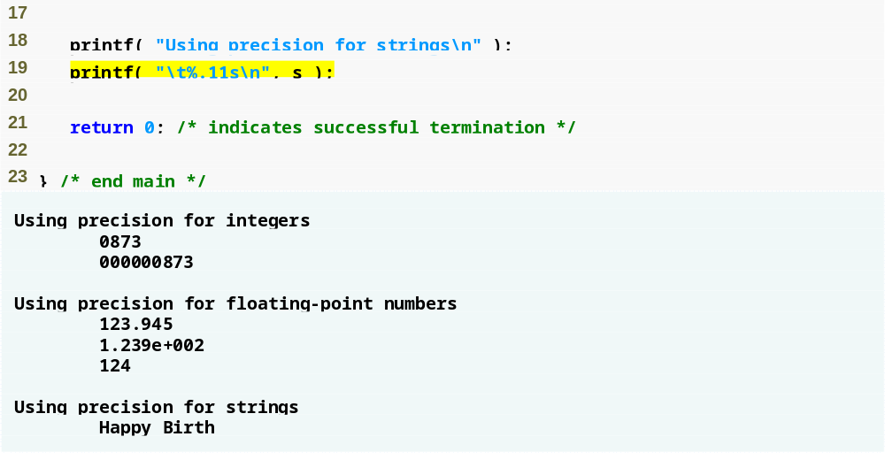
Outline
Precision for strings specifies the maximum number of characters to be printed
fig09_09.c
(2 of 2 )

Slide 38
9.9 Using Flags in the printf Format Control String
Flags
  Supplement formatting capabilities
  Place flag immediately to the right of percent sign
  Several flags may be combined

Slide 39
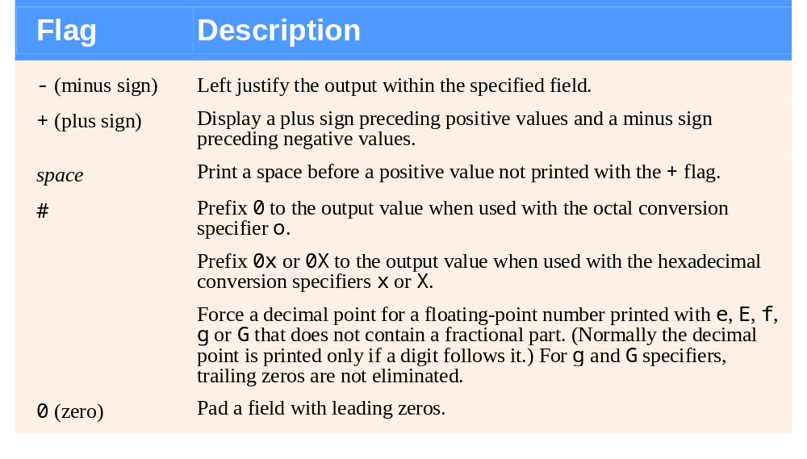
Fig. 9.10 | Format control string flags.

Slide 40
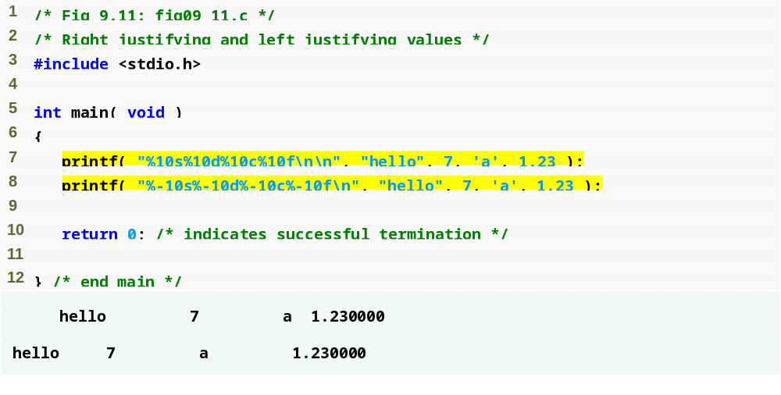
Outline
fig09_11.c
- flag left justifies characters in a field

Slide 41
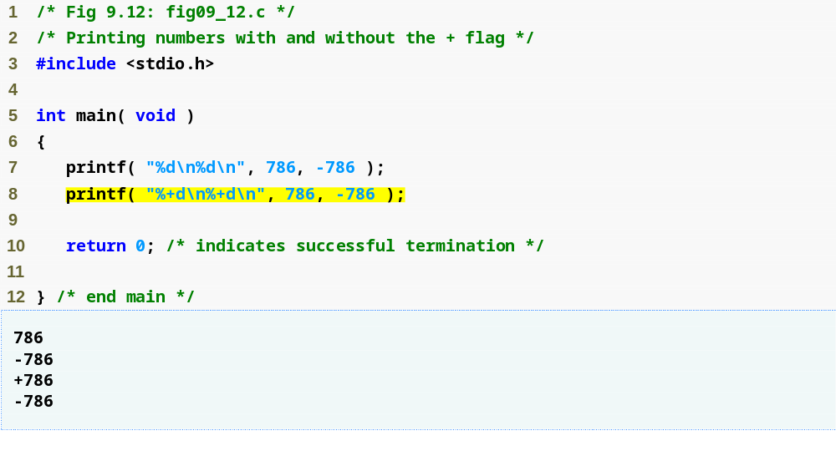
Outline
fig09_12.c
+ flag forces a plus sign on positive numbers

Slide 42
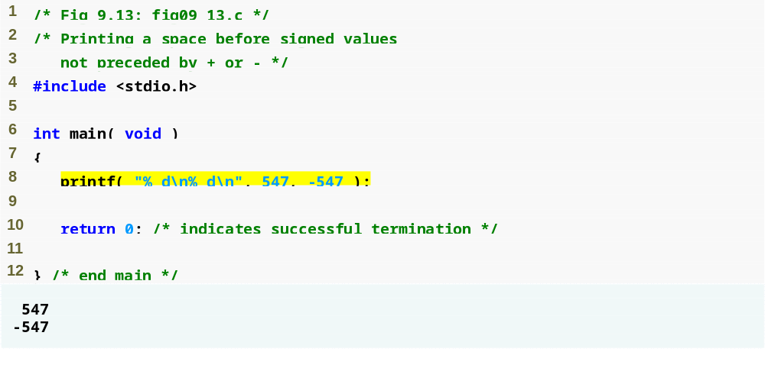
Outline
fig09_13.c
Space flag forces a space on positive numbers

Slide 43
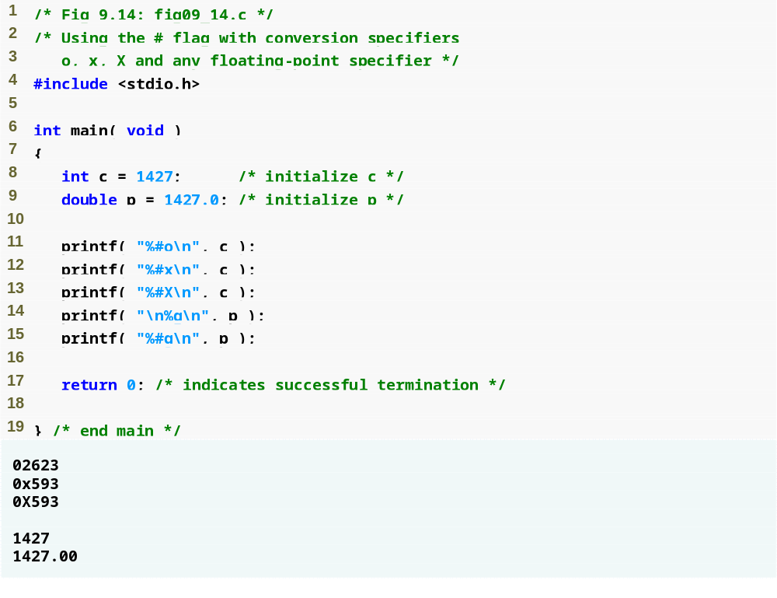
Outline
fig09_14.c
# flag prefixes a 0 before octal integers
# flag prefixes a 0x before hexadecimal integers
# flag forces a decimal point on floating-point numbers with no fractional part

Slide 44
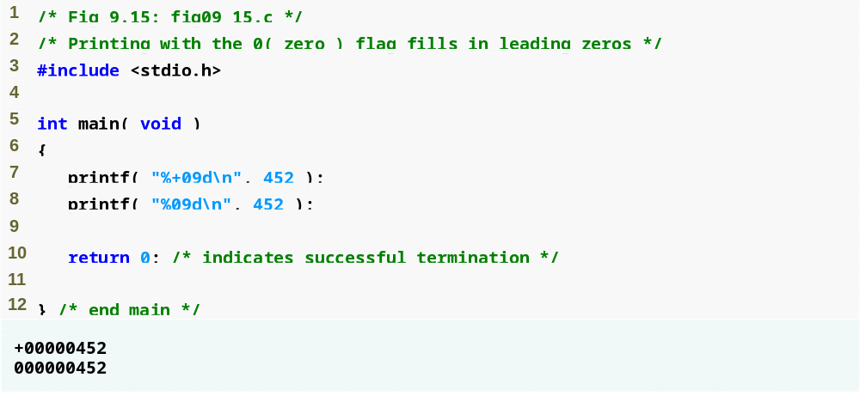
Outline
fig09_15.c
0 flag fills empty spaces with zeros

Slide 45
9.10 Printing Literals and Escape Sequences
Printing Literals
  Most characters can be printed
  Certain "problem" characters, such as the quotation mark "
  Must be represented by escape sequences
    Represented by a backslash \ followed by an escape character

Slide 46
Common Programming Error 9.9
Attempting to print as literal data in a printf statement a single quote, double quote or backslash character without preceding that character with a backslash to form a proper escape sequence is an error.

Slide 47
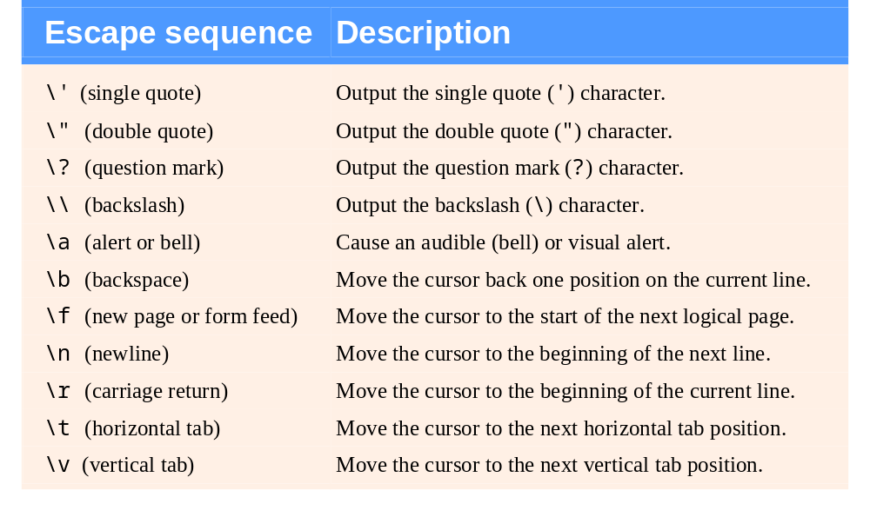
Fig. 9.16 | Escape sequences.

Slide 48
9.11 Formatting Input with scanf
scanf
  Input can be formatted much like output can
  scanf conversion specifiers are slightly different from those used with printf

Slide 49
Good Programming Practice 9.2
When inputting data, prompt the user for one data item or a few data items at a time. Avoid asking the user to enter many data items in response to a single prompt.

Slide 50
Good Programming Practice 9.3
Always consider what the user and your program will do when (not if) incorrect data is entered—for example, a value for an integer that is nonsensical in a program’s context, or a string with missing punctuation or spaces.

Slide 51
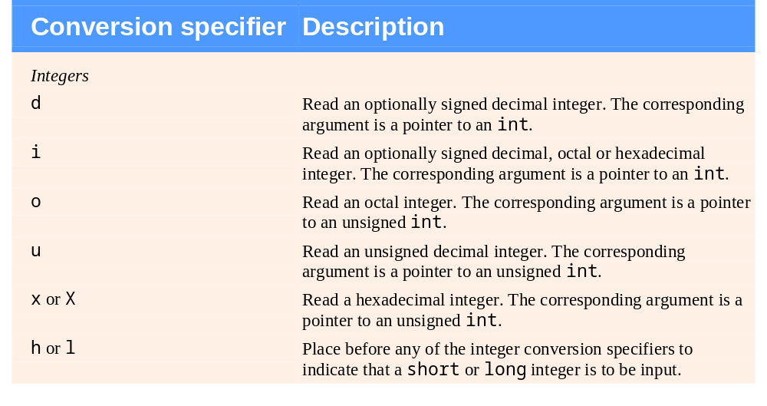
Fig. 9.17 | Conversion specifiers for scanf. (Part 1 of 3.)

Slide 52
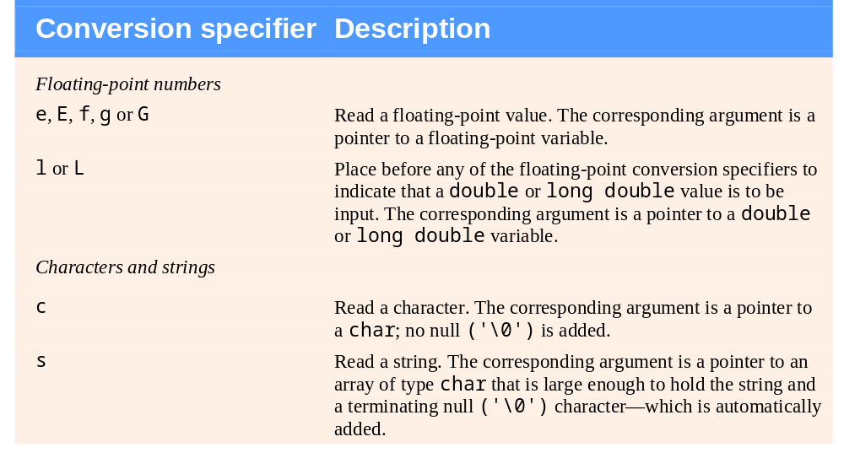
Fig. 9.17 | Conversion specifiers for scanf. (Part 2 of 3.)

Slide 53
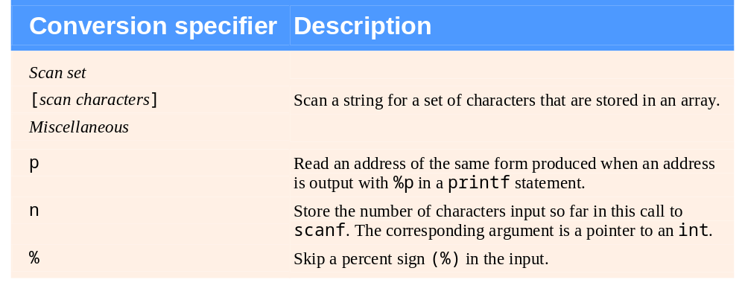
Fig. 9.17 | Conversion specifiers for scanf. (Part 3 of 3.)

Slide 54
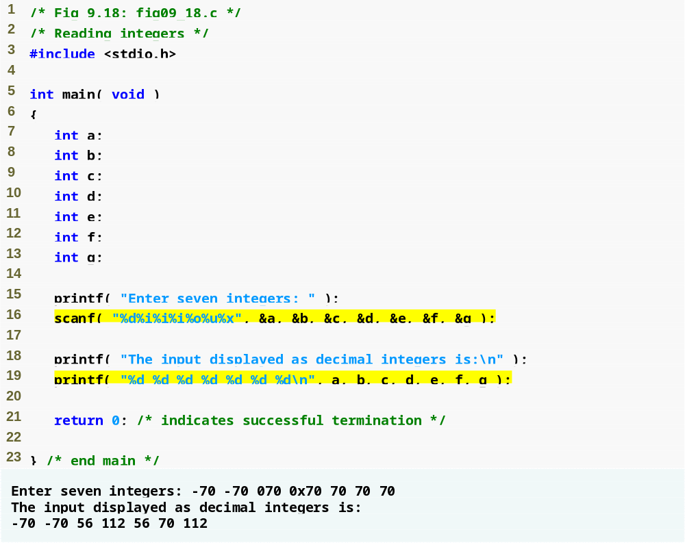
Outline
d specifies a decimal integer will be input
fig09_18.c
i specifies an integer will be input
o specifies an octal integer will be input
u specifies an unsigned decimal integer will be input
x specifies a hexadecimal integer will be input

Slide 55
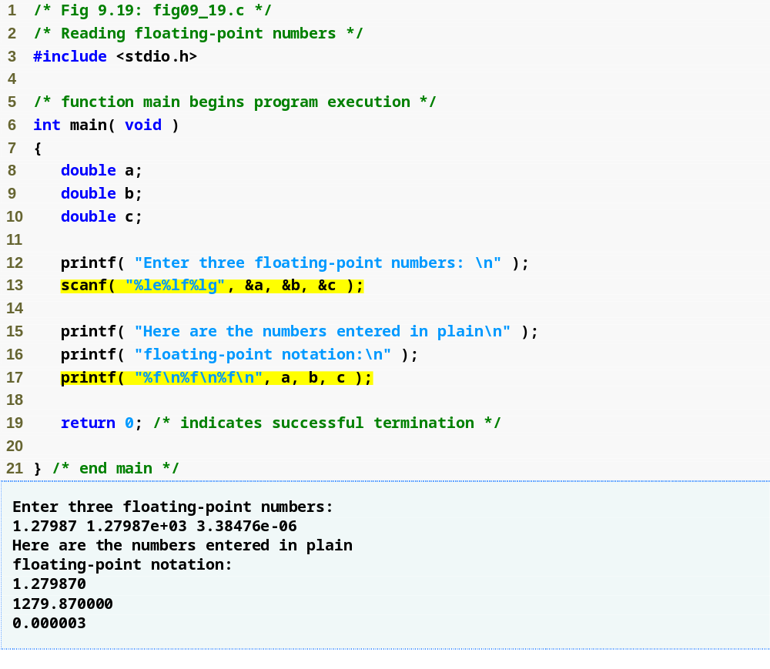
Outline
e, f, and g specify a floating-point number will be input
fig09_19.c
l specifies a double or long double will be input

Slide 56
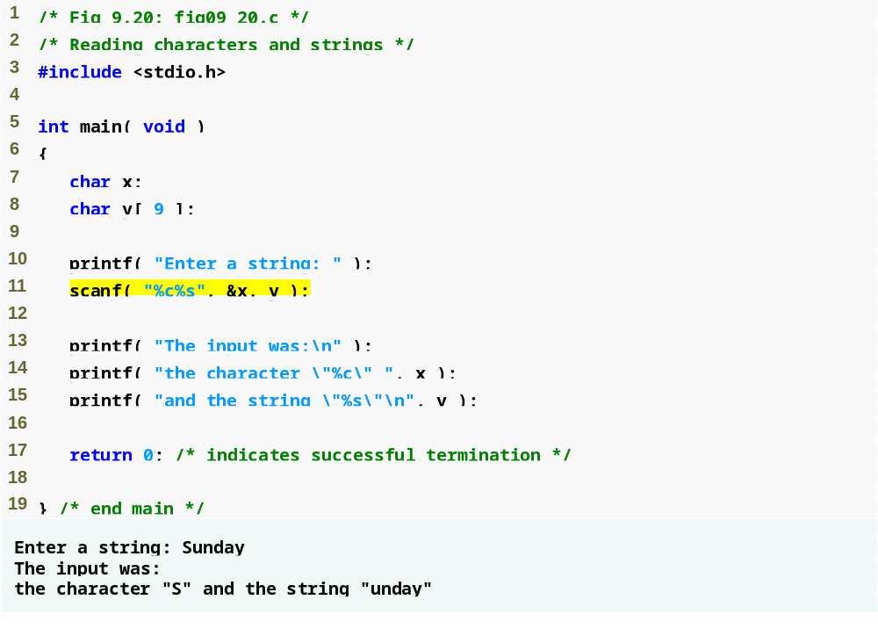
Outline
c specifies a character will be input
fig09_20.c
s specifies a string will be input

Slide 57
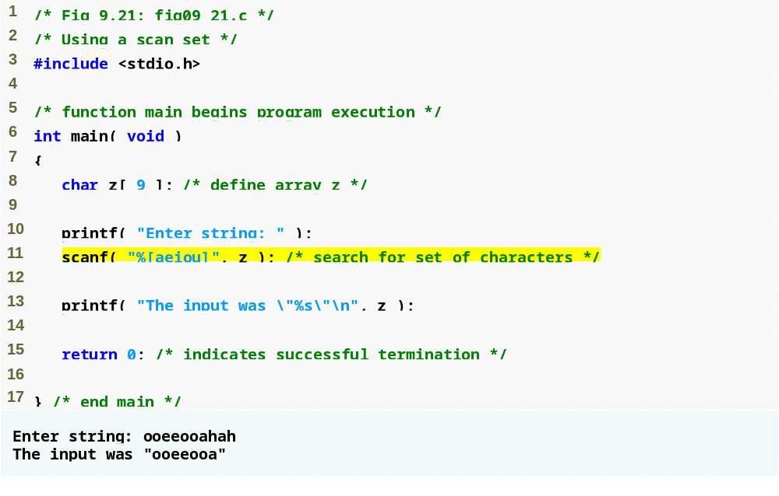
Outline
fig09_21.c
[] specifies only the initial segment of a string that contains the characters in brackets will be read

Slide 58
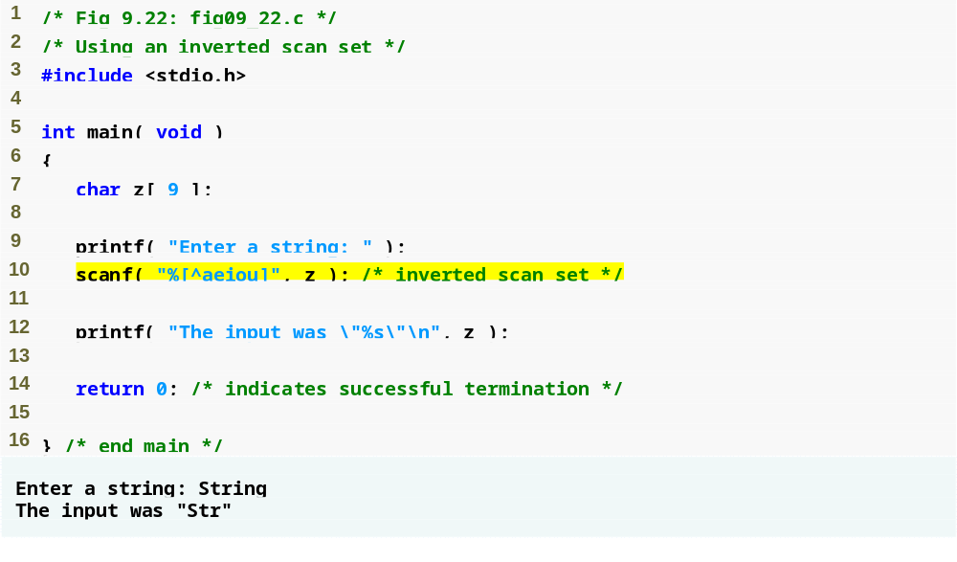
Outline
fig09_22.c
[] and ^ specify only the initial segment of a string that does not contain the characters in brackets will be read

Slide 59
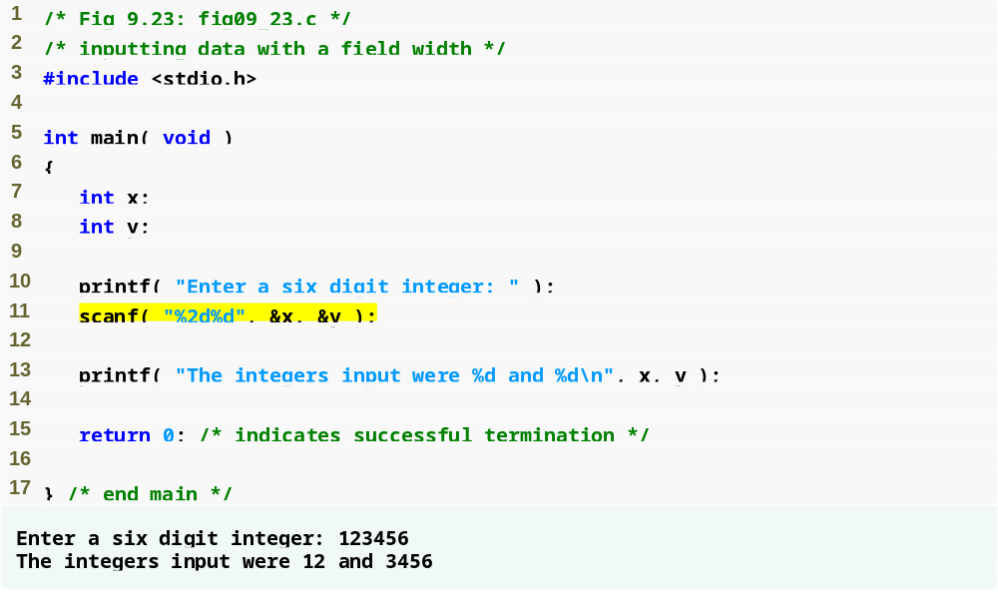
Outline
A field width of 2 tells C to only read the first 2 characters of that input
fig09_23.c

Slide 60
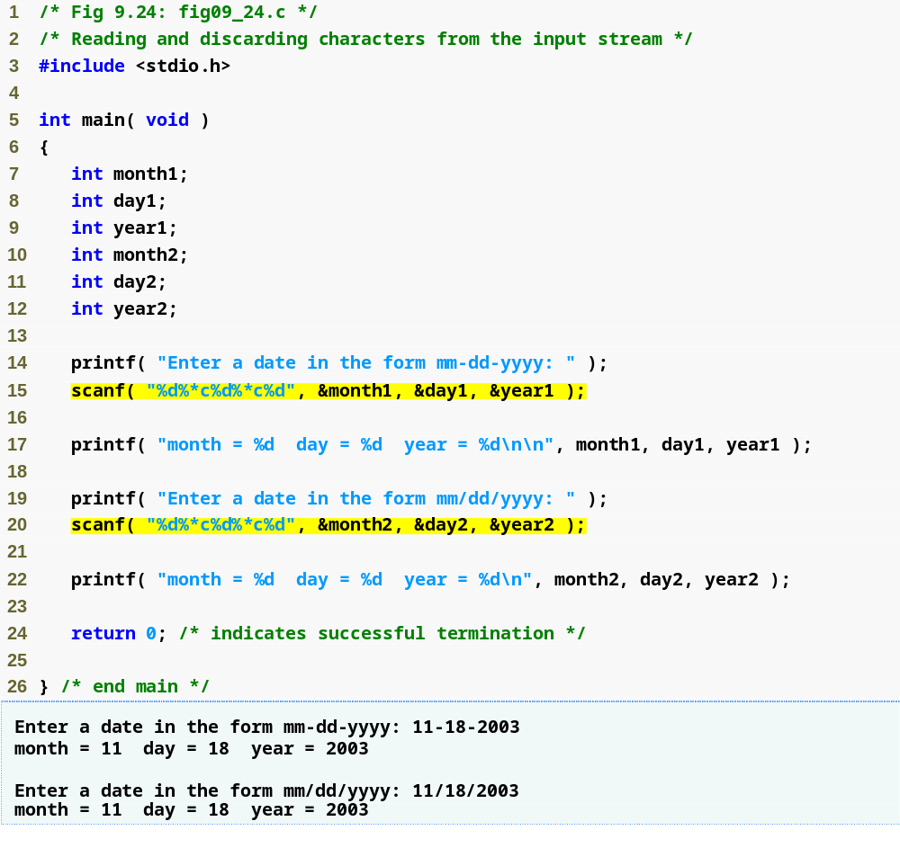
Outline
fig09_24.c
* is a wildcard—scanf will disregard anything between the two inputs on either side of it

