Slide 1
11
C File Processing

Slide 2
I read part of it all the way through.
  Samuel Goldwyn
Hats off!
The flag is passing by.
  Henry Holcomb Bennett

Slide 3
Consciousness … does not appear to itself chopped up in bits. … A “river” or a “stream” are the metaphors by which it is most naturally described.
  William James
I can only assume that a “Do Not File” document is filed in a “Do Not File” file.
  Senator Frank Church

Slide 4
OBJECTIVES
In this chapter you will learn:
To create, read, write and update files.
Sequential access file processing.
Random-access file processing.

Slide 5
11.1 Introduction
11.2 Data Hierarchy
11.3 Files and Streams
11.4 Creating a Sequential-Access File
11.5 Reading Data from a Sequential-Access File
11.6 Random-Access Files
11.7 Creating a Random-Access File
11.8 Writing Data Randomly to a Random-Access File
11.9 Reading Data from a Random-Access File
11.10 Case Study: Transaction-Processing Program

Slide 6
11.1 Introduction
Data files
  Can be created, updated, and processed by C programs
  Are used for permanent storage of large amounts of data
    Storage of data in variables and arrays is only temporary

Slide 7
11.2 Data Hierarchy
Data Hierarchy:
  Bit – smallest data item
    Value of 0 or 1
  Byte – 8 bits
    Used to store a character
      Decimal digits, letters, and special symbols
  Field – group of characters conveying meaning
    Example: your name
  Record – group of related fields
    Represented by a struct or a class
    Example: In a payroll system, a record for a particular employee that contained his/her identification number, name, address, etc.

Slide 8
11.2 Data Hierarchy
Data Hierarchy (continued):
  File – group of related records
    Example: payroll file
  Database – group of related files

Slide 9
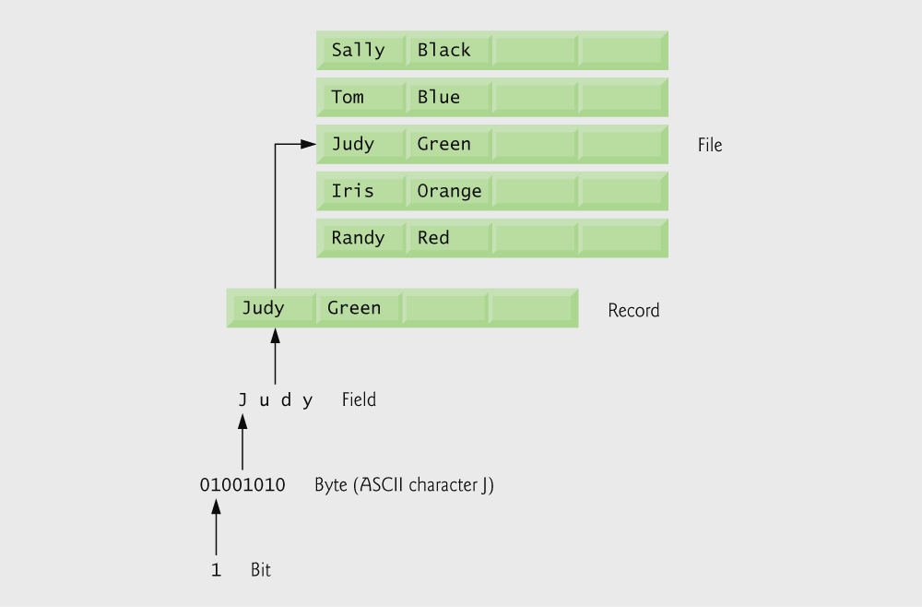
Fig. 11.1 | Data hierarchy.

Slide 10
11.2 Data Hierarchy
Data files
  Record key
    Identifies a record to facilitate the retrieval of specific records from a file
  Sequential file
    Records typically sorted by key

Slide 11
11.3 Files and Streams
C views each file as a sequence of bytes
  File ends with the end-of-file marker
    Or, file ends at a specified byte
Stream created when a file is opened
  Provide communication channel between files and programs
  Opening a file returns a pointer to a FILE structure
    Example file pointers:
    stdin - standard input (keyboard)
    stdout - standard output (screen)
    stderr - standard error (screen)

Slide 12
11.3 Files and Streams
FILE structure
  File descriptor
    Index into operating system array called the open file table
  File Control Block (FCB)
    Found in every array element, system uses it to administer the file

Slide 13

Fig. 11.2 | C’s view of a file of n bytes.

Slide 14
11.3 Files and Streams
Read/Write functions in standard library
  fgetc
    Reads one character from a file
    Takes a FILE pointer as an argument
    fgetc( stdin ) equivalent to getchar()
  fputc
    Writes one character to a file
    Takes a FILE pointer and a character to write as an argument
    fputc( 'a', stdout ) equivalent to putchar( 'a' )
  fgets
    Reads a line from a file
  fputs
    Writes a line to a file
  fscanf / fprintf
    File processing equivalents of scanf and printf

Slide 15
11.4 Creating a Sequential-Access File
C imposes no file structure
  No notion of records in a file
  Programmer must provide file structure
Creating a File
  FILE *cfPtr;
    Creates a FILE pointer called cfPtr
  cfPtr = fopen(“clients.dat", “w”);
    Function fopen returns a FILE pointer to file specified
    Takes two arguments – file to open and file open mode
    If open fails, NULL returned

Slide 16
11.4 Creating a Sequential-Access File
  fprintf
    Used to print to a file
    Like printf, except first argument is a FILE pointer (pointer to the file you want to print in)
  feof( FILE pointer )
    Returns true if end-of-file indicator (no more data to process) is set for the specified file
  fclose( FILE pointer )
    Closes specified file
    Performed automatically when program ends
    Good practice to close files explicitly
Details
  Programs may process no files, one file, or many files
  Each file must have a unique name and should have its own pointer

Slide 17
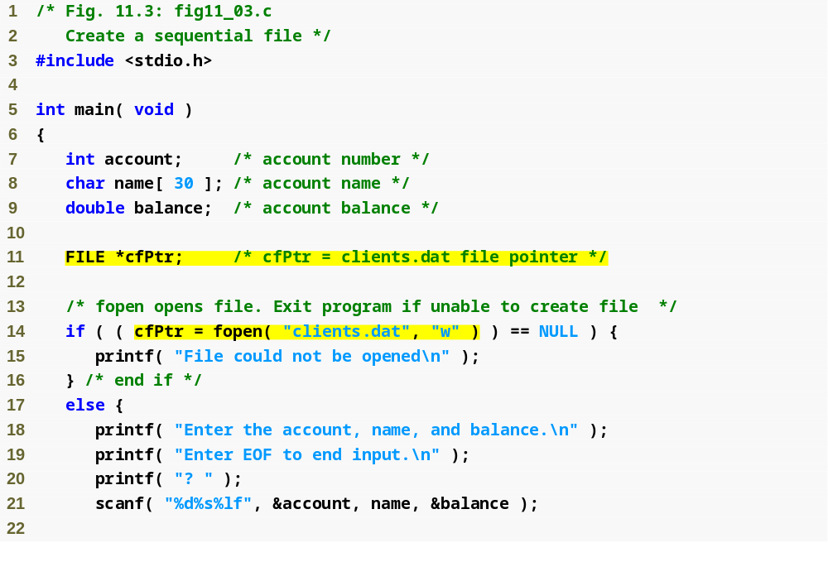
Outline
fig11_03.c
(1 of 2 )
FILE pointer definition creates new file pointer
fopen function opens a file; w argument means the file is opened for writing

Slide 18
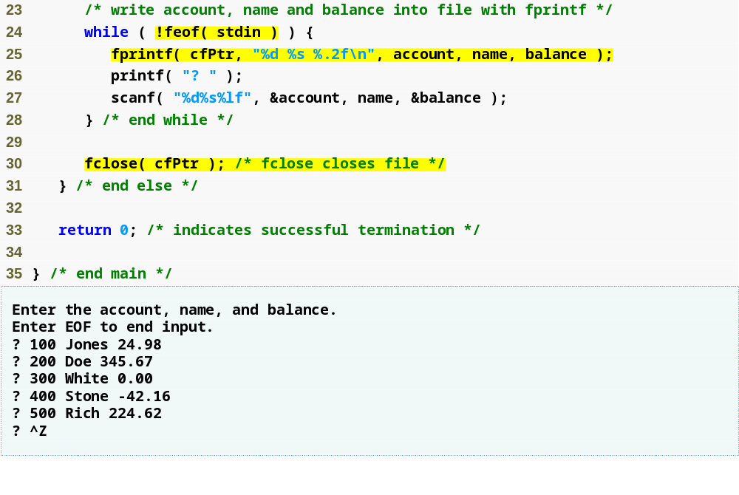
Outline
feof returns true when end of file is reached
fprintf writes a string to a file
fig11_03.c
(2 of 2 )
fclose closes a file

Slide 19
Common Programming Error 11.1
Opening an existing file for writing ("w") when, in fact, the user wants to preserve the file, discards the contents of the file without warning.

Slide 20
Common Programming Error 11.2
Forgetting to open a file before attempting
to reference it in a program is a logic error.

Slide 21
Common Programming Error 11.3
Using the wrong file pointer to refer to a file is a logic error.

Slide 22
Error-Prevention Tip 11.1
Be sure that calls to file processing functions
in a program contain the correct file pointers.

Slide 23
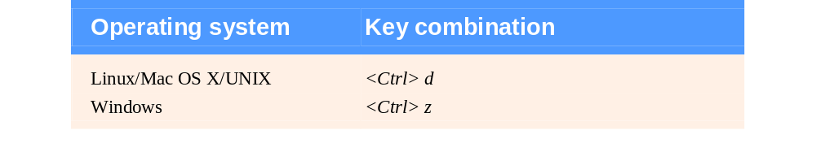
Fig. 11.4 | End-of-file key combinations for various popular
operating systems.

Slide 24
Good Programming Practice 11.1
Explicitly close each file as soon as it is known that the program will not reference the file again.

Slide 25
Performance Tip 11.1
Closing a file can free resources for which other users or programs may be waiting.

Slide 26
Common Programming Error 11.4
Opening a nonexistent file for reading is an error.

Slide 27
Common Programming Error 11.5
Opening a file for reading or writing without having been granted the appropriate access rights to the file (this is operating-system dependent) is an error.

Slide 28
Common Programming Error 11.6
Opening a file for writing when no disk space is available is an error.

Slide 29
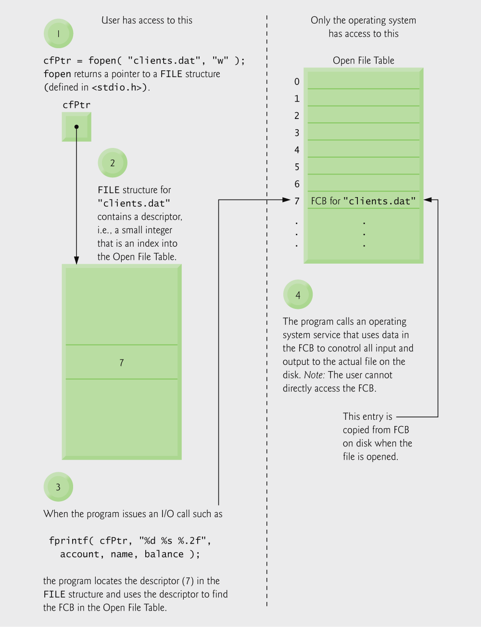
Fig. 11.5 | Relationship between FILE pointers, FILE structures and FCBs.

Slide 30
Common Programming Error 11.7
Opening a file with the incorrect file mode is
a logic error. For example, opening a file in write mode ("w") when it should be opened in update mode ("r+") causes the contents of the file to be discarded.

Slide 31
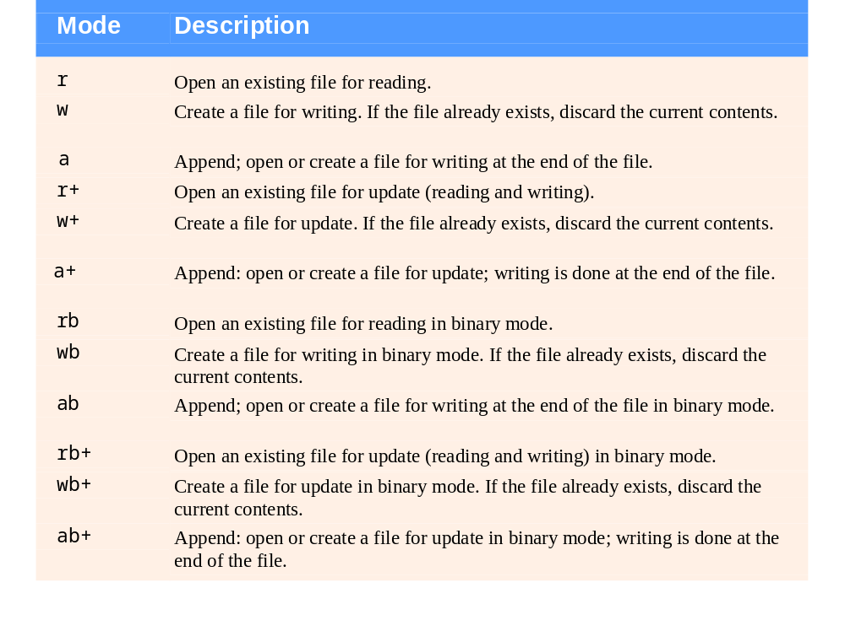
Fig. 11.6 | File opening modes.

Slide 32
Error-Prevention Tip 11.2
Open a file only for reading (and not update) if the contents of the file should not be modified. This prevents unintentional modification of the file’s contents. This is another example of the principle of least privilege.

Slide 33
11.5 Reading Data from a Sequential-Access File
Reading a sequential access file
  Create a FILE pointer, link it to the file to read
    cfPtr = fopen( “clients.dat", "r" );
  Use fscanf to read from the file
    Like scanf, except first argument is a FILE pointer
    fscanf( cfPtr, "%d%s%f", &accounnt, name, &balance );
  Data read from beginning to end
  File position pointer
    Indicates number of next byte to be read / written
    Not really a pointer, but an integer value (specifies byte location)
    Also called byte offset
  rewind( cfPtr )
    Repositions file position pointer to beginning of file (byte 0)

Slide 34
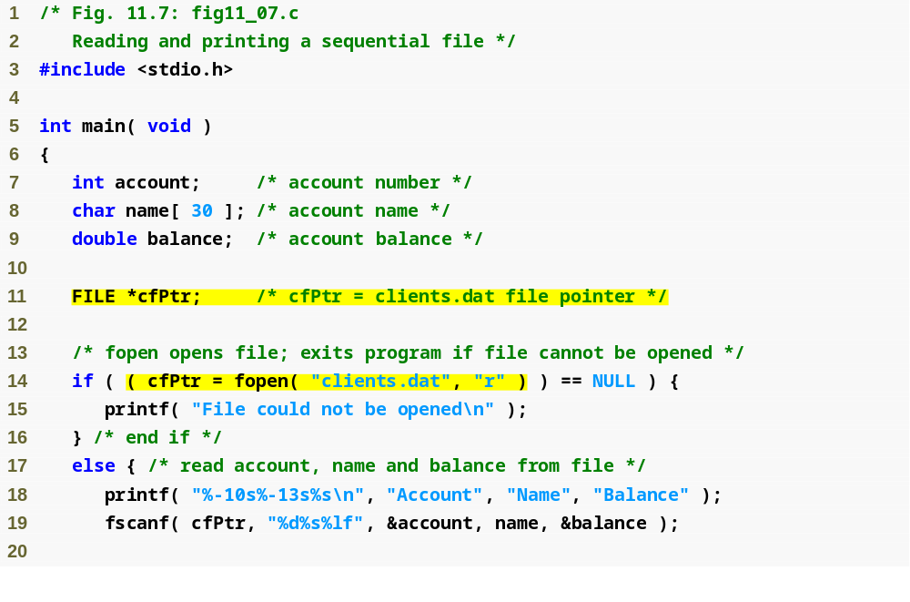
Outline
fig11_07.c
(1 of 2 )
fopen function opens a file; r argument means the file is opened for reading

Slide 35
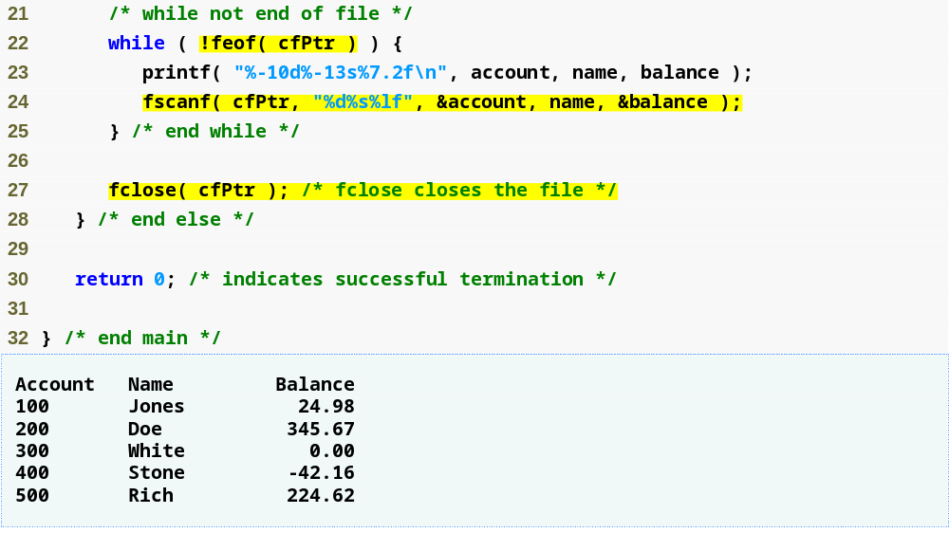
Outline
fscanf function reads a string from a file
fig11_07.c
(2 of 2 )

Slide 36
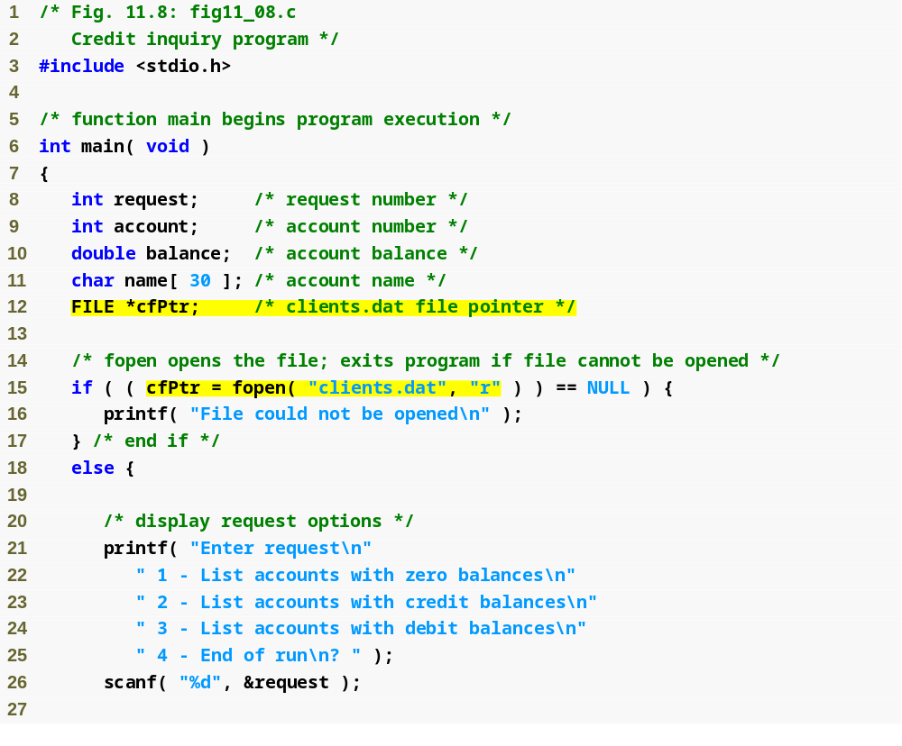
Outline
fig11_08.c
(1 of 4 )

Slide 37
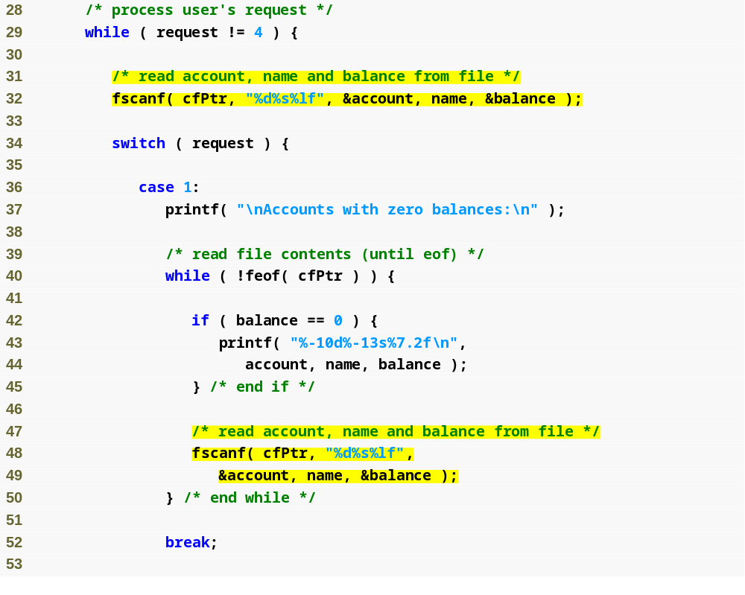
Outline
fig11_08.c
(2 of 4 )

Slide 38
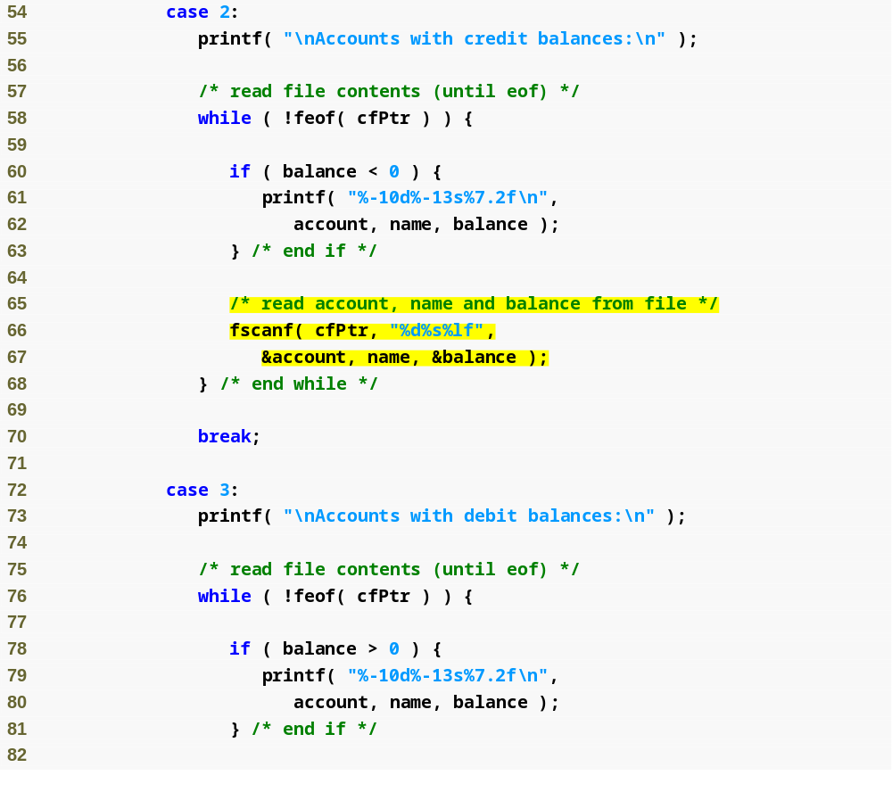
Outline
fig11_08.c
(3 of 4 )

Slide 39
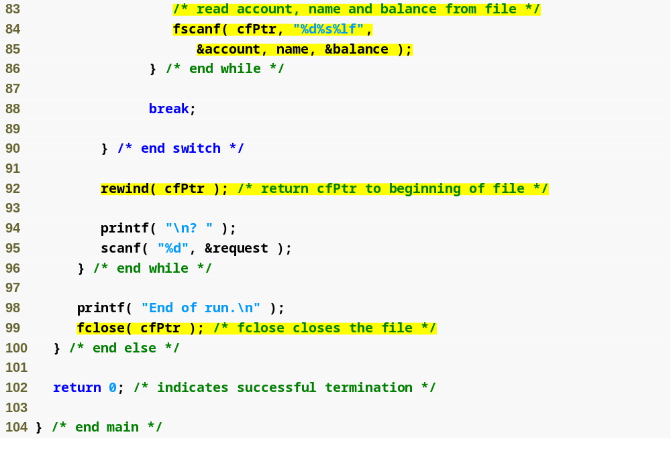
Outline
fig11_08.c
(4 of 4 )
rewind function moves the file pointer back to the beginning of the file

Slide 40
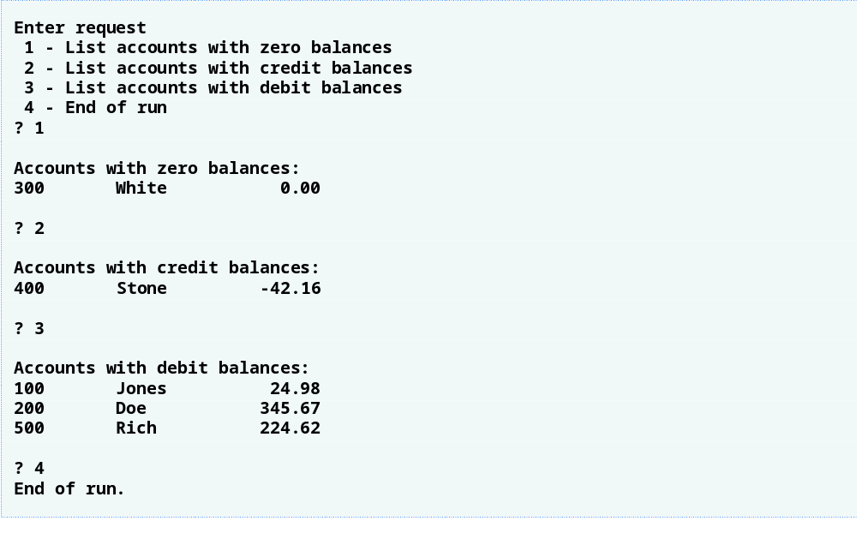
Outline

Slide 41
11.5 Reading Data from a Sequential-Access File
Sequential access file
  Cannot be modified without the risk of destroying other data
  Fields can vary in size
    Different representation in files and screen than internal representation
    1, 34, -890 are all ints, but have different sizes on disk

Slide 42
11.6 Random-Access Files
Random access files
  Access individual records without searching through other records
  Instant access to records in a file
  Data can be inserted without destroying other data
  Data previously stored can be updated or deleted without overwriting
Implemented using fixed length records
  Sequential files do not have fixed length records

Slide 43
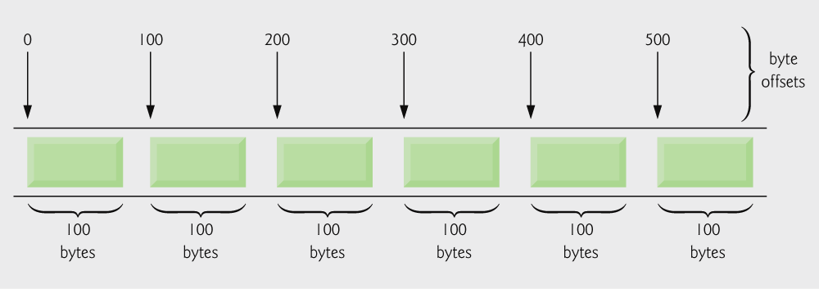
Fig. 11.10 | C’s view of a random-access file.

Slide 44
11.7 Creating a Random-Access File
Data in random access files
  Unformatted (stored as "raw bytes")
    All data of the same type (ints, for example) uses the same amount of memory
    All records of the same type have a fixed length
    Data not human readable

Slide 45
11.7 Creating a Random-Access File
Unformatted I/O functions
  fwrite
    Transfer bytes from a location in memory to a file
  fread
    Transfer bytes from a file to a location in memory
  Example:
    fwrite( &number, sizeof( int ), 1, myPtr );
    &number – Location to transfer bytes from
    sizeof( int ) – Number of bytes to transfer
    1 – For arrays, number of elements to transfer
      In this case, "one element" of an array is being transferred
    myPtr – File to transfer to or from

Slide 46
11.7 Creating a Random-Access File
Writing structs
  fwrite( &myObject, sizeof (struct myStruct), 1, myPtr );
  sizeof – returns size in bytes of object in parentheses
To write several array elements
  Pointer to array as first argument
  Number of elements to write as third argument

Slide 47
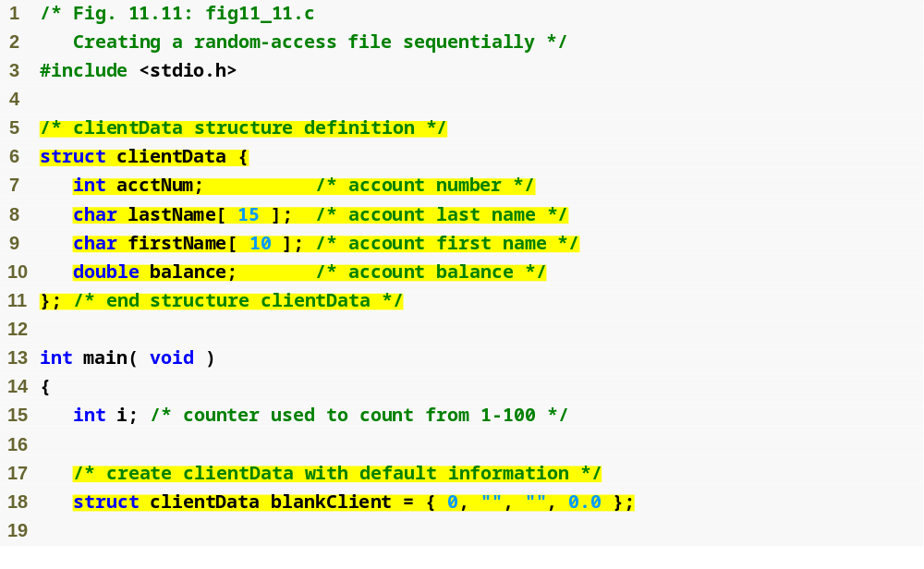
Outline
fig11_11.c
(1 of 2 )

Slide 48
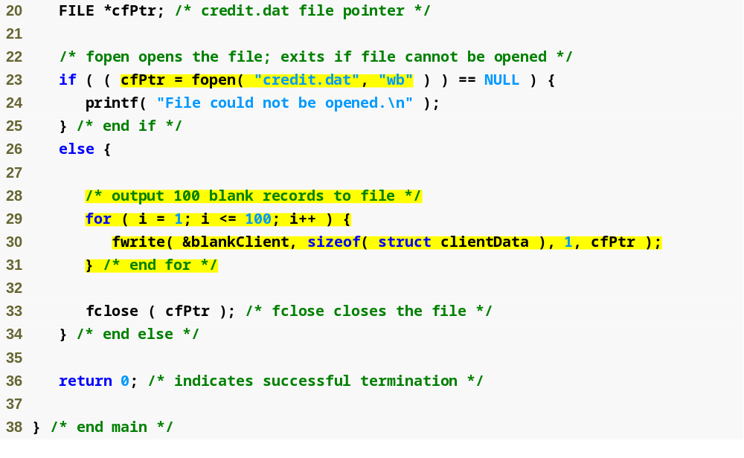
Outline
fopen function opens a file; wb argument means the file is opened for writing in binary mode
fig11_11.c
(2 of 2 )
fwrite transfers bytes into a random-access file

Slide 49
11.8 Writing Data Randomly to a Random-Access File
fseek
  Sets file position pointer to a specific position
  fseek( pointer, offset, symbolic_constant );
    pointer – pointer to file
    offset – file position pointer (0 is first location)
    symbolic_constant – specifies where in file we are reading from
    SEEK_SET – seek starts at beginning of file
    SEEK_CUR – seek starts at current location in file
    SEEK_END – seek starts at end of file

Slide 50
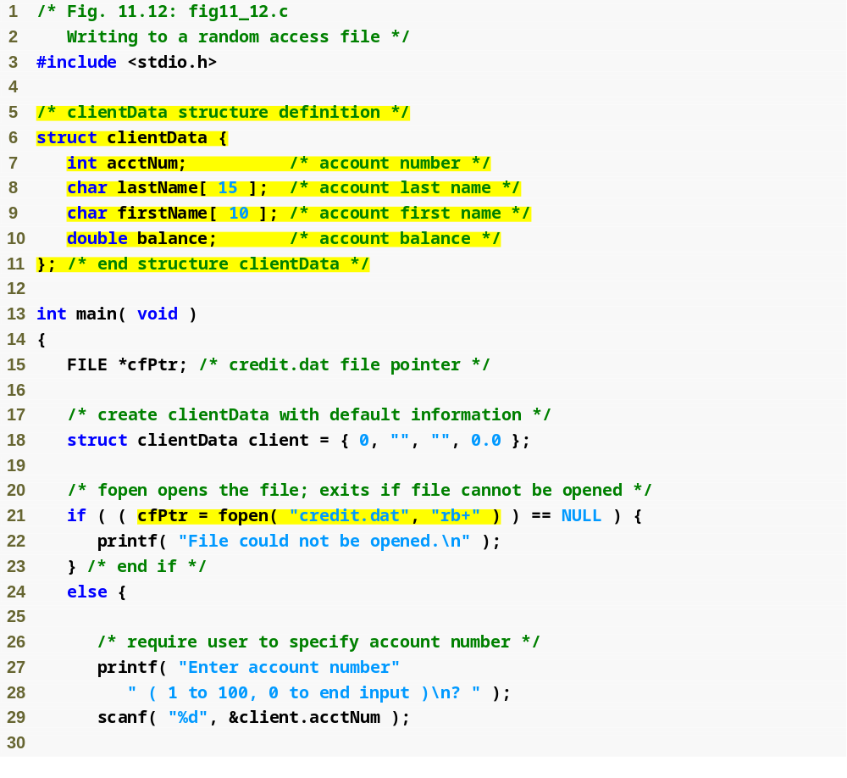
Outline
fig11_12.c
(1 of 2 )

Slide 51
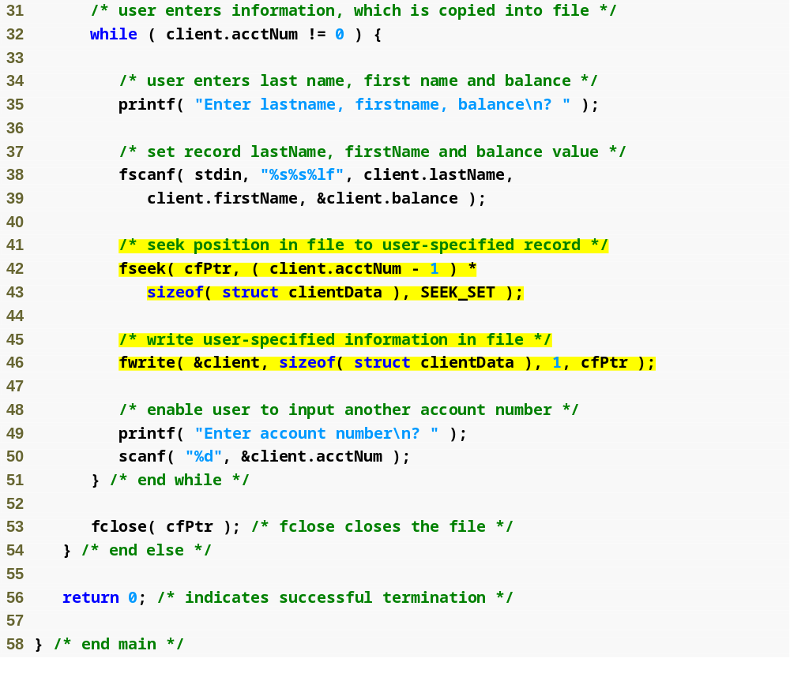
Outline
fig11_12.c
(2 of 2 )
fseek searches for a specific location in the random-access file

Slide 52
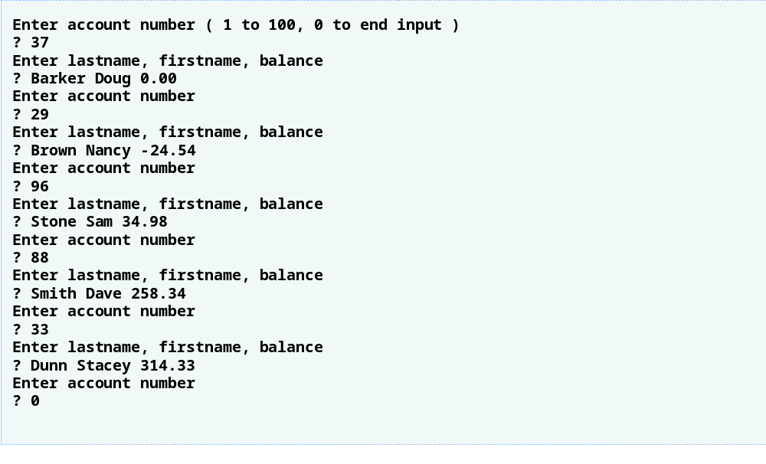
Outline

Slide 53
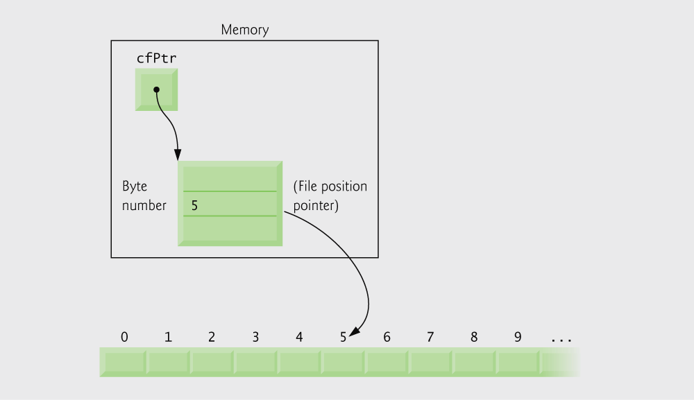
Fig. 11.14 | File position pointer indicating an offset of 5 bytes from
the beginning of the file.

Slide 54
11.9 Reading Data from a Random-Access File
fread
  Reads a specified number of bytes from a file into memory
    fread( &client, sizeof (struct clientData), 1, myPtr );
  Can read several fixed-size array elements
    Provide pointer to array
    Indicate number of elements to read
  To read multiple elements, specify in third argument

Slide 55
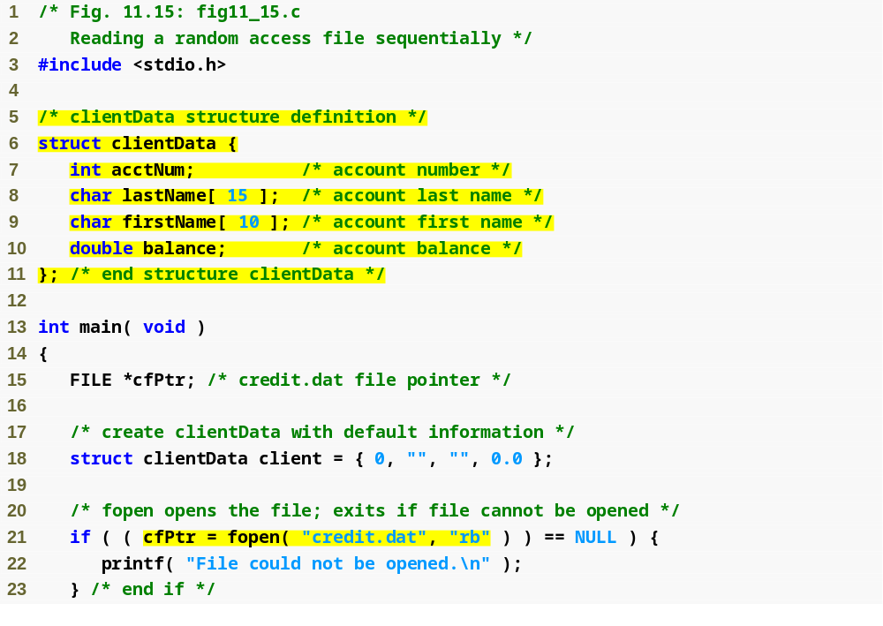
Outline
fig11_15.c
(1 of 2 )

Slide 56
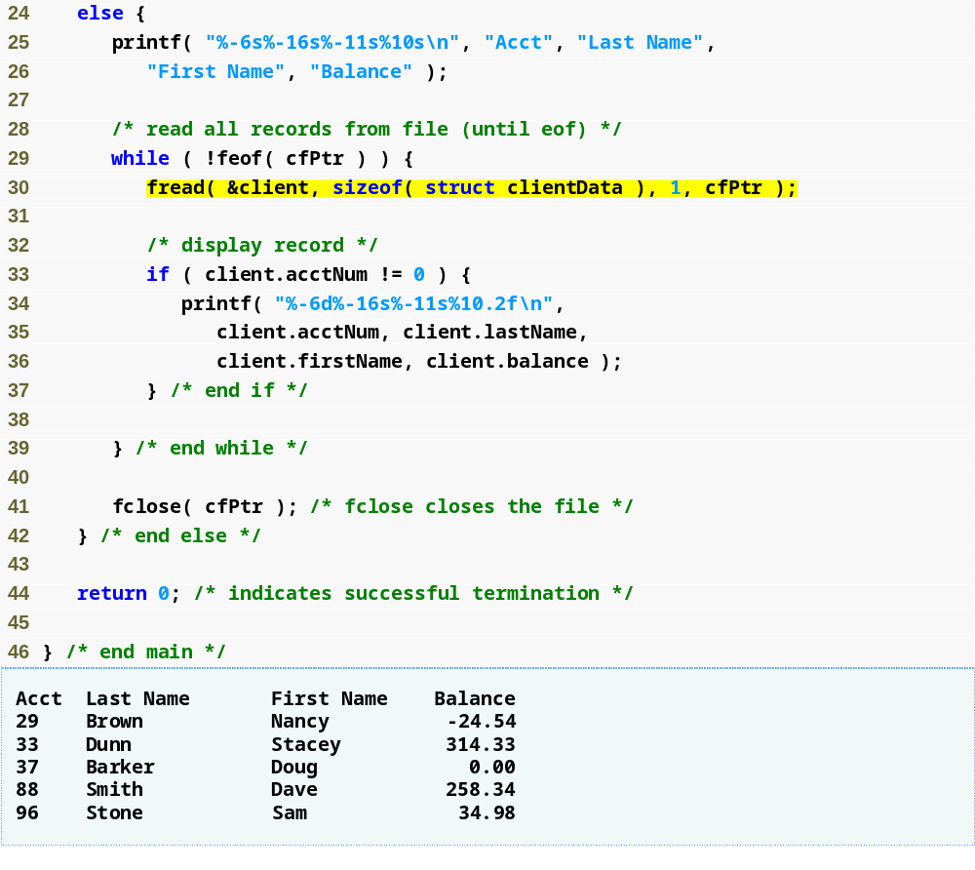
Outline
fig11_15.c
(2 of 2 )
fread reads bytes from a random-access file to a location in memory

Slide 57
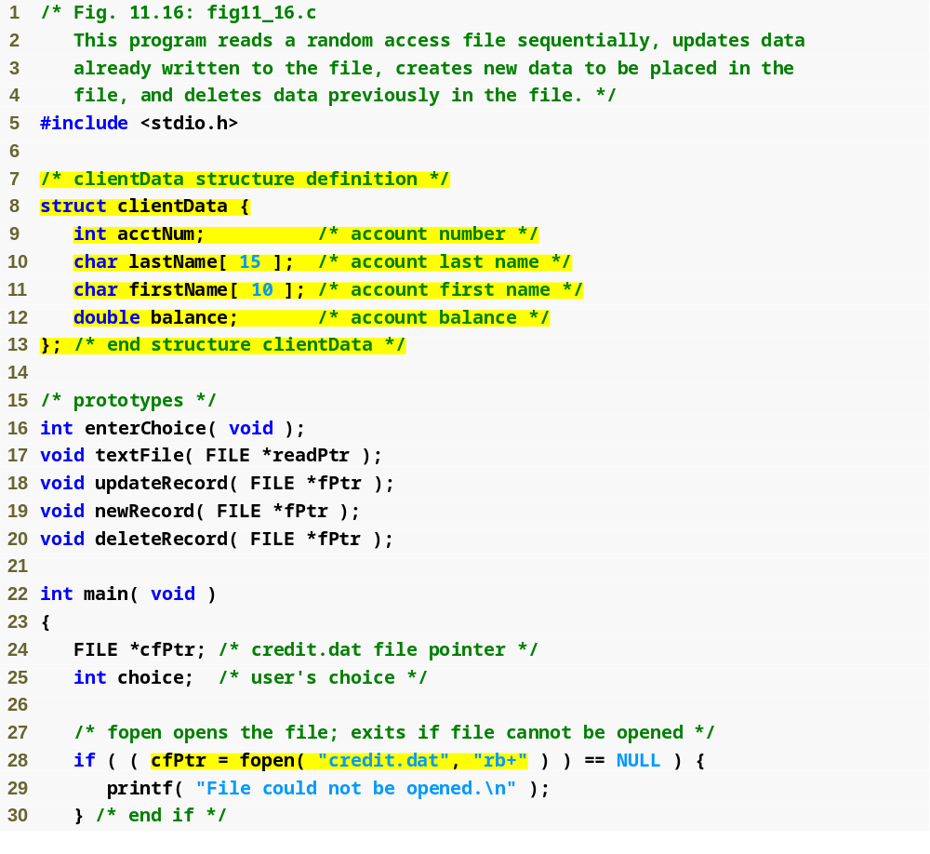
Outline
fig11_16.c
(1 of 10 )

Slide 58
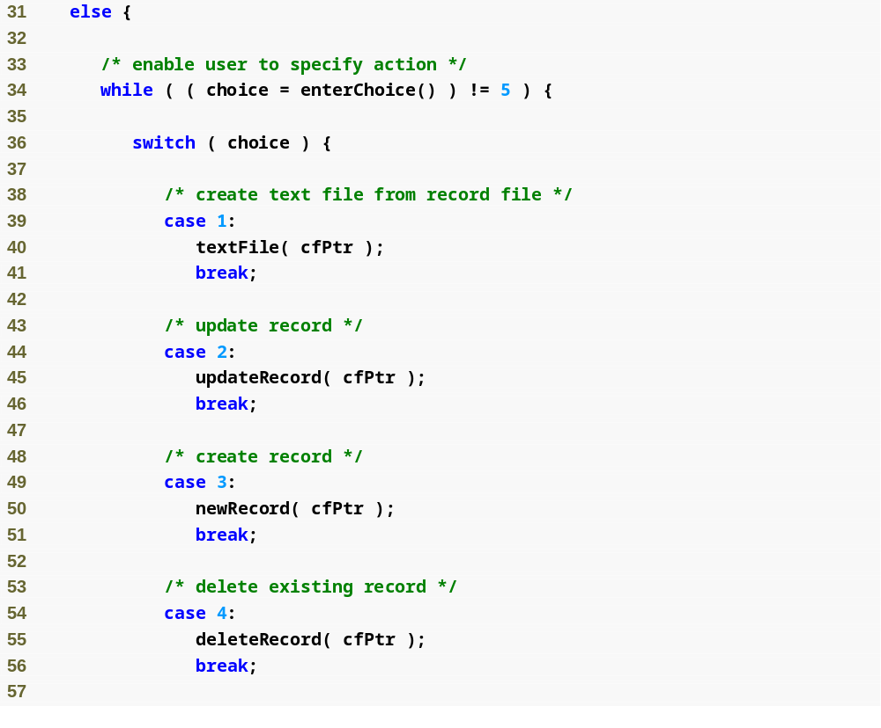
Outline
fig11_16.c
(2 of 10 )

Slide 59
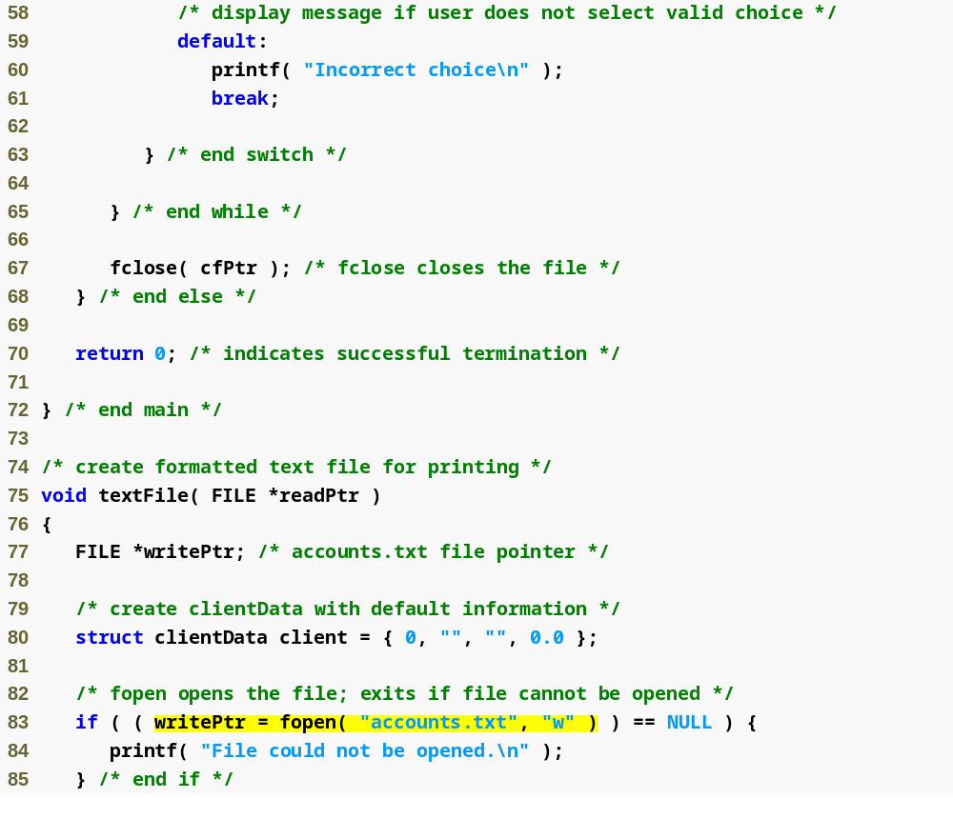
Outline
fig11_16.c
(3 of 10 )
Function textFile creates a text file containing all account data

Slide 60
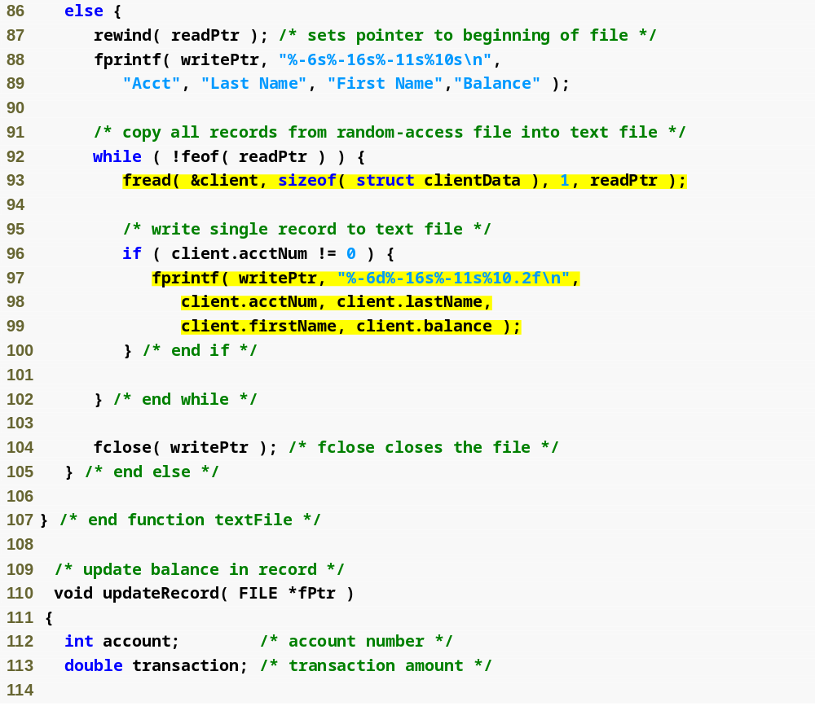
Outline
fig11_16.c
(4 of 10 )
Function updateRecord changes the balance of a specified account

Slide 61
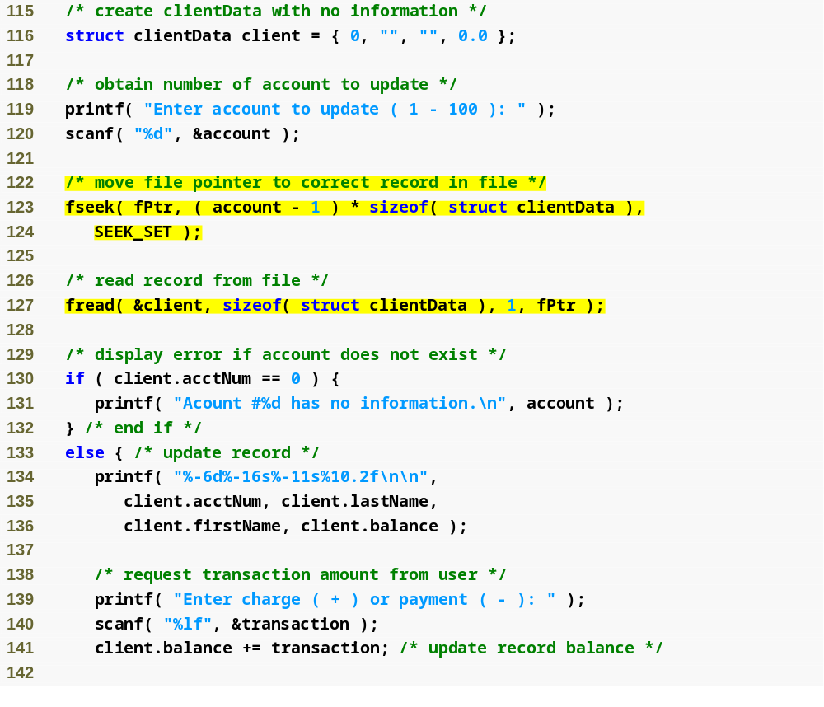
Outline
fig11_16.c
(5 of 10 )

Slide 62
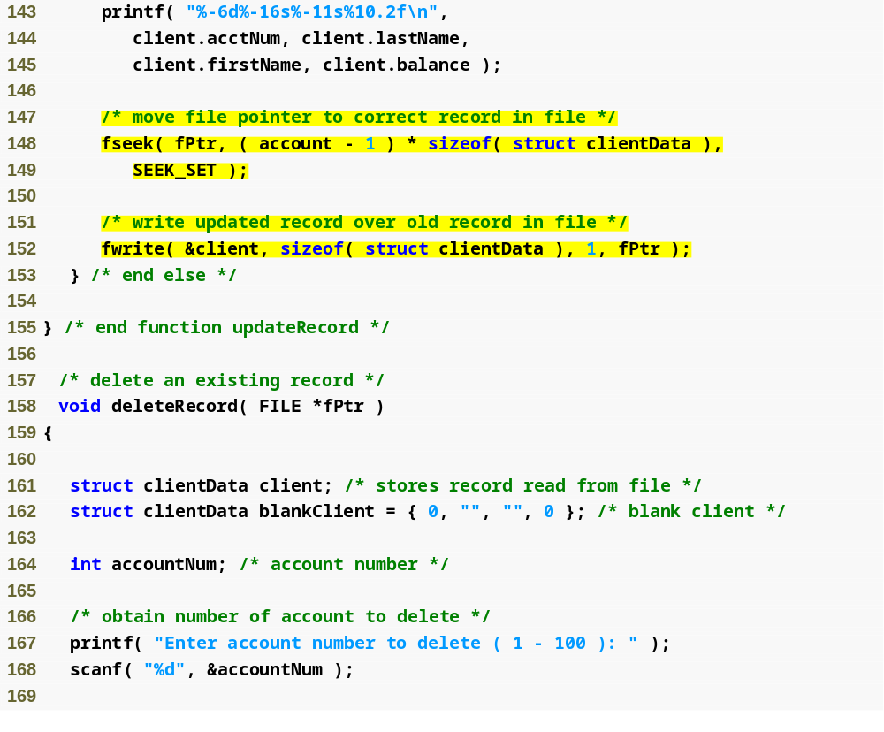
Outline
fig11_16.c
(6 of 10 )
Function deleteRecord removes an existing account from the file

Slide 63
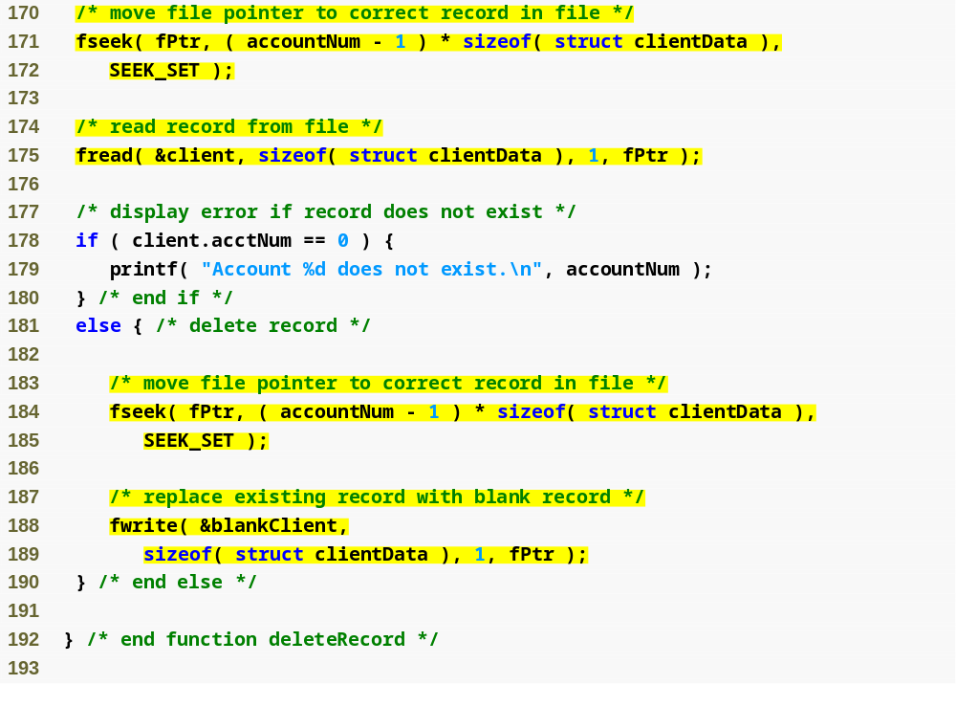
Outline
fig11_16.c
(7 of 10 )

Slide 64
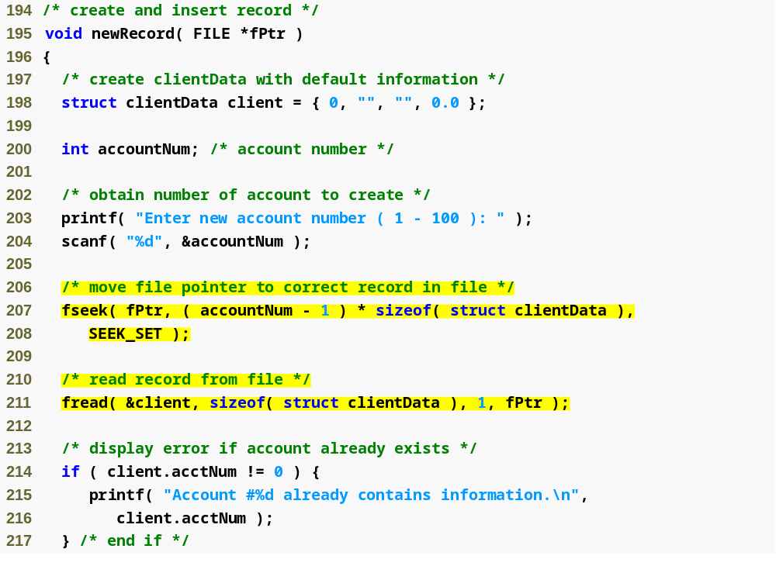
Outline
Function newRecord adds a new account to the file
fig11_16.c
(8 of 10 )

Slide 65
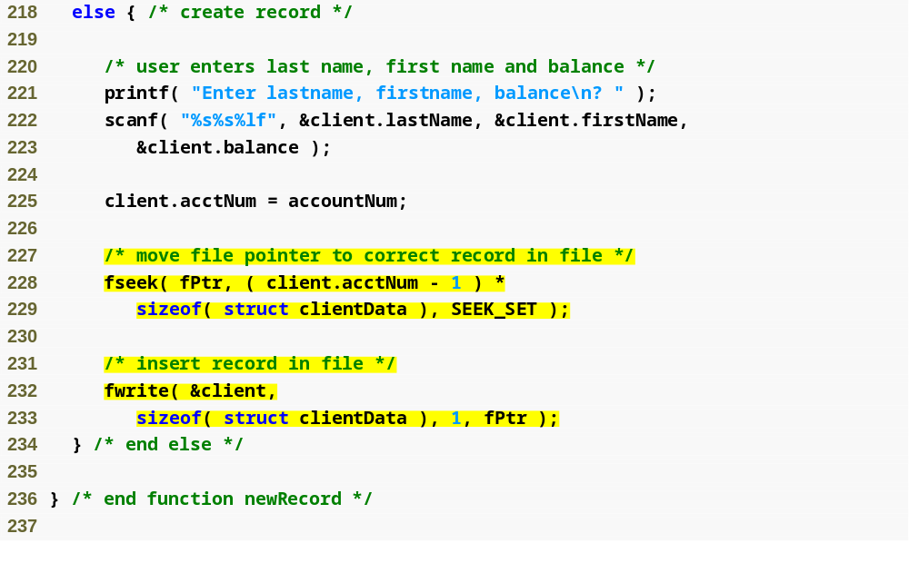
Outline
fig11_16.c
(9 of 10 )

Slide 66
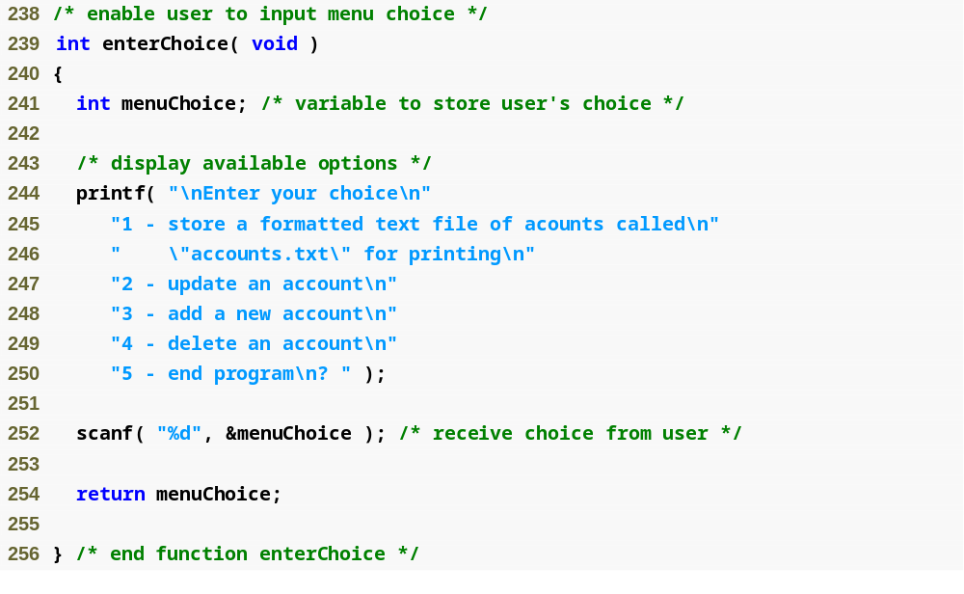
Outline
fig11_16.c
(10 of 10 )

