Slide 1
Structs

Slide 2
Objectives
Understand the mechanics of struct variables
Understand why struct variables are used
Understand how to design programs (functions) that use structs

Slide 3
Why Structs?
Frequently two or more variables are required to represent one “unit” of information
  An employee record may have the name, social security number, home address, etc., etc.

Slide 4
What is a struct
A struct is an aggregate of multiple variables
  By defining a “struct variable”, we automatically get all of the variables inside the struct
  By passing the struct as an argument, we automatically pass all the variables inside the struct
Other than some minor alignment issues
  A struct is treated EXACTLY like the variables that are “inside” it.

Slide 5
Syntax: Struct Definition
struct Employee {
char name[30];
int sn;
char address[60];
};
The struct definition tells us how many, and what types of variables are used to make up the struct.
It does not actually create any of these variables!
  We cannot initialize data members
  Therefore following initialization is not allowed
struct Employee {
char name[30] = “ Ali”; //error
int sn = 21; //error
char address[60] = “Lahore”; //error
};

Slide 6
#include<stdio.h>
#include<conio.h>
struct Student
{
int rollno;
char name[15];
int marks;
};
int main()
{
struct Student st1,st2,st3 = {3,"Asim",17};
printf("\nEnter rollno : ");
scanf("%d",&st1.rollno);
fflush(stdin);
printf("\nEnter name : ");
gets(st1.name);
printf("\nEnter marks : ");
scanf("%d",&st1.marks);

Slide 7
printf("\nEnter rollno : ");
scanf("%d",&st2.rollno);
fflush(stdin);
printf("\nEnter name : ");
gets(st2.name);
printf("\nEnter marks : ");
scanf("%d",&st2.marks);
printf("\nRollno : %d",st1.rollno);
printf("\nName : %s",st1.name);
printf("\nMarks : %d",st1.marks);
printf("\nRollno : %d",st2.rollno);
printf("\nName : %s",st2.name);
printf("\nMarks : %d",st2.marks);
printf("\nRollno : %d",st3.rollno);
printf("\nName : %s",st3.name);
printf("\nMarks : %d",st3.marks);
return 0;
}

Slide 8
More on Struct Definitions
The name of the struct can be (almost) anything you like
There can be as many variables in the struct as you want.
The variables can be any type that you want
  The variables inside a struct can even be other struct variables (not the same kind of struct)

Slide 9
Example
struct Address {
char street[20];
char city[20];
char state[20];
int zip;
};
struct Employee {
char name[30];
int ssn;
struct Address home_address;
};

Slide 10
Some Details
NOTE: C++ struct syntax is slightly different from C
  C++ creates two “type names”, e.g., both “struct Employee” and “Employee” are names for the struct type
  C creates only one type name, “struct Employee”
  We can use a typedef in C to create the second type name if we want it

Slide 11
10.6 typedef
typedef
  Creates synonyms (aliases) for previously defined data types
  Use typedef to create shorter type names
  Example:
      typedef struct Card *CardPtr;
  Defines a new type name CardPtr as a synonym for type struct Card *
  typedef does not create a new data type
    Only creates an alias

Slide 12
Defining struct student:
struct student
{ int a,
int b,
};
Declaring struct student type objects:
struct student obj = {1,1};
If we use typedef:
typedef struct student Student;
Now we can declare objects using following syntax:
Student obj = {1,1};
Accessing data member using obj:
obj.a
obj.b
obj
1 | 1
a | b

Slide 13
Good Programming Practice 10.4
Capitalize the first letter of typedef names to emphasize that they are synonyms for other type names.

Slide 14
Portability Tip 10.2
Use typedef to help make a program
more portable.

Slide 15
#include<stdio.h>
struct blah
{
int a;
float f;
char c;
}obj1;
int main()
{
struct blah obj2 = {1,2.4,’y’};
typedef struct blah Blah;
Blah obj3 = {4,5.5,’N’};
obj1 = obj2;
printf(“ %d %f %c”,obj1.a,obj1.f,obj1.c);
printf(“ %d %f %c”,obj2.a,obj2.f,obj2.c);
printf(“ %d %f %c”,obj3.a,obj3.f,obj3.c);
return 0;
}

Slide 16
Details Cont.
A struct cannot have a variable inside it whose type is the same as the struct
A struct can have a variable inside it whose type is a pointer to the struct!
struct Blah {
int x;
struct Blah y; // illegal, requires infinite memory
};
struct Bleh {
int x;
struct Bleh* p; // perfectly fine, requires only 4 bytes for p
};

Slide 17
Beware the Ending “;”
This is the only place in C/C++ where you have the sequence “};” and it’s very easy to forget.
While we’re talking style… I suggest that you
  Put your struct definitions in a .h file (and #include that file in any .cpp file that uses the struct)
  Do not declare actual struct variables in the same statement that defines the struct type
  You can create your own header file like conio.h and can place definition of your structure there

Slide 18
Creating struct Variables
struct Address {
char street[20];
char city[20];
char state[20];
int zip;
};
struct Employee {
char name[30];
int ssn;
struct Address home_address;
};
int main(void) {
struct Employee emp; // creates several variables
strcpy(emp.name,“Farooq”);
emp.ssn = 111223333;
strcpy(emp.home_address.street, “1 Defence Road”);
}
Declare a struct variable (actually a collection of variables) using the type name for the struct
Access the variables inside the struct using “.”

Slide 19
Assignment and Arguments
Structs can be used (almost) as if they were ordinary variables
struct Employee x;
//assigning one struct variable values to other struct variable (both should be of same type)
x = emp; // assigns all variables inside x
if (x == emp) // illegal! cannot compare structs

Slide 20
Pointers and Structs
If you calculate the address of a struct
  You get the address of the first byte in the struct (just like with ordinary variables)
  Obviously, this is also the address of the first variable inside the struct
Dereferencing a pointer to a struct gives you a reference to the struct
  You would still use “.” to access the individual variables inside the struct

Slide 21
The -> shortcut
It’s tedious to type (and hard to read) programs with lots of “(*p).x” stuff
C/C++ provides an alternate syntax (that means precisely the same thing): p->x
The -> is just a convenience, you can use either the (*p).x or p-> syntax, whatever you’re most comfortable with
  Most experienced programmers use the p->x

Slide 22
Passing struct to a function
Passing structures to functions
  Pass entire structure
    Or, pass individual members
  Both pass call by value
To pass structures call-by-reference
  Pass its address
  Pass reference to it
To pass arrays call-by-value
  Create a structure with the array as a member
  Pass the structure

Slide 23
Pass by Value?
structs are passed just like ordinary variables
  A new struct is created in the activation record
Hence, changing the parameter will not affect the value of the original argument
typedef struct{
int x;
}Blah;
void doit(Blah b) {
b.x = 42; // changes the parameter – which is local to doit!
}
int main(void) {
Blah a;
a.x = 0;
doit(a); // puts a COPY of b into the activation record
printf(“%d”, a.x); // prints 0
}

Slide 24
Pass by Reference?
structs are passed just like ordinary variables
  Pass its address
  Pass reference to it
Hence, changing the parameter will affect the value of the original argument
Struct Blah
{
int x;
};
void doit(struct Blah a, struct Blah *b) {
a.x = 42; // does not change the actual argument value
b->x=34; // changes the actual argument value
}
int main(void) {
struct Blah f, g;
f.x = 20;
g.x = 20;
doit(f,&g); // puts a COPY of b into the activation record
printf(“%d %d”, f.x, g.x); // prints 20 34
}

Slide 25
Pass array of struct?
structs arrays are passed just like ordinary arrays
  Pass its address
Hence, changing the parameter will affect the value of the original argument
Struct Blah
{
int x;
};
void doit(Blah b[]) {
b[0].x = 42; // changes the parameter – which is local to doit!
b[1].x=34
}
int main(void) {
Blah b[2];
b[0].x = 20;
b[1].x=20;
doit(b); // puts a COPY of b into the activation record
printf(“%d %d”, b[0].x, b[1].x); // prints 42 34
}

Slide 26
#include<stdio.h>
#include<conio.h>
typedef struct
{
int rollno;
char name[20];
float fee;
}Student;
int main()
{
Student st1 = {1,"Ali",20000.0};
Student x[3]={1,"Ali",20000.0};
Student *stptr;
int i;
printf("\nEnter roll number :");
scanf("%d",&st1.rollno);
fflush(stdin);
printf("\nEnter name : ");
gets(st1.name);
printf("\nEnter fee : ");
scanf("%f",&st1.fee);

Slide 27
printf("\nRoll number : %d",st1.rollno);
printf("\nName : %s",st1.name);
printf("\nFee : %.2f",st1.fee);
//Getting values using array
for(i=0;i<3;i++)
{
printf("\nEnter roll number :");
scanf("%d",&x[i].rollno);
fflush(stdin);
printf("\nEnter name : ");
gets(x[i].name);
printf("\nEnter fee : ");
scanf("%f",&x[i].fee);
}

Slide 28
for(i=0;i<3;i++)
{
printf("\nRoll number : %d",x[i].rollno);
printf("\nName : %s",x[i].name);
printf("\nFee : %.2f",x[i].fee);
}
//using pointer
stptr = &st1;
printf("\nRoll number : %d",stptr->rollno);
printf("\nName : %s",stptr->name);
printf("\nFee : %.2f",stptr->fee);
return 0;
}

Slide 29
Unions
union
  Memory that contains a variety of objects over time
  Only contains one data member at a time
  Members of a union share space
  Conserves storage
  Only the last data member defined can be accessed
union definitions
  Same as struct
      union Number {
      int x;
      float y;
      };
      union Number value;

Slide 30
Unions
Valid union operations
  Assignment to union of same type: =
  Taking address: &
  Accessing union members: .
  Accessing members using pointers: ->

Slide 31
Software Engineering Observation 10.1
As with a struct definition, a union definition simply creates a new type. Placing a union or struct definition outside any function does not create a global variable.

Slide 32
Common Programming Error 10.10
Comparing unions is a syntax error.

Slide 33
Portability Tip 10.4
The amount of storage required to store a union is implementation dependent but will always be at least as large as the largest member of the union.

Slide 34
Portability Tip 10.5
Some unions may not port easily to other computer systems. Whether a union is portable or not often depends on the storage alignment requirements for the union member data types on a given system.

Slide 35
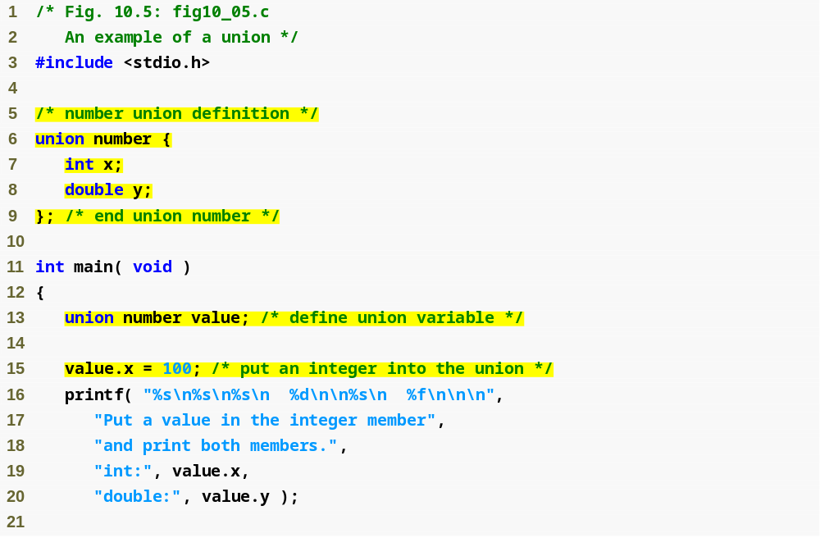
Outline
fig10_05.c
(1 of 2 )

Slide 36
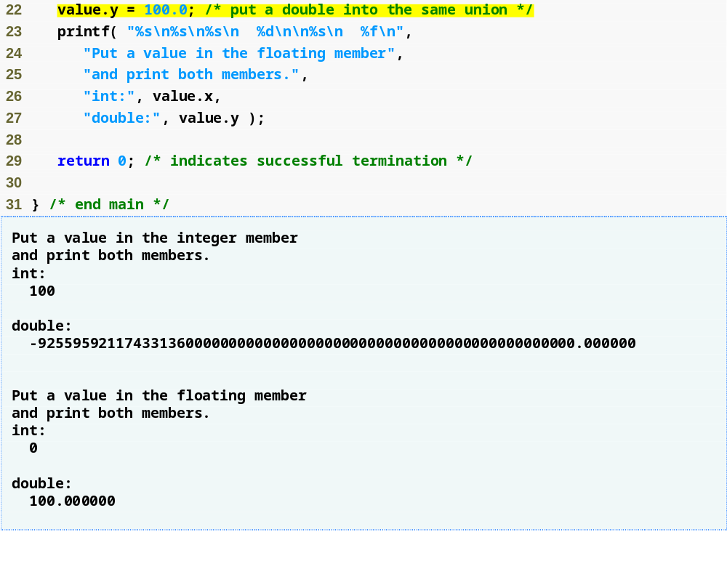
Outline
fig10_05.c
(2 of 2 )

Slide 37
10.11 Enumeration Constants
Enumeration
  Set of integer constants represented by identifiers
  Enumeration constants are like symbolic constants whose values are automatically set
    Values start at 0 and are incremented by 1
    Values can be set explicitly with =
    Need unique constant names
  Example:
    enum Months { JAN = 1, FEB, MAR, APR, MAY, JUN, JUL, AUG, SEP, OCT, NOV, DEC};
    Creates a new type enum Months in which the identifiers are set to the integers 1 to 12
  Enumeration variables can only assume their enumeration constant values (not the integer representations)

Slide 38
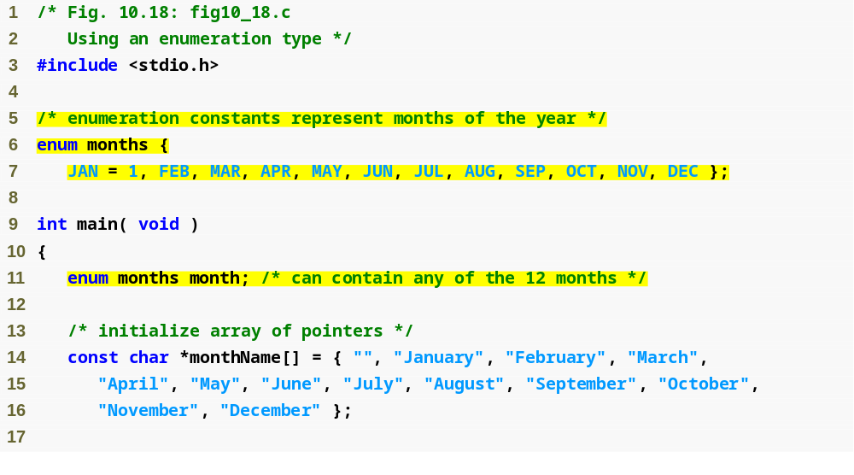
Outline
fig10_18.c
(1 of 2 )

Slide 39
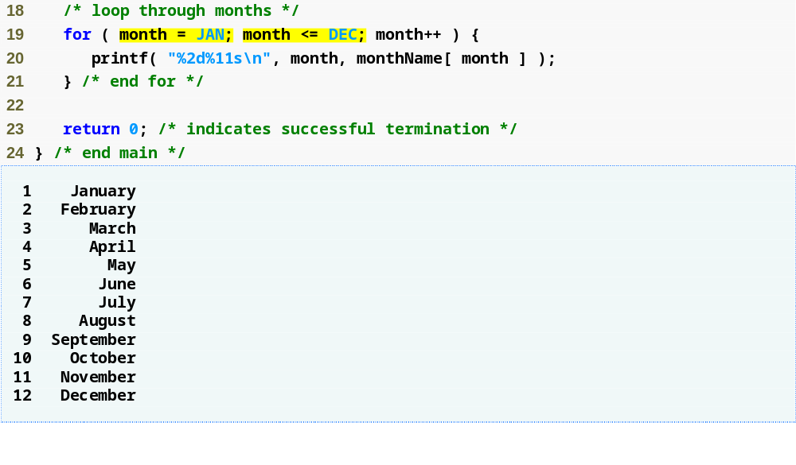
Outline
fig10_18.c
(2 of 2 )
Like symbolic constants, enumeration constants are replaced by their values at compile time

Slide 40
Common Programming Error 10.16
Assigning a value to an enumeration constant after it has been defined is a syntax error.

Slide 41
Good Programming Practice 10.5
Use only uppercase letters in the names of enumeration constants. This makes these constants stand out in a program and reminds you that enumeration constants
are not variables.

