Slide 1
Assembly Language for x86 Processors 6th Edition
Kip R. Irvine
Chapter 16: BIOS-Level Programming
Slide show prepared by the author
Revision date: 2/15/2010
(c) Pearson Education, 2010. All rights reserved. You may modify and copy this slide show for your personal use, or for use in the classroom, as long as this copyright statement, the author's name, and the title are not changed.

Slide 2
Chapter Overview
Introduction
Keyboard Input with INT 16h
VIDEO Programming with INT 10h
Drawing Graphics Using INT 10h
Memory-Mapped Graphics
Mouse Programming

Slide 3
Personalities
Bill Gates: co-authored QBASIC interpreter
Gary Kildall: creator of CP/M-86 operating system
  multitasking capabilities
Peter Norton:
  Inside the IBM-PC first book to thoroughly explore IBM-PC software and hardware
  created the Norton Utilities software
Michael Abrash: columnist, expert programmer
  worked on Quake and Doom computer games
  optimized graphics code in Windows NT
  book: The Zen of Code Optimization

Slide 4
PC-BIOS
The BIOS (Basic Input-Output System) provides low-level hardware drivers for the operating system.
  accessible to 16-bit applications
  written in assembly language, of course
  source code published by IBM in early 1980's
Advantages over MS-DOS:
  permits graphics and color programming
  faster I/O speeds
  read mouse, serial port, parallel port
  low-level disk access

Slide 5
BIOS Data Area
Fixed-location data area at address 00400h
  this area is also used by MS-DOS
  this area is accessible under Windows 98 & Windows Me, but not under Windows NT, 2000, or XP.
Contents:
  Serial and parallel port addresses
  Hardware list, memory size
  Keyboard status flags, keyboard buffer pointers, keyboard buffer data
  Video hardware configuration
  Timer data

Slide 6
What's Next
Introduction
Keyboard Input with INT 16h
VIDEO Programming with INT 10h
Drawing Graphics Using INT 10h
Memory-Mapped Graphics
Mouse Programming

Slide 7
Keyboard Input with INT 16h
How the Keyboard Works
INT 16h Functions

Slide 8
How the Keyboard Works
Keystroke sends a scan code to the keyboard serial input port
Interrupt triggered: INT 9h service routine executes
Scan code and ASCII code inserted into keyboard typeahead buffer

Slide 9
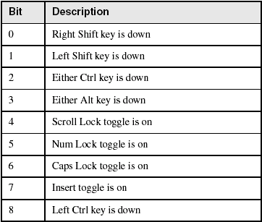
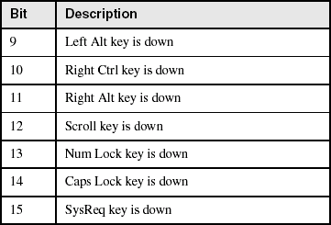
Keyboard Flags
16-bits, located at 0040:0017h – 0018h.

Slide 10
INT 16h Functions
Provide low-level access to the keyboard, more so than MS-DOS.
Input-output cannot be redirected at the command prompt.
Function number is always in the AH register
Important functions:
  set typematic rate
  push key into buffer
  wait for key
  check keyboard buffer
  get keyboard flags

Slide 11
Function 10h: Wait for Key
If a key is waiting in the buffer, the function returns it immediately. If no key is waiting, the program pauses (blocks), waiting for user input.
.data
scanCode BYTE ?
ASCIICode BYTE ?
.code
mov ah,10h
int 16h
mov scanCode,ah
mov ASCIICode,al

Slide 12
Function 12h: Get Keyboard Flags
Retrieves a copy of the keyboard status flags from the BIOS data area.
.data
keyFlags WORD ?
.code
mov ah,12h
int 16h
mov keyFlags,ax

Slide 13
Clearing the Keyboard Buffer
Function 11h clears the Zero flag if a key is waiting in the keyboard typeahead buffer.
L1: mov ah,11h ; check keyboard buffer
int 16h ; any key pressed?
jz noKey ; no: exit now
mov ah,10h ; yes: remove from buffer
int 16h
cmp ah,scanCode ; was it the exit key?
je quit ; yes: exit now (ZF=1)
jmp L1 ; no: check buffer again
noKey: ; no key pressed
or al,1 ; clear zero flag
quit:

Slide 14
What's Next
Introduction
Keyboard Input with INT 16h
VIDEO Programming with INT 10h
Drawing Graphics Using INT 10h
Memory-Mapped Graphics
Mouse Programming

Slide 15
VIDEO Programming with INT 10h
Basic Background
Controlling the Color
INT 10h Video Functions
Library Procedure Examples

Slide 16
Video Modes
Graphics video modes
  draw pixel by pixel
  multiple colors
Text video modes
  character output, using hardware or software-based font table
  mode 3 (color text) is the default
  default range of 80 columns by 25 rows.
  color attribute byte contains foreground and background colors

Slide 17
Three Levels of Video Access
MS-DOS function calls
  slow, but they work on any MS-DOS machine
  I/O can be redirected
BIOS function calls
  medium-fast, work on nearly all MS-DOS-based machines
  I/O cannot be redirected
Direct memory-mapped video
  fast – works only on 100% IBM-compatible computers
  cannot be redirected
  does not work under Windows NT, 2000, or XP

Slide 18
Controlling the Color
Mix primary colors: red, yellow, blue
  called subtractive mixing
  add the intensity bit for 4th channel
Examples:
  red + green + blue = light gray (0111)
  intensity + green + blue = white (1111)
  green + blue = cyan (0011)
  red + blue = magenta (0101)
Attribute byte:
  4 MSB bits = background
  4 LSB bits = foreground

Slide 19
Constructing Attribute Bytes
Color constants defined in Irvine32.inc and Irvine16.inc:
Examples:
  Light gray text on a blue background:
    (blue SHL 4) OR lightGray
  White text on a red background:
    (red SHL 4) OR white

Slide 20
INT 10h Video Functions
AH register contains the function number
00h: Set video mode
  text modes listed in Table 15-5
  graphics modes listed in Table 15-6
01h: Set cursor lines
02h: Set cursor position
03h: Get cursor position and size
06h: Scroll window up
07h: Scroll window down
08h: Read character and attribute

Slide 21
INT 10h Video Functions (cont)
09h: Write character and attribute
0Ah: Write character
10h (AL = 03h): Toggle blinking/intensity bit
0Fh: Get video mode
13h: Write string in teletype mode

Slide 22
Displaying a Color String
Write one character and attribute:
  mov si,OFFSET string
  . . .
  mov ah,9 ; write character/attribute
  mov al,[si] ; character to display
  mov bh,0 ; video page 0
  mov bl,color ; attribute
  or bl,10000000b ; set blink/intensity bit
  mov cx,1 ; display it one time
  int 10h

Slide 23
Gotoxy Procedure
;--------------------------------------------------
Gotoxy PROC
;
; Sets the cursor position on video page 0.
; Receives: DH,DL = row, column
; Returns: nothing
;---------------------------------------------------
pusha
mov ah,2
mov bh,0
int 10h
popa
ret
Gotoxy ENDP

Slide 24
Clrscr Procedure
Clrscr PROC
pusha
mov ax,0600h ; scroll window up
mov cx,0 ; upper left corner (0,0)
mov dx,184Fh ; lower right corner (24,79)
mov bh,7 ; normal attribute
int 10h ; call BIOS
mov ah,2 ; locate cursor at 0,0
mov bh,0 ; video page 0
mov dx,0 ; row 0, column 0
int 10h
popa
ret
Clrscr ENDP

Slide 25
What's Next
Introduction
Keyboard Input with INT 16h
VIDEO Programming with INT 10h
Drawing Graphics Using INT 10h
Memory-Mapped Graphics
Mouse Programming

Slide 26
Drawing Graphics Using INT 10h
INT 10h Pixel-Related Functions
DrawLine Program
Cartesian Coordinates Program
Converting Cartesian Coordinates to Screen Coordinates

Slide 27
INT 10h Pixel-Related Functions
Slow performance
Easy to program
0Ch: Write graphics pixel
0Dh: Read graphics pixel

Slide 28
DrawLine Program
Draws a straight line, using INT 10h function calls
Saves and restores current video mode
Excerpt from the DrawLine program (DrawLine.asm):
mov ah,0Ch ; write pixel
mov al,color ; pixel color
mov bh,0 ; video page 0
mov cx,currentX
int 10h

Slide 29
Cartesian Coordinates Program
Draws the X and Y axes of a Cartesian coordinate system
Uses video mode 6A (800 x 600, 16 colors)
Name: Pixel2.asm
Important procedures:
  DrawHorizLine
  DrawVerticalLine

Slide 30
Converting Cartesian Coordinates to Screen Coordinates
Screen coordinates place the origin (0,0) at the upper-left corner of the screen
Graphing functions often need to display negative values
  move origin point to the middle of the screen
For Cartesian coordinates X, Y and origin points sOrigX and sOrigY, screen X and screen Y are calculated as:
  sx = (sOrigX + X)
  sy = (sOrigY – Y)

Slide 31
What's Next
Introduction
Keyboard Input with INT 16h
VIDEO Programming with INT 10h
Drawing Graphics Using INT 10h
Memory-Mapped Graphics
Mouse Programming

Slide 32
Memory-Mapped Graphics
Binary values are written to video RAM
  video adapter must use standard address
Very fast performance
  no BIOS or DOS routines to get in the way

Slide 33
Mode 13h: 320 X 200, 256 Colors
Mode 13h graphics (320 X 200, 256 colors)
  Fairly easy to program
  read and write video adapter via IN and OUT instructions
  pixel-mapping scheme (1 byte per pixel)

Slide 34
Mode 13h Details
OUT Instruction
  16-bit port address assigned to DX register
  output value in AL, AX, or EAX
  Example:
  mov dx,3c8h ; port address
  mov al,20h ; value to be sent
  out dx,al ; send to the port
Color Indexes
  color integer value is an index into a table of colors called a palette

Slide 35
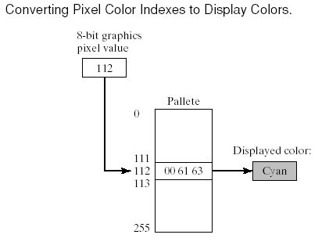
Color Indexes in Mode 13h

Slide 36
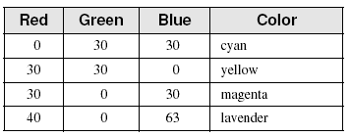
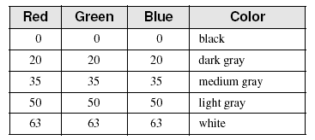
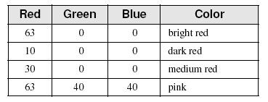
RGB Colors
Additive mixing of light (red, green, blue). Intensities vary from 0 to 255.
Examples:

Slide 37
What's Next
Introduction
Keyboard Input with INT 16h
VIDEO Programming with INT 10h
Drawing Graphics Using INT 10h
Memory-Mapped Graphics
Mouse Programming

Slide 38
Mouse Programming
MS-DOS functions for reading the mouse
Mickey – unit of measurement (200th of an inch)
  mickeys-to-pixels ratio (8 x 16) is variable
INT 33h functions
Mouse Tracking Program Example

Slide 39
Reset Mouse and Get Status
INT 33h, AX = 0
Example:
  mov ax,0
  int 33h
  cmp ax,0
  je MouseNotAvailable
  mov numberOfButtons,bx

Slide 40
Show/Hide Mouse
INT 33h, AX = 1 (show), AX = 2 (hide)
Example:
  mov ax,1 ; show
  int 33h
  mov ax,2 ; hide
  int 33h

Slide 41
Get Mouse Position & Status
INT 33h, AX = 4
Example:
  mov ax,4
  mov cx,200 ; X-position
  mov dx,100 ; Y-position
  int 33h

Slide 42
Get Button Press Information
INT 33h, AX = 5
Example:
  mov ax,5
  mov bx,0 ; button ID
  int 33h
  test ax,1 ; left button down?
  jz skip ; no - skip
  mov X_coord,cx ; yes: save coordinates
  mov Y_coord,dx

Slide 43
Other Mouse Functions
AX = 6: Get Button Release Information
AX = 7: Set Horizontal Limits
AX = 8: Set Vertical Limits

Slide 44
Mouse Tracking Program
Tracks the movement of the text mouse cursor
X and Y coordinates are continually updated in the lower-right corner of the screen
When the user presses the left button, the mouse’s position is displayed in the lower left corner of the screen
Source code (c:\Irvine\Examples\ch15\mouse.asm)

Slide 45
Set Mouse Position
INT 33h, AX = 3
Example:
  mov ax,3
  int 33h
  test bx,1
  jne Left_Button_Down
  test bx,2
  jne Right_Button_Down
  test bx,4
  jne Center_Button_Down
  mov Xcoord,cx
  mov yCoord,dx

Slide 46
Summary
Working at the BIOS level gives you a high level of control over hardware
Use INT 16h for keyboard control
Use INT 10h for video text
Use memory-mapped I/O for graphics
Use INT 33h for the mouse

Slide 47

The End

