Slide 1
Assembly Language for x86 Processors 7th Edition
Kip R. Irvine
Chapter 7: Integer Arithmetic
Slides prepared by the author
Revised by Zuoliu Ding at Fullerton College, 08/2014
(c) Pearson Education, 2015. All rights reserved. You may modify and copy this slide show for your personal use, or for use in the classroom, as long as this copyright statement, the author's name, and the title are not changed.

Slide 2
Chapter Overview
Shift and Rotate Instructions
Shift and Rotate Applications
Multiplication and Division Instructions
Extended Addition and Subtraction
ASCII and Unpacked Decimal Arithmetic
Packed Decimal Arithmetic
Irvine, Kip R. Assembly Language for x86 Processors 7/e, 2015.

Slide 3
Shift and Rotate Instructions
Logical vs Arithmetic Shifts
SHL Instruction
SHR Instruction
SAL and SAR Instructions
ROL Instruction
ROR Instruction
RCL and RCR Instructions
SHLD/SHRD Instructions
Irvine, Kip R. Assembly Language for x86 Processors 7/e, 2015.

Slide 4

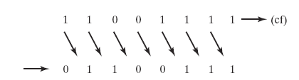
Logical Shift
A logical shift fills the newly created bit position with zero:
Irvine, Kip R. Assembly Language for x86 Processors 7/e, 2015.

Slide 5

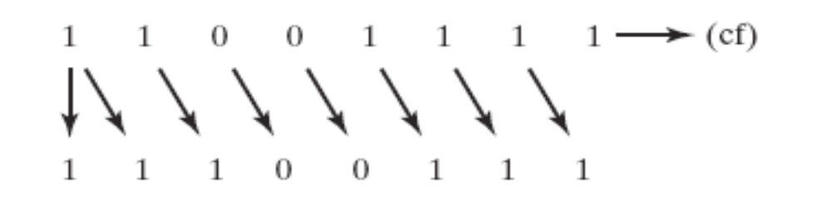
Arithmetic Shift
An arithmetic shift fills the newly created bit position with a copy of the number’s sign bit:
Irvine, Kip R. Assembly Language for x86 Processors 7/e, 2015.

Slide 6
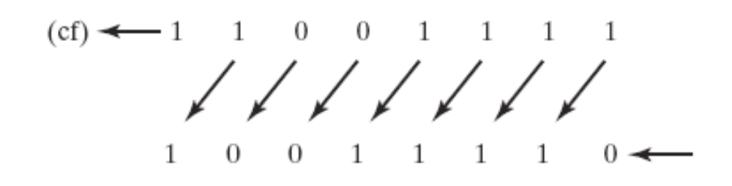
SHL Instruction
The SHL (shift left) instruction performs a logical left shift on the destination operand, filling the lowest bit with 0.
Operand types for SHL:
SHL reg,imm8
SHL mem,imm8
SHL reg,CL
SHL mem,CL
(Same for all shift and rotate instructions)
Irvine, Kip R. Assembly Language for x86 Processors 7/e, 2015.

Slide 7

Fast Multiplication
Shifting left 1 bit multiplies a number by 2
mov dl,5
shl dl,1
Shifting left n bits multiplies the operand by 2^{n}
For example, 5 * 2² = 20
mov dl,5
shl dl,2 ; DL = 20
Irvine, Kip R. Assembly Language for x86 Processors 7/e, 2015.

Slide 8
SHR Instruction
The SHR (shift right) instruction performs a logical right shift on the destination operand. The highest bit position is filled with a zero.
Shifting right n bits divides the operand by 2^{n}
mov dl,80
shr dl,1 ; DL = 40
shr dl,2 ; DL = 10
Q: How about 81 shr 1?
40
Irvine, Kip R. Assembly Language for x86 Processors 7/e, 2015.

Slide 9
SAL and SAR Instructions
SAL (shift arithmetic left) is identical to SHL.
SAR (shift arithmetic right) performs a right arithmetic shift on the destination operand.
An arithmetic shift preserves the number's sign.
mov dl,-80 ; 10110000
sar dl,1 ; DL = -40
sar dl,2 ; DL = -10, 11110110b
Q: How about -81 sar 1? (1010 1111)
-41 (1101 0111)
Irvine, Kip R. Assembly Language for x86 Processors 7/e, 2015.

Slide 10
Your turn . . .
Indicate the hexadecimal value of AL after each shift:
mov al,6Bh
shr al,1 a.
shl al,3 b.
mov al,8Ch
sar al,1 c.
sar al,3 d.
35h
A8h
C6h
F8h
0110 1011 = 107
0011 0101 = 53
1010 1000 = 168
1000 1100 = -116
1100 0110 = -58
1111 1000 = -8
mov ax, -128 ; EAX=????FF80h
movsx eax, ax
How to implement with shifts?
mov ax, -128
shl eax, 16
sar eax, 16
Irvine, Kip R. Assembly Language for x86 Processors 6/e, 2010.

Slide 11

ROL Instruction
ROL (rotate) shifts each bit to the left
The highest bit is copied into both the Carry flag and into the lowest bit
No bits are lost
mov al,11110000b
rol al,1 ; AL = 11100001b
mov dl,3Fh
rol dl,4 ; DL = F3h
Irvine, Kip R. Assembly Language for x86 Processors 7/e, 2015.

Slide 12

ROR Instruction
ROR (rotate right) shifts each bit to the right
The lowest bit is copied into both the Carry flag and into the highest bit
No bits are lost
mov al,11110000b
ror al,1 ; AL = 01111000b
mov dl,3Fh
ror dl,4 ; DL = F3h
Irvine, Kip R. Assembly Language for x86 Processors 7/e, 2015.

Slide 13
Your turn . . .
Indicate the hexadecimal value of AL after each rotation:
mov al,6Bh
ror al,1 a.
rol al,3 b.
0110 1011
B5h 1011 0101
Adh 1010 1101
Attention: what is CF?
Irvine, Kip R. Assembly Language for x86 Processors 7/e, 2015.

Slide 14
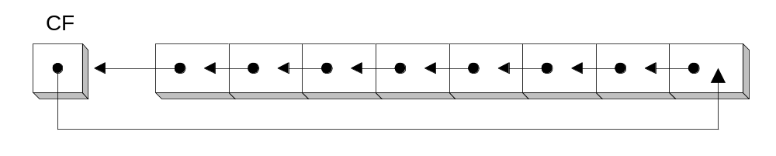
RCL Instruction
RCL (rotate carry left) shifts each bit to the left
Copies the Carry flag to the least significant bit
Copies the most significant bit to the Carry flag
clc ; CF = 0
mov bl,88h ; CF,BL = 0 10001000b
rcl bl,1 ; CF,BL = 1 00010000b
rcl bl,1 ; CF,BL = 0 00100001b
Irvine, Kip R. Assembly Language for x86 Processors 7/e, 2015.

Slide 15
RCR Instruction
RCR (rotate carry right) shifts each bit to the right
Copies the Carry flag to the most significant bit
Copies the least significant bit to the Carry flag
stc ; CF = 1
mov ah,10h ; CF,AH = 1 00010000b
rcr ah,1 ; CF,AH = 0 10001000b
Irvine, Kip R. Assembly Language for x86 Processors 7/e, 2015.

Slide 16
Your turn . . .
Indicate the hexadecimal value of AL after each rotation:
stc
mov al,6Bh
rcr al,1 a.
rcl al,3 b.
0110 1011
B5h 1011 0101 CF=1
AEh 1010 1110 CF=1
Recover a bit from CF:
shr al, 1
jc dosomething
……
rcl al, 1
Irvine, Kip R. Assembly Language for x86 Processors 6/e, 2010.

Slide 17
Signed Overflow
mov al,127 ; AL = 0111 1111b
rol al,1 ; AL = 1111 1110b, OF=1
mov al,-128 ; AL = 1000 0000b
shr al,1 ; AL = 0100 0000b, OF=1
Added by Zuoliu Ding

Slide 18
SHLD Instruction
Shifts a destination operand a given number of bits to the left
The bit positions opened up by the shift are filled by the most significant bits of the source operand
The source operand is not affected
Syntax:
  SHLD destination, source, count
Operand types:
SHLD reg16/32, reg16/32, imm8/CL
SHLD mem16/32, reg16/32, imm8/CL
Irvine, Kip R. Assembly Language for x86 Processors 7/e, 2015.

Slide 19
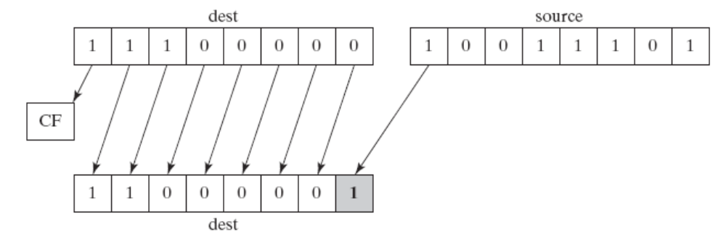
SHLD Example
Shift count of 1:
mov al,11100000b
mov bl,10011101b
shld al,bl,1
Irvine, Kip R. Assembly Language for x86 Processors 7/e, 2015.

Slide 20
Another SHLD Example
Shift wval 4 bits to the left and replace its lowest 4 bits with the high 4 bits of AX:
.data
wval WORD 9BA6h
.code
mov ax,0AC36h
shld wval,ax,4
Before:
After:
CF=?
If wval is 8BA6h, CF=?
Irvine, Kip R. Assembly Language for x86 Processors 6/e, 2010.

Slide 21
SHRD Instruction
Shifts a destination operand a given number of bits to the right
The bit positions opened up by the shift are filled by the least significant bits of the source operand
The source operand is not affected
Syntax:
  SHRD destination, source, count
Operand types:
SHRD reg16/32, reg16/32, imm8/CL
SHRD mem16/32, reg16/32, imm8/CL
Irvine, Kip R. Assembly Language for x86 Processors 7/e, 2015.

Slide 22
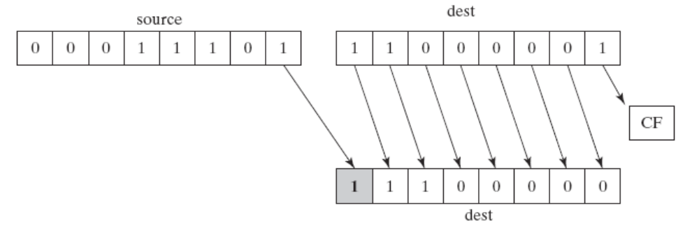
SHRD Example
Shift count of 1:
mov al,11000001b
mov bl,00011101b
shrd al,bl,1
Irvine, Kip R. Assembly Language for x86 Processors 7/e, 2015.

Slide 23
Another SHRD Example
Shift AX 4 bits to the right and replace its highest 4 bits with the low 4 bits of DX:
mov ax,234Bh
mov dx,7654h
shrd ax,dx,4
Before:
After:
CF dependant on which bit?
Compare 234B and 2347
Irvine, Kip R. Assembly Language for x86 Processors 7/e, 2015.

Slide 24
Your turn . . .
Indicate the hexadecimal values of each destination operand:
mov ax,7C36h
mov dx,9FA6h
shld dx,ax,4 ; DX =
shrd dx,ax,8 ; DX =
FA67h
36FAh
Irvine, Kip R. Assembly Language for x86 Processors 7/e, 2015.

Slide 25
What's Next
Shift and Rotate Instructions
Shift and Rotate Applications
Multiplication and Division Instructions
Extended Addition and Subtraction
ASCII and Unpacked Decimal Arithmetic
Packed Decimal Arithmetic
Irvine, Kip R. Assembly Language for x86 Processors 7/e, 2015.

Slide 26
Shift and Rotate Applications
Shifting Multiple Doublewords
Binary Multiplication
Displaying Binary Bits
Isolating a Bit String
Irvine, Kip R. Assembly Language for x86 Processors 7/e, 2015.

Slide 27
Shifting Multiple Doublewords
Programs sometimes need to shift all bits within an array, as one might when moving a bitmapped graphic image from one screen location to another.
The following shifts an array of 3 doublewords 1 bit to the right
.data
ArraySize = 3
array DWORD ArraySize DUP(99999999h) ; 1001 1001...
.code
mov esi,0
shr array[esi + 8],1 ; high dword
rcr array[esi + 4],1 ; middle dword, include Carry
rcr array[esi],1 ; low dword, include Carry
23456789
23456789
23456789
23456789 23456789 23456789
--------------------------
11A2B3C4 91A2B3C4 91A2B3C4
[esi] [esi + 4] [esi + 8]
Irvine, Kip R. Assembly Language for x86 Processors 6/e, 2010.

Slide 28
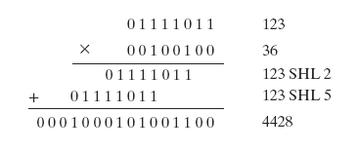
Binary Multiplication
mutiply 123 * 36
Irvine, Kip R. Assembly Language for x86 Processors 7/e, 2015.

Slide 29
Binary Multiplication
We already know that SHL performs unsigned multiplication efficiently when the multiplier is a power of 2.
You can factor any binary number into powers of 2.
  For example, to multiply EAX * 36, factor 36 into 32 + 4 and use the distributive property of multiplication to carry out the operation:
EAX * 36
= EAX * (32 + 4)
= (EAX * 32)+(EAX * 4)
mov eax,123
mov ebx,eax
shl eax,5 ; mult by 2⁵
shl ebx,2 ; mult by 2²
add eax,ebx
Irvine, Kip R. Assembly Language for x86 Processors 7/e, 2015.

Slide 30
Your turn . . .
Multiply AX by 26, using shifting and addition instructions. Hint: 26 = 16 + 8 + 2.
mov ax,2 ; test value
mov dx,ax
shl dx,4 ; AX * 16
push edx ; save for later
mov dx,ax
shl dx,3 ; AX * 8
shl ax,1 ; AX * 2
add ax,dx ; AX * 10
pop edx ; recall AX * 16
add ax,dx ; AX * 26
How about the multiplier 27?
Irvine, Kip R. Assembly Language for x86 Processors 7/e, 2015.

Slide 31
Displaying Binary Bits
Algorithm: Shift MSB into the Carry flag; If CF = 1, append a "1" character to a string; otherwise, append a "0" character. Repeat in a loop, 32 times. BinToAsc.asm
Ref: WriteBinB in Irvine32.asm
.data
buffer BYTE 32 DUP(0),0
.code
mov ecx,32
mov esi,OFFSET buffer
L1: shl eax,1
mov BYTE PTR [esi],'0'
jnc L2
mov BYTE PTR [esi],'1'
L2: inc esi
loop L1
Irvine, Kip R. Assembly Language for x86 Processors 7/e, 2015.

Slide 32
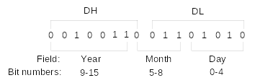
Isolating a Bit String
The MS-DOS file date field packs the year, month, and day into 16 bits: year is relative to 1980
1999/03/10
Isolate the Month field:
mov ax,dx ; make a copy of DX
shr ax,5 ; shift right 5 bits
and al,00001111b ; clear bits 4-7
mov month,al ; save in month variable
Irvine, Kip R. Assembly Language for x86 Processors 6/e, 2010.

Slide 33
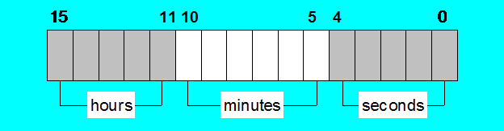
DOS File Time Fields
Time stamp field:
  Bit0 to bit4 for 2-second increments
Q: What is 00010 010000 00111 ?
02:16:14
Irvine, Kip R. Assembly Language for Intel-Based Computers 5/e, 2007.

Slide 34
What's Next
Shift and Rotate Instructions
Shift and Rotate Applications
Multiplication and Division Instructions
Extended Addition and Subtraction
ASCII and Unpacked Decimal Arithmetic
Packed Decimal Arithmetic
Irvine, Kip R. Assembly Language for x86 Processors 7/e, 2015.

Slide 35
Multiplication and Division Instructions
MUL Instruction
IMUL Instruction
DIV Instruction
Signed Integer Division
CBW, CWD, CDQ Instructions
IDIV Instruction
Implementing Arithmetic Expressions
Irvine, Kip R. Assembly Language for x86 Processors 7/e, 2015.

Slide 36
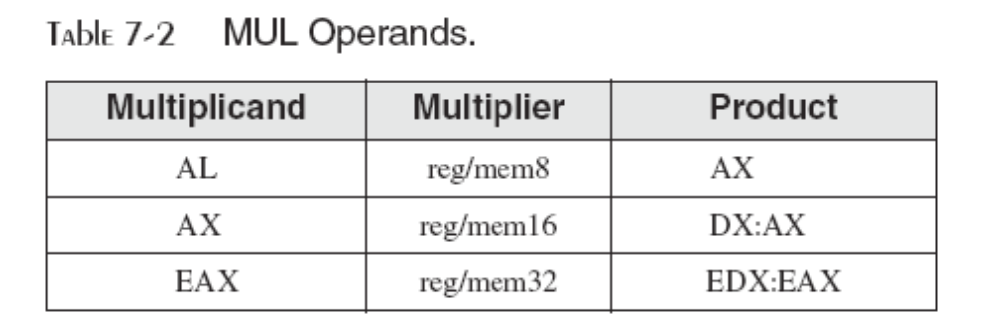
MUL Instruction
In 32-bit mode, MUL (unsigned multiply) instruction multiplies an 8-, 16-, or 32-bit operand by either AL, AX, or EAX.
The instruction formats are:
    MUL r/m8
    MUL r/m16
    MUL r/m32
Irvine, Kip R. Assembly Language for x86 Processors 7/e, 2015.

Slide 37
64-Bit MUL Instruction
In 64-bit mode, MUL (unsigned multiply) instruction multiplies a 64-bit operand by RAX, producing a 128-bit product.
The instruction formats are:
    MUL r/m64
Example:
mov rax,0FFFF0000FFFF0000h
mov rbx,2
mul rbx ; RDX:RAX = 0000000000000001FFFE0001FFFE0000
Irvine, Kip R. Assembly Language for x86 Processors 7/e, 2015.

Slide 38
MUL Examples
100h * 2000h, using 16-bit operands:
.data
val1 WORD 2000h
val2 WORD 100h
.code
mov ax,val1
mul val2 ; DX:AX = 00200000h, CF=1
The Carry flag indicates whether or not the upper half of the product contains significant digits.
12345h * 1000h, using 32-bit operands:
mov eax,12345h
mov ebx,1000h
mul ebx ; EDX:EAX = 0000000012345000h, CF=0
Irvine, Kip R. Assembly Language for x86 Processors 7/e, 2015.

Slide 39
Your turn . . .
What will be the hexadecimal values of DX, AX, and the Carry flag after the following instructions execute?
mov ax,1234h
mov bx,100h
mul bx
DX = 0012h, AX = 3400h, CF = 1
Irvine, Kip R. Assembly Language for x86 Processors 7/e, 2015.

Slide 40
Your turn . . .
What will be the hexadecimal values of EDX, EAX, and the Carry flag after the following instructions execute?
mov eax,00128765h
mov ecx,10000h
mul ecx
EDX = 00000012h, EAX = 87650000h, CF = 1
Irvine, Kip R. Assembly Language for x86 Processors 7/e, 2015.

Slide 41
IMUL Instruction
IMUL (signed integer multiply ) multiplies an 8-, 16-, or 32-bit signed operand by either AL, AX, or EAX
Preserves the sign of the product by sign-extending it into the upper half of the destination register
Example: multiply 48 * 4, using 8-bit operands:
mov al,48
mov bl,4
imul bl ; AX = 00C0h, OF=1
OF=1 because AH is not a sign extension of AL.
Irvine, Kip R. Assembly Language for x86 Processors 7/e, 2015.

Slide 42
Using IMUL in 64-Bit Mode
You can use 64-bit operands. In the two-operand format, a 64-bit register or memory operand is multiplied against RDX
  128-bit product produced in RDX:RAX
The three-operand format produces a 64-bit product in RAX
.data
multiplicand QWORD -16
.code
imul rax, multiplicand, 4 ; RAX = FFFFFFFFFFFFFFC0 (-64)
Irvine, Kip R. Assembly Language for x86 Processors 7/e, 2015.

Slide 43
IMUL Examples
Multiply 4,823,424 * −423:
mov eax,4823424
mov ebx,-423
imul ebx ; EDX:EAX = FFFFFFFF86635D80h, OF=0
OF=0 because EDX is a sign extension of EAX.
Irvine, Kip R. Assembly Language for x86 Processors 7/e, 2015.

Slide 44
Your turn . . .
What will be the hexadecimal values of DX, AX, and the Carry flag after the following instructions execute?
mov ax,8760h
mov bx,100h
imul bx
DX = FF87h, AX = 6000h, OF = 1
Irvine, Kip R. Assembly Language for x86 Processors 7/e, 2015.

Slide 45
Benchmarking Two Multiplications
Comparing Multiplications: CompareMult.asm
  mult_by_shifting
  mult_by_MUL
What is the result?
How about the result from the text:
  Using MUL 241% slow?
Irvine, Kip R. Assembly Language for Intel-Based Computers 5/e, 2007.

Slide 46
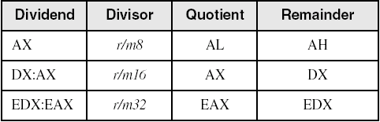
DIV Instruction
The DIV (unsigned divide) instruction performs 8-bit, 16-bit, and 32-bit division on unsigned integers
A single operand is supplied (register or memory operand), which is assumed to be the divisor
Instruction formats:
    DIV reg/mem8
    DIV reg/mem16
    DIV reg/mem32
Default Operands:
Irvine, Kip R. Assembly Language for x86 Processors 7/e, 2015.

Slide 47
DIV Examples
Divide 8003h by 100h, using 16-bit operands:
mov dx,0 ; clear dividend, high
mov ax,8003h ; dividend, low
mov cx,100h ; divisor
div cx ; AX = 0080h, DX = 3
Same division, using 32-bit operands:
mov edx,0 ; clear dividend, high
mov eax,8003h ; dividend, low
mov ecx,100h ; divisor
div ecx ; EAX = 00000080h, EDX = 3
Irvine, Kip R. Assembly Language for x86 Processors 7/e, 2015.

Slide 48
64-Bit DIV Example
Divide 000001080000000033300020h by 00010000h:
.data
dividend_hi QWORD 00000108h
dividend_lo QWORD 33300020h
divisor QWORD 00010000h
.code
mov rdx, dividend_hi
mov rax, dividend_lo
div divisor ; RAX = quotient
; RDX = remainder
RAX (quotient): 0108000000003330h
RDX (remainder): 0000000000000020h
Irvine, Kip R. Assembly Language for x86 Processors 7/e, 2015.

Slide 49
Your turn . . .
What will be the hexadecimal values of DX and AX after the following instructions execute? Or, if divide overflow occurs, you can indicate that as your answer:
mov dx,0087h
mov ax,6000h
mov bx,100h
div bx
DX = 0000h, AX = 8760h
Irvine, Kip R. Assembly Language for x86 Processors 7/e, 2015.

Slide 50
Your turn . . .
What will be the hexadecimal values of DX and AX after the following instructions execute? Or, if divide overflow occurs, you can indicate that as your answer:
mov dx,0087h
mov ax,6002h
mov bx,10h
div bx
Divide Overflow
Irvine, Kip R. Assembly Language for x86 Processors 7/e, 2015.

Slide 51
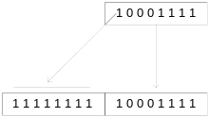
Signed Integer Division (IDIV)
Signed integers must be sign-extended before division takes place
  fill high byte/word/doubleword with a copy of the low byte/word/doubleword's sign bit
For example, the high byte contains a copy of the sign bit from the low byte:
Irvine, Kip R. Assembly Language for x86 Processors 7/e, 2015.

Slide 52
CBW, CWD, CDQ Instructions
The CBW, CWD, and CDQ instructions provide important sign-extension operations:
  CBW (convert byte to word) extends AL into AH
  CWD (convert word to doubleword) extends AX into DX
  CDQ (convert doubleword to quadword) extends EAX into EDX
Example:
    .data
    dwordVal SDWORD -101 ; FFFFFF9Bh
    .code
    mov eax,dwordVal
    cdq ; EDX:EAX = FFFFFFFFFFFFFF9Bh
Irvine, Kip R. Assembly Language for x86 Processors 7/e, 2015.

Slide 53
IDIV Instruction
IDIV (signed divide) performs signed integer division
Same syntax and operands as DIV instruction
Example: 8-bit division of –48 by 5
mov al,-48
cbw ; extend AL into AH
mov bl,5
idiv bl ; AL = -9, AH = -3
The remainder always has the same sign as the dividend
All arithmetic status flags undefined after DIV and IDIV
if this
    mov bl, -5 ; AL = 9, AH = -3
Irvine, Kip R. Assembly Language for x86 Processors 7/e, 2015.

Slide 54
IDIV Examples
Example: 16-bit division of –48 by 5
mov ax,-48
cwd ; extend AX into DX
mov bx,5
idiv bx ; AX = -9, DX = -3
Example: 32-bit division of –48 by 5
mov eax,-48
cdq ; extend EAX into EDX
mov ebx,5
idiv ebx ; EAX = -9, EDX = -3
Irvine, Kip R. Assembly Language for x86 Processors 7/e, 2015.

Slide 55
Your turn . . .
What will be the hexadecimal values of DX and AX after the following instructions execute? Or, if divide overflow occurs, you can indicate that as your answer:
mov ax,0FDFFh ; -513
cwd
mov bx,100h
idiv bx
DX = FFFFh (−1), AX = FFFEh (−2)
Irvine, Kip R. Assembly Language for x86 Processors 7/e, 2015.

Slide 56
Unsigned Arithmetic Expressions
Some good reasons to learn how to implement integer expressions:
  Learn how do compilers do it
  Test your understanding of MUL, IMUL, DIV, IDIV
  Check for overflow (Carry and Overflow flags)
Example: var4 = (var1 + var2) * var3
; Assume unsigned operands
mov eax,var1
add eax,var2 ; EAX = var1 + var2
mul var3 ; EAX = EAX * var3
jc TooBig ; check for carry
mov var4,eax ; save product
Irvine, Kip R. Assembly Language for x86 Processors 7/e, 2015.

Slide 57
Signed Arithmetic Expressions (1 of 2)
Example: eax = (-var1 * var2) + var3
mov eax,var1
neg eax
imul var2
jo TooBig ; check for overflow
add eax,var3
jo TooBig ; check for overflow
Example: var4 = (var1 * 5) / (var2 – 3)
mov eax,var1 ; left side
mov ebx,5
imul ebx ; EDX:EAX = product
mov ebx,var2 ; right side
sub ebx,3
idiv ebx ; EAX = quotient
mov var4,eax
Irvine, Kip R. Assembly Language for x86 Processors 7/e, 2015.

Slide 58
Signed Arithmetic Expressions (2 of 2)
Example: var4 = (var1 * -5) / (-var2 % var3);
mov eax,var2 ; begin right side
neg eax
cdq ; sign-extend dividend
idiv var3 ; EDX = remainder
mov ebx,edx ; EBX = right side
mov eax,-5 ; begin left side
imul var1 ; EDX:EAX = left side
idiv ebx ; final division
mov var4,eax ; quotient
Sometimes it's easiest to calculate the right-hand term of an expression first.
Irvine, Kip R. Assembly Language for x86 Processors 7/e, 2015.

Slide 59
Your turn . . .
Implement the following expression using signed 32-bit integers:
eax = (ebx * 20) / ecx
mov eax,20
imul ebx
idiv ecx
Irvine, Kip R. Assembly Language for x86 Processors 7/e, 2015.

Slide 60
Your turn . . .
Implement the following expression using signed 32-bit integers. Save and restore ECX and EDX:
eax = (ecx * edx) / eax
push edx
push eax ; EAX needed later
mov eax,ecx
imul edx ; left side: EDX:EAX
pop ebx ; saved value of EAX
idiv ebx ; EAX = quotient
pop edx ; restore EDX, ECX
Irvine, Kip R. Assembly Language for x86 Processors 7/e, 2015.

Slide 61
Your turn . . .
Implement the following expression using signed 32-bit integers. Do not modify any variables other than var3:
var3 = (var1 * -var2) / (var3 – ebx)
mov eax,var1
mov edx,var2
neg edx
imul edx ; left side: EDX:EAX
mov ecx,var3
sub ecx,ebx
idiv ecx ; EAX = quotient
mov var3,eax
Irvine, Kip R. Assembly Language for x86 Processors 7/e, 2015.

Slide 62
What's Next
Shift and Rotate Instructions
Shift and Rotate Applications
Multiplication and Division Instructions
Extended Addition and Subtraction
ASCII and UnPacked Decimal Arithmetic
Packed Decimal Arithmetic
Irvine, Kip R. Assembly Language for x86 Processors 7/e, 2015.

Slide 63
Extended Addition and Subtraction
ADC Instruction
Extended Precision Addition
SBB Instruction
Extended Precision Subtraction
The instructions in this section do not apply to 64-bit mode programming.
Irvine, Kip R. Assembly Language for x86 Processors 7/e, 2015.

Slide 64
Extended Precision Addition
Adding two operands that are longer than the computer's word size (32 bits).
  Virtually no limit to the size of the operands
The arithmetic must be performed in steps
  The Carry value from each step is passed on to the next step.
Irvine, Kip R. Assembly Language for x86 Processors 7/e, 2015.

Slide 65
ADC Instruction
ADC (add with carry) instruction adds both a source operand and the contents of the Carry flag to a destination operand.
Operands are binary values
  Same syntax as ADD, SUB, etc.
Example
  Add two 32-bit integers (FFFFFFFFh + FFFFFFFFh), producing a 64-bit sum in EDX:EAX:
    mov edx,0
    mov eax,0FFFFFFFFh
    add eax,0FFFFFFFFh
    adc edx,0 ;EDX:EAX = 00000001FFFFFFFEh
Irvine, Kip R. Assembly Language for x86 Processors 7/e, 2015.

Slide 66
Extended Addition Example
Task: Add 1 to EDX:EAX
  Starting value of EDX:EAX: 00000000FFFFFFFFh
  Add the lower 32 bits first, setting the Carry flag.
  Add the upper 32 bits, and include the Carry flag.
mov edx,0 ; set upper half
mov eax,0FFFFFFFFh ; set lower half
add eax,1 ; add lower half
adc edx,0 ; add upper half
    EDX:EAX = 00000001 00000000
Irvine, Kip R. Assembly Language for x86 Processors 7/e, 2015.

Slide 67
SBB Instruction
The SBB (subtract with borrow) instruction subtracts both a source operand and the value of the Carry flag from a destination operand.
Operand syntax:
  Same as for the ADC instruction
Irvine, Kip R. Assembly Language for x86 Processors 7/e, 2015.

Slide 68
Extended Subtraction Example
Task: Subtract 1 from EDX:EAX
  Starting value of EDX:EAX: 0000000100000000h
  Subtract the lower 32 bits first, setting the Carry flag.
  Subtract the upper 32 bits, and include the Carry flag.
mov edx,1 ; set upper half
mov eax,0 ; set lower half
sub eax,1 ; subtract lower half
sbb edx,0 ; subtract upper half
EDX:EAX = 00000000 FFFFFFFF
Irvine, Kip R. Assembly Language for x86 Processors 7/e, 2015.

Slide 69
What's Next
Shift and Rotate Instructions
Shift and Rotate Applications
Multiplication and Division Instructions
Extended Addition and Subtraction
ASCII and UnPacked Decimal Arithmetic
Packed Decimal Arithmetic
Irvine, Kip R. Assembly Language for x86 Processors 7/e, 2015.

Slide 70
ASCII and Packed Decimal Arithmetic
Binary Coded Decimal
ASCII Decimal
AAA Instruction
AAS Instruction
AAM Instruction
AAD Instruction
Packed Decimal Integers
DAA Instruction
DAS Instruction
The instructions in this section do not apply to 64-bit mode programming.
Irvine, Kip R. Assembly Language for x86 Processors 7/e, 2015.

Slide 71
Binary-Coded Decimal
Binary-coded decimal (BCD) integers use 4 binary bits to represent each decimal digit
A number using unpacked BCD representation stores a decimal digit in the lower four bits of each byte
  For example, 5,678 is stored as the following sequence of hexadecimal bytes:
05
06
07
08
Irvine, Kip R. Assembly Language for x86 Processors 7/e, 2015.

Slide 72
ASCII Decimal
A number using ASCII Decimal representation stores a single ASCII digit in each byte
  For example, 5,678 is stored as the following sequence of hexadecimal bytes:
35
36
37
38
Irvine, Kip R. Assembly Language for x86 Processors 7/e, 2015.

Slide 73
AAA Instruction
The AAA (ASCII adjust after addition) instruction adjusts the binary result of an ADD or ADC instruction. It makes the result in AL consistent with ASCII decimal representation.
  The Carry value, if any ends up in AH
Example: Add '8' and '2'
What if add 8 and 2
then aaa?
mov ah,0
mov al,'8' ; AX = 0038h
add al,'2' ; AX = 006Ah
aaa ; AX = 0100h (adjust result)
or ax,3030h ; AX = 3130h = '10'
Irvine, Kip R. Assembly Language for x86 Processors 7/e, 2015.

Slide 74
AAS Instruction
The AAS (ASCII adjust after subtraction) instruction adjusts the binary result of an SUB or SBB instruction. It makes the result in AL consistent with ASCII decimal representation.
  It places the Carry value, if any, in AH
Example: Subtract '9' from '8'
mov ah,0
mov al,'8' ; AX = 0038h
sub al,'9' ; AX = 00FFh
aas ; AX = FF09h, CF=1
or al,30h ; AL = '9'
How about subtracting 9 from 8?
Adjust only when the subtraction generates a negative result
Irvine, Kip R. Assembly Language for x86 Processors 7/e, 2015.

Slide 75
AAM Instruction
The AAM (ASCII adjust after multiplication) instruction adjusts the binary result of a MUL instruction. The multiplication must have been performed on unpacked BCD numbers.
mov bl,05h ; first operand
mov al,06h ; second operand
mul bl ; AX = 001Eh
aam ; AX = 0300h
Try this, what is the result in AX? Notice not 65h
mov ax, 65
aam
AX: 0605
Irvine, Kip R. Assembly Language for x86 Processors 7/e, 2015.

Slide 76
AAD Instruction
The AAD (ASCII adjust before division) instruction adjusts the unpacked BCD dividend in AX before a division operation
.data
quotient BYTE ?
remainder BYTE ?
.code
mov ax,0307h ; dividend
aad ; AX = 0025h
mov bl,5 ; divisor
div bl ; AX = 0207h
mov quotient,al
mov remainder,ah
Q: What means 0307h and 0025h ?
Irvine, Kip R. Assembly Language for x86 Processors 7/e, 2015.

Slide 77
What's Next
Shift and Rotate Instructions
Shift and Rotate Applications
Multiplication and Division Instructions
Extended Addition and Subtraction
ASCII and UnPacked Decimal Arithmetic
Packed Decimal Arithmetic
Irvine, Kip R. Assembly Language for x86 Processors 7/e, 2015.

Slide 78
Packed Decimal Arithmetic
Packed decimal integers store two decimal digits per byte
  For example, 12,345,678 can be stored as the following sequence of hexadecimal bytes:
12
34
56
78
Packed decimal is also known as packed BCD.
Good for financial values – extended precision possible, without rounding errors.
Irvine, Kip R. Assembly Language for x86 Processors 7/e, 2015.

Slide 79
DAA Instruction
The DAA (decimal adjust after addition) instruction converts the binary result of an ADD or ADC operation to packed decimal format.
  The value to be adjusted must be in AL
  If the lower digit is adjusted, the Auxiliary Carry flag is set.
  If the upper digit is adjusted, the Carry flag is set.
Irvine, Kip R. Assembly Language for x86 Processors 7/e, 2015.

Slide 80
DAA Logic
If (AL(lo) > 9) or (AuxCarry = 1)
AL = AL + 6
AuxCarry = 1
Else
AuxCarry = 0
Endif
If (AL(hi) > 9) or Carry = 1
AL = AL + 60h
Carry = 1
Else
Carry = 0
Endif
If AL = AL + 6 sets the Carry flag, its value is used when evaluating AL(hi).
Irvine, Kip R. Assembly Language for x86 Processors 7/e, 2015.

Slide 81
DAA Examples
Example: calculate BCD 35 + 48
mov al,35h
add al,48h ; AL = 7Dh, AC =0, CF =0, OF =0
daa ; AL = 83h, AC =1, CF =0
Example: calculate BCD 35 + 65
mov al,35h
add al,65h ; AL = 9Ah, AC =0, CF =0, OF =1
daa ; AL = 00h, AC =1, CF =1
Example: calculate BCD 69 + 29
mov al,69h
add al,29h ; AL = 92h, AC =1, CF =0, OF =1
daa ; AL = 98h, AC =1, CF =0
Irvine, Kip R. Assembly Language for Intel-Based Computers 5/e, 2007.

Slide 82
Your turn . . .
A temporary malfunction in your computer's processor has disabled the DAA instruction. Write a procedure in assembly language that performs the same actions as DAA.
Test your procedure using the values from the previous slide.
___________________________________________________
Sample: AddPacked.asm
Irvine, Kip R. Assembly Language for x86 Processors 7/e, 2015.

Slide 83
DAS Instruction
The DAS (decimal adjust after subtraction) instruction converts the binary result of a SUB or SBB operation to packed decimal format.
The value must be in AL
Example: subtract BCD 48 from 85
mov al,85h
mov bl,48h
sub al,bl ; AL = 3Dh, AC =1, CF =0, OF =1
das ; AL = 37h, AC =1, CF =0
Irvine, Kip R. Assembly Language for x86 Processors 7/e, 2015.

Slide 84
DAS Logic
If (AL(lo) > 9) OR (AuxCarry = 1)
AL = AL − 6;
AuxCarry = 1;
Else
  AuxCarry = 0;
Endif
If (AL > 9FH) or (Carry = 1)
AL = AL − 60h;
Carry = 1;
Else
Carry = 0;
Endif
If AL = AL − 6 sets the Carry flag, its value is used when evaluating AL in the second IF statement.
Irvine, Kip R. Assembly Language for x86 Processors 7/e, 2015.

Slide 85
DAS Examples (1 of 2)
Example: subtract BCD 48 – 35
mov al,48h
sub al,35h ; AL = 13h, AC =0, CF =0, OF =0
das ; AL = 13h, AC =0, CF =0
Example: subtract BCD 62 – 35
mov al,62h
sub al,35h ; AL = 2Dh, AC =1, CF =0, OF =0
das ; AL = 27h, AC =1, CF =0
Example: subtract BCD 12 – 29
mov al,12h
sub al,29h ; AL = E9h, AC =1, CF =1, OF =0
das ; AL = 83h, AC =1, CF =1
Irvine, Kip R. Assembly Language for x86 Processors 6/e, 2010.

Slide 86
DAS Examples (2 of 2)
Example: subtract BCD 32 – 39
mov al,32h
sub al,39h ; AL = F9h, AC =1, CF = 1
das ; AL = 93h, AC =1, CF = 1
Steps:
AL = F9h
CF = 1, so subtract 6 from F9h
AL = F3h
F3h > 9Fh, so subtract 60h from F3h
AL = 93h, CF = 1
Irvine, Kip R. Assembly Language for x86 Processors 7/e, 2015.

Slide 87
Your turn . . .
A temporary malfunction in your computer's processor has disabled the DAS instruction. Write a procedure in assembly language that performs the same actions as DAS.
Test your procedure using the values from the previous two slides.
Irvine, Kip R. Assembly Language for x86 Processors 7/e, 2015.

Slide 88
Summary
Shift and rotate instructions are some of the best tools of assembly language
  finer control than in high-level languages
  SHL, SHR, SAR, ROL, ROR, RCL, RCR
MUL and DIV – integer operations
  close relatives of SHL and SHR
  CBW, CDQ, CWD: preparation for division
32-bit Mode only:
  Extended precision arithmetic: ADC, SBB
  ASCII decimal operations (AAA, AAS, AAM, AAD)
  Packed decimal operations (DAA, DAS)
Irvine, Kip R. Assembly Language for x86 Processors 7/e, 2015.

Slide 89
55 74 67 61 6E 67 65 6E
Irvine, Kip R. Assembly Language for x86 Processors 7/e, 2015.

