Slide 1

Financial & Managerial
Accounting
The Basis for Business Decisions
TWELFTH EDITION
Williams Haka Bettner Meigs

Slide 2

Chapter
1
ACCOUNTING:
Information for Decision Making
Notes:
2

Slide 3
The accounting process
Accounting “links” decision makers with economic activities ⎯ and with the results of their decisions.
Economic activities
Accounting
information
Actions (decisions)
Decision makers
Notes:
3

Slide 4

Types of Accounting Information
Financial
Tax
Managerial
Notes:
3

Slide 5
Information System
Cost & Revenue Determination
Job costing
Process costing
ABC
Sales
Assets & Liabilities
Plant and
equipment
Loans & equity
Receivables,
payables & cash
Cash Flows
From operations
From financing
From investing
Information Users
Investors
Creditors
Managers
Owners
Customers
Employees
Regulatory
agencies
-SEC
-IRS
-EPA
Decision Support
CVP analysis
Performance
evaluation
Incremental
analysis
Budgeting
Capital
allocation
Earnings per
share
Ratio analysis
Notes:
3

Slide 6



Basic Functions of an Accounting System
Interpret and record business transactions.
Payment
Car

Slide 7

Basic Functions of an Accounting System
Interpret and record business transactions.
Classify similar transactions into useful reports.
Summarize and communicate information to decision makers.

Slide 8
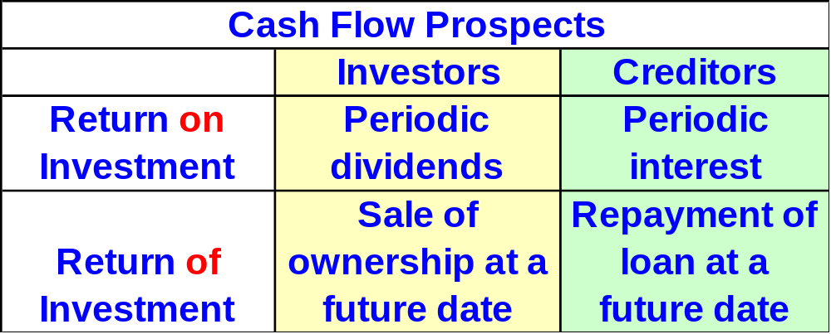
Objectives of External Financial Reporting
The primary external users of financial information are investors and creditors.
Notes:
3

Slide 9
(Specific)
Information about economic resources, claims to resources, and changes in resources and claims.
Objectives of Financial Reporting
Information useful in assessing amount, timing and uncertainty of future cash flows.
Information useful in making investment and credit decisions.
(General)
Notes:
3

Slide 10


Objectives of External Financial Reporting
Balance Sheet
Income Statement
The primary financial statements.
Statement of Cash Flows

Slide 11



Financial Statements:
A Lens to View Business
Financial Reporting
Financial Statements
Financial Reporting
Notes:
3

Slide 12

Characteristics of Externally Reported Information
A Means to an End
Usefulness Enhanced via Explanation
Broader than Financial Statements
Based on General Purpose Assumption
Historical in Nature
Results from Inexact and Approximate Measures
Notes:
3

Slide 13

Internal Users of Accounting Information
Board of Directors
Chief Executive Officer
Chief Financial Officer
Vice Presidents
Business Unit Managers
Plant Managers
Store Managers
Line Supervisors
Notes:
3

Slide 14
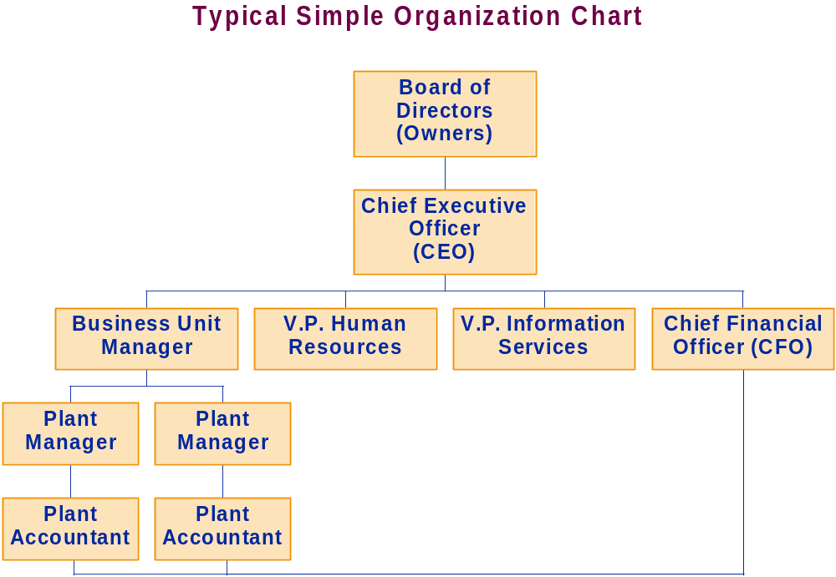
Notes:
3

Slide 15
Information about decision-making
authority, for decision-making support, and for evaluating and rewarding decision-making performance.
Objectives of Managerial Reporting
Information useful in assessing
both the past performance and future directions of the enterprise and information from external and internal sources.
Information useful to help the enterprise achieve its goal, objectives and mission.
Notes:
3

Slide 16

Characteristics of Management Accounting Information
Timeliness
Identify Decision-Making Authority
A Means to an End
Measures of Efficiency and Effectiveness
Oriented Toward Future
Notes:
3

Slide 17

Integrity of Accounting Information
Institutional Features
Generally Accepted Accounting Principles (GAAP)
Financial Accounting Standards Board
Securities and Exchange Commission
Internal Control Structure
Audits
Notes:
3

Slide 18
Integrity of Accounting Information
Professional Organizations
American Institute of Certified Public Accountants
Institute of Management Accountants
Institute of Internal Auditors
American Accounting Association
Notes:
3

Slide 19
Integrity of Accounting Information
Competence, Judgment and Ethical Behavior
Certified Public Accountants (CPAs)
Certificate in Management Accounting (CMA)
Certificate in Internal Auditing (CIA)
Code of Professional Conduct
AOU
Notes:
3

Slide 20

End of Chapter 1
Notes:
4

