Slide 1

Chapter
2
BASIC FINANCIAL STATEMENTS
Notes:
2

Slide 2
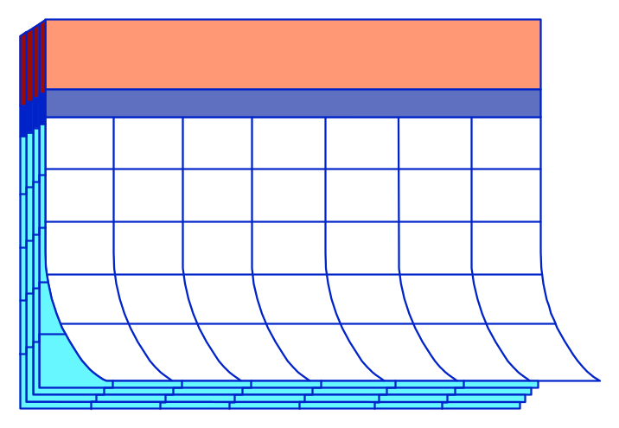
Introduction to Financial Statements
Companies prepare interim financial statements and annual financial statements.
2000
X

Slide 3



Introduction to Financial Statements
Three primary financial statements.
Balance Sheet
Income Statement
Statement of Cash Flows
We will use a corporation to describe these statements.

Slide 4

Introduction to Financial Statements
Describes where the enterprise stands at a specific date.
Balance Sheet
Income Statement
Statement of Cash Flows

Slide 5

Introduction to Financial Statements
Balance Sheet
Depicts the revenue and expenses for a designated period of time.
Income Statement
Statement of Cash Flows

Slide 6
Introduction to Financial Statements
Revenues result in positive cash flow.
Expenses result in negative cash flow.
Either in the past, present, or future.

Slide 7
Introduction to Financial Statements
Balance Sheet
Net income (or net loss) is simply the difference between revenues and expenses.
Income Statement
Statement of Cash Flows

Slide 8

Introduction to Financial Statements
Balance Sheet
Income Statement
Statement of Cash Flows
Depicts the ways cash has changed during a designated period of time.

Slide 9

The Concept of the Business Entity
A business entity is separate from the personal affairs of its owner.
Vagabond Travel Aoun Agency

Slide 10
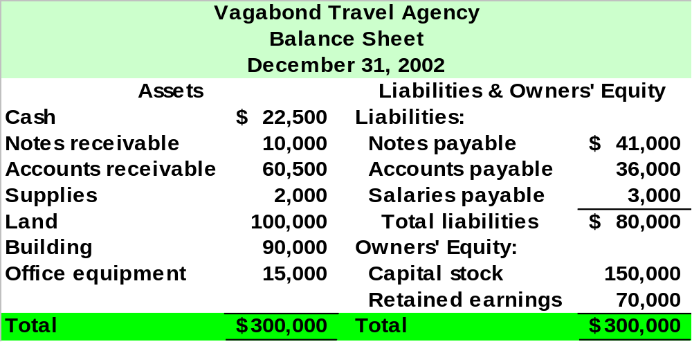

A Starting Point: Statement of Financial Position

Slide 11
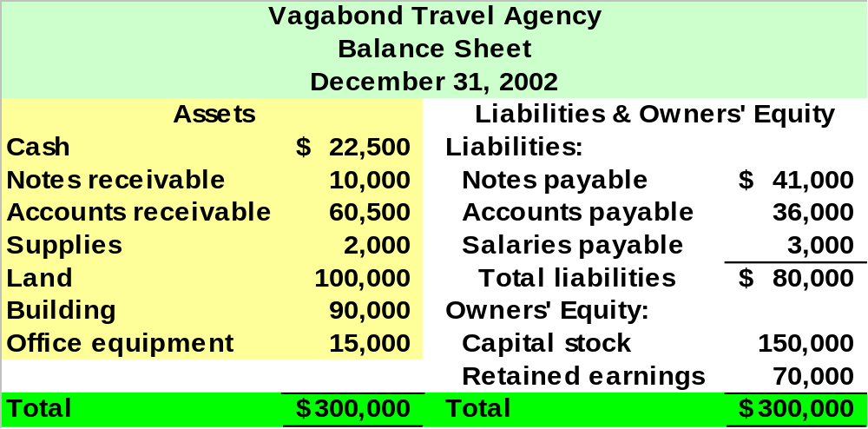
Assets
Assets are economic resources that are owned by the business and are expected to provide positive future cash flows.

Slide 12
Assets
Cost Principle
Stable-Dollar
Assumption
These accounting principles support cost as the basis for asset valuation.
Going-Concern
Assumption
Objectivity
Principle

Slide 13
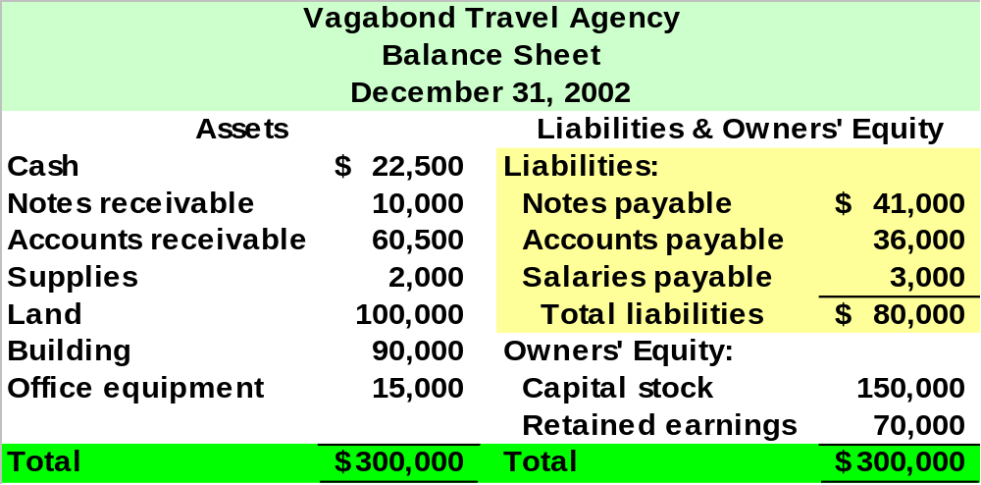
Liabilities
Liabilities are debts that represent negative future cash flows for the enterprise.

Slide 14
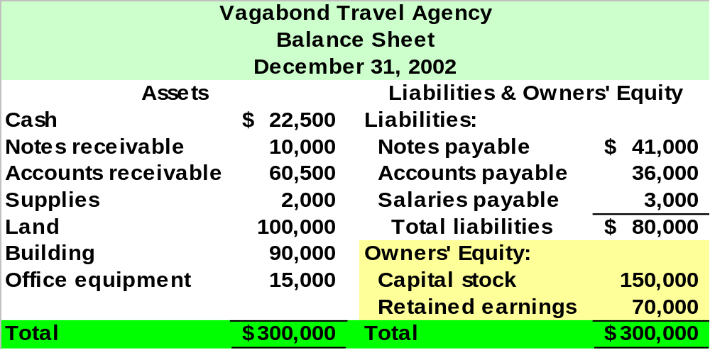
Owners’ Equity
Owners’ equity represents the owner’s claim to the assets of the business.

Slide 15
Owners’ Equity
Changes in Owners’ Equity
Owners’ Investments
Business Earnings
Payments to Owners
Business Losses

Slide 16
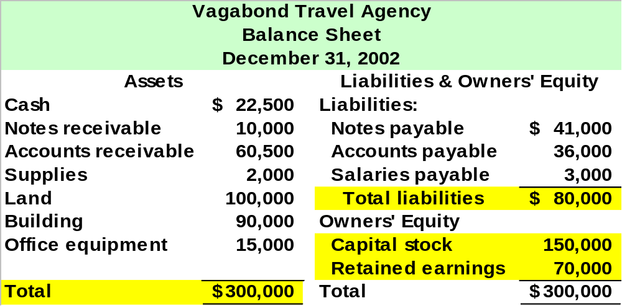
The Accounting Equation
Assets = Liabilities + Owners’ Equity
$300,000 = $80,000 + $220,000
Notes:
3

Slide 17

Let’s analyze some transactions for JJ’s Lawn Care Service.

Slide 18
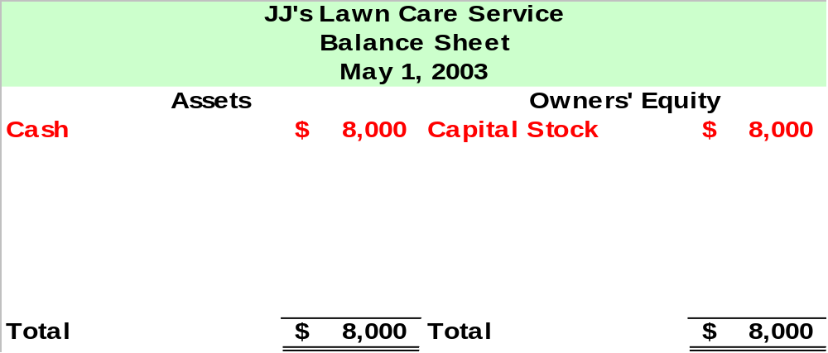
On May 1, 2003, Jill Jones and her family invested $8,000 in JJ’s Lawn Care Service and received 800 shares of stock.
Notes:
3

Slide 19
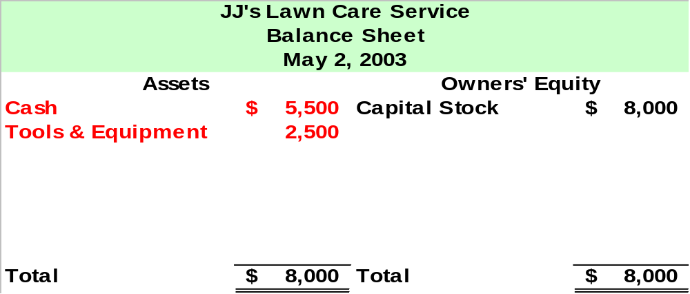
On May 2, JJ’s purchased a riding lawn mower for $2,500 cash.
Notes:
3

Slide 20
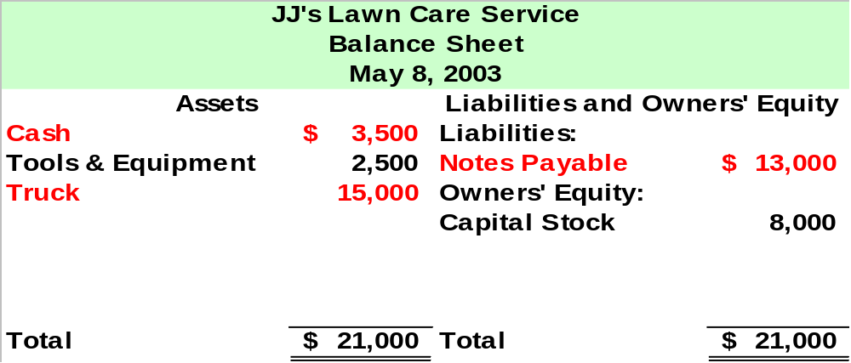
On May 8, JJ’s purchased a $15,000 truck.
JJ’s paid $2,000 down in cash and issued a note payable for the remaining $13,000.
Notes:
3

Slide 21
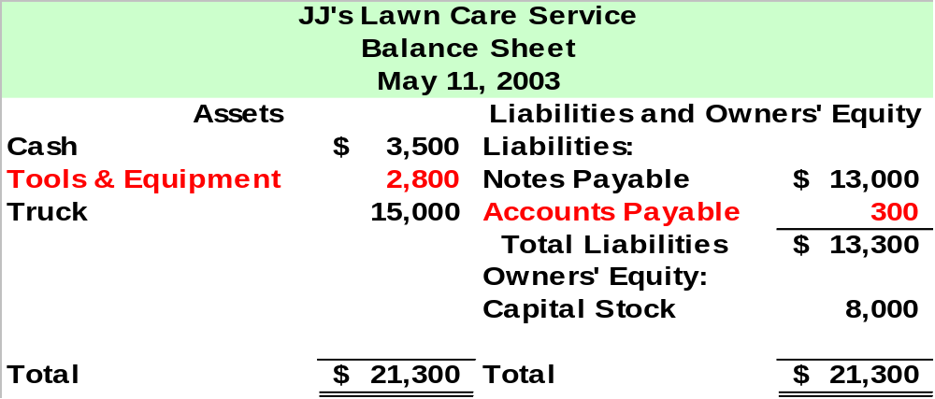
On May 11, JJ’s purchased some repair parts for $300 on account.
Notes:
3

Slide 22
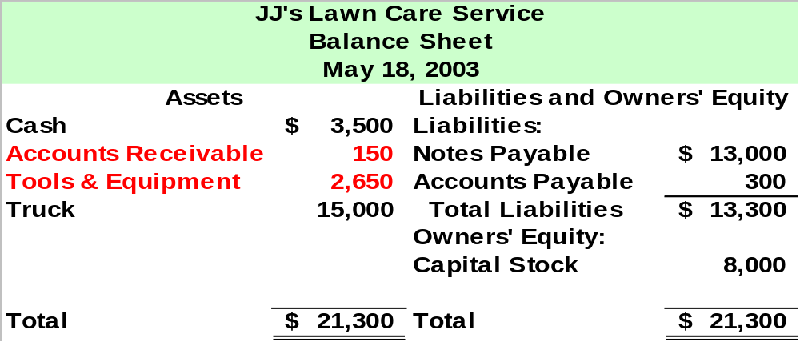
Jill realized she had purchased more repair parts than needed.
On May 18, JJ’s was able to sell half of the repair parts to ABC Lawns for $150, a price equal to JJ’s cost. JJ’s will receive the cash within 30 days.
Notes:
3

Slide 23
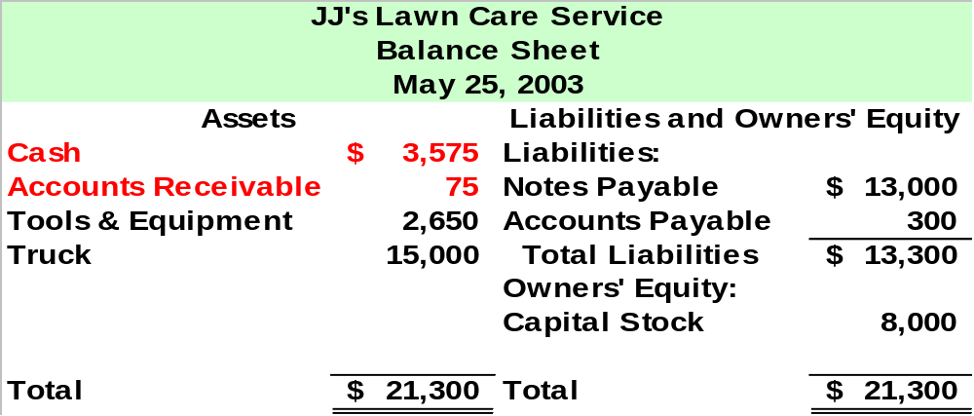
On May 25, ABC Lawns pays JJ’s $75 as a partial settlement of its accounts receivable.
Notes:
3

Slide 24
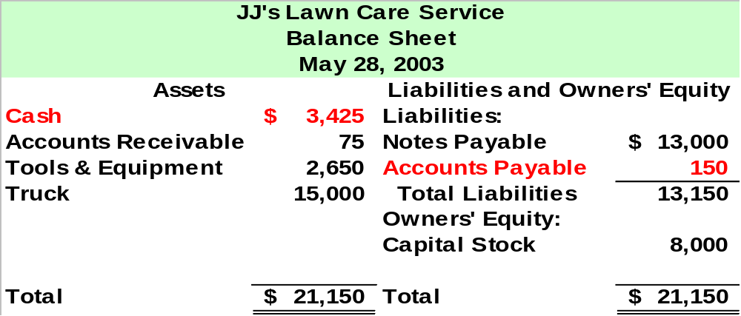
On May 28, JJ’s pays $150 of its accounts payable.
Notes:
3

Slide 25
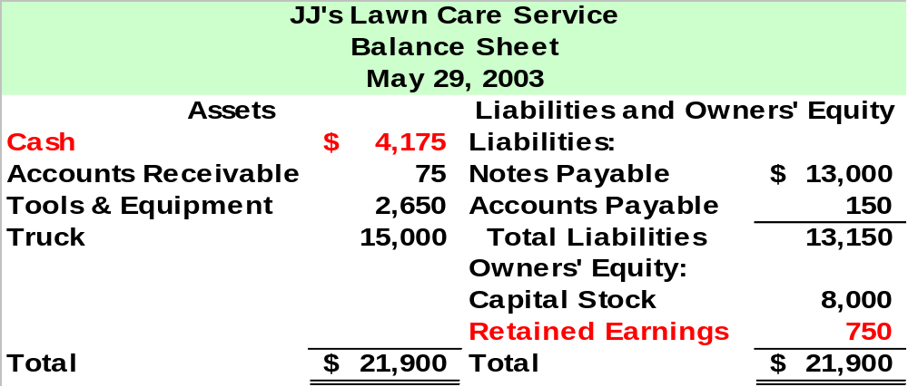
On May 29, JJ’s recorded lawn care services provided during May of $750. All clients paid in cash.
Notes:
3

Slide 26

On May 31, JJ’s purchased gasoline for the lawn mower and the truck for $50 cash.
Now, let’s review how JJ’s transactions affected the accounting equation.
Notes:
3

Slide 27
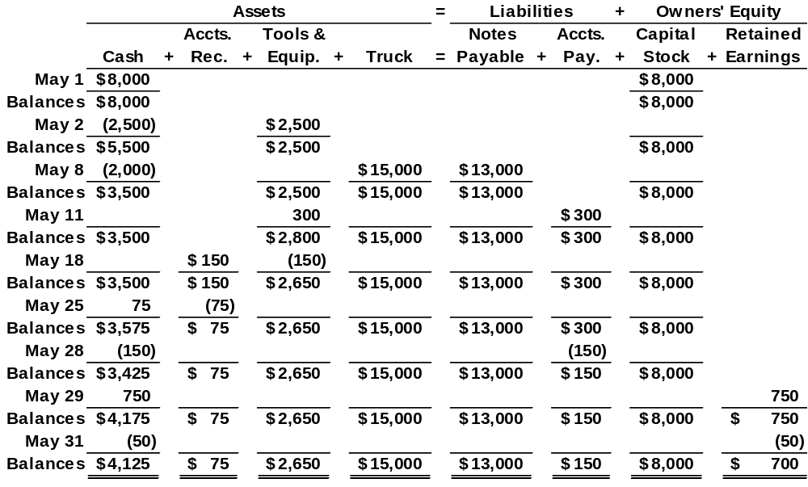
Notes:
3

Slide 28
Let’s prepare the Income Statement and Statement of Cash Flows for JJ’s Lawn Care Service for the month ending May 31, 2003.
These transactions impact the Statement of Cash Flows.
These transactions impact the Income Statement.
Notes:
3

Slide 29
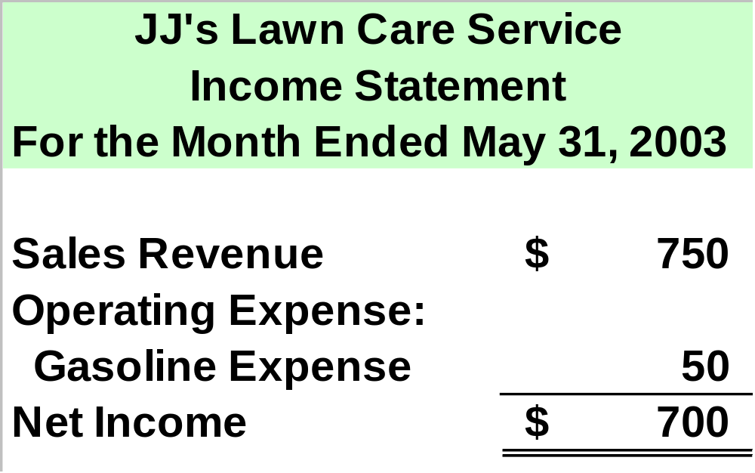
Investments by and payments to the owners are not included on the Income Statement.
Notes:
3

Slide 30
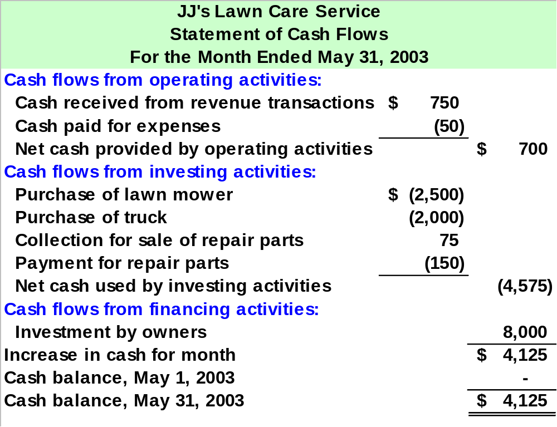
Notes:
3

Slide 31
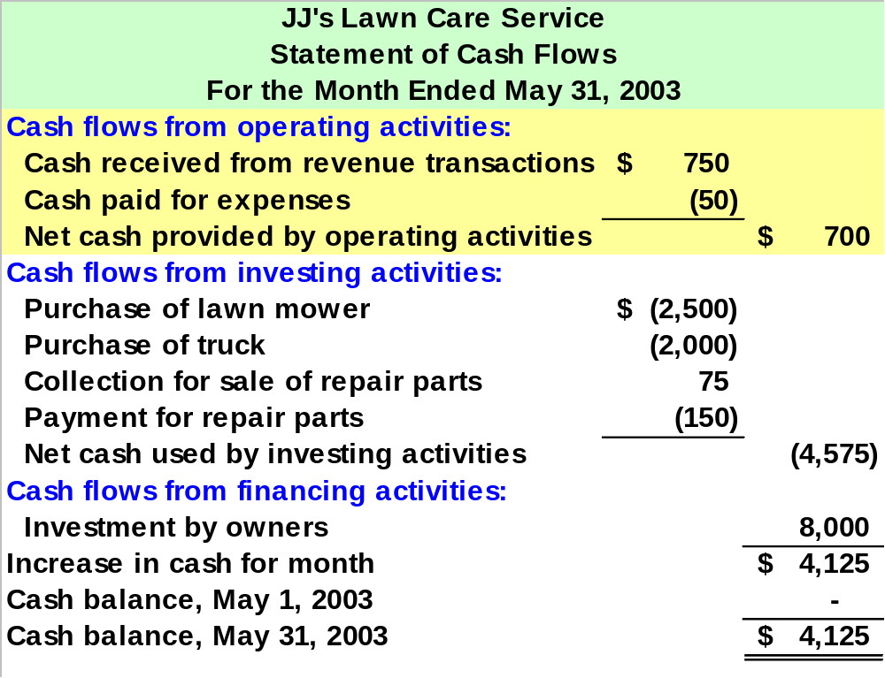
Operating activities include the cash effects of revenue and expense transactions.
Notes:
3

Slide 32
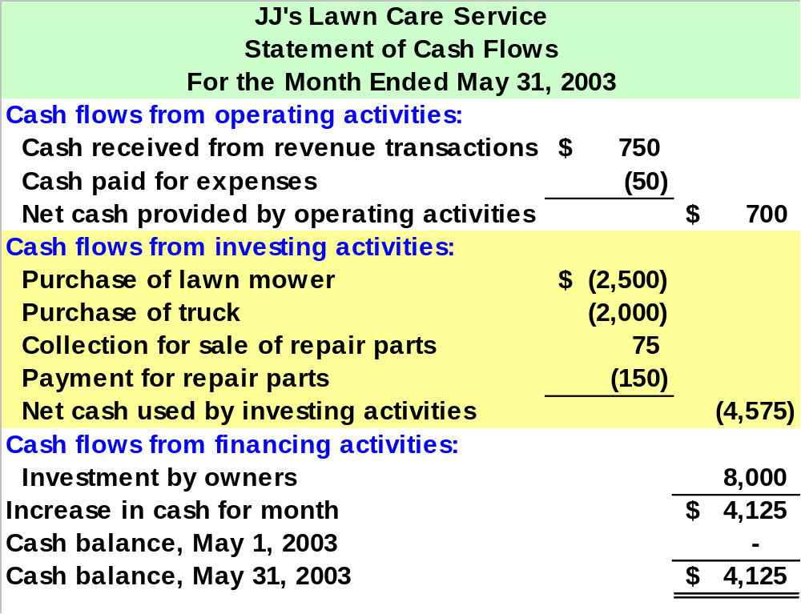
Investing activities include the cash effects of purchasing and selling assets.
Notes:
3

Slide 33
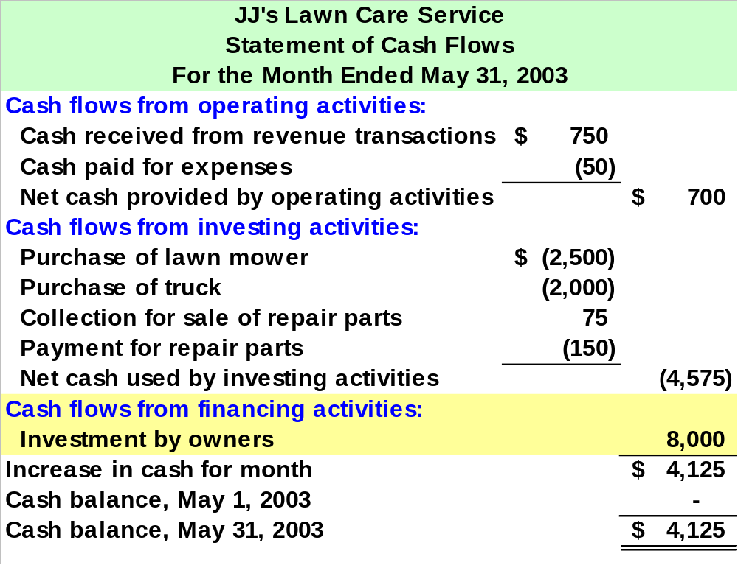
Financing activities include the cash effects of transactions with the owners and creditors.
Notes:
3

Slide 34
Relationships Among Financial Statements
Beginning of period
End of period
Time
Balance Sheet
Balance Sheet
Income Statement
Statement of Cash Flows
Notes:
3

Slide 35



Forms of Business Organizations
Sole Proprietorship
Partnership
Corporation

Slide 36

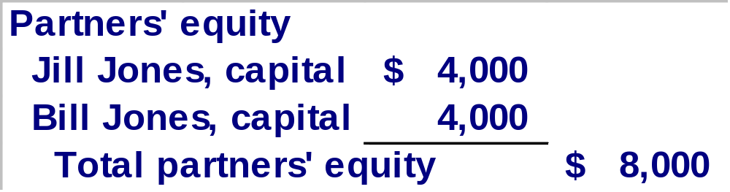
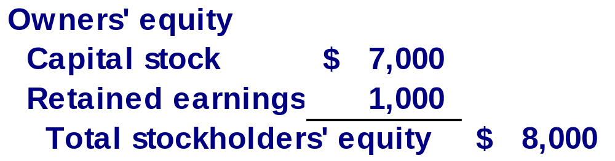
Reporting Ownership Equity in the Balance Sheet
Sole Proprietorship
Partnership
Corporation

Slide 37


The Use of Financial Statements by Outsiders
Two concerns:
Solvency
Profitability
Creditors
Investors

Slide 38
The Need for Adequate Disclosure
Balance Sheet
Notes to the financial statements often provide facts necessary for the proper interpretation of the statements.
Income Statement
Statement of Cash Flows

Slide 39

End of Chapter 2
Notes:
4

