Slide 1

THE ACCOUNTING CYCLE:
Capturing Economic Events
Chapter
3
Notes:
2

Slide 2
The Role of Accounting Records
Establishes accountability for assets and transactions.
Keeps track of routine business activities.
Obtains detailed information about a particular transaction.
Evaluates efficiency and performance within company.
Maintains evidence of company’s business activities.

Slide 3



The Ledger
Accounts are individual records showing increases and decreases.
Cash
Accounts Payable
The entire group of accounts is kept together in an accounting record called a ledger.
Capital
Stock

Slide 4
The Use of Accounts
Increases are recorded on one side of the T-account, and decreases are recorded on the other side.
Title of Account
Left or Debit Side
Right or Credit Side

Slide 5

Let’s see how debits and credits are recorded in the Cash account for JJ’s Lawn Care Service.

Slide 6
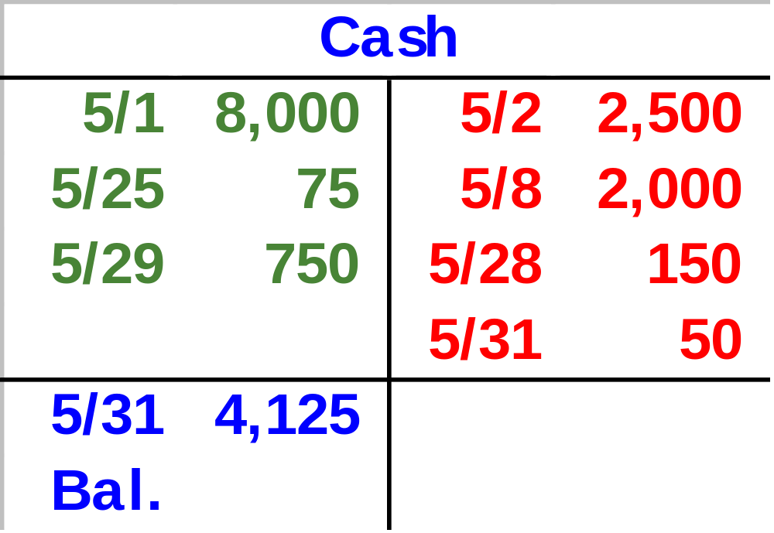
Debit and Credit Entries
Receipts are on the debit side.
Payments are on the credit side.
The balance is the difference between the debit and credit entries in the account.

Slide 7
Debit and Credit Rules
Debits and credits affect accounts as follows:
A = L + OE
ASSETS
LIABILITIES
EQUITIES
Debit for Increase
Credit for Decrease
Debit for Decrease
Credit for Increase
Debit for Decrease
Credit for Increase
Notes:
13

Slide 8
Double Entry Accounting ⎯ The Equality of Debits and Credits
A = L + OE
=
Debit balances
Credit balances
In the double-entry accounting system, every transaction is recorded by equal dollar amounts of debits and credits.
Notes:
13

Slide 9
Let’s record selected transactions for JJ’s Lawn Care Service in the accounts.
Notes:
9

Slide 10
May 1: Jill Jones and her family invested $8,000 in JJ’s Lawn Care Service and received 800 shares of stock.
Will Capital Stock increase or decrease?
Will Cash increase or decrease?
Notes:
3

Slide 11


May 1: Jill Jones and her family invested $8,000 in JJ’s Lawn Care Service and received 800 shares of stock.
Capital Stock increases $8,000 with a credit.
Cash increases $8,000 with a debit.
Notes:
3

Slide 12
May 2: JJ’s purchased a riding lawn mower for $2,500 cash.
Will Tools & Equipment increase or decrease?
Will Cash increase or decrease?
Notes:
3

Slide 13
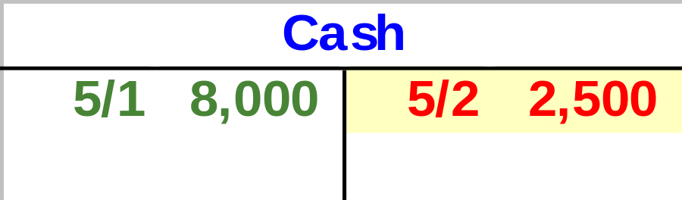
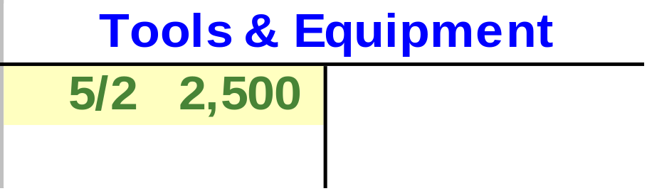
May 2: JJ’s purchased a riding lawn mower for $2,500 cash.
Tools & Equipment increases $2,500 with a debit.
Cash decreases $2,500 with a credit.
Notes:
3

Slide 14
May 8: JJ’s purchased a $15,000 truck. JJ’s paid $2,000 down in cash and issued a note payable for the remaining $13,000.
Will Cash and Notes Payable increase or decrease?
Will Truck increase or decrease?
Notes:
3

Slide 15
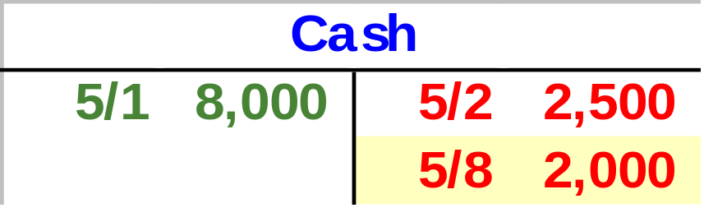

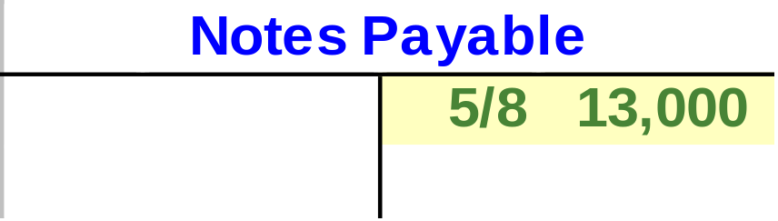
May 8: JJ’s purchased a $15,000 truck. JJ’s paid $2,000 down in cash and issued a note payable for the remaining $13,000.
Cash decreases $2,000 with a credit. Notes Payable increases $13,000 with a credit.
Truck increases $15,000 with a debit.
Notes:
3

Slide 16
May 11: JJ’s purchased some repair parts for $300 on account.
Will Tools & Equipment increase or decrease?
Will Accounts Payable increase or decrease?
Notes:
3

Slide 17
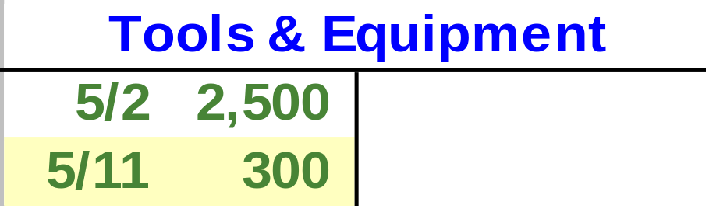
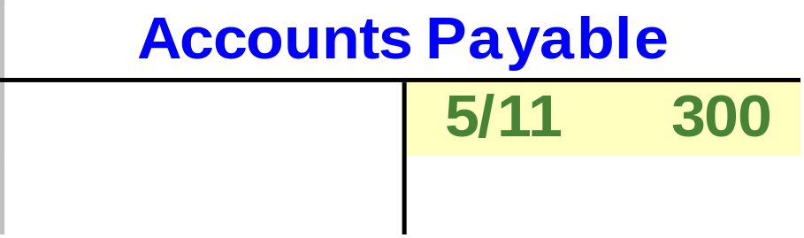
May 11: JJ’s purchased some repair parts for $300 on account.
Tools & Equipment increases $300 with a debit.
Accounts Payable increases $300 with a credit.
Notes:
3

Slide 18
May 18: JJ’s sold half of the repair parts to ABC Lawns for $150, a price equal to JJ’s cost. ABC Lawns agrees to pay JJ’s within 30 days.
Will Tools & Equipment increase or decrease?
Will Accounts Receivable increase or decrease?
Notes:
3

Slide 19
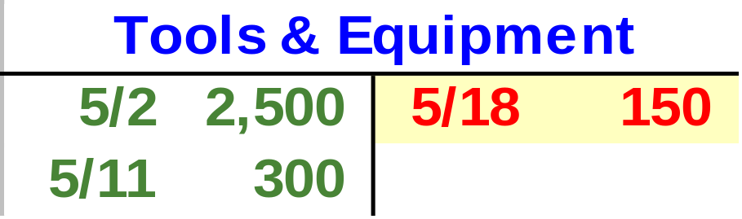
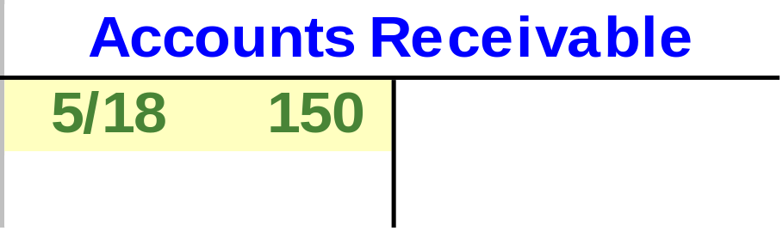
May 18: JJ’s sold half of the repair parts to ABC Lawns for $150, a price equal to JJ’s cost. ABC Lawns agrees to pay JJ’s within 30 days.
Tools & Equipment decreases $150 with a credit.
Accounts Receivable increases $150 with a debit.
Notes:
3

Slide 20
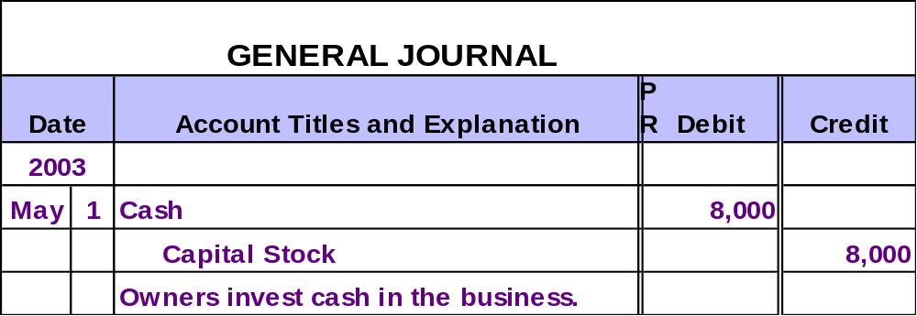
The Journal
In an actual accounting system, transactions are initially recorded in the journal.
Notes:
4

Slide 21

Posting Journal Entries to the Ledger Accounts
Posting involves copying information from the journal to the ledger accounts.
Notes:
4

Slide 22
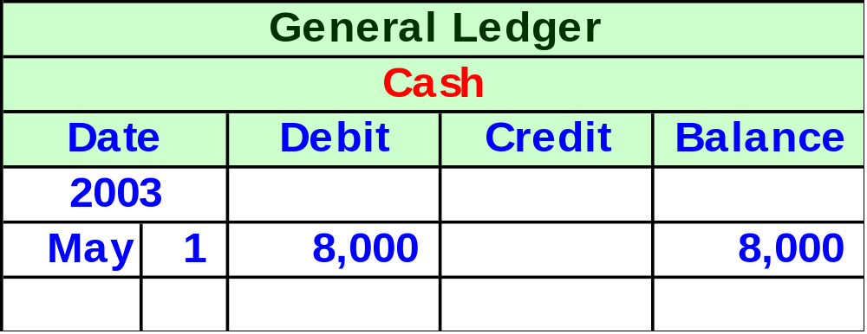
Posting Journal Entries to the Ledger Accounts
Notes:
4

Slide 23
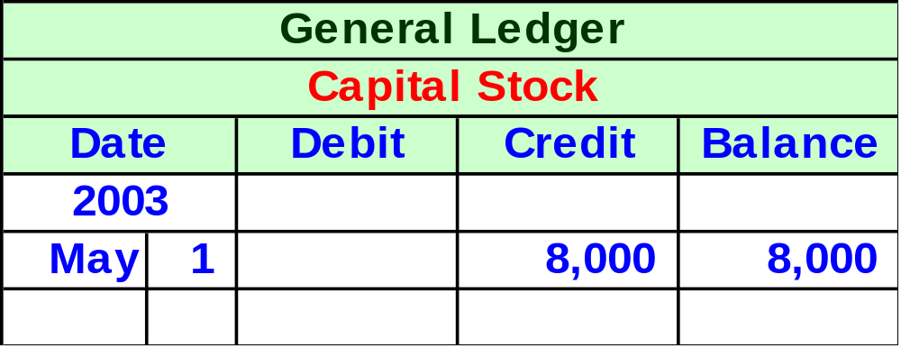
Posting Journal Entries to the Ledger Accounts
Notes:
4

Slide 24
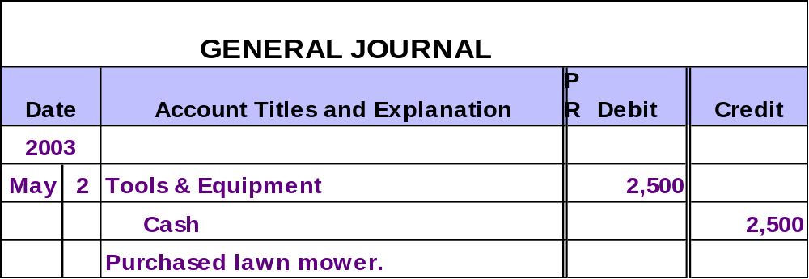
Posting Journal Entries to the Ledger Accounts
Let’s see what the cash account looks like after posting the cash portion of this transaction for JJ’s Lawn Care Service.
Notes:
4

Slide 25
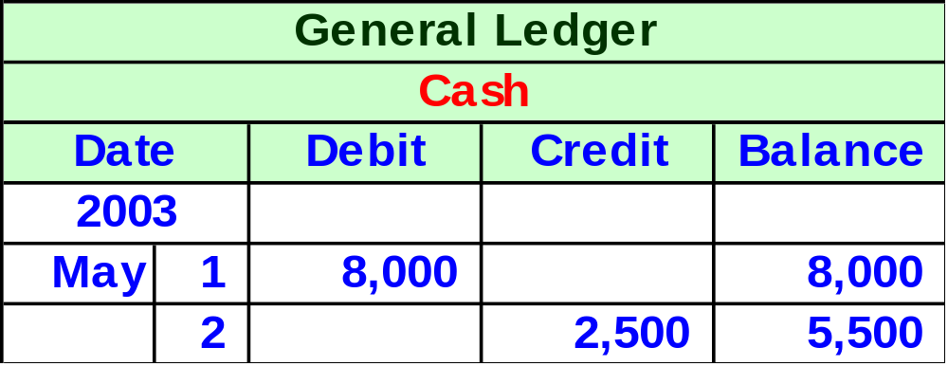
Ledger Accounts After Posting
This ledger format is referred to as a running balance (as opposed to simple T accounts).
Notes:
4

Slide 26
What is Net Income?
Net income is not an asset ⎯ it’s an increase in owners’ equity from profits of the business.
A = L + OE
Increase
Decrease
Increase
Either (or both) of these effects occur as net income is earned . . .
. . . but this is what “net income” really means.
Notes:
3

Slide 27
Retained Earnings
A = L + OE
Capital Stock
Retained Earnings
The balance in the Retained Earnings account represents the total net income of the corporation over the entire lifetime of the business, less all amounts which have been distributed to the stockholders as dividends.
Notes:
3

Slide 28


Revenue and Expenses
The price for goods sold
and services rendered during a given accounting period.
Increases owner’s equity.
The costs of goods and services used up in the process of earning revenue.
Decreases owner’s equity.

Slide 29

The Realization Principle: When To Record Revenue
Realization Principle
Revenue should be recognized at the time goods are sold and services are rendered.

Slide 30
The Matching Principle: When To Record Expenses
Matching Principle
Expenses should be recorded in the period in which they are used up.

Slide 31
Debits and Credits for Revenue and Expense
Expenses decrease owner’s equity.
EQUITIES
Revenues increase owner’s equity.
Debit for Decrease
Credit for Increase
EXPENSES
REVENUES
Debit for Increase
Credit for Decrease
Debit for Decrease
Credit for Increase

Slide 32
Investments by and Payments to Owners
Payments to owners decrease owners’ equity.
Owners’ investments increase owners’ equity.
EQUITIES
Debit for Decrease
Credit for Increase
DIVIDENDS
CAPITAL STOCK
Debit for Increase
Credit for Decrease
Debit for Decrease
Credit for Increase

Slide 33
Let’s analyze the revenue, and expense transactions for JJ’s Lawn Care Service for the month of May.
We will also analyze a dividend transaction.
Notes:
9

Slide 34
May 29: JJ’s provided lawn care services for a client and received $750 in cash.
Will Sales Revenue increase or decrease?
Will Cash increase or decrease?
Notes:
3

Slide 35
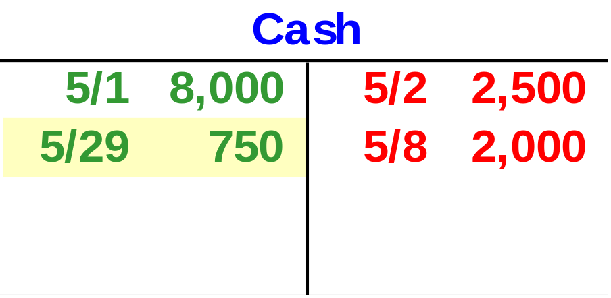
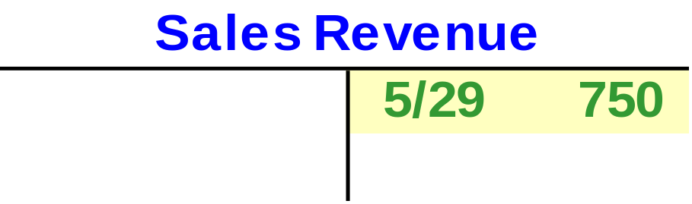
May 29: JJ’s provided lawn care services for a client and received $750 in cash.
Sales Revenue increases $750 with a credit.
Cash increases $750 with a debit.
Notes:
3

Slide 36
May 31: JJ’s purchased gasoline for the lawn mower and the truck for $50 cash.
Will Gasoline Expense increase or decrease?
Will Cash increase or decrease?
Notes:
3

Slide 37
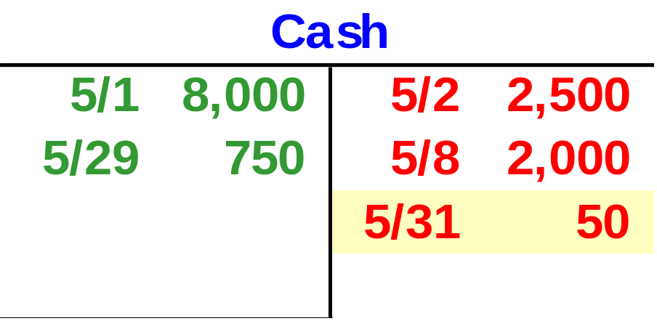
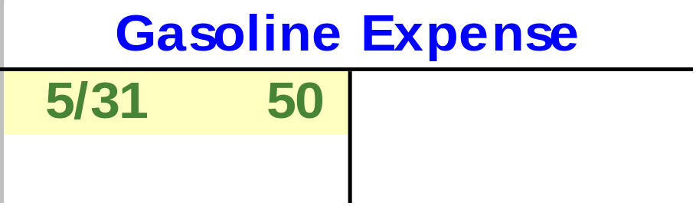
May 31: JJ’s purchased gasoline for the lawn mower and the truck for $50 cash.
Gasoline Expense increases $50 with a debit.
Cash decreases $50 with a credit.
Notes:
3

Slide 38
May 31: JJ’s Lawn Care paid Jill Jones and her family a $200 dividend.
Will Dividends increase or decrease?
Will Cash increase or decrease?
Notes:
3

Slide 39
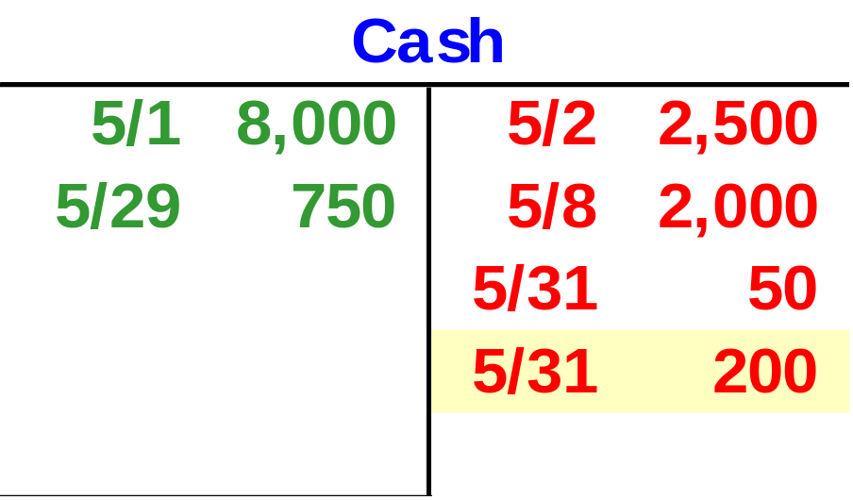

May 31: JJ’s Lawn Care paid Jill Jones and her family a $200 dividend.
Cash decreases $200 with a credit.
Dividends increase $200 with a debit.
Notes:
3

Slide 40
Now, let’s look at the Trial Balance for JJ’s Lawn Care Service for the month of May.
Notes:
9

Slide 41
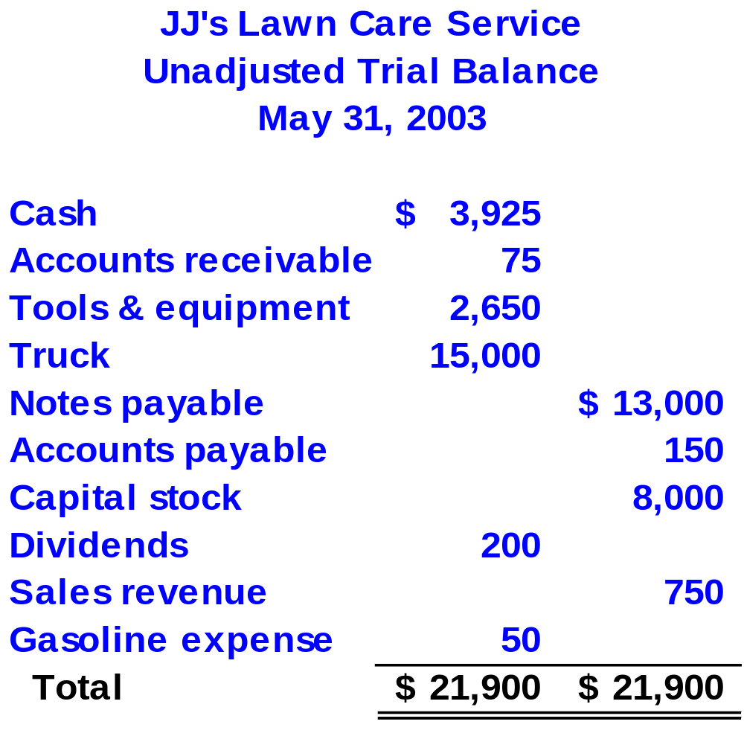
All balances are taken from the ledger accounts on May 31 after considering all of JJ’s transactions for the month.
Proves equality of debits and credits.
Notes:
4

Slide 42




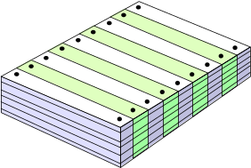
The Accounting Cycle
Make end-of-year adjustments.
Journalize transactions.
Post entries to the ledger accounts.
Prepare trial balance.
Prepare after closing trial balance.
Journalize and post closing entries.
Prepare financial statements.
Prepare adjusted trial balance.
Notes:
3

Slide 43

End of Chapter 3
Notes:
4

