Slide 1

THE ACCOUNTING CYCLE:
Accruals and Deferrals
Chapter
4
Notes:
2

Slide 2

At the end of the period, we need to make adjusting entries to get the accounts up to date for the financial statements.

Slide 3
Adjusting Entries
Adjusting entries are
Every adjusting
needed whenever revenue or expenses affect more than one
entry involves a change in either a revenue or expense
accounting period.
and an asset or liability.
Notes:
4

Slide 4
Types of Adjusting Entries
Converting assets to expenses
Converting liabilities to revenue
Accruing unpaid expenses
Accruing uncollected revenues
Notes:
4

Slide 5
Converting Assets to Expenses
End of Current Period
Prior Periods
Current Period
Future Periods
Transaction
Paid future expenses in advance
(creates an asset).
Adjusting Entry
Recognize portion
of asset consumed
as expense, and
Reduce balance of
asset account.
Notes:
4

Slide 6

Converting Assets to Expenses
Examples Include:
Depreciation
Supplies
Expiring Insurance Policies
Notes:
4

Slide 7
Converting Assets to Expenses
$2,400 Insurance Policy Coverage for 12 Months
$200 Monthly Insurance Expense
Jan. 1
Dec. 31
On January 1, Webb Co. purchased a one-year insurance policy for $2,400.
Notes:
4

Slide 8
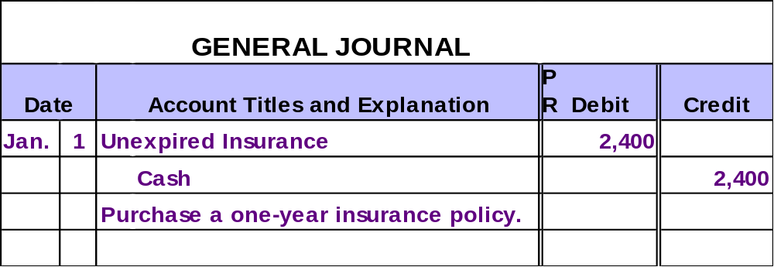
Converting Assets to Expenses
Initially, costs that benefit more than one accounting period are recorded as assets.
Notes:
4

Slide 9
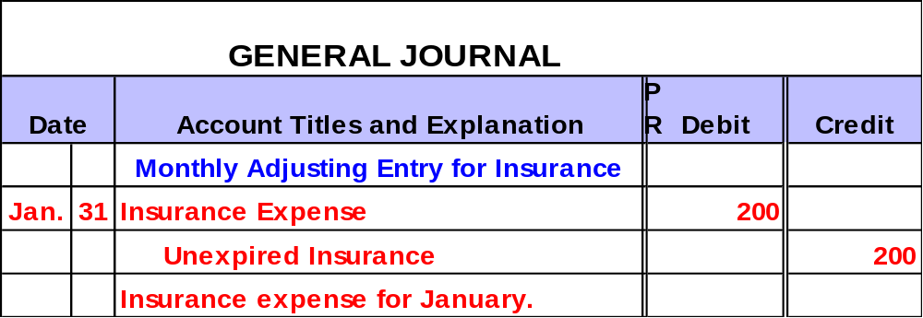
Converting Assets to Expenses
The costs are expensed as they are used to generate revenue.
Notes:
4

Slide 10
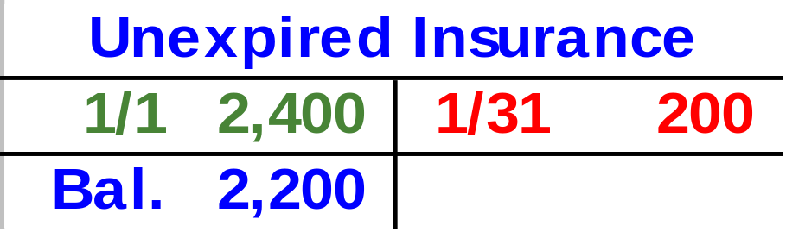
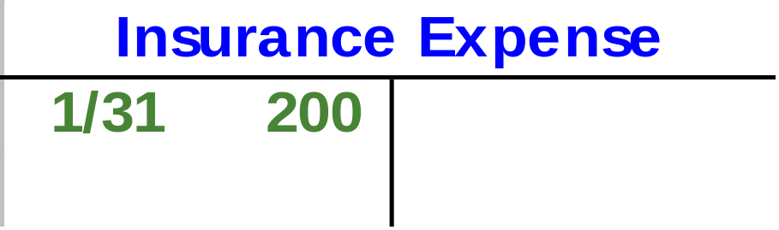
Converting Assets to Expenses
Balance Sheet
Cost of assets that benefit future periods.
Income Statement
Cost of assets used this period to generate revenue.
Notes:
4

Slide 11
The Concept of Depreciation
Depreciable assets are physical objects that retain their size and shape but lose their economic usefulness over time.
Depreciation is the systematic allocation of the cost of a depreciable asset to expense.

Slide 12
The Concept of Depreciation
The portion of an asset’s utility that is used up must be expensed in the period used.
Fixed Asset (debit)
The asset’s usefulness is partially consumed during the period.
Accumulated Depreciation (credit)
On date when initial payment is made . . .
At end of period . . .
Depreciation Expense (debit)
Cash (credit)

Slide 13

Depreciation Is Only an Estimate
On May 2, 2003, JJ’s Lawn Care Service purchased a lawn mower with a useful life of 50 months for $2,500 cash.
Using the straight-line method, calculate the monthly depreciation expense.
Depreciation
expense (per
period)
Cost of the asset
Estimated useful life
=
$50
$2,500
50
=

Slide 14
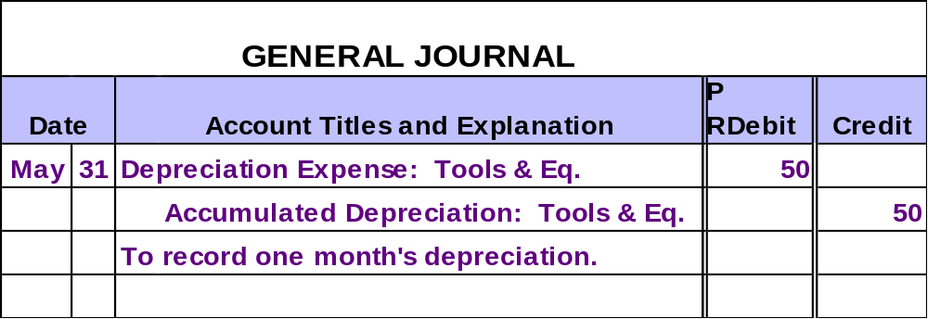
Depreciation Is Only an Estimate
JJ’s Lawn Care Service would make the following adjusting entry.
Contra-asset
Notes:
4

Slide 15

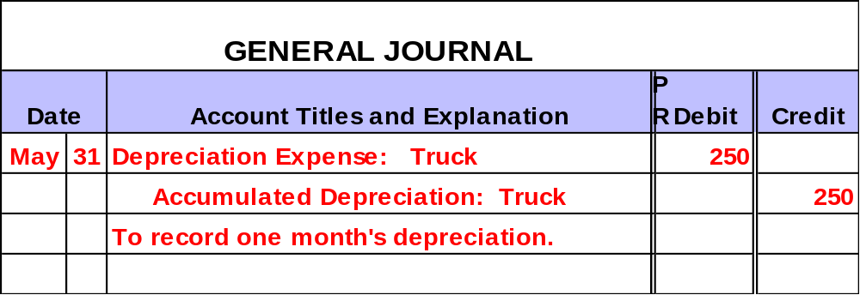
Depreciation Is Only an Estimate
JJ’s $15,000 truck is depreciated over 60 months as follows:
$15,000 ÷ 60 months = $250 per month
Notes:
4

Slide 16

Accumulated depreciation would appear on the balance sheet as follows:
Notes:
4

Slide 17
Converting Liabilities to Revenue
End of Current Period
Prior Periods
Current Period
Future Periods
Transaction
Collected from customers in advance
(creates a liability).
Adjusting Entry
Recognize portion
earned as revenue,
and
Reduce balance of
liability account.
Notes:
4

Slide 18

Converting Liabilities to Revenue
Examples Include:
Airline Ticket Sales
Sports Teams’ Sales of Season Tickets
Notes:
4

Slide 19

Converting Liabilities to Revenue
$6,000 Rental Contract Coverage for 12 Months
$500 Monthly Rental Revenue
Jan. 1
Dec. 31
On January 1, Webb Co. received $6,000 in advance for a one-year rental contract.
Notes:
4

Slide 20
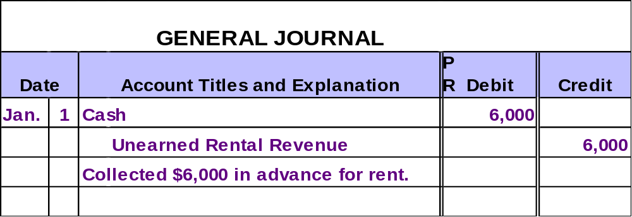
Converting Liabilities to Revenue
Initially, revenues that benefit more than one accounting period are recorded as liabilities.
Notes:
4

Slide 21
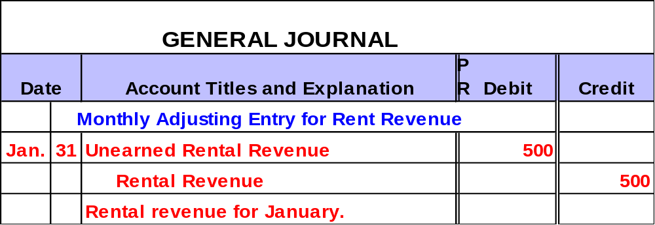
Converting Liabilities to Revenue
Over time, the revenue is recognized as it is earned.
Notes:
4

Slide 22
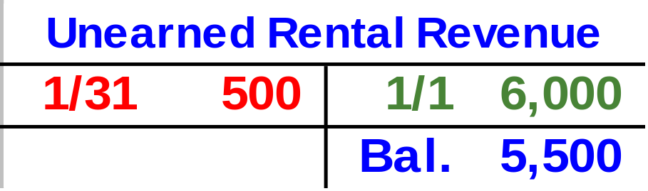
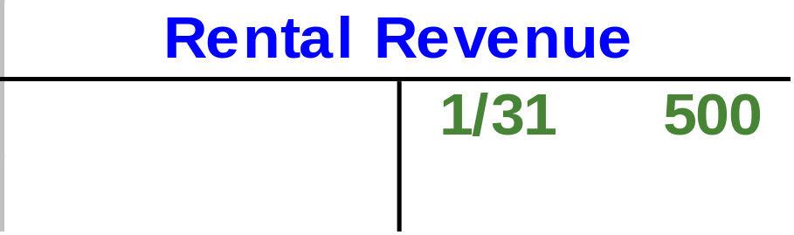
Converting Liabilities to Revenue
Balance Sheet
Liability for future periods.
Income Statement
Revenue earned this period.
Notes:
4

Slide 23
Accruing Unpaid Expenses
End of Current Period
Prior Periods
Current Period
Future Periods
Adjusting Entry
Recognize expense
incurred, and
Record liability for
future payment.
Transaction
Liability will be paid.
Notes:
4

Slide 24

Accruing Unpaid Expenses
Hey, when do we get paid?
Examples Include:
Interest
Wages and Salaries
Property Taxes
Notes:
4

Slide 25
Accruing Unpaid Expenses
$3,000 Wages Expense
Monday,
May 29
Wednesday,
May 31
Friday, June 2
On May 31, Webb Co. owes wages of $3,000. Pay day is Friday, June 2.
Notes:
4

Slide 26
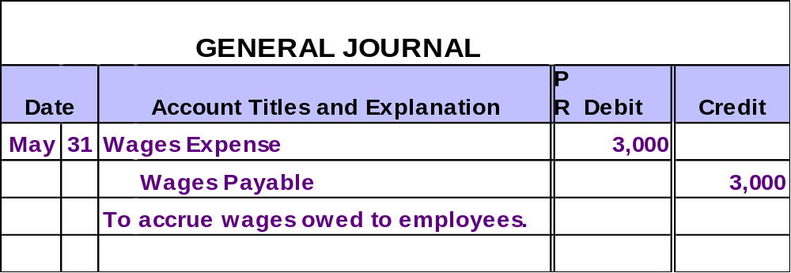
Accruing Unpaid Expenses
Initially, an expense and a liability are recorded.
Notes:
4

Slide 27
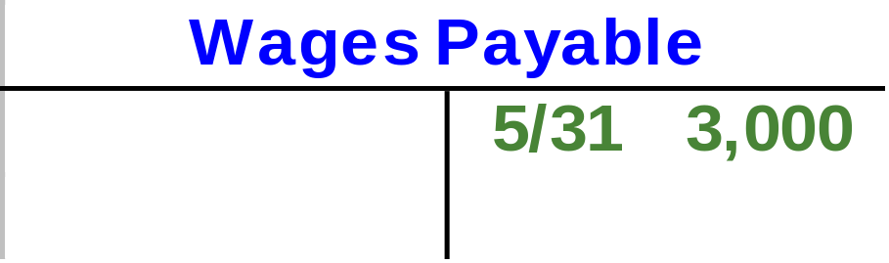
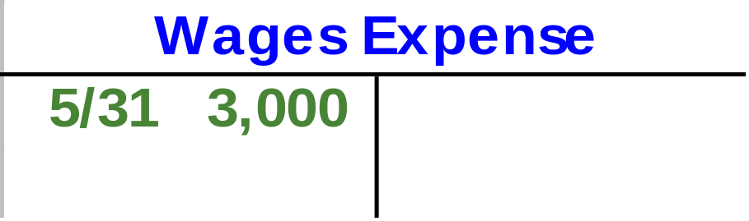
Accruing Unpaid Expenses
Balance Sheet
Liability to be paid in a future period.
Income Statement
Cost incurred this period to generate revenue.
Notes:
4

Slide 28
Accruing Unpaid Expenses
$5,000 Weekly Wages
$3,000 Wages Expense
$2,000 Wages Expense
Monday,
May 29
Wednesday,
May 31
Friday, June 2
Let’s look at the entry for June 2.
Notes:
4

Slide 29
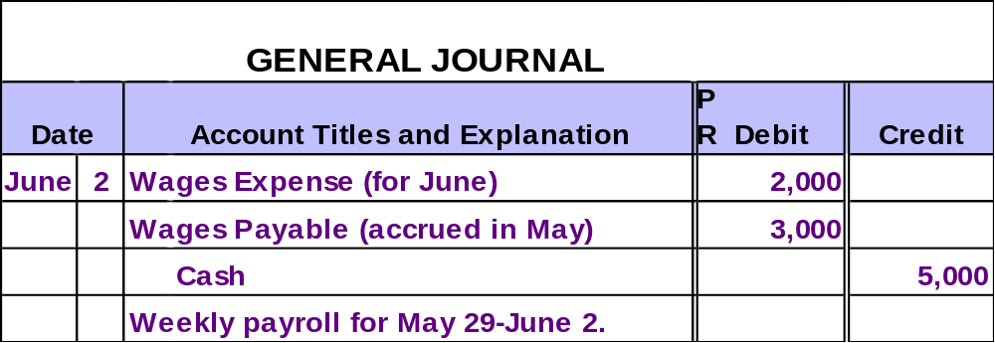
Accruing Unpaid Expenses
The liability is extinguished when the debt is paid.
Notes:
4

Slide 30
Accruing Uncollected Revenue
End of Current Period
Prior Periods
Current Period
Future Periods
Adjusting Entry
Recognize revenue
earned but not yet
recorded, and
Record receivable.
Transaction
Receivable will be collected.
Notes:
4

Slide 31
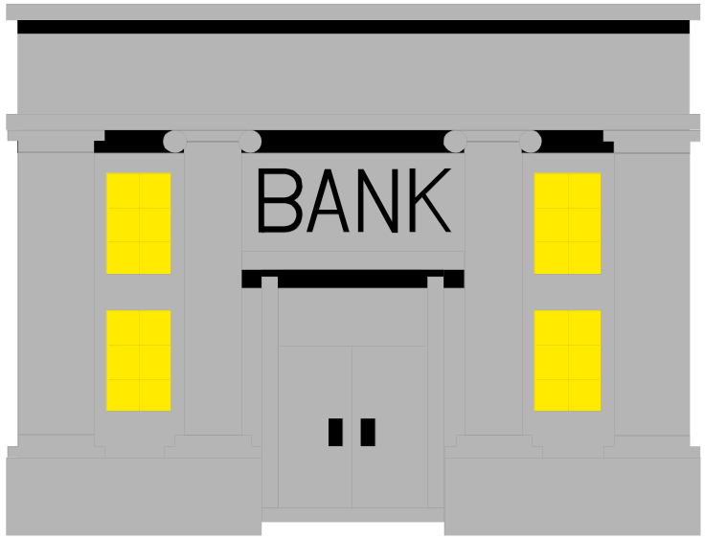
Accruing Uncollected Revenue
Examples Include:
Interest Earned
Work Completed But Not Yet Billed to Customer
Notes:
4

Slide 32
Accruing Uncollected Revenue
$170 Interest Revenue
Saturday,
Jan. 15
Monday,
Jan. 31
Tuesday, Feb. 15
On Jan. 31, the bank owes Webb Co. interest of $170. Interest is paid on the 15th day of each month.
Notes:
4

Slide 33
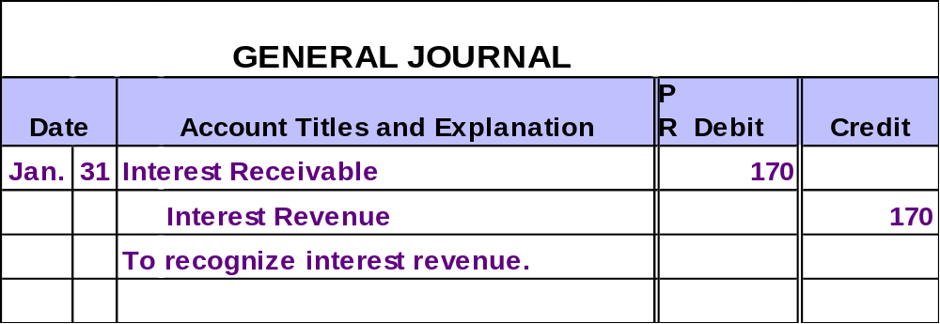
Accruing Uncollected Revenue
Initially, the revenue is recognized and a receivable is created.
Notes:
4

Slide 34
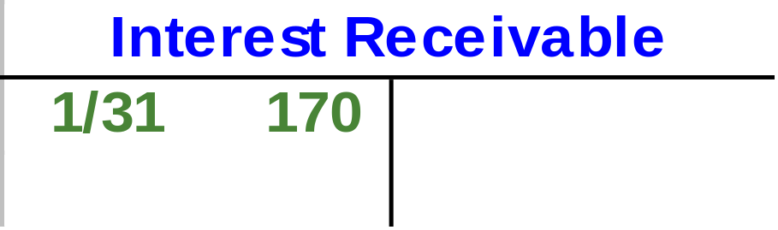
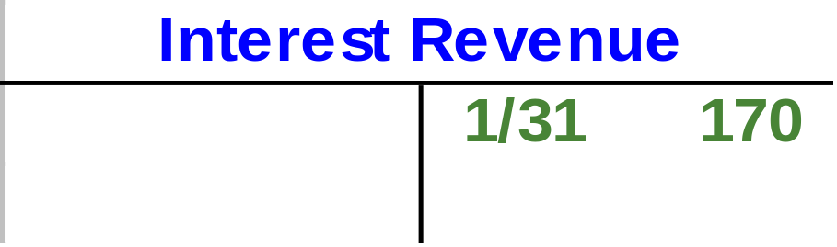
Accruing Uncollected Revenue
Balance Sheet
Receivable to be collected in a future period.
Income Statement
Revenue earned this period.
Notes:
4

Slide 35
Accruing Uncollected Revenue
$320 Monthly Interest
$170 Interest Revenue
$150 Interest Revenue
Saturday,
Jan. 15
Monday,
Jan. 31
Tuesday, Feb. 15
Let’s look at the entry for February 15.
Notes:
4

Slide 36
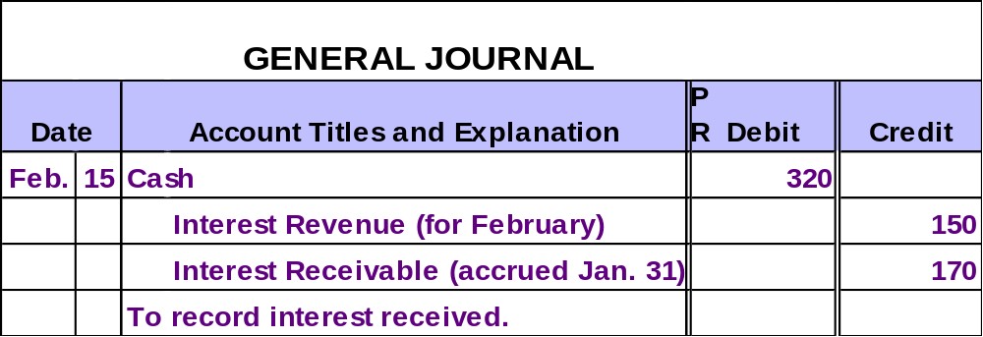
Accruing Uncollected Revenue
The receivable is collected in a future period.
Notes:
4

Slide 37
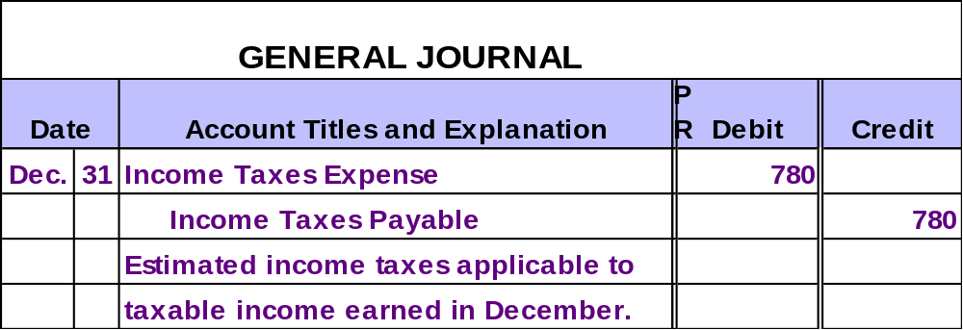
Accruing Income Taxes Expense: The Final Adjusting Entry
As a corporation earns taxable income, it incurs income taxes expense, and also a liability to governmental tax authorities.
Notes:
4

Slide 38
Adjusting Entries and Accounting Principles
Costs are matched with revenue in two ways:
Direct association of costs with specific revenue transactions.
Systematic allocation of costs over the “useful life” of the expenditure.

Slide 39




The Concept of Materiality
An item is “material” if knowledge of the item might reasonably influence the decisions of users of financial statements.
Many companies immediately charge the cost of immaterial items to expense.
Lightbulbs
Supplies

Slide 40




Effects of the Adjusting Entries
Make end-of-year adjustments.
Journalize transactions.
Post entries to the ledger accounts.
Prepare trial balance.
Recall from the accounting cycle discussed in Chapter 3, that after the adjusting entries are made, an adjusted trial balance is prepared.
Prepare adjusted trial balance.
Notes:
3

Slide 41

End of Chapter 4
Notes:
4

