Slide 1

THE ACCOUNTING CYCLE:
Reporting Financial Results
Chapter
5
Notes:
2

Slide 2
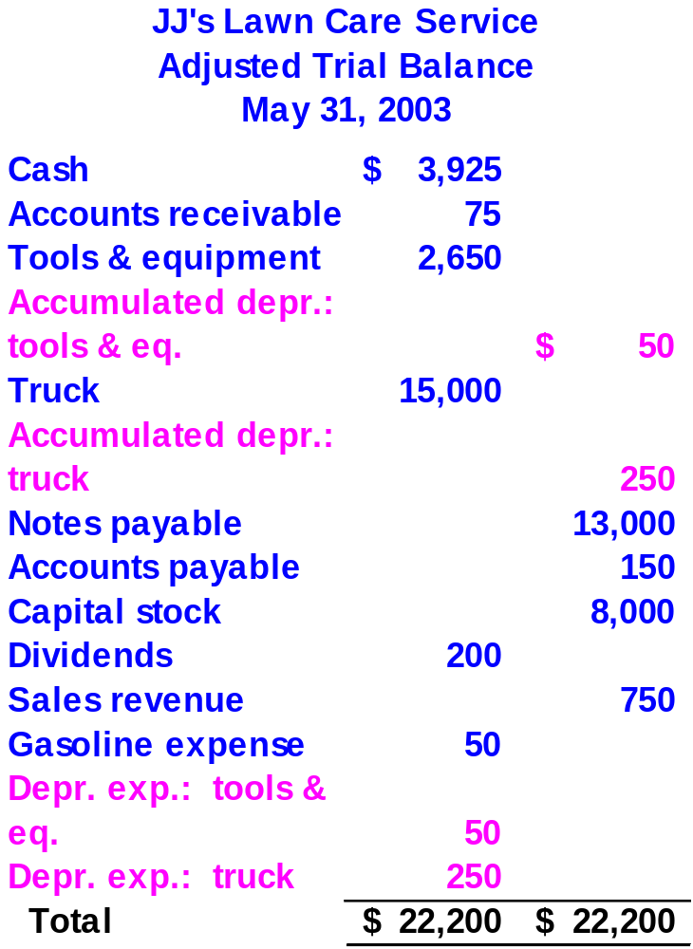

This is the Adjusted Trial Balance for JJ’s.
Now, let’s prepare the financial statements for JJ’s Lawn Care Service for May.
Notes:
4

Slide 3
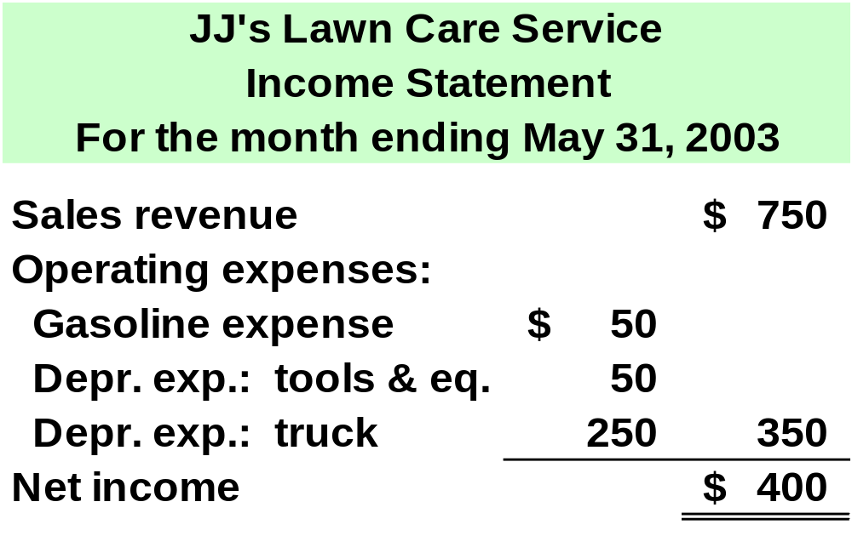
Net income also appears on the Statement of Owner’s Equity.
Notes:
4

Slide 4
Statement of Retained Earnings
This statement summarizes the increases and decreases in Retained Earnings during the period.
Business Earnings
Dividends
Business Losses
Notes:
4

Slide 5
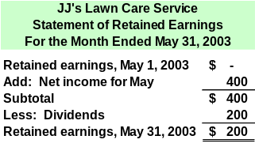
Now, let’s prepare the Balance Sheet.
Notes:
4

Slide 6
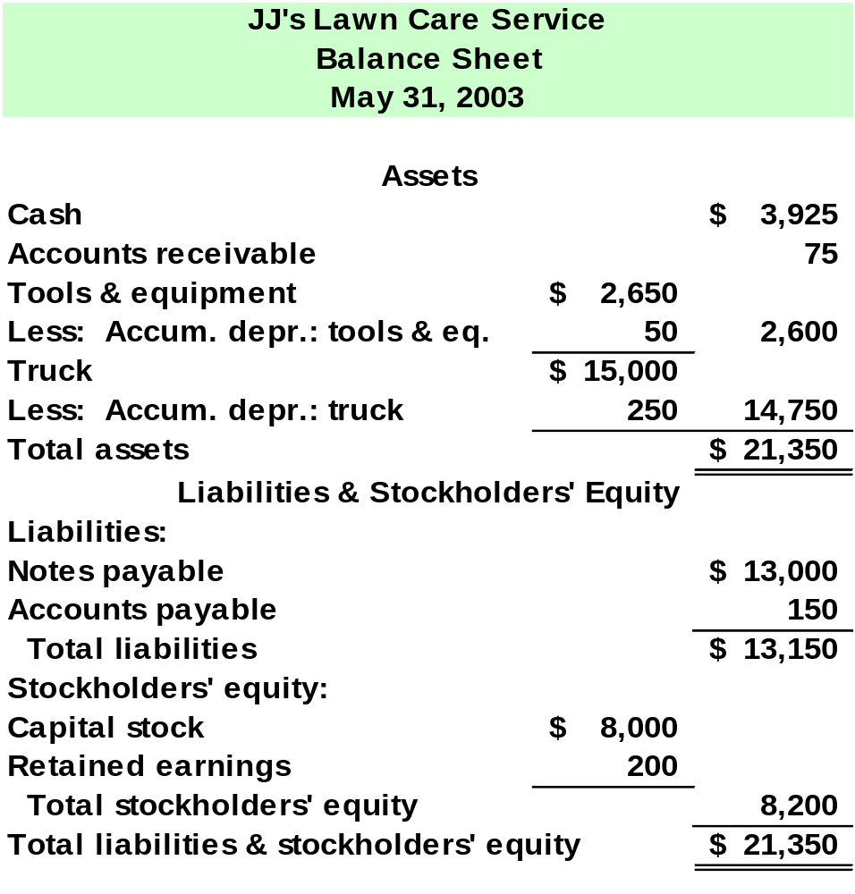
Next, let’s prepare the Statement of Cash Flows for JJ’s Lawn Care Service for May.
Notes:
4

Slide 7
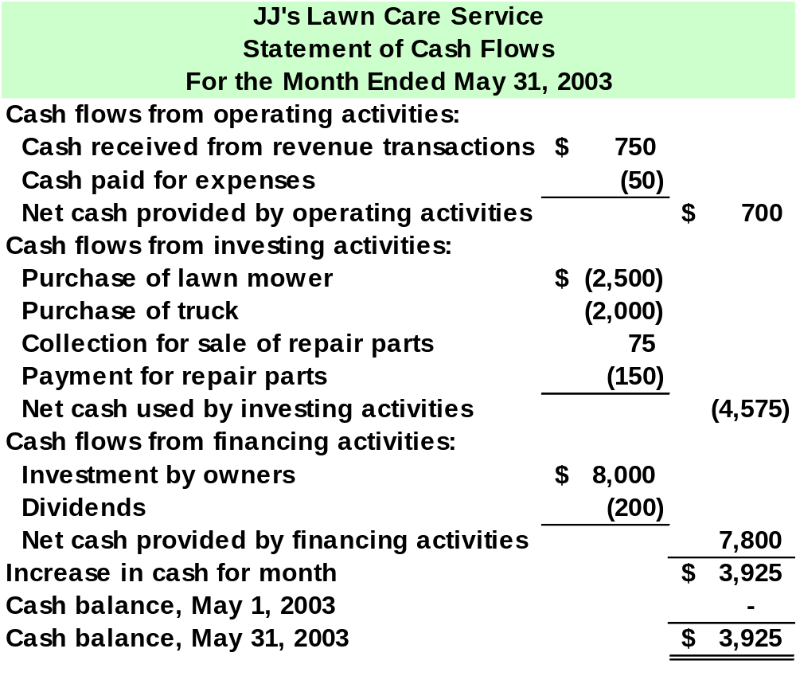
Notes:
4

Slide 8

Drafting Notes to the Financial Statements
Examples of Items Disclosed
Lawsuits pending
Scheduled plant closings
Governmental investigations
Significant events occurring
after the balance sheet date
Specific customers that
account for a large portion of
revenue
Unusual transactions and
related party transactions
Notes to the
Financial Statements

Slide 9

Closing the Temporary Equity Accounts
The closing process gets the temporary accounts ready for the next accounting period.
Close Revenue accounts to Income Summary.
Close Expense accounts to Income Summary.
Close Income Summary account to Retained Earnings.
Close Dividends to Retained Earnings.
Notes:
4

Slide 10
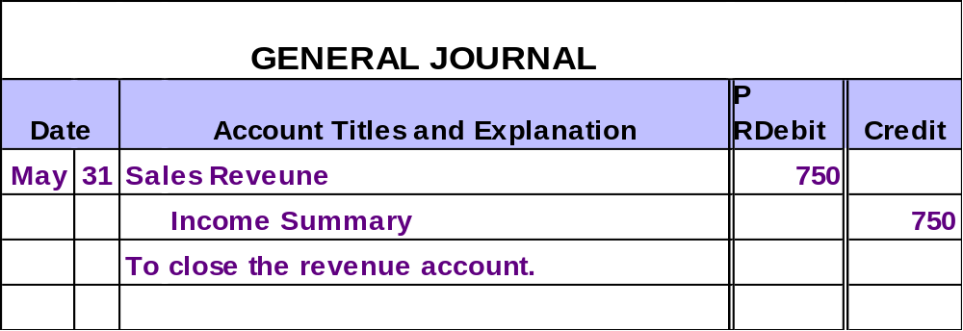
Closing Entries for Revenue Accounts
Since Sales Revenue has a credit balance, the closing entry requires a debit to the Sales Revenue account.
Notes:
4

Slide 11
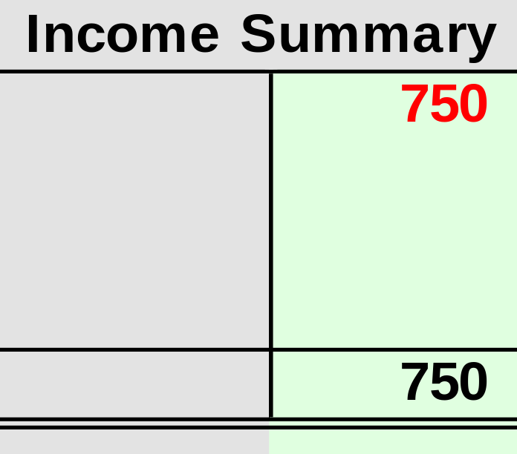
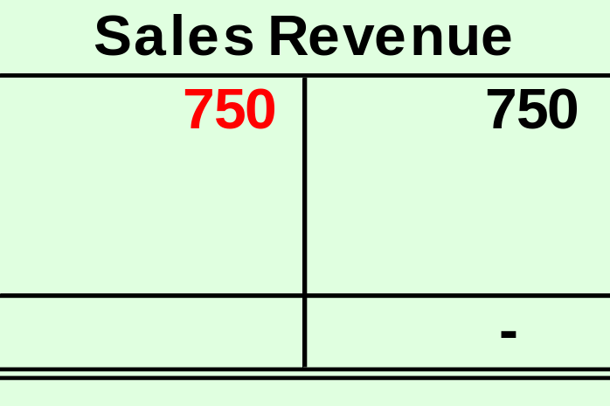
Closing Entries for Revenue Accounts

Slide 12
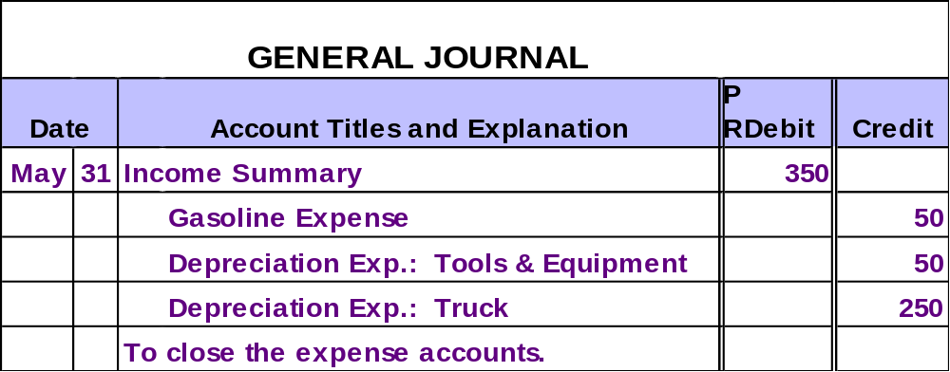
Closing Entries for Expense Accounts
Since expense accounts have a debit balance, the closing entry requires a credit to the expense accounts.
Notes:
4

Slide 13
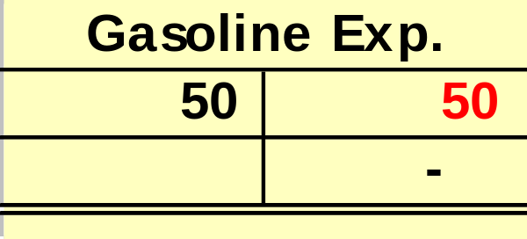
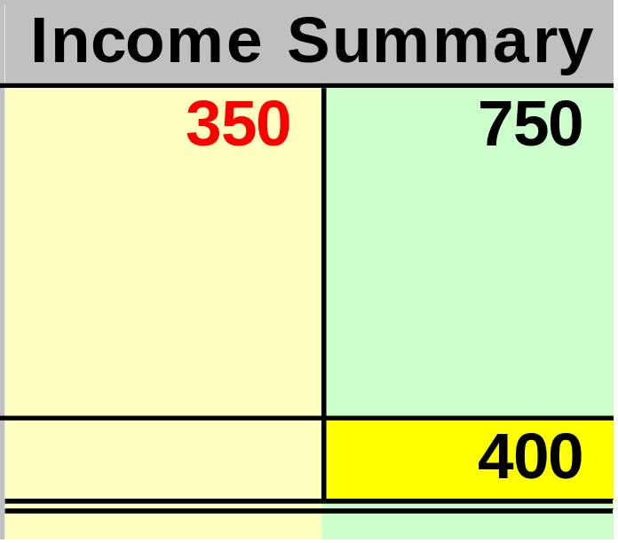
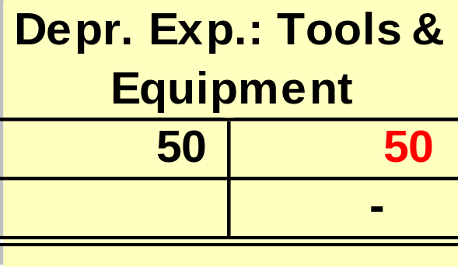
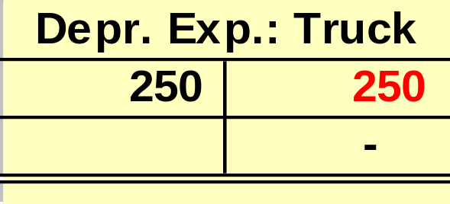
Closing Entries for Expense Accounts
Net Income

Slide 14
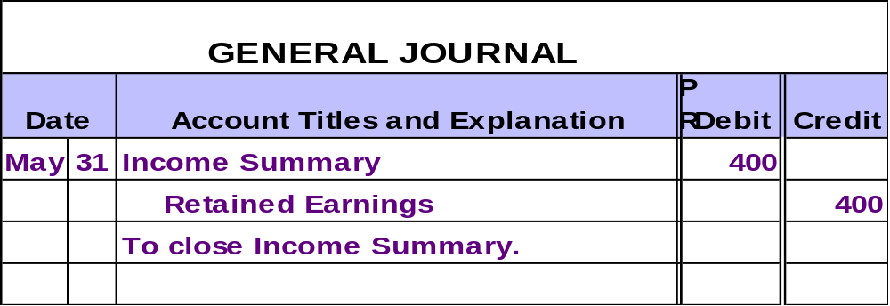
Closing the Income Summary Account
Since Income Summary has a $400 credit balance, the closing entry requires a debit to Income Summary.
Notes:
4

Slide 15
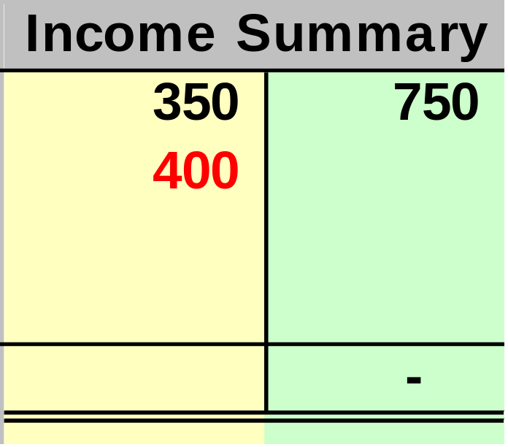
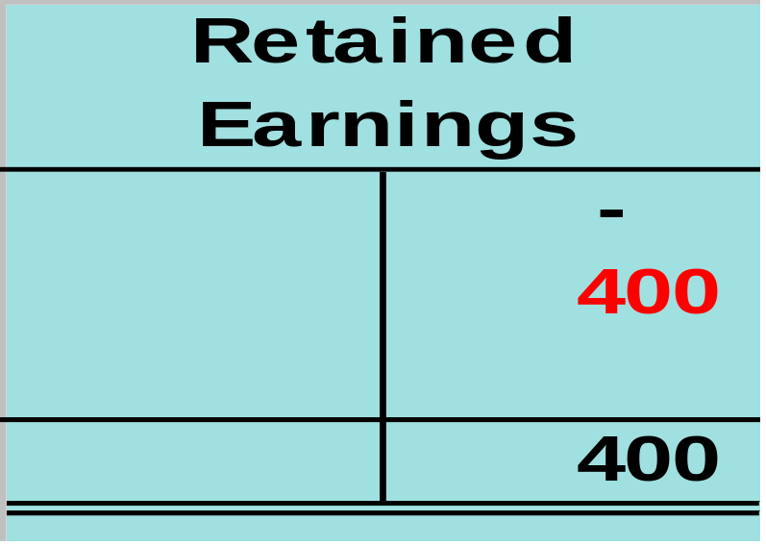
Closing the Income Summary Account
The balance in Income Summary is now zero.

Slide 16
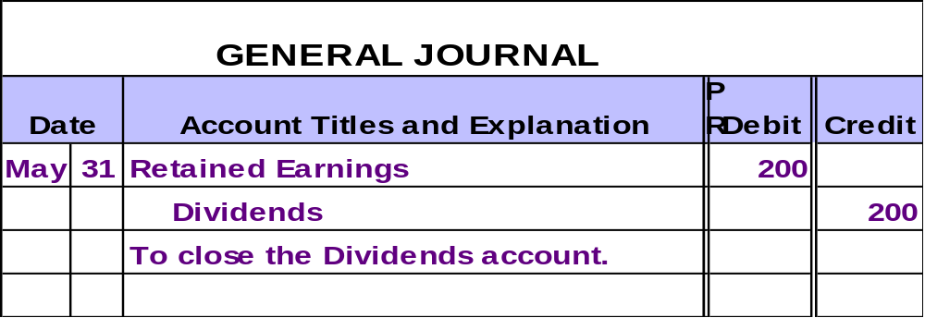
Closing the Dividends Account
Since the Dividends account has a debit balance, the closing entry requires a credit to the Dividends account.
Notes:
4

Slide 17
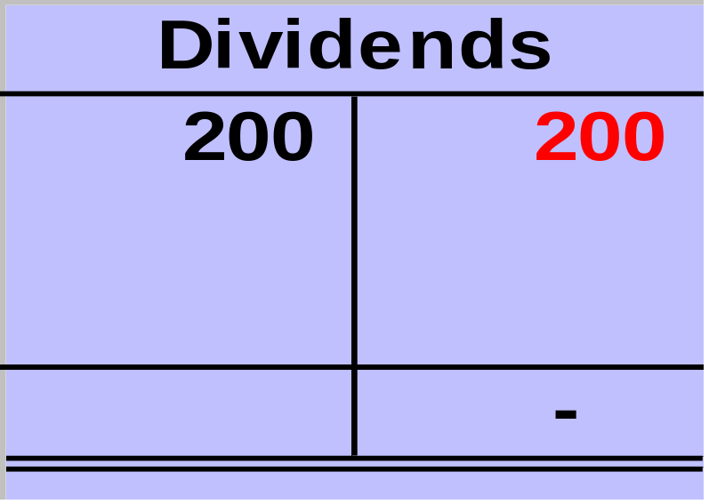
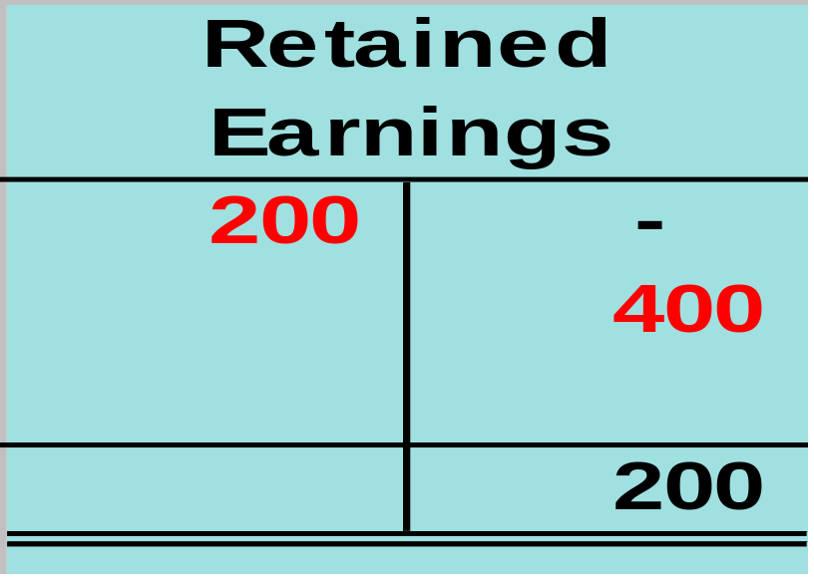
Closing the Dividends Account

Slide 18
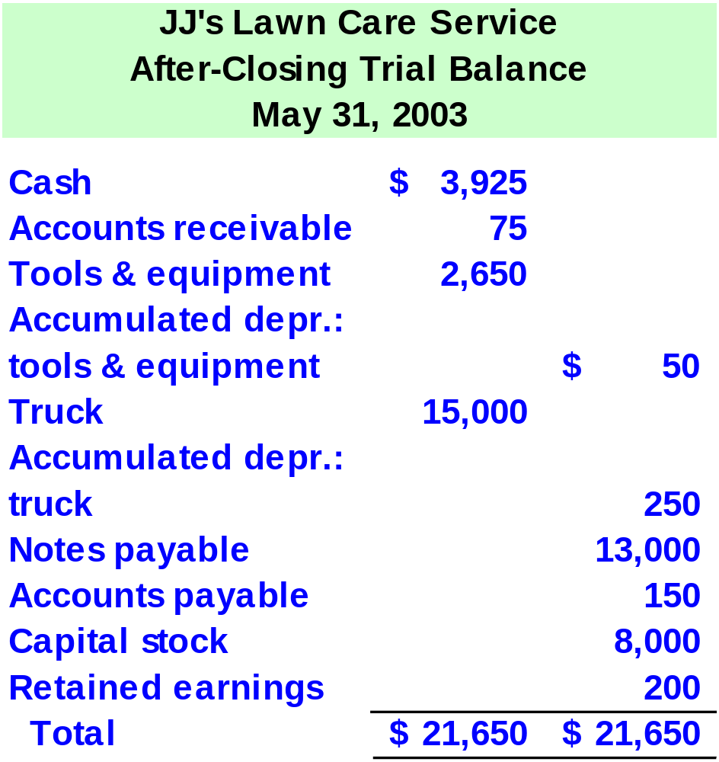
After all closing entries are made, JJ’s After-Closing Trial Balance looks like this.
Notes:
4

Slide 19
Evaluating the Business
Evaluating Profitability
Evaluating Solvency
Did the business earn a profit or loss in the current period?
What is the business’s future potential for a profit?
Does the business have assets available to pay debts as they are due?

Slide 20
Evaluating the Business
Are product lines profitable?
Are resources being used efficiently?
Are production processes efficient?
Focusing Management’s Attention

Slide 21
Preparing Financial Statements Covering Different Periods of Time
Many companies prepare financial statements at various points throughout the year.
Annually
Quarterly
Interim Financial Statements
Monthly
Jan. 1
Dec. 31
Notes:
3

Slide 22

End of Chapter 5
Notes:
4

