Slide 1

Chapter
6
ACCOUNTING FOR MERCHANDISING ACTIVITIES
Notes:
2

Slide 2
Operating Cycle of a Merchandising Company
Cash
1. Purchase of merchandise
3. Collection of the receivables
Accounts Receivable
Inventory
2. Sale of merchandise on account

Slide 3


Comparing Merchandising Activities with Manufacturing Activities
Manufacture inventory and have a longer and more complex operating cycle
Purchase inventory in ready-to-sell condition.
Merchandising Company
Manufacturing Company

Slide 4


Retailers and Wholesalers
Wholesalers buy merchandise from several different manufacturers and then sell this merchandise to several retailers.
Retailers sell merchandise directly to the public.
Notes:
4

Slide 5
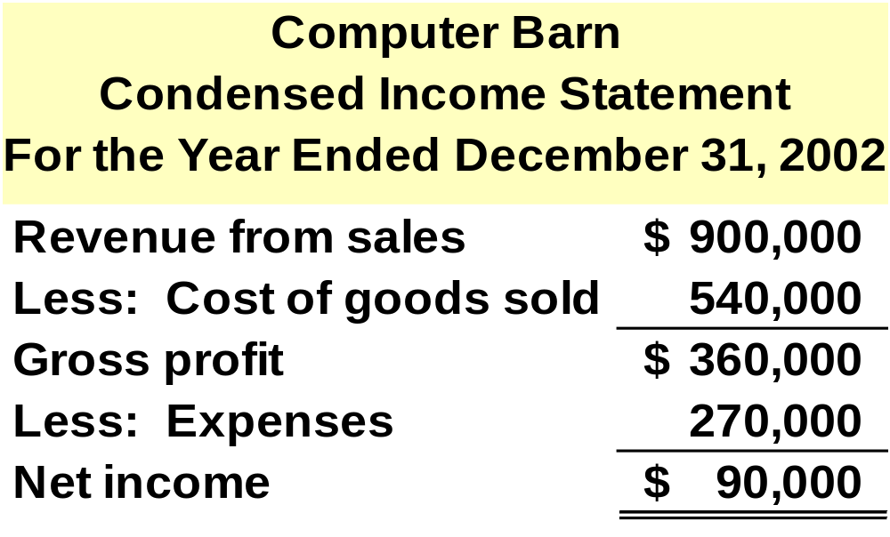
Income Statement of a Merchandising Company
Cost of goods sold represents the expense of goods that are sold to customers.
Gross profit is a useful means of measuring the profitability of sales transactions.
Notes:
4

Slide 6
What Accounting Information Does a Merchandising Company Need?
Examples
Revenues
Expenses
Customer Ledgers
Tax Reports
Financial Reporting Requirements
Daily Business Operating Requirements
Special Reporting Requirements
Notes:
4

Slide 7
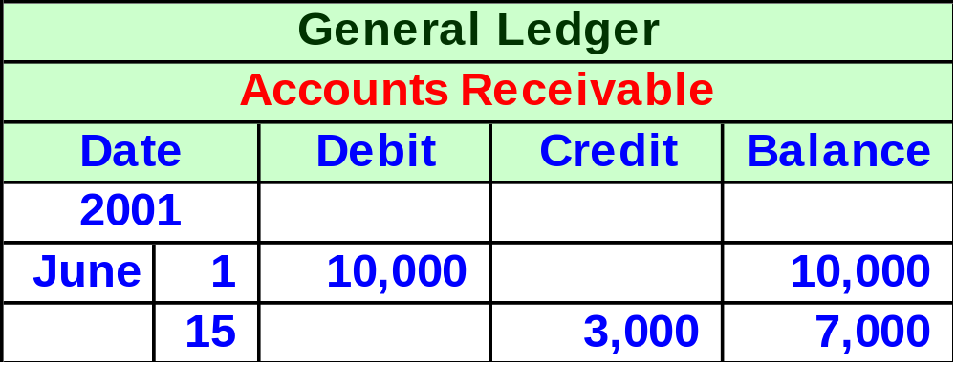
General Ledger Accounts
Although general ledger accounts provide useful information, they do not provide much of the detailed information needed in the daily business operations.
Who owes us money?
Notes:
4

Slide 8

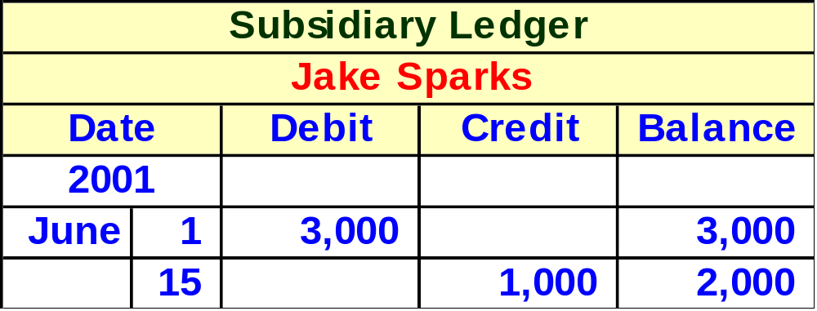
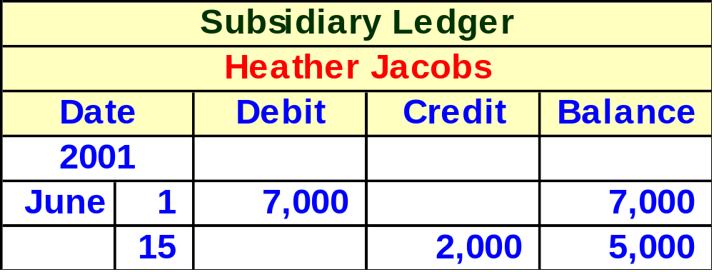
Subsidiary Ledgers: A Source of Needed Details
Controlling Account
Notes:
4

Slide 9
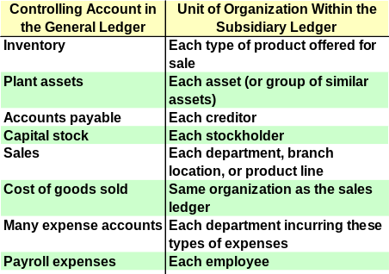
Notes:
4

Slide 10
Two Approaches Used in Accounting for Merchandise Transactions
Perpetual Inventory System
Periodic Inventory System
Notes:
4

Slide 11
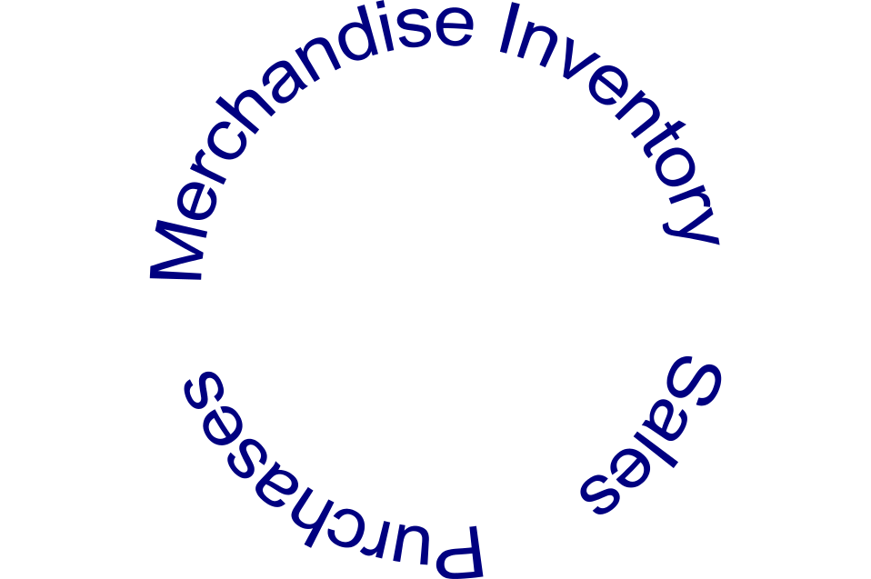

Perpetual Inventory System
The inventory account is continuously updated to reflect items on hand.
Let’s look at some entries!
Notes:
4

Slide 12
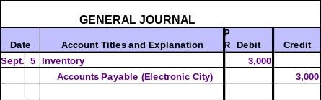
Perpetual Inventory System
On September 5, Worley Co. purchased 100 laser lights for resale for $30 per unit from Electronic City on account .

Slide 13
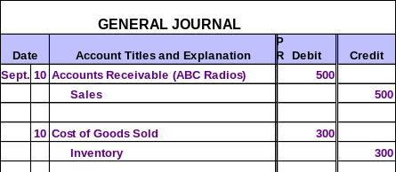
Perpetual Inventory System
On September 10, Worley Co. sold 10 laser lights for $50 per unit on account to ABC Radios.
10 × $30 = $300

Slide 14
Perpetual Inventory System
On September 10, Worley Co. sold 10 laser lights for $50 per unit on account to ABC Radios.
Retail
Cost

Slide 15
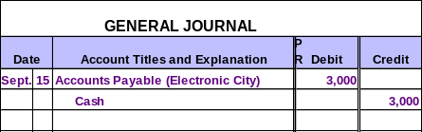
Perpetual Inventory System
On September 15, Worley Co. paid Electronic City $3,000 for the September 5 purchase.

Slide 16
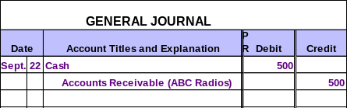
Perpetual Inventory System
On September 22, Worley Co. received $500 from ABC Radios as payment in full for their purchase on September 10.

Slide 17
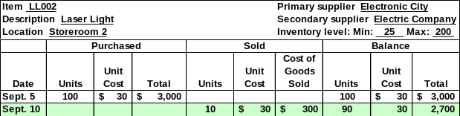
The Inventory Subsidiary Ledger
At the end of the period, management compares the physical inventory count with the inventory ledger to determine inventory shrinkage.
Notes:
4

Slide 18

Taking a Physical Inventory
In order to ensure the accuracy of their perpetual records, most businesses take a complete physical count of the merchandise on hand at least once a year.
Notes:
4

Slide 19
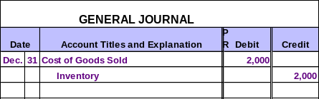
Taking a Physical Inventory
Reasonable amounts of inventory shrinkage are viewed as a normal cost of doing business. Examples include breakage, spoilage and theft.
On December 31, Worley Co. counts its inventory. An inventory shortage of $2,000 is discovered.
Notes:
4

Slide 20

Closing Entries in a Perpetual Inventory System
Close Revenue accounts (including Sales) to Income Summary.
Close Expense accounts (including Cost of Goods Sold) to Income Summary.
Close Income Summary account to Retained Earnings.
Close Dividends to Retained Earnings.
The closing entries are the same!
Notes:
4

Slide 21

Next is the periodic inventory system!
Notes:
4

Slide 22

Periodic Inventory System
No effort is made to keep up-to-date records of either inventory or cost of goods sold.
Let’s look at some entries!
Notes:
4

Slide 23

Periodic Inventory System
On September 5, Worley Co. purchased 100 laser lights for resale for $30 per unit from Electronic City on account .
Notice that no entry is made to Inventory.

Slide 24
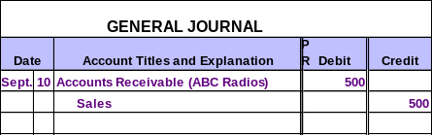
Periodic Inventory System
On September 10, Worley Co. sold 10 laser lights for $50 per unit on account to ABC Radios.
Retail

Slide 25
Periodic Inventory System
On September 15, Worley Co. paid Electronic City $3,000 for the September 5 purchase.

Slide 26
Periodic Inventory System
On September 22, Worley Co. received $500 from ABC Radios as payment in full for their purchase on September 10.

Slide 27

Computing Cost of Goods Sold in a Periodic Inventory System
The accounting records of Party Supply show the following:
Inventory, Jan. 1, 2003 $ 14,000
Purchases (during 2003) 130,000
At December 31, 2003, Party Supply counted the merchandise on hand at $12,000.
Calculate Party Supply’s cost of goods sold for 2003.
Notes:
4

Slide 28
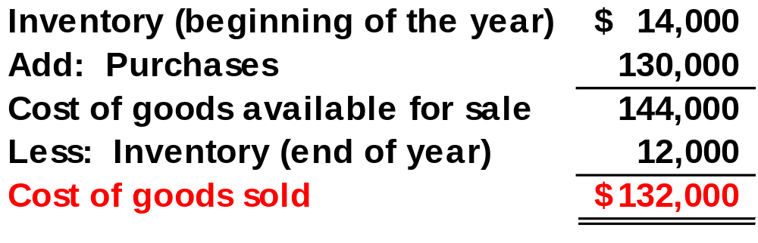
Computing Cost of Goods Sold in a Periodic Inventory System
Cost of Goods Sold can be calculated as follows:
Notes:
4

Slide 29

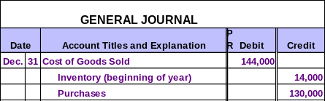
Creating Cost of Goods Sold in a Periodic Inventory System
Now, Party Supply must create the Cost of Goods Sold account.
Notes:
4

Slide 30

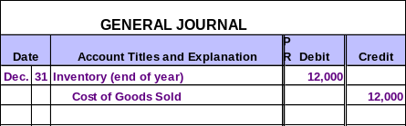
Creating Cost of Goods Sold in a Periodic Inventory System
Now, Party Supply must record the ending inventory amount.
Notes:
4

Slide 31
Completing the Closing Process
Close Revenue accounts (including Sales) to Income Summary.
Close Expense accounts (including Cost of Goods Sold) to Income Summary.
Close Income Summary account to Retained Earnings.
Close Dividends to Retained Earnings.
The closing entries are the same!
Notes:
4

Slide 32
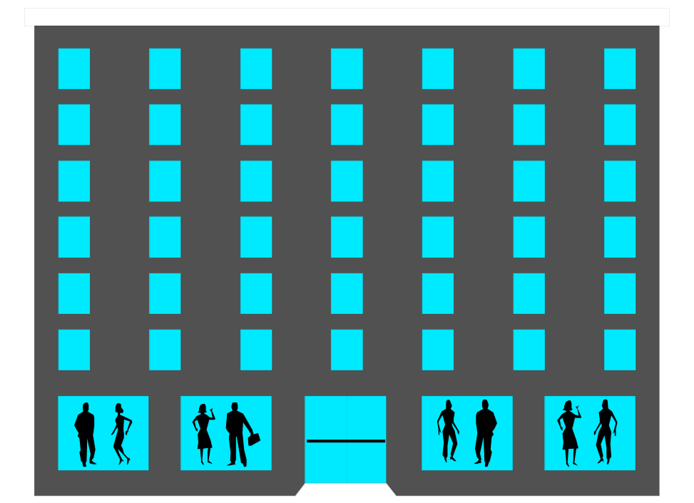

Comparison of Perpetual and Periodic Inventory Systems
Perpetual Inventory System
Periodic Inventory System
Large Department Stores
Jo’s Dress Shop
Notes:
4

Slide 33

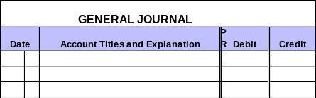
Modifying an Accounting System
Most businesses use special journals rather than a general journal to record routine transactions that occur frequently.
Notes:
4

Slide 34
Credit Terms and Cash Discounts
When manufacturers and wholesalers sell their products on account, the credit terms are stated in the invoice.
2/10, n/30
Read as: “Two ten, net thirty”
Notes:
4

Slide 35
Credit Terms and Cash Discounts
2/10, n/30
Percentage of Discount
# of Days Discount Is Available
Otherwise, the Full Amount Is Due
# of Days when Full Amount Is Due
Notes:
22
22

Slide 36
Credit Terms and Cash Discounts
Purchases are recorded at their net amounts.
Net Method
Purchase discounts lost are recorded when payment is made outside the discount period.
Notes:
23
23

Slide 37
Credit Terms and Cash Discounts
On July 6, Play Clothes purchased $4,000 of merchandise on credit with terms of
2/10, n/30 from Kid’s Clothes.
Prepare the journal entry for Play Clothes.
Notes:
24
24

Slide 38
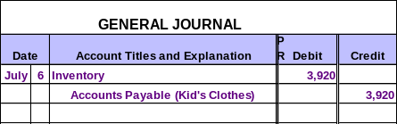
Credit Terms and Cash Discounts
On July 6, Play Clothes purchased $4,000 of merchandise on credit with terms of
2/10, n/30 from Kid’s Clothes.
Prepare the journal entry for Play Clothes.
$4,000 × 98% = $3,920
Notes:
24
24

Slide 39
Credit Terms and Cash Discounts
On July 15, Play Clothes pays the full amount due to Kid’s Clothes.
Prepare the journal entry for Play Clothes.
Notes:
24
24

Slide 40

Credit Terms and Cash Discounts
On July 15, Play Clothes pays the full amount due to Kid’s Clothes.
Prepare the journal entry for Play Clothes.
Notes:
24
24

Slide 41
Credit Terms and Cash Discounts
Now, assume that Play Clothes waited until July 20 to pay the amount due in full to Kid’s Clothes.
Prepare the journal entry for Play Clothes.
Notes:
24
24

Slide 42
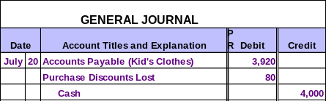
Credit Terms and Cash Discounts
Now, assume that Play Clothes waited until July 20 to pay the amount due in full to Kid’s Clothes.
Prepare the journal entry for Play Clothes.
Nonoperating Expense
Notes:
24
24

Slide 43
Recording Purchases at Gross Invoice Price
Purchases are recorded at their gross amounts.
Gross Method
Purchase discounts taken are recorded when payment is made inside the discount period.
Notes:
23
23

Slide 44
Recording Purchases at Gross Invoice Price
On July 6, Play Clothes purchased $4,000 of merchandise on credit with terms of
2/10, n/30 from Kid’s Clothes.
Prepare the journal entry for Play Clothes.
Notes:
24
24

Slide 45

Recording Purchases at Gross Invoice Price
On July 6, Play Clothes purchased $4,000 of merchandise on credit with terms of
2/10, n/30 from Kid’s Clothes.
Prepare the journal entry for Play Clothes.
Notes:
24
24

Slide 46
Recording Purchases at Gross Invoice Price
On July 15, Play Clothes pays the full amount due to Kid’s Clothes.
Prepare the journal entry for Play Clothes.
Notes:
24
24

Slide 47
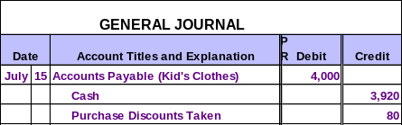
Recording Purchases at Gross Invoice Price
On July 15, Play Clothes pays the full amount due to Kid’s Clothes.
Prepare the journal entry for Play Clothes.
Reduces Cost of Goods Sold
$4,000 × 98% = $3,920
Notes:
24
24

Slide 48
Recording Purchases at Gross Invoice Price
Now, assume that Play Clothes waited until July 20 to pay the full amount due to Kid’s Clothes.
Prepare the journal entry for Play Clothes.
Notes:
24
24

Slide 49

Recording Purchases at Gross Invoice Price
Now, assume that Play Clothes waited until July 20 to pay the full amount due to Kid’s Clothes.
Prepare the journal entry for Play Clothes.
Notes:
24
24

Slide 50
Returns of Unsatisfactory Merchandise
On August 5, Play Clothes returned $500 of unsatisfactory merchandise purchased from Kid’s Clothes on credit terms of 2/10, n/30. The purchase was originally recorded at net cost.
Prepare the journal entry for Play Clothes.
Notes:
24
24

Slide 51
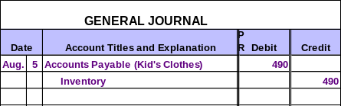
Returns of Unsatisfactory Merchandise
On August 5, Play Clothes returned $500 of unsatisfactory merchandise purchased from Kid’s Clothes on credit terms of 2/10, n/30. The purchase was originally recorded at net cost.
Prepare the journal entry for Play Clothes.
$500 × 98% = $490
Notes:
24
24

Slide 52

Transportation Costs on Purchases
Transportation costs related to the acquisition of assets are part of the cost of the asset being acquired.
Notes:
24
24

Slide 53
Now, let’s talk about sales!
Notes:
24
24

Slide 54
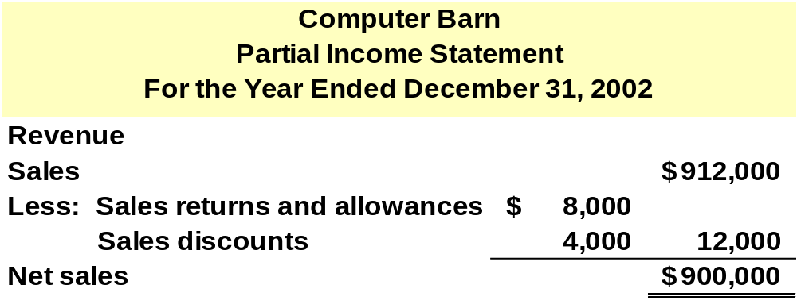
Transactions Relating to Sales
Credit terms and merchandise returns affect the amount of revenue earned by the seller.
Notes:
24
24

Slide 55

Sales Returns and Allowances
On August 2, Kid’s Clothes sold $2,000 of merchandise to Play Clothes on credit terms 2/10, n/30. Kid’s Clothes originally paid $1,000 for the merchandise.
Because Kid’s Clothes uses a perpetual inventory system, they must make two entries.
Notes:
24
24

Slide 56

Sales Returns and Allowances
On August 2, Kid’s Clothes sold $2,000 of merchandise to Play Clothes on credit terms 2/10, n/30. Kid’s Clothes originally paid $1,000 for the merchandise.
Because Kid’s Clothes uses a perpetual inventory system, they must make two entries.
Notes:
24
24

Slide 57
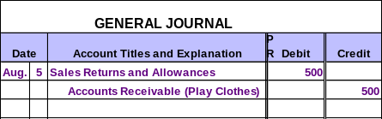
Sales Returns and Allowances
On August 5, Play Clothes returned $500 of unsatisfactory merchandise to Kid’s Clothes from the August 2 sale. Kid’s Clothes cost for this merchandise was $250.
Because Kid’s Clothes uses a perpetual inventory system, they must make two entries.
Contra-revenue
Notes:
24
24

Slide 58
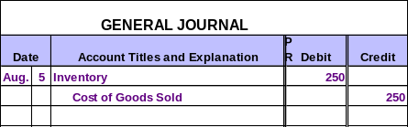
Sales Returns and Allowances
On August 5, Play Clothes returned $500 of unsatisfactory merchandise to Kid’s Clothes from the August 2 sale. Kid’s Clothes cost for this merchandise was $250.
Because Kid’s Clothes uses a perpetual inventory system, they must make two entries.
Notes:
24
24

Slide 59

Sales Discounts
On July 6, Kid’s Clothes sold $4,000 of merchandise to Play Clothes on credit with terms of 2/10, n/30. The merchandise originally cost Kid’s Clothes $2,000.
Because Kid’s Clothes uses a perpetual inventory system, they must make two entries.
Notes:
24
24

Slide 60

Sales Discounts
On July 6, Kid’s Clothes sold $4,000 of merchandise to Play Clothes on credit with terms of 2/10, n/30. The merchandise originally cost Kid’s Clothes $2,000.
Because Kid’s Clothes uses a perpetual inventory system, they must make two entries.
Notes:
24
24

Slide 61
Sales Discounts
On July 15, Kid’s Clothes receives the full amount due from Play Clothes.
Prepare the journal entry for Kid’s Clothes.
Notes:
24
24

Slide 62
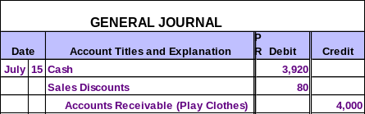
Sales Discounts
On July 15, Kid’s Clothes receives the full amount due from Play Clothes.
Prepare the journal entry for Kid’s Clothes.
Contra-revenue
$4,000 × 98% = $3,920
Notes:
24
24

Slide 63
Sales Discounts
Now, assume that it wasn’t until July 20 that Kid’s Clothes received the full amount due from Play Clothes.
Prepare the journal entry for Kid’s Clothes.
Notes:
24
24

Slide 64
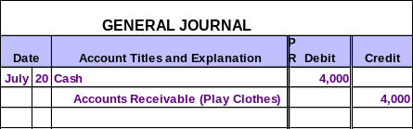
Sales Discounts
Now, assume that it wasn’t until July 20 that Kid’s Clothes received the full amount due from Play Clothes.
Prepare the journal entry for Kid’s Clothes.
Notes:
24
24

Slide 65

Delivery Expenses
Delivery costs incurred by sellers are debited to Delivery Expense, an operating expense.
Notes:
24
24

Slide 66
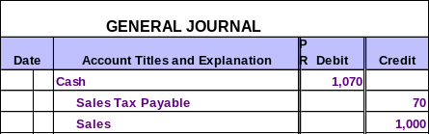
Accounting for Sales Taxes
Businesses collect sales tax at the point of sale.
Then, they remit the tax to the appropriate governmental agency at times specified by law.
$1,000 sale × 7% tax = $70 sales tax
Notes:
24
24

Slide 67
Evaluating the Performance of a Merchandising Company
Net Sales
Gross Profit Margins
Trends overtime
Comparable store sales
Sales per square foot of selling space
Gross Profit ÷ Net Sales
Overall Gross Profit Margin
Gross Profit Margins by Department and Products

Slide 68

End of Chapter 6
Notes:
4

