Slide 1

Chapter
7
FINANCIAL ASSETS
Notes:
2

Slide 2

How Much Cash Should a Business Have?
Every business needs enough cash to pay its bills!
$

Slide 3
How Much Cash Should a Business Have?
Financial Assets
Cash
Receivables
Short-term Investments

Slide 4
How Much Cash Should a Business Have?
Collections from customers
Cash (and cash equivalents)
Cash payments
Accounts
receivable
“Excess” cash is invested temporarily.
Investments are sold as cash is needed.
Marketable securities
(short-term investments)

Slide 5
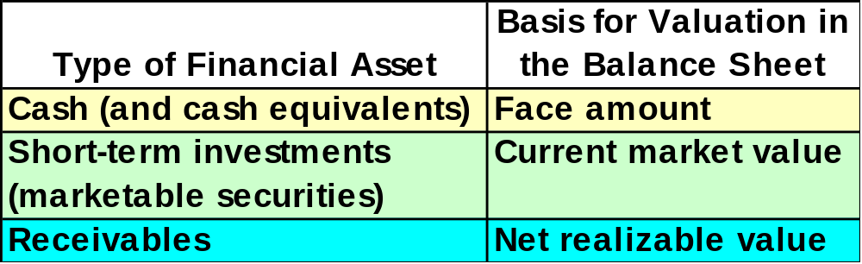
The Valuation of Financial Assets
Estimated collectible amount
Notes:
4

Slide 6
Cash
Coins and paper money
Checks
Cash is defined as any deposit banks will accept.
Bank credit card sales
Money orders
Travelers’ checks
Notes:
4

Slide 7
Reporting Cash in the Balance Sheet
Combined with cash on balance sheet
Liquid short-term investments
Matures within 90 days of acquisition
Cash Equivalents
Stable market values
Notes:
4

Slide 8
Reporting Cash in the Balance Sheet
Not available for paying current liabilities
“Restricted” Cash
Not a current asset
Listed as an investment
Notes:
4

Slide 9
Reporting Cash in the Balance Sheet
Bank agrees in advance to lend money.
Lines of Credit
Liability is incurred when line of credit is used.
Unused line of credit is disclosed in notes.
Notes:
4

Slide 10

The Statement of Cash Flows
Statement of Cash Flows
Summarizes cash transactions for an accounting period.
Includes cash and cash equivalents.
Notes:
4

Slide 11

Cash Management
Accurately account for cash.
Prevent theft and fraud.
Assure the availability of adequate amounts of cash.
Avoid unnecessarily large amounts of idle cash.
Notes:
4

Slide 12


Using Excess Cash Balances Efficiently
Cash available for long-term investment may be used to finance growth and expansion of the business, or to repay debt.
Cash not needed for business purposes should be distributed to the company’s stockholders.
Notes:
4

Slide 13

Internal Control Over Cash
Segregate authorization, custody and recording of cash.
Prepare a cash budget.
Prepare a control listing of cash receipts.
Require daily deposits.
Make all payments by check.
Verify every expenditure before payment.
Promptly reconcile bank statements.

Slide 14
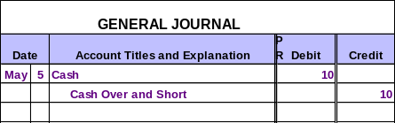
Cash Over and Short
On May 5, XBAR, Inc.’s cash drawer was counted and found to be $10 over.
Cash Over and Short is debited for shortages and credited for overages.
Notes:
4

Slide 15

Bank Statements
Shows the beginning bank balance, deposits made, checks paid, other debits and credits in the month, and the ending bank balance.
Bank Statement
Notes:
90
90
9
9

Slide 16
Reconciling the Bank Statement
Explains the difference between cash reported on bank statement and cash balance in depositor’s accounting records.
Provides information for reconciling journal entries.
Notes:
90
90
9
9

Slide 17
Reconciling the Bank Statement
Balance per Bank
Balance per Depositor
+ Deposits by Bank
(credit memos)
+ Deposits in Transit
- Service Charge
- NSF Checks
- Outstanding Checks
± Bank Errors
± Book Errors
= Adjusted Balance
= Adjusted Balance
Notes:
91
91
10
10

Slide 18
Reconciling the Bank Statement
All reconciling items on the book side require an adjusting entry to the cash account.
Balance per Depositor
+ Deposits by Bank
(credit memos)
- Service Charge
- NSF Checks
± Book Errors
= Adjusted Balance
Notes:
91
91
10
10

Slide 19
Reconciling the Bank Statement
Example
Prepare a July 31 bank reconciliation statement and the resulting journal entries for the Simmons Company. The July 31 bank statement indicated a cash balance of $9,610, while the cash ledger account on that date shows a balance of $7,430.
Additional information necessary for the reconciliation is shown on the next page.
Notes:
95
95
14
14

Slide 20
Outstanding checks totaled $2,417.
A $500 check mailed to the bank for deposit had not reached the bank at the statement date.
The bank returned a customer’s NSF check for $225 received as payment of an account receivable.
The bank statement showed $30 interest earned on the bank balance for the month of July.
Check 781 for supplies cleared the bank for $268 but was erroneously recorded in our books as $240.
A $486 deposit by Acme Company was erroneously credited to our account by the bank.
Notes:
96
96
15
15

Slide 21
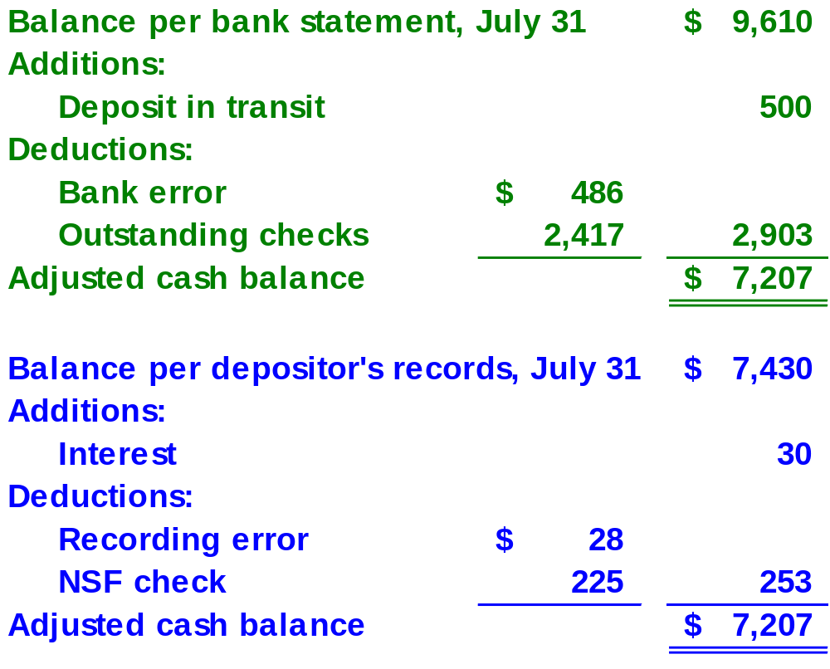
Reconciling the Bank Statement
Example
Reconciling the Bank Statement
Example
Notes:
98
98
17
17

Slide 22
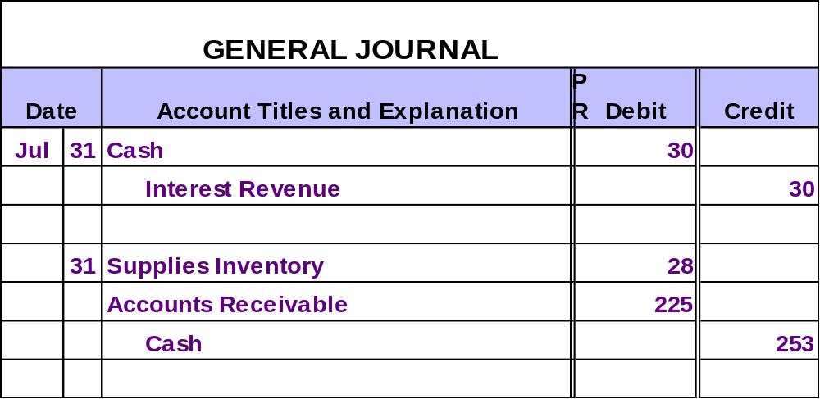
Reconciling the Bank Statement
Example
Notes:
99
99
18
18

Slide 23
Petty Cash Funds
Used for minor expenditures.
Petty Cash Funds
Has one custodian.
Replenished periodically.
Notes:
4

Slide 24
Short-Term Investments
Bond Investments
Capital Stock Investments
Marketable Securities are . . .
Readily Marketable
Current Assets
Almost As Liquid As Cash
Notes:
4

Slide 25
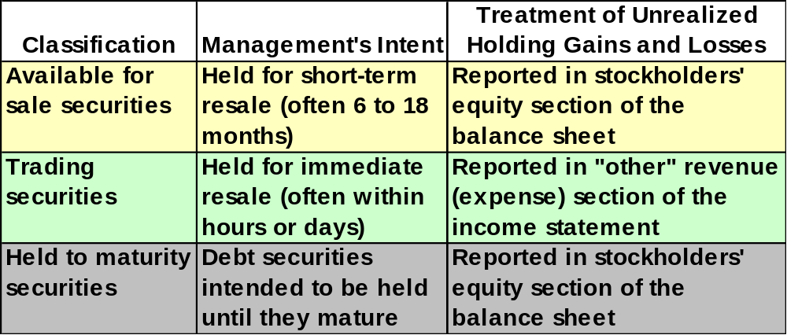
Mark-to-Market: A New Principle of Asset Valuation
Short-term investments in marketable securities appear on the balance sheet at their current market value as of the balance sheet date.
Notes:
4

Slide 26

Let’s turn our attention to accounts receivable.

Slide 27

Uncollectible Accounts
If a company makes credit sales to customers, some accounts inevitably will turn out to be uncollectible.
PAST DUE

Slide 28

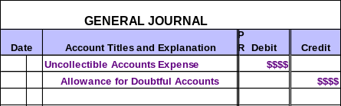
Reflecting Uncollectible Accounts in the Financial Statements
At the end of each period, record an estimate of the uncollectible accounts.
Selling expense
Contra-asset account

Slide 29
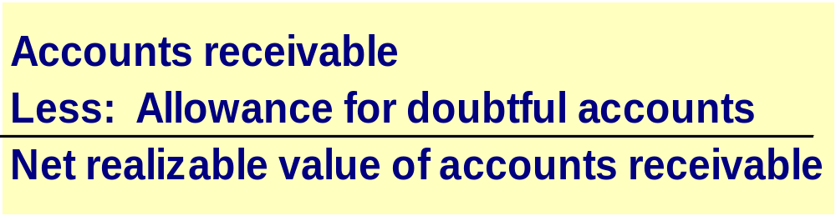
The Allowance for Doubtful Accounts
The net realizable value is the amount of accounts receivable that the business expects to collect.
Notes:
49
49

Slide 30
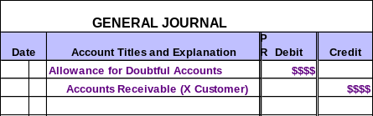
Writing Off an Uncollectible Account Receivable
When an account is determined to be uncollectible, it no longer qualifies as an asset and should be written off.

Slide 31
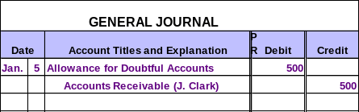
Writing Off an Uncollectible Account Receivable
Assume that on January 5, K-Max determined that Jason Clark would not pay the $500 he owes.
K-Max would make the following entry.
Notes:
51
51

Slide 32

Writing Off an Uncollectible Account Receivable
Assume that before this entry, the Accounts Receivable balance was $10,000 and the Allowance for Doubtful Accounts balance was $2,500.
Let’s see what effect the write-off had on these accounts.
Notes:
53
53

Slide 33
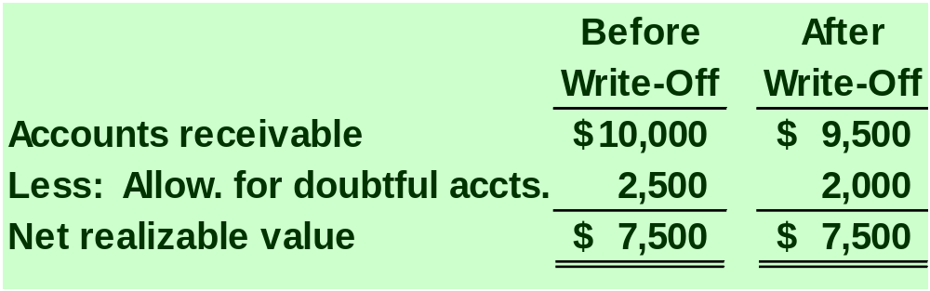
Writing Off an Uncollectible Account Receivable
Notice that the $500 write-off did not change the net realizable value nor did it affect any income statement accounts.
Notes:
54
54

Slide 34
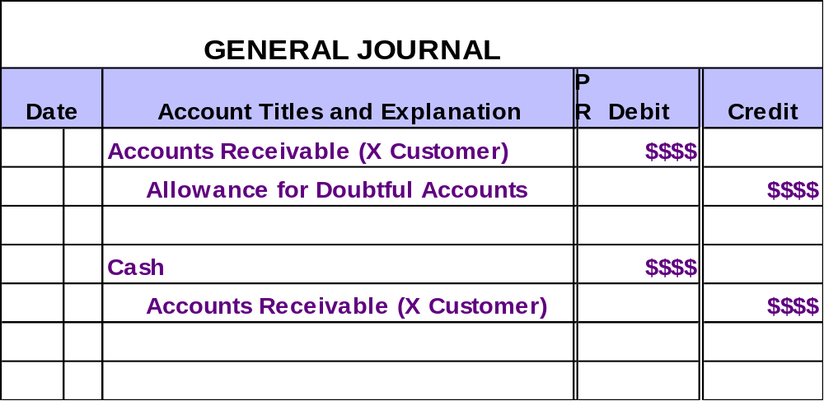
Recovery of an Account Receivable Previously Written Off
Subsequent collections require that the original write-off entry be reversed before the cash collection is recorded.

Slide 35

Monthly Estimates of Credit Losses
At the end of each month, management should estimate the probable amount of uncollectible accounts and adjust the Allowance for Doubtful Accounts to this new estimate.

Slide 36

Monthly Estimates of Credit Losses Example
At December 31, 2003, MusicLand’s accounting records indicate the following:
Accounts Receivable = $50,000
Allowance for Doubtful Accounts = $200 (credit)
Past experience suggests that 5% of receivables are uncollectible.
What is MusicLand’s Uncollectible Accounts Expense for 2003?

Slide 37
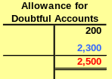


Monthly Estimates of Credit Losses Example
Desired balance in Allowance for Doubtful Accounts.

Slide 38

Let’s look at another way to estimate the uncollectible accounts!

Slide 39

Estimating Credit Losses — The “Balance Sheet” Approach
Year-end Accounts Receivable is broken down into age classifications.
Each age grouping has a different likelihood of being uncollectible.
Compute a separate allowance for each age grouping.

Slide 40
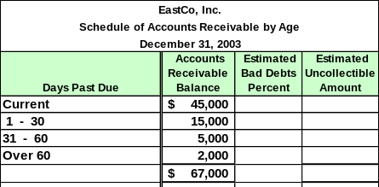
Estimating Credit Losses — The “Balance Sheet” Approach
At December 31, 2003, the receivables for EastCo, Inc. were categorized as follows:

Slide 41
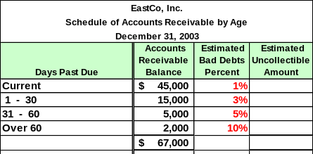
Estimating Credit Losses — The “Balance Sheet” Approach
At December 31, 2003, the receivables for EastCo, Inc. were categorized as follows:

Slide 42
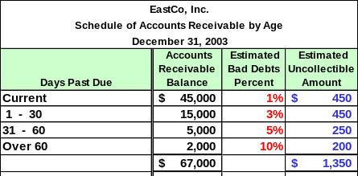
Estimating Credit Losses — The “Balance Sheet” Approach
At December 31, 2003, the receivables for EastCo, Inc. were categorized as follows:

Slide 43
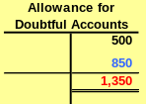
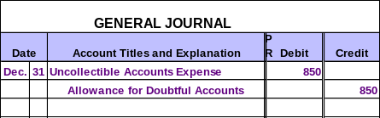
Estimating Credit Losses — The “Balance Sheet” Approach
EastCo’s unadjusted balance in the allowance account is $500.
Per the previous computation, the desired balance is $1,350.

Slide 44
Guess What! There is another alternative to estimate the uncollectible accounts!

Slide 45

An Alternative Approach to Estimating Credit Losses
Uncollectible accounts’ percentage is based on actual uncollectible accounts from prior years’ credit sales.
Focus is on determining the amount to record on the income statement as Uncollectible Accounts Expense.
Notes:
62
62

Slide 46
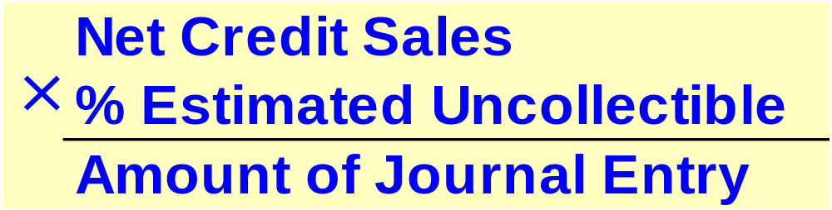
An Alternative Approach to Estimating Credit Losses
Notes:
62
62

Slide 47
An Alternative Approach to Estimating Credit Losses
In 2003, EastCo had credit sales of $60,000.
Historically, 1% of EastCo’s accounts have been uncollectible.
For 2003, the estimate of uncollectible accounts expense is $600.
($60,000 × .01 = $600)
Now, prepare the adjusting entry for December 31, 2003.
Notes:
66
66

Slide 48


An Alternative Approach to Estimating Credit Losses
Notes:
67
67

Slide 49
Uncollectible Accounts
Summary
% of Receivables
Aging of Receivables
% of Sales
Emphasis on Realizable Value
Emphasis on Realizable Value
Emphasis on Matching
Accts. Rec.
Accts. Rec.
Sales
All. for Doubtful Accts.
All. for Doubtful Accts.
Uncoll. Accts. Exp.
Balance Sheet Focus
Balance Sheet Focus
Income Statement Focus

Slide 50

Direct Write-Off Method
This method makes no attempt to match revenue with the expense of uncollectible accounts.

Slide 51

Income Tax Regulations and Financial Reporting
Direct write-off method required to calculate taxable income.
Taxable Income
Allowance methods better match expenses with revenues.
GAAP
GAAP
GAAP
GAAP
Financial Statement Income

Slide 52
Internal Controls for Receivable
Separate the following duties:
Maintenance of the accounts receivable subsidiary ledger.
Custody of cash receipts.
Authorization of accounts receivable write-offs.

Slide 53
Management of Accounts Receivable
Credit Terms
Extending credit encourages customers to buy from us . . .
Minimize Accounts Receivable
. . . but it ties up resources in accounts receivable.

Slide 54
Ways to Minimize Amounts in Accounts Receivable
Selling Accounts Receivable
Credit Card Sales

Slide 55

Evaluating the Quality of Accounts Receivable
Accounts Receivable Turnover Ratio
This ratio provides useful information for evaluating how efficient management has been in granting credit to produce revenue.
Net Sales
Average Accounts Receivable

Slide 56
Evaluating the Quality of Accounts Receivable
Avg. Number of Days to Collect A/R
This ratio helps judge the liquidity of a company’s accounts receivable.
Days in Year
Accounts Receivable Turnover Ratio

Slide 57

End of Chapter 7
Notes:
4

