Slide 1

Chapter
8
INVENTORIES AND THE
COST OF GOODS SOLD
Notes:
2

Slide 2

Inventory Defined
Inventory
Goods owned
and held for sale
to customers
Current
asset

Slide 3
The Flow of Inventory Costs
BALANCE SHEET
Current assets:
As purchase costs (or manufacturing costs) are incurred
Inventory
$
$
as goods are sold
INCOME STATEMENT
Revenue
$
Cost of goods sold
Gross profit
Expenses
Net income

Slide 4
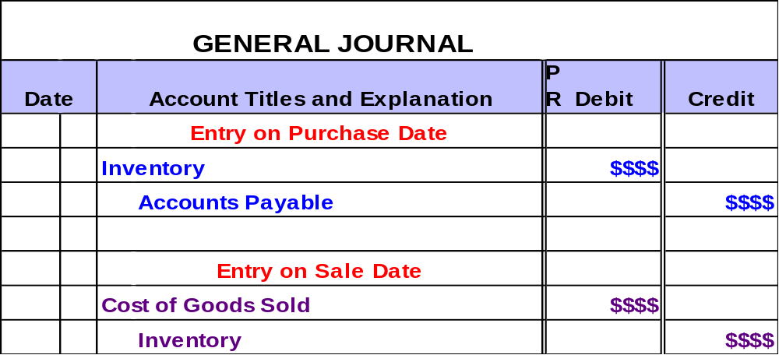
The Flow of Inventory Costs
In a perpetual inventory system, inventory entries parallel the flow of costs.

Slide 5
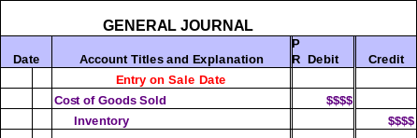
Which Unit Did We Sell?
When identical units of inventory have different unit costs, a question naturally arises as to which of these costs should be used in recording a sale of inventory.
Notes:
4

Slide 6
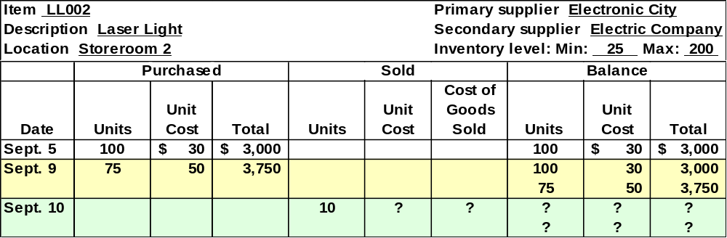
Inventory Subsidiary Ledger
A separate subsidiary account is maintained for each item in inventory.
How can we determine the unit cost for the Sept. 10 sale?

Slide 7
Inventory Cost Flows
We use one of these inventory valuation methods to determine cost of inventory sold.
Specific identification
Average cost
FIFO
LIFO
Notes:
4

Slide 8
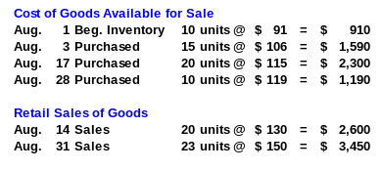

Information for the Following Inventory Examples
The Bike Company (TBC)

Slide 9
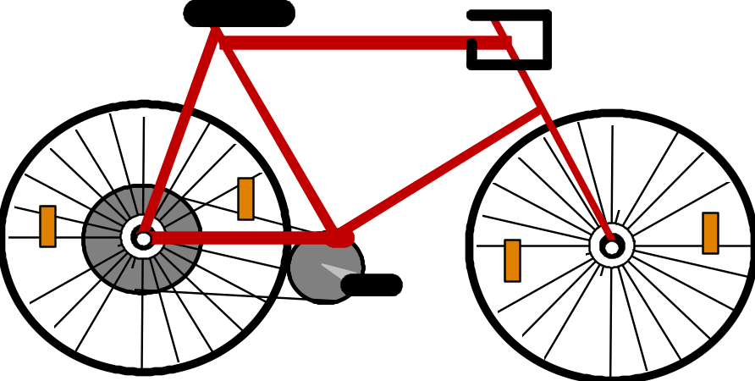
Specific Identification
When a unit
is sold, the specific cost of the unit sold is added to cost of goods sold.

Slide 10


Specific Identification – Example
On August 14, TBC sold 20 bikes for $130 each.
Nine bikes originally cost $91 and 11 bikes originally cost $106.
Continue

Slide 11
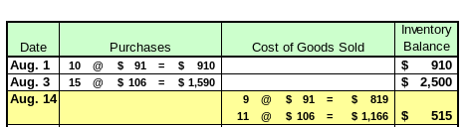
Specific Identification – Example
The Cost of Goods Sold for the August 14 sale is $1,985, leaving $515 and 5 units in inventory.
Let’s look at the entries for the Aug. 14 sale.
Continue

Slide 12
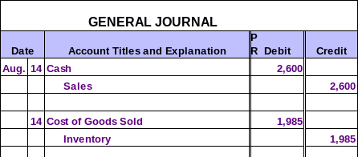
Specific Identification – Example
Retail
Cost
A similar entry is
made after each sale.
Continue

Slide 13
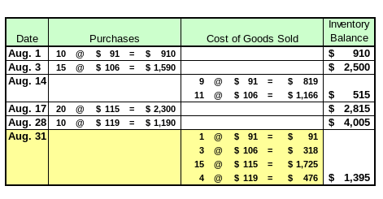
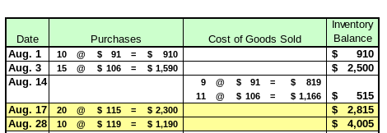
Specific Identification – Example
Cost of Goods Sold for August 31 = $2,610
Additional purchases were made on August 17 and 28.
Costs associated with sales on August 31 were as follows: 1 @ $91, 3 @ $106, 15 @ $115, & 4 @ $119.
Continue

Slide 14
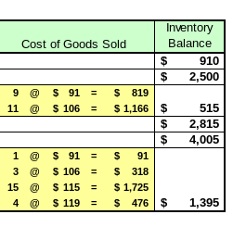


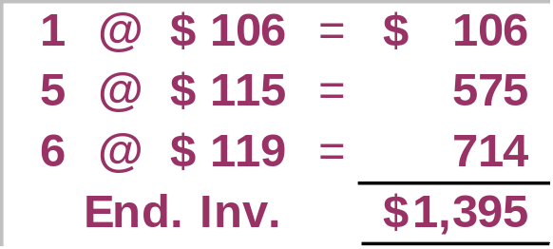
Specific Identification – Example
Income Statement
COGS = $4,595
Balance Sheet
Inventory = $1,395

Slide 15

Not really. Specific identification is hard to use when we sell a lot of inventory that has lots of different costs.
Since specific identification is so easy, can’t we use it all the time?

Slide 16

Average-Cost Method
When a unit is sold,
the average cost of each unit in inventory is assigned to cost
of goods sold.
Cost of Goods Available for Sale
Units on hand on the date of sale
÷

Slide 17

Average-Cost Method – Example
The average cost per unit must be computed prior to each sale.
$100 = $2,500 ÷ 25
On August 14, TBC sold 20 bikes for $130 each.
Continue

Slide 18
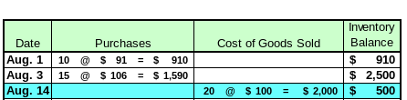
Average-Cost Method – Example
The average cost per unit is $100.
$100 = $2,500 ÷ 25
Let’s look at the entries for the Aug. 14 sale.
Continue

Slide 19

Average-Cost Method – Example
Retail
Cost
A similar entry is
made after each sale.
Continue

Slide 20
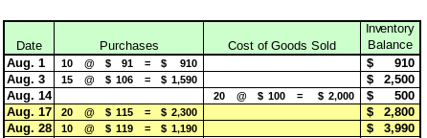
Average-Cost Method – Example
Additional purchases were made on August 17 and August 28.
On August 31, an additional 23 units were sold.
Continue

Slide 21
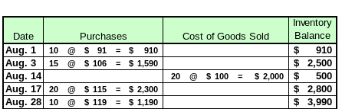
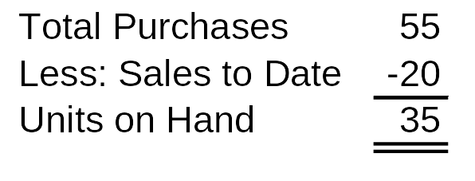
Average-Cost Method – Example
$114 = $3,990 ÷ 35

Slide 22
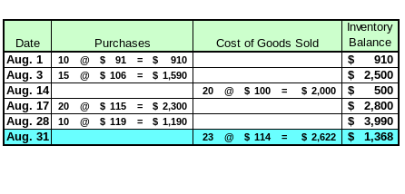
Average-Cost Method – Example
The average cost per unit is $114.
$114 = $3,990 ÷ 35

Slide 23
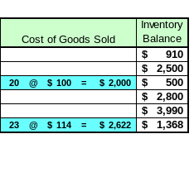
Average-Cost Method – Example
Income Statement
COGS = $4,622
Balance Sheet
Inventory = $1,368
$114 × 12 = $1,368

Slide 24

First-In, First-Out Method (FIFO)
Oldest Costs
Costs of Goods Sold
Recent Costs
Ending Inventory

Slide 25

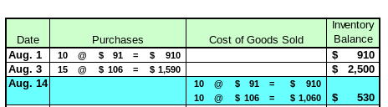
FIFO – Example
The Cost of Goods Sold for the August 14 sale is $1,970, leaving $530 and 5 units in inventory.
On August 14, TBC sold 20 bikes for $130 each.
Continue

Slide 26
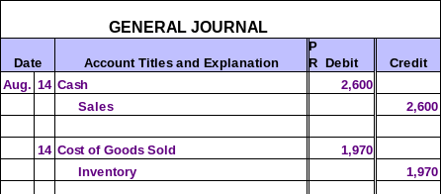
FIFO – Example
Retail
Cost
A similar entry is
made after each sale.
Continue

Slide 27
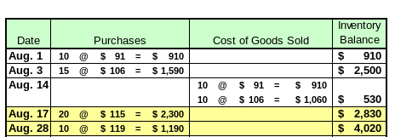
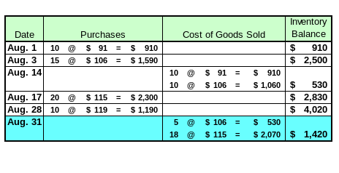
FIFO – Example
Additional purchases were made on Aug. 17 and Aug. 28.
On August 31, an additional 23 units were sold.
Cost of Goods Sold for August 31 = $2,600
Continue

Slide 28
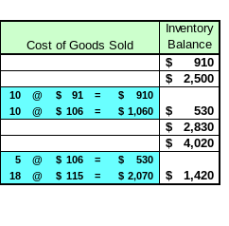
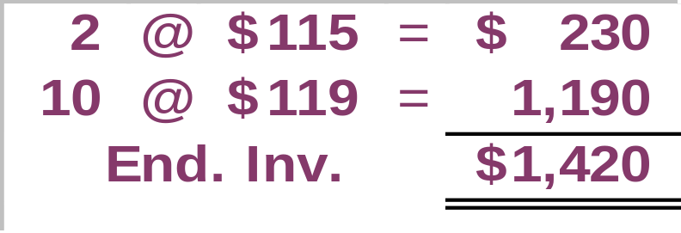
FIFO – Example
Income Statement
COGS = $4,570
Balance Sheet
Inventory = $1,420

Slide 29

Last-In, First-Out Method (LIFO)
Recent Costs
Costs of Goods Sold
Oldest Costs
Ending Inventory

Slide 30
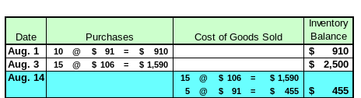
LIFO – Example
The Cost of Goods Sold for the August 14 sale is $2,045, leaving $455 and 5 units in inventory.
On August 14, TBC sold 20 bikes for $130 each.
Continue

Slide 31


LIFO – Example
Retail
Cost
A similar entry is
made after each sale.
Continue

Slide 32
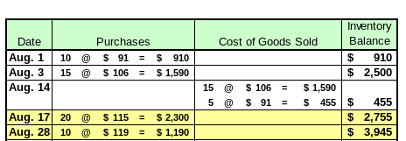
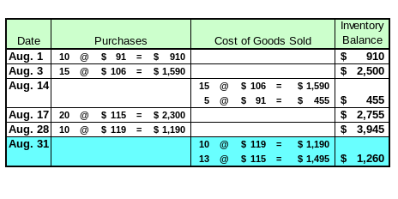
LIFO – Example
Additional purchases were made on Aug. 17 and Aug. 28.
On Aug. 31, an additional 23 units were sold.
Cost of Goods Sold for August 31 = $2,685
Continue

Slide 33
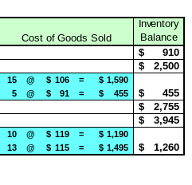
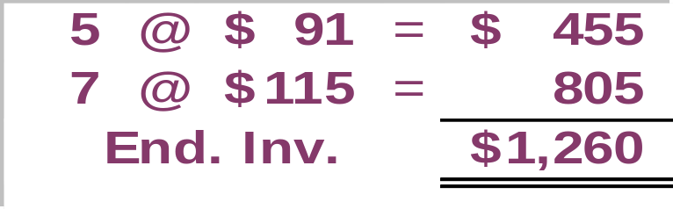
LIFO – Example
Income Statement
COGS = $4,730
Balance Sheet
Inventory = $1,260

Slide 34
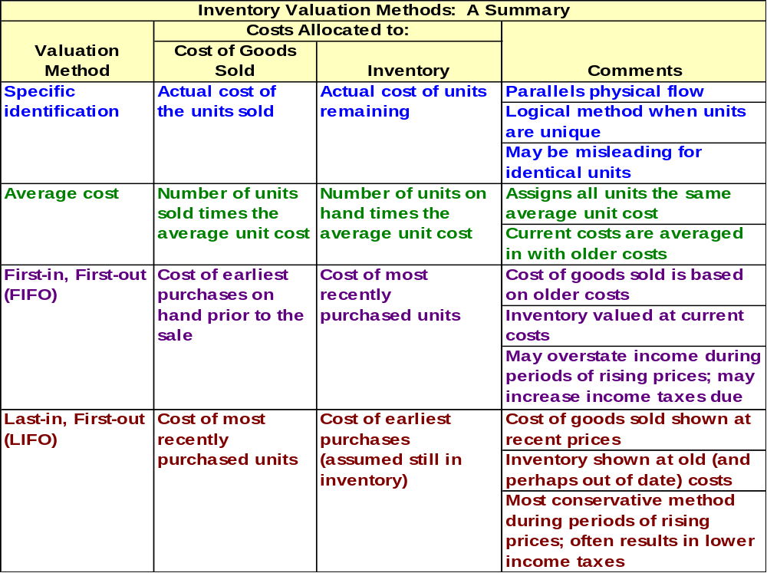

Slide 35

The Principle of Consistency
Once a company has adopted a particular accounting method, it should follow that method consistently, rather than switch methods from one year to the next.

Slide 36
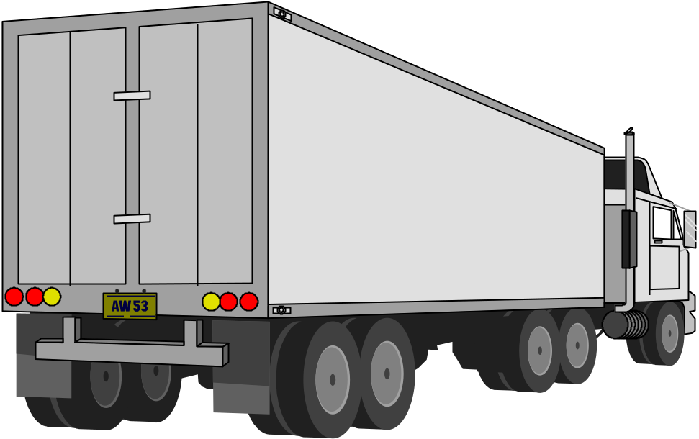

Just-In-Time (JIT) Inventory Systems
This inventory arrived just in time for us to use in the manufacturing process.

Slide 37
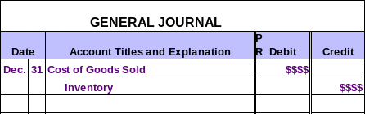
Taking a Physical Inventory
The primary reason for taking a physical inventory is to adjust the perpetual inventory records for unrecorded shrinkage losses, such as theft, spoilage, or breakage.

Slide 38
LCM and Other Write-Downs of Inventory
Reduces the value of the inventory.
Obsolescence
Lower of Cost or Market (LCM)
Adjust inventory value to the lower of historical cost or current replacement cost (market).

Slide 39

Goods In Transit
A sale should be recorded when title to the merchandise passes to the buyer.
F.O.B. shipping point ⎯ title passes to buyer at the point of shipment.
F.O.B. destination point ⎯ title passes to buyer at the point of destination.
Year End

Slide 40
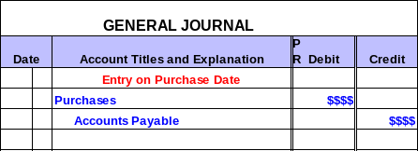
Periodic Inventory Systems
In a periodic inventory system, inventory entries are as follows.
Note that an entry is not made to inventory.
Notes:
4

Slide 41
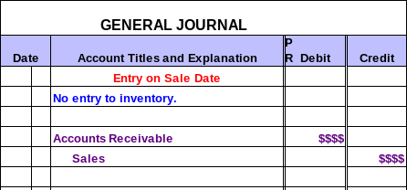
Periodic Inventory Systems
In a periodic inventory system, inventory entries are as follows.
Notes:
4

Slide 42

Periodic Inventory Systems
The inventory on hand and the cost of goods sold for the year are not determined until year-end.
Notes:
4

Slide 43
Periodic Inventory Systems
We use one of these inventory valuation methods in a periodic inventory system.
Specific identification
Average cost
FIFO
LIFO
Notes:
4

Slide 44
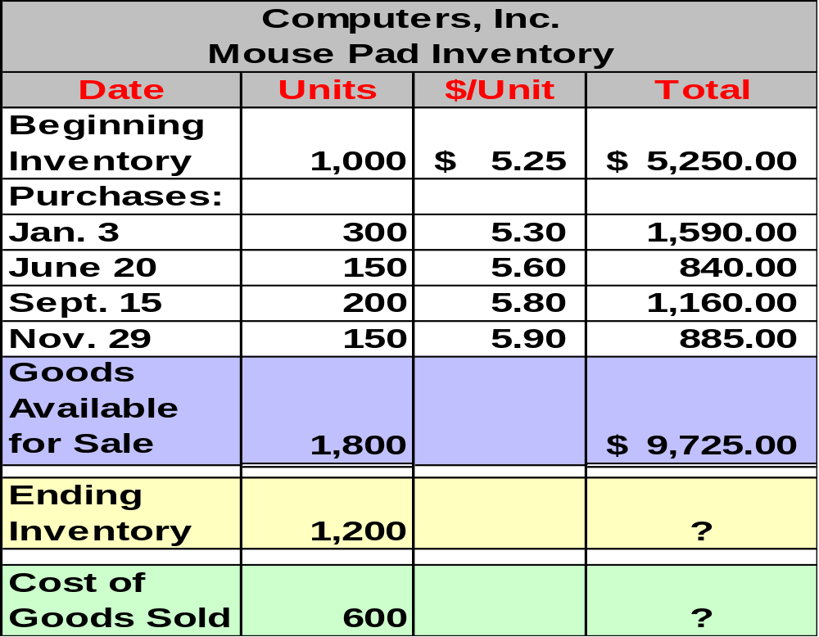
Information for the Following Inventory Examples
Notes:
50
51
51
51

Slide 45
Specific Identification – Example
By reviewing actual purchase invoices, Computers, Inc. determines that the 1,200 mouse pads on hand at year-end have an actual total cost of $6,400.
Determine the cost of goods sold for the year.

Slide 46
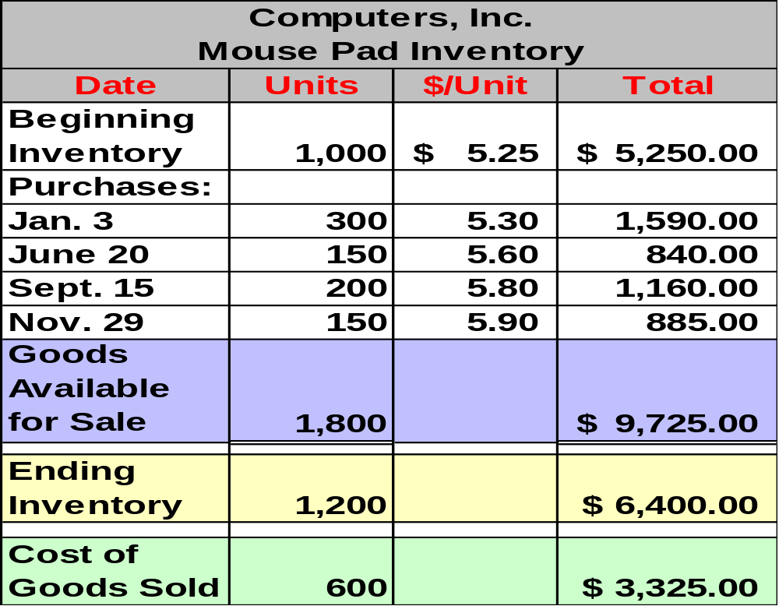
Specific Identification – Example
Cost of Goods Sold
$9,725 - $6,400 = $3,325
Notes:
50
51
51
51

Slide 47
Average-Cost Method
The average cost is calculated at year-end as follows:
Total Cost of Goods Available for Sale
Total Number of Units Available for Sale
÷

Slide 48
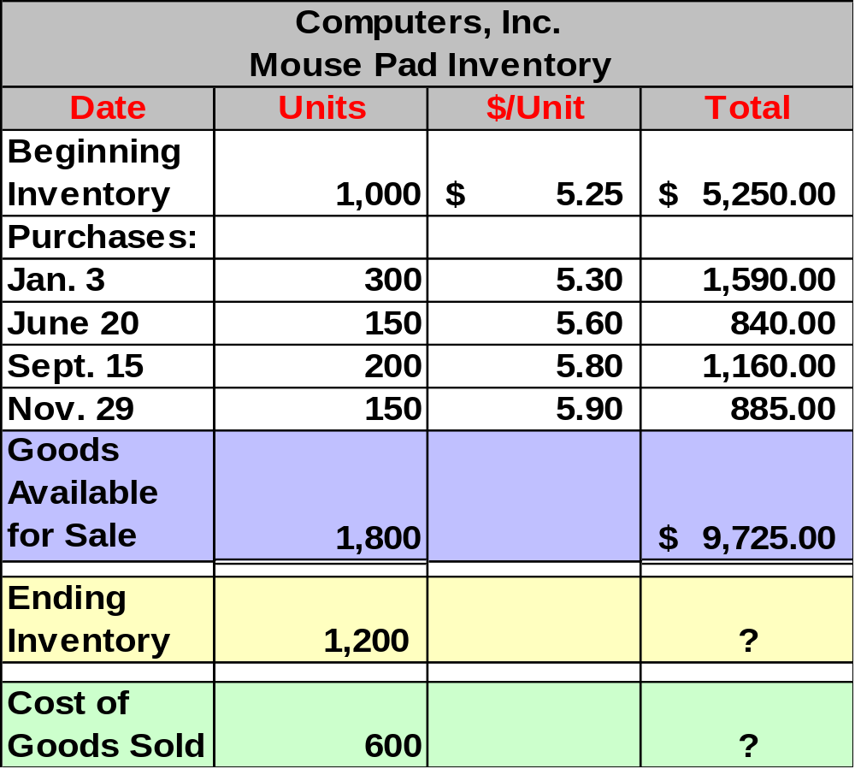
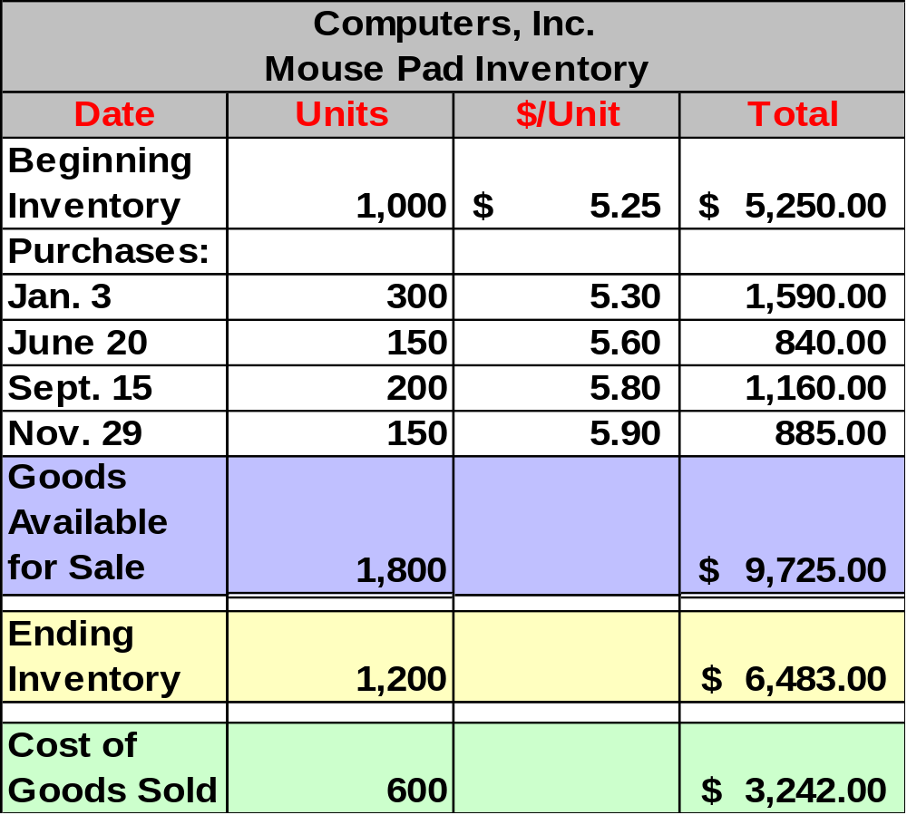
Average-Cost Method – Example
Avg. Cost $9,725 ÷ 1,800 = $5.40278
Ending Inventory
Avg. Cost $5.40278 × 1,200 = $6,483
Cost of Goods Sold
Avg. Cost $5.40278 × 600 = $3,242
Notes:
50
51
51
51

Slide 49
First-In, First-Out Method (FIFO)
Oldest Costs
Costs of Goods Sold
Recent Costs
Ending Inventory

Slide 50

FIFO – Example
Remember: Start with the 11/29 purchase and then add other purchases until you reach the number of units in ending inventory.
Notes:
29
29
29
29

Slide 51
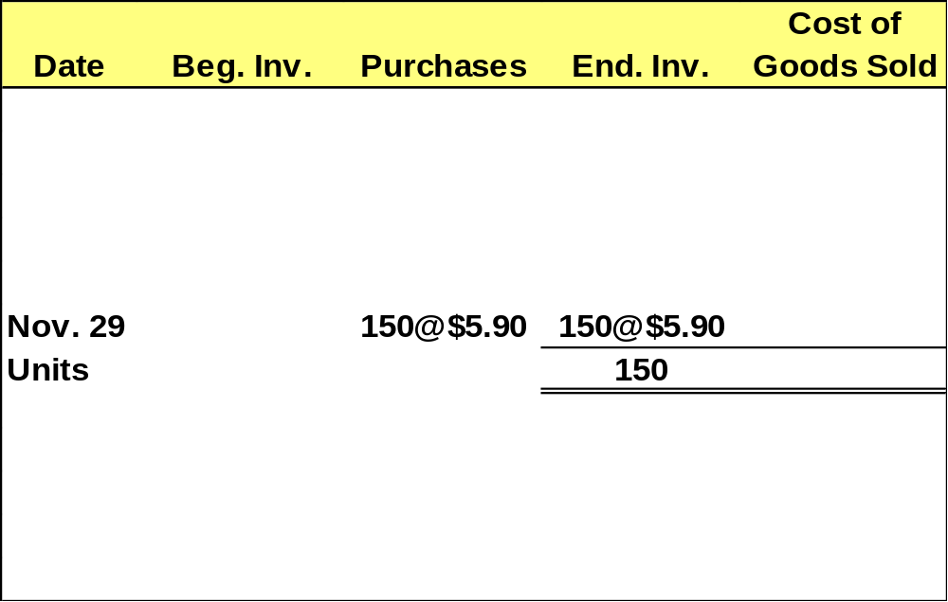
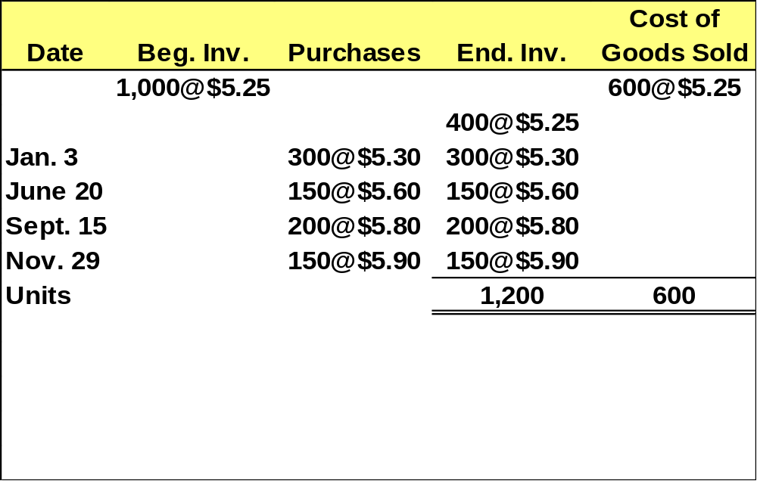
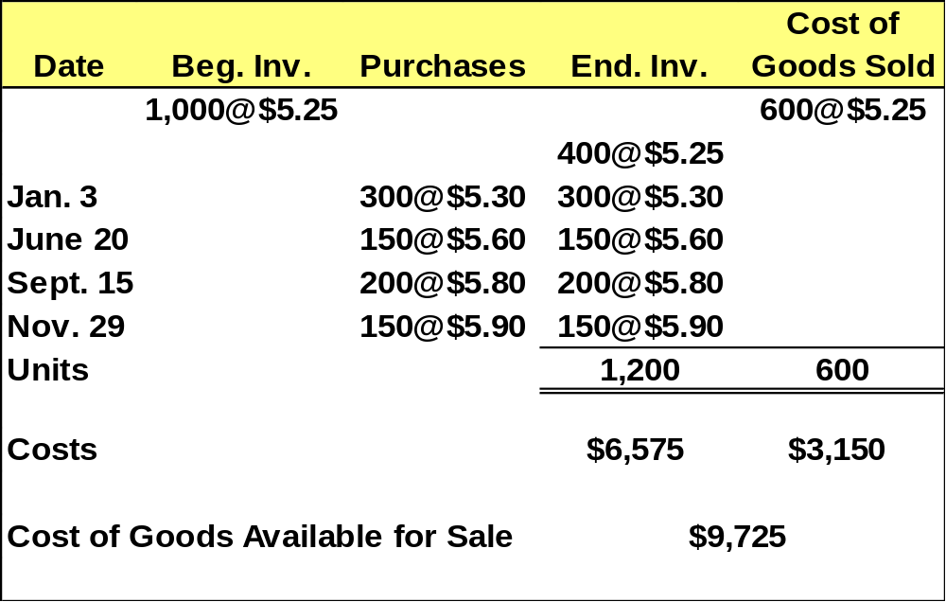
FIFO – Example
Now, we have allocated the cost to all 1,200 units in ending inventory.
Now, let’s complete the table.
Notes:
30
30
36
36

Slide 52

FIFO – Example
Completing the table summarizes the computations just made.
Notes:
29
29
29
29

Slide 53
Last-In, First-Out Method (LIFO)
Recent Costs
Costs of Goods Sold
Oldest Costs
Ending Inventory

Slide 54
LIFO – Example
Remember: Start with beginning inventory and then add other purchases until you reach the number of units in ending inventory.
Notes:
41
41
41
41

Slide 55
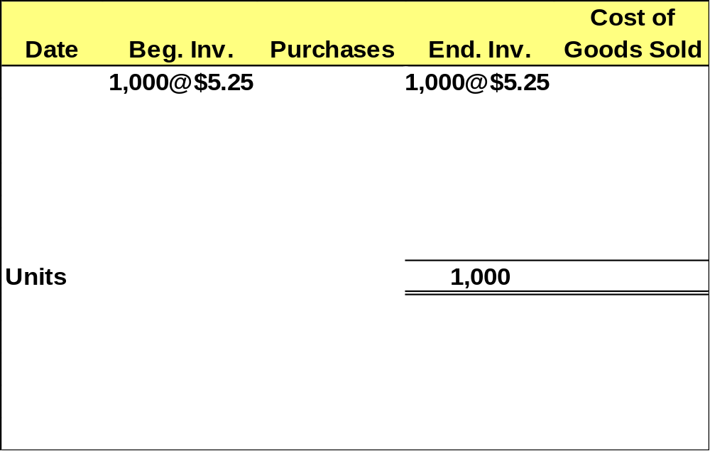
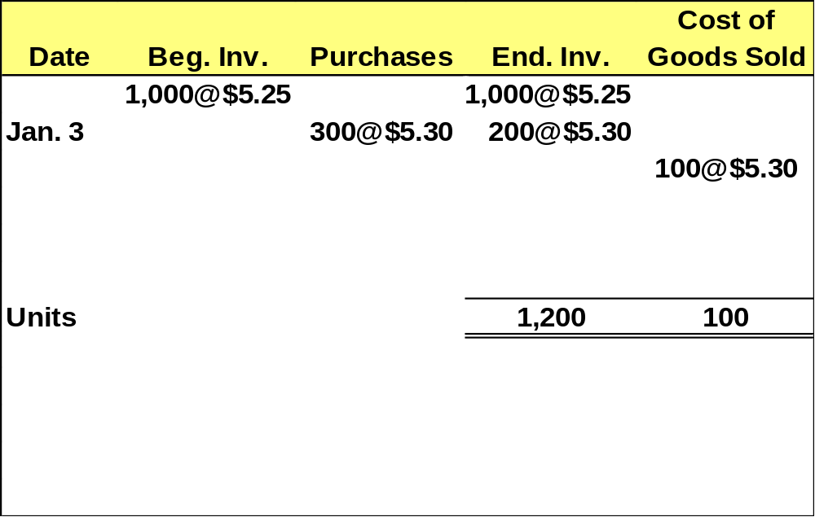
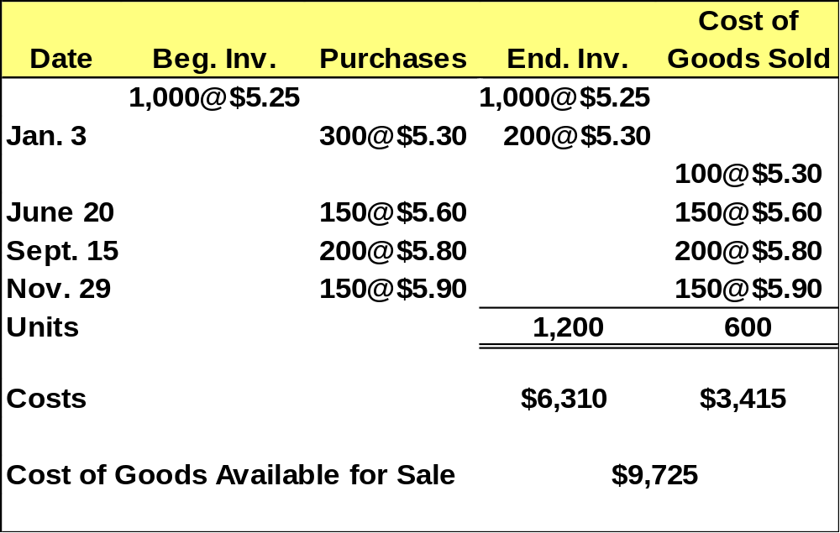
LIFO – Example
Now, we have allocated the cost to all 1,200 units in ending inventory.
Next, let’s complete the table.
Notes:
42
47
47
47

Slide 56

LIFO – Example
Completing the table summarizes the computations just made.
Notes:
29
29
29
29

Slide 57
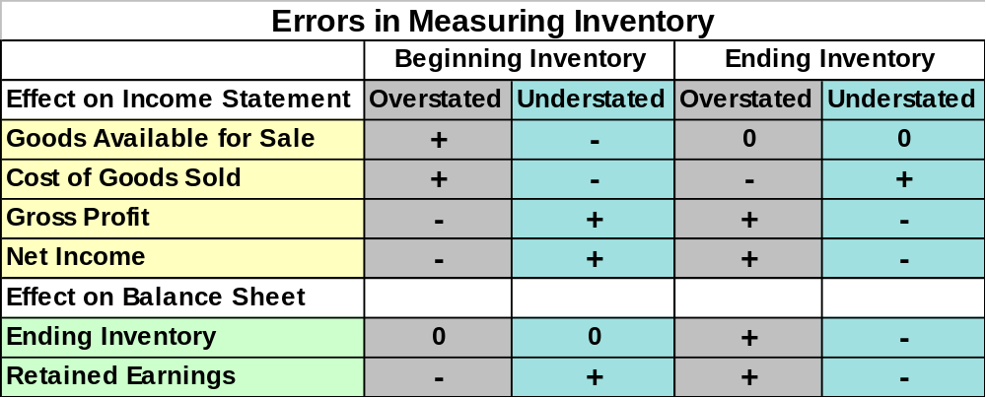
Importance of an Accurate Valuation of Inventory
An error in ending inventory in a year will result in the
same error in the beginning inventory of the next year.
Notes:
18
18
18
18

Slide 58

For interim financial statements, we may need to estimate ending inventory and cost of goods sold.

Slide 59
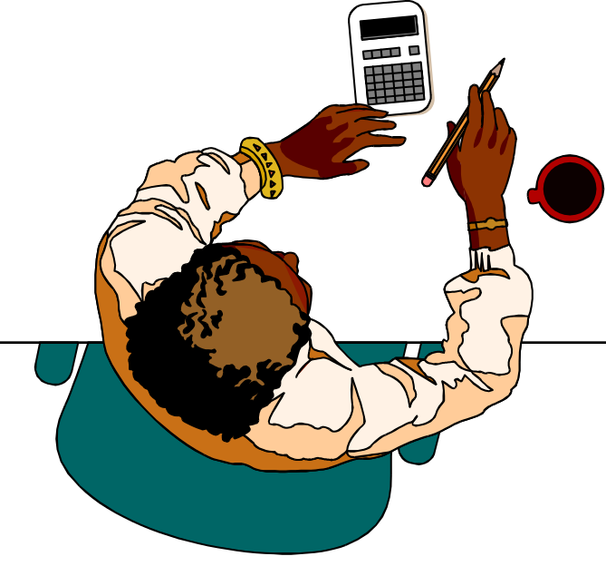
The Gross Profit Method
Determine cost of goods available for sale.
Estimate cost of goods sold by multiplying the net sales by the cost ratio.
Deduct cost of goods sold from cost of goods available for sale to determine ending inventory.

Slide 60
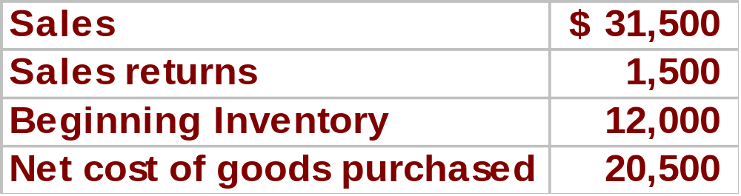

Gross Profit Method – Example
In March of 2003, Chemico’s inventory was destroyed by fire. Chemico’s normal gross profit ratio is 30% of net sales. At the time of the fire, Chemico showed the following balances:

Slide 61
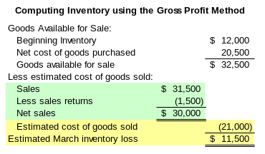
Gross Profit Method – Example
× 70%

Slide 62

Inventory Turnover Rate
Measures how quickly a company
sells its merchandise inventory.
Average Inventory = (Beg. Inv. + End. Inv.) ÷ 2
A ratio that is low compared to competitors suggests inefficient use of assets.
Notes:
97
97
97
97

Slide 63

Accounting Methods Can Affect Analytical Ratios
Remember that identical companies that use different inventory methods (e.g., FIFO and LIFO) will have different inventory turnover ratios.
Notes:
97
97
97
97

Slide 64

End of Chapter 8
Careful! If you
drop the inventory
we will have another
write down.
Notes:
97
97
97
97

