Slide 1

Chapter
9
PLANT AND INTANGIBLE ASSETS
Notes:
2

Slide 2

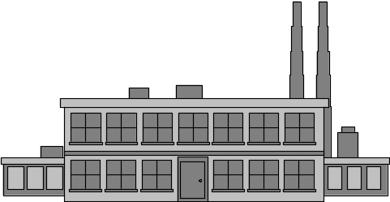
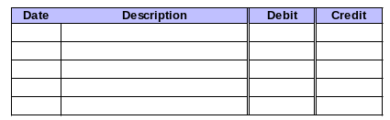
Plant Assets
Long-lived assets acquired for use in business operations.
Similar to long-term prepaid expenses
As years pass, and the services are used, the cost is transferred to depreciation expense.
The cost of plant assets is the advance purchase of services.

Slide 3
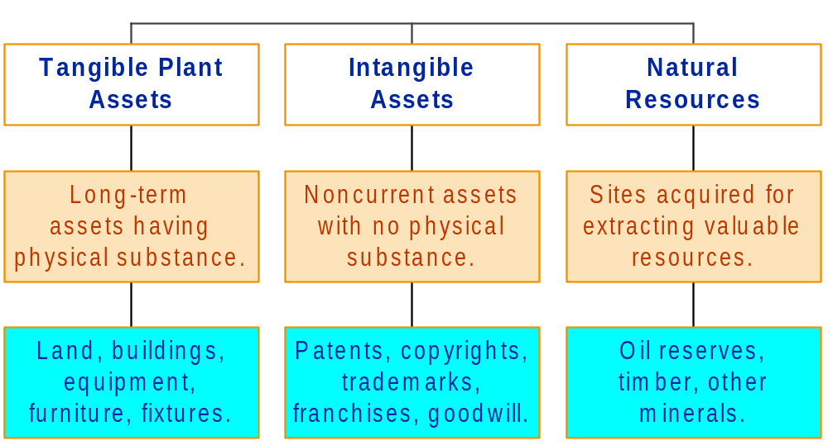
Major Categories of Plant Assets

Slide 4
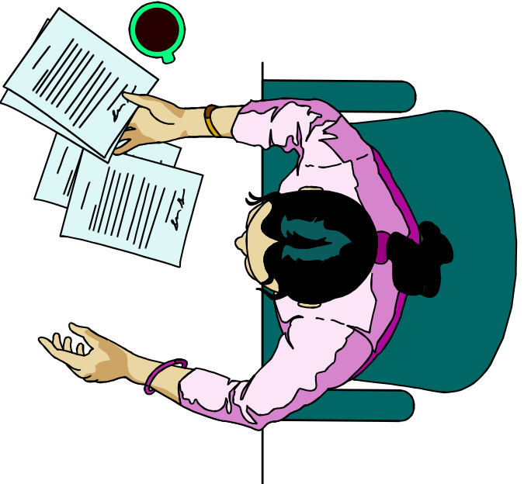
Accountable Events
Acquisition.
Allocation of the acquisition cost to expense over the asset’s useful life (depreciation).
Sale or disposal.

Slide 5
Acquisition of Plant Assets
Asset price
Cost
+
Reasonable and necessary costs . . .
. . . for getting the asset to the desired location.
. . . for getting the asset ready for use.

Slide 6

Determining Cost
On May 4, Heat Co., an Ohio maker of stoves, buys a new machine from a Texas company. The new machine has a price of $52,000. Sales tax was computed at 8%.
Heat Co. pays $500 shipping cost to get the machine to Ohio. After the machine arrives, set-up costs of $1,300 are incurred, along with $4,000 in testing costs.
Compute the cost of Heat Co.’s new machine.

Slide 7
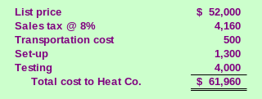
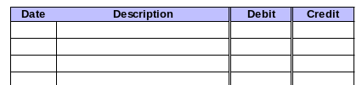
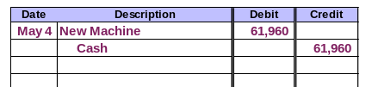
Determining Cost
Prepare the journal entry.

Slide 8

Special Considerations
Cost includes real estate commissions, escrow fees, legal fees, clearing and grading the property.
Land
Improvements to land such as driveways, fences, and landscaping are recorded separately.
Land Improvements

Slide 9
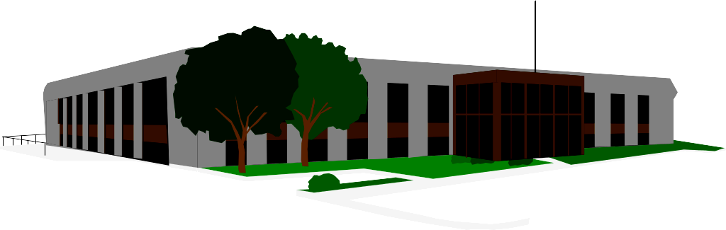
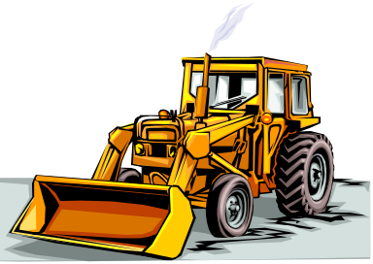
Special Considerations
Repairs made prior to the building being put in use are considered part of the building’s cost.
Buildings
Related interest, insurance, and property taxes are treated as expenses of the current period.
Equipment

Slide 10


Special Considerations
Allocation of a Lump-Sum Purchase
The total cost must be allocated to separate accounts for each asset.
The allocation is based on the relative Fair Market Value of each asset purchased.
I think I’ll buy the whole thing; barn, land, and animals.

Slide 11


Capital Expenditures and Revenue Expenditures
Capital
Expenditure
Revenue
Expenditure
Any material expenditure
that will benefit several
accounting periods.
Expenditure for
ordinary repairs
and maintenance.
To capitalize an expenditure
means to charge it to an
asset account.
To expense an expenditure
means to charge it to an
expense account.

Slide 12

Depreciation
The allocation of the cost of a plant asset to expense in the periods in which services are received from the asset.
Balance Sheet
Cost of plant assets
Assets:
Plant and
equipment
Income Statement
as the services are received
Revenues:
Expenses:
Depreciation

Slide 13

Depreciation
Book Value
  Cost – Accumulated Depreciation
Accumulated Depreciation
  Contra-asset
  Represents the portion of an asset’s cost that has already
  been allocated to expense.
Causes of Depreciation
  Physical deterioration
  Obsolescence

Slide 14

Straight-Line Depreciation
Depreciation
Expense per Year
Cost - Residual Value
Years of Useful Life
=

Slide 15



Straight-Line Depreciation
On January 1, 2003, Bass Co. buys a new boat. Bass Co. pays $24,000 for the boat. The boat has an estimated residual value of $3,000 and an estimated useful life of 5 years.
Compute depreciation for 2003 using the straight-line method.

Slide 16
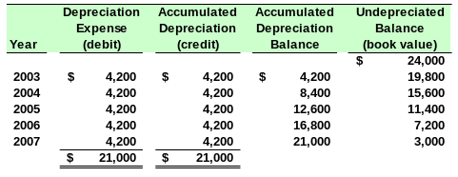
Straight-Line Depreciation
Bass Co. will record $4,200 depreciation each year for five years. Total depreciation over the estimated useful life of the boat is:
Salvage Value

Slide 17
Depreciation for Fractional Periods
When an asset is acquired during the year, depreciation in the year of acquisition must be prorated.
Half-Year Convention
In the year of acquisition, record six months of depreciation.
½

Slide 18

Half-Year Convention
Using the half-year convention, calculate the straight-line depreciation on December 31, 2001, for equipment purchased in 2003. The equipment cost $75,000, has a useful life of 10 years and an estimated salvage value of $5,000.
Depreciation = ($75,000 - $5,000) ÷ 10
= $7,000 for a full year
Depreciation = $7,000 × ¹/₂ = $3,500

Slide 19

Declining-Balance Method
Depreciation in the early years of an asset’s estimated useful life is higher than in later years.
The double-declining balance depreciation rate is 200% of the straight-line depreciation rate of 1/Useful Life.

Slide 20

Declining-Balance Method
On January 1, 2003, Bass Co. buys a new boat. Bass Co. pays $24,000 for the boat. The boat has an estimated residual value of $3,000 and an estimated useful life of 5 years.
Compute depreciation for 2003 using the double-declining balance method.

Slide 21
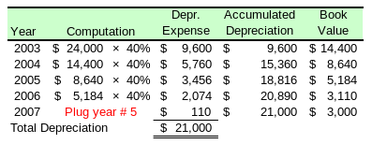
Declining-Balance Method
Total depreciation over the estimated useful life of an asset is the same using either the straight-line method or the declining-balance method.
Compute depreciation for the rest of the boat’s estimated useful life.

Slide 22

Financial Statement Disclosures
Estimates of Useful Life and Residual Value
  May differ from company to company.
  The reasonableness of management’s estimates is evaluated by external auditors.
Principle of Consistency
  Companies should avoid switching depreciation methods from period to period.

Slide 23
Revising Depreciation Rates
Predicted
salvage value
Predicted
useful life
So depreciation
is an estimate.
Over the life of an asset, new information may come to light that indicates the
original estimates need to be revised.

Slide 24
Revising Depreciation Rates
On January 1, 2003, equipment was purchased that cost $30,000, has a useful life of 10 years and no salvage value. During 2006, the useful life was revised to 8 years total (5 years remaining).
Calculate depreciation expense for the year ended December 31, 2006, using the straight-line method.

Slide 25

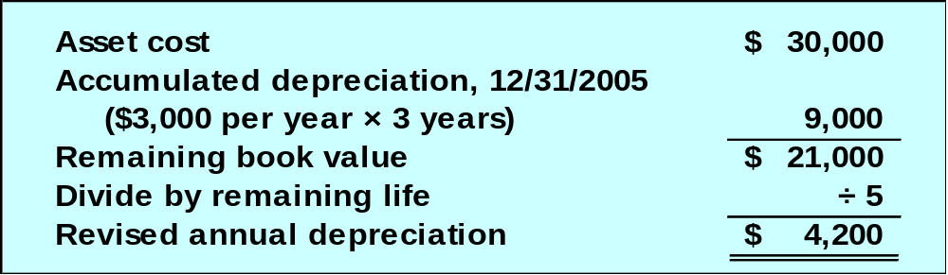
Revising Depreciation Rates
When our estimates change, depreciation is:
Book value at
date of change
Salvage value at
date of change
–
Remaining useful life at date of change

Slide 26

Impairment of Assets
  If the cost of an asset cannot be recovered through future use or sale, the asset should be written down to its net realizable value.

Slide 27
Disposal of Plant and Equipment
Update depreciation
to the date of disposal.
Journalize disposal by:
Recording cash
received (debit)
or paid (credit).
Recording a
gain (credit)
or loss (debit).
Removing accumulated
depreciation (debit).
Removing the
asset cost (credit).

Slide 28
Disposal of Plant and Equipment
If Cash > BV, record a gain (credit).
If Cash < BV, record a loss (debit).
If Cash = BV, no gain or loss.
Recording cash
received (debit)
or paid (credit).
Recording a
gain (credit)
or loss (debit).
Removing accumulated
depreciation (debit).
Removing the
asset cost (credit).

Slide 29

Disposal of Plant and Equipment
On September 30, 2003, Evans Map Company sells a machine that originally cost $100,000 for $60,000 cash. The machine was placed in service on January 1, 1998. It has been depreciated using the straight-line method with an estimated salvage value of $20,000 and an estimated useful life of 10 years.
Let’s answer the following questions.

Slide 30

Disposal of Plant and Equipment
The amount of depreciation recorded on September 30, 2003,
to bring depreciation up to date is:
a. $8,000.
b. $6,000.
c. $4,000.
d. $2,000.
Annual Depreciation:
($100,000 - $20,000) ÷ 10 Yrs. = $8,000
Depreciation to Sept. 30:
9/12 × $8,000 = $6,000

Slide 31
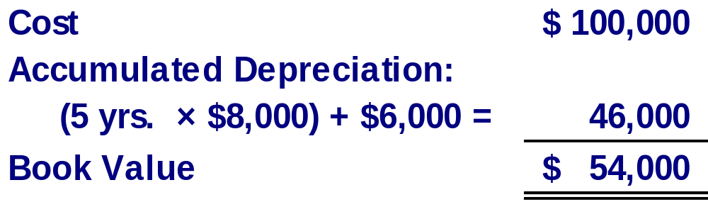
Disposal of Plant and Equipment
After updating the depreciation, the machine’s book value on September 30, 2003, is:
a. $54,000.
b. $46,000.
c. $40,000.
d. $60,000.

Slide 32
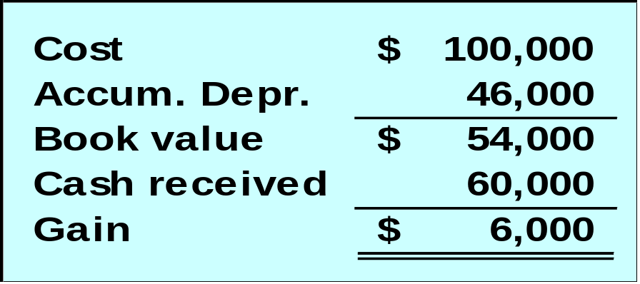
Disposal of Plant and Equipment
The machine’s sale resulted in:
a. a gain of $6,000.
b. a gain of $4,000.
c. a loss of $6,000.
d. a loss of $4,000.

Slide 33

Trading in Used Assets for New Ones
Accounting depends on whether
assets are similar or dissimilar.
Airplane
for
Airplane
Truck
for
Airplane
Only situations where cash
is paid will be demonstrated.

Slide 34
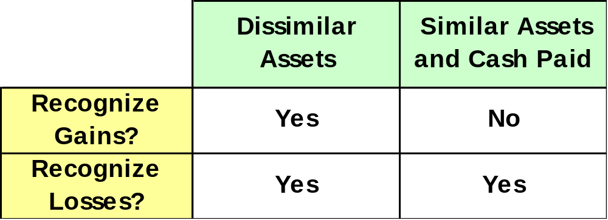
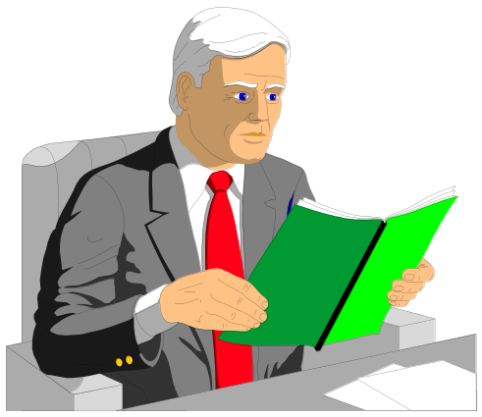
Trading in Used Assets for New Ones

Slide 35



Trading in Used Assets for New Ones – Similar Assets
On May 30, 2003, Essex Company exchanged a used airplane and $35,000 cash for a new airplane. The old airplane originally cost $40,000, had up-to-date accumulated depreciation of $30,000, and a fair value of $4,000.
SIMILAR

Slide 36
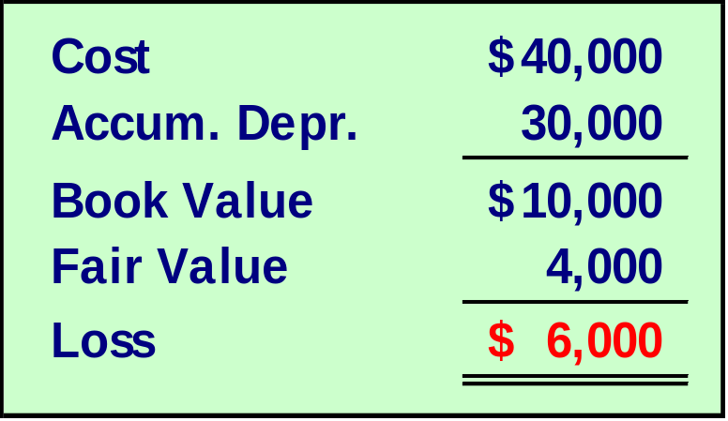

Trading in Used Assets for New Ones – Similar Assets
The exchange resulted in a:
a. gain of $6,000.
b. loss of $6,000.
c. loss of $4,000.
d. gain of $4,000.
Prepare a journal entry
to record the exchange.

Slide 37
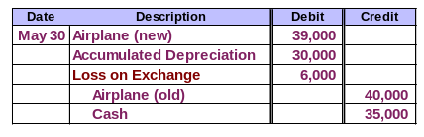
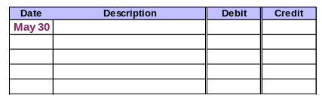
Trading in Used Assets for New Ones – Similar Assets
Prepare the journal entry to record the trade.

Slide 38
Intangible Assets
Noncurrent assets
without physical
substance.
Often provide
exclusive rights
or privileges.
Characteristics
Useful life is
often difficult
to determine.
Usually acquired
for operational
use.

Slide 39

Intangible Assets
Record at current cash equivalent cost, including purchase price, legal fees, and filing fees.
Patents
Copyrights
Leaseholds
Leasehold
Improvements
Goodwill
Trademarks and
Trade Names

Slide 40

Intangible Assets
Amortize over shorter of economic
life or legal life, subject to a maximum
of 40 years.
Use straight-line method.
Research and development costs are
normally expensed as incurred.

Slide 41
Intangible Assets – Goodwill
Goodwill
Occurs when one
company buys
another company.
Only purchased
goodwill is an
intangible asset.
The amount by which the
purchase price exceeds the fair
market value of net assets acquired.

Slide 42

Intangible Assets – Goodwill
Eddy Company paid $1,000,000 to purchase all of James Company’s assets and assumed liabilities of $200,000. The acquired assets were appraised at a fair value of $900,000.

Slide 43
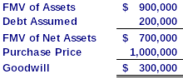
Intangible Assets – Goodwill
Intangible Assets – Goodwill
What amount of goodwill should be recorded on Eddy Company books?
a. $100,000.
b. $200,000.
c. $300,000.
d. $400,000.

Slide 44

Intangible Assets – Patents
Exclusive right granted
by federal government to sell or manufacture an invention.
Cost is purchase
price plus legal
cost to defend.
Amortize cost
over the shorter of
useful life or 17 years.

Slide 45

Intangible Assets –
Trademarks and Trade Names
A symbol, design, or logo
associated with a business.
Purchased
trademarks
are recorded
at cost, and
amortized over
shorter of legal
or economic life,
or 40 years.
Internally
developed
trademarks
have no
recorded
asset cost.

Slide 46

Intangible Assets – Franchises
Legally protected right to sell products or provide services purchased by franchisee from franchisor.
Purchase price is intangible asset which is amortized over the shorter of the protected right or 40 years.

Slide 47
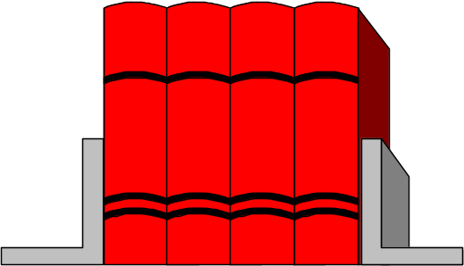
Intangible Assets – Copyrights
Exclusive right granted by the federal government to protect artistic or intellectual properties.
Legal life is
life of creator
plus 50 years.
Amortize cost
over a period not
to exceed 40 years.

Slide 48

Natural Resources
Total cost,
including
exploration and
development,
is charged to
depletion expense
over periods
benefited.
Extracted from
the natural
environment
and reported
at cost less
accumulated
depletion.
Examples: oil, coal, gold

Slide 49
Depletion of Natural Resources
Depletion is calculated using the
units-of-production method.
Unit depletion rate is calculated as follows:
Cost – Salvage Value
Total Units of Capacity

Slide 50
Depletion of Natural Resources
Total depletion cost for a period is:
Unit Depletion
×
Number of Units
Rate
Extracted in Period
Cost of
goods sold
Total
depletion
cost
Inventory
for sale
Unsold
Inventory

Slide 51
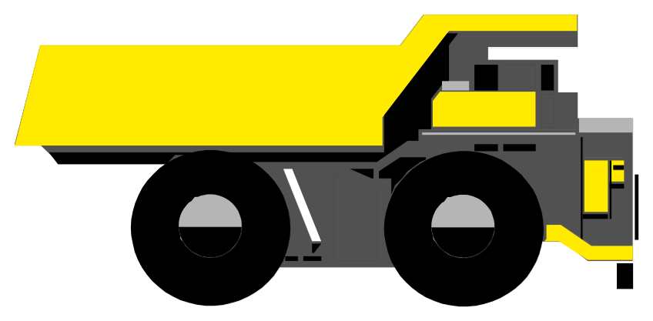
Depletion of Natural Resources
Specialized plant assets may be required to extract the natural resource.
These assets are recorded in a separate account and depreciated.

Slide 52
The Units-of-Output Method
Cost per Unit
of Output
Cost - Residual Value
Estimated Units of Output
=
Depreciation
Expense
Cost per Unit
of Output
Number of
Units Produced
=
×

Slide 53
MACRS: The “Tax Method”
MACRS = Modified Accelerated Cost Recovery System
Based on Declining-Balance Methods
The only accelerated method allowed by the IRS when computing depreciation for tax return purposes.
Asset Cost × MACRS rate
Rates are available from tables provided by the IRS.

Slide 54
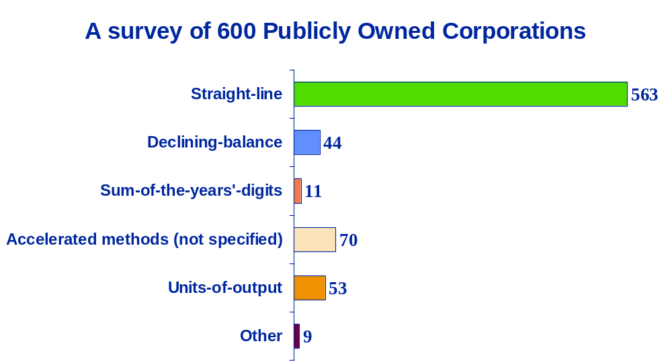
Which Depreciation Methods
Do Most Businesses Use?

Slide 55

End of Chapter 9
Notes:
4

