Slide 1

Chapter
10
LIABILITIES
Notes:
2

Slide 2

The Nature of Liabilities
Defined as debts or obligations arising from past transactions or events.
Maturity = 1 year or less
Maturity > 1 year
Current Liabilities
Noncurrent Liabilities
I.O.U.

Slide 3




Distinction Between
Debt and Equity
The acquisition of assets is financed from two sources:
DEBT
EQUITY
Funds from creditors, with a definite due date, and sometimes bearing interest.
Funds from owners

Slide 4
Liabilities – Question
Devon Mfg. borrows $100,000 from First Bank. The loan will be repaid in 20 years and has an annual interest rate of 8%.
Is this a current liability or a noncurrent liability?
The obligation will not be paid within one year or one operating cycle, so it is a noncurrent liability.

Slide 5
Evaluating Liquidity
An important indicator of a company’s ability to meet its current obligations.
Two commonly used measures:
Working Capital = Current Assets - Current Liabilities
Current Ratio = Current Assets ÷ Current Liabilities

Slide 6

Liabilities – Question
Devon Mfg. has current liabilities of $230,000 and current assets of $322,000.
What is Devon’s current ratio?

Slide 7
Accounts Payable
Short-term obligations to suppliers for purchases of merchandise and to others for goods and services.
Office supplies invoices
Merchandise inventory invoices
Utility and phone bills
Shipping charges

Slide 8
Notes Payable
When a company borrows money, a note payable is created.
Current Portion of Notes Payable
The portion of a note payable that is due within one year, or one operating cycle, whichever is longer.
Total Notes Payable
Current Notes Payable
Noncurrent Notes Payable

Slide 9
Notes Payable
PROMISSORY NOTE
Location Date
after this date
promises to pay to the order of
the sum of with interest at the rate
of per annum.
signed
title
Miami, Fl
Nov. 1, 2003
Six months
Porter Company
Security National Bank
$10,000.00
12.0%
John Caldwell
treasurer
Notes:
2
2

Slide 10
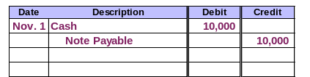
Notes Payable
On November 1, 2003, Porter Company would make the following entry.
Notes:
2
2

Slide 11

Interest Payable
Interest expense is the compensation to the lender for giving up the use of money for a period of time.
The liability is called interest payable.
To the lender, interest is a revenue.
To the borrower, interest is an expense.
Interest Rate Up!

Slide 12
Interest Payable
The interest formula includes three variables that must be considered when computing interest:
Interest = Principal × Interest Rate × Time
When computing interest for one year, “Time” equals 1. When the computation period is less than one year, then “Time” is a fraction.
For example, if we needed to compute interest for 3 months, “Time” would be 3/12.

Slide 13
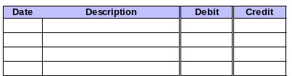
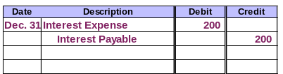
Interest Payable – Example
What entry would Porter Company make on December 31, the fiscal year-end?
$10,000 × 12% × ²/₁₂ = $200

Slide 14







Payroll Liabilities
Gross Pay
Net Pay
State and Local Income Taxes
Voluntary Deductions
Medicare Taxes
Federal Income Tax
FICA Taxes
Notes:
2
2

Slide 15
Unearned Revenue
Cash is sometimes collected from the customer before the revenue is actually earned.
As the earnings process is completed . .
Cash is received in advance.
Deferred revenue is recorded.
Earned revenue is recorded.
a liability account.

Slide 16


Long-Term Debt
Relatively small debt needs can be filled from single sources.
or
or
Insurance Companies
Pension Plans
Banks

Slide 17

Long-Term Debt
Large debt needs are often filled by issuing bonds.

Slide 18
Installment Notes Payable
Long-term notes that call for a series of installment payments.
Each payment covers interest for the period AND a portion of the principal.
With each payment, the interest portion gets smaller and the principal portion gets larger.

Slide 19

Allocating Installment Payments Between Interest and Principal
Identify the unpaid principal balance.
Unpaid Principal × Interest rate = Interest expense.
Installment payment - Interest expense = Reduction in unpaid principal balance.
Compute new unpaid principal balance.

Slide 20

Allocating Installment Payments Between Interest and Principal
On January 1, 2003, Rocket Corp. borrowed $7,581.57 from First Bank of River City. The loan was a five-year loan and had an interest rate of 10%. The annual payment is $2,000.
Prepare an amortization table for Rocket Corp.’s loan.

Slide 21
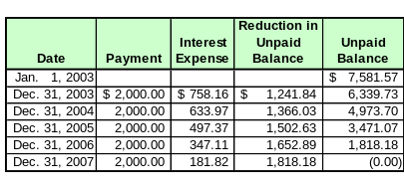
Allocating Installment Payments Between Interest and Principal
Now, prepare the entry for the first payment on December 31, 2003.

Slide 22
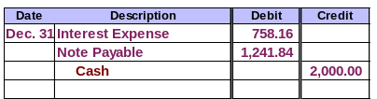
Allocating Installment Payments Between Interest and Principal
The information needed for the journal entry can be found on the amortization table. The payment amount, the interest expense, and the amount to credit to principal are all on the table.

Slide 23

Bonds Payable
Bonds usually involve the borrowing of a large sum of money, called principal.
The principal is usually paid back as a lump sum at the end of the bond period.
Individual bonds are often denominated with a par value, or face value, of $1,000.

Slide 24
Bonds Payable
Bonds usually carry a stated rate of interest, also called a contract rate.
Interest is normally paid semiannually.
Interest is computed as:
Interest = Principal × Stated Rate × Time

Slide 25
Bonds Payable
Bonds are issued through an intermediary called an underwriter.
Bonds can be sold on organized securities exchanges.
Bond prices are usually quoted as a percentage of the face amount.
  For example, a $1,000 bond priced at 102 would sell for $1,020.

Slide 26

Types of Bonds
Mortgage Bonds
Debenture Bonds
Convertible Bonds
Junk Bonds

Slide 27
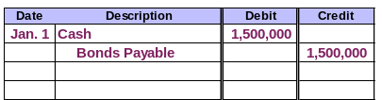
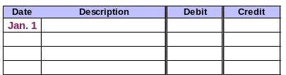
Accounting for Bonds Payable
On January 1, 2003, Rocket Corp. issues $1,500,000 of 12%, 10-year bonds payable. Interest is payable semiannually, each July 1 and January 1.
Assume the bonds are issued at face value.
Record the issuance of the bonds.

Slide 28

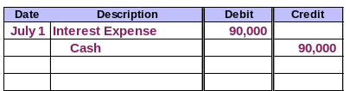
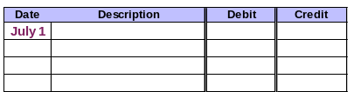
Accounting for Bonds Payable
Record the interest payment
on July 1, 2003.

Slide 29
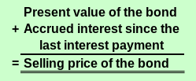
Bonds Sold Between Interest Dates
Bonds are often sold between interest dates.
The selling price of the bond is computed as:

Slide 30


The Concept of Present Value
$1,000 invested today at 10%.
In 5 years it will be worth $1,610.51.
In 25 years it will be worth $10,834.71!
Present Value
Future Value
Money can grow over time, because it can earn interest.

Slide 31




The Concept of Present Value
How much is a future amount worth today?
How much is a future amount worth today?
Three pieces of information must be known to solve a present value problem:
  The future amount.
  The interest rate (i).
  The number of periods (n) the amount will be invested.
Present Value
Interest compounding periods
FutureValue
Today

Slide 32
The Concept of Present Value
Two types of cash flows are involved with bonds:
Periodic interest payments called annuities.
Today
Maturity
Principal payment at maturity.

Slide 33
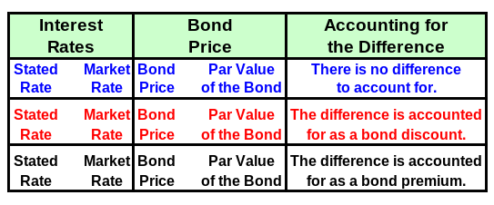

The Present Value Concept and Bond Prices
The selling price of the bond is determined by the market based
on the time value of money.
=
=
<
<
>
>

Slide 34

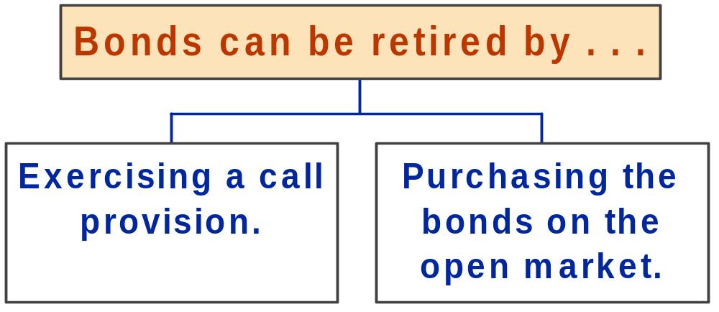
Early Retirement of Debt
Gains or losses incurred as a result of retiring bonds should be reported as extraordinary items on the income statement.

Slide 35
Lease Payment Obligations
Operating Leases
Capital Leases
Lease agreement transfers risks and benefits associated with ownership to lessee.
Lessor retains risks and benefits associated with ownership.
Lessee records rent expense as incurred.
Lessee records a leased asset and lease liability.
Notes:
5
73

Slide 36
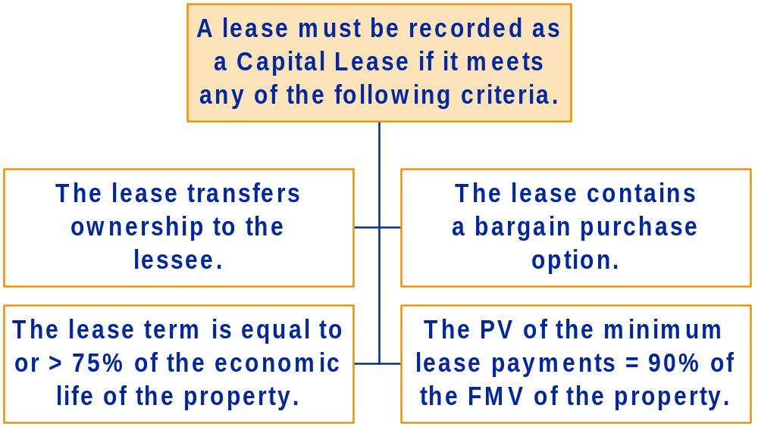
Capital Lease Criteria
Notes:
5
73

Slide 37


Pensions
Employers offer pension plans to employees.
The employer makes payments to a pension fund. Usually, this is an independent entity managed by a professional fund manager.
Retirees receive pension payments from the pension fund.

Slide 38
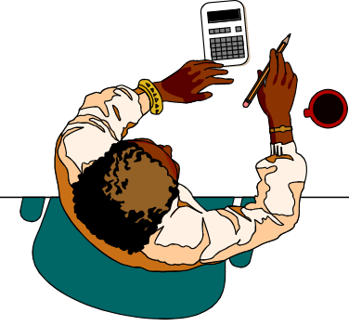

Pensions
Actuaries make the pension expense computations, based on:
Average age, retirement age, life expectancy.
Employee turnover rates.
Compensation levels.
Expected rate of return for the fund.
The accountant then posts the entry to record pension expense and pension liability.

Slide 39

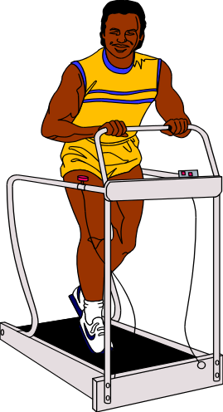
Other Postretirement Benefits
Many companies offer benefits to retirees other than pensions, such as health coverage or fitness club memberships.
Amount to
be funded
next year
Current
liability
Unfunded liability
for nonpension
postretirement
benefits
Remainder
of unfunded
amount
Long-term
liability

Slide 40
Deferred Income Taxes
Corporations pay income taxes quarterly.
Notes:
5
73

Slide 41
Deferred Income Taxes
The Internal Revenue Code is the set of rules for preparing tax returns.
GAAP is the set of rules for preparing financial statements.
Results in . . .
Usually. . .
Results in . . .
Financial statement income tax expense.
IRS income taxes payable.
The difference between tax expense and tax payable is recorded in an account called deferred taxes.

Slide 42
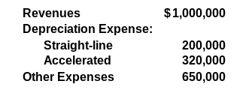
Deferred Income Taxes – Example
Examine the December 31, 2003, information for X-Off Inc.
X-Off uses straight-line depreciation for financial reporting and accelerated depreciation for income tax reporting. X-Off’s tax rate is 30%.

Slide 43
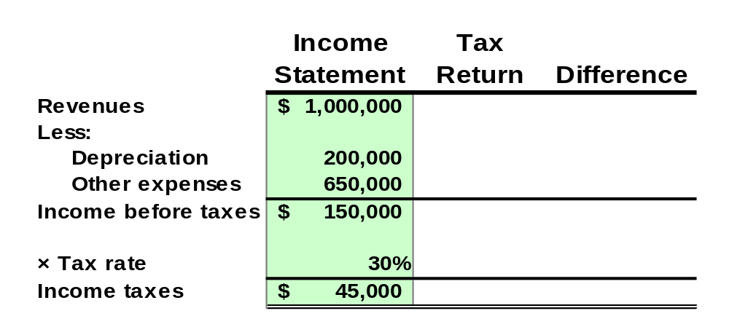
Deferred Income Taxes – Example
Compute X-Off’s income tax expense and income tax payable.
The income tax amount computed based on financial statement income is income tax expense for the period.

Slide 44
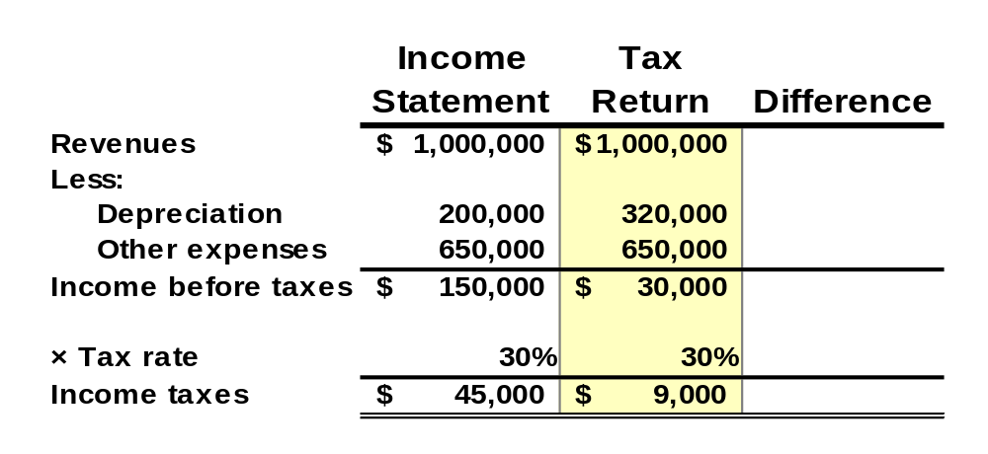
Deferred Income Taxes – Example
Compute X-Off’s income tax expense and income tax payable.
Income taxes based on tax return income are the taxes payable for the period.

Slide 45
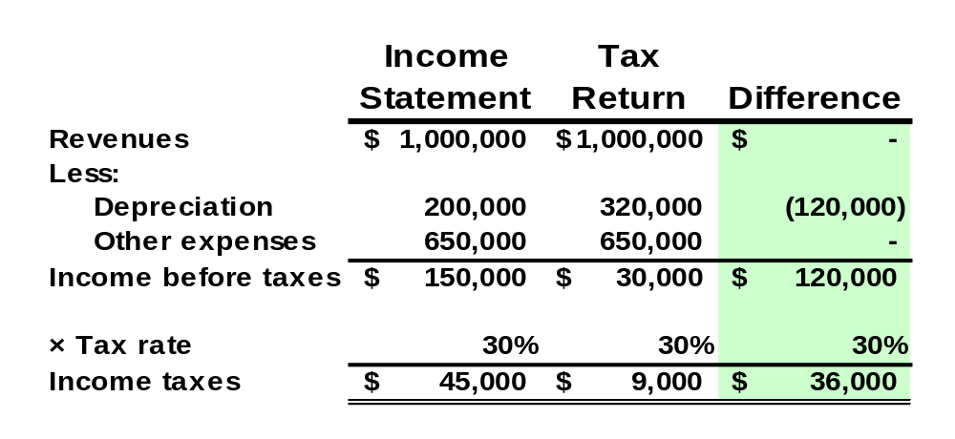
Deferred Income Taxes – Example
The deferred tax for the period of $36,000 is the difference between income tax expense of $45,000 and income tax payable of $9,000.

Slide 46

Financial Leverage
Borrowing at one rate and investing at a higher rate.
If we borrow $1,000,000 at 8% and invest it at 10%, we will clear $20,000 profit!

Slide 47

End of Chapter 10
Are we having fun yet?

