Slide 1
Chapter 4:
Threads

Slide 2
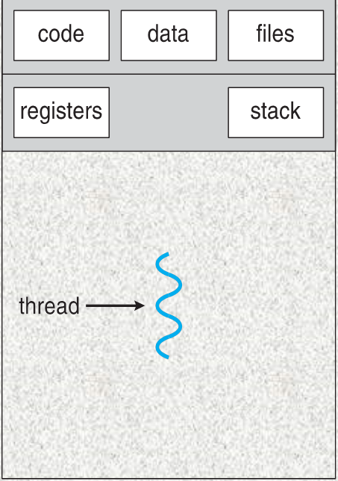
Take another look at processes
A process includes
  An address space (code, data)
  A resource container (OS resource, accounting)
  A “thread of control” which defines where the process is currently executing
    basically, PC, registers, and stack

Slide 3

Web Server Example
How does a web server handle 1 request?
A web server needs to handle many concurrent requests
Solution 1:
  Have a parent process fork as many processes as needed
  Processes communicate with each other via inter-process communication

Slide 4
How to Processes Communicate?
Relatively costly – they do not share memory
  via shared files
  via mailbox (communication channels)
OK for coarse-grained interactions but too costly for complex interactions
  Drop into kernel twice
  Lots of copying (sharing in-memory caching difficult)

Slide 5
How to Improve – Idea 1
Allow (mutually consenting) processes to share part of their memory
  All modern OS support this in some way
  Process can now interact efficiently (through shared memory)
  But each still has its own address space, set of OS resources and accounting info
    Address space has maintenance cost

Slide 6
Let’s think about it
Often, what’s similar in these processes?
  Share the same code and data (address space)
  Use the same resources (files, communication channels)
What don’t they share?
  Each has its own PC, registers, stack pointer (thread of control)

Slide 7
Idea 2 -- Threads
Separate the concepts of a “thread of control” (PC, SP, registers) from the rest of the process (address space, resources, accounting etc.)
Many modern OS support two entities
  The task (process), which defines an address space, a resource container, accounting info
  The thread (lightweight process), which defines a single sequential execution stream within a task (process)

Slide 8
Threads
A thread is a flow of execution through the process code
So far, we have discussed that a process has a single thread of execution
Now consider having multiple program counters per process
  Multiple locations can execute at once
    Multiple threads of control -> threads
Must then have storage for thread details, multiple program counters in PCB.

Slide 9
Threads vs. Processes
There can be several threads in a single address space
Threads are the unit of scheduling; tasks are containers in which threads execute
In this model, a conventional process consists of a task and a single thread of control

Slide 10

Single and Multithreaded Processes

Slide 11
Difference between Process and Thread
Process | Thread
Process is heavy weight or resource intensive. | Thread is light weight, taking lesser resources than a process.
Process switching needs interaction with operating system. | Thread switching does not need to interact with operating system.
In multiple processing environments, each process executes the same code but has its own memory and file resources. | All threads can share same set of open files, child processes.
If one process is blocked, then no further execution is possible until it gets unblocked. | While one thread is blocked and waiting, a second thread in the same task can run.
In multiple processes each process operates independently of the others. | One thread can read, write or change another thread's data.

Slide 12
Threads
Example: Consider a multi-threaded application. If one thread is blocked by some I/O request, the other can continue its execution.
Switching among threads is faster.
  Only PC and registers
Threads are also known as ‘lightweight’ process.
  Only one thread can be executed at a time
  A thread can be in one of the several states, like Rn, Rd etc.
  Different stacks and registers
  But same memory

Slide 13
Process Control Block (PCB)
Process management information
  Process state (running, ready, waiting)
  PC & CPU registers, parents, etc.
  CPU scheduling information (priorities, etc.)
Memory-management information
  memory allocated to the process (segments, page tables etc.)
I/O and file management
  Communication ports, directories, file descriptors etc.,

Slide 14
Thread Control Block
Shared Information
  Process info: parent process
  Memory: code/data segment, page table, and stats
  I/O and file: communication ports, open file descriptors
Private state
  State (ready, running and waiting)
  Registers, Program counter
  Execution stack

Slide 15
Programming with Threads
Flexible, but error-prone, since there is no protection between threads
  In C/C++
    Automatic variables are private to each thread
    Global variables and dynamically allocated memory are shared
Need synchronization!

Slide 16
Definition: Kernel Thread
Kernel thread is the kernel scheduling unit
In user thread implementation, all user threads of the same process are effectively mapped to one kernel thread
Only kernel threads are scheduled by the scheduler

Slide 17
User Thread Implementation
Thread management done by user-level thread library
  Creation/Scheduling
  No kernel intervention (kernel sees single entity)
Usually faster to create and manage
Drawbacks: a blocking system call blocks the whole process
Examples
  POSIX Pthreads
  Mach C-threads
  Solaris 2 UI-threads
  Java Threads

Slide 18
Kernel Thread Implementation
Kernel performs thread creation, scheduling, and management
Generally slower
A blocking system call will not block the whole process
Each user thread maps to a kernel thread
May lead to too many kernel threads
Examples
  Windows family
  Linux

Slide 19
Multithreading Models
Three common ways to establishing a relation between user and kernel threads are as follow:
  Many-to-One
  One-to-One
  Many-to-Many

Slide 20

Many-to-One
Many user-level threads mapped to single kernel thread
Thread management is done by a thread library in user space
Drawback: blocking system call blocks the whole process
Multiple threads may not run in parallel on multi-core system because only one may be in kernel at a time
Few systems currently use this model
Examples:
  Solaris Green Threads
  GNU Portable Threads

Slide 21
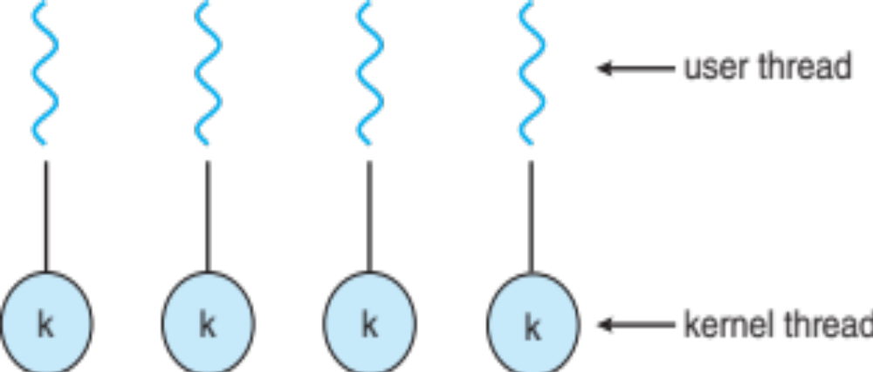
One-to-One
Each user-level thread maps to a kernel thread
  Provides more concurrency than many-to-one model
Used in kernel thread implementation
System keeps running while one thread executes a blocking system call
Creating a user-level thread creates a kernel thread
It also allow multiple threads to run in parallel on multiprocessor system
Number of threads per process sometimes restricted due to overhead
May lead to too many kernel threads
Examples
  Windows
  Linux
  Solaris 9 and later

Slide 22

Many-to-Many Model
Allows many user level threads to be mapped to many kernel threads
Allows the OS to create a sufficient number of kernel threads running in parallel
  When one blocks, schedule another user thread
Examples
  Solaris 2
  Windows NT/2000

Slide 23

Two-level Model
Similar to M:M, except that it allows a user thread to be bound to kernel thread
Examples
  IRIX
  HP-UX
  Tru64 UNIX
  Solaris 8 and earlier

Slide 24
Context Switching threads
Context switching two user-level threads
If belong to the same process
  Handled by the dispatcher in the library
    Only need to store/load the TCB information
  OS does not do anything
If belong to different processes
  Like an ordinary context switch of two processes
    Handled by OS (drop in/out of the kernel)
    OS needs to load/store PCB and TCB information

Slide 25

Threading Issues
Semantics of fork( ) and exec( ) system calls
  Does fork( ) duplicate only the calling thread or all threads?
Thread cancellation
  Terminating a thread before it has finished
  Two general approaches:
    Asynchronous cancellation terminates the target thread immediately
    Deferred cancellation allows the target thread to periodically check if it should be cancelled (only occurs when thread reaches cancellation point)
  On Linux systems, thread cancellation is handled through signals

Slide 26
Threading Issues: Signal Handling
Signals are used in UNIX systems to notify a process that a particular event has occurred.
A signal handler is used to process signals
  Signal is generated by particular event
  Signal is delivered to a process
  Synchronous and asynchronous Signal handling
  Signal is handled by one of two signal handlers:
    Every signal has default handler that kernel runs when handling signal
    User-defined signal handler can override default hander
Where should a signal be delivered for multi-threaded?
  Deliver the signal to the thread to which the signal applies
  Deliver the signal to every thread in the process
  Deliver the signal to certain threads in the process
  Assign a specific thread to receive all signals for the process

Slide 27
Threading Issues: Thread Specific Data
Thread-local storage (TLS) allows each thread to have its own copy of data
Useful when you do not have control over the thread creation process (i.e., when using a thread pool)
Different from local variables
  Local variables visible only during single function invocation
  TLS visible across function invocations
Similar to static data
  TLS is unique to each thread

Slide 28

Threading Issues: Scheduler Activations
Many:Many models require communication to maintain the appropriate number of kernel threads allocated to the application
Typically use an intermediate data structure between user and kernel threads – lightweight process (LWP)
  Appears to be a virtual processor on which process can schedule user thread to run
  Each LWP attached to kernel thread
  How many LWPs to create?
Scheduler activations provide upcalls - a communication mechanism from the kernel to the upcall handler in the thread library
This communication allows an application to maintain the correct number kernel threads

Slide 29
Motivation
Most modern applications are multithreaded
Threads run within application
Multiple tasks with the application can be implemented by separate threads
  Update display
  Fetch data
  Spell checking
  Answer a network request
Process creation is heavy-weight while thread creation is light-weight
Can simplify code, increase efficiency
Kernels are generally multithreaded

Slide 30
Benefits
Responsiveness – may allow continued execution if part of process is blocked, especially important for user interfaces
  Multi-threaded Web browser:
    User interaction
    Image loading
Resource Sharing – threads share resources of process, easier than shared memory or message passing
Economy – cheaper than process creation, thread switching lower overhead than context switching
  Solaris: creating process is thirty times slower
  Context-switch is about five times slower
Scalability – Utilization of multiprocessor architectures

Slide 31
Multicore Programming
Multicore or multiprocessor systems putting pressure on programmers, challenges include:
  Dividing activities
  Balance
  Data splitting
  Data dependency
  Testing and debugging
Parallelism implies a system can perform more than one task simultaneously
Concurrency supports more than one task making progress
  Single processor / core, scheduler providing concurrency

Slide 32
Multicore Programming (Cont.)
Types of parallelism
  Data parallelism – distributes subsets of the same data across multiple cores, same operation on each
  Task parallelism – distributing threads across cores, each thread performing unique operation
As # of threads grows, so does architectural support for threading
  CPUs have cores as well as hardware threads
  Consider Oracle SPARC T4 with 8 cores, and 8 hardware threads per core

Slide 33


Concurrency vs. Parallelism
Concurrent execution on single-core system:
Parallelism on a multi-core system:

Slide 34

Amdahl’s Law
Identifies performance gains from adding additional cores to an application that has both serial and parallel components
S is serial portion
N processing cores
That is, if application is 75% parallel / 25% serial, moving from 1 to 2 cores results in speedup of 1.6 times
As N approaches infinity, speedup approaches 1 / S
Serial portion of an application has disproportionate effect on performance gained by adding additional cores
But does the law take into account contemporary multicore systems?

Slide 35
Thread Libraries
Thread library provides programmer with API for creating & managing threads
Two primary ways of implementing
  Library entirely in user space
  Kernel-level library supported by the OS

Slide 36
Pthreads
May be provided either as user-level or kernel-level
A POSIX standard (IEEE 1003.1c) API for thread creation and synchronization
Specification, not implementation
API specifies behavior of the thread library, implementation is up to development of the library
Common in UNIX operating systems (Solaris, Linux, Mac OS X)

Slide 37

Pthreads Example

Slide 38
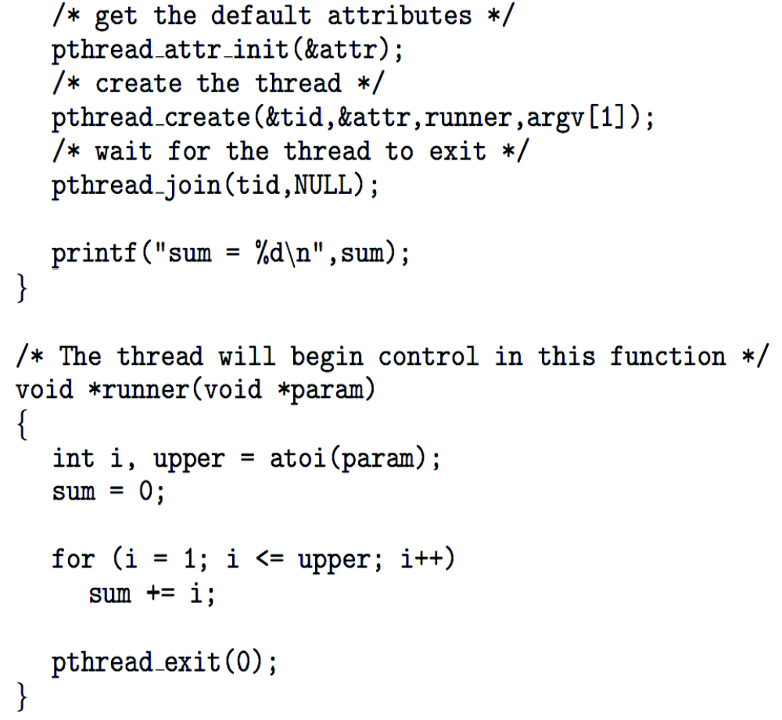
Pthreads Example (Cont.)

Slide 39
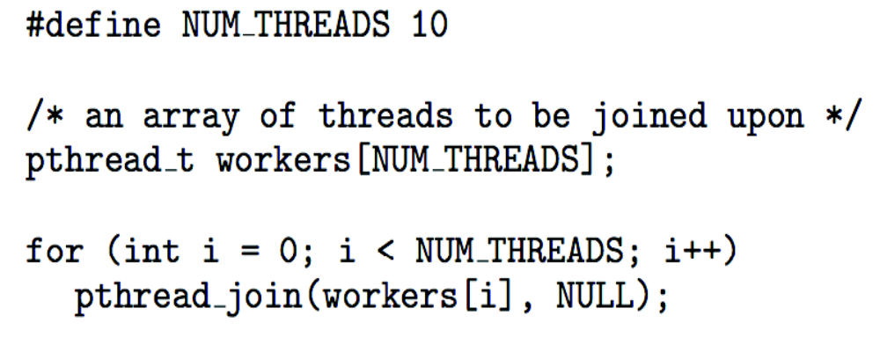
Pthreads Code for Joining 10 Threads

Slide 40

Java Threads
Java threads may be created by:
  Extending Thread class
  Implementing the Runnable interface
Java threads are managed by the JVM
Typically implemented using the threads model provided by underlying OS

Slide 41

Java Multithreaded Program

Slide 42

Java Multithreaded Program (Cont.)

Slide 43
Linux Threads
Linux refers to them as tasks rather than threads
Thread creation is done through clone() system call
clone() allows a child task to share the address space of the parent task (process)

Slide 44
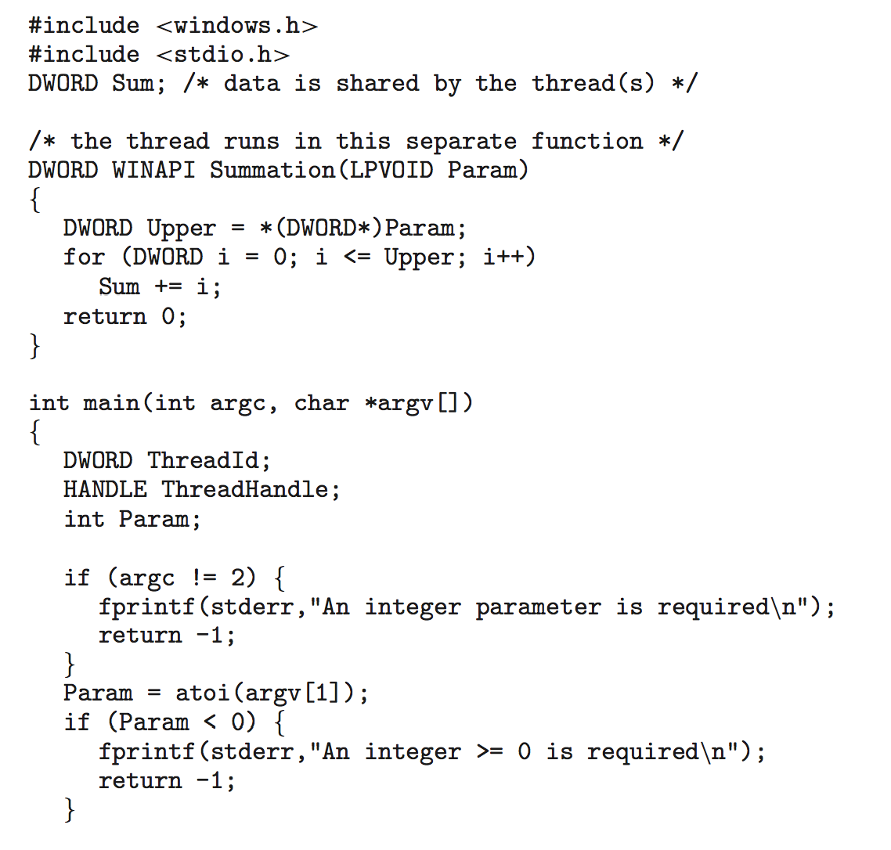
Windows Multithreaded C Program

Slide 45
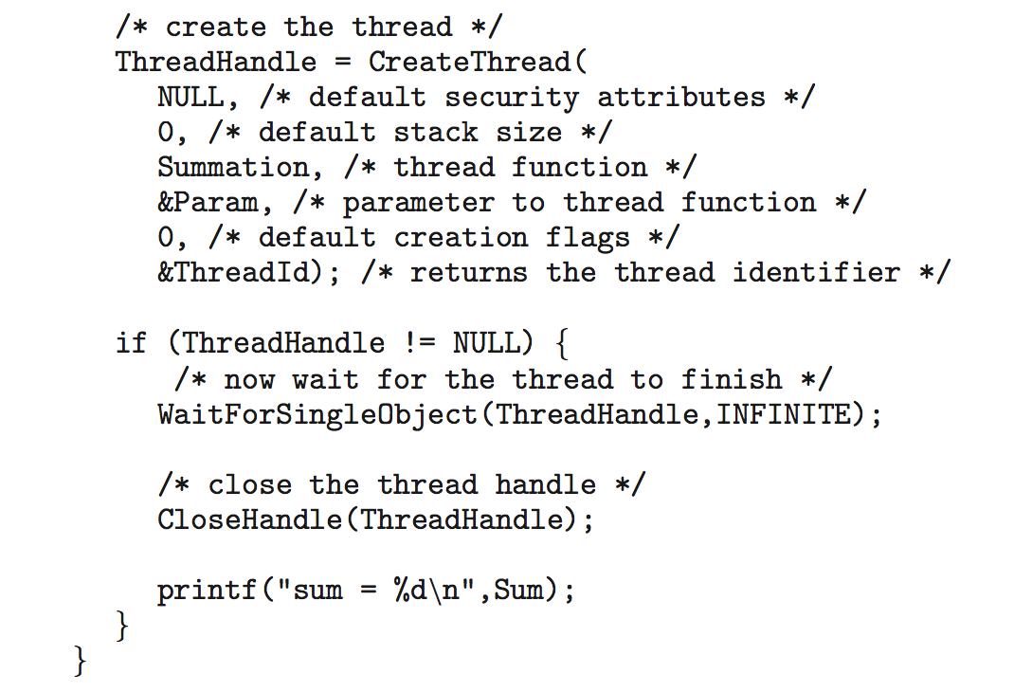
Windows Multithreaded C Program (Cont.)

Slide 46
Implicit Threading
Growing in popularity as numbers of threads increase, program correctness more difficult with explicit threads
Creation and management of threads done by compilers and run-time libraries rather than programmers
Three methods explored
  Thread Pools
  OpenMP
  Grand Central Dispatch
Other methods include Microsoft Threading Building Blocks (TBB), java.util.concurrent package

Slide 47
Threading Issues: Thread Pools
Create a number of threads in a pool where they await work
Advantages:
  Usually slightly faster to service a request with an existing thread than create a new thread
  Allows the number of threads in the application(s) to be bound to the size of the pool
  Separating task to be performed from mechanics of creating task allows different strategies for running task
    i.e. Tasks could be scheduled to run periodically

Slide 48

OpenMP
Set of compiler directives and an API for C, C++, FORTRAN
Provides support for parallel programming in shared-memory environments
Identifies parallel regions – blocks of code that can run in parallel
#pragma omp parallel
Create as many threads as there are cores
#pragma omp parallel for for(i=0;i<N;i++) {
c[i] = a[i] + b[i];
}
Run for loop in parallel

Slide 49

Grand Central Dispatch
Apple technology for Mac OS X and iOS operating systems
Extensions to C, C++ languages, API, and run-time library
Allows identification of parallel sections
Manages most of the details of threading
Block is in “^{ }” - ˆ{ printf("I am a block"); }
Blocks placed in dispatch queue
  Assigned to available thread in thread pool when removed from queue
Two types of dispatch queues:
  Serial: blocks removed in FIFO order, queue is per process, called main queue
    Programmers can create additional serial queues within program
  concurrent – removed in FIFO order but several may be removed at a time
    Three system wide queues with priorities low, default, high

