Slide 1
Design and Analysis of Algorithms
CSC201
Shahid Hussain

Slide 2
Books
Introduction to Algorithms (Second Edition) T.H. Cormen, C.E. Leiserson, R.N. Rivest, C. Stein - McGraw Hill - MIT Press, 2001
Computer Algorithms: Introduction to Design and Analysis, Sara Baase, Allen Van Gelder, Prentice hall, 1999
Introduction to Algorithms, A Creative Approach, Udi Manber, Addison-Wesley, 1989.

Slide 3
Course Outline
Data Structure (Recap)
Introduction of Algorithms and its notation
Basics algorithms and its analysis
Asymptotic notations
Recursion and recurrence relations
Divide-and-conquer approach
Sorting; Search trees
Hashing

Slide 4
Course Outline (Cont !!!)
Binary Search Tree
Graph algorithms; Shortest paths; Network flow; Disjoint Sets; Polynomial and matrix calculations;
Greedy approach
Dynamic programming
String matching algorithms
Amortized analysis
NP complete problems

Slide 5
Data Structure Recap

Slide 6
Data Structure Recap
The term data refer to collection of facts or figures
There are two ways to process and manipulate data.
  Data Structure
    Refer to temporary and manipulation of data
    E.g. Variables and array of a procedural language
  Database
    Refer to Permanent storage and manipulation of data
    E.g. MS Access, Foxpro etc
Data structure is way to process and manipulate data through set of operations

Slide 7
Data Structure Recap
Consider following C language program
    Main()
    {
    int a, b, c;
    a=3;
    b=5
    // OR cin>>a>>b;
    c=a+b;
    cout<<“Sum=“<<c;
    }
Execute first time:
Output will 8
Execute second and other times.
Again Output will 8
What concluded here

Slide 8
Data Structure Recap
Type of Data Structures according to the presentation of data (i.e. How data is presented)
Linear Data Structure
  Sequential Data Structures
    Array
    Queue
    Stack
  Pointer Data Structure (Linked List)
Non Linear Data Structure
  Tree
  Graphs

Slide 9
Data Structure Recap
Type of Data Structures according to memory representation
Logical Data Structure
  Map data according to partition structure of memory
  E.g. One Dimensional Array
Physical Data Structures
  Can not map data easily according to partition structure of memory
  E.g Two Dimensional Array, Tree etc
  A special method is needed to convert physical Data Structure into Logical, such as dope vector is used to convert 2-D into 1-D.

Slide 10
Data Structure Recap
Common operation for all Data Structure are.
  Insert ( Insert new item/element into a data structure)
  Delete (Remove an item from Data Structure)
  Sort (Use to arrange all items in either ascending or descending order)
  Search (Use to locate an element/item of a data structure)
  Merge (Use to combine the elements of more than one similarly data structure
  Traversing (Scanning or visit of each element for view etc)

Slide 11
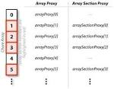
Data Structure Recap
Array
  Linear and sequential
  Array is combination of homogenous element with
    N Consecutive index numbers (Such as 1,2,3,4, . . .)
    Successive memory location (such as 102, 104, 106 . . . )
  Successive memory location depend on the size of data types, such as in C language size of integer data type is 2 bytes)
  Two types of array are commonly used.
    One Dimensional (1-D) ( Only logical data structure)
    Two Dimensional (2-D) (Physical Data structure)
  Dope Vector method is used to convert 2-D into 1-D

Slide 12
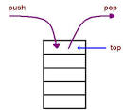
Data Structure Recap
Stack Data Structure
  Linear and sequential
  Work on following principles
    LIFO (Last In First Out) OR Total
    FILO (First In Last Out) Size=
  Two Conditions are N=5
    Overflow (It will occur when stack is full and you try to insert new element)
    Underflow (It will occur when stack is empty and you try to delete an element)

Slide 13
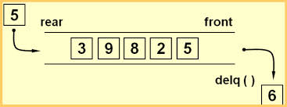
Data Structure Recap
Queue Data Structure
  Linear and sequential
  Work on following principles
    FIFO (First In First Out) OR
    LILO (Last In Last Out)
  Two Conditions are
    Overflow (It will occur when Queue is full and you try to insert new element)
    Underflow (It will occur when Queue is empty and you try to delete an element)
  Type of Queues are
    Circular Queue
    Priority Queue
    Double Ended Queue

Slide 14
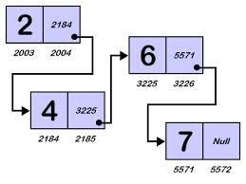
Data Structure Recap
Linked List Data Structure
  Linear and Pointer
  Each element of linked list represented through a node which have two , three or more parts depends on types of linked list
  Type of Linked List are
    One way linked List
    Two Way linked List (Doubly Linked List)

Slide 15
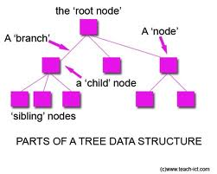
Data Structure Recap
Tree Data Structure
  Non Linear Data Structure
  Each element of linked list represented through a node which have two , three or more parts depends on types of tree
  Type of Linked List are
    General Tree
    Binary Tree
    B+ Tree
    Balance and Unbalance Tree

Slide 16
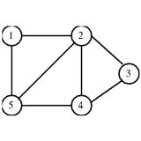
Data Structure Recap
Graph Data Structure
  Non Linear Data Structure
  Each element of linked list represented through a node
  Type of Graph are
    Connected Graph
    Weighted Graph

Slide 17
Summary
Data structure is way for storing and manipulation of data
Two main categories or types of data structure are linear and non linear data structure.
In case of memory representation, data structure are of two types logical and physical data structure.
Insert, Delete, Merge, Sort and search are common operations for all types of data structure.
Array, Stack and Queue are linear and sequential data structures.
Linked List is linear and pointer based data structure.
Tree and graphs are non linear data structures

Slide 18
What to be Next
In Next lecture, we will discuss algorithms, its characteristics and convention.

