Slide 1
Lecture10.
How to Solve Recursive relations

Slide 2
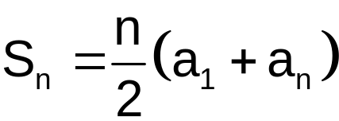
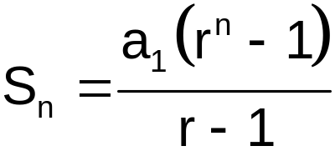
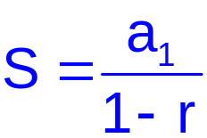
Recap
The sum of finite arithmetic series can be found by using following formula
The sum of finite Geometric series can be found by using following formula
The sum of infinite Geometric series can be found by using following formula

Slide 3
Recap
Mathematical induction principle is used to varify or proof the predicates or proposition such as a value is divisible by 5

Slide 4
Solving Recurrence Relations
To solve a recurrence relation T(n) we need to derive a form of T(n) that is not a recurrence relation. Such a form is called a closed form of the recurrence relation.
There are four methods to solve recurrence relations that represent the running time of recursive methods
  Iteration method (unrolling and summing)
  Substitution method (Guess the solution and verify by induction)
  Recursion tree method
  Master theorem (Master method)

Slide 5

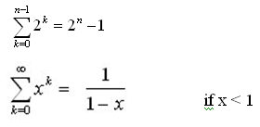


Solving Recurrence Relations
Steps:
  Expand the recurrence
  Express the expansion as a summation by plugging the recurrence back into itself until you see a pattern.
  Evaluate the summation
In evaluating the summation one or more of the following summation formulae may be used:
Special Cases of Geometric Series and Arithmetic series:
Geometric Series:

Slide 6

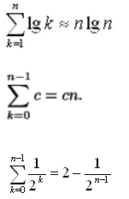
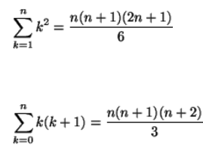
Solving Recurrence Relations
Harmonic Series:
Others:

Slide 7
The Iteration Method
Convert the recurrence into a summation and try to bound it using known series
  Iterate the recurrence until the initial condition is reached.
  Use back-substitution to express the recurrence in terms of n and the initial (boundary) condition.

Slide 8
The Iteration Method (Cont !!!)
T(n) = c + T(n/2)
T(n) = c + T(n/2)
= c + c + T(n/4)
= c + c + c + T(n/8)
Assume n = 2^{k}
T(n) = c + c + … + c + T(1)
= clgn + T(1)
= Θ(lgn)
T(n/2) = c + T(n/4)
T(n/4) = c + T(n/8)
k times

Slide 9
Iteration Method – Example
T(n) = n + 2T(n/2)
T(n) = n + 2T(n/2)
= n + 2(n/2 + 2T(n/4))
= n + n + 4T(n/4)
= n + n + 4(n/4 + 2T(n/8))
= n + n + n + 8T(n/8)
… = in + 2^{i}T(n/2^{i})
= kn + 2^{k}T(1)
= nlgn + nT(1) = Θ(nlgn)
Assume: n = 2^{k}
T(n/2) = n/2 + 2T(n/4)

Slide 10
Substitution method
Guess a solution
Use induction to prove that the solution works

Slide 11
Substitution method (Cont !!!)
Guess a solution
  T(n) = O(g(n))
  Induction goal: apply the definition of the asymptotic notation
    T(n) ≤ d g(n), for some d > 0 and n ≥ n₀
  Induction hypothesis: T(k) ≤ d g(k) for all k < n
Prove the induction goal
  Use the induction hypothesis to find some values of the constants d and n₀ for which the induction goal holds

Slide 12
Example-1: Binary Search
T(n) = c + T(n/2)
Guess: T(n) = O(lgn)
  Induction goal: T(n) ≤ d lgn, for some d and n ≥ n₀
  Induction hypothesis: T(n/2) ≤ d lg(n/2)
Proof of induction goal:
T(n) = T(n/2) + c ≤ d lg(n/2) + c
= d lgn – d + c ≤ d lgn if: – d + c ≤ 0, d ≥ c

Slide 13
Example 2
T(n) = T(n-1) + n
Guess: T(n) = O(n²)
  Induction goal: T(n) ≤ c n², for some c and n ≥ n₀
  Induction hypothesis: T(n-1) ≤ c(n-1)² for all k < n
Proof of induction goal:
T(n) = T(n-1) + n ≤ c (n-1)² + n
= cn² – (2cn – c - n) ≤ cn²
if: 2cn – c – n ≥ 0 ⇔ c ≥ n/(2n-1) ⇔ c ≥ 1/(2 – 1/n)
  For n ≥ 1 ⇒ 2 – 1/n ≥ 1 ⇒ any c ≥ 1 will work

Slide 14
Example 3
T(n) = 2T(n/2) + n
Guess: T(n) = O(nlgn)
  Induction goal: T(n) ≤ cn lgn, for some c and n ≥ n₀
  Induction hypothesis: T(n/2) ≤ cn/2 lg(n/2)
Proof of induction goal:
T(n) = 2T(n/2) + n ≤ 2c (n/2)lg(n/2) + n
= cn lgn – cn + n ≤ cn lgn
if: - cn + n ≤ 0 ⇒ c ≥ 1

Slide 15
Example 4
T(n) = 3T(n/4) + cn²
Guess: T(n) = O(n²)
  Induction goal: T(n) ≤ dn², for some d and n ≥ n₀
  Induction hypothesis: T(n/4) ≤ d (n/4)²
Proof of induction goal:
T(n) = 3T(n/4) + cn²
≤ 3d (n/4)² + cn²
= (3/16) d n² + cn²
≤ d n² if: d ≥ (16/13)c
Therefore: T(n) = O(n²)

Slide 16
The recursion-tree method
Convert the recurrence into a tree:
  Each node represents the cost incurred at various levels of recursion
  Sum up the costs of all levels
Used to “guess” a solution for the recurrence

Slide 17
Recursion tree
Visualizing recursive tree method
eg. T(n)=T(n/4)+T(n/2)+n²
n²
n²
T(n/4)
T(n/2)
(n/4)²
(n/2)²
T(n/16)
T(n/8)
T(n/8)
T(n/4)

Slide 18
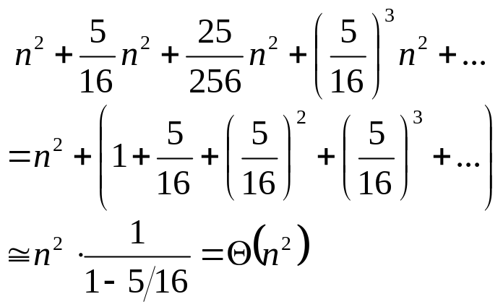

Recursion tree (Cont !!!)
n²
n²
(n/4)²
(n/2)²
(5/16)n²
(n/16)²
(n/8)²
(n/8)²
(n/4)²
(25/256)n²
………
………
………
………
………
………
………
………
(5/16)³n²
When the summation is infinite and |x| < 1, we have the infinite decreasing geometric series

Slide 19
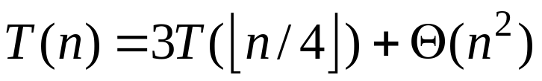
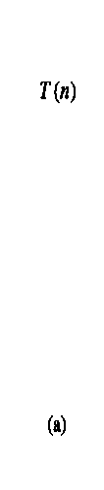
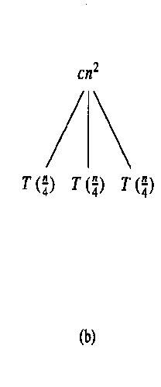
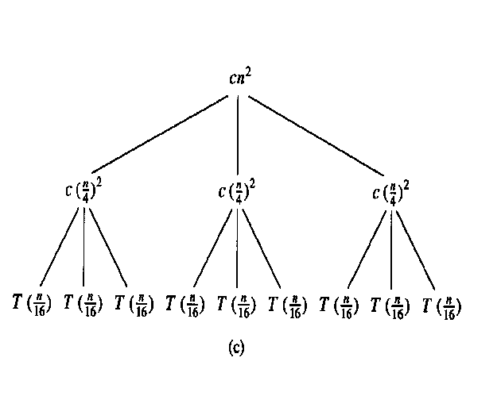
Recursion-tree method (Cont !!!)

Slide 20

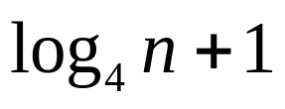

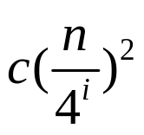
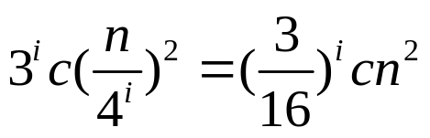
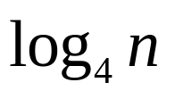

Recursion-tree method (Cont !!!)
Subproblem size for a node at depth i
Total level of tree
Number of nodes at depth i
Cost of each node at depth i
Total cost at depth i
Last level, depth , has nodes

Slide 21
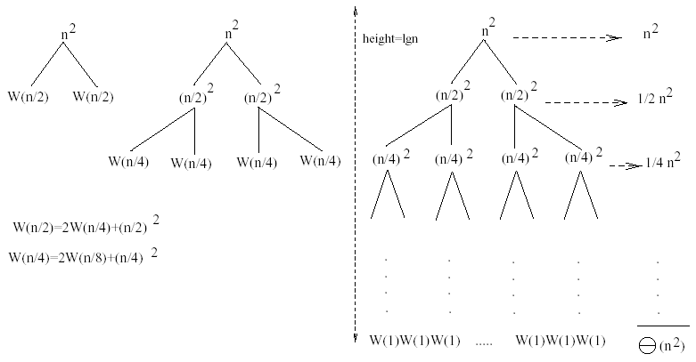
Example 1
W(n) = 2W(n/2) + n²
Subproblem size at level i is: n/2^{i}
Subproblem size hits 1 when 1 = n/2^{i} ⇒ i = lgn
Cost of the problem at level i = (n/2^{i})² No. of nodes at level i = 2^{i}
Total cost:
⇒ W(n) = O(n²)

Slide 22
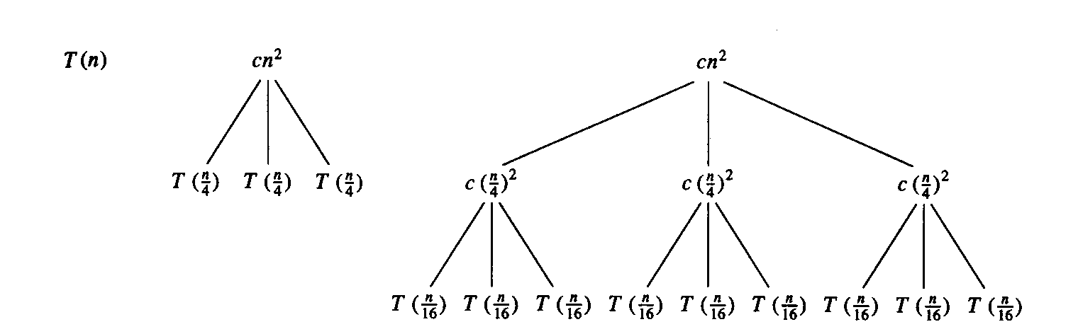
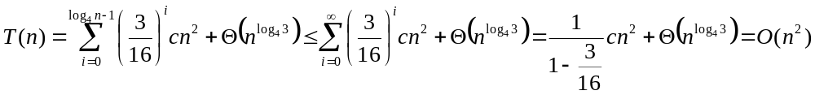
Example 2
E.g.: T(n) = 3T(n/4) + cn²
Subproblem size at level i is: n/4^{i}
Subproblem size hits 1 when 1 = n/4^{i} ⇒ i = log₄n
Cost of a node at level i = c(n/4^{i})²
Number of nodes at level i = 3^{i} ⇒ last level has 3^{log}₄^{n} = n^{log}₄³ nodes
Total cost:
⇒ T(n) = O(n²)

Slide 23
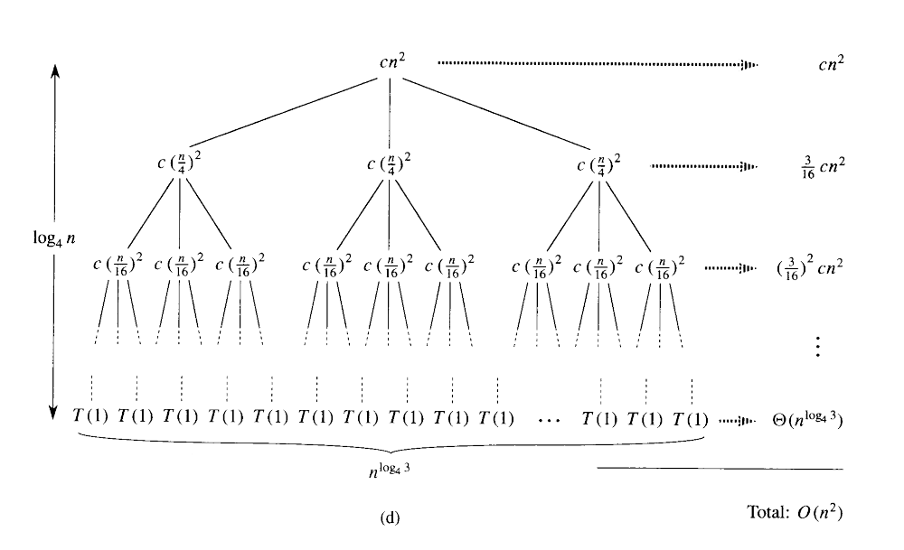
Recursion-tree method (Cont !!!)

Slide 24
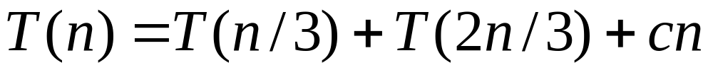
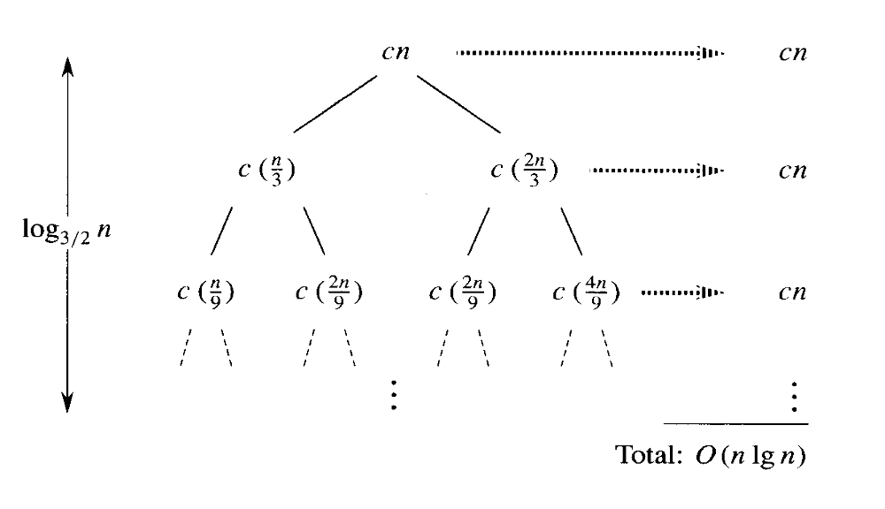
Recursion-tree method((Cont !!!)

Slide 25
Summary
There are four methods to solve a recursive relation
  Iterative
  Substitution
  Tree method
  Master Theorem
In iterative method you will Convert the recurrence into a summation and try to bound it using known series.
In substitution method, you will use guess or induction process to solve a recursive relation
In Tree method, you will form a tree and then sum up the values of nodes and also use gueses

Slide 26
In Next Lecturer
In next lecture, we will discuss the master theorem to solve the recursive relations

