Slide 1
Lecture 11.
Master Theorem for analyzing Recursive relations

Slide 2
Recap
There are four methods to solve a recursive relation
  Iterative
  Substitution
  Tree method
  Master Theorem
In iterative method you will Convert the recurrence into a summation and try to bound it using known series.
In substitution method, you will use guess or induction process to solve a recursive relation
In Tree method, you will form a tree and then sum up the values of nodes and also use gueses

Slide 3



Master Theorem
Let T(n) be a monotonically increasing function that satisfies
T(n) = a T(n/b) + f(n)
T(1) = c
where a ≥ 1, b ≥ 2, c>0. If f(n) is Θ(n^{d}) where d ≥ 0 then
 |  | if a < b^{d}
T(n) = |  | If a = b^{d}
 |  | if a > b^{d}

Slide 4

Master Theorem: Pitfalls
You cannot use the Master Theorem if
  T(n) is not monotone, e.g. T(n) = sin(x)
  f(n) is not a polynomial, e.g., T(n)=2T(n/2)+2^{n}
  b cannot be expressed as a constant, e.g.
Note that the Master Theorem does not solve the recurrence equation
Does the base case remain a concern?

Slide 5
Master Theorem: Example 1
Let T(n) = T(n/2) + ½ n2 + n. What are the parameters?
a =
b =
d =
Therefore, which condition applies?
1
 |  | if a < b^{d}
T(n) = |  | If a = b^{d}
 |  | if a > b^{d}
2
2
1 < 2², case 1 applies
We conclude that
T(n) ∈ Θ(n^{d}) = Θ (n²)

Slide 6
Master Theorem: Example 2
Let T(n)= 2 T(n/4) + √n + 42. What are the parameters?
a =
b =
d =
Therefore, which condition applies?
2
 |  | if a < b^{d}
T(n) = |  | If a = b^{d}
 |  | if a > b^{d}
4
1/2
2 = 4^{1/2}, case 2 applies
We conclude that

Slide 7

Master Theorem: Example 3
Let T(n)= 3 T(n/2) + 3/4n + 1. What are the parameters?
a =
b =
d =
Therefore, which condition applies?
3
2
 |  | if a < b^{d}
T(n) = |  | If a = b^{d}
 |  | if a > b^{d}
1
3 > 2¹, case 3 applies
We conclude that
Note that log₂3≈1.584…, can we say that T(n) ∈ Θ (n^{1.584})
No, because log₂3≈1.5849… and n^{1.584} ∉ Θ (n^{1.5849})

Slide 8
Master Theorem: Example 4
Let T(n)= 2T(n/2) + nlogn. What are the parameters?
a =
b =
d =
Therefore, which condition applies?
2
 |  | if a < b^{d}
T(n) = |  | If a = b^{d}
 |  | if a > b^{d}
2
1
2 = 2¹, case 2 applies
We conclude that
T(n) = Θ ( n¹ log n) = Θ (nlogn)

Slide 9
Master Theorem: Example 5
Let T(n)= T(n/3) + nlogn. What are the parameters?
a =
b =
d =
Therefore, which condition applies?
1
 |  | if a < b^{d}
T(n) = |  | If a = b^{d}
 |  | if a > b^{d}
3
1
1 < 3¹, case 1 applies
We conclude that
T(n) = Θ ( n¹ ) = Θ (n)

Slide 10
Master Theorem: Example 6
Let T(n)= 4T(n/2) + n. What are the parameters?
a =
b =
d =
Therefore, which condition applies?
4
 |  | if a < b^{d}
T(n) = |  | If a = b^{d}
 |  | if a > b^{d}
2
1
4 > 2¹, case 3 applies
We conclude that
T(n) = Θ ( log_{b}a ) = Θ (log₂4)
Note that log₂4≈1.684…, can we say that T(n) ∈ Θ (n^{1.684})

Slide 11
Master Theorem: Example 7
Let T(n)= 8T(n/2) + n². What are the parameters?
a =
b =
d =
Therefore, which condition applies?
8
 |  | if a < b^{d}
T(n) = |  | If a = b^{d}
 |  | if a > b^{d}
2
2
8 > 2², case 3 applies
We conclude that
T(n) = Θ ( log_{b}8 ) = Θ (log₂8)
Note that log₂8≈1.784…, can we say that T(n) ∈ Θ (n^{1.784})

Slide 12
Master Theorem: Example 8
Let T(n)= 9T(n/3) + n³. What are the parameters?
a =
b =
d =
Therefore, which condition applies?
9
 |  | if a < b^{d}
T(n) = |  | If a = b^{d}
 |  | if a > b^{d}
3
3
9 = 3³, case 2 applies
We conclude that
T(n) = Θ ( n³ log n) = Θ (n³logn)

Slide 13
Master Theorem: Example 9
Let T(n)= T(n/2) + 1. What are the parameters?
a =
b =
d =
Therefore, which condition applies?
1
 |  | if a < b^{d}
T(n) = |  | If a = b^{d}
 |  | if a > b^{d}
2
0
1 = 2⁰, case 2 applies
We conclude that
T(n) = Θ ( n^{0logn}) = Θ (logn)

Slide 14
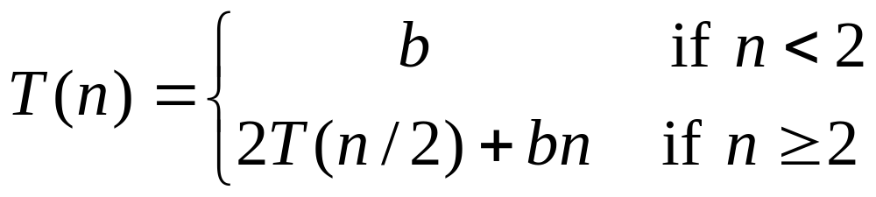
Recurrence Relation

Slide 15
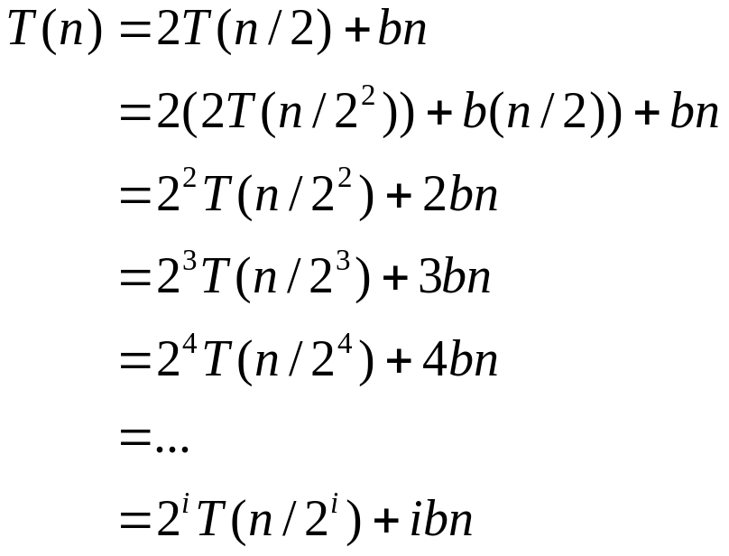

Iterative Substitution
In the iterative substitution, or “plug-and-chug,” technique, we iteratively apply the recurrence equation to itself and see if we can find a pattern:
Note that base, T(n)=b, case occurs when 2^{i}=n. That is, i = log n. So,
Thus, T(n) is O(n log n).

Slide 16
The Recursion Tree
Draw the recursion tree for the recurrence relation and look for a pattern:
depth | T’s | size
0 | 1 | n
1 | 2 | n/2
i | 2^{i} | n/2^{i}
… | … | …
time
bn
bn
bn
…
Total time = bn + bn log n

Slide 17
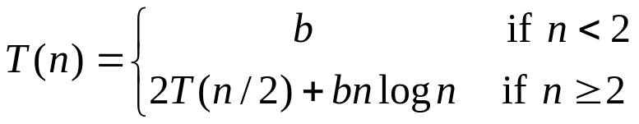
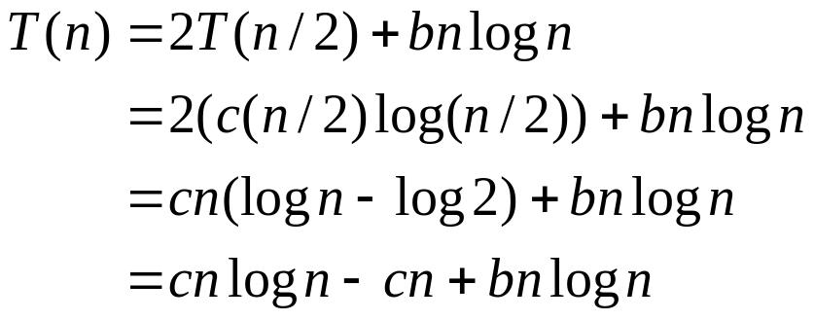
Guess-and-Test Method
In the guess-and-test method, we guess a closed form solution and then try to prove it is true by induction:
Guess: T(n) < cn log n.
Wrong: we cannot make this last line be less than cn log n

Slide 18
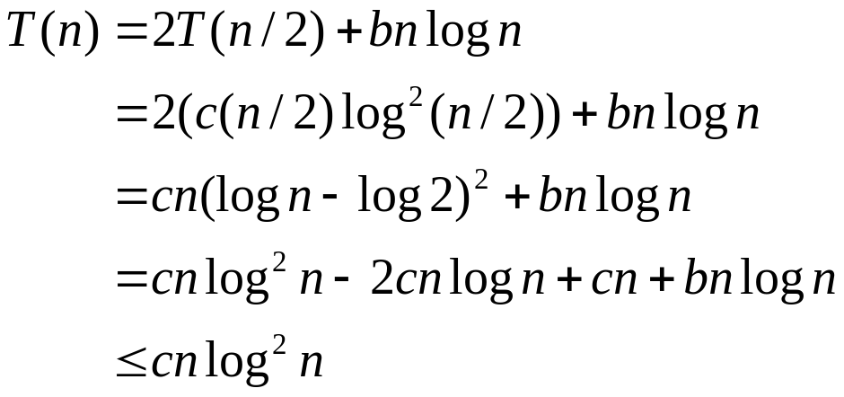
Guess-and-Test Method, Part 2
Recall the recurrence equation:
Guess #2: T(n) < cn log² n.
  if c > b.
So, T(n) is O(n log² n).
In general, to use this method, you need to have a good guess and you need to be good at induction proofs.

Slide 19
Master Theorem:
Let T(n)= 2T(n/2) + bnlogn. What are the parameters?
a =
b =
d =
Therefore, which condition applies?
2
 |  | if a < b^{d}
T(n) = |  | If a = b^{d}
 |  | if a > b^{d}
2
1
2 = 2¹, case 2 applies
We conclude that
T(n) = Θ ( n¹ log n) = Θ (nlogn)

Slide 20
Summary
Let T(n) be a monotonically increasing function that satisfies
T(n) = a T(n/b) + f(n)
T(1) = c
where a ≥ 1, b ≥ 2, c>0. If f(n) is Θ(n^{d}) where d ≥ 0 then
 |  | if a < b^{d}
T(n) = |  | If a = b^{d}
 |  | if a > b^{d}

Slide 21
In Next Lecturer
In next lecture, we will discuss the analysis of searching algorithms

